Slide 1
Major Project and Research Methods Research Methodology #3
BSc Applied Computing

Slide 2
In this session…
Recap:
Project Proposal
Aims and Objectives
Research Methodologies
Research Methodology: Time Horizon
Research Methodology: Data Collection
Research Methodology: Choice
Qualitative vs Quantitative data
Primary and Secondary Research
Task

Slide 3
Recap
Major Project and Research Methods

Slide 4
The Project Proposal
The purpose of the project proposal is to establish exactly what is to be achieved by the project and to establish a plan to do this.
“A research proposal is a simply a structured, formal document that explains what you plan to research (i.e. your research topic), why it’s worth researching (i.e. your justification), and how you plan to investigate it (i.e. your practical approach).“ [1]
“The purpose of the research proposal […] is to convince your research supervisor, committee or university that your research is suitable (for the requirements of the degree program) and manageable (given the time and resource constraints you will face).” [1]
You will be required to deliver a project proposal document for your major project prior to the delivery of your interim viva presentation (More on this in a few weeks).
Notes:
1. Jansen, D. What (Exactly) Is A Research Proposal?. Available at: https://gradcoach.com/what-is-a-research-proposal-dissertation-thesis. Last Accessed: 5/9/2022.

Slide 5
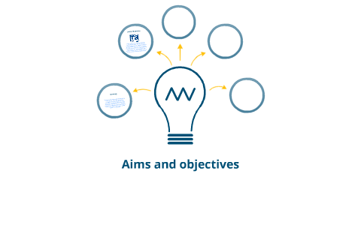
Aims and Objectives
In a nutshell:
Aim = what you hope to achieve. [2]
Objective = the action(s) you will take in order to achieve the aim. [2]
[3]
Notes:
2. Solent Online Learning. Dissertation proposals, Aims and objectives. Available at: https://learn.solent.ac.uk/mod/book/view.php?id=116233&chapterid=15294. Last Accessed. 5/9/2022.
3. Aims and objectives by Tom Steinmetz on Prezi Next [image on the Internet]. C 2012 [cited 6/9/2022]. Available from: https://prezi.com/mzbjf-vbrsll/aims-and-objectives.

Slide 6
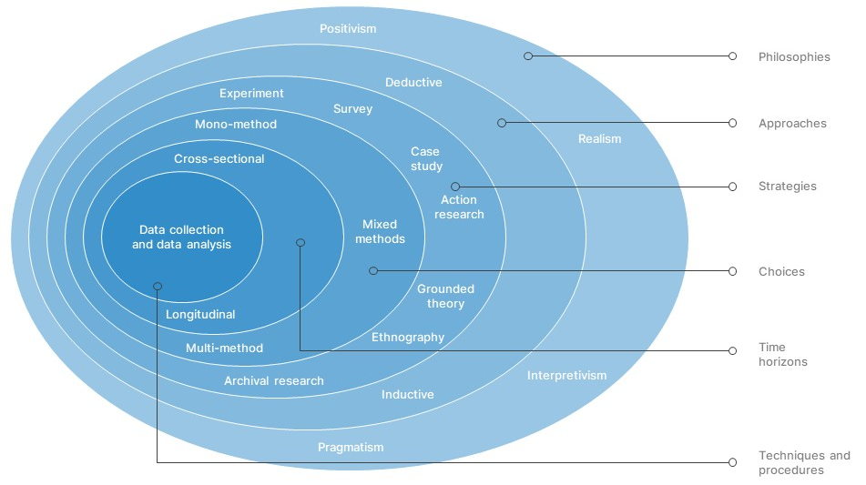
The Research Onion
At each stage, decisions should be based on, and guided by the aims and objectives established for the project.
[4]
Notes:
4. Research-Onion-Template [image on the Internet]. [cited 6/9/2022]. Available from: https://slidebazaar.com/items/research-onion-template.

Slide 7
Research Methodology: Time Horizon
Major Project and Research Methods

Slide 8
Research Methodology: Time Horizon
“The time horizon simply describes how many points in time you plan to collect your data at. Two options exist – the cross sectional and longitudinal time horizon.”
“Imagine that you’re […] on social media and […] want to study the language of memes and how this language evolves over time”. For this study, you’d need to collect data over multiple points in time – perhaps over a few weeks, months, or even years. Therefore, you’d make use of a longitudinal time horizon. This option is highly beneficial when studying changes and progressions over time.”
“If instead, you wanted to study the language used in memes at a certain point in time (for example, in 2020), you’d make use of a cross-sectional time horizon. This is where data is collected at one point in time, so you wouldn’t be gathering data to see how language changes, but rather what language exists at a snapshot point in time. The type of data collected could be qualitative, quantitative or a mix of both, as the focus is on the time of collection, not the data type.” [5]
Notes:
5. Phair, D, Warren, K. Saunders’ Research Onion: Explained Simply. Available at: https://gradcoach.com/saunders-research-onion. Last Accessed: 6/9/22.

Slide 9
Research Methodology: Data Collection
Major Project and Research Methods

Slide 10
Research Methodology: Data Collection
“Finally, we reach the centre of the onion – this is where you get down to the real practicalities of your research to make choices regarding specific techniques and procedures.”
“Specifically, this is where you’ll:
Decide on what data you’ll collect and what data collection methods you’ll use (for example, will you use a survey? Or perhaps one-on-one interviews?).
Decide how you’ll go about sampling the population (for example, snowball sampling, random sampling, convenience sampling, etc).
Determine the type of data analysis you’ll use to answer your research questions (such as content analysis or a statistical analysis like correlation).
Set up the materials you’ll be using for your study (such as writing up questions for a survey or interview).” [5]
Notes:
5. Phair, D, Warren, K. Saunders’ Research Onion: Explained Simply. Available at: https://gradcoach.com/saunders-research-onion. Last Accessed: 6/9/22.

Slide 11
Research Methodology: Data Collection
Data collection strategies which are commonly used for computer science research projects include : *
Focus Group
Survey/Questionnaire
Observation
Document Review
Interview
Literature Search
This layer of the research onion is closely tied to another… Choices.

Slide 12
Research Methodology: Choice
Major Project and Research Methods

Slide 13
Research Methodology: Choice
[…] this layer is simply about deciding how many data types (qualitative or quantitative) you’ll use in your research. There are three options – mono, mixed, and multi-method. […]”
[…] a mono method means that you’ll only make use of one data type – either qualitative or quantitative. For example, if you were to conduct a study investigating a community’s opinions on a specific pizza restaurant, you could make use of a qualitative approach only, so that you can analyse participants’ views and opinions of the restaurant.”
“If you were to make use of both quantitative and qualitative data, you’d be taking a mixed-methods approach. Keeping with the previous example, you may also want to assess how many people in a community eat specific types of pizza. For this, you could make use of a survey to collect quantitative data and then analyse the results statistically, producing quantitative results in addition to your qualitative ones.”
“Lastly, there’s multi-method. With a multi-method approach, you’d make use of a wider range of approaches, with more than just a one quantitative and one qualitative approach. For example, if you conduct a study looking at archives from a specific culture, you could make use of two qualitative methods (such as thematic analysis and content analysis), and then additionally make use of quantitative methods to analyse numerical data.” [5]
Notes:
5. Phair, D, Warren, K. Saunders’ Research Onion: Explained Simply. Available at: https://gradcoach.com/saunders-research-onion. Last Accessed: 6/9/22.

Slide 14
Research Methodology: Choice
Different data collection methods should be used for different purposes (e.g. interviews to get a feel for the issues, then questionnaires to address the important issues – or vice versa).
Using multiple methods enables triangulation to take place (the use of different data collection methods in a study to evaluate the extent to which findings are consistent, may be trusted and inferences made).
Confidence in the trustworthiness of findings is VERY important!

Slide 15
Research Methodology: Qualitative vs Quantitative data
Major Project and Research Methods

Slide 16
Qualitative and quantitative data
[6]
Notes:
6. Quant+Qual+Cartoon [image on the Internet, c 2018]. [cited 6/9/2022]. Available from: https://www.ikoninternational.org/news/2018/2/26/qualitative-vs-quantitative-research.

Slide 17
Qualitative data
Qualitative Research is primarily exploratory research.
It is used to:
Gain an understanding of underlying reasons, opinions, and motivations.
Provides insights into the problem or helps to develop ideas or hypotheses for potential quantitative research.
To uncover trends in thought and opinions, and dive deeper into the problem.
Qualitative data collection methods vary using unstructured or semi-structured techniques.
Some common methods include:
Focus groups (group discussions).
Individual interviews.
Participation/observations.
The sample size is typically small, and respondents are selected to fulfil a given quota.

Slide 18
Quantitative data
Quantitative Research is used to quantify the problem by way of generating numerical data or data that can be transformed into usable statistics.
It is used to quantify attitudes, opinions, behaviours, and other defined variables – and generalize results from a larger sample population.
Quantitative Research uses measurable data to formulate facts and uncover patterns in research.
Quantitative data collection methods are much more structured than Qualitative data collection methods.
Quantitative data collection methods include:
Surveys (including online surveys, paper surveys, mobile surveys and kiosk surveys).
Interviews.
Longitudinal studies.
Website interceptors.
Online polls.
Systematic observations.

Slide 19
Research Methodology: Primary and secondary research
Major Project and Research Methods

Slide 20
Primary and secondary research
Primary data:
Data collected by the investigator himself/ herself for a specific purpose.
This is the data that your project will generate.
Examples:
Data collected by a student for his/her thesis or research project.
Secondary data:
Data collected by someone else for some other purpose (but being utilized by the investigator for another purpose).
This will form the literature review portion of your project report.
Examples:
Census data being used to analyse the impact of education on career choice and earning.

Slide 21
Research Methodology: Task
Major Project and Research Methods

Slide 22
Task
You will work in groups of three which you will organise for yourselves.
Prepare and deliver a presentation for the next session.
For each of these methods:
Focus Group.
Survey/Questionnaire.
Observation.
Document Review.
Interview.
Literature Search.
Provide a clear description.
State the advantages.
State the disadvantages and explain how you could overcome them.
Note: Keep your references.

Slide 23
Task
All group members should contribute equally to the assignment so share the workload between group members.
It is poor practice to work completely independently and only bring the work together at the 11th hour.
All work should be merged into a final outcome in plenty of time for all members to:
Familiarise themselves with the final outcome.
Ensure all work is consistent and well presented.
Ensure all work produced meets the requirements of the task.

Slide 24
In this session…
Recap:
Project Proposal
Aims and Objectives
Research Methodologies
Research Methodology: Time Horizon
Research Methodology: Data Collection
Research Methodology: Choice
Qualitative vs Quantitative data
Primary and Secondary Research
Task

Slide 25
Any questions?
No?
Make a start!

