Slide 1
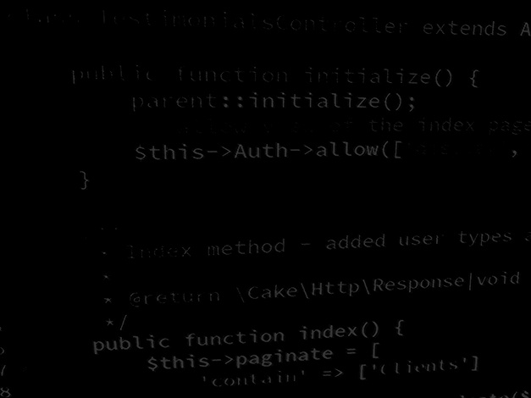
Programming Skills Course introduction
BSc Applied Computing

Slide 2
In this session…
Course objectives
Course topics
Assessment
Tools

Slide 3
Course introduction
BSc Applied Computing

Slide 4
Course objectives
Prepare students for progression to the third year BSc top up course.
Prepare students for employment in the IT sphere.
Improve understanding of programming concepts.
Improve programming skill and confidence.
Provide experience of programming in different, industry standard environments and languages.

Slide 5
Course topics
Unit introduction and Java environment configuration.
Java: Saving and loading unstructured data.
Java: Semi-structured data with CSV files.
Java: MVC/OOP project architecture, planning classes.
Java: Recoding the CSV project as MVC/OOP.
Java: Adapting the project to load and save XML.
Java: Adapting the project to load and save JSON.
Java: Structured data store using a MySQL database.
Java: Semi-structured data store using a MongoDB database.
PHP: Introduction to PHP.
PHP: Using the session array.
PHP: Connecting to MySQL.
PHP: Using OOP.
PHP: Introduction to the Laravel framework.
PHP: Using a Laravel project as an API.
JavaScript: Building an API client.

Slide 6
Assessment
There is no assessment!
Please keep up with the sessions.
These sessions will prepare you to develop complex and feature rich projects both this year and next.

Slide 7
Tools
Visual Studio Code – IDE, code editing for both PHP and Java.
Also VS Code extensions such as:
Extension Pack for Java
Format HTML in PHP
HTML Format
IntelliSense for CSS
PHP IntelliSense
PHP Extension Pack
(and any others you like the look of…)
XAMPP – PHP / Web / Database server environment.
Composer – PHP Package Manager.
Latest Java JDK – Programming environment, compiler, etc.
GitHub – Cloud based code VCS.

Slide 8
Any questions?
Next…
Environment configuration.

