Slide 1
Major Project and Research Methods Research Methodology #2
BSc Applied Computing

Slide 2
In this session…
Recap:
Project Proposal
Aims and Objectives
Research Methodologies
Research Methodology: Strategy
Experiment.
Survey.
Case study.
Action research.
Task

Slide 3
Recap
Major Project and Research Methods

Slide 4
The Project Proposal
The purpose of the project proposal is to establish exactly what is to be achieved by the project and to establish a plan to do this.
“A research proposal is a simply a structured, formal document that explains what you plan to research (i.e. your research topic), why it’s worth researching (i.e. your justification), and how you plan to investigate it (i.e. your practical approach).“ [1]
“The purpose of the research proposal […] is to convince your research supervisor, committee or university that your research is suitable (for the requirements of the degree program) and manageable (given the time and resource constraints you will face).” [1]
You will be required to deliver a project proposal document for your major project prior to the delivery of your interim viva presentation (More on this in a few weeks).
Notes:
1. Jansen, D. What (Exactly) Is A Research Proposal?. Available at: https://gradcoach.com/what-is-a-research-proposal-dissertation-thesis. Last Accessed: 5/9/2022.

Slide 5
Aims and Objectives
The aims of a project are its ultimate goals.
An indication of the quality and/or extent of the implementation would ideally form an aspect of the project aim.
Project objectives should indicate how the aims are to be met.
Objectives should conform to the SMART target framework.
Objectives should clearly describe the individual sub goals of the project, which are required to meet the ultimate goal (the aim).
An analysis of how the objectives are to be achieved including a breakdown of the project into identifiable sub-tasks should be form a part of the project plan.

Slide 6
Aims and Objectives
In a nutshell:
Aim = what you hope to achieve. [2]
Objective = the action(s) you will take in order to achieve the aim. [2]
[3]
Notes:
2. Solent Online Learning. Dissertation proposals, Aims and objectives. Available at: https://learn.solent.ac.uk/mod/book/view.php?id=116233&chapterid=15294. Last Accessed. 5/9/2022.
3. Aims and objectives by Tom Steinmetz on Prezi Next [image on the Internet]. C 2012 [cited 6/9/2022]. Available from: https://prezi.com/mzbjf-vbrsll/aims-and-objectives.

Slide 7
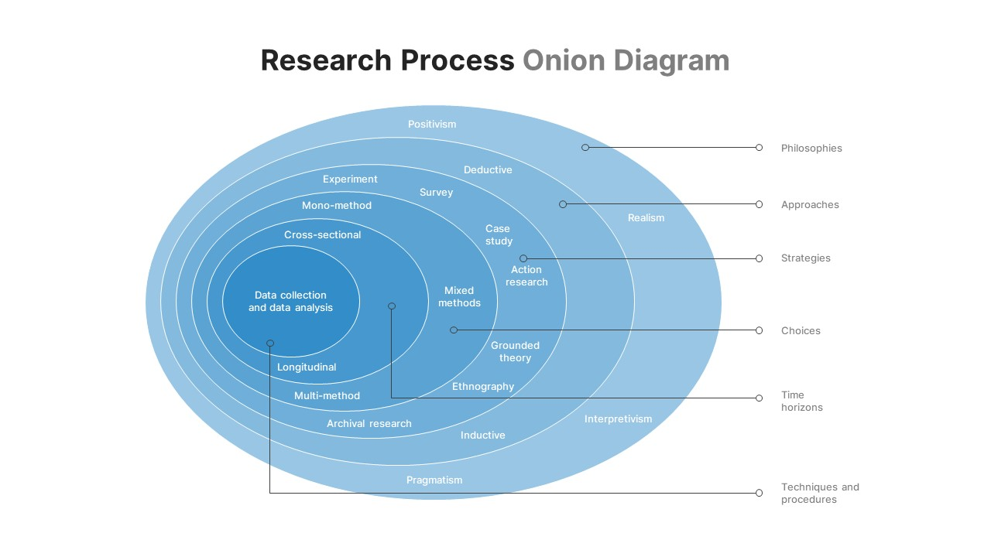
Research Methodology
A Research Methodology is the specific procedures or techniques used to identify, select, process, and analyse information about a topic.
There are a lot of methodologies used by researchers and some are better for computing research than others.
A good starting point is the ‘research onion’. [4]
[5]
Notes:
4. Phair, D, Warren, K. Saunders’ Research Onion: Explained Simply. Available at: https://gradcoach.com/saunders-research-onion. Last Accessed: 6/9/22.
5. Research-Onion-Template [image on the Internet]. [cited 6/9/2022]. Available from: https://slidebazaar.com/items/research-onion-template.

Slide 8
The Research Onion
The first layer of the onion, research philosophy requires definition. This creates the starting point for the appropriate research approach, which is adopted in the second step.
In the third layer, the research strategy is adopted, and the fourth layer identifies the time horizon.
The fifth layer represents the stage at which the data collection methodology is identified.
[5]
Notes:
5. Research-Onion-Template [image on the Internet]. [cited 6/9/2022]. Available from: https://slidebazaar.com/items/research-onion-template.

Slide 9
The Research Onion
At each stage, decisions should be based on, and guided by the aims and objectives established for the project.
[5]
Notes:
5. Research-Onion-Template [image on the Internet]. [cited 6/9/2022]. Available from: https://slidebazaar.com/items/research-onion-template.

Slide 10
Research Methodology: Strategy
Major Project and Research Methods

Slide 11
Research Methodology: Strategy
“This layer of the research onion details how, based on the aims of the study, research can be conducted.” [2]
Your research strategy is the general plan of how you will go about achieving your research objectives.
The research strategy is determined by four key issues:
Research questions/objectives.
Costs or budget available to the researcher.
Time available and target date for completion.
Skills of the researcher.
You must have valid reasons for all your research strategy decisions.
The justification should be based primarily on your research objectives (what suits best).
Notes:
2. Phair, D, Warren, K. Saunders’ Research Onion: Explained Simply. Available at: https://gradcoach.com/saunders-research-onion. Last Accessed: 6/9/22.

Slide 12
Research Methodology: Strategy
There are a number of strategies or approaches available to the researcher, including: *
Experiment.
Case study.
Action research.
[6]
Notes:
6. Brand-Research-Strategy-min [image on the Internet]. [cited 6/9/2022]. Available from: https://www.questionpro.com/blog/brand-research-strategy.
* As with previous layers of the Research Onion, this is not an exhaustive list. These are the strategies which would commonly be used for a computer science research project.

Slide 13
Strategy: Experiments
The experimental method is usually taken to be the most scientific of all strategies, as there is a lack of control with alternatives.
Experimentation sets out to examine the relationship between two factors (or variables) by manipulating one whilst measuring changes in the other.
Experiments are used to determine if a causal relationship exists - in other words, if the alteration of one variable ‘causes’ a change in another.
In computing we test new software and hardware by putting them through stress and load tests to find out what the software and hardware are capable of and what point they slow or brake at, we also do this to compare them to existing software and hardware to see where they stand.

Slide 14
Strategy: Experiments
What is the clinical utility of Glass in a typical academic paediatric surgical practice?
Google previously introduced Glass, a device that is worn like a normal pair of glasses, but that combines a computerised CPU, touchpad, display screen, high-definition camera, microphone, and wireless connectivity.
This experiment its applicability in daily surgical practice and in relevant experimental settings.
Wearing Glass throughout the day for the study interval was well tolerated.
Colleagues, staff, families and patients overwhelmingly had a positive response to Glass.
Useful applications for Glass were hands-free photo/video documentation, making hands-free telephone calls, and internet searches for unfamiliar medical terms or syndromes.
Drawbacks encountered with the current equipment were low battery endurance, data protection issues, poor overall audio quality, as well as long transmission latency combined with interruptions and cut-offs during internet videoconferencing. [7]
Notes:
7. Muensterer, O, et al. Google Glass in pediatric surgery: An exploratory study. Available at: https://www.sciencedirect.com/science/article/pii/S1743919114000405. Last Accessed 6/9/2022.

Slide 15
Strategy: Experiments
Google had previously introduced Glass, a device that is worn like a normal pair of glasses, but that combines a computerised CPU, touchpad, display screen, high-definition camera, microphone, and wireless connectivity.
This experiment obtained this device through Google's Explorer program.
It tested its applicability in daily surgical practice and in relevant experimental settings. [7]
[7]
Notes:
7. Muensterer, O, et al. Google Glass in pediatric surgery: An exploratory study. Available at: https://www.sciencedirect.com/science/article/pii/S1743919114000405. Last Accessed 6/9/2022.

Slide 16
Strategy: Case study
“A case study is a detailed, in-depth study of a single subject – for example, a person, a group or an institution, or an event, phenomenon or issue. […] The objective here is to gain an in-depth understanding within the context of the study – not (necessarily) to generalise the findings.”
“It is vital that, when conducting case study research, you take the social context and culture into account, which means that this type of research is (more often than not) qualitative in nature and tends to be inductive. Also, since the researcher’s assumptions and understanding play a role in case study research, it is typically informed by an interpretivist philosophy.”
“For example, a study on political views of a specific group of people needs to take into account the current political situation within a country and factors that could contribute towards participants taking a certain view.” [2]
Notes:
2. Phair, D, Warren, K. Saunders’ Research Onion: Explained Simply. Available at: https://gradcoach.com/saunders-research-onion. Last Accessed: 6/9/22.

Slide 17
Strategy: Case study
A case study is an extensive examination of a single instance of a phenomenon of interest and is an example of a phenomenological methodology.
Thus, a case study approach implies a single unit of analysis, such as a company or a group of workers, an event, a technology, a process or even an individual.
It can be defined as a method for developing a complete understanding of a process, program, event or activity.
Involves gathering very detailed data and using it to explain what is happening.
In an attempt to convince and coerce professionals, case studies are often used to present a problem and a subsequent solution.
Computing Example:
Visiting schools to investigate the use of iPads in the classroom.
The NHS have dabbled in computerising their system for many years now, and in 2011, an attempt to implement a CDSS (Clinical Decision Support System) was made to improve the decision making of 999 calls, making them more efficient, faster and safer.

Slide 18
Strategy: Action Research
“Action research is conducted in practical settings such as a classroom, a hospital, a workspace, etc – as opposed to controlled environments like a lab. Action research helps to inform researchers of problems or weaknesses related to interactions within the real-world. With action research, there’s a strong focus on the participants (the people involved in the issue being studied, which is why it’s sometimes referred to as “participant action research” or PAR. […]”
“This kind of research is generally applied in the social sciences, specifically in professions where individuals aim to improve on themselves and the work that they are doing. Action research is most commonly adopted in qualitative studies and is rarely seen in quantitative studies. This is because, as you can see in the above examples, action research makes use of language and interactions rather than statistics and numbers.”[2]
Notes:
2. Phair, D, Warren, K. Saunders’ Research Onion: Explained Simply. Available at: https://gradcoach.com/saunders-research-onion. Last Accessed: 6/9/22.

Slide 19
Strategy: Action Research
Action research can take place when the researcher actively promotes change (e.g. within an organisation). It commonly involves:
Taking a static picture of a situation.
Making some change (e.g. the introduction of a new computer system in an organisation).
Taking and evaluating a second picture of the situation (monitoring the results of the change).
The researcher is “learning by doing” and is not just an observer, but is an active participant in the action for change. The co-operation of others (e.g. company personnel, users, etc.) will be crucial to the success of this strategy.
Theorists describe Action Research as a strategy ‘whereby the researcher aims to add to the body of knowledge in an area by applying theory to a practical problem, and evaluating the results’.
It is by far the most common research strategy in a systems development project. This strategy, for example, can involve using systems analysis and design techniques to identify current problems for a particular system/organisation, design and implement a computerised solution, and evaluate the design decisions, results and conclusions.

Slide 20
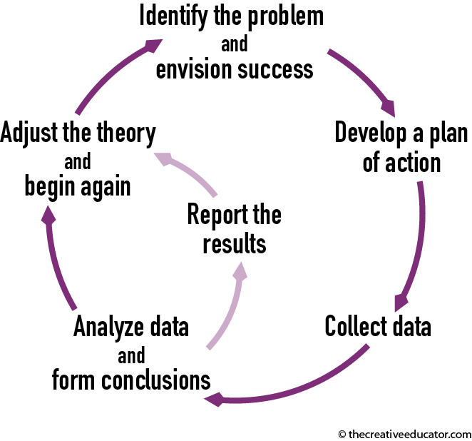
Strategy: Action Research
In software development, the process of Alpha and Beta Testing is a form of Action research.
The software is put through the Alpha test, finding the bugs currently in the software, working on and solving them.
Then it is put through the Beta test to find the additional bugs and flaws, then fixing them. The project then moves on to more testing or on to publishing the software if all found bugs and flaws have been fixed.
[8]
Notes:
8. Embrace Action Research [image on the Internet]. [cited 6/9/2022]. Available from: https://www.thecreativeeducator.com/v07/articles/Embracing_Action_Research

Slide 21
Research Methodology: Task
Major Project and Research Methods

Slide 22
Task
You will work in groups of three which you will organise for yourselves.
For each strategy discussed (Experiment, Case Study, Action Research):
Research at least four specific examples of the strategy being used in successful computer science research projects.
Use these examples to inform a review of the advantages and disadvantages of the strategy.
Prepare and deliver a presentation for the next session.

Slide 23
Task
All group members should contribute equally to the assignment so share the workload between group members.
It is poor practice to work completely independently and only bring the work together at the 11th hour.
All work should be merged into a final outcome in plenty of time for all members to:
Familiarise themselves with the final outcome.
Ensure all work is consistent and well presented.
Ensure all work produced meets the requirements of the task.

Slide 24
In this session…
Recap:
Project Proposal
Aims and Objectives
Research Methodologies
Research Methodology: Strategy
Experiment.
Survey.
Case study.
Action research.
Task

Slide 25
Any questions?
No?
Make a start!

