Slide 1
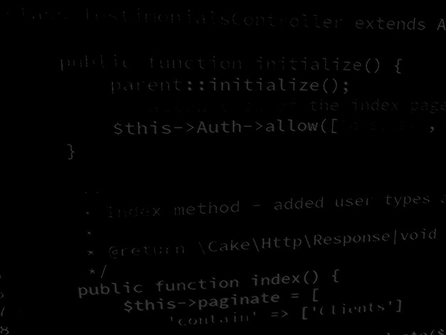
Server-side coding with PHP and Laravel Learning PHP #2 – PHP Session, Stateful and RESTful applications
BSc Applied Computing

Slide 2
In this session…
Recap welcome to PHP
Last exercise progress
Reading list
Quick recap
Session, Stateful and RESTful applications
What is the Session?
Why do we need to maintain state
Stateful vs RESTful applications
Noughts and Crosses game step by step
Project setup
HTML (and CSS, this time we do need a little)
PHP logic

Slide 3
Recap simple PHP
BSc Applied Computing

Slide 4
Quick recap
PHP is procedural (unless coded specifically in another paradigm).
PHP’s scope covers any code blocks in the same page (or view).
Application logic should come first.
PHP is loosely typed (can be easier, can cause issues).
PHP has access to many aspects of the HTTP request and the environment that it is running in through associative arrays ($_GET, $_POST, $_SERVER, $_REQUEST and so on).
PHP conditionals are largely similar to other languages.
Each run of a PHP application:
Starts with a request to the webserver
PHP application logic composes a HTML page
Page is passed to the webserver to be delivered to the requesting client

Slide 5
Session, Stateful and RESTful applications
BSc Applied Computing

Slide 6
What is the Session?
“When you work with an application, you open it, do some changes, and then you close it. This is much like a Session. The computer knows who you are. It knows when you start the application and when you end. But on the internet there is one problem: the web server does not know who you are or what you do, because the HTTP address doesn't maintain state. Session variables solve this problem by storing user information to be used across multiple pages (e.g. username, favourite colour, etc.). By default, session variables last until the user closes the browser. So, session variables hold information about one single user, and are available to all pages in one application.”
W3Schools

Slide 7
What is the Session?
As PHP applications run a request -> logic -> render process, Session allows the user to perform many actions and for the application to keep track of what they are doing.
Example: User login – imagine having to log into Facebook every time you change the view or into Twitter every time you tweet something.
Session uses a cookie (a small text file saved to the browser) which is sent to the webserver with each request and which allows the webserver to identify the person making the request.
PHP can save information (such as username and login status) to the session, this is then held in memory on the webserver so that when that user returns they do not need to log in again.
Session cookies are usually renewed with each request and contain an inactivity timeout (which means that they are deleted if not renewed for X amount of time).

Slide 8
Stateful vs RESTful
Any application which keeps track of state (for example the state of being logged in, usually involving a session) is known as “Stateful”.
Networked applications are commonly either Stateful or RESTful.
RESTful applications do no use a session or keep track of state from request to request.
RESTful applications usually supply a security token to the client which is then sent with each subsequent request.
Stateful requests – response depends on the current state meaning that different responses are possible from the same request.
RESTful requests – response is always exactly the same.

Slide 9
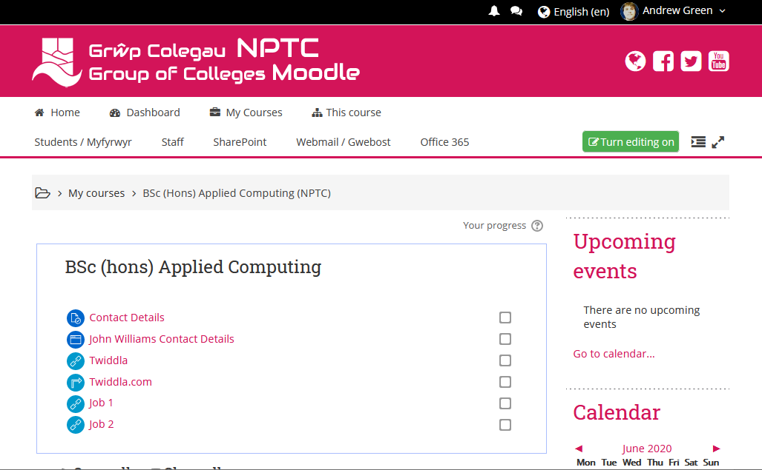
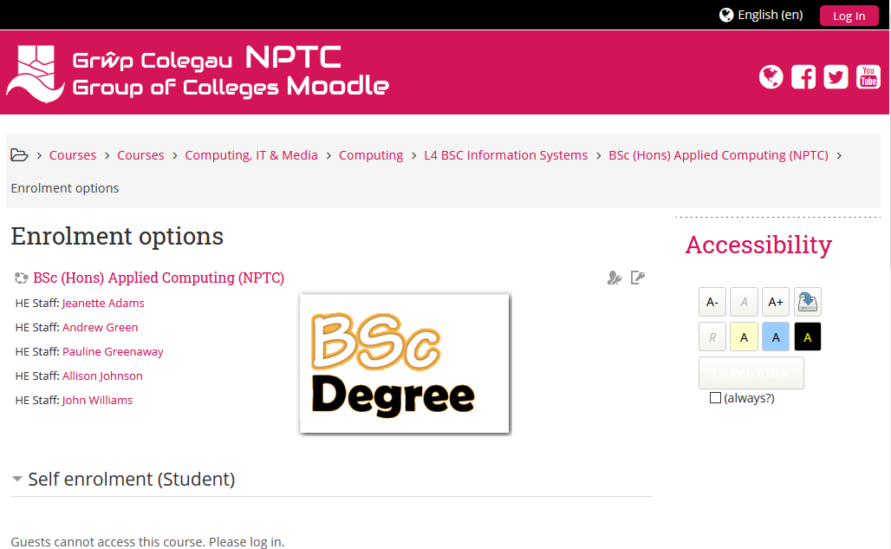
Stateful example
Click this link to Moodle.
If you are already logged into Moodle, you get the BSc course page.
If you are not logged in you get the enrolment options page.
Same request in both cases – different response.
This means that Moodle uses a session and is a Stateful application.
Logged in
Not logged in

Slide 10
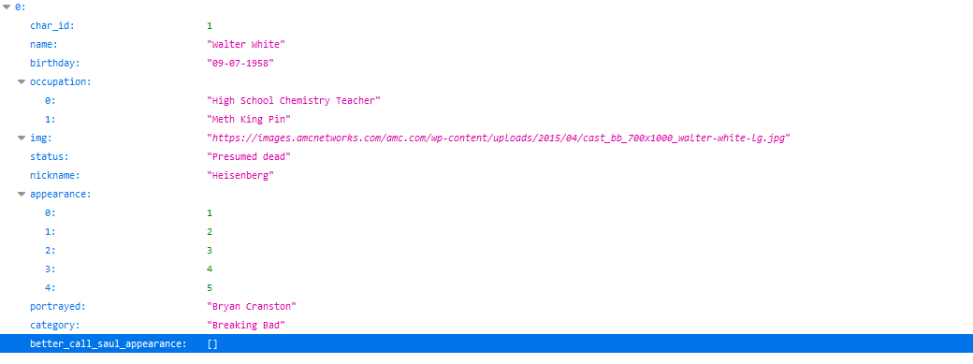
RESTful example
RESTful applications often serve data through an API.
Using the Breaking Bad API, a request for character 1 (char_id=1).
https://breakingbadapi.com/api/characters/1.
Always returns the same data = no state so is RESTful.

Slide 11
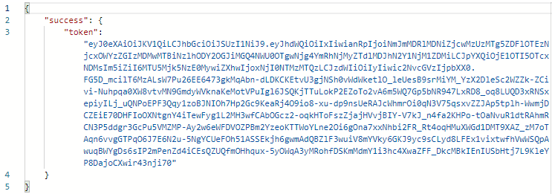
RESTful example
RESTful applications can still authenticate clients.
A request to a login API results in the return of a security token, so a successful login request can look like this:
This token data is then added to the headers of all subsequent requests so that the API knows that this user has passed a login check.
Whether the request has or does not have this token, it is the same request each time and gets the same reply.

Slide 12
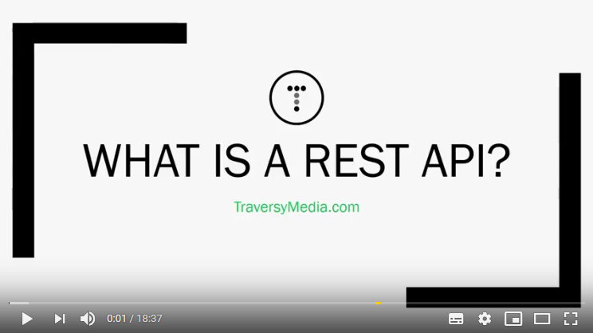
RESTful further reading (watching)
Original definition of REST (white paper)

Slide 13
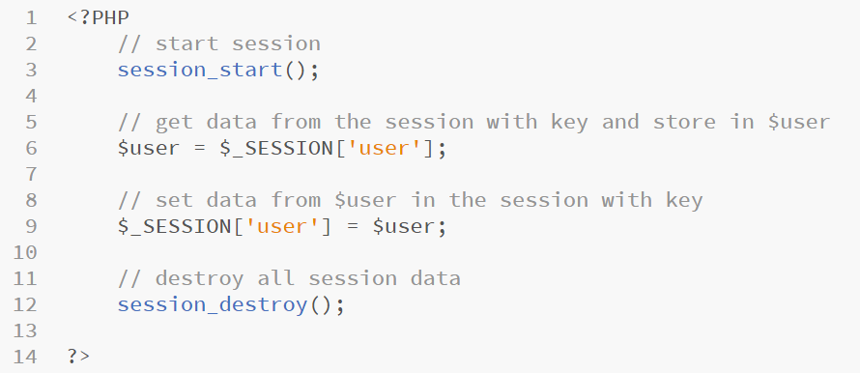
PHP session
If we want to use the session in a PHP page we can do so by using code similar to that shown below.
Note: The session_start() statement MUST be placed before any rendered HTML element or the session will not function correctly.

Slide 14
Session project: Noughts and Crosses
BSc Applied Computing

Slide 15
Setup
You should create a new virtual host for this project (use the instructions from week 1 if needed)
Project folder: NoughtsAndCrosses
Project URL: noughtsandcrosses.game
This tutorial will use the Brackets editor but the process is similar in VS Code.
All new code will be highlighted, other code will be included to indicate placement of new code only and should not be entered.
PHP can use // or # to indicate a comment.
This tutorial will use // for all comments.
Further explanation of code is included in the notes pane of specific slides.

Slide 16
Starting out
Right click the project folder and select Open as a Brackets project
In the left hand area of Brackets, right click, select new file
Name the file index.php
Add in the simple HTML and CSS code shown on the next page

Slide 17
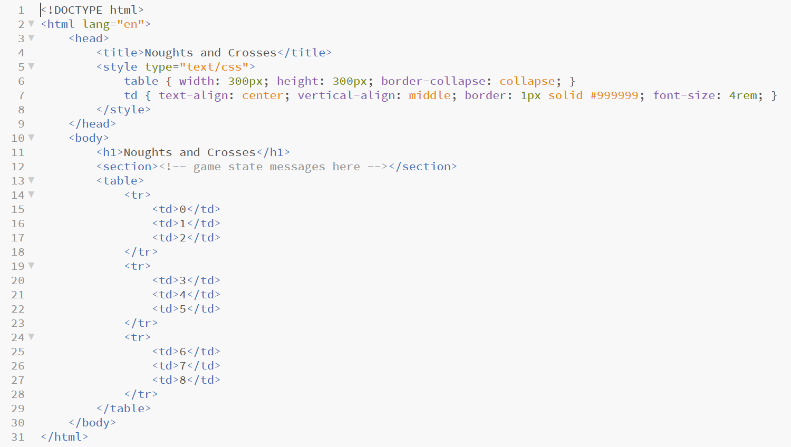
Starting out

Slide 18
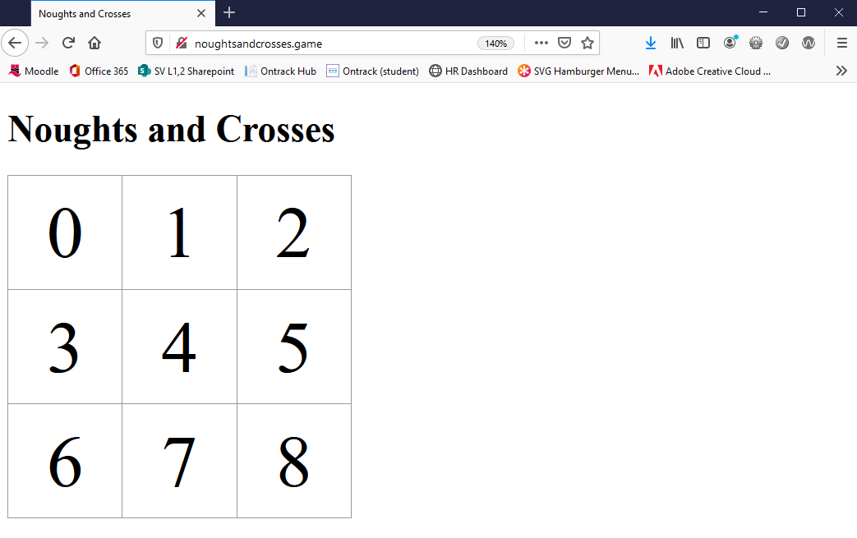
Quick test
Open your browser and enter the project URL.
You should see the page below.
If you do not see this page, double check that the virtual host is working.

Slide 19
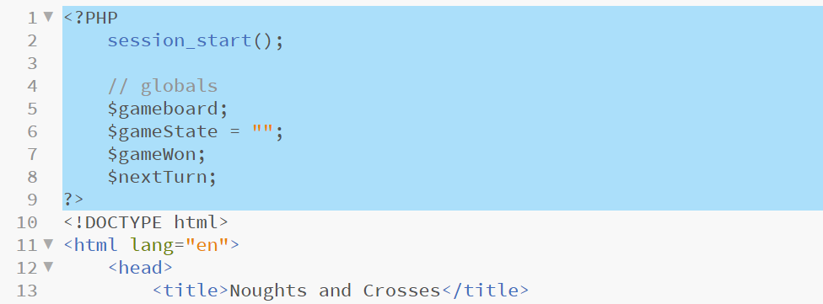
Project global variables
Add the PHP block shown below to the top of the file.
Initially we start the session so that we can add data to it as we go.
Global variables are discussed in the notes pane.
Notes:
Global variables
- $gameboard will contain an array[0-8] which will keep a track of the current state of the cells in the gameboard
- $gameState is a string which will contain messages to be displayed to the users (this is a 2 user game)
- $gameWon is a Boolean which will indicate if someone has won the game or not
- $nextTurn is string which will be used to keep track of who’s turn it is next X or O

Slide 20
Adding win conditions
Determining if a player has won the game is more complex in this project.
A row, column or diagonal would all win if they contain the same symbol.
To check for win conditions we create a list of each set of winning cells.
Example: cells 0 + 1 + 2 would win as would 1 + 4 + 7.

Slide 21
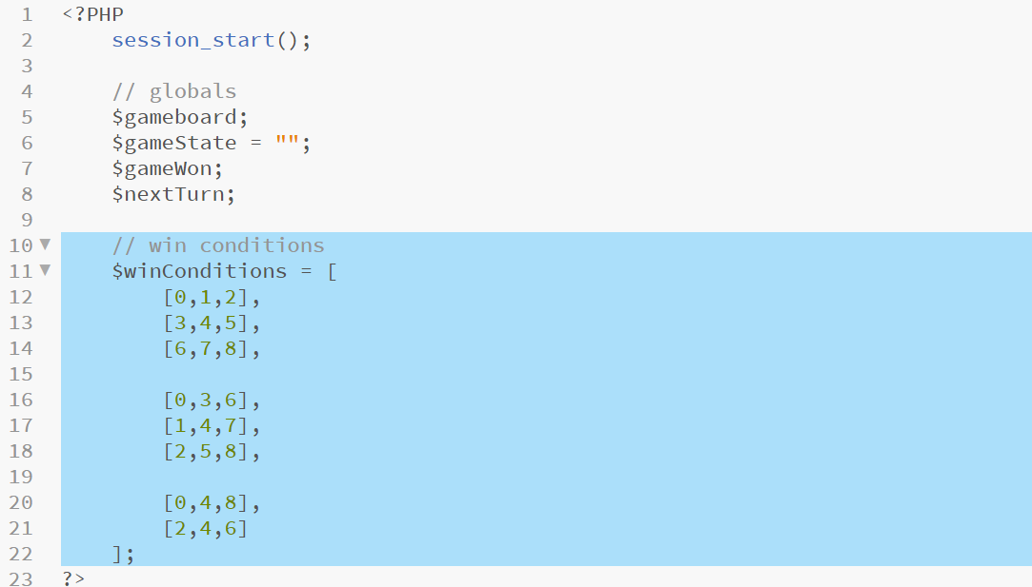
Adding win conditions
We will organise the lists of winning cells inside another list making them easy to loop over (a list of lists).
The lists are formatted for legibility, add the highlighted code.
Notes:
The lists are grouped for legibility –
First three are row win conditions
Second group of three are column win conditions
Last 2 are diagonal win conditions

Slide 22
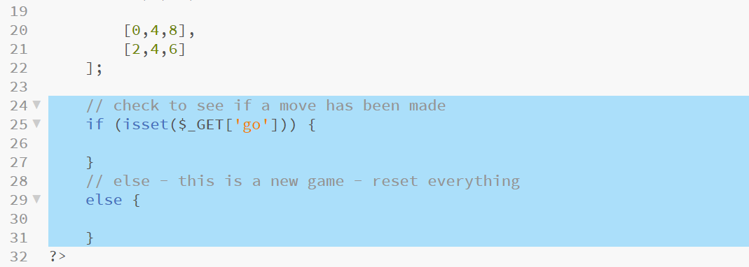
Using GET
This game will use GET to record player moves.
This is not sensitive data so does not need to be hidden and if we use GET we can use URL parameters and avoid having to have a HTML form.
We will be using a GET parameter with a key of go, so we will use this to determine if we are starting a new game or not.*
Add the highlighted if / else block.
Notes:
* This is similar to the method used last week using GET instead of POST

Slide 23
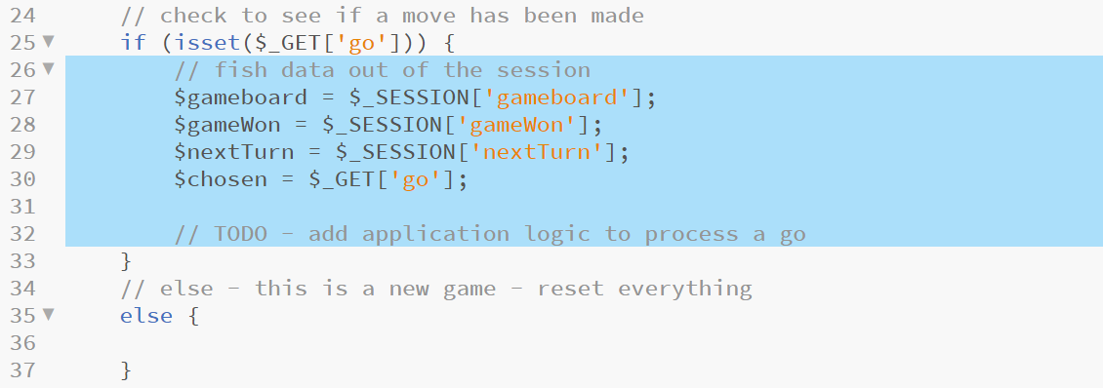
Process a turn
The if block will run if the user has selected a cell for their turn.
This means that the game is underway and that we should update the state of the game from session.
Add the highlighted code to set the global variables from the session and from the $_GET array.
Notes:
Add the placeholder TODO comment for game logic as we will come back to that in a while

Slide 24
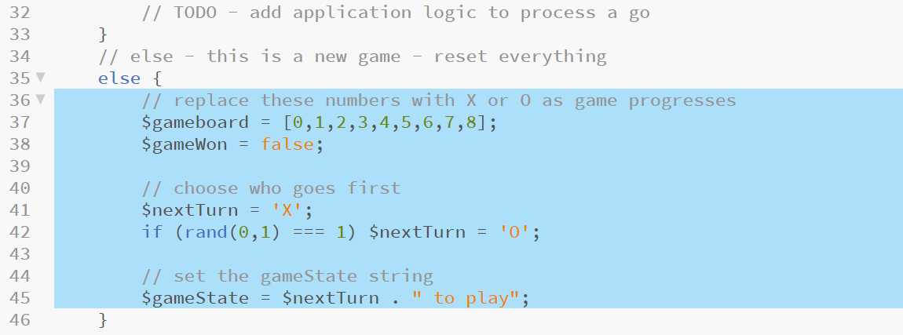
Setup a new game
If no data is found in $_GET[“go”], it is the start of a new game.
We need to reset all global variables to reflect this.
Add the highlighted code and comments.
Notes:
Here we set $gameboard to a new array containing 0 to 9 – these numbers will represent the cells of the game board and will get replaced with O or X as the game progresses
$gameWon is set to false – as this is a new game, no one has won and so this must but false
Lines 41 and 42 decide which player goes first – we start by setting X and then generate a random number which is either 0 or 1, if it generates 1 we change the player going first to O giving a 50%/50% chance of either player being the one that starts the game
$gameState contains our status message for the player which gets printed into the HTML page – in this case we simply tell the players who’s go it is

Slide 25
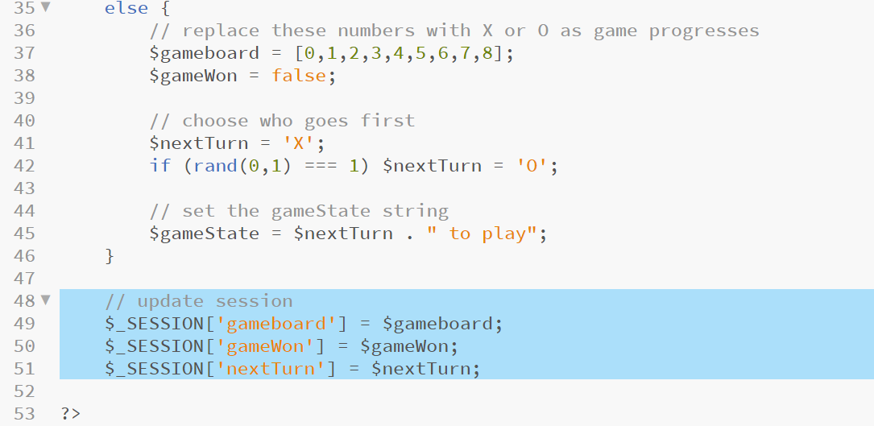
Update the session
Global variables have been updated to reflect a player taking a turn, or have been reset for a new game.
They now need to be added to the session.
Add the highlighted code.
Notes:
Here we add the three game state global variables into the session from where they will be retrieved in subsequent turns by the if statement block added in slides 24 and 25

Slide 26
Creating functions
As with other languages, processes which need to be run more than once or which can be more clearly defined as a separate process are coded as functions (scoped blocks of code).
PHP requires use of the function keyword similarly to some other languages (Perl, JavaScript, etc.).
PHP functions can (but do not have to) accept arguments and can (but do not have to) return data.
Functions can help the readability of this kind of program by hiding complex operations behind a suitably named function call.
On the next slide we will add a function to help us draw the game board cells, something that we need to do 9 times.

Slide 27
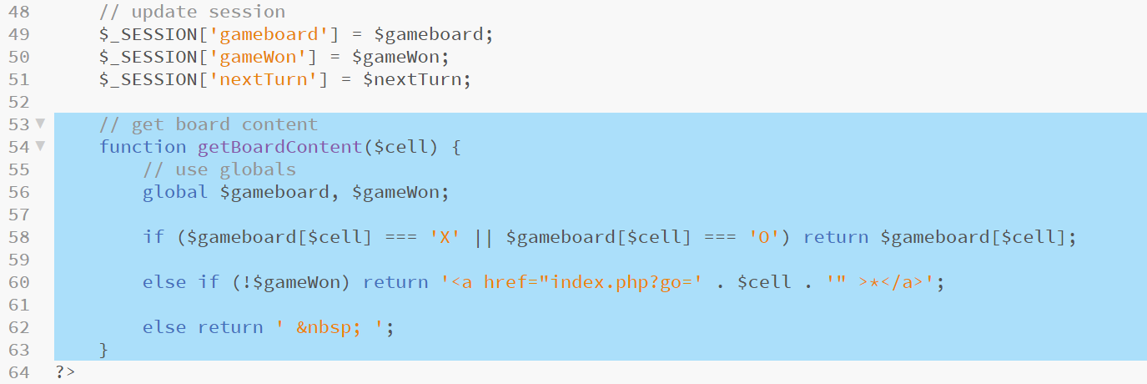
Creating functions
Add the highlighted code and comments to implement the getBoardContent function.
This function will be used to draw the contents of each game board cell into the HTML page.
Notes:
This function is passed one argument, which is the cell of the game board being processed (so $cell will contain a single digit number in the range 0-9 at any one point)
Line 56 uses the global keyword as function block the scope of variables defined in the parent scope (this is not common to all languages but is a feature of some), in order to be able to use $gameboard and $gameWon, we define them as global. Alternatively, these could have been passed to the function as arguments.
Line 58 examines the data in the $gameboard array which corresponds to this cell, if it finds a string matching either ‘X’ or ‘O’, this data is returned to be drawn into the page
Line 60 checks to see that the game is ongoing by asking if not $gameWon - if(!$gameWon) – as $gameWon is a Boolean we can simply test it in an if statement – If the game is ongoing and as we know that this cell has not been chosen yet, we return a string containing a hyperlink which includes a GET parameter named go and data which specifies this cell, which will allow the user to choose this cell for their next turn
Lastly, line 62 will run if the cell has not been chosen but the game has been won – in this case we want to draw an empty cell. HTML does not like empty table cells so we return the HTML special character for a space (&nbsp;)

Slide 28
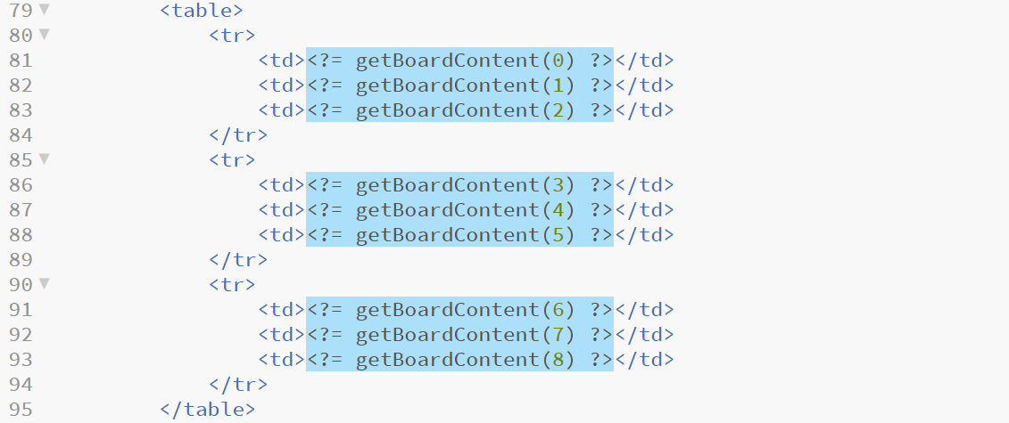
Calling getBoardContent
We need to call the function just created from inside the HTML table, in each case passing the cell number as an argument.
Add the highlighted code replacing the numbers which were in these cells
Notes:
These statements will call the function added on slide 29 each time the page is drawn, they will interrogate the $gameboard array and decide what content to draw.
We have included the PHP quick print statement <?= … ?> to draw whatever the getBoardContent function returns directly into the page

Slide 29
Drawing $gameState
As we are adding PHP prints to the HTML portion of the project, add the highlighted code below, replacing the placeholder comment.
This will print the content of the $gameState variable into the HTML page allowing us to keep the player informed of who’s go is next and if the game has been won.

Slide 30
Sanity checking input
The issue with using GET is that all data sent to the application is visible to the players.
If either wanted to cheat, they could simply retype the URL parameters directly into the browser’s address bar and take a cell already assigned to another player.
To prevent this we will include another function which will check that a cell is free before allowing it to be chosen.
If the player wants to input their move directly into the address bar, they still can, but this will force them to make a valid move rendering the method of user input irrelevant.
Add the highlighted function on the next slide below the previous getBoardContent function block.

Slide 31
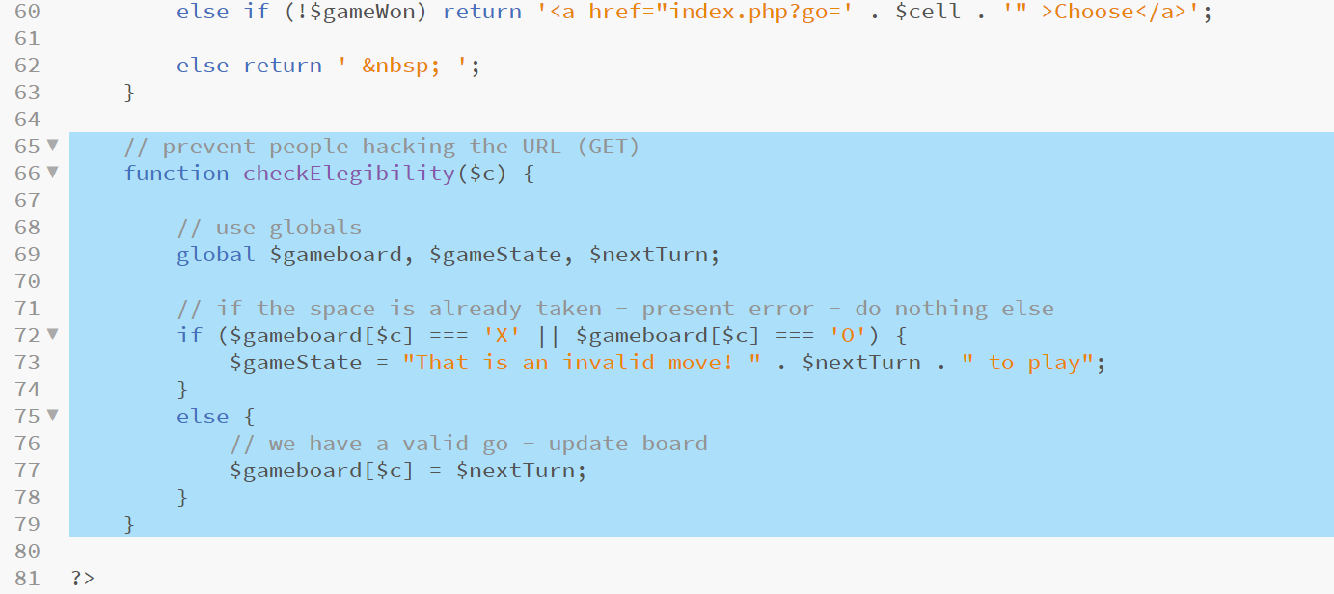
Sanity checking input
Add the highlighted function below the previous getBoardContent function block.
Notes:
First we define a function block called checkElegibility – this function will only be called from one place but as it is a self-contained action it is defined as a function for legibility
The function is passed one argument which is the number of the game cell that the user has chosen as their next turn ($c, short for cell)
We declare that we want access to the global data $gameboard, $gameState and $nextTurn
We check that the chosen cell does not contain data of a string of “X” or a string of “O” – if it is, this is an invalid move so we set a suitable error message in the $gameState variable to be displayed to the players
If the cell does not contain one of these strings, it is a valid choice and we update the contents of the $gameboard array with either “X” or “O” depending on which of these is currently in $nextTurn
This function does not return any data We will add a call to this function in a few steps time

Slide 32
Checking win conditions
Our final game logic function will lead on from the last where a move is made.
This function will loop over each list of win conditions and check to see if any of them are true by comparing the first cell with the other 2 cells, if all have the same symbol, that player has won.
If the game has been won, we reflect this state in the $gameWon variable as well as setting a suitable congratulations message.
As the game board will already draw itself to reflect a win state we have nothing more to do there.
Finally, if no win condition is met, we can reverse which player’s turn it is.
Add the highlighted code on the next slide below the checkEligibility function coded on the last slide.

Slide 33
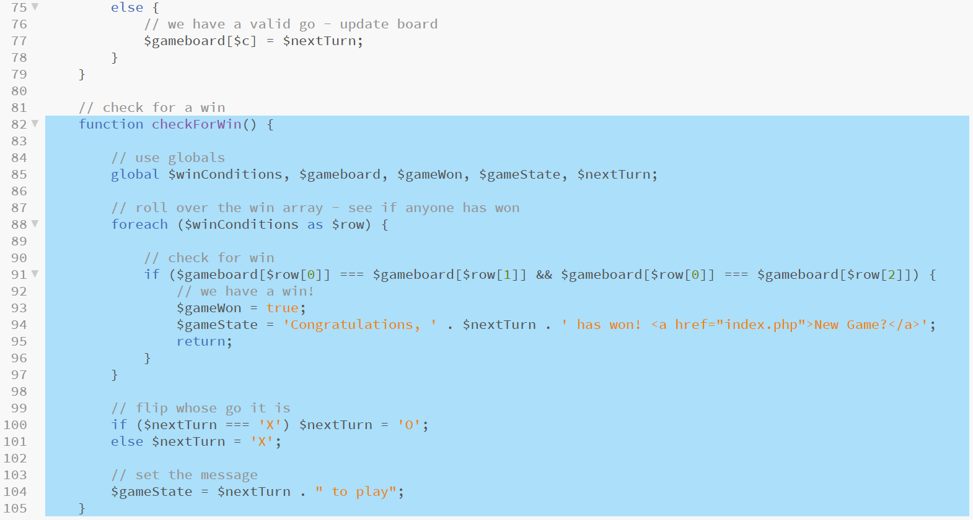
Checking win conditions
Add the highlighted code below the checkEligibility function.
Notes:
This is a big function which is separate again for legibility – this one accepts no arguments and returns no data
Line 82 defines a function called checkForWin which accepts no arguments
Line 85 makes all global data necessary for this game visible to this function
Line 88 defines a foreach loop (like for loop but for looping over every element of specified arrays – in each iteration of the loop, the next entry in the array is loaded into $row, a reference to the internal list which comprises one win condition – and which is in scope only within the foreach block.
For example, on the first iteration of the foreach loop, the first entry in $winConditions will be loaded into $row – this means that $row will = [0,1,2]– and that $row[0] will specify cell 0, $row[1] will specify cell 1 and $row[2] will specific cell 2. On the next iteration $row[0] will be cell 3, $row[1] will be cell 4 and $row[2] will be cell 5. This will continue for each of the sets of win conditions or until a win condition is found (more on that below).
Line 91 examines the three cell numbers specified in the array in $row and compares the data in the corresponding cells in $gameboard – if the 3 $gameboard cells all contain the same data the if statement resolves to true and the block of code that it defines runs (note: as we are comparing strings with strings, we use === to compare value AND data type).
Lines 93 and 94 set $gameState and $gameWon as appropriate to reflect a matching win condition.
Line 95 ends the function. As we have found a win, there is no need to check other win conditions or perform any other processing – the return statement exits the function and returns to the main program flow at the point where the function is called.
If the program reaches lines 100 and 101, then no win condition has been met, so we alter who’s go it is by comparing $nextTurn to “X” and swapping to “O” if true and “X” if not true.
Line 104 sets the $gameState message appropriately.

Slide 34
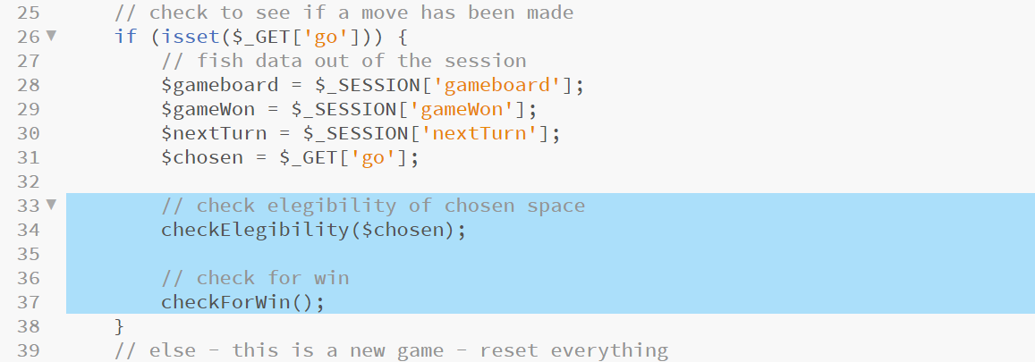
Calling the game logic functions
Remember the placeholder comment that we left in the if block earlier?
We can now replace this comment with our function calls.
We sent the cell chosen for the next go to the checkEligibility function.
We simply call the checkForWin function.
Replace the comment with the highlighted code.

Slide 35
Testing the game
The game is now playable!
Refresh your browser and give it a go!
It has a few issues!
There is no condition for a draw, in this instance the game hangs as no more moves are possible
If a user does choose an invalid cell via the address bar, they lose their turn
Others?
These issues should be relatively simple to solve.
Demonstrate your understanding of this code by attempting to resolve these issues for yourself.
If you get very stuck jump to the last slide.
Notes:
There are a few possible solutions to both of the stated issues – it will be interesting to see which way you go

Slide 36
Project review
We have reused a number of aspects of PHP covered last week.
PHP is loosely typed.
PHP conditionals.
PHP print statements.
Scoping data in PHP.
This project demonstrates:
How to create a stateful application using the PHP session to store and access data
Use of arrays and nested arrays
PHP function syntax
PHP global keyword
Use of break and return in PHP to control program blocks

Slide 37
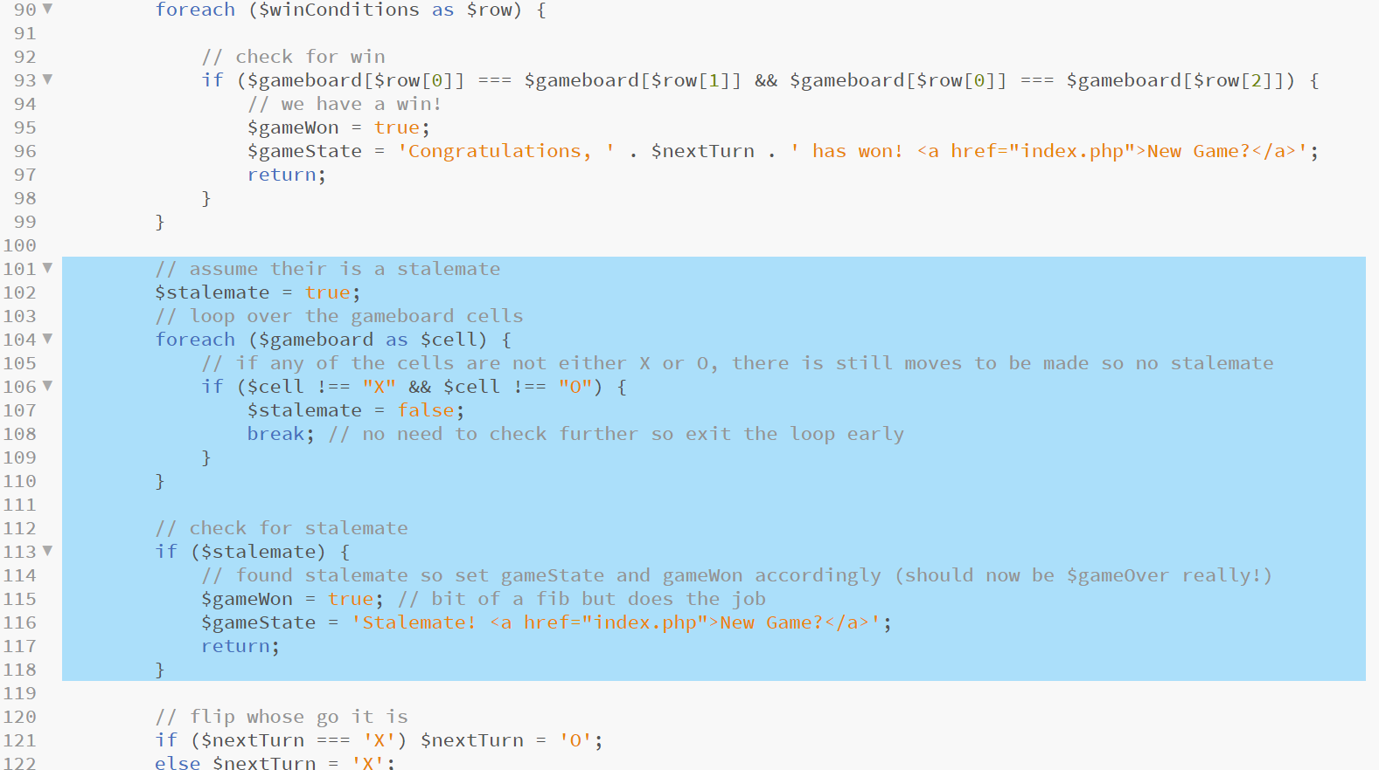
Stalemate solution (issue #1)
See if you can find where this code should go
Notes:
Look over the code and make sure that you understand what it is doing

Slide 38
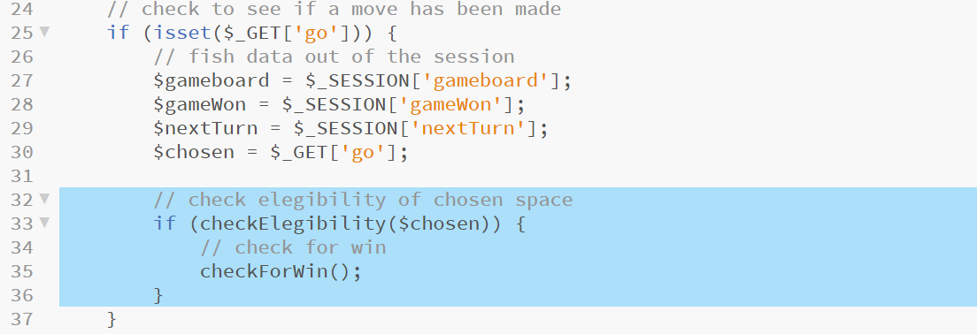
Invalid move solution (issue #2)
See if you can find where this code should go
This is code block 1 of 2
Notes:
Look over the code and make sure that you understand what it is doing
In this solution we introduce a return condition to checkEligibility which returns a Boolean value of true if all is okay and false if cheating has been detected.
We then test it in the main program loop and only execute checkForWin if the cell selected was valid
This is a more efficient solution

Slide 39
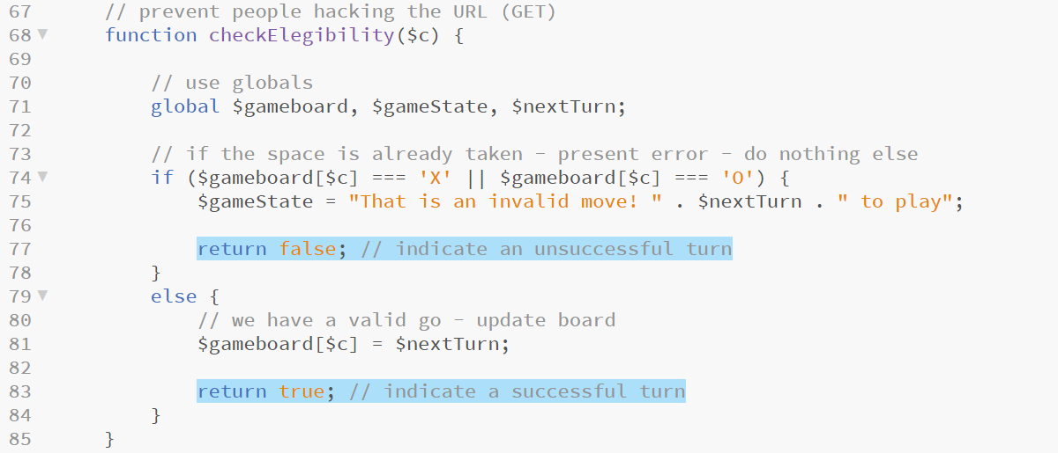
Invalid move solution (issue #2)
See if you can find where this code should go
This is code block 2 of 2
Notes:
Look over the code and make sure that you understand what it is doing
In this solution we introduce a return condition to checkEligibility which returns a Boolean value of true if all is okay and false if cheating has been detected.
We then test it in the main program loop and only execute checkForWin if the cell selected was valid
This is a more efficient solution

Slide 40
Session review and blended learning tasks
BSc Applied Computing

Slide 41
Recap
Recap welcome to PHP
Last exercise progress
Reading list
Quick recap
Session, Stateful and RESTful applications
What is the Session?
Why do we need to maintain state
Stateful vs RESTful applications
Noughts and Crosses game step by step
Project setup
HTML (and CSS, this time we do need a little)
PHP logic

Slide 42
Any questions?
Next…
Connecting PHP to a MySQL database

