Slide 1
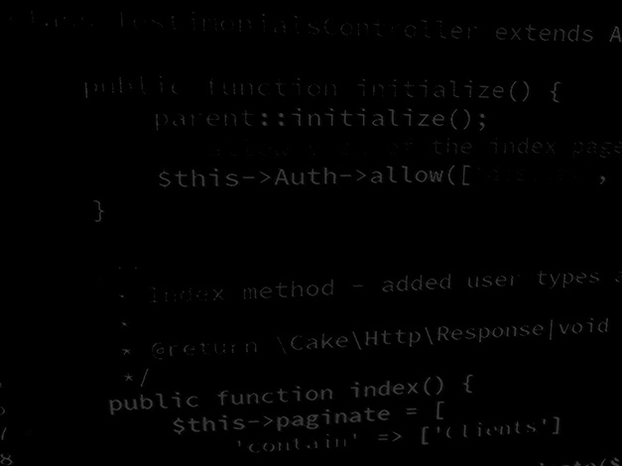
Major Project and Research Methods Project Proposal Briefing
BSc Applied Computing

Slide 2
In this session…
The purpose of the project proposal
The structure of the proposal
Statement of the problem
Reading around the subject
Aims and objectives
Research methodology
Project resources
References and appendices
Planning your work
Word limit

Slide 3
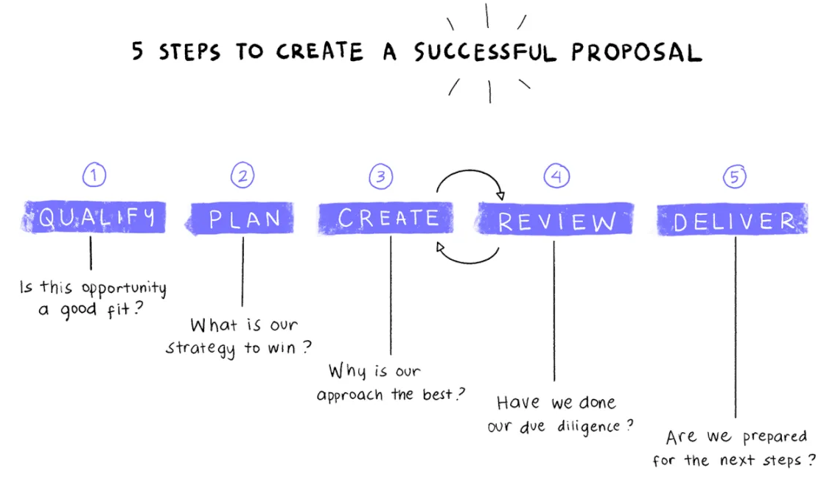
Purpose of the Proposal
Essentially, the purpose of the project proposal is to establish exactly what is to be achieved by the project and to establish a plan to do this.
It should be regarded as a sort of contract between you and your supervisor.
[1]
Notes:
1. How To Write A Project Proposal 5 steps [image on the Internet]. [cited 7/9/2022]. Available from: https://thedigitalprojectmanager.com/write-project-proposal.

Slide 4
Structure of the Project Proposal
Title Page
The course title
The project title
The name of the student undertaking the project.
The name of the (proposed) supervisor.
The date
Statement of the problem to be solved together with any background/rationale that might be appropriate. This chapter should be split into sections.
The aims and objectives of the project (including an analysis of how the objectives are to be achieved).
The research methodology to be used in the project.
Project resources (computer systems, application packages and programming languages etc. to be used).
Project plan (a breakdown of the project into identifiable tasks, deliverables and milestones).
References.
Completed ethics form (available on Moodle).

Slide 5
Statement of the Problem
This chapter is a mini literature review and should be split into sections including an introduction and a conclusion (See Literature Review PP).
It should set the context for the project.
What is the background and reason for your research?
What previous research has been done on your research topic?

Slide 6
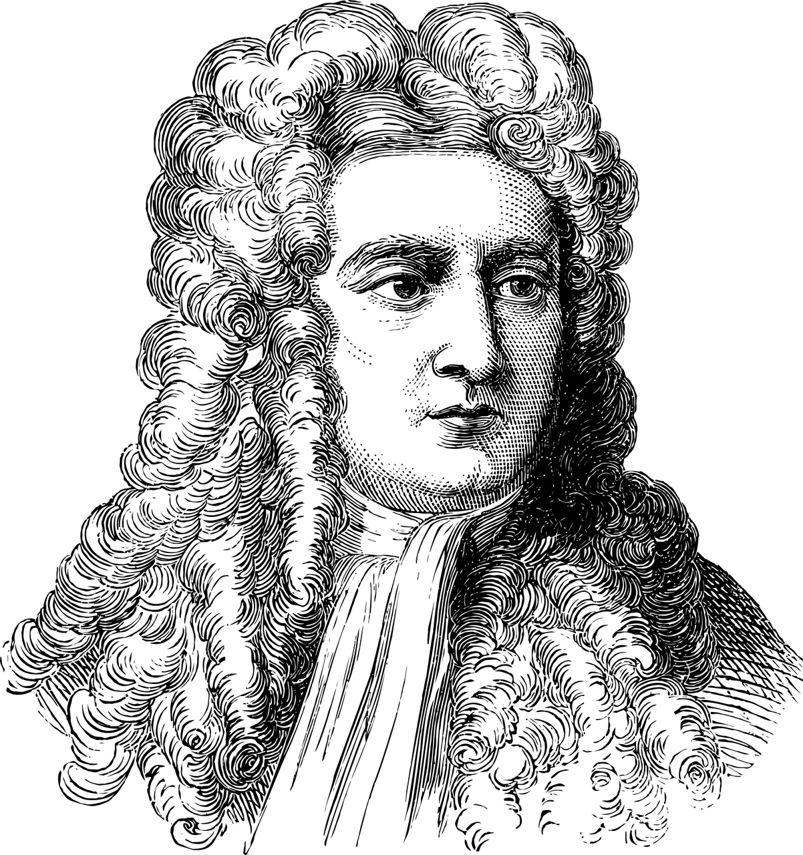
Reading Around the Subject
Reading is very important, a large proportion of your time should be spent reading!
Referring to the work of others is very important.
“If I have seen further, it is by standing on the shoulders of giants” - Isaac Newton [2]
[3]
Notes:
2. Elshaikh, M. Standing on the Shoulders of Invisible Giants. Available at: https://www.khanacademy.org/humanities/big-history-project/big-bang/how-did-big-bang-change/a/standing-on-the-shoulders-of-invisible-giants. Last Accessed: 7/9/2022.
3. Isaac Newton. [image on the Internet]. [cited 7/9/2022]. Available from: https://pixabay.com/vectors/isaac-newton-portrait-vintage-3936704.

Slide 7
Read Around the Subject
Identifying what to read:
You WILL read material that is irrelevant.
Skim through the text first to see relevance.
Not all information available on the Internet is correct and accurate so VALIDATE your sources (CRAAP test).
Casual relaxed reading is generally more productive.
Mark pages and sources if something interesting is encountered.
Keep a project notebook and copy important passages into this (remember to include book title and page numbers when doing so).
Post-It-Notes can be used to keep a record of important research.

Slide 8
Read Around the Subject
Read purposefully.
Choose carefully what you record.
Unfortunately, you cannot know what information you are going to encounter in your reading.
It is common that you feel overloaded with information.
Evaluate the quality of your sources (CRAAP test).
Read about even if you have experience in the subject.
Compare contrasting viewpoints.

Slide 9
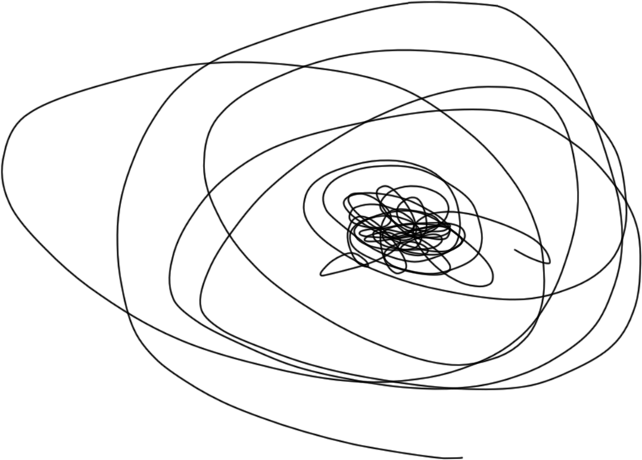
Read Around the Subject
You start off with a generic area of interest.
Your idea will usually be fairly vague, occasionally defined.
You will narrow down a subject as your research progresses.
Keep on refining until you are satisfied with the outcome.
Discuss progress frequently with your supervisor.
You may start by having :
A research area or topic.
A research theme.
A research problem.
A research question.
A hypothesis.
[4]
Notes:
4. The Research process. [Original Image]. 7/9/2022.

Slide 10
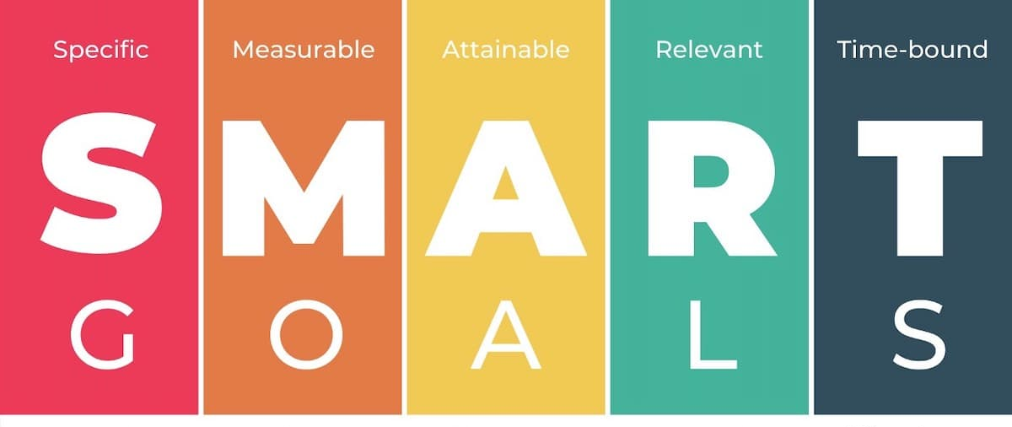
Aims and Objectives
The aim are the ultimate goals of the project.
Ideally it should contain an indication of the quality and/or extent of the implementation.
The objectives (SMART) should clearly describe the individual sub goals of the project, which are required to meet the ultimate goal (i.e. the aim).
Include an analysis of how the objectives are to be achieved including a breakdown of the project into identifiable sub-tasks.
[5]
Notes:
5. How to write effective SMART goals [image on the Internet]. [cited 6/9/2022]. Available from: https://www.breeze.pm/blog/how-to-write-effective-smart-goals.

Slide 11
Research methodology
Research methodology is:
A rationale used to gather data.
It is an informed way of properly arguing a case.
It is the science of method.
Remember that a convincing argument means that contrasting viewpoints are considered.

Slide 12
Research methodology
Identify and justify the research methods that you will use.
Work your way through the Research Onion.
For each layer, explain:
WHICH method you will use.
WHY this method is appropriate.
HOW you will use any particular advantages of this method.
HOW you will avoid any of the problems of this method.
[6]
Notes:
6. Research-Onion-Template [image on the Internet]. [cited 6/9/2022]. Available from: https://slidebazaar.com/items/research-onion-template.

Slide 13
Project Resources
Identify the tools and other resources you will need to complete the project:
Computer systems.
Application packages.
Programming languages.
Others?
Stakeholders can be considered a resource:
Clients.
Test users.
Data / Information gatekeepers.

Slide 14
References and Appendices
References (numeric system of referencing).
Vancouver system.
Guides are available on Moodle.
You could use a citation management tool like citethisforme. [7]
Appendices:
Contain information that, while not important or interesting enough to be included in the body of the report, is nevertheless relevant.
Your report stands alone without these, but the reader may optionally and occasionally wish to refer to them.
The key word here is “occasionally”.
Notes:
7. Citethisforme. Citing Vancouver. Available at: https://www.citethisforme.com/vancouver/source-type. Last Accessed: 7/8/2022.

Slide 15
Planning your Work
Major Project and Research Methods

Slide 16
Planning your Work
Why do we plan?
Ease anxiety.
Provide focus to discussions.
To see whether you are on track.
To plan time off, if you can.
Take the Project Management Approach.
Use a GANNT chart.
TeamGantt is a reasonable choice (and has a free option). [8]
Allocate time to tasks.
Get visibility.
Notes:
8. TeamGantt. Website. Available at: https://www.teamgantt.com. Last Accessed: 7/8/2022.

Slide 17
Planning your Work
Some other tools you can use to plan:
Microsoft Project
Microsoft Excel
Outlook Task List
Open Source Packages
What do we add in a plan?
Tasks
Resources
Time
Possibly budgets
Deadlines

Slide 18
Planning your Work
What Happens when things do not go to plan?
See if you were realistic in your plan.
Build in some slack into your plan.
Have contingencies.
Typical time wasters:
Web surfing.
Getting distracted.
What your plan should look like
Gantt chart.
Show all of the stages of your research methodology.
Show all of the stages of your development methodology.
Include all suitable milestones.

Slide 19
Word Limit
Nominal word limit of 2500 words.
Other relevant material may be included in appendices and are not subject to the word limit…
…but anything in the appendices will not be marked as material in an appendix is extra (it may be referred to, this is all).
The word limit is set for the following reasons.
The discipline to write at this length is considerable.
It encourages incisiveness and a good grasp of technical/theoretical issues.
It necessitates a tight definition of the topic.
It necessitates a meaningful analysis of the relevant literature.
It necessitates communication of complex ideas in clear and precise fashion.

Slide 20
Project Supervision Meetings
Major Project and Research Methods

Slide 21
Project Supervision Meetings
1 Session per week, per student.
20 minutes per session.
Can be remote or in person. *
Time slots will be set by your supervisor and are potentially negotiable.
Attendance is mandatory!
You will be set weekly project targets.
It is up to you to keep to these targets and to demonstrate your progress to your supervisor when asked (and you WILL be asked).
Sessions start week 4 (this week).
Notes:
* Yes I know, I am asking for it aren’t I!

Slide 22
In this session…
The purpose of the project proposal
The structure of the proposal
Statement of the problem
Reading around the subject
Aims and objectives
Research methodology
Project resources
References and appendices
Planning your work
Word limit

Slide 23
Any questions?
No?
Then you can make a start!!

