Slide 1
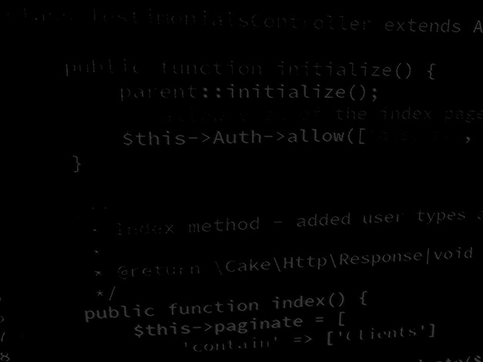
Server-side coding with PHP and Laravel Introduction to Laravel
BSc Applied Computing

Slide 2
In this session…
Recap OOP PHP
Last exercise progress
OOP fundamentals (class, namespace and use statements)
Frameworks are OOP
Frameworks are the easiest way of implementing an API
Introduction to Laravel
Server-side OOP PHP framework for both web applications and APIs
Object-relational mapping (ORM)
Composer and package managers
Tour of a Laravel project
Laravel task list project
Project setup
Project development workshop

Slide 3
Recap OOP PHP
BSc Applied Computing

Slide 4
Quick recap
OOP fundamentals (class, namespace and use statements)
PHP is not OOP by default – it has to be used in that way
OOP splits up the application into manageable functional chunks
Helps make larger projects more understandable
Allows a development team work on different aspects of the same application simultaneously without interfering with each other
Most server-side frameworks use the OOP paradigm (Laravel, CakePHP, etc)
Creating an API using a framework is much easier if you understand OOP

Slide 5
Laravel, a PHP server-side framework
BSc Applied Computing

Slide 6
Laravel
“The PHP Framework for Web Artisans Laravel is a web application framework with expressive, elegant syntax.“
Laravel.com
A Rapid Application Development (RAD) framework
Simplifies the development of complex web application projects
Laravel is an object-oriented framework for server-side web application projects and works equally well as a server-side API
It is fairly easy to learn when compared with its main rivals
But, as with everything, there is still a learning curve!

Slide 7
Object-relational mapping (ORM)
Frameworks are often used as they provide many of the essential aspects of complex web projects without the need for the developer to code them or port them from other projects
One important aspect that frameworks often provide is object-relational mapping (ORM)
An ORM handles connections and all interactions with the database for you
ORM interact with a database and create a virtual database of data records represented as lists of objects which are then presented to the framework
Laravel’s ORM implementation, Eloquent, completely removes the need for any direct database interaction to be coded by the developer once a data structure has been defined
This means no monitoring, opening or closing connections, no SQL statements, no dealing with different types of response from the database, no mapping result objects to PHP structures so the data becomes available – all of this is done for you!
Learning and using an ORM is a significant time saving for larger web application projects
Notes:
There are many implementations of ORM including some libraries such as Java’s Hibernate library, which are only ORM and require adding to other frameworks

Slide 8
ORM example
Rather than the lengthily process needed to save a new record in the last project that we built:
In Eloquent:
Note: this example also demonstrates another function that is provided for us by Laravel – password encryption

Slide 9
Composer, a PHP dependency manager
Current web development practice involves multiple packages
Packages are built on other packages
Lightbox.js requires jQuery for example
Fluid sites (or under development) require updated packages
Easy to break dependencies by updating a single package if that then requires updates to its dependency packages
Dependancy managers resolve this
They keep track of the packages installed and oversee updates making sure that any new requirements of an updated package are met
Different languages have different managers… including:
Maven for Java
NuGet for C# / Visual Studio
Composer for PHP
You were asked to make sure that Composer was installed for this session
If it is still not installed, please install it now

Slide 10
Tour of a Laravel project
A fresh Laravel install will include a complex folder structure
You do not need to be familiar with all of these, but there are some areas which you are likely to want to use at some point:
App/HTTP/Controllers – application logic
App/HTTP/Middleware – authentication logic
App/Models – data object classes default folder (can be changed if preferred)
Routes – all URL request are routed to controllers and methods (web.php and api.php)
Public – images, CSS and JavaScript resources
Resources/Views – HTML templates known as blades which combine to form views
Database/Migrations – Data structure information used to configure the database tables

Slide 11
Laravel task list project
BSc Applied Computing

Slide 12
Project setup
You should create a new virtual host for this project (use the instructions from week 1 if needed)
Project URL: laravel.tasklist
Project folder: LaravelTaskList (do not create the folder yet, just add to httpd-vhosts.conf including a reference to a subfolder that Laravel will create for us, public)
This tutorial is largely the same as the Laravel Quickstart tutorial but updated for Laravel 7 to take advantage of simpler authentication etc.
This project will be developed further in the next session so it is imperative that you complete this stage
This tutorial will use the Brackets editor
All new code will be highlighted, other code will be included to indicate placement of new code only and should not be entered
Further explanation of code is included in the notes pane of specific slides

Slide 13
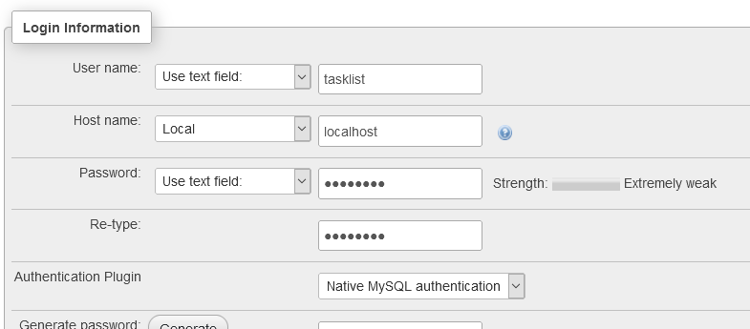
Database setup
Even using Laravel, the database itself and the user account for the webserver still need to be set up using PHPMyAdmin*
Set up a new database with the following details
Database: tasklist
Username: tasklist
Password: tasklist
Hostname: localhost
Notes:
* See PHP session #3 for how to do this if you are unsure

Slide 14
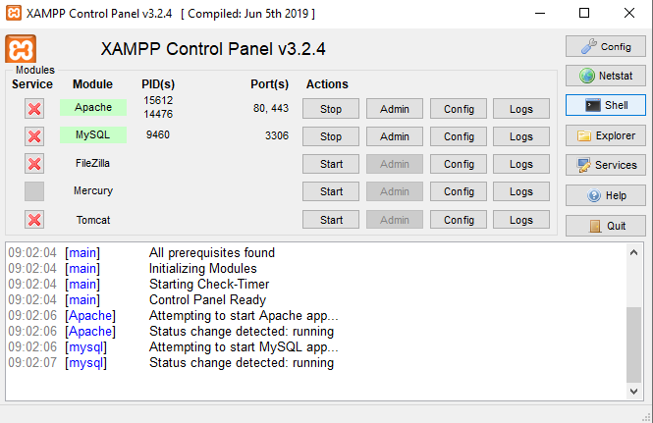
Creating a new Laravel project
Open the XAMPP control panel and find the Shell button
This opens a command line window which allows us to use PHP and composer to create a new project

Slide 15
Creating a new Laravel project
The shell opens in the c:\xampp folder
Navigate to the htdocs folder with the command cd htdocs
Create a new Laravel project with composer using the command
composer create-project laravel/laravel LaravelTaskList 8.6.12 –prefer-dist
This will create a new project folder called LaravelTaskList and download a fresh Laravel install to it
Notes:
CD = change directory

Slide 16
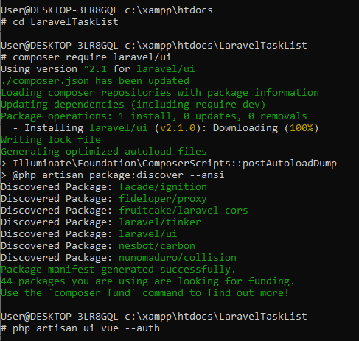
Adding authentication
Laravel has a bespoke user authentication module*
Move into the project folder with the command
cd LaravelTaskList
Tell composer that we want to add authentication with the command
composer require laravel/ui
Install the authentication scaffolding with the command
php artisan ui vue --auth
Notes:
* Many project require user authentication so this is another job which comes already done for us

Slide 17
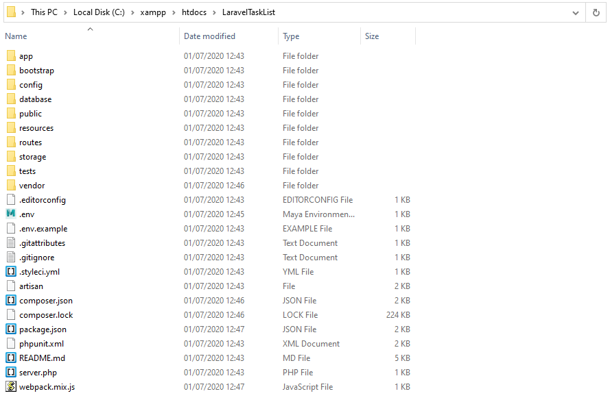
Project folder
Installing Laravel may take a moment
When it is complete, take a look in the project folder, it should look something like this
Notes:
Take a moment to have a look at some of the folders discussed earlier
App/HTTP/Controllers – application logic
App/HTTP/Middleware – authentication logic
App – data object classes default folder (can be changed if preferred)
Routes – all URL request are routed to controllers and methods (web.php and api.php)
Public – images, CSS and JavaScript resources
Resources/Views – HTML templates known as blades which combine to form views
Database/Migrations – Data structure information used to configure the database tables

Slide 18
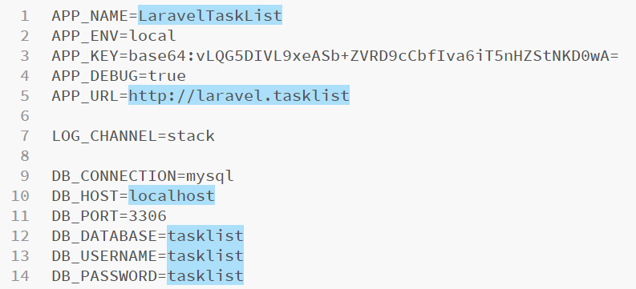
Database configuration
Laravel needs access to the database that we have set up for this project, this is contained in the .env file
Navigate to the project folder in Windows Explorer or similar, right click and select Open as a Brackets Project
Locate and open the .env file in the project root folder – make the highlighted changes below then save this file

Slide 19
Database Migrations
“Laravel's database migrations provide an easy way to define your database table structure and modifications” – Laravel Quickstart
Useful for team projects as these files can be used to setup all databases identically – similar in concept to the dbsetup.php script used last week
This project requires 2 tables, users and tasks
As we have included the Auth module, we now have a default users table migration file already set up
Migration files contain two important methods, up for data to be added to the database and down for how this can be removed from the database
The default users migration from the new project is on the next slide
Migrations can add whole tables or adjust the structure of existing tables

Slide 20
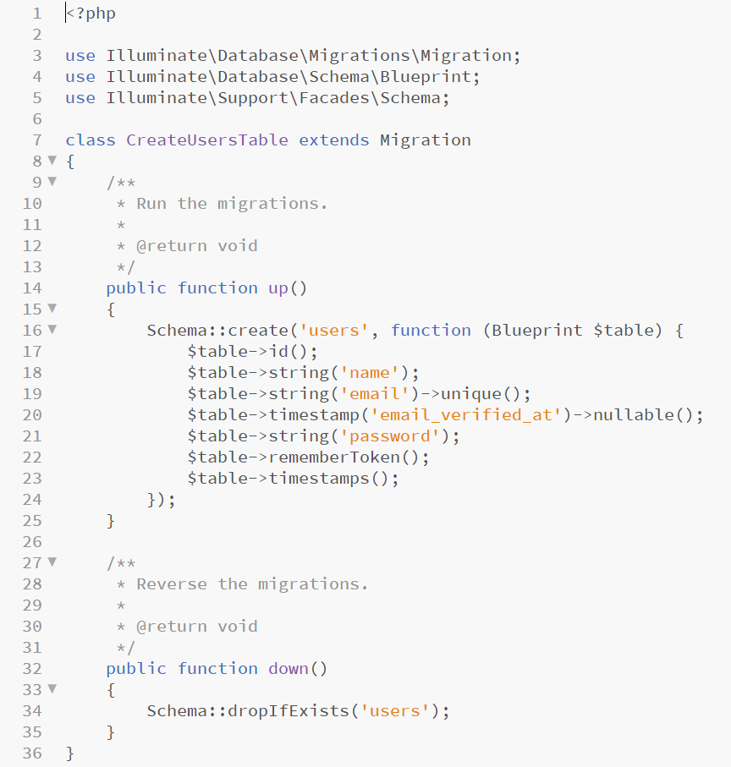
Users migration
The up function contains the table structure to be added
The down function contains information about how this can be removed should this be required later

Slide 21
Creating a Tasks migration
Laravel includes a command line interface known as Artisan
Artisan is very useful for creating new Laravel files as it will setup the object structure, includes and place the new file in the appropriate folder
This cuts down on an LOT of potential errors
As Artisan is a command line interface, open the XAMPP control panel and use the Shell button
Make sure that the shell is navigated to the project folder (the path will be shown and should end in LaravelTaskList)
Type the following command to create the tasks table migration
php artisan make:migration create_tasks_table --create =tasks
Notes:
Artisan command line interface docs here - https://laravel.com/docs/7.x/artisan
To break this down:
We specify a php artisan command called make and pass it the Laravel concept (migration) that we want to make a new one of
The create_tasks_table is simply a name for this migration file
Finally we specify what type of migration we want, in this case a new table (create) and the table name, tasks

Slide 22
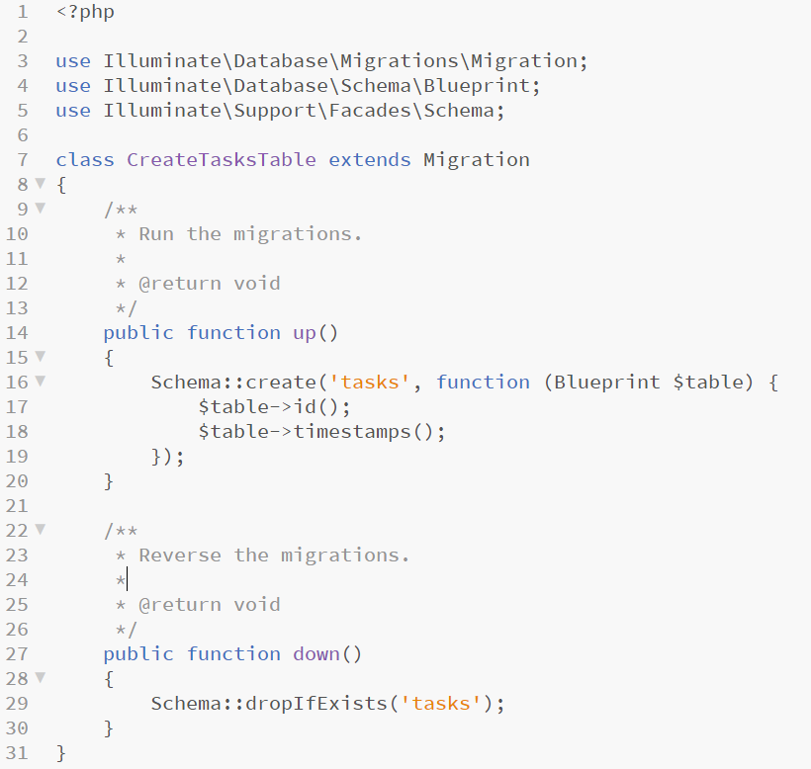
Creating a Tasks migration
A new file has been created in the database/migrations folder
It will have a filename of the current date/time and will include create_tasks_table
Open this file in Brackets

Slide 23
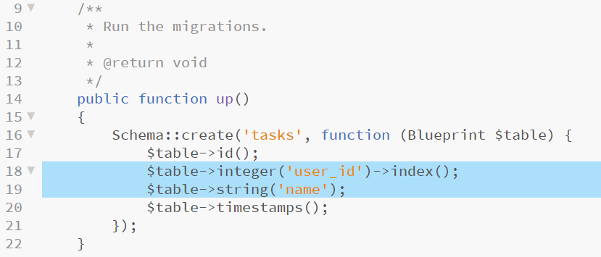
Configuring the Tasks migration
The tasks table requires a string to hold the task name and a user id field to associate the tasks with the user that owns it
Add two lines to the up method which specify these columns – add the highlighted code below and save the migration file
Notes:
Most of this should be self-explanatory except maybe the ->index() directive
As the application will be running searches on this table mostly using the user_id column, making this an index improves the speed of these queries – there is a small server-performance hit for doing this so if you include it in your projects, do so sparingly and only where a specific field is the one being searched in nearly all cases

Slide 24
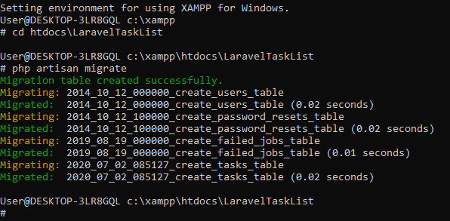
Running the migrations
Return to the XAMPP Shell, make sure that the shell is located inside the current project folder, then run the following Artisan command
php artisan migrate
This will configure the database specified in .env with all of the configurations in the migrate folder

Slide 25
Testing migrations
Test that the migrations have been successful by checking the strucuture of the tasks table
The table should have been added to the database so check the tasks table in PHPMyAdmin
If your tasks table looks like the one above, the migration was successful
Migrations are a very powerful, portable and easy syntax for database management tasks
They are worth exploring further > migrations documentation
Notes:
Full migrations documentation: https://laravel.com/docs/7.x/migrations

Slide 26
Eloquent Models
“Eloquent is Laravel's default ORM (object-relational mapper). Eloquent makes it painless to retrieve and store data in your database using clearly defined "models". Usually, each Eloquent model corresponds directly with a single database table.” – Laravel Quickstart
Models by default live in the app folder – as we have included the Auth module, the Users model has already been created and placed here for us
In order to create the Tasks model, return to the XAMPP Shell and use the following command
php artisan make:model Task
Notes:
This time we specify the make artisan command, tell it that we want a new model and the name of the singular object that the model should correspond to Task
Beware of capitalisation and plurals here:
– Tables in the database are all lowercase and plural as they hold many of… whatever (e.g. tasks)
Models are objects so are capitalised and are singular (Task rather than tasks) as each instance of the Task object will hold data for exactly one task
The docs say:
“We do not have to explicitly tell the Eloquent model which table it corresponds to because it will assume the database table is the plural form of the model name. So, in this case, the Task model is assumed to correspond with the tasks database table.”

Slide 27
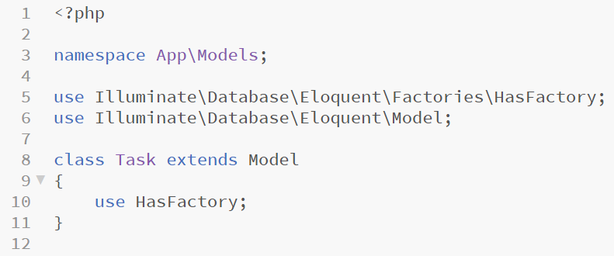
Configuring the Task model
Artisan has made a new Tasks object in the app/Models folder
Open this in Brackets, it should look like the file below, fairly sparse

Slide 28
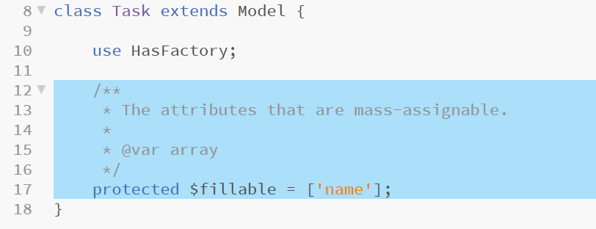
Configuring the Task model
The name field should be filled with data that the user can add, all other columns in the Task model are auto-numbered (id), default value (created_at and updated_at) or assigned through a relationship (user_id)
Fields which contain user data are known as mass assignable
Add the highlighted code to the Task model to set the name field as mass assignable, then save the file

Slide 29
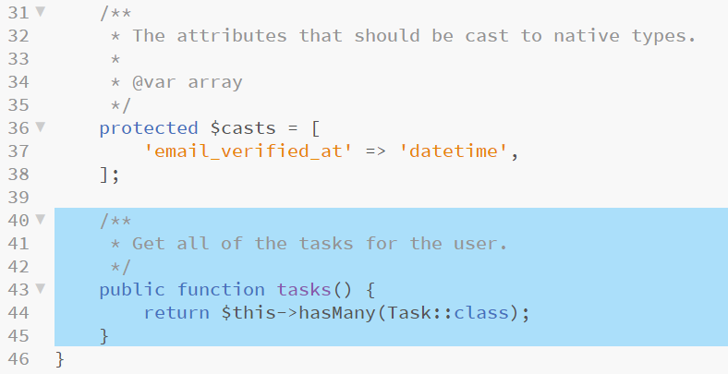
Entity relationships
Defining a relationship between two tables requires editing of both model files, in this case one user can have many tasks
First, define the relationship in the User model… User hasMany Task
Open app/Models/User.php in Brackets and add the highlighted method and comment to the bottom of this class
Notes:
Pay close attention to the trailing bracket which closes the class – the new method needs to be included before this trailing brace.
We do not need to add a reference to the Task class (the “use” keyword) as it is found in the same directory as the User class

Slide 30
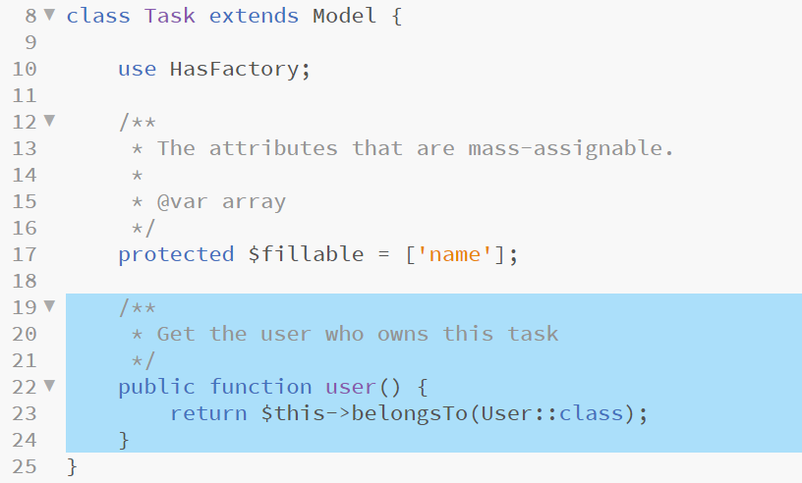
Entity relationships
Next, establish the relationship for the Task model
Each task has only one user so… Task belongsTo User
Open app/Model/Task.php in Brackets and add the highlighted method to the end of the class
Notes:
Pay close attention to the trailing bracket which closes the class – the new method needs to be included before this trailing brace.

Slide 31
Entity relationships, example use
Now that the relationship between these two models is established, retrieving all of the tasks for any user is a simple as this
Do not include this code, it is here as an example of how powerful model relationships are and is not intended for inclusion in the project… not yet!
This concludes the building of our models and relationships for this project, ready for use in the Controllers later on

Slide 32
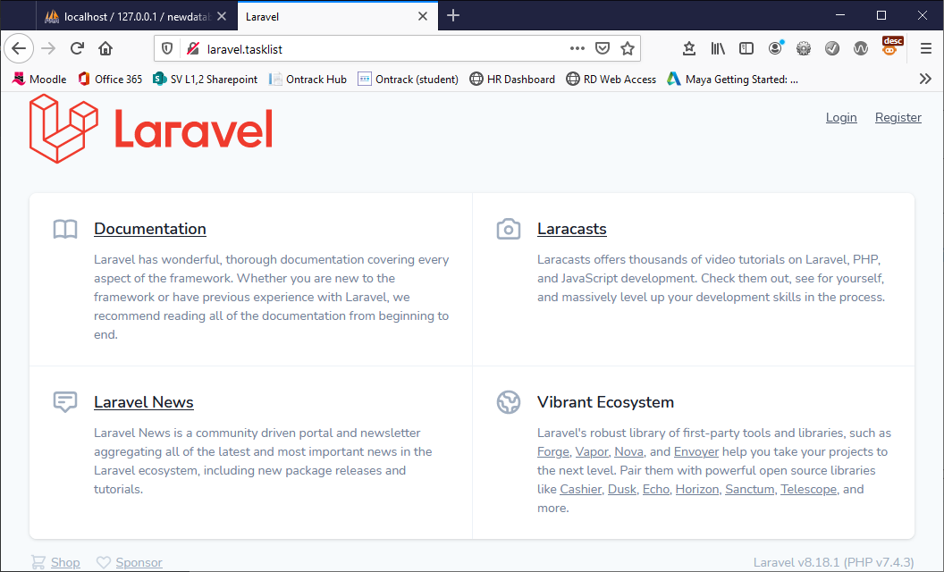
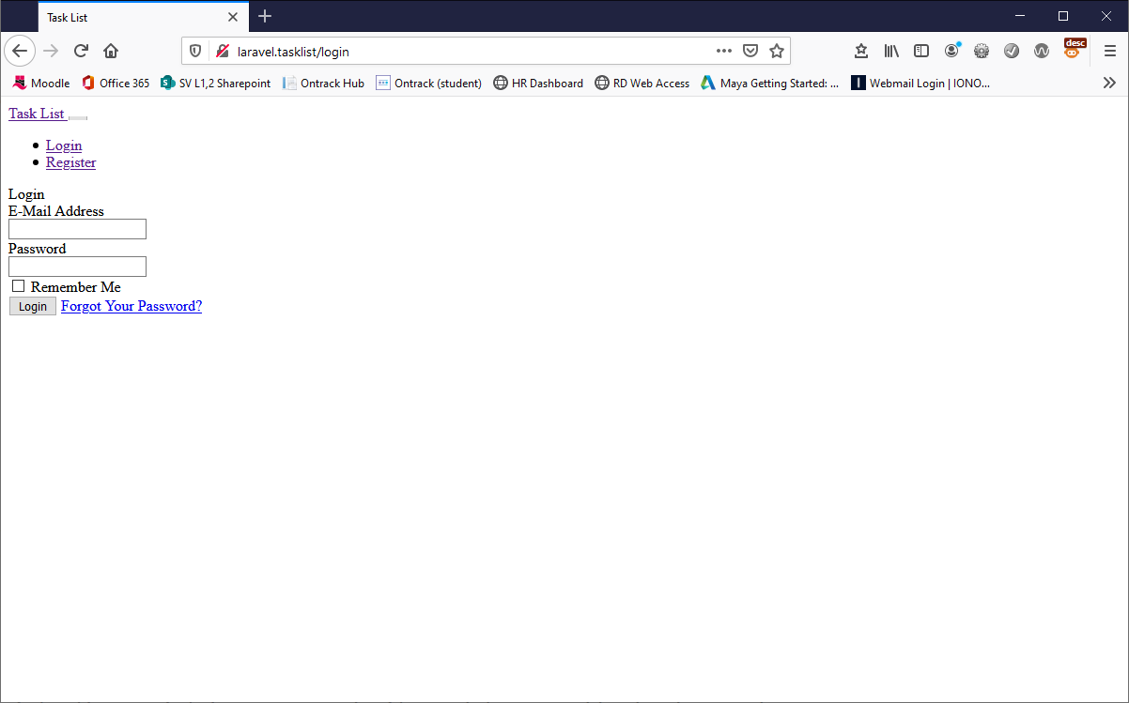
Quick test
Open a browser and navigate to http://laravel.tasklist you should see the default Laravel boilerplate page
Now try http://laravel.tasklist/login, you should see a plain login form

Slide 33
Routing
If you completed last week’s project, you would have had a sneaky preview of Laravel Routing
Laravel project commonly employ close relationships between HTTP routes and controller methods
Open routes/web.php in Brackets – this is where all of the website HTTP requests are contained*
Notes:
*The API equivalent file is routes/api.php
Lines 16 – 18 define a Closure, that is a route without a controller method to map to which simply returns a view – this is not encouraged as it leads to a messy Routes file
Line 20 includes all of the authentication routes, /login, /register and /confirm

Slide 34
Removing the Closure route
We have no further need of the Laravel boilerplate page
As we have a /home route defined we will use that as the default page view from here
In Brackets, delete the highlighted code from the /routes/web.php file
This add the highlighted line shown below*
Notes:
This leaves all of our auth routes intact and routes any request to just the domain name to the index method in HomeController
So now http://larval.tasklist/ and http://larval.tasklist/home both route to the same controller and method

Slide 35
Adding Routes to TaskController
The tasks model will require some application logic to manage the task list data, this will be added to a TaskController class
Before creating the TaskController, add the routes to it
Add the highlighted lines to the bottom of web.php to implement routes to the TaskController functions then save the file

Slide 36
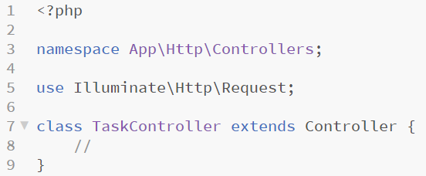
Creating TaskController
TaskController --plain
We know that we need a Controller with the name TaskController and with methods named index, store and destroy
Add this controller using the XAMPP Shell and the following command
php artisan make:controller TaskController
The new TaskController can be found in app/HTTP/Controllers, open it in Brackets and have a look at the default file that has been created

Slide 37
Requiring authentication
To use the functionality provided by TaskController, the user would need to be logged in, we need to restrict access to TaskController to only those that have logged in
Laravel, as many other server-side frameworks, make this kind of requirement relatively easy through a layer known as Middleware.
As we have included the Auth module, the Auth Middleware has been pre-built for us and we only need to specify that we want it used in the TaskController
In Laravel, required Middleware is specified for each class in its constructor function
If you would like to look over the authentication Middleware, it can be found in app/HTTP/Middleware/authentication.php and the routing to this Middleware can be found in app/HTTP/Controllers/Kernel.php (do not make any changes to these files)
Notes:
Laravel Middleware docs - https://laravel.com/docs/7.x/middleware
These docs are useful for additional authentication requirements when creating this kind of server-side web application as it is relatively easy to add your own Middleware classes with specific requirements – for example, admin users may require different levels of access to other users, additional middleware can check that not only has a user been logged in but that they have the right kind of account to be accessing a particular function

Slide 38
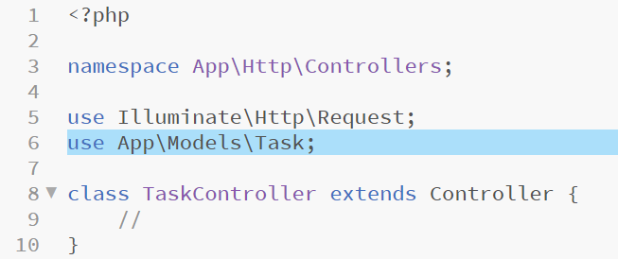
Adding the model reference
The TaskController will need to reference the Task class
To add a reference to Task to the top of TaskController add the following highlighted code*
Notes:
* If using a later revision of Laravel, the Task class *might* be in App\Model\Task – be sure to check!

Slide 39
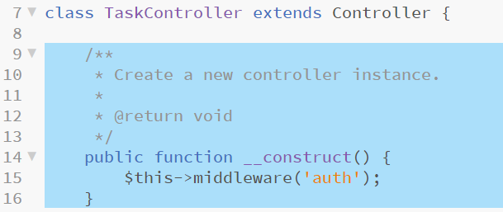
Requiring authentication
Add the highlighted code and comments to TaskController to implement a constructor function and include the authentication Middleware

Slide 40
Routes and views (blades)
Each route links a URL to a controller function as previously mentioned
The controller functions perform application logic and return a view for the browser to display
In Laravel views are split into a number of template files known as Blades
All blades have a filename which includes <name>.blade.php – this instructs Laravel to use the blade templating engine when rendering the view which allows access to a simple and elegant syntax for defining these views
Blades are to be found in the resources/views folder and many will already exist here in folders for the authentication views such as login or register and layouts which contain the overall page structure into which specific views are added (much like the brief HTML framework in the index.php file in the previous project)
As we add functionality to our controller, we will also add blades into the resources folder to display the results
This project will include one view with a form to add new tasks and a table to display stored tasks (much as the previous tasks list project had)
Notes:
Blades documentation - https://laravel.com/docs/7.x/blade

Slide 41
Application layout blade
The application will use resources/views/layout/app.blade.php to include structural HTML, include CSS and JS references and so on
The file that has been created for us contains references to a number of Bootstrap files which come packaged but not compiled or installed
Compiling this requires NPM a Node.js package manager*
If you want to compile the bootstrap files you will need to install Node.js before the next step (if you do not want to do this, the rest of the project will work fine, it just won’t look very nice)
With Node installed and using the XAMPP Shell, enter the commands
npm install
npm run dev
This should build and deploy the JS and CSS that the bootstrap template is looking for
Notes:
*Node.js is quite important for a number of aspects of this unit so downloading and installing it is advised as the earlier that you start using these things, the better!
Bootstrap - https://getbootstrap.com/
I usually do not encourage use of Bootstrap as its bland, lazy and generic – for speed I will live with it in this project
May fail if Vue-loader needs an update… if so look here (https://vue-loader.vuejs.org/guide/) and run this - npm install -D vue-loader vue-template-compiler

Slide 42
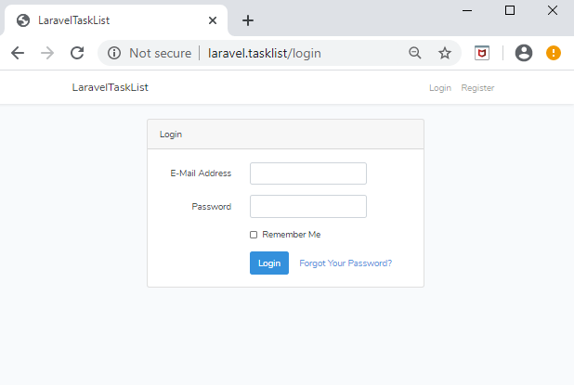
Testing the bootstrap template
Simply reload your browser, the login form should now look a little bit more finished

Slide 43
App.blade.php
The application will use resources/views/layout/app.blade.php to include structural HTML, include CSS and JS references and so on
Line 79 contains the statement @yield(‘content’), this is a special Blade directive that specifies where all child pages that extend the layout can inject their own content.
Line 42 contains @guest and line 72 contains @endguest – all of the code between these statements will display only if the user is NOT logged in – this is an example of how code blocks are defined in the blade syntax
CSS is included on Line 20 – the {{ assets(‘css/app.css’) }} statement returns a URL to a file named app.css which is contained in the public/css folder – you can hard-code these if preferred but any changes to the project environment would then also have to be mirrored in the blades
Often, properties are passed to the view by the controller and are displayed in page with the double brace indicators {{ --something-- }} – for example, line 57 includes {{ Auth::user()->name }} which prints the name attribute of the currently authenticated user object into the page (effectively displaying the name of the person logged in)

Slide 44
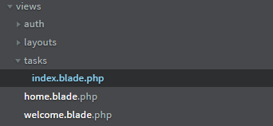
Adding a tasks view
We are ready to add our tasks view blade
Add a new folder inside the resources/views folder named tasks
Add a new file inside the resources/views/tasks named index.blade.php

Slide 45
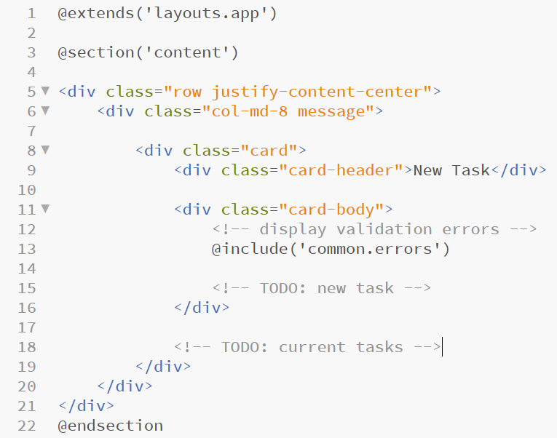
Adding a tasks view
Open index.blade.php in Brackets and add the following code
Notes:
Line 3 specifies that this blade extends the app.blade.php file found inside the resources/views/layouts folder
Line 3 and line 22 define the start and end of the content block which will be included in the app.blade.php template at the point of the @yield(‘content’) statement discussed on slide 43
Line 13 includes another blade which we have not added yet resources/views/common/errors.blade.php we will add this soon but for now it will cause the application to fail to load the view, so do not try this out in the browser just yet!

Slide 46
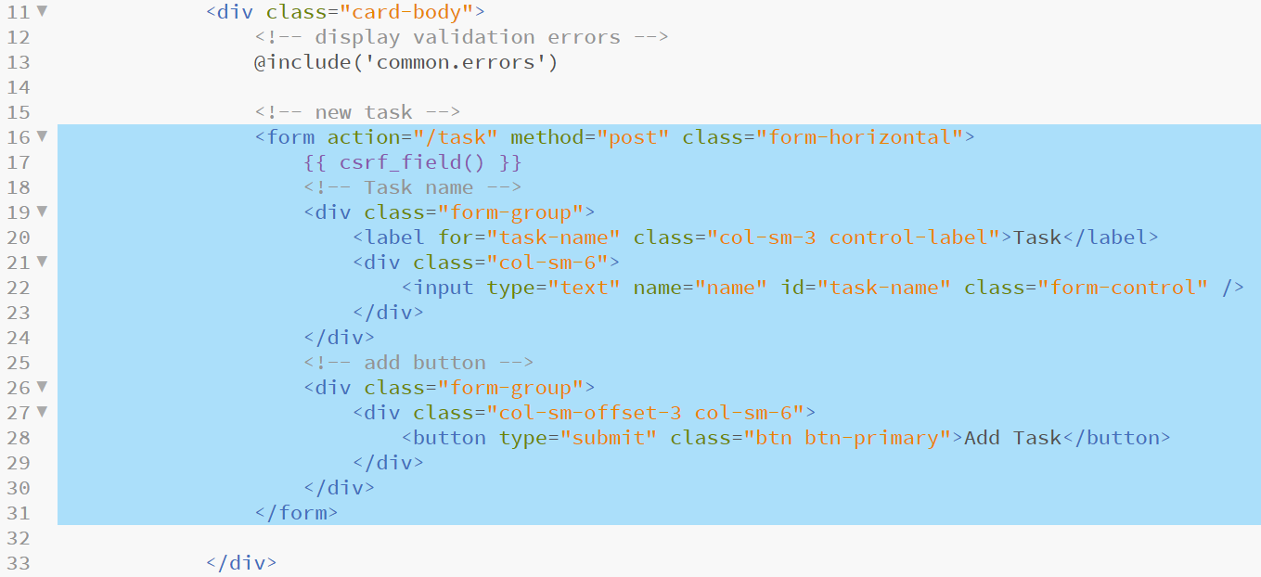
Adding the new task form
Replace the TODO: new task form comment with the following highlighted code to add a HTML form to index.blade.php
Notes:
Line 17 is important – it draws an encrypted string into the form which Laravel checks for on all form sends – this is done to lessen the likelihood of an attacker hard coding their own forms in an attempt to break or disrupt the system – this is known as a CSRF (cross-site request forgery) attack (more on this here: https://owasp.org/www-community/attacks/csrf)
Other than the CSRF field, this is fairly straightforward HTML form.
Note: The form’s action attribute is set to /task and the method to post (and so will be picked up by the route defined earlier in routes/web.php = Route::post('/task', 'TaskController@store');)

Slide 47
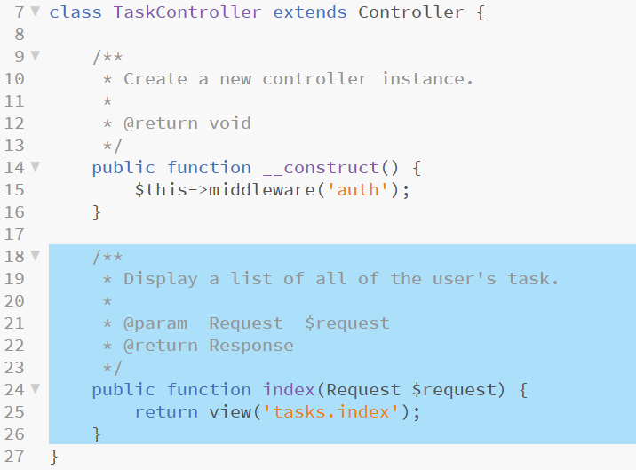
Returning the index view
As we now have a view to return we can instruct the TaskController to do this by creating the index method specified earlier in routes/web.php
Open TaskController in Brackets and add the highlighted code
Notes:
Once again, please pay attention to the trailing brace which closes the class - make sure that the block is added before this last brace

Slide 48
Validating a request
We have set up a route for post requests sent to /form and have built a form that can send these, now we handle these requests
Initially, we will create the store method specified in routes/web.php and make sure that we validate the incoming data
Eloquent deals with SQL injections for us and as we have included the CSRF field we are also protected from that kind of attack
We should still validate the incoming data to make sure that we have been sent a suitable task name
Open TaskController in Brackets and add the highlighted code on the next slide to implement the store method and add the validate clause to check that name has content (required) and is no longer than 255 characters

Slide 49
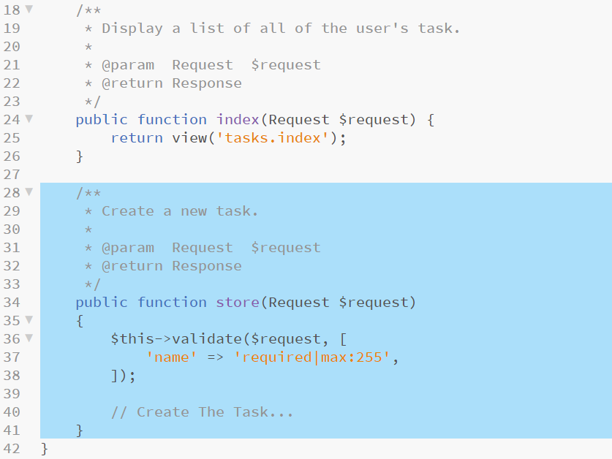
Validating a request
Notes:
Since we are in a controller, we can leverage the convenience of the ValidatesRequests trait that is included in the base Laravel controller. This trait exposes a simple validate method which accepts a request and an array of validation rules.
Traits are similar to abstract classes as they contains methods with can be leveraged in a concrete class like TaskController – unlike abstract classes, traits cannot be extended, only implemented
Laravel validation rules docs are found here - https://laravel.com/docs/7.x/validation

Slide 50
The $errors variable
Remember that we used the @include('common.errors') directive in index.blade.php to render form validation errors
The common.errors.blade.php file will allow us to easily show validation errors in the same format across all of our pages
We have yet created this file so let’s do so now
Make a new folder named common in resources/views
Add a new file, errors.blade.php in the resources/views/common folder
The code for this file is on the following slide

Slide 51
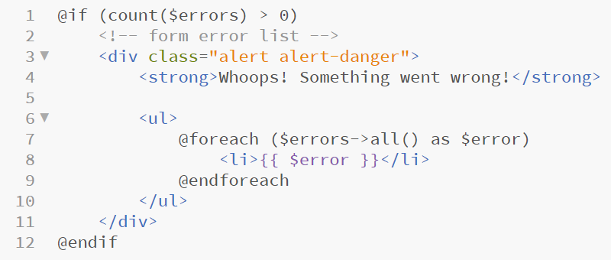
The $errors variable
Open the errors.blade.php file in Brackets and add the following code saving when complete
Notes:
Line 1 contains an if statements which examines the number of $errors which presently exist, if it finds none, no extra content is added to the page – if errors are found the extra HTML needed to draw the error box and alert the user is added to the page
Lines 7 and 9 define the start and end of a foreach loop
This loop iterates over each error contained in the Laravel $errors object (and accessed with $errors->all())
Each error is printed to the page with {{ $error }} (the Blade engine equivalent of <?= $error; ?>)
Each error is contained in an <li>…</li> block, as these tags are contained in the foreach loop, they will also be repeated for each error delivering a nicely formatted HTML unordered list

Slide 52
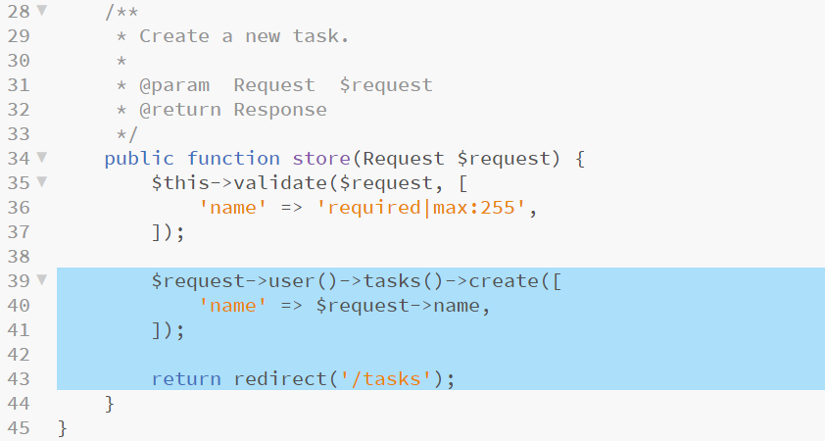
Completing the store method
Now that any errors are trapped and handled, we can complete the store method in the TaskController
Open TaskController in Brackets and add the highlighted code
Notes:
“Most of Laravel's relationships expose a create method, which accepts an array of attributes and will automatically set the foreign key value on the related model before storing it in the database.
In this case, the create method will automatically set the user_id property of the given task to the ID of the currently authenticated user, which we are accessing using $request->user().”
https://laravel.com/docs/5.1/quickstart-intermediate

Slide 53
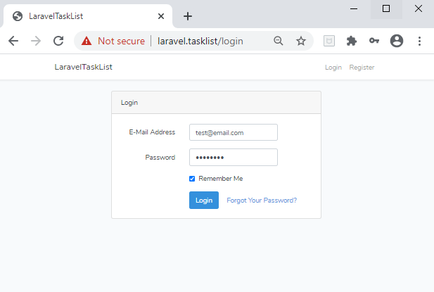
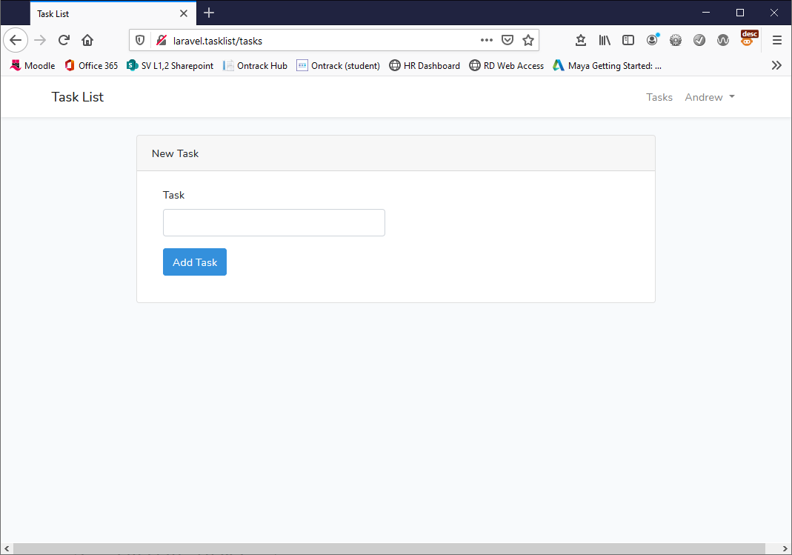
Testing the current functionality
Return to and refresh your browser, you should now be able to register a user, log in and create a new task
Check that the data is being added correctly in PHPMyAdmin

Slide 54
Testing shows up a few issues
There is no control to get from home to tasks
This can also be fixed with a simple addition to resources/views/layout/app.blade.php
Open this blade, add the highlighted code below and save

Slide 55
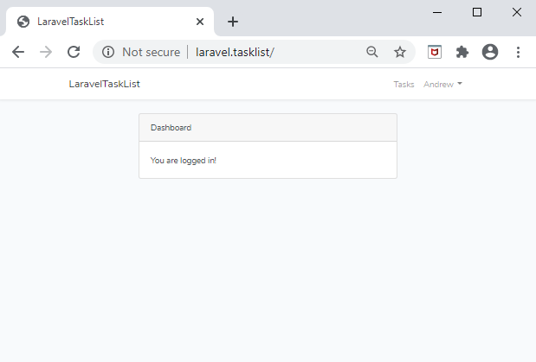
Retest
Both of these issues should now be resolved

Slide 56
Named routes
The link that was just added for the tasks page was hard-coded
This works fine as it is but becomes an issue if the URL has to change
Laravel has a system in place to deal with this kind of maintenance known as named Routes
Each route in routes/web.php can be extended with a name and that name used in blades, if the route changes, so does the hyperlink
Open routes/web.php in Brackets and add the highlighted code

Slide 57
Named routes
Return to app.blade.php and replace the /tasks location in the hyperlink that we just added with the code highlighted below
Save all files and retest the site, you will see no difference in the presented code but now if we change the route for /tasks we will not need to pick through blades which might implement this URL and change those as well

Slide 58
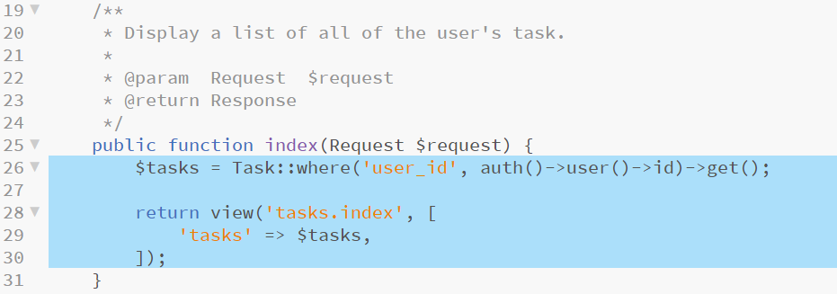
Building a list of existing tasks
Now we can add tasks, we need a way to display all of the existing tasks which have been added to the database
In order to do this TaskController needs to collect all existing tasks and package them before passing them to the view
Open TaskController in brackets and alter the contents of the index method to the code shown below
Notes:
Line 26 queries for all tasks where user_id matches the id of the currently logged in user and stores this in $tasks
Lines 28,29 and 30 call the tasks/index.blade.php view as before but now pass the $tasks collection into the view as well

Slide 59
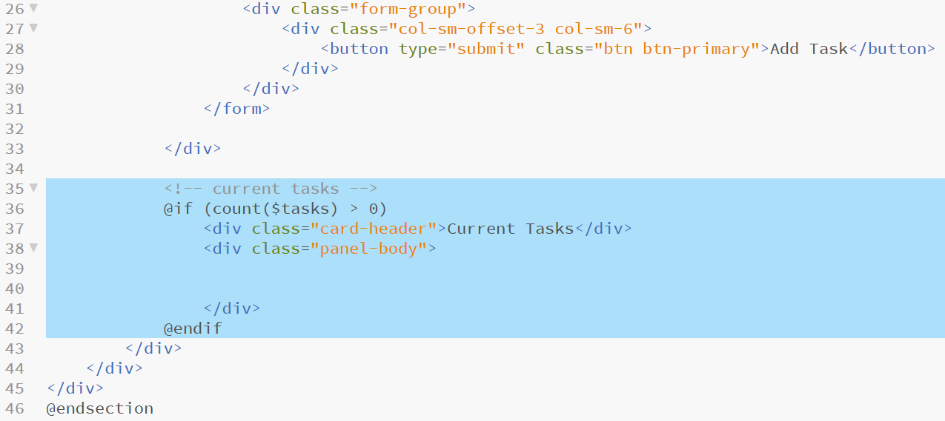
Displaying the tasks
Now that a collection of tasks for this user is passed to the view, we need only add display logic for this to the view
Open index.blade.php in Brackets and add the highlighted code replacing the TODO comment
Notes:
This code adds a new panel to contain the tasks table but does not yet at the table itself
As with the errors.blade.php file, this block checks that the collection is present and larger than 0, if it isn’t, none of the code is drawn

Slide 60
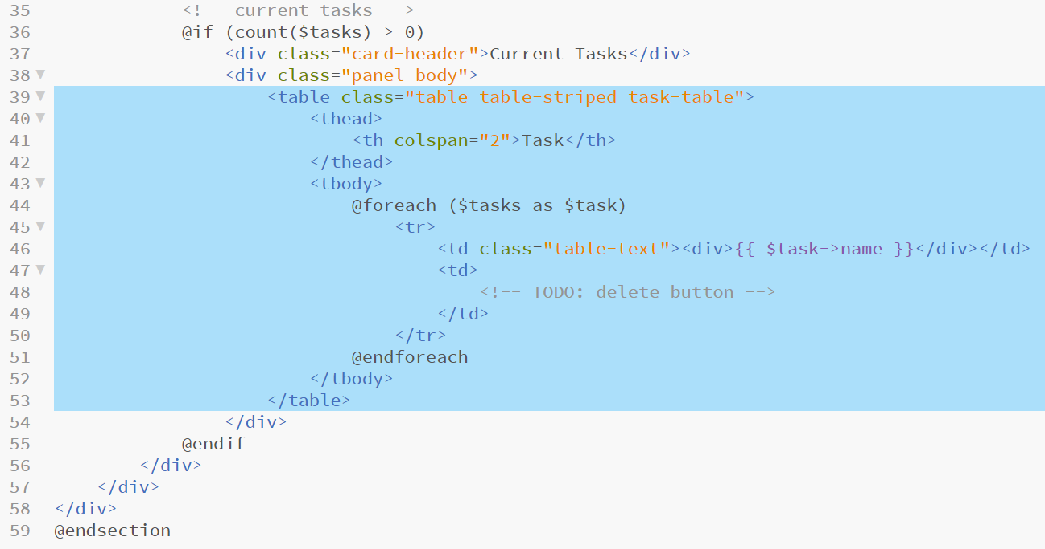
Displaying the tasks
Next, add the highlighted code to implement the table itself
Notes:
As before, a foreach block is coded to create in this instance a table row for each of the tasks in the collection
Note: the TODO comment on line 48 – we will come back to this shortly

Slide 61
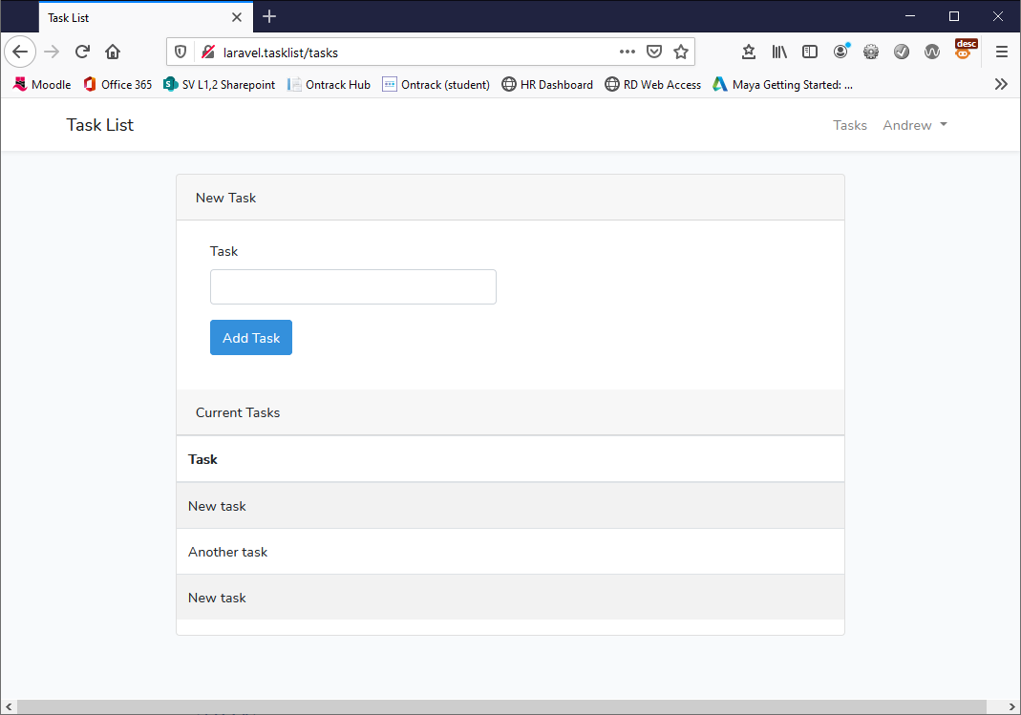
Testing the table
Open your browser and refresh the site, you should now be able to enter and see all tasks for the currently logged in user

Slide 62
Adding a delete button
This is not as simple as it might at first appear
What is relatively simple is adding the HTML to index.blade.php
Replace the TODO comment with the highlighted code
Explanations are the notes pane
Notes:
This control requires a form – the action of the form is the named route for /tasks followed by a / and then the id of the task to be deleted.
This targets this route defined earlier in web.php - Route::delete('/task/{task}', 'TaskController@destroy'); - whenever we specify {something} in a route, any data in those braces is delivered to the method specified in the route
“Note that the delete button's form method is listed as POST, even though we are responding to the request using a Route::delete route. HTML forms only allow the GET and POST HTTP verbs, so we need a way to spoof a DELETE request from the form.
We can spoof a DELETE request by outputting the results of the method_field('DELETE') function within our form. This function generates a hidden form input that Laravel recognizes and will use to override the actual HTTP request method. The generated field will look like the following: <input type="hidden" name="_method" value="DELETE"> - https://laravel.com/docs/5.1/quickstart-intermediate

Slide 63
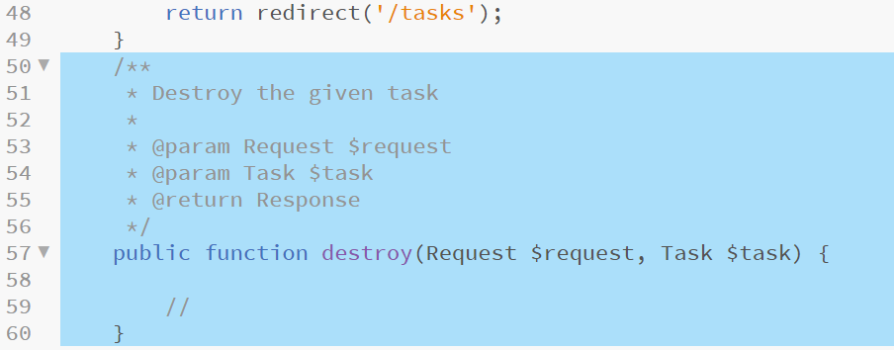
Adding the destroy method
Now we have a delete button and a route which points this to the destroy method of the TaskController which we should now add
Without adding any additional code, Laravel would inject the given task ID into the TaskController@destroy method
Add the following highlighted method definition to TaskController
Notes:
As with previous method additions, please pay very close attention to the position of the trailing brace which closes this TaskController class, make sure that the destroy method is added before this brace
The {task} portion of the route presents the task id to this method and Laravel’s inbuilt implicit model bindings (https://laravel.com/docs/7.x/routing#route-model-binding) – resolve this to the Task object to be deleted

Slide 64
Authorisation
Now, we have a Task instance injected into our destroy method, however, we have no guarantee that the authenticated user actually "owns" the given task*
We will use Laravel's authorization capabilities to make sure the authenticated user actually owns the Task to be deleted
Laravel uses "policies" to organize authorization logic into simple, small classes
Typically, each policy corresponds to a model.
Create a TaskPolicy using the XAMPP Shell and entering the following Artisan command
php artisan make:policy TaskPolicy
Notes:
* Presently any authenticated user could build a fake form targeted at /tasks/{task} with a delete method and a CSRF field. They could maliciously delete other user’s tasks (this would be an effort but is a security risk nevertheless)

Slide 65
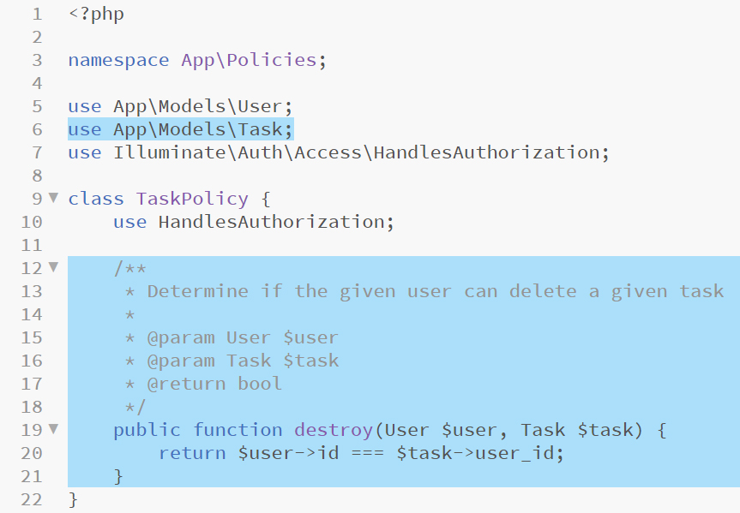
Coding the TaskPolicy
A TaskPolicy file has been created for us in app/Policies
Presently this only contains a constructor method which we will not need
Replace the constructor with the code highlighted below, do not forget to add the use statement to include the Task model, and save the file
Notes:
Line 19 specifies a destroy method mirroring the method name being authorised in the TaskController - this method accepts a User and a Task object as arguments
Line 20 compares the $user->id with the $task-user_id to determine if the Task object belongs to the User object – as it begins with a return statement and as a comparison operator is used, a Boolean will be returned as a result of this test

Slide 66
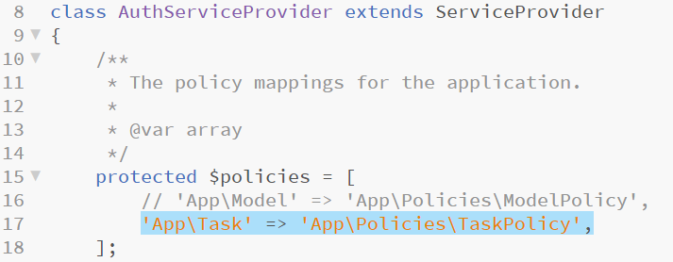
Associating Task and TaskPolicy
At present, these two classes are unaware of each other but we can fix this in app/Providers/AuthServiceProvider by adding a line to the $policies list
Open the above file in Brackets, locate the $policies list and add the highlighted line, save when finished
Notes:
Now, whenever /task is requested, the TaskPolicy is examined for the specific action being run

Slide 67
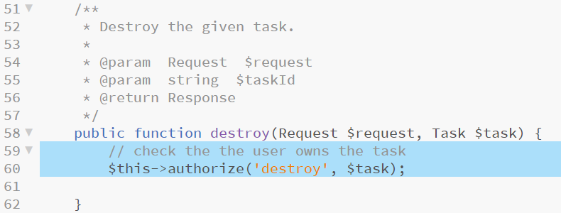
Authorising the destroy action
Now that we have our Policy in place let’s use it
Laravel Controllers utilise an AuthorizeRequests trait which allows them to take advantage of an authorize method
Open the TaskController in Brackets and add the highlighted code to the destroy method
Notes:
Line 60 – the first argument is the name of the method called (corresponds to the policy method name), the second is the Task that we want to run this against. The current User will also be sent to the policy method so no need to pass that argument
If the authorisation fails, Laravel will generate a 404 not found error and display the relevant error page
This is only one way to take advantage of Laravel’s detailed authorisation framework – The manual for this is - https://laravel.com/docs/7.x/authorization

Slide 68
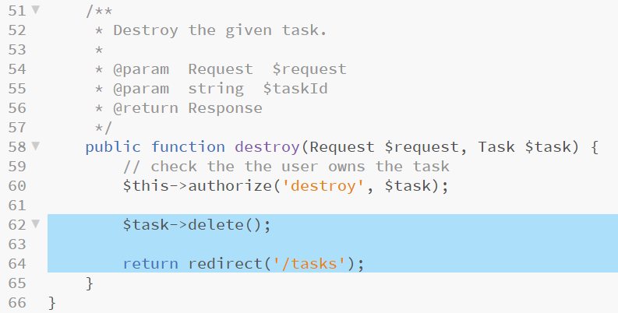
Deleting the Task
We are now happy that the task belongs to this user
We use Eloquent’s delete method to remove the task
Finally, we re-direct back to the /tasks view
Add the code highlighted below
Notes:
This is a quick and dirty app, good UI/UX would be to include a double check that the user actually wants to delete the task and then a confirmation that this had been done successfully.

Slide 69
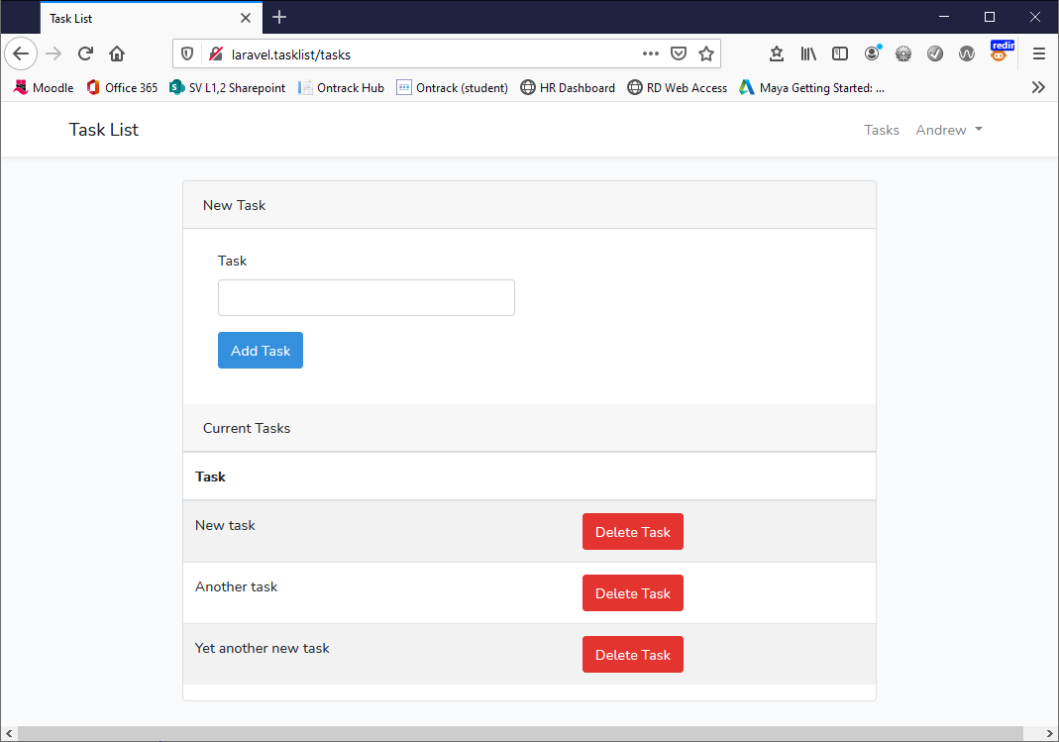
Final testing
Make sure that all files are saved
Refresh your web browser and test the application
You should be able to add users and for each user you should be able to see the tasks that only they have entered
Each user should be able to delete their tasks

Slide 70
Project review
This has been a weighty introduction to Laravel which has covered a lot of core functionality
MVC architectural aspects
Routing
Blades
Eloquent models and implicit model bindings
Authorisation, Validation and Policies
Method spoofing*
All of this is useful for building robust server-side web applications
A good deal of it is also useful when using Laravel to drive an API (Eloquent, Models, Routing, Controllers, Policies etc)
Please make sure that you complete this project as you will need it next week when we turn this application into a Task API
Notes:
* I don’t use this much – I prefer to include more named routes using either get or post all of which can be routed to whatever controller I like – although using a delete method is more expressive, it is not using HTML or HTTP entirely as they were intended to be used and this makes me a little uncomfortable.

Slide 71
Session review
BSc Applied Computing

Slide 72
Recap
Recap OOP PHP
Last exercise progress
OOP fundamentals (class, namespace and use statements)
Frameworks are OOP
Frameworks are the easiest way of implementing an API
Introduction to Laravel
Server-side OOP PHP framework for both web applications and APIs
Object-relational mapping (ORM)
Composer and package managers
Tour of a Laravel project
Laravel task list project
Project setup
Project development workshop

Slide 73
Any questions?
Next…
Modifying the task list application to a web service API

