Slide 1
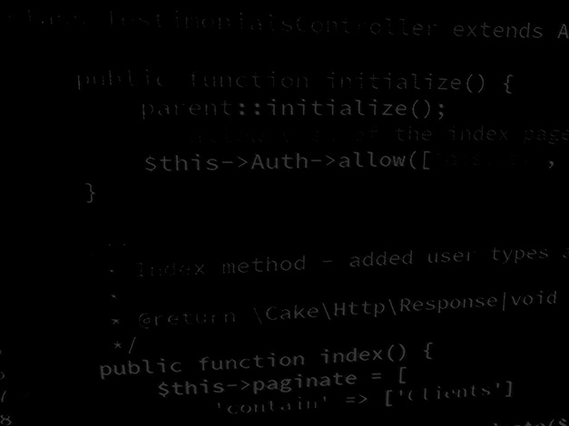
Major Project and Research Methods Research Methodology #6
BSc Applied Computing

Slide 2
In this session…
Recap:
Project Proposal
Approaches to information systems development.
SDLC.
Prototyping.
Rapid Application Development.
Process-oriented.
Data-driven.
Object-oriented.
People/organisational-oriented.
Project planning
Project Plan
Deliverables
Work Breakdown Structure
Gantt Charts

Slide 3
Recap
Major Project and Research Methods

Slide 4
The Project Proposal
The purpose of the project proposal is to establish exactly what is to be achieved by the project and to establish a plan to do this.
“A research proposal is a simply a structured, formal document that explains what you plan to research (i.e. your research topic), why it’s worth researching (i.e. your justification), and how you plan to investigate it (i.e. your practical approach).“ [1]
“The purpose of the research proposal […] is to convince your research supervisor, committee or university that your research is suitable (for the requirements of the degree program) and manageable (given the time and resource constraints you will face).” [1]
Notes:
1. Jansen, D. What (Exactly) Is A Research Proposal?. Available at: https://gradcoach.com/what-is-a-research-proposal-dissertation-thesis. Last Accessed: 5/9/2022.

Slide 5
Approaches to information systems development
Major Project and Research Methods

Slide 6
Which approaches/methods/tools to use?
Development managers who must develop large applications find it useful to mix and match development methods and tools in order to reduce development time, costs and complexity.
They may switch from one methodology to another for different parts of a large system, depending on a variety of considerations.
Choosing an appropriate set of methods will provide structure for your project and lend it some credibility as you will have followed a commonly recognised ‘correct’ practice.

Slide 7
General approaches to information systems development
Whichever frameworks/strategies/approaches are selected for a project, they should be sympathetic with the project aims and objectives.
Common approaches in computer science research projects include:
SDLC.
Prototyping.
Rapid Application Development.
Process-oriented.
Data-driven.
Object-oriented.
People/organisational-oriented.

Slide 8
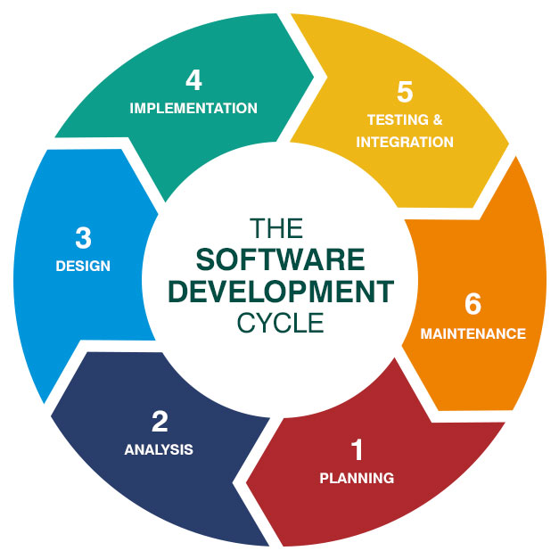
Traditional System Development Life Cycle (SDLC)
The SDLC is a structured framework that consists of distinct sequential processes: systems investigation, systems analysis, systems design, programming, testing, implementation, operation, and maintenance.
These processes, in turn, consist of well-defined tasks.
Some of these tasks are present in most projects, while others are present in only certain types of projects.
Smaller development projects may require only a subset of the tasks, and large projects typically require all tasks.
[2]
Notes:
2. SDLC [image on the Internet, c2019]. [cited 9/9/2022]. Available from: https://bigwater.consulting/2019/04/08/software-development-life-cycle-sdlc.

Slide 9
Advantages of SDLC
Project managers have more control as there is a formal review at the end of each stage.
Formal documents give precise details of requirements.
The complete system is designed before development, including how each component works together. Therefore a thorough understanding of the system is gained before development, and a lot of uncertainty is removed.
Notes:
.

Slide 10
Disadvantages of SDLC
Documentation can be costly and time consuming.
The end user does not see the system until it is almost complete, and may feel that it does not meet their needs.
Changes in technology and stiff competition from rivals may mean that quick changes may be required, and this methodology makes this difficult.
Notes:
.

Slide 11
Prototyping
A general idea of user requirements is obtained rather than a complete set of user specifications.
The system is not developed all at once. Instead, a prototype is developed quickly which either contains parts of the new system of most interest to the users, or is a small-scale working model of the entire system.
The prototype is given to the users, who use it and make suggestions for improving it.
The developers review the prototype with the users and use the suggestions to refine the prototype.
This process continues until either the users approve the system or it becomes apparent that the system cannot meet users’ needs.
If the system is viable, the developers can use the prototype on which to build the full system.

Slide 12
Advantages of Prototyping
Identify problems early in the development stage, the developer will be more likely to discover what the end user is expecting.
End-user buy-in, as user is involved throughout the process.
More likely to meet requirements as the prototyping process will ensure it meets the business and user needs.
Cost Effective, as it is cheaper to rectify problems earlier in the development stage and staff will be familiar so training costs may be reduced.

Slide 13
Disadvantages of Prototyping
Increased Development Time as end-users may ask for extra features that were not agreed upon for systems specification, and may ask for repeated amendments.
Too much focus on one section of the system which may result in other areas not being developed satisfactorily.
Complexity as the user can become confused if there are many different prototypes.

Slide 14
Rapid Application Development (RAD)
Rapid application development (RAD) is a systems development method that can rapidly produce a high-quality system.
RAD is an iterative prototyping approach.
With RAD, users are intensively involved early in the development process.
Sessions are held with users to experience prototypes and help shape system requirements for the next iteration.
[3]
Notes:
3. Rapid Application Development Methodology Template. [image on the Internet]. [cited 9/9/2022]. Available from: https://www.lucidchart.com/blog/rapid-application-development-methodology.

Slide 15
Advantages of RAD
Quick development process.
Changes can be made to the original specifications.
Fewer people are required to develop the project.
Easy to keep track of progress.
Can avoid analysis paralysis (too much time spent on analysis stage before any design or prototype prepared).

Slide 16
Disadvantages of RAD
Only suitable for projects where requirements are well known.
The users are required to be involved throughout the project.
This model can be too fast, and there is a danger that thorough testing may not be carried out and this could result in a security risk.
Feature creep!

Slide 17
Object-Oriented
An object-oriented (OO) approach begins not with the task to be performed, but with the aspects of the real world that must be modelled to perform that task.
The object is the fundamental element it represents, a tangible real-world entity, such as a customer, bank account, student, or course.
OO view an information system as a collection of interacting objects that work together to accomplish tasks.

Slide 18
Advantages of Object-Oriented
Simplicity as the model is based on real world objects that exist (for example, customer, supplier) rather than the process which can lead to a more natural solution.
Reduced Maintenance Costs: -
Reusability as objects contain data and functions (encapsulation) code can be reused for new systems.
Maintainability as encapsulation also means it is easier to identify errors, and code cannot be tampered with.
Improved timescale as the developer has to spend less time and effort and can concentrate on other aspects of the system.
Simple integration of third party classes to simplify and speed the development effort.

Slide 19
Disadvantages of Object-Oriented
The design stage can be too simple to satisfy the needs of the project.
Can lead to less focus on analysis and design and more focus on the code.
Unsuitable for simple projects as it introduces unneeded complexity.
Skill intensive as it is not easy to define the different objects and classes for the system without experience.
Reuse of code may not always be feasible.

Slide 20
Project Planning
Major Project and Research Methods

Slide 21
Project Planning
Adequate planning leads to the correct completion of work.
Inadequate planning leads to frustration towards the end of the project and poor project performance.
The biggest single problem that afflicts software developing is that of underestimating resources required for a project.
Developing a realistic project plan is essential to gain an understanding of the resources required, and how these should be applied.

Slide 22
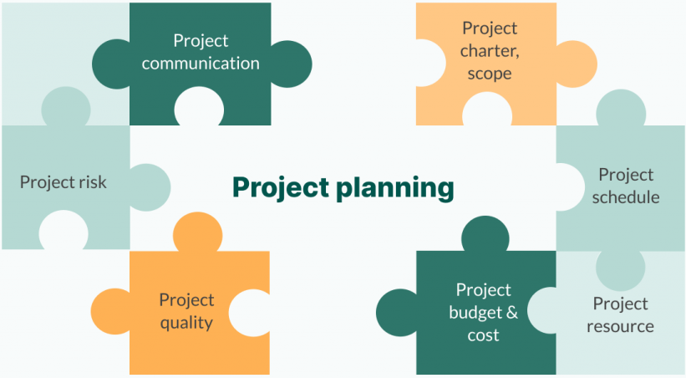
The Project Plan
Specifies the order of work to be carried out, resources, responsibilities, and so on.
Can vary from small and relatively informal to large and very formal.
Developing a project plan is as important as properly designing code.
It is important not to:
Overestimate your ability.
Simply tell clients what they want to hear.
[4]
Notes:
4. A Project Plan Scheme. [image on the Internet, c2021]. [cited 9/9/2022]. Available from: https://blog.ganttpro.com/en/how-to-create-a-project-plan-step-by-step.

Slide 23
Deliverable
A deliverable is an output of the project that can meaningfully be assessed.
Examples:
A report (requirements spec, development report, literature review).
Code (alpha tested product, class, prototype).
Deliverables are indicators (but only indicators) of progress.
[5]
Notes:
5. Manage Project Deliverables Project Manager Roles and Responsibilities. [image on the Internet, c2020]. [cited 9/9/2022]. Available from: https://www.ntaskmanager.com/blog/guide-to-project-deliverables-for-your-project.

Slide 24
Work Breakdown Structure (WBS)
The building blocks of a schedule start with a Work Breakdown Structure (WBS).
The WBS is a hierarchical reflection of all the work in the project in terms of deliverables.
In order to produce these deliverables, work must be performed.
A typical approach in developing a WBS is to start at the highest level, with the product of the project.
[5]
Notes:
5. Manage Project Deliverables Project Manager Roles and Responsibilities. [image on the Internet, c2020]. [cited 9/9/2022]. Available from: https://www.ntaskmanager.com/blog/guide-to-project-deliverables-for-your-project.

Slide 25
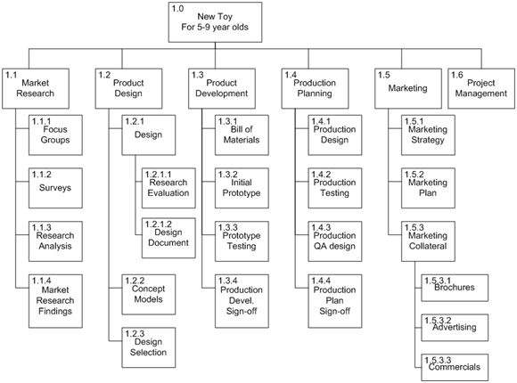
Work Breakdown Structure Example
You are assigned as the project manager of a New Product Development project.
The new product you are developing is a new toy for children age's five through nine. The objective of this product development project is to increase the revenue of the organization by ten percent.
[6]
Notes:
6. Index. [image on the Internet, c2014]. [cited 9/9/2022]. Available from: http://marshalpublication.weebly.com/uploads/4/3/2/5/43251727/4.pdf.

Slide 26
Activities
Once all the deliverables of the project have been identified, activities will be performed in order to create the deliverables.
In some cases, these activities are the physical deliverables, but in other cases they are the actions that need to be performed.
Listing out each of the activities to be performed will result in an activity list as demonstrated.
[5]
Notes:
5. Manage Project Deliverables Project Manager Roles and Responsibilities. [image on the Internet, c2020]. [cited 9/9/2022]. Available from: https://www.ntaskmanager.com/blog/guide-to-project-deliverables-for-your-project.

Slide 27
Milestones
A milestone is a point at which progress on the project may be assessed.
Typically a major turning point in the project.
Examples:
Delivery of requirements spec.
Delivery of alpha tested code.
[5]
Notes:
5. Manage Project Deliverables Project Manager Roles and Responsibilities. [image on the Internet, c2020]. [cited 9/9/2022]. Available from: https://www.ntaskmanager.com/blog/guide-to-project-deliverables-for-your-project.

Slide 28
Creating a plan
Start with your objectives.
Use these to create Milestones.
Subdivide Milestones to create tasks and activities.
Start to think about how long each activity will take.
Start to think about which activities need to happen after others.
Start putting all of this together and before you know it, you have a…

Slide 29
Gantt Chart
[6]
Notes:
6. Gantt Chart for making a cup of tea. [Original image, c2020].

Slide 30
Task
Major Project and Research Methods

Slide 31
Task
Continue working on your Project Proposal document.
Use your aims and objective to create a work breakdown structure.
Use the work breakdown structure to create a Gantt chart for the project.

Slide 32
In this session…
Recap:
Project Proposal
Approaches to information systems development.
SDLC.
Prototyping.
Rapid Application Development.
Process-oriented.
Data-driven.
Object-oriented.
People/organisational-oriented.
Project planning
Project Plan
Deliverables
Work Breakdown Structure
Gantt Charts

Slide 33
Any questions?
No?
Work on the Project Proposal.

