Slide 1
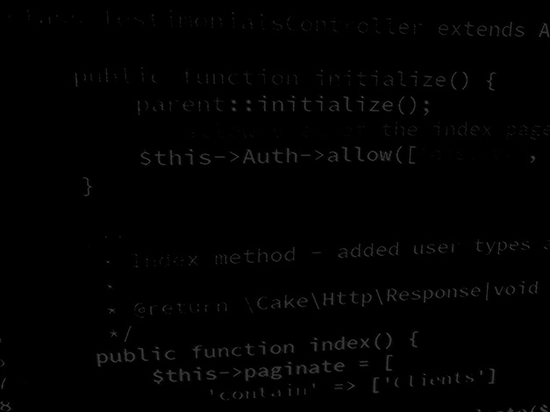
Data handling in Application development MVC architecture application development
BSc Applied Computing

Slide 2
In this session…
Last Session
Semi-structured data
Schema forms
Result Calculator application project
MVC architecture
What is MVC architecture
MVC and OOP
Interfaces
Data classes
MVCing the Result Calculator
Defining classes
Static vs instantiated

Slide 3
Last session
BSc Applied Computing

Slide 4
Semi-structured data
“Semi-structured data refers to data that is not captured or formatted in conventional ways. Semi-structured data does not follow the format of a tabular data model or relational databases because it does not have a fixed schema. However, the data is not completely raw or unstructured, and does contain some structural elements such as tags and organizational metadata that make it easier to analyse. The advantages of semi-structured data is that it is more flexible and simpler to scale compared to structured data.”[6]
In order for an application to be able to use data, rather than just edit it, the data needs to conform to some kind of schema so that the application can recognise one bit of data from another.
Notes:
6: Teradata. What is Semi-Structured Data? Available at: https://www.teradata.com/Glossary/What-is-Semi-Structured-Data. Last Accessed: 29/6/22

Slide 5
Semi-structured data
Flexibility is the key as most of the useful data that we could store is irregular in nature.
For example,
Name: | Microsoft Corporation
Address: | One Microsoft Way
 | Redmond
 | Washington
 | 98052-6399
 | USA
Phone: | (800) 426-9400
Phone: | (425) 882-8080
Fax: | (425) 706-7329
URL: | http://www.Microsoft.com
Name: | Amazon Ltd
Address: | Unit 1
 | Kings Meadow
 | Ferry Hinksey Road
 | Oxford
 | England
 | OX2 0DP
Phone: | 020 7084 7911
Fax: | 0800 068 5523
URL: | http://www.amazon.co.uk

Slide 6
Schema forms
There are a number of ways in which data can be organised so that the nature of the data can be understood.
Order: Name, Fax, URL, Phone, Address
In this example the data is separated by commas.
If all records correspond to this order then the application will know that the first element in the record is the company name, the second is the fax number… and so on.
This is known as a Comma Separated Value (CSV) record.[1]
CSV files are easy to compose and save as well as being relatively easy to read.
CSVs become difficult to manage when they have to cope with an uncertain number of elements such as multiple phone numbers.
Notes:
1: Poudel, D. What is CSV(Comma Separated Value) file? When to use CSV File? How to open CSV file Format? Available at: https://ourtechroom.com/tech/what-is-csv-file-how-to-open-csv-file-when-to-use-csv-file. Last accessed: 7/7/22.

Slide 7
Schema forms
There are a number of ways in which data can be organised so that the nature of the data can be understood.
Key, value pairs: Name=“<value>”, Fax=“<value>”, URL=“value>……
In this example each element of data is provided a label, known as a key, as a method of identification.
With this kind of schema, the order of the elements is unimportant.
This approach also allows for the easy duplication of fields such as when two phone numbers are required.
This approach is often codified into a common format such as XML or JSON.
This approach does require a little more effort to encode the data before it is saved and to decode the data before the application can use it.

Slide 8
MVC architecture
BSc Applied Computing

Slide 9
What is MVC architecture?
“MVC (Model-View-Controller) is a pattern in software design commonly used to implement user interfaces, data, and controlling logic. It emphasizes a separation between the software's business logic and display.” [2]
Model – data load save structure.
View – the UI elements that the user can interact with.
Controller – the application logic.
MVC is a design pattern often used in application design.
MVC splits the project into three distinct areas which can then be assigned to different programming teams.
MVC allows areas of the project to be easily overhauled (for example, if the project moves to a new database or new view framework the application logic does not need any adjustments)
Notes:
2: Mozilla Corporation. MVC. Available at: https://developer.mozilla.org/en-US/docs/Glossary/MVC. Last accessed: 7/7/22.

Slide 10
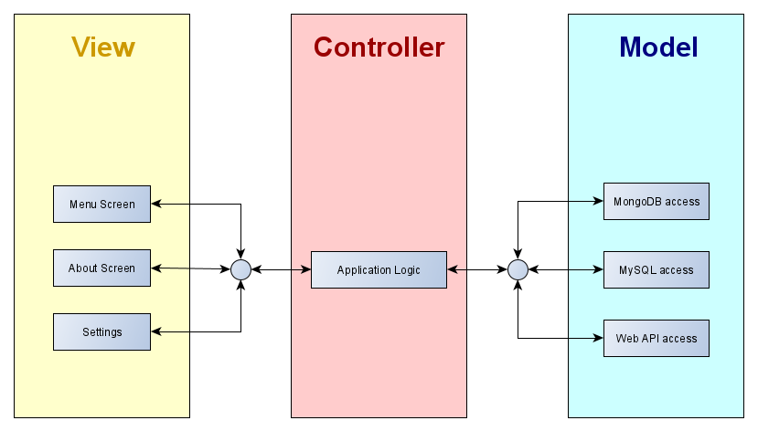
MVC and OOP
MVC divides a build up into specific functional areas.
Best achieved by adopting the object-oriented programming paradigm.
Allows a clean division of labour, the database interface programmer does not need to know anything about the code created by the UI designer, or vice versa.

Slide 11
MVC and OOP
A project should contain many objects.
Objects are defined by function with an object containing all data, methods and events associated with its area of the application.
Example, each separate window of a UI should exist in its own class.
Splitting the data down into functional areas allows:
A more streamlined approach to development.
Easier debugging of code (less to wade through).
Modularity (ease of maintenance).
The use of interfaces to define behaviour.

Slide 12
Interfaces
Interfaces are a special type of object.
Interfaces are never instantiated or extended.
The interface forces all classes to respond to an application similarly.
An interface defines the methods which any class implementing them must include.
In the example below, any class implementing this interface must include:
A method named getName which returns a String.
A method named setName which accepts a single String as an argument.

Slide 13
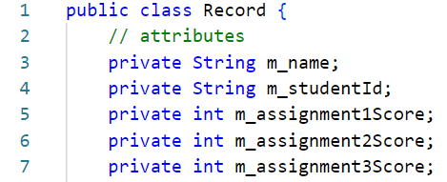
Data classes
MVC architecture applications often employ data classes. *
These are instantiated with a single record of data and stored in a collection (ArrayList, HashMap, etc).
Using data classes significantly simplifies data handling.
For our Result Calculator, we could define a class with the following fields:
Storing the data like this avoids all of the parsing that the last version of the application required.
Notes:
* In Java these are often referred to as POJOs (Plain Old Java Object) or Java Beans (kind of, our example above is not quite a Java Bean as it does not implement the Serializable interface). In Python they are data classes. Other languages may use other terminology, the idea is the same.

Slide 14
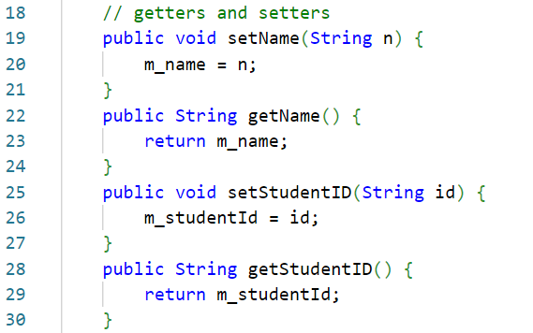
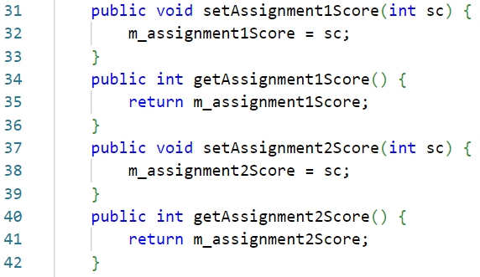
Data classes
The attributes in the example are all marked as private.
It is possible to declare them as public and edit them directly but this is considered bad practice as it is inherently dangerous.
Instead, we use getter and setter methods to access each attribute.
Getter and setter methods can contain validation and other safety features (although the example below does not).

Slide 15
Try it out…
Considering the Result Calculator project.
How could the code in this project be divided up into an MVC framework?
Start with the objects required in each of the three areas, then subdivide based on function.
Note down a list of classes that you think might be required.
You have 15 minutes.

Slide 16
Result calculator project
BSc Applied Computing

Slide 17
Solution *
Model:
Java bean class for storing student record data.
Access interface which dictates how the application can load and save data.
Class which controls loading and saving data to a CSV.
View:
Main UI window.
Add and edit record window.
Controller:
Main application logic (where the initial main method is).
This is not THE solution… it is A solution.
Notes:
* There are actually a two more classes required but these are quite specific and will be covered in more detail later.

Slide 18
Static vs instantiated classes
The next decision is which classes will be static and which will be instantiated.
“A static class […] is a type of class which is instantiated only once in a program. It must contain a static member (variable) or a static member function (method) or both. The variables and methods are accessed without the creation of an object.”[3]
“Instantiating means to create an instance of an object in […] memory. Instantiated classes are those classes which require an object to be created before it’s variables and methods are called. It is similar to a normal class used in C++, Java and other programming languages. These classes can be instantiated more than once and holds unique values for each of its object.”[3]
Instantiated classes are only in memory while active and can be destroyed.
Static classes are always in memory.
Notes:
3: GeeksForGeeks. When to use static vs instantiated classes in PHP? Available at: https://www.geeksforgeeks.org/when-to-use-static-vs-instantiated-classes-in-php/. Last Accessed: 5/8/22.

Slide 19
Static vs instantiated classes
Static classes should be used where their functionality is required only once (such as application logic).
Instantiated classes should be used:
When there is more than one instance of the class required and these instances contain different data (such as a Java Bean).
Where performance heavy aspects of the application (such as the UI) can be removed from memory when no longer required.
Considering the Result Calculator:
Both view UI classes will be instantiated to improve performance. *
The Java bean class will need to be instantiated once for each student record.
The CSV load / save class uses an interface and so needs to be instantiated.
The application logic is singular and should be static.
Notes:
* In this instance, the main window is always in memory… but as the application could be modified to remove or hide it when not in use and as Swing required an instantiated object, we will use that model.

Slide 20
Project design
For our Result Calculator project:
We have separated the application into functional units using the MVC architecture model.
We know how many classes we will need.
We know which types of classes these will be.
We have already built the application logic once.
Some of this will have to change as the application will now access a list of objects rather than a list of CSV strings.
Much of the remaining logic will be very similar.
We will begin the rebuild in the next session.

Slide 21
Session Summary
BSc Applied Computing

Slide 22
This session has covered…
The MVC Architecture model for application development.
Splitting the application into functional OOP classes.
Main benefits:
Easier to code.
Easier to debug.
Easier to work on a single project as a group of developers.
Data classes as a means of housing information.
Interfaces as a means of dictating how an the application logic can interact with other layers in the MVC model.
Designing the classes required for an MVC version of the Result Calculator project.

Slide 23
Session recap…
Last Session
Semi-structured data
Schema forms
Result Calculator application project
MVC architecture
What is MVC architecture
MVC and OOP
Interfaces
Data classes
MVCing the Result Calculator
Defining classes
Static vs instantiated

Slide 24
Any questions?
Next…
Rebuilding the project.

