Slide 1
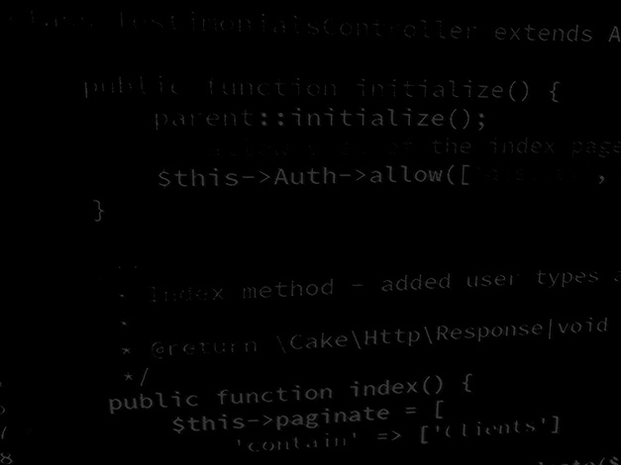
Server-side coding with PHP and Laravel Learning PHP #1 – Higher or Lower
BSc Applied Computing

Slide 2
In this session…
Introduction to PHP
Why PHP?
Reference
Resources
Syntax and use
Higher or lower game step by step
HTML (and CSS if you absolutely must add it!)
PHP logic

Slide 3
Introduction to PHP
BSc Applied Computing

Slide 4
Why PHP?
PHP (PHP Hypertext Pre-processor).
Used to be Perl HomePages (as PHP was developed from Perl).
Open source, so no formal support but free to use.
Works very well with Apache and MySQL.
PHP is used in just under 80% of all websites driven by server-side languages and has been for a lot of years.
PHP has frameworks which allow web services to be built easily.
PHP also has a socket programming implementation (most high and medium level languages do).

Slide 5
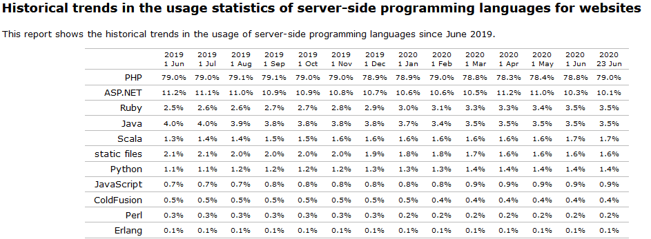
Why PHP?
We are starting with web services and if you build web services you are VERY likely to come across PHP.
w3techs.com

Slide 6
Use a reference and resources
As with any other type of programming, it is impossible to remember all that you need, so use a reference.
PHP.net reference
At other times, if struggling with how to approach a particular routine or process, there is a LOT of help available on the web:
Stackoverflow
Codecademy
W3Schools
PHP may be a different language but it has many of the same commands as other languages and you will solve many problems in exactly the same ways as you have elsewhere.

Slide 7
Syntax and use
PHP has a few idiosyncrasies.
No set data type, just variables (loosely typed).
Variables all start with $.
The concatenation operator is . rather than +.
PHP uses { and } to indicate blocks of code in the same way as C#, Java and JavaScript do.
Any one file can have many PHP blocks with all of the blocks in the same file being in scope at the same time (this means that you can declare a variable in one block and use it in another).
By default, PHP is a procedural language and as such makes heavy use of language functions rather than object methods for many tasks (example: PHP = rand(1,10) rather than C# = Math.random(1,11) to generate a random number between 1 and 10).
PHP can be coded using either Object Oriented or Functional programming paradigms without issue.

Slide 8
Higher or lower game tutorial
BSc Applied Computing

Slide 9
Setup
You should have already created a virtual host for this project as specified in the task at the end of the last session.
Project folder: higherlowerPHP
Project URL: higherlower.game
This tutorial will use the Brackets editor.
All new code will be highlighted, other code will be included to indicate placement of new code only and should not be entered.
PHP can use // or # to indicate a comment.
This tutorial will use // for all comments.
Further explanation of code is included in the notes pane of specific slides.

Slide 10
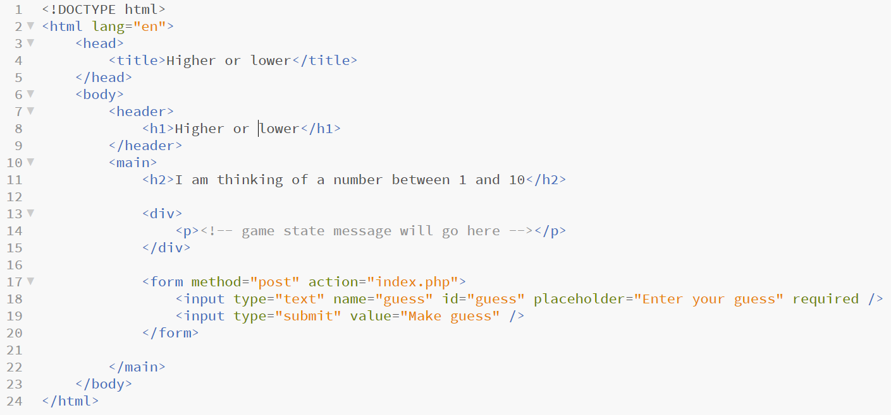
Starting out
Right click the project folder and select Open as a Brackets project.
In the left hand area of Brackets, right click, select new file.
Name the file index.php.
Add in the simple HTML code shown below and save the file.

Slide 11
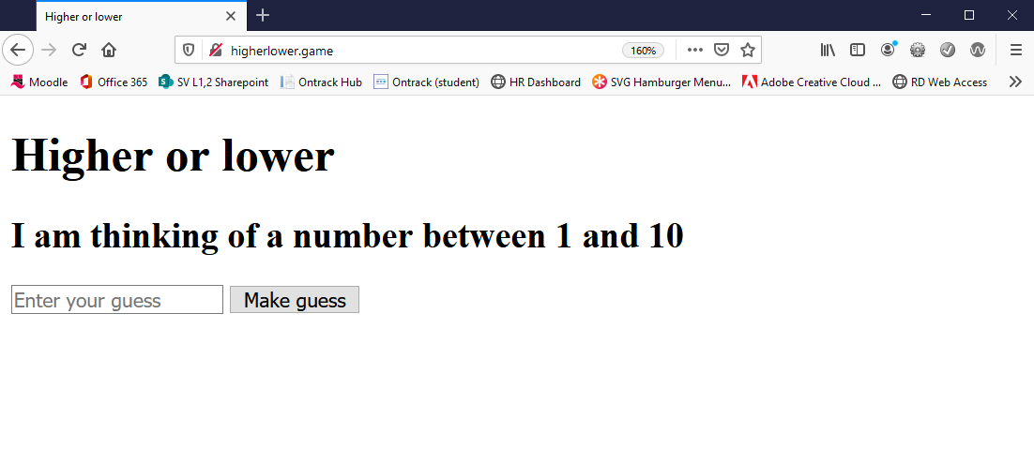
Quick test
Open your browser and enter the project URL.
You should see the page below.
If you do not see this page, double check that the virtual host is working.

Slide 12
PHP block
PHP code can be included in the same file as HTML (although as projects become more complex this becomes less viable).
PHP code has to be entered inside a PHP block statement such as the one shown below.
It is preferable (but not mandatory) to do as much application logic as possible before the page starts to draw, hence the PHP block is added above all HTML.
Please add a PHP block to the index.php file as highlighted below.
Save when ready

Slide 13
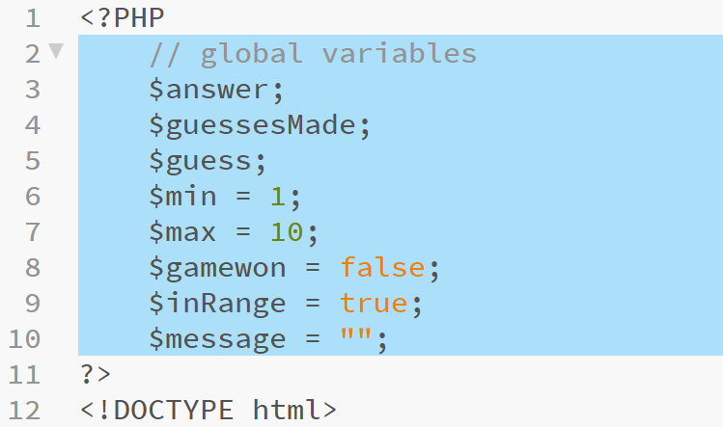
Global variables
This project requires use of a few global variables so these will be included first (note: use of int, string and boolean all use the same declaration, explanations in the notes pane).
Notes:
$answer is the target number that the computer chooses and the user has to guess
$guessesMade keeps track of how many guesses the user has made
$guess is the last guess made by the user
$min is the lowest number that the computer can choose as a target
$max is the highest number that the computer can choose as a target
$gamewon is a Boolean which indicates whether the game has been won or not
$inRange is a Boolean which will be used to sanity check the users input
$message is a string which will be used to keep the user up to date with the status of the game

Slide 14
Using POST
The HTML form that we included in the page has a method of POST* and an input with the name of guess.
Any data submitted by this form will be sent to the webserver and so to PHP where it will appear in a global array $_POST (all server arrays start with $_).
Every request to this page is either the start of a new game or a player making a guess.
To check if a player is making a guess we can check to see if any data for guess exists in $_POST.
As this is a conditional with 2 outcomes, we use an if / else block.
*GET vs POST explanation
Notes:
$_POST is an associative array – which is an array which uses key terms rather than numbers to access specific elements – it is similar to the Dictionary object in C# in this respect
Most languages have some form of associative array as they are very handy for storing key/value pairs in no specific order
$_POST is a superglobal which means that it is absolutely always in scope

Slide 15
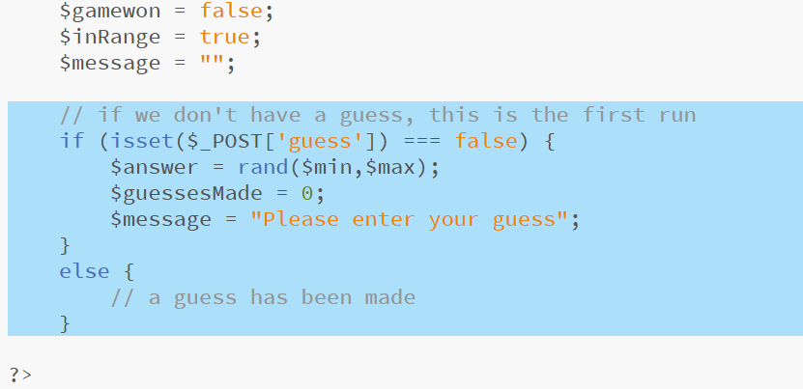
Using POST
In the code below, isset() is a PHP method which tests whether a variable contains a value or not returning true if data is found and false if not.
As PHP is loosely typed, we can use === as a comparison operator, this tests that values and data types match (to just test values, use ==).
Enter the highlighted code and save the file when complete.
Notes:
PHP function isset() - https://www.php.net/manual/en/function.isset.php
PHP function rand() - https://www.php.net/manual/en/function.rand.php
PHP comparison operators - https://www.php.net/manual/en/language.operators.comparison.php
In the code above if the form has not been used then $_POST[‘guess’] will be empty and the isset() method will return false so the top block of code will run and a new game will be started

Slide 16
New game setup
We have now populated all of our global variables and can start to use them in amongst the HTML.
If we simply want to include a variable value in our HTML we can use a shortcut PHP print statement <?= $var ?>
We will start by including the message text, replace the comment with the highlighted code at the location shown below.
Notes:
Because PHP does not scope variables inside <?PHP ?> blocks, $message is still in scope even down amongst the HTML code

Slide 17
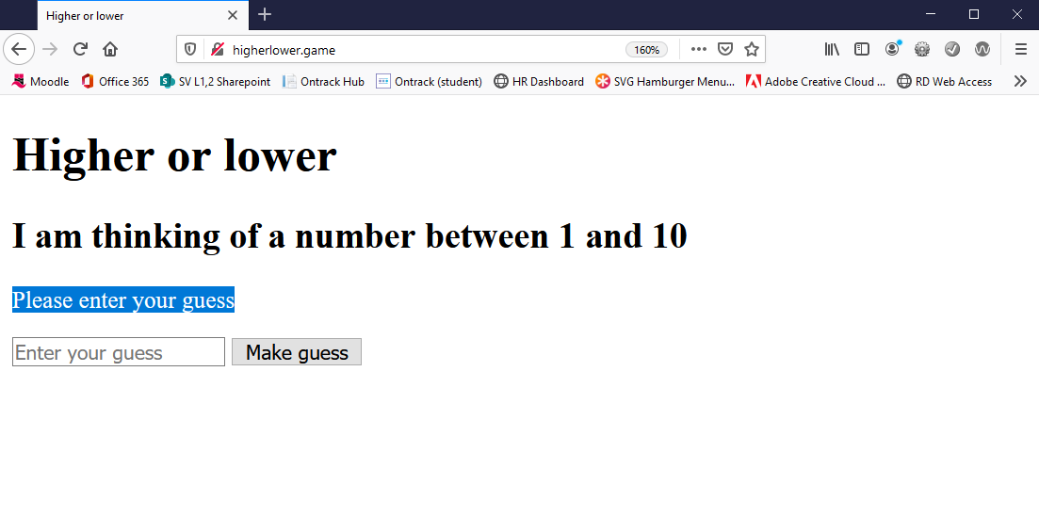
Testing the print statement
Reload your browser and you should now see the highlighted message appear in page.
Notes:
In this instance, the form has not been used so the $message variable is set to the text “Please enter your guess” which is then printed between the <p></p> tags by the <?= $message; ?> statement

Slide 18
New game setup
The game needs to keep track of the target number that the user is trying to guess and also to keep a running count of how many attempts have been made.
To do this whilst keeping the values secret from the user we will use a special hidden HTML input as these will send the values but will not draw in the browser.
Enter the highlighted code below (note the PHP print statements in the value of each input tag).

Slide 19
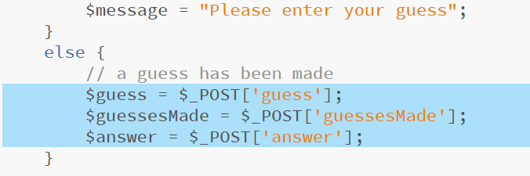
Game logic
We need to capture the data sent from the form when it is submitted.
Add the highlighted code to the existing else block as shown below.
This code extract the form data from $_POST and assigns it to the global variables set up previously.

Slide 20
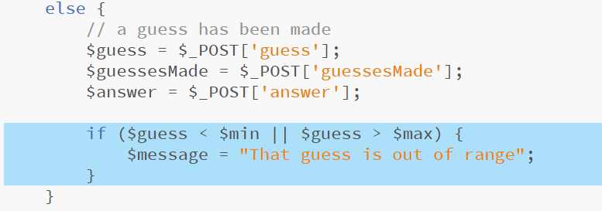
Sanity checking the input
As PHP is loosely typed we can compare the strings which are presented with $_POST to any other data type
In the code below $guess is a string, $min and $max are ints and we compare them using < and > which are mathematical comparison operators
In this case, PHP will try to convert the strings to numbers and will then be able to make the comparison
Notes:
If $guess is < $min (which is set to 1) or > $max (which is set to 10) then it does not matter what it actually is, (words, numbers or nothing at all) as only numbers 1 to 10 will fail this statement and so not run the block which sets the error in $message
As this is an OR conditional statement, indicated by ||, if either the < test or the > test is passed, then the code block will run

Slide 21
Game won condition
Next, extend the if statement with else if which will be tested only if the test in the if block fails.
We can now assume that the input in $guess is something that we can work with so we test to see if the user has guessed the right number by comparing the value in $guess with the value in $answer.
Note: We use == to compare only values as one of these variables ($answer) is an integer and the other ($guess) is a string.
Notes:
If the user has guessed right
- they have made a valid guess so increase the number of guesses made by one (we only do this if the guess is a valid number)
- we set the $message string to reflect the fact that the game has been won
- we set the $gamewon Boolean to reflect the fact that the game has been won
We use . to concatenate the number of $guessesMade and the $answer into the $message string

Slide 22
Valid but not winning guess
We have dealt with invalid input and with a winning guess, the only remaining state is a valid but incorrect guess.
As this is the only remaining possibility, we use else as we have no need of any further state testing.
Inside this block is another if/else block which tests if the guess is too high or too low and sets the $message string accordingly.
Notes:
If the user has made a valid guess but is incorrect
- increase the number of guesses they have made
- if their guess is too low, set $message to reflect this
- else their guess must be too high as we know it is not correct and that it is a number in the acceptable range – we set $message to reflect a guess that is too high
Both strings use . to concatenate the number guessed into the $message string

Slide 23
Reflecting a winning guess in the page
If the player has won, they do not need to see the HTML form with which they make a guess
Use 2 PHP blocks to add an if statement which tests that $gameWon is set to false and draws the form as long as this is the case
Notes:
The ! operator stands for “not”
This test is shorthand – it reads, if not $gamewon – as $gamewon is a Boolean it is either true or false
If we had said if ($gamewon) { - then the test would pass and the block of code would run if $gamewon is set to true.
We want the opposite to happen and the block to run when $gamewon is set to false so including ! reverses the meaning and the test passes if $gamewon === false
The second PHP block only includes the closing curly brace for this test. It is important to include this as if we don’t the block isn’t closed and won’t compile – also it indicates where the optional block of code ends
These two blocks cause the HTML form to draw into the page only if $gamewon === false

Slide 24
Restarting the game
If the game has been won, it would be nice to include a way to restart it
Extending the if statement that we just included with an else block allows this to happen.
The restart control is a simple hyperlink back to this same page.
The hyperlink does not use HTTP post data so should pass the initial if (isset($_POST['guess']) === false) statement and setup a new game.
Be careful to add ONLY the highlighted code.

Slide 25
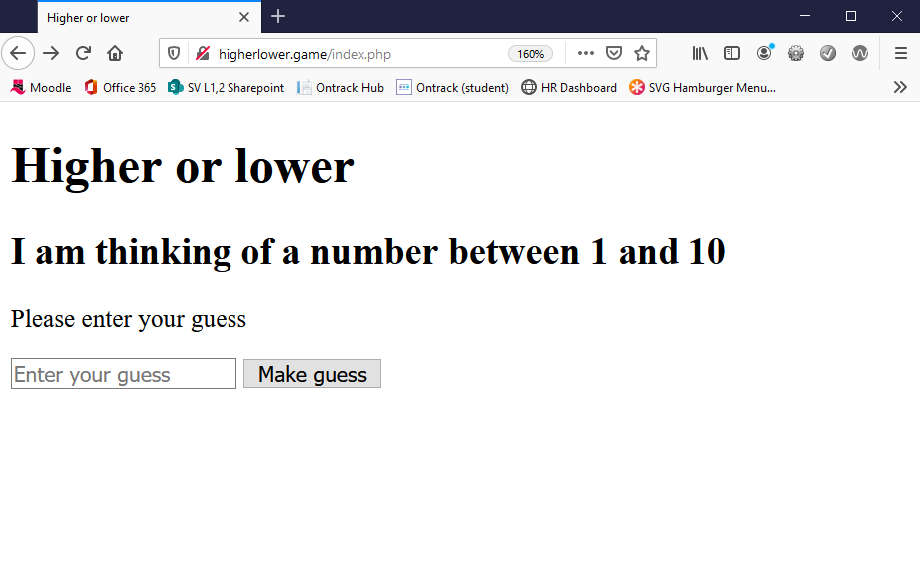
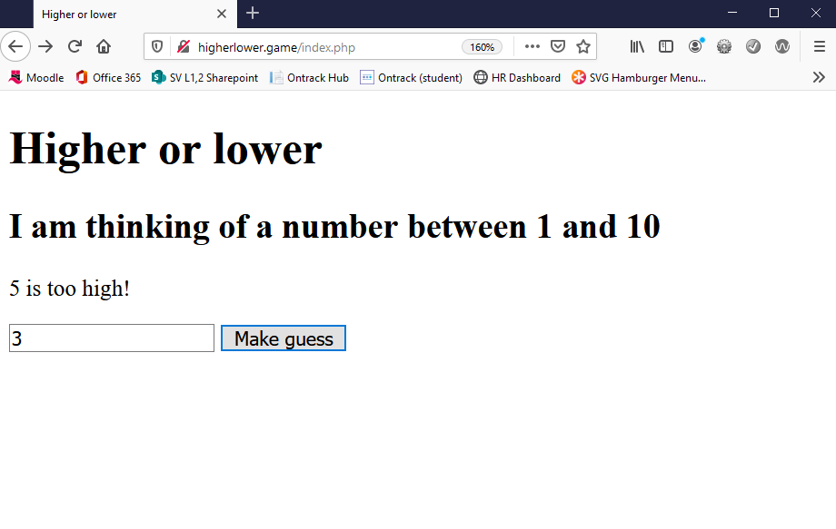
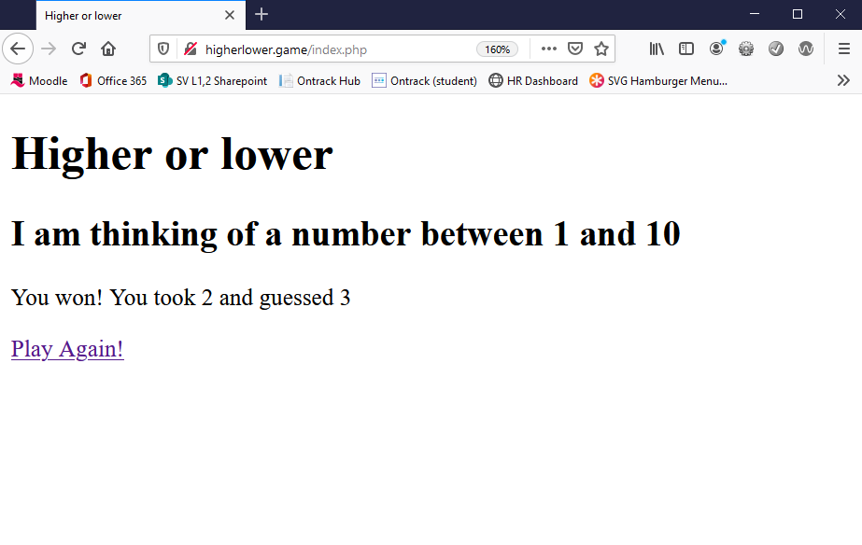
Project complete!
The game should now be playable!
Notes:
At each stage use the view source function of the browser to observe the HTML being sent to the browser
Note that no PHP is included in the HTML code
Also note that you can easily cheat and find the target number doing this as you can see the values in the hidden form elements

Slide 26
Project review
PHP is loosely typed.
PHP uses === to compare value and data type.
PHP uses . to concatenate (join) strings.
PHP can use many code blocks in the same file, all are in scope.
PHP can extract HTTP POST data through $_POST.
It can also extract HTTP GET data through $_GET (but this project did not use this).
PHP code has to be compiled by a webserver, it cannot be simply opened in a browser as HTML can.
This project demonstrates:
How to create and use variables
How to use conditionals (if / else / else if)
How to print PHP variable values into the HTML page
How to use the $_POST array
PHP global scoping

Slide 27
Session review
BSc Applied Computing

Slide 28
Recap
Introduction to PHP
Why PHP?
Reference
Resources
Syntax and use
Higher or lower game step by step
HTML (and CSS if you absolutely must add it!)
PHP logic

Slide 29
Any questions?
Next…
Keeping track of connections in PHP with the http session

