Slide 1
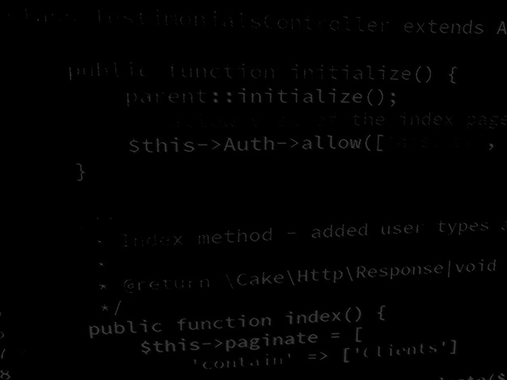
Major Project and Research Methods Research Methodology #4
BSc Applied Computing

Slide 2
In this session…
Recap:
Project Proposal
Aims and Objectives
Research Methodologies
Explore what a literature review is and the purpose of it
Critical reading (to ensure critical writing)
Writing the review:
Structure
Introductions
Conclusions
Critical approaches to writing
Task

Slide 3
Recap
Major Project and Research Methods

Slide 4
The Project Proposal
The purpose of the project proposal is to establish exactly what is to be achieved by the project and to establish a plan to do this.
“A research proposal is a simply a structured, formal document that explains what you plan to research (i.e. your research topic), why it’s worth researching (i.e. your justification), and how you plan to investigate it (i.e. your practical approach).“ [1]
“The purpose of the research proposal […] is to convince your research supervisor, committee or university that your research is suitable (for the requirements of the degree program) and manageable (given the time and resource constraints you will face).” [1]
Notes:
1. Jansen, D. What (Exactly) Is A Research Proposal?. Available at: https://gradcoach.com/what-is-a-research-proposal-dissertation-thesis. Last Accessed: 5/9/2022.

Slide 5
Aims and Objectives
In a nutshell:
Aim = what you hope to achieve. [2]
Objective = the action(s) you will take in order to achieve the aim. [2]
[3]
Notes:
2. Solent Online Learning. Dissertation proposals, Aims and objectives. Available at: https://learn.solent.ac.uk/mod/book/view.php?id=116233&chapterid=15294. Last Accessed. 5/9/2022.
3. Aims and objectives by Tom Steinmetz on Prezi Next [image on the Internet]. C 2012 [cited 6/9/2022]. Available from: https://prezi.com/mzbjf-vbrsll/aims-and-objectives.

Slide 6
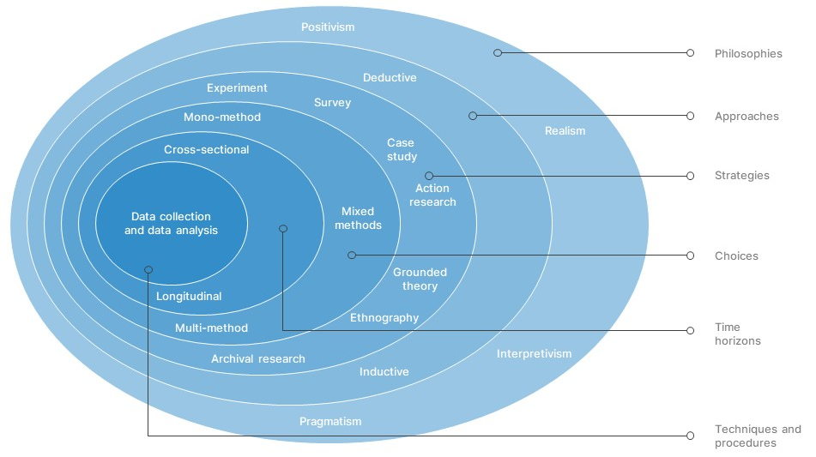
The Research Onion
At each stage, decisions should be based on, and guided by the aims and objectives established for the project.
[4]
Notes:
4. Research-Onion-Template [image on the Internet]. [cited 6/9/2022]. Available from: https://slidebazaar.com/items/research-onion-template.

Slide 7
Literature Review
Major Project and Research Methods

Slide 8
Literature Review
Questions:
What is a literature review?
What is the purpose of the literature review in your major project?

Slide 9
What is a Literature Review?
A literature review summarises, critically analyses and evaluates previous research available on the subject, presenting this in an organised way. It should address a clearly articulated question or series of questions.
It is NOT:
A descriptive list or summaries of books/articles etc
An exhaustive bibliography on everything ever written on the topic- you need to make a decision about what to include
Your arguments and ideas (like an essay)

Slide 10
Critical Review of Literature
The aim of a literature review is to provide the conceptual background to your particular research topic.
The literature review shows what other people asking similar questions have discovered:
“Exposes main gaps in knowledge and identifies principal areas of dispute and uncertainty.”
“Helps identify general patterns to findings from multiple examples of research in the same area.”
“Juxtaposes studies with apparently conflicting findings to help explore explanations for discrepancies.”
“Helps define your terminology or identify variations in definitions used by researchers or practitioners.”
“Helps to identify appropriate research methodologies and instruments (e.g. interview schedules, validated tests and scales). The review helps you understand the topic under consideration, but also provides you with a point of evaluation for your conclusions“ [5, P.52]
The review helps you understand the topic under consideration, but also provides you with a point of evaluation for your conclusions.
Notes:
5. Robson, C. McCartan, K. Real World Research: 4th Edition. Chichester. Wiley. 2016.

Slide 11
Why do we write a literature review?
In addition, the literature review should:
Demonstrate an in-depth understanding of your topic area including key concepts, terminology, theories and definitions.
Identify who the major thinkers are.
convince the reader that your research questions are significant, important and interesting.
Convince the reader that your thesis will make an original contribution to the area being investigated.

Slide 12
Steps to complete the literature review
Find relevant literature on your topic and follow trails of references.
Identify themes/ideas/theories/approaches to the topic that have emerged from reading.
Introduce ideas by themes/theory/approach/chronologically or any other appropriate structure but do not just list different authors’ viewpoints.
Introduce and explain each theme (or theory/approach), present evidence from readings (agreements/ disagreements), critically commentate and relate to your own research.

Slide 13
Task
Major Project and Research Methods

Slide 14
Task: The importance of critical reading
Come up with at least 5 questions that you would ask yourself when critically analysing a text for your review.

Slide 15
Critical questioning when reading
Who is the author?
What is the authors central point or main argument?
What findings and conclusions are made?
What evidence is used to support the conclusions?
Is the evidence relevant? What methodology has the author used? What are the strengths and limitations?
Does the author make any assumptions?
What is not being said?
Is there any explicit or hidden bias?
How is the text relevant to YOUR project or assignment?
How does this link with other texts that you have read?

Slide 16
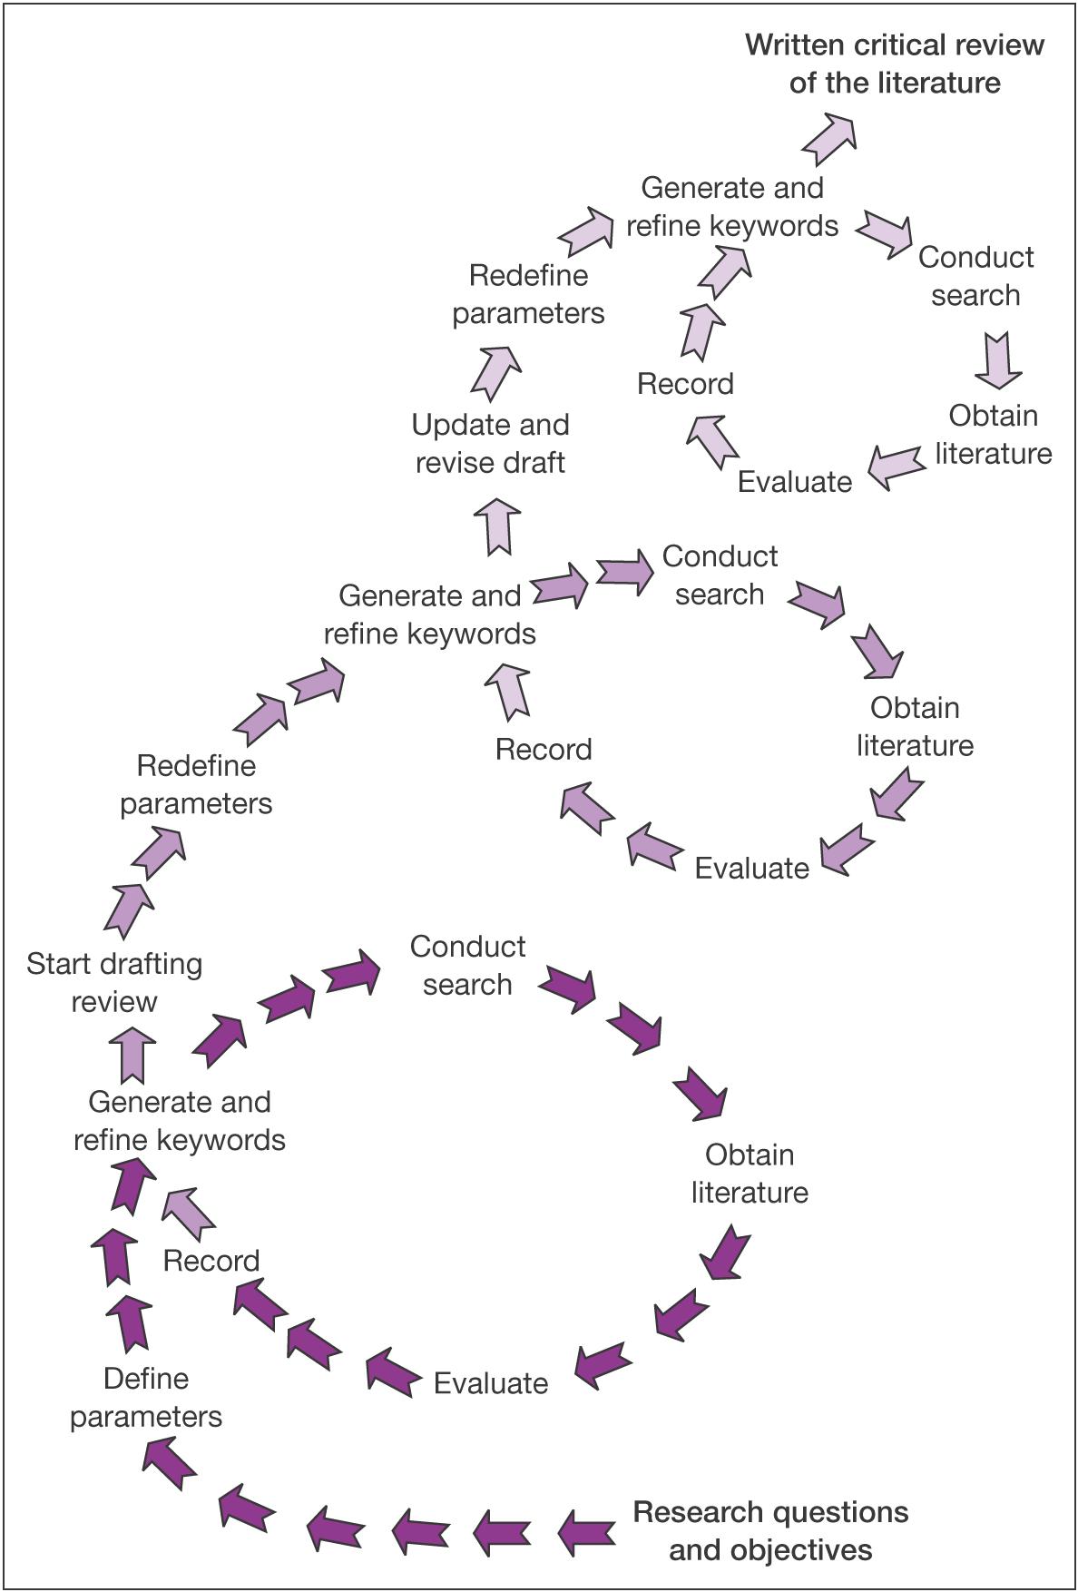
Critical questioning when reading
Starts generally.
Becomes more focussed.
Follow up references in sources to expand the review with more sources.
Do not be afraid to include diverse sources from other disciplines.
Remember: the literature review should cover all aspects of the project.
[6, P.56]
Notes:
6. Saunders, M. Lewis, P. Thornhill, A. Research Methods for Business Students. Edinburgh: Pearson Education Limited. 2007.

Slide 17
What is the big picture?
What is the big picture? When reading for your review you’re trying to identify links between papers. Not just reviewing each paper separately. What’s the story? The overview in your topic?
[7]
Notes:
7. Big Picture. [Original Image, 2022].

Slide 18
What is the big picture?
You might read first during which you start to develop ideas for themes.
What ideas seem to come up in several articles?
Are the same ideas presented from the same or different perspectives?
Are there any major debates that need addressing.
Does there seem to be a change in thought over time?
What ideas/themes are relevant to answer my question(s).
Are there different methodology being applied? (a review might evaluate different methods).

Slide 19
What is the big picture?
You might already have a big picture idea.
Your reading may then either:
Confirm and support the structure of your initial plan.
Or lead you to change your plan due to new ideas you have developed in your reading.
[8]
Notes:
8. Literature Review Guide. [image on the Internet, c2022]. [cited 6/9/2022]. Available from: https://www.scribbr.co.uk/thesis-dissertation/literature-review.

Slide 20
Example topics
Major Project and Research Methods

Slide 21
Literature Review – An investigation into Software in the Childcare business
1 Introduction
2 Childcare Profession in the UK
3 Early Years Education
4 Cultural Shift
4.1 Changing role of men
4.2 Family roles
5 Modern-day Childcare
5.1 Modern-day Demand
6 Benefits and Drawbacks of Childcare
7 UK Legislation
7.1 Additional legal considerations
8 Available Tools
8.1 Nursery Genie
8.2 MyMontessoriChild
8.3 iChildCare
8.4 Independent Childminder
9 Potential Methods and Technologies
9.1 Locally installed software
9.2 Mobile Application
9.3 Web-based Application
10 Conclusion

Slide 22
Literature Review – An Investigation into the use of Android Applications to aid Communication for Motor Neurone Disease Patients
1 Introduction
2 What is Motor Neurones disease?
2.1 What are Motor Neurones?
2.2 Types of and symptoms Motor Neurone Disease
3 Communication issues in MND Patients
4 Current communication methods and technology available
5 Current communication tools and applications available
6 Research Ethics
7 Conclusion

Slide 23
Literature Review – An investigation into the use of educational software to teach programming in the FE sector
1. Introduction
2. What is Programming?
3. Programming Skills Shortage in the UK
4. Secondary Education in the UK – ICT and Computing
5. How Students learn
5.1 Learning Styles
5.2 Motivating Students
6. Teaching Styles and Tools
6.1 Teaching Styles
6.2 Digital Tools
7. Tools for Teaching Programming Skills
7.1 CodeAcademy
7.2 Scratch
7.3 Sololearn
8. Potential Platform, IDE and Language
8.1 Platform
8.2 IDE (Integrated development environment) and Language
9. Conclusion

Slide 24
Writing the Literature Review
Major Project and Research Methods

Slide 25
Literature Review Introduction
Sets out why this project is being undertaken… what is the impetus?
Why the topic is important- is it an area of current interest?
The scope of the review including the aspects of the topic that will be covered.
How the review is organised.
Has the topic been widely researched?
Significant gaps in the research into your topic
Is there debate and controversy about the topic or a consensus?

Slide 26
General writing advice
Provide the reader with strong "umbrella" sentences at beginnings of paragraphs, "signposts" throughout, and brief "so what" summary sentences at intermediate points in the review to aid in understanding comparisons and analyses.
Use language to show confidence/caution:
e.g. There is clearly a link.../This suggests a possible link...
Use you own voice to comment on the literature (this is very important as the purpose of the research project is to demonstrate your understanding).
Check spelling, grammar, punctuation, etc. Part of your mark will include presentation. Poorly presented submissions will attract fewer marks.

Slide 27
General writing advice
Write in the third person. For example, rather than ‘ I found…’ you should say something like ‘It was evident…’.
Use a formal style of writing. For example:
no contractions – ‘it’s’ should be ‘it is’, ‘don’t’ = ‘do not’.
Avoid slang – ‘if you pay peanuts, you get monkeys’.
Avoid abbreviations (i.e. – use ‘for example’).
Never use etc.
Always:
Spellcheck your work.
Grammar check.
Get somebody to proof-read your work where possible.

Slide 28
Conclusions
Conclude your literature review with a statement which summarises your review and links this to your own research/current issues.
Example:
“In conclusion, extensive research has shown space to be an important concept that vastly affects society. Definitions of public and private spaces are changing noticeably over time, in particular in Western cities such as the UK. An increasing withdrawal from public life can be observed as technology and other factors largely impact the way we live and experience otherness. These changes in public, private and electronic spaces do and will continue to greatly impact fundraising activities and giving behaviour. This research therefore fills an evident gap in charity and geographical research, bringing these two concepts together in an important investigation of space and charity.”

Slide 29
Referencing
Keep a record of all the sources that you use!
It is much easier to record references WHILE YOU ARE READING rather than hunting for them when writing the review!
Keep page numbers, authors, title, type of reference (book, journal, website, other).
Use the correct referencing style (Vancouver… refer to the guides on Moodle).
You could use a citation management tool like citethisforme. [9]
Notes:
9. Citethisforme. Citing Vancouver. Available at: https://www.citethisforme.com/vancouver/source-type. Last Accessed: 7/8/2022

Slide 30
Referencing
The steps to avoid mistakes and hours spent chasing references at the end of the dissertation are simple and obvious, yet often ignored.
Always keep notes tidy and file them systematically.
Understand what information you need to include in a bibliography and always put a full bibliographical reference, in the correct form, on every note taken. Include the page numbers of the reference.
If you copy a quotation into your notes for later use in your dissertation be sure to do so fully and without abbreviations, you can always abbreviate later. Check the quote thoroughly to make sure that you have not misrepresented the author's views. Remember to record the specific page number the quote comes from.

Slide 31
Critical Analysis
Students often fail to be sufficiently analytical or evaluative and try to compensate with a greater amount of information instead. Quantity cannot substitute for the quality of analysis.
The review should not be a simple recitation or list of what other authors have written. It is essential that you link ideas, compare and contrast the material and look for any trends or themes.
Literature cited must be up-to-date. This is especially important when considering the speed at which computer science research develops.

Slide 32
Critical Analysis
Avoid a biased review. Try to cite references for and against your argument (it also makes for more interesting reading).
Be analytical. Do not just LIST the different arguments. Pick the RELEVANT views and discuss them.
Link ideas together. Try to compare and contrast views, and interpret what they mean.

Slide 33
Literature Review: Final thoughts
Major Project and Research Methods

Slide 34
Try to keep in mind…
What is the purpose for the literature review and make sure your review specifically addresses your purpose(s).
Write as you read, and revise as you read more. Rather than wait until you have read everything you are planning to review, start writing as soon as you start reading.
You will need to reorganize and revise it all later. But writing a summary of an article when you read it helps you to think more carefully about the article.
Having drafts and annotations to work with will also make writing the full review easier since you won’t have to rely completely on your memory or have to keep thumbing back through all the articles.
The first draft is for you, so you can tell yourself what you are thinking. Later you can rewrite it for others to tell them what you think.

Slide 35
Task
Major Project and Research Methods

Slide 36
Task
Begin planning your literature review.
Design structure / headings.
Use the previous examples to help you consider areas that your review should include.
You have the rest of the session…

Slide 37
In this session…
Recap:
Project Proposal
Aims and Objectives
Research Methodologies
Explore what a literature review is and the purpose of it
Critical reading (to ensure critical writing)
Writing the review:
Structure
Introductions
Conclusions
Critical approaches to writing
Task

Slide 38
Any questions?
No?
Make a start!

