Slide 1
Major Project and Research Methods Interim Viva Briefing
BSc Applied Computing

Slide 2
In this session…
The purpose of the Interim Viva
The structure of the Interim Viva
Statement of the problem
Aims and objectives
Main findings of the Literature Review
A project plan.
References.

Slide 3
Purpose of the Interim Viva
Students are required to attend a 30 minute total oral examination of their project before at least two examiners. These are normally the student’s project supervisor and a second marker. Occasionally, other members of staff, e.g. the Project Co-ordinator, might be present.
During the viva, the student should give a presentation on his/her project for 17 -20 minutes using a PowerPoint presentation to assist. The student should summarise their project, presenting the aims and objectives and the main findings of the literature review, so far. The student should also present a plan ie Gantt chart for the rest of the project.
Remember that the second marker has no knowledge of your project, so your presentation should be pitched to accommodate the second marker. *
Notes:
* In the handbook, the university suggest that you aim to speak for 10-15 minutes. My advice is to speak for 17-20 minutes as this still leaves enough time for questioning but makes better use of the total 30 mins.

Slide 4
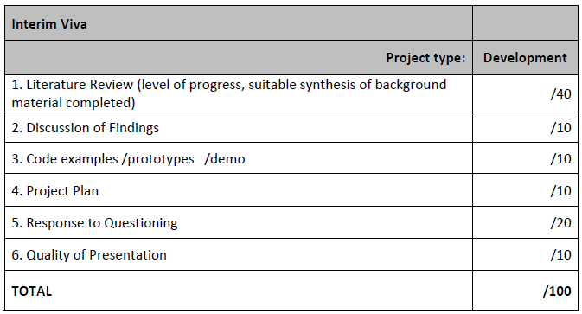
Grading
Mark distribution for the Interim Viva.

Slide 5
Structure of the Interim Viva
Statement of the problem to be solved together with any background/rationale that might be appropriate.
The aims and objectives of the project (including an brief discussion of how the objectives are to be achieved).
Main findings of the Literature Review (not an exhaustive account of everything you have read thus far).
A Project Plan (Gantt Chart).
Prototypes / Work in Progress (Anything that is developed already and could help you illustrate your project outcomes).
References.

Slide 6
Statement of the Problem
Shorter than the Project Proposal.
It should still set the context for the project.
What is the background and reason for your research?
What previous research has been done on your research topic?
[1]
Notes:
1. Problem Statement for Start-ups. [image on the Internet, c.2021]. [cited 16/9/2022]. Available from: https://togroundcontrol.com/blog/creating-a-problem-statement.

Slide 7
Aims and Objectives
The aim are the ultimate goals of the project.
Ideally it should contain an indication of the quality and/or extent of the implementation.
The objectives (SMART) should clearly describe the individual sub goals of the project, which are required to meet the ultimate goal (i.e. the aim).
Whilst these should be SMART objectives, do not waste time in the Viva explaining why they are SMART.
[2]
Notes:
2. How to write effective SMART goals [image on the Internet]. [cited 6/9/2022]. Available from: https://www.breeze.pm/blog/how-to-write-effective-smart-goals.

Slide 8
Main findings of the Literature Review
Your Literature Review should be reasonably large by this point.
Distil it down to just the most salient points.
Aim to cover the breadth of your review material :
Research Methods (reasons for choices).
Culture of practice (real world processes, people, tasks).
Currently available applications which exist in the same sphere as your idea.
Developmental approaches which you have considered.
Legal and ethical compliance.
Other?
Remember, this section is not just a synopsis of your reading!
It is also an analysis of this with a view to defining the approach your project will take.

Slide 9
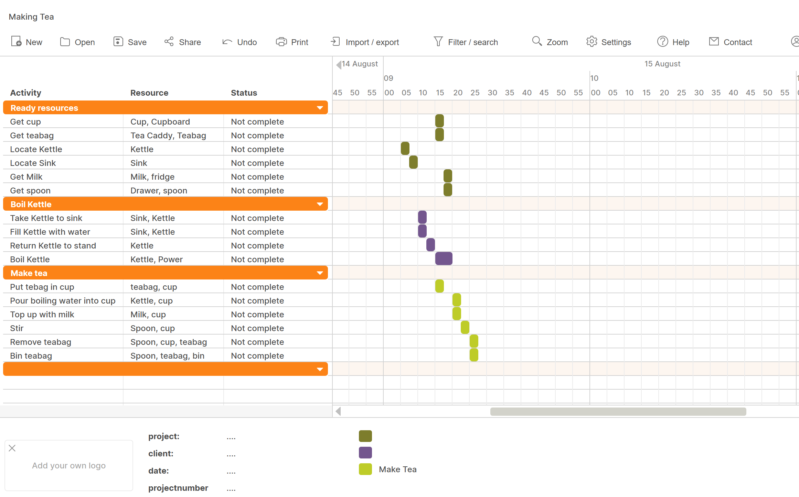
A Project Plan
Take your aims and objectives.
Identify sub-tasks.
[3]
Notes:
3. Gantt Chart Example [Original image c. 2019].

Slide 10
Prototypes / Work in Progress
You have probably started working on development of the project.
You should have started, perhaps completed initial designs.
The more detailed your design are, the better.
The more functional your development, the better.
Do not include everything, for example, if you have started with low fidelity rough UI designs and then used these to create medium or high fidelity wireframes or visualisations, just include the medium or high fidelity designs.
You can demonstrate code if your development is not significantly complete.
Demonstrating completed and working aspects of the application will be the clearest and most impressive way to illustrate your project.

Slide 11
References and Appendices
References (numeric system of referencing).
Vancouver system.
Guides are available on Moodle.
You could use a citation management tool like citethisforme. [4]
Include references either in the notes pane (as in these example slides) or on slide(s) at the end of the slideshow.
Appendices:
No need for these in the Interim Viva.
Notes:
4. Citethisforme. Citing Vancouver. Available at: https://www.citethisforme.com/vancouver/source-type. Last Accessed: 7/8/2022.

Slide 12
Final notes
Much of the Interim Viva should be drawn from the Project Proposal.
This does not meant that these are the same thing and that you are simply presenting the Project Proposal.
Try to stick to the structure above.
Most importantly, practice your presentation to make sure that you can deliver all of the material comprehensibly in the time allowed.

Slide 13
Summary
Major Project and Research Methods

Slide 14
In this session…
The purpose of the Interim Viva
The structure of the Interim Viva
Statement of the problem
Aims and objectives
Main findings of the Literature Review
A project plan.
References.

Slide 15
Any questions?
No?
Then you can make a start!!

