Slide 1
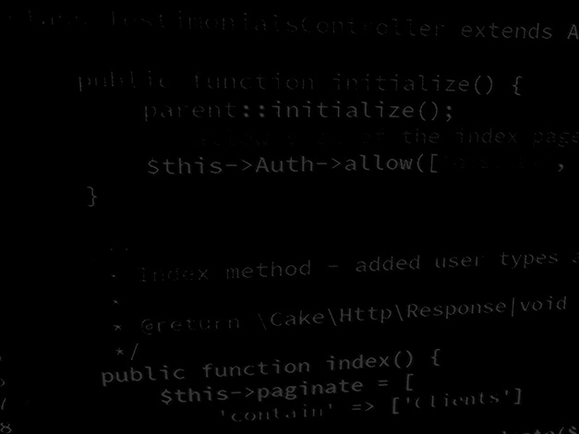
Socket Programming and Concurrency Building a RESTful AJAX client for the TaskList API
BSc Applied Computing

Slide 2
In this session…
Recap JavaScript AJAX and APIs
What is an API?
Stateful vs RESTful applications
Modern JavaScript
ECMAScript 6
Arrow functions
Spread Operator
Array functions
Cross origin resource sharing
JavaScript specific (browser-based)
Rationale
HTTP headers
Configuring Apache for CORS
AJAX (recap)
What is AJAX
XML vs JSON
Asynchronous operations
Promises
Fetch
Building an AJAX client for the Task List application
Project setup
Implementing CORS headers on the API
HTML and CSS project files
JS coding
Testing with browser, observing data with Postman

Slide 3
Recap API
BSc Applied Computing

Slide 4
What is an API?
A web service is a type of API
API (Application Programming Interface)
APIs make visible data and methods to other applications / clients / systems
Web services expose data usually (but not always) via HTTP or HTTPS
Web services expose data formatted using a transport language, usually JSON (but also XML)
Web services allow a variety of clients (mobile, PC, etc.) to connect to and use the same resources

Slide 5
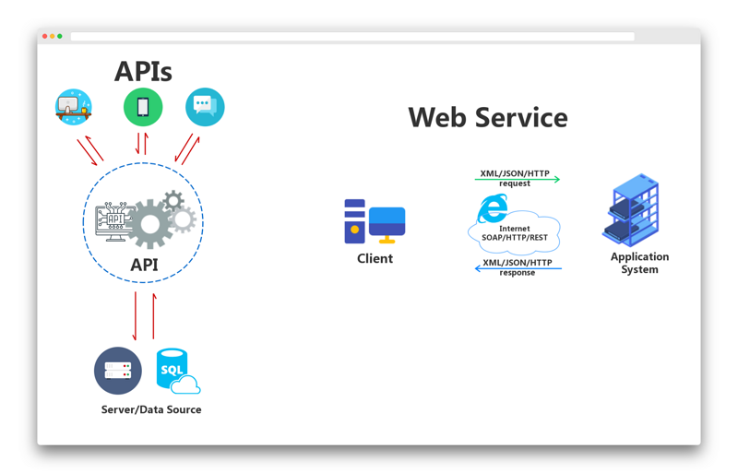
APIs and Web services

Slide 6
Stateful vs RESTful (recap)
Any application which keeps track of state (for example the state of being logged in, usually involving a session) is known as “Stateful”
Networked applications are commonly either Stateful or RESTful
RESTful applications do no use a session or keep track of state from request to request
RESTful applications usually supply a security token to the client which is then sent with each subsequent request
Stateful requests – response depends on the current state meaning that different responses are possible from the same request
RESTful requests – response is always exactly the same

Slide 7
Modern JavaScript
BSc Applied Computing

Slide 8
ECMAScript 6
JavaScript is under constant revision
It takes a while for browsers to catch up to the full spec
2015 revision of JavaScript is ECMA 6
Full support in all modern web browsers (Opera 2018 was the last)
Lots of new features:
Let (locally scoped replacement for var)
Const (constant values)
Arrow functions
Full object class support
Default parameters (default values passed to functions as arguments)
Others…
These work in all modern browsers, so there is no reason at all not to use them in our code…
Notes:
https://www.w3schools.com/js/js_es6.asp

Slide 9
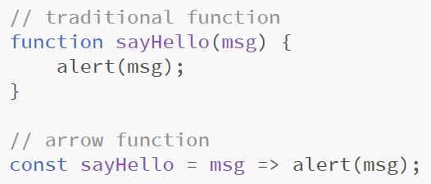
Arrow functions
Arrow functions are more compact ways in which to express functions
Becoming more popular amongst JavaScript programmers
Common practice for coding certain frameworks and libraries (React)
They are not usable as object methods as they do not redefine the value of this*
Arrow functions make blind (call back) functions more readable
Example:
Notes:
*JS is funny with this values and not consistent with how other languages define this
References:
https://www.w3schools.com/js/js_arrow_function.asp
https://developer.mozilla.org/en-US/docs/Web/JavaScript/Reference/Functions/Arrow_functions
https://javascript.info/arrow-functions-basics

Slide 10
Spread operator
Spread operator (…) allows the expansion of collections (arrays usually)
The spread operator copies the original collection before expanding the contents
Allows the manipulation of collection data without modification of the original collection (useful when working with constants and certain function arguments)
Example:
Notes:
https://developer.mozilla.org/en-US/docs/Web/JavaScript/Reference/Operators/Spread_syntax

Slide 11
New array methods
ECMA 6 and 5 have introduced new array methods
Like the spread operator these allow us to work with the contents of arrays and collections without modifying the original collection*
What is different about these methods is that they take functions as arguments rather than simple values
Array.map(<function>);
Array.filter(<function>);
When combined with arrow functions these are VERY powerful
Notes:
https://www.w3schools.com/jsref/jsref_map.asp
https://www.w3schools.com/jsref/jsref_filter.asp
*Each returns a new array which is the result of running the function against the elements of the original collection

Slide 12
Cross origin resource sharing (CORS)
BSc Applied Computing

Slide 13
Rationale
Web applications and web services mostly operate from the same domain but this is not always possible
Sometimes it is necessary to operate across domains (the server application is not in the same domain as the client application)
CORS prevents malicious, duplicate client applications to pharm data from a server
This is a web-application-specific problem (not applicable to application sockets)
Setting up 2 virtual hosts (one server and one client) allows for us to test that our webservice API is compatible with CORS
This will be important for assignment 2
We will deal with the specifics of CORS in more detail when we have our own API to test against (it is really simple to deploy in Apache)
Notes:
https://developer.mozilla.org/en-US/docs/Web/HTTP/CORS
https://www.w3.org/wiki/CORS_Enabled

Slide 14
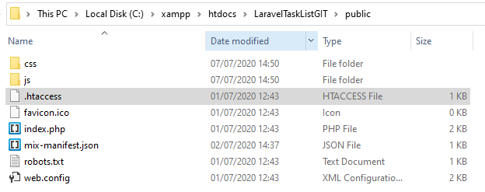
Applying CORS to an Apache project
Access-Control-Allow-Origin
To enable CORS we need to configure the server to send and additional header: Access-Control-Allow-Origin
In Apache we can do this in a number of places, in the server config, the virtual host config or in the .htaccess file (I am using the last of these)
As we have installed Laravel as a framework for the Task List project we already have a .htaccess file in the project folder to deal with the URL rewriting that Laravel uses for routing so we can add headers to that
Open C:\xampp\htdocs\LaravelTaskList\public\.htaccess in Notepad++
Notes:
https://www.w3.org/wiki/CORS_Enabled

Slide 15
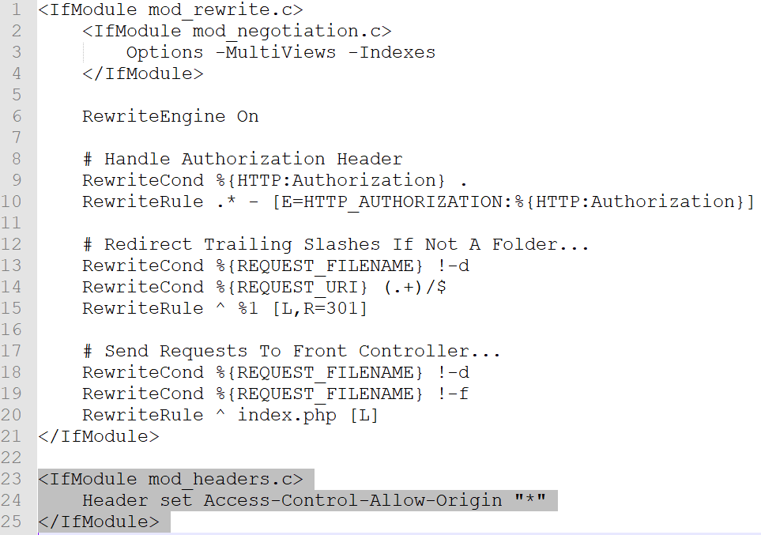
Applying CORS to an Apache project
Paste the highlighted code UNDER the existing code in this file
Stop and restart Apache using the control panel
Your Task List API will now serve data across multiple origins
Notes:
https://www.w3.org/wiki/CORS_Enabled

Slide 16
AJAX
BSc Applied Computing

Slide 17
AJAX
“AJAX allows web pages to be updated asynchronously by exchanging data with a web server behind the scenes. This means that it is possible to update parts of a web page, without reloading the whole page.” W3Schools
AJAX = Asynchronous JavaScript And XML
Not a programming language in its own right
Uses browsers built in XMLHttpRequest object
Also requires JavaScript and a HTML page to display the resulting data
The only choice for web-based API client applications
Cuts down server traffic as the client-side application handles logic and only accesses the server to obtain data
Notes:
https://www.w3schools.com/xml/ajax_intro.asp

Slide 18
XML vs JSON
XML and JSON are two methods of describing and transporting complex blobs of data
XML used to be used exclusively (hence the X in AJAX)
XML is easier for people to read but is quite tricky to program with as the whole data object requires parsing and traversing before the data is usable in other areas of the program
JSON is JavaScript Object Notation (a list of objects expanded to their key/value pairs and expressed as a string)
JSON is very close to high level programming syntax and so is very easy for all high level languages to parse
JSON returns a collection of data key/value pairs expressed as a nested collection of objects
JSON makes all data simple to access with standard dot notation

Slide 19
Asynchronous operations
Client / server relationships often require communication over a network
Networks are not instant but the JavaScript using it IS instant!
Software usually moves sequentially from one statement to the next waiting for each command to complete before attempting the next
Loading data over a network using AJAX is a comparatively slow operations and can cause performance issues
The solution is asynchronous operations
An asynchronous operation can be started and then ignored while the rest of the program progresses
This allows for multiple operations to occur at the same time
An event is attached to the asynchronous operation which listens for the operation to complete and then runs further code

Slide 20
Promises
“The Promise object represents the eventual completion (or failure) of an asynchronous operation and its resulting value.” developer.mozilla.org
The Promise object is a handy wrapper for asynchronous operations which either resolves or rejects the operation depending on whether or not it succeeds
Jake Archibald has written an informative collection of pages about Promises and why they are a good thing, have a read
Essentially, they make the process of using AJAX far simpler as each operation can be linked specifically to success and failure conditions
Example code on the next slide…
Notes:
https://developer.mozilla.org/en-US/docs/Web/JavaScript/Reference/Global_Objects/Promise
https://developer.mozilla.org/en-US/docs/Web/JavaScript/Guide/Using_promises
https://web.dev/promises/

Slide 21
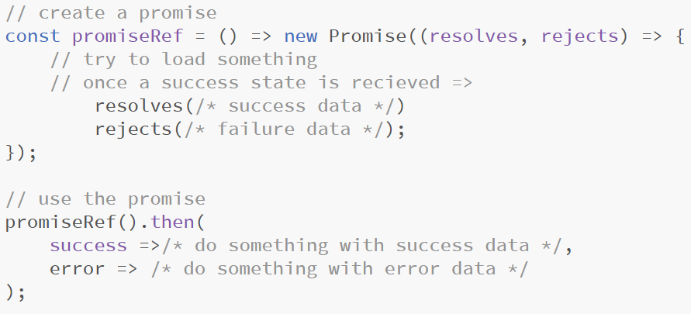
Promises
Example promise structure (not full code)
Notes:
https://developer.mozilla.org/en-US/docs/Web/JavaScript/Reference/Global_Objects/Promise
https://developer.mozilla.org/en-US/docs/Web/JavaScript/Guide/Using_promises
https://web.dev/promises/

Slide 22
Fetch
“fetch() allows you to make network requests similar to XMLHttpRequest (XHR). The main difference is that the Fetch API uses Promises, which enables a simpler and cleaner API, avoiding callback hell and having to remember the complex API of XMLHttpRequest.” – Google Developers
Fetch is a wrapper for both XMLHttpRequest and Promises and it makes the process of accessing APIs FAR simpler
We will be using fetch, then and catch from now on
Basic syntax of a fetch request is shown below
Notes:
https://developers.google.com/web/updates/2015/03/introduction-to-fetch

Slide 23
AJAX Client for the Laravel Task List API
BSc Applied Computing

Slide 24
Project setup
This tutorial will use the Brackets editor
All new code will be highlighted, other code will be included to indicate placement of new code only and should not be entered
Further explanation of code is included in the notes pane of specific slides
There is no need for a new virtual host for this project (unless you want one, if so use the instructions from week 1)*
Postman will be used at various stages to simulate queries to the API and observe response data
HTML, and CSS code is supplied on Moodle, download and unzip archive
Notes:
*I have setup a virtual host for this:
Server name = ajax.tasklist
Path = C:\xampp\htdocs\TaskList-AjaxClient

Slide 25
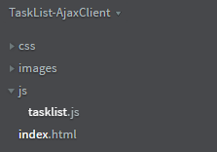
Project start
This project contains some complex and fairly dense code, if any of it seems unclear you should use a reference and familiarise yourself with what is happening*
Open the unzipped folder as a Brackets project
The HTML code contains links to the existing CSS file
There is one linked file missing, in Brackets open the js subfolder and right click to add a new file named tasklist.js
Notes:
* Understanding the code now will make life easier in the coming weeks where things will only get more complex!

Slide 26
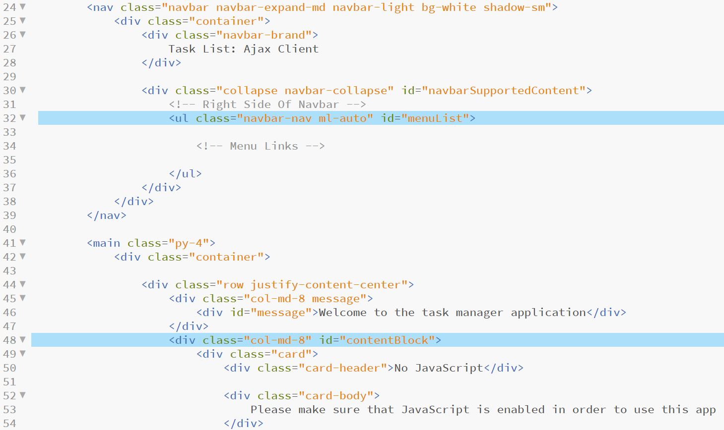
Viewing the HTML
Open the existing index.html file in brackets*
Notes:
*Notes:
Line 32: Is an empty <ul> list area which will be used to load menu items into depending on the current view
Line 48: Is currently filled with default messages in case JavaScript is not enabled. All of this will be replaced when the JavaScript runs. This area is where the page views will appear
For the sake of consistency, most of the same Bootstrap styling and overall structural code as the Laravel app will be used for this version (I have tweaked it a little where I found bits that I didn’t like)

Slide 27
HTML element references
The JavaScript will use functions to add content into the various areas of the HTML page as and when required
Only two of these areas actually exist in the index.html file, the others will be added as a part of the views added by the JavaScript itself
As these are functions and are not run until the page after the page is draw, we can use these references to areas which are not yet loaded
Add the following highlighted code to tasklist.js

Slide 28
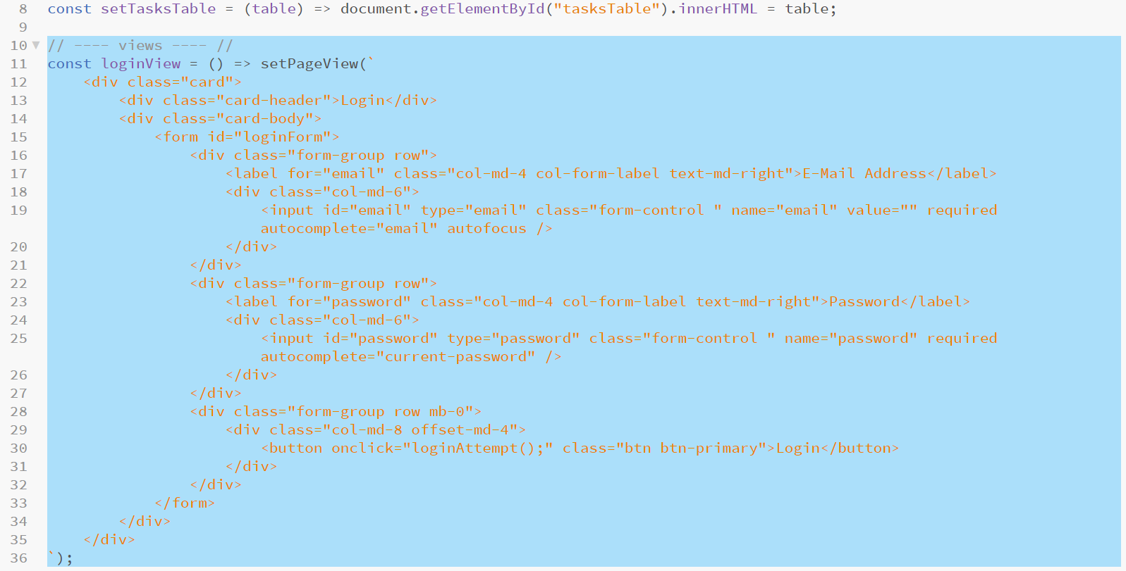
Adding the login view
Using one of the functions just added, add another function to set the HTML for the login view
Add the following highlighted code*
Notes:
* When complete, to swap the main page body to the login view we only have to call loginView();
This code calls the function to set the main page body HTML and passes it a backtick string so that the HTML spacing can be maintained and code debugged more easily

Slide 29
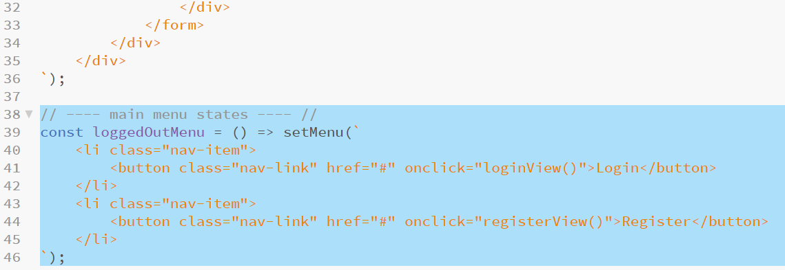
Adding the login menu content
Next, add a function to draw the logged out menu links into the main menu area (<ul id=“menuList”>)
Add the following highlighted code:

Slide 30
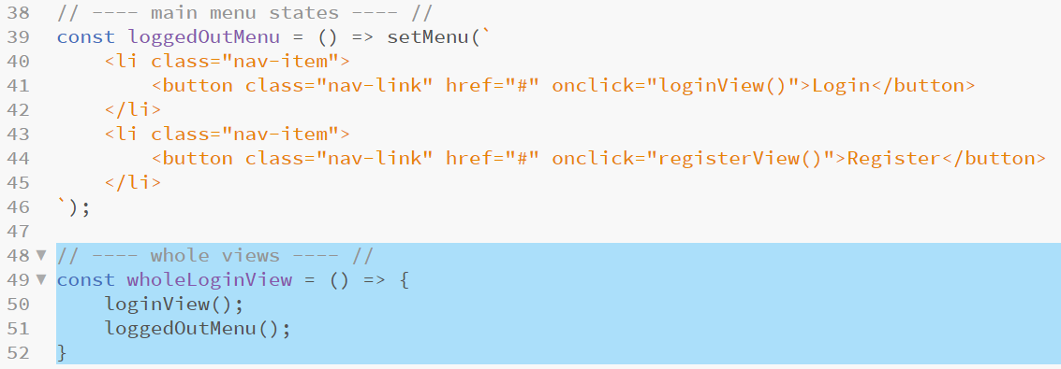
Completing the login view
To complete the login view, add a function to call both of the functions required to draw the login page
Add the following highlighted code to implement this function which in turn calls the previously added two functions*
Notes:
Using a cascade of function calls in this way will make the remainder of our script much easier to write as we have handy hooks to change bits of data and shortcuts to entire page redraws

Slide 31
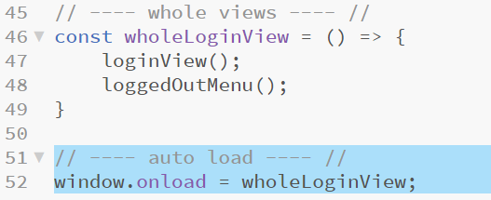
Drawing the login page
This JavaScript is loaded in the HTML <head> tag
Most of the code in this file will be in functions which will run as needed so this will not be an issue for them
In order for the script to be able to draw the initial login page it requires that the HTML is entirely loaded before running
We can instruct the code to wait for the rest of the HTML and other data to load fully before running with the window.onload event handler
We set the window.onload event to the wholeLoginView function
Add the following highlighted code to tasklist.js*
Notes:
*To keep things organised I will be added code under the respective comment headings already established keeping the window.onload event at the bottom of the file. I am doing this as it is tidy coding. If you would prefer to simply add each new section at the bottom of the file, fine, it will work but will be much harder to debug.
As long as window.onload appear underneath the function that it calls, the rest of the code can be in any order

Slide 32
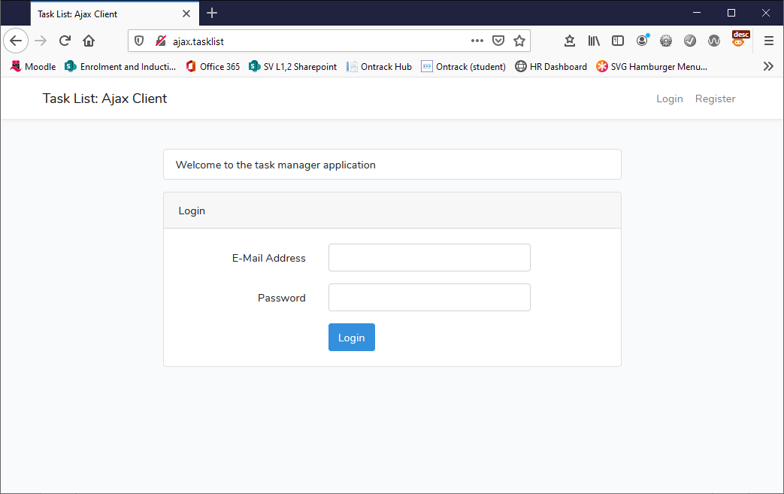
Testing the login page
Open the HTML page directly in a browser or use the address if using a virtual host to test that the login view draws correctly *
Notes:
* Do not forget that you will need Apache and MySQL both started and running the Task List API Laravel project for this to work.

Slide 33
Adding the register view
Next, add the other view accessible to users who are not logged in, the register view
This page is called from the menu control added previously which calls a function named registerView
In order to keep the code tidy, this function will be added after the loginView function and above the main menu states comment
Doing this keeps all of the view code in the same area of the script and makes things easier to find if issues persist
The HTML required for the register form is larger than the login equivalent and so requires and can be found on the entire next slide

Slide 34
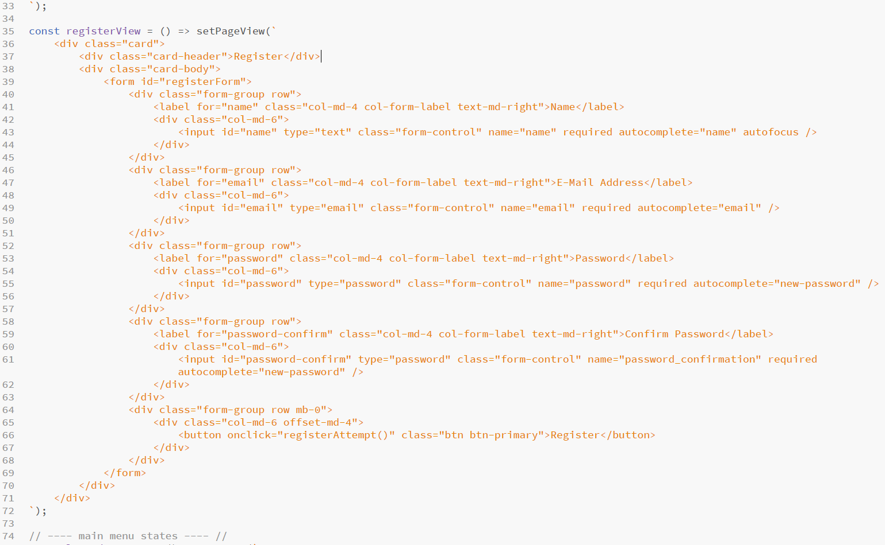
Register view HTML code
Notes:
As with loginView, this function calls setPageView and passes a backtick string containing the HTML for the register form (which is a little larger than the login view)

Slide 35
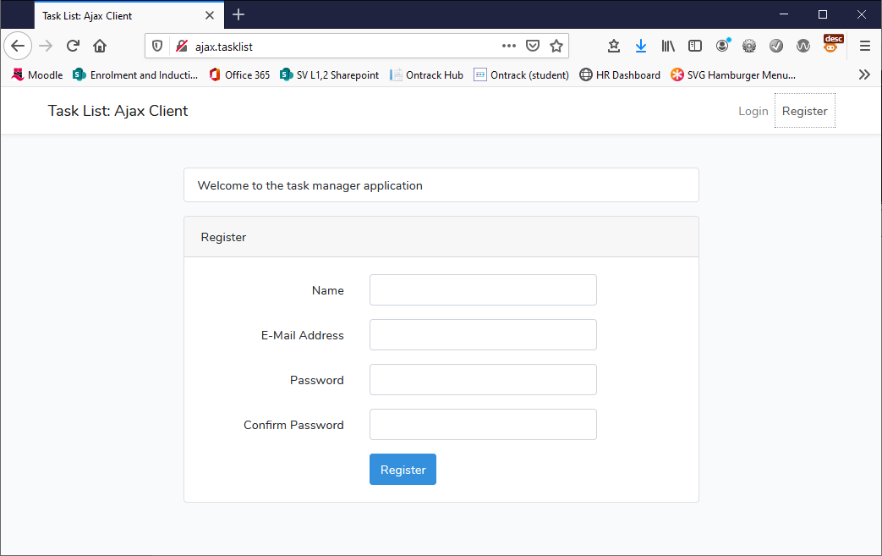
Testing the register view
Open the HTML page in your browser
Use shift + refresh if still loaded to reload the script file
You should now be able to navigate back and forth between the login and register forms

Slide 36
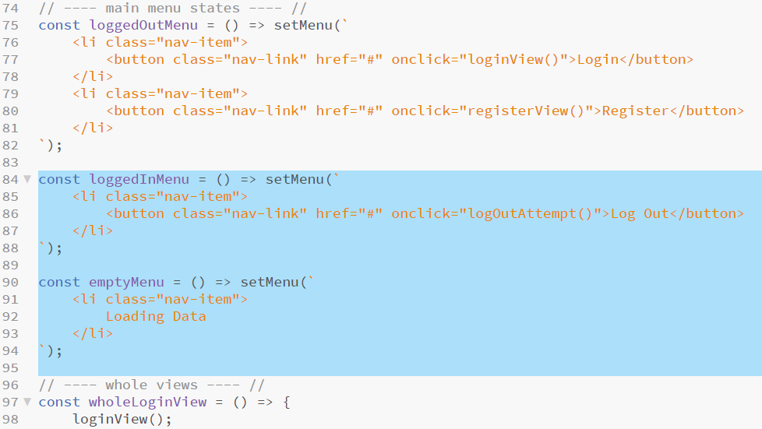
Adding remaining menus
There are two more main menu states to add to the application, these are loading and logged in
When logged in, the only option is to log out
Add the following highlighted code after the loggedOutMenu function and before the Whole Views comment
Notes:
As before, this code passes backtick strings to, in this case, the setMenu function
We will use these menus later

Slide 37
A few necessary references
Global values definitely lead to errors and should generally be avoided, here we will use a global user object to keep track of whomever is logged into the app
We need a constant which contains the URL of the API we will access
We need an empty object to hold user data
Add the following highlighted code at the very top of the script file

Slide 38
Using Postman to help development
The following code makes request to the Task List API and the API responds with JSON
The code collects these responses into an object called data in each instance
In order to understand what the structure of the response is, use Postman to query the API and to observe the result
Initially we will handle a login request
Open Postman and run or rerun (if you have one saved) a login request
Observe the result

Slide 39
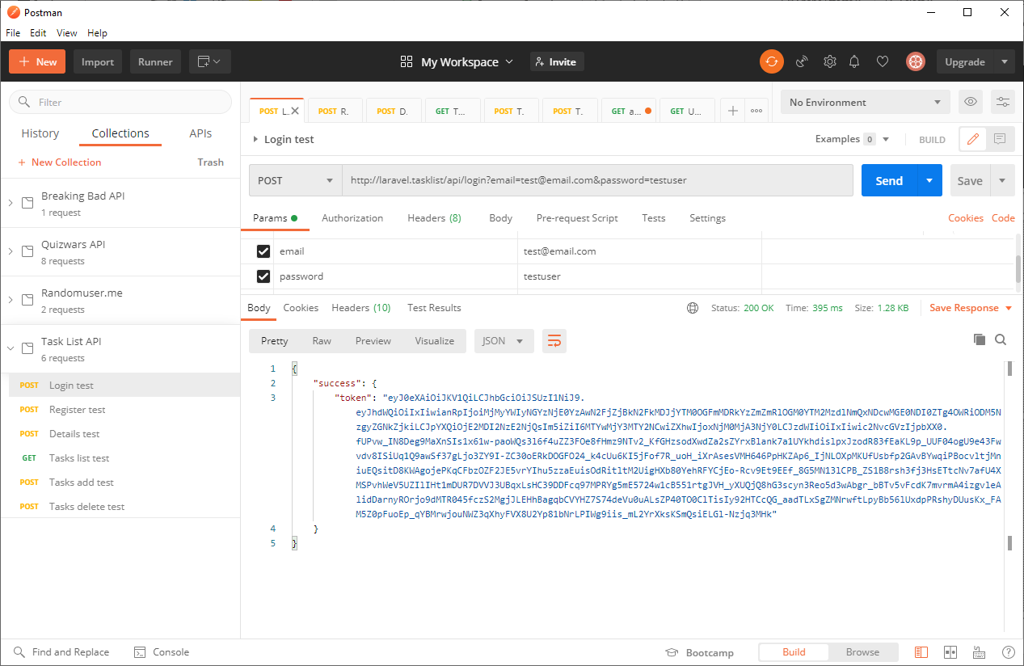
Postman login request
Notes:
From this we are returned an object with an attribute called “success”, the data in this attribute is another object with an attribute named “token” and an associated string value which is the security token data. From this, a successful login will provide a security token that we can use in our application by accessing data.success.token
Remember! When observing JSON blobs { } is an object containing key / value pairs and [ ] is a list

Slide 40
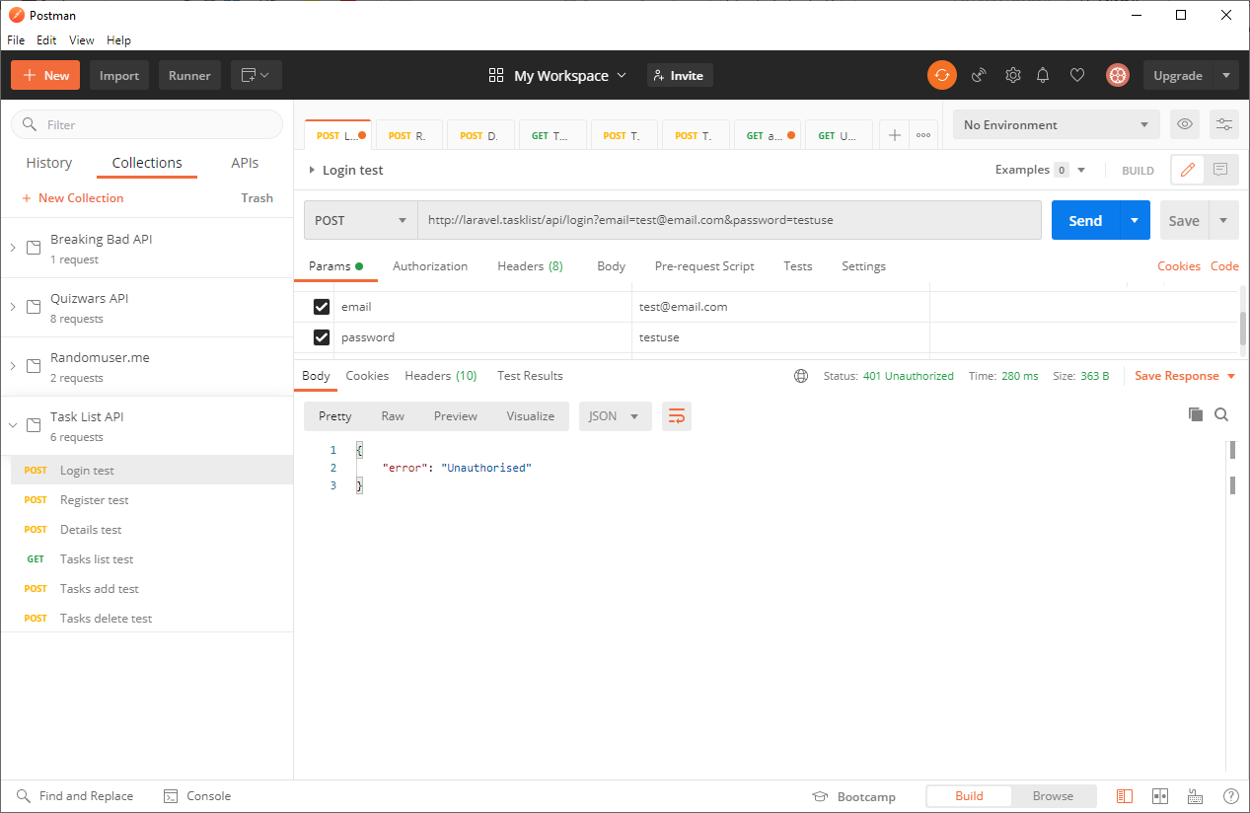
Postman login failed request
Notes:
It is also important to understand what a failed request looks like – deliberately enter incorrect login data and re-run the query
This returns an object with a single attribute named “error” – the data associated with this is a string containing the reason for the error, in this case “unauthorised”
This is important as we will have to handle both success and error responses

Slide 41
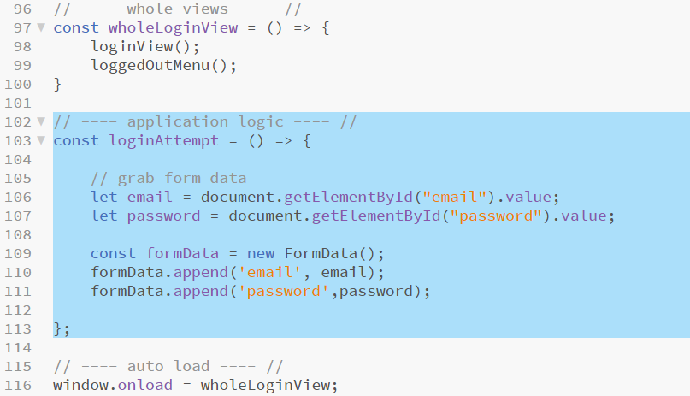
Dealing with a login attempt
The login view contains a button control which, when pressed calls a function named loginAttempt
Add the following highlighted code* after the wholeLoginView function and before the auto load comment
Notes:
This is not a complete function yet!
Line 106: gets text entered into the username form field
Line 107: gets text entered into the password field of the form
Lines 109 to 111: use the built-in JavaScript FormData object which we can use to fake a HTML form send Note: If we were building a very robust ap, we would do some validation on this form data here…. But we aren’t so we won’t, we will rely on Laravel’s very good input sanitisation to save us.

Slide 42
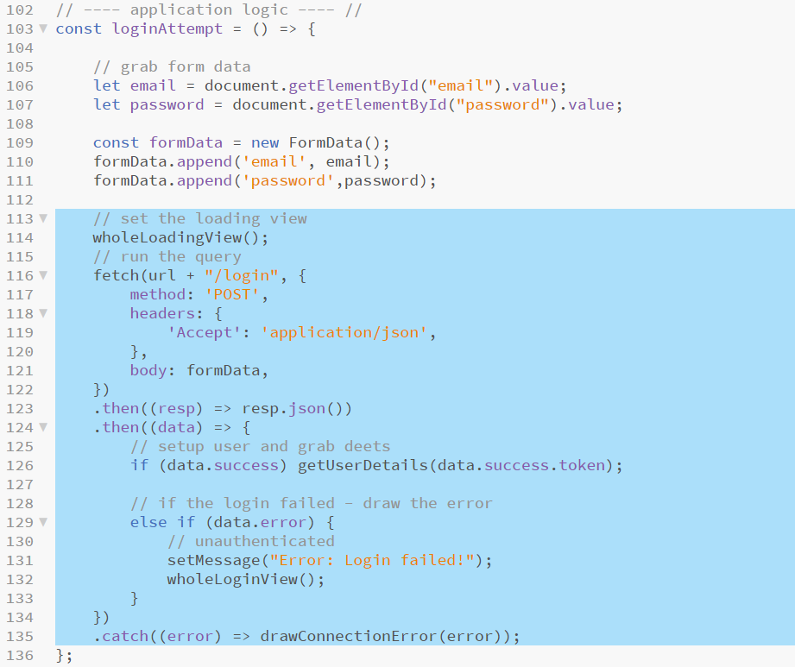
Completing the login function
Add the following highlighted code to complete this function*
Notes:
Line 114: calls a function which we have not built yet – this will draw the loading screen which will remain until the loading attempt either succeeds or fails
Line 116: begins a fetch block using the url constant set on a previous slide and adding the login route, we set POST headers and that we expect a JSON response, we also add our formData object so that the request appears to be a form send
Line 123: converts the response from a JSON text string to a collection of JavaScript objects
Line 124: takes the converted JSON (through the (data) parameter)
Line 126: examines the data object to see if the request provided a data.success response, if so another function which we have yet to include is called to deal with the users login data (getUserDetails) which is passed the authentication token sent back by the API to prove that this user has logged in (data.success.token)
Line 129: examines the data object to see if the request provided a data.error response, if so the page message block is re-drawn with an appropriate error message and the login view is re-presented
Line 135: catches any connection errors and displays an appropriate error message using another function which is yet to be included (drawConnectionError)

Slide 43
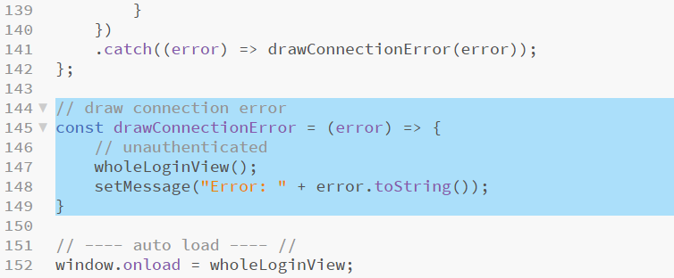
Drawing connection errors
The last function calls three functions which are yet to be included, one of these is drawConnectionError
This function is required as the app makes many connections to the API, any one of which could realistically generate an error
As these would all be dealt with similarly, the require a function
Add the following highlighted code in the application logic area under the loginAttempt function and before the auto load comment*
Notes:
* This is a simple two line function which resets the view to the default login view adding an appropriate error message passed as an argument into the function

Slide 44
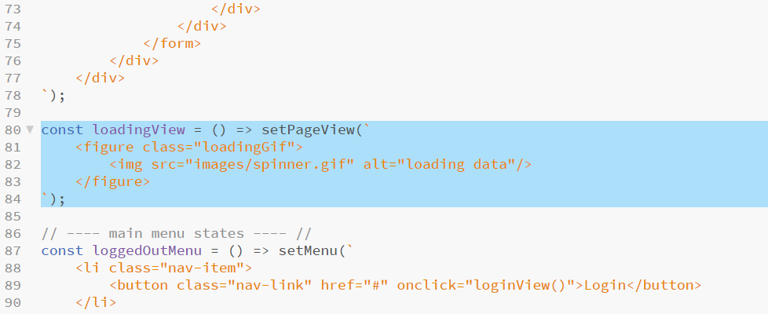
Loading view
Another function needed is the view for the application as it is loading, which contains a loading GIF
Add the following highlighted code to the views area of the script below the registerView function and above the main menu states comment*
Notes:
* Again, this is a simple function which sets the page view as a backtick string containing code to draw the animated GIF in the images folder into the page

Slide 45
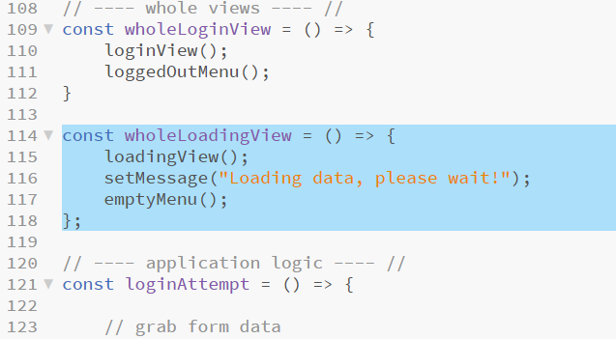
Adding the loading view
Next we add a wrapper function to call the empty loading menu, set a status message and draw the loading view while the API returns data
Add the following highlighted code under the wholeLoginView function and before the application logic comment*
Notes:
* This shouldn’t require explanation by now

Slide 46
Getting user details in Postman
We need to retrieve the user details for the logged in user and understand what the JSON response will look like
The user needs to be authorised and for that we need the security token provide when logged in
Re-run the log in query in Postman and copy the security token text
Start a new query to access http://laravel.tasklist/api/details
Set headers:
Accept: application/json
Authorisation: Bearer (paste the security token string here)
Run the query (the token is enough to identify the user)

Slide 47
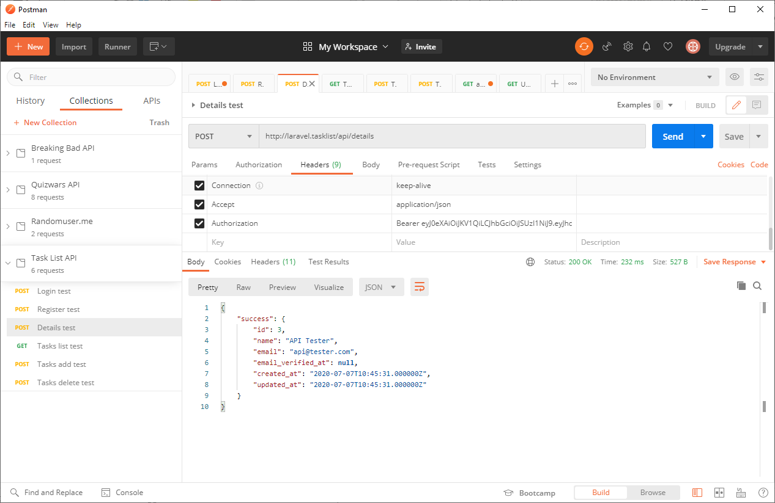
Getting user details in Postman
Notes:
We get a successful response – in this case the object data associated with the success key is another object containing key / value pairs for id, name, email and other things that are in the database but that we do not care about for this application
From this we can see that we can get at this data by using paths such as:
User name: data.success.name
ID: data.success.id
Email: data.success.email
It is important to run Postman queries for EVERY route in the API like this so that you are able to see the response and understand the structure of the data returned

Slide 48
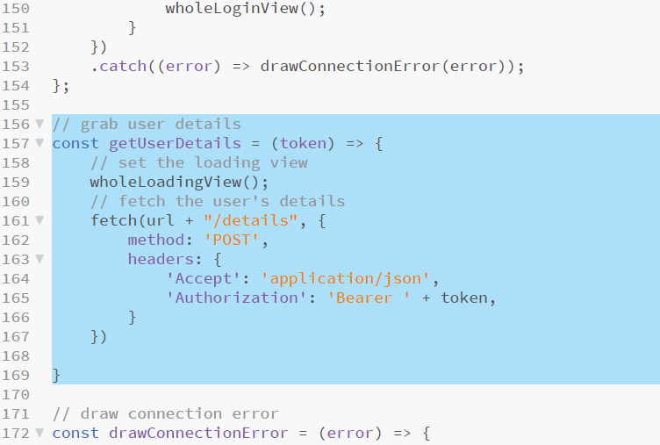
Adding the get user details function
Add the highlighted code after the loginAttempt function and before the drawConnectionError function (this is not a complete function yet)*
Notes:
*This is not a complete method just yet as we are only adding the fetch block
Line 159: redraws the loading view (in case we came here from somewhere other than loginAttempt)
Line 161: starts a new fetch to the API – this time calling the details route – again setting POST and JSON response in the headers as well as a new parameter which adds the users authentication token and should be sufficient credentials to have their user details returned.

Slide 49
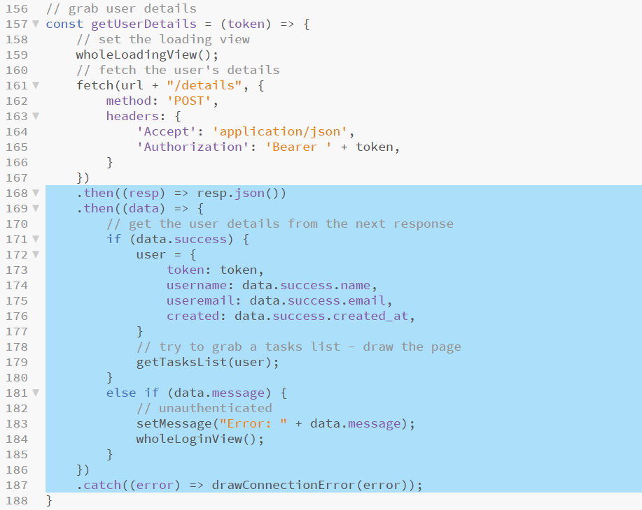
Completing get user details
Add the following highlighted code into the getUserDetails function*
Notes:
* As before, the fetch wrapper returns a response…
Line 168: converts the JSON response string into a collection of JavaScript objects which it then passes to …
Line 169: collects the data collection and… -
Line 171: check for a data.success response, if it finds one it populates the global user object created in a previous slide with data retrieved from the API
Line 179: calls another function which has yet to be included, this one will get all current tasks for this user from the API
Lines 181, 183 and 184: checks for a data.message response (which is usually an authentication error with an application this simple) and sets the view back to login, adding the appropriate error message
Line 187: deals with connection errors as before

Slide 50
Adding tasks view
The user is now logged in and information about them has been loaded
The next step is to retrieve a list of their current tasks and display these using a table of tasks assigned to this user
We will need three small view functions to draw the overall view, the tasks table and an individual table item
Add the following highlighted code after the loadingView function and before the main menu states comment*
Notes:
* This block takes one argument which is a task object which exists inside our overall collection of JSON response objects
The properties inside the task object will mirror the column names in the database, the only two we are interested in is task.id (so that we can delete the task) and task.name (so that we can display it)
The button control we are drawing here calls another function which has not yet been added – deleteTaskAttempt and passes the task.id to it – the idea being that when the button is clicked, we ask the API to delete this task

Slide 51
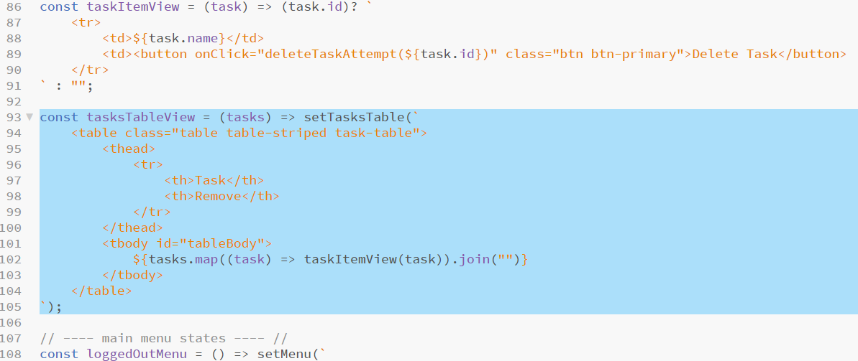
Adding the tasks view
Add the highlighted code after the taskItemView function and above the main menu states comment*
Notes:
*This view works in the same way as the previous example. It accepts an array of JSON task objects from the database as an argument
Line 102: uses the array.map function to send each of the task objects in the collection to the taskItemView function coded on the previous slide and (as this returns another list) uses .join(“”) to convert the code sent back into HTML that can be added to the view

Slide 52
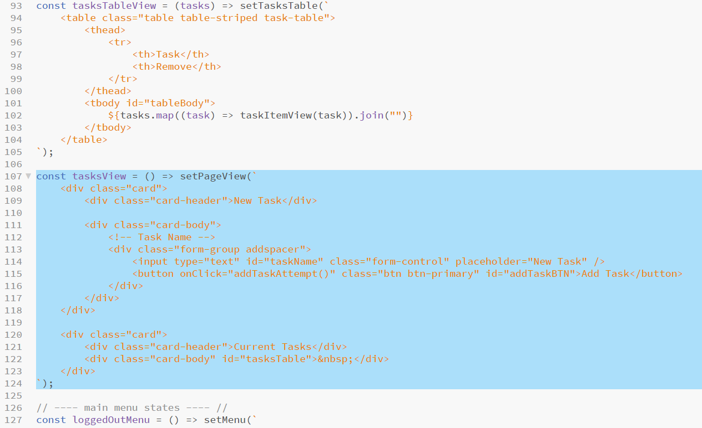
Adding the tasks view
Add the highlighted code after the tasksTableView function and above the main menu states comment*
Notes:
* This is a simple overall page view for the tasks page, it assumes no tasks for this user and will be altered by the tasksTableView method coded on the last slide as this calls setTasksTable which sets the content of the <div id=“tasksTable”> block added here.

Slide 53
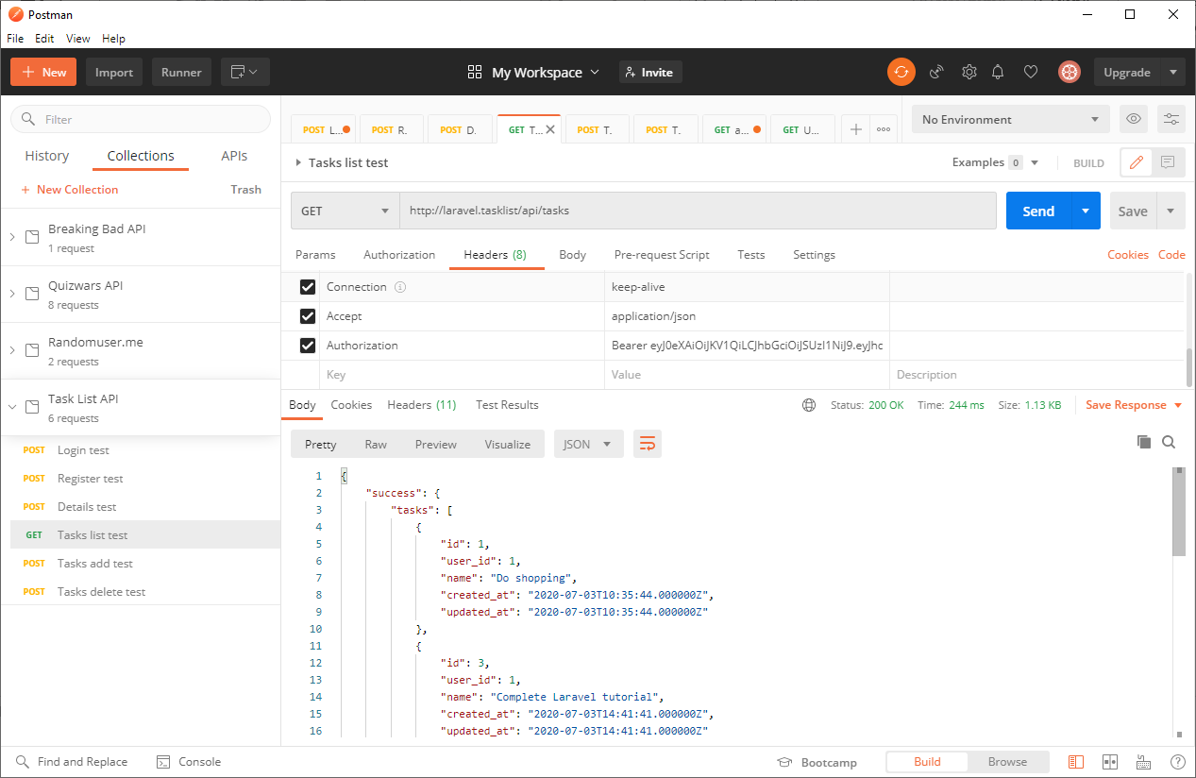
Observing tasks list response data
Notes:
In this case, again, headers are enough as the route identifies the data requested and the security token identifies the user
In this response we are only interested in the task id and task name
The “success” object contains another object which has a “tasks” key and a list of objects as its data
We could access the name and id of the first task in this list as shown below
ID = data.success.tasks[0].id
Name = data.success.tasks[0].name
We will not need to deal with tasks individually unless we are deleting them so individual list item access in this manner will not be needed… all the same, understanding the structure of the data is important
Remember! When observing JSON blobs { } is an object containing key / value pairs and [ ] is a list

Slide 54
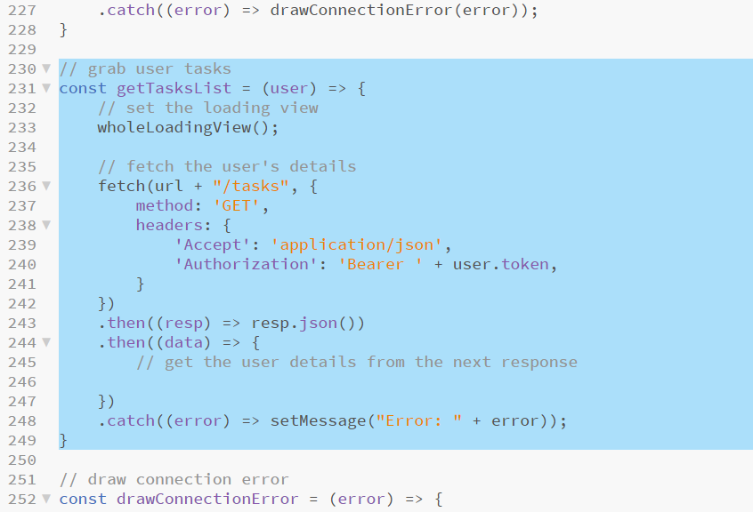
Adding get tasks list
The initial structure for the getTasksList function is very similar to the previous API query tasks
Add the following highlighted code after the getUserDetails function and above the drawConnectionError function*
Notes:
* All of this is the same as the last query functions… the difference here is what we do with the data when it is loaded… and that will be added on the next slide

Slide 55
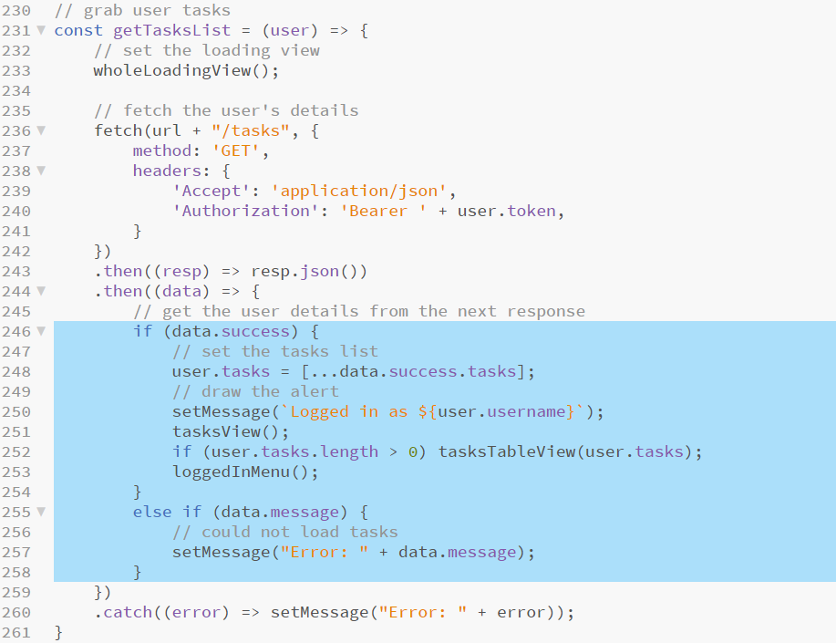
Adding get tasks list
Add the following highlighted code into the .then((data) => { block of the getTasksList function*
Notes:
* Taking this one line at a time…
Lines 246 and 255: deal with success and error message responses as before
Line 248: uses the spread operator (…) and a set of [ ] brackets to make a new list from the data.success.tasks list and stores this in the global user object
Line 250: sets a success message to display in the view
Line 251: calls the method which draws the task view framework HTML (not the tasks table itself)
Line 252: draws the tasks table view into the previous view if the logged in user has 1 or more tasks assigned to them
Line 253: sets the menu to the logged in menu (adds a logout control)

Slide 56
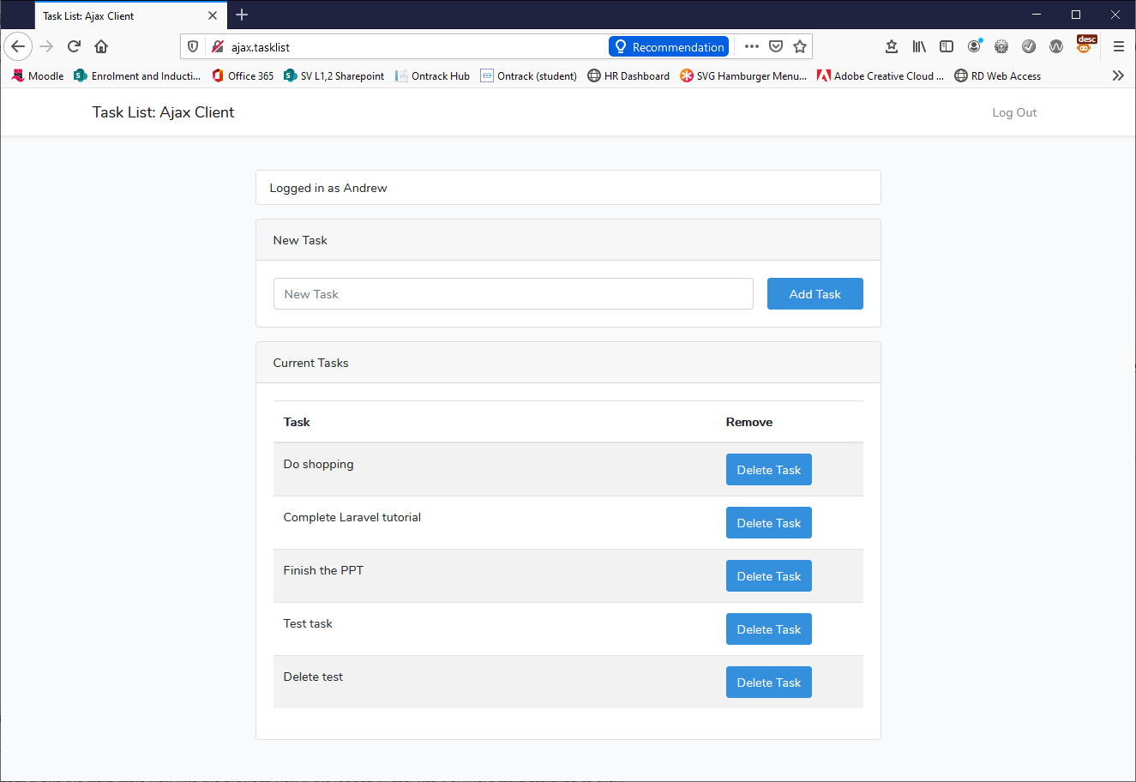
Testing the tasks view
Save the script and reload the application in your browser
You should be able to log in and see the tasks view

Slide 57
Summary so far…
The client app now connects to the API
It can log into existing accounts and display tasks for them
This is still some distance from a completed application
Remaining to add are the following functions:
Handle registering a new user
Handle adding a task for the current user
Handle removing a task for the current user
Handling a request to log out
As registering a new user is almost identical to the code used to log in, this will be added first

Slide 58
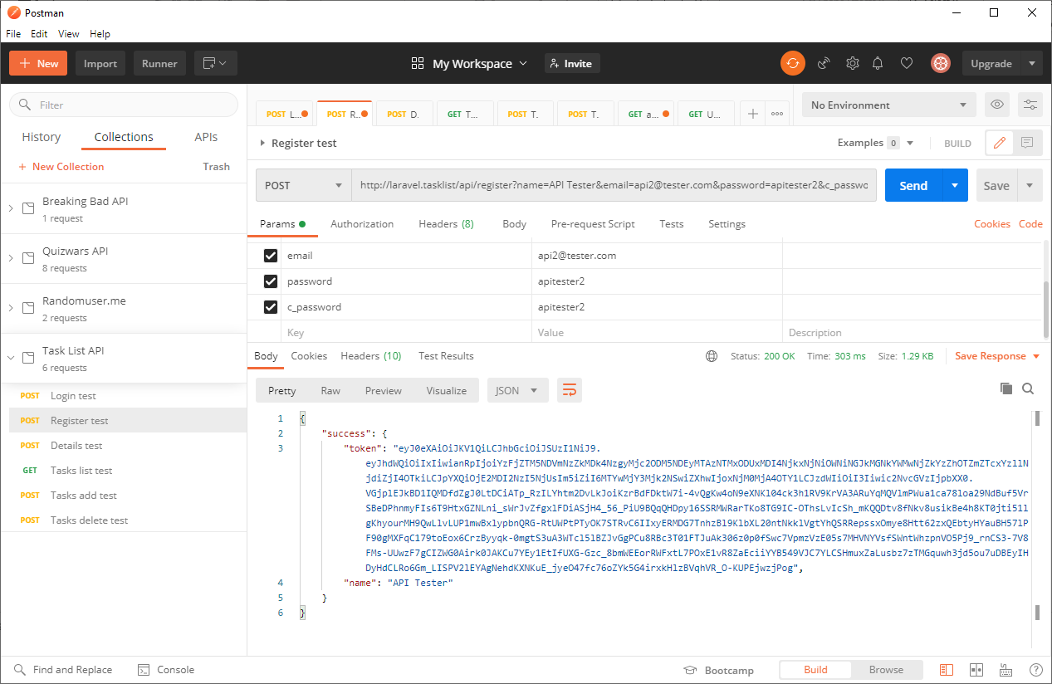
Observing register users data
Notes:
More form data is needed to test a registration response, in that passwords are entered twice and a name is also entered
What is returned from the API is identical to the successful login response

Slide 59
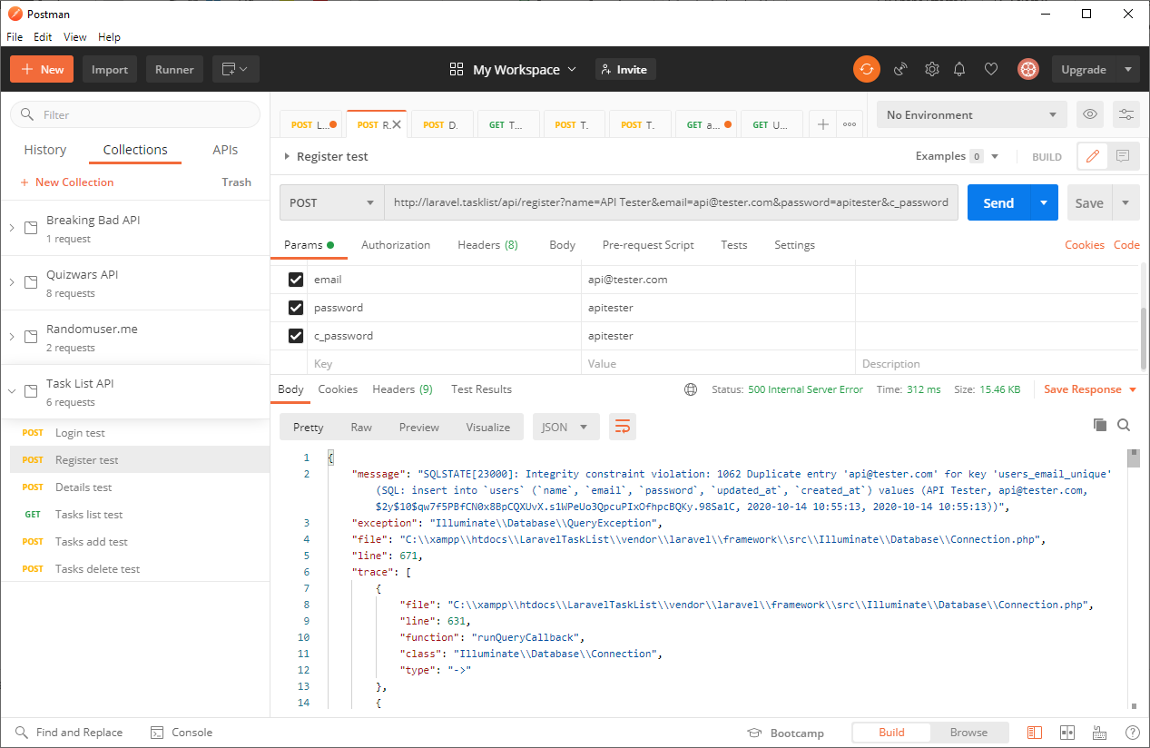
Observing failed register users data
Notes:
On the other hand, a failed response to register a new user is quite a different block of data from the comparative failed login attempt and needs to be handled differently in the .then block of the fetch.then statement

Slide 60
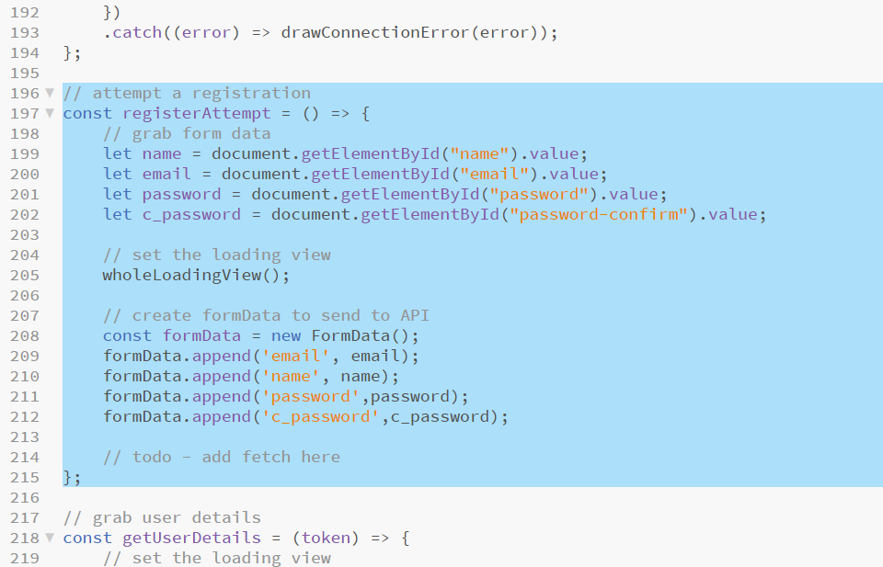
Adding the ability to register users
Add the following highlighted code after the loginAttempt function and before the getUserDetails function (keeps similar functions together) *
Notes:
* This block of code is not yet complete. The only differences here are the extra form data elements which are recorded from the HTML form and added to the formData object If we were building a robust application, this would be a good place to check that the password and c_password match before sending the query – this build lazily lets the API handle that – in a production application this would result in excessive server load

Slide 61
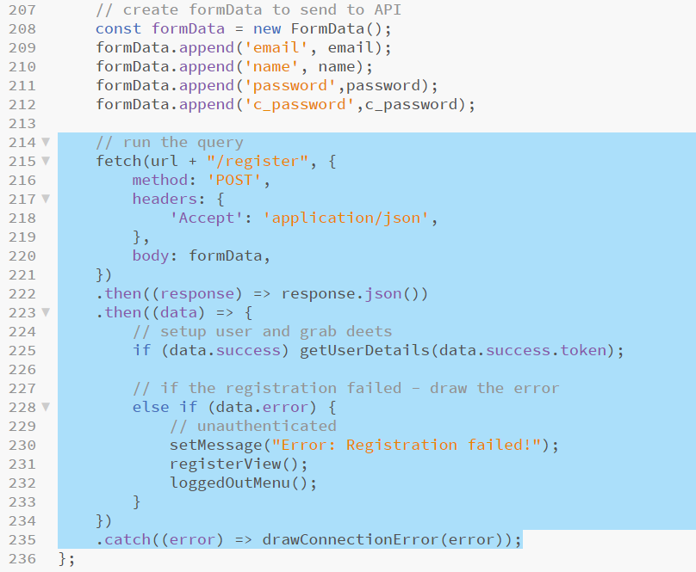
Completing register users function
Add the following highlighted code to replace the todo comment in the previous slide *
Notes:
* The fetch.then.catch blocks here are nearly identical to those added for the loginAttempt function, see previous slides for explanations
The only difference here is that if data.error is detected, the register view is redrawn rather than the login view This function feeds on to getUserDetails if successful in the same way as loginAttempt does

Slide 62
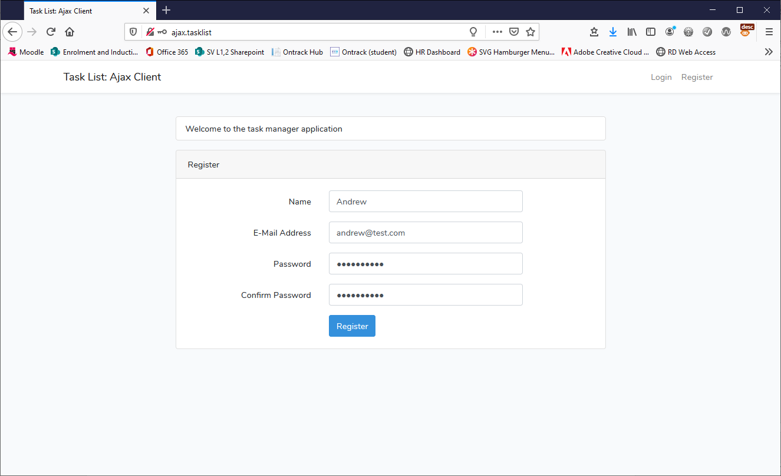
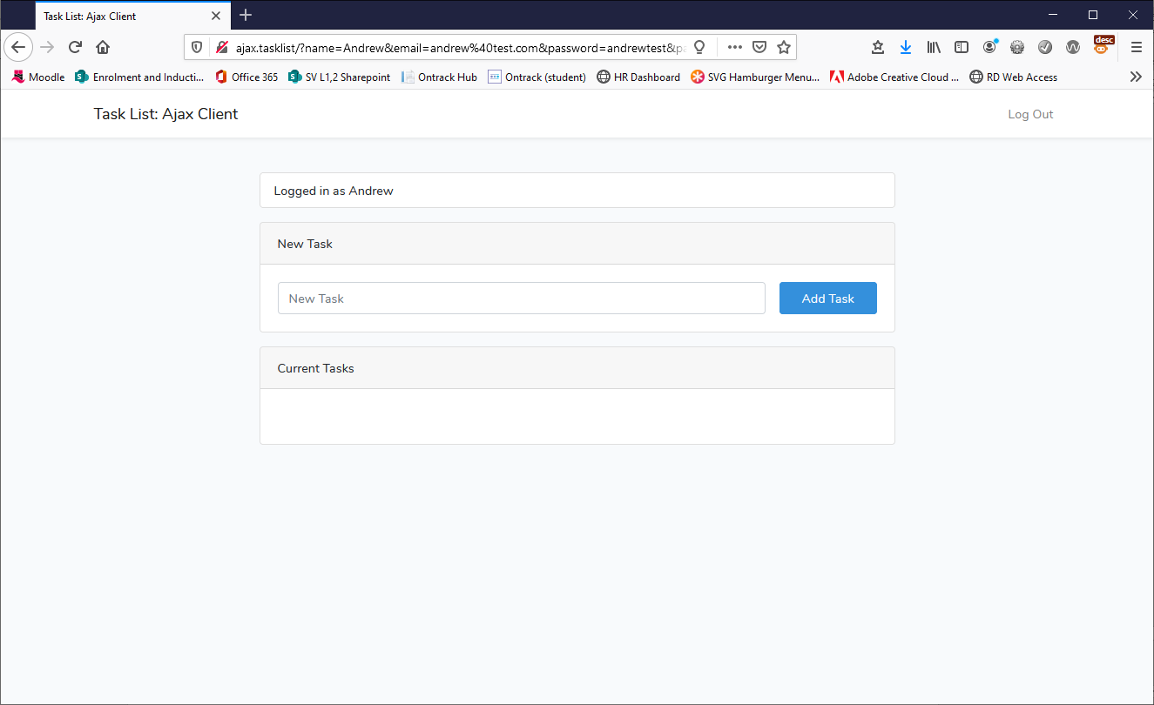
Testing register a user
Refresh the browser, navigate to the register view and try to add a new user, the app should log you in as that user when complete

Slide 63
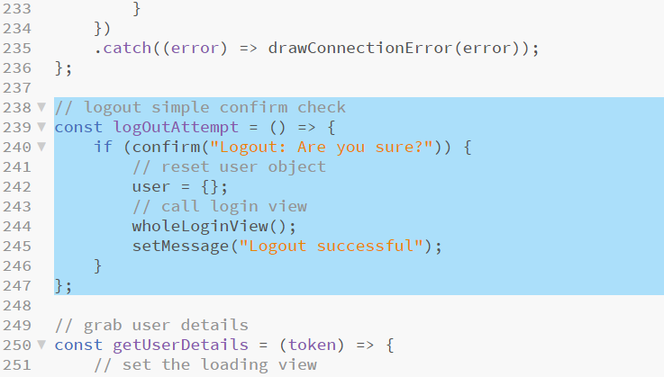
Adding the ability to log out
Most of the necessary code for implementing log out is present already, all that is needed is a simple handler function which is called by the logout control
Add the following highlighted code under the registerAttempt function and before the getUserDetails function*
Notes:
* Very small – simple function to handle a logout Line 240: uses the built-in browser confirm dialog box which returns true if the user presses “OK” or false if they press “Cancel” (this is fairly dirty from a UX perspective but also quick and effective)
Line 242: clears out the global user object
Lines 244 and 245: reset the view back to the login view with a suitable message

Slide 64
Summary so far…
Save the code, reload the app in the browser and test logging in and out with various accounts (tough to screen-grab that)
The last two functions which are still outstanding are:
The ability to add a new task for the logged in user
The ability to delete a task for the logged in user
Unsurprisingly both of these are fairly similar in structure but as one is a request to delete, also contains a confirmation check
First we will deal with adding a new task

Slide 65
Observing the data for adding a new task
Notes:
This JSON blob should be relatively straightforward by now
New task name = data.success.add.name
New task id = data.success.add.id
We don’t care about the rest!
Make sure that the Accept and Authorisation headers are included or this query won’t run correctly

Slide 66
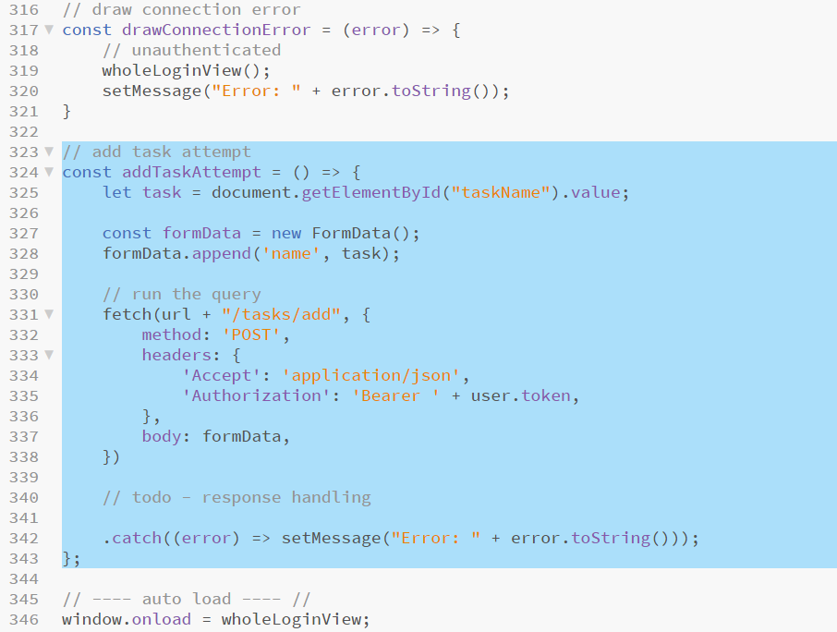
Adding a task
Add the following highlighted code after the drawConnectionError function and before the auto load comment *
Notes:
* All we need to complete this request is the name of the new task to add (this function is called when the “Add Task” button is pressed) Line 325: gets the task name as entered into the new task text entry
Lines 327 and 328: create a formData object and add the task name
The .then blocks have been omitted in this code sample. They will replace the toto comment in the next step

Slide 67
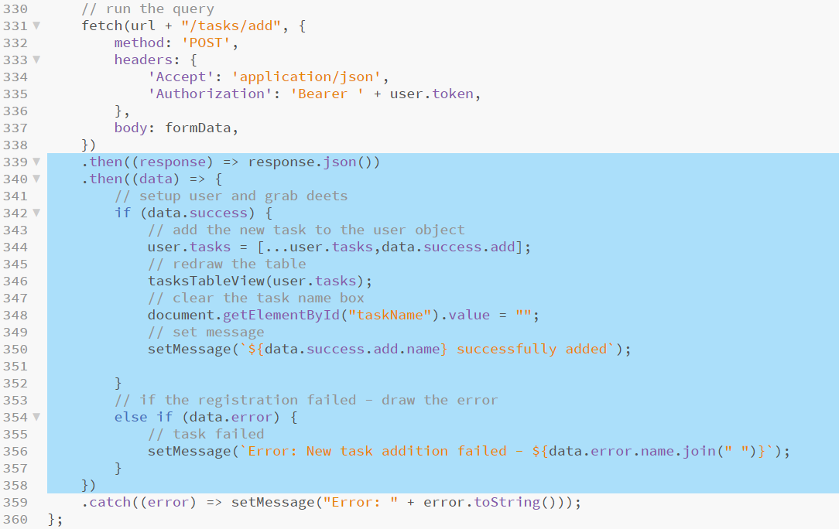
Adding a task
Add the following highlighted code replacing the todo comment added in the previous step*
Notes:
* The /tasks/add route causes the API to store the new task for the user corresponding to the token data sent – it then responds with data.success and an object containing the task details (task.id etc) Line 344: uses the spread operator to expand the current global user.tasks list into a new list, adds the new task object from the API response and stores this back into the global user.tasks list
Line 346: redraws the tasks table now including the newly added task
Line 348: clears out the new task textbox
Line 350: draws a success message

Slide 68
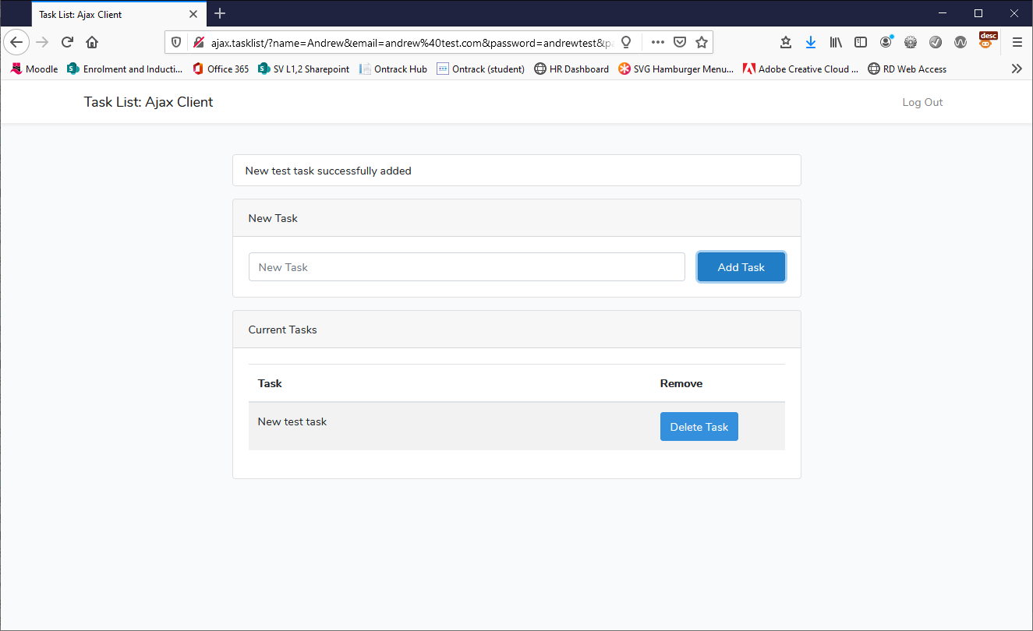
Testing add a new task
Save the script, reload the app in the browser, log in and try adding a new task for the user account

Slide 69
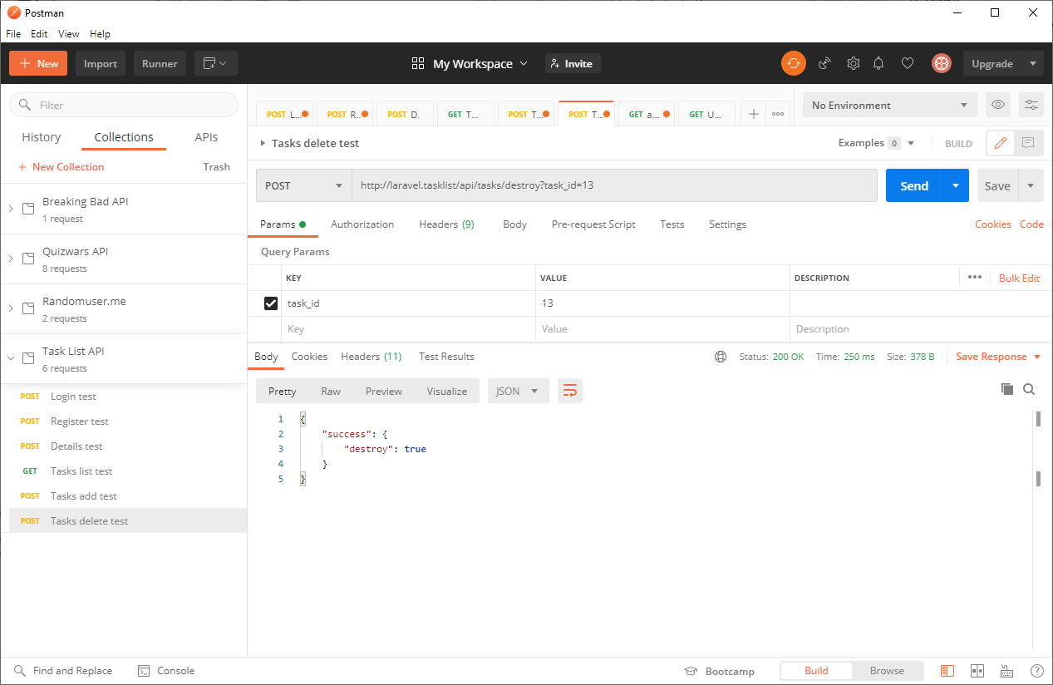
Observing task delete data
Notes:
This should not require explanation by this point
Make sure that the Accept and Authorisation headers are included or this query won’t run correctly

Slide 70
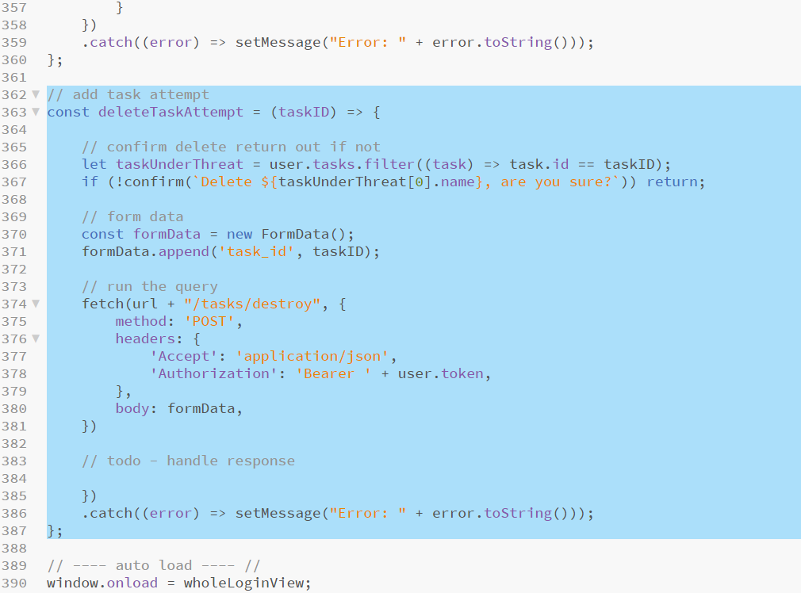
Adding the delete task function
Finally, we add the function to delete tasks when complete
Add the following highlighted code after the addTaskAttempt function and before the auto load comment *
Notes:
* The final function required – this function is called when the “Delete Task” button is pressed from the respective task row in the tasks table – the button passes the task id to be deleted
Line 366: retrieves the specific task under threat of deletion from the global user.tasks collection using the array.filter method which returns a new array based on the test specified
Line 367: Again uses the (quick and dirty) built in confirm dialog to ask the user if they are sure they would like to delete the task. If they choose “Cancel”, the return statement at the end of the line ends this function and the delete request
Line 370-381 and Line 386: are only accessibly by pressing “OK” on the confirm dialog. None of this code is new in function or structure, only the call to the /tasks/destroy route is different than previous blocks Handling the response for this query will be completed in the next slide, replacing the todo comment on line 383

Slide 71
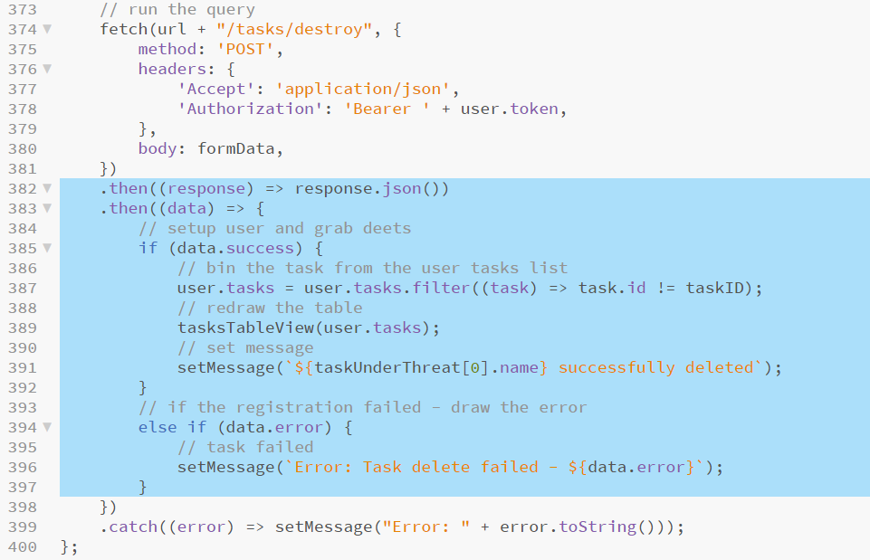
Adding the delete task function
Add the following highlighted code to handle the response from the API replacing the todo comment on line 383 *
Notes:
* Finally, we handle the response from the /tasks/destroy route replacing the todo comment which was on line 383
Line 387: resets the user.tasks list to a new list without the removed task again using array.filter in this instance to remove the deleted entry
All other code here is similar or identical to previous functions

Slide 72
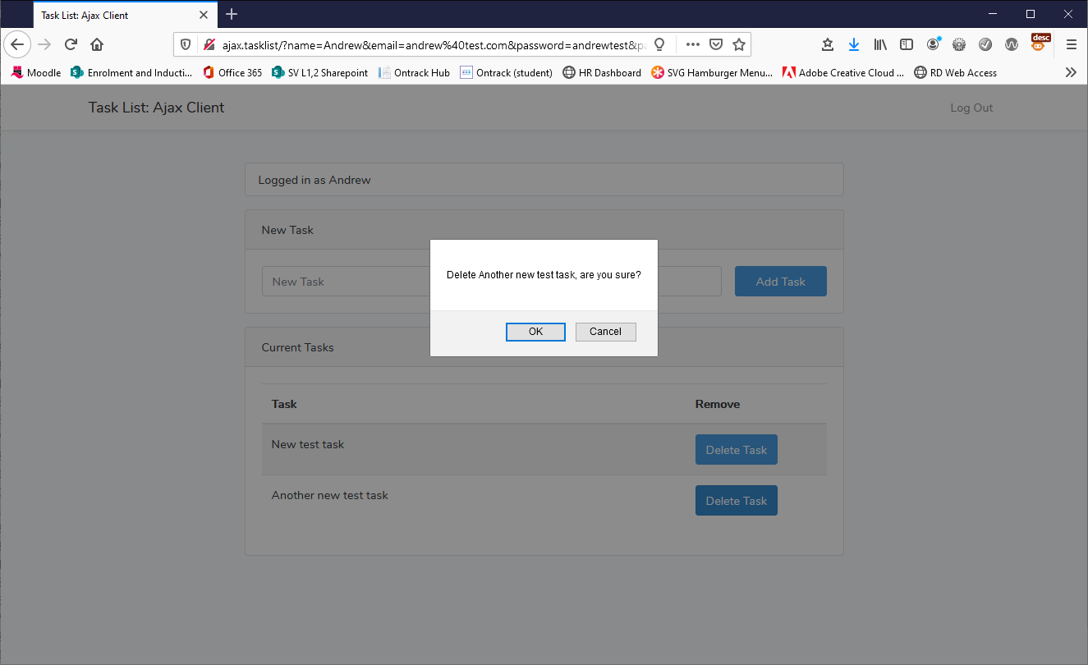
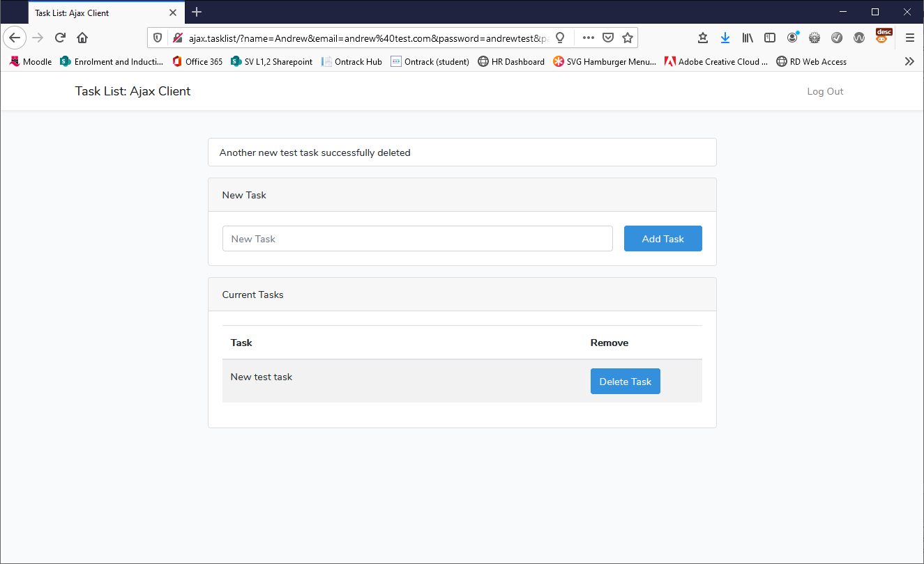
Final tests
Save the script, reload the app in the browser, log in and try deleting a task for the user account

Slide 73
Project debrief
BSc Applied Computing

Slide 74
Project debrief
This project ties up the client-side end of the server-side Task List application and API completed in previous sessions
It demonstrates how a different client built in a different language can interact with a server-side API and create between them a working application
It demonstrates further how to use and consume JSON data
It demonstrates how to use tokenised RESTful authentication
This project has some flaws:
It puts all the burden of validation and input sanitisation onto the API which is inefficient
It does not handle some errors (error 500, internal server error, for example, will leave this client in an endless loading loop as it does not respond with JSON but the connection attempt succeeds), some kind of timeout or another branch in the if/else if blocks would fix this
There is a lot of repetition in the code which could possibly be streamlined with some callback function arguments and generalisation (this would make it a bit hard to follow at this stage)
The styling is rubbish (thanks Bootstrap)!!!!!!

Slide 75
Session review
BSc Applied Computing

Slide 76
Recap
Recap JavaScript AJAX and APIs
What is an API?
Stateful vs RESTful applications
Modern JavaScript
ECMAScript 6
Arrow functions
Spread Operator
Array functions
Cross origin resource sharing
JavaScript specific (browser-based)
Rationale
HTTP headers
Configuring Apache for CORS
AJAX (recap)
What is AJAX
XML vs JSON
Asynchronous operations
Promises
Fetch
Building an AJAX client for the Task List application
Project setup
Implementing CORS headers on the API
HTML and CSS project files
JS coding
Testing with browser, observing data with Postman

Slide 77
Any questions?
Next…
Building a WebSocket client/server network game using Node and Express

