Slide 1
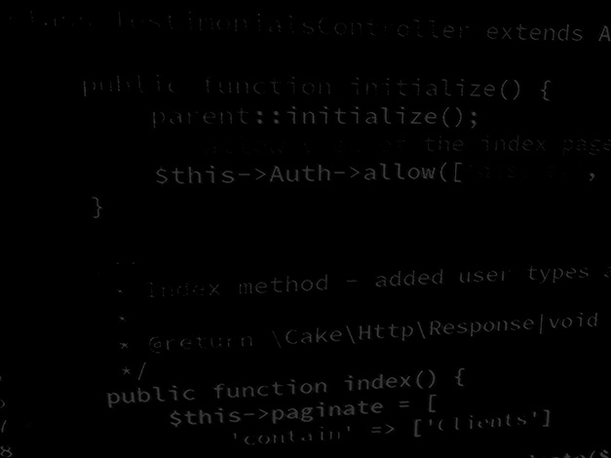
Server-side coding with PHP and Laravel Learning PHP #4 – Object-oriented PHP
BSc Applied Computing

Slide 2
In this session…
Recap PHP and MySQL connectivity
Last exercise progress
Reading list
Stateful vs RESTful
Use of the PHP session
PHP and Object-orientation
PHP and OOP
Namespace and foldering
Using a specific class
MVC and frameworks
Simple OOP user account system
Project setup
Project development workshop

Slide 3
Recap PHP and MySQL connectivity
BSc Applied Computing

Slide 4
Quick recap
Reasons to use a database:
The site’s content changes frequently
The business uses ecommerce
The site employs user-driven content
PHP can use a lot of databases
MySQL, a database server
PHPMyAdmin use
User account access for the webserver

Slide 5
Object-oriented PHP
BSc Applied Computing

Slide 6
Object orientation
“Object-oriented programming (OOP) is a programming paradigm based on the concept of "objects", which can contain data, in the form of fields (often known as attributes or properties), and code, in the form of procedures (often known as methods). A feature of objects is an object's procedures that can access and often modify the data fields of the object with which they are associated (objects have a notion of "this" or "self"). In OOP, computer programs are designed by making them out of objects that interact with one another. OOP languages are diverse, but the most popular ones are class-based, meaning that objects are instances of classes, which also determine their types. “
Wikipedia

Slide 7
Object-oriented programming

Slide 8
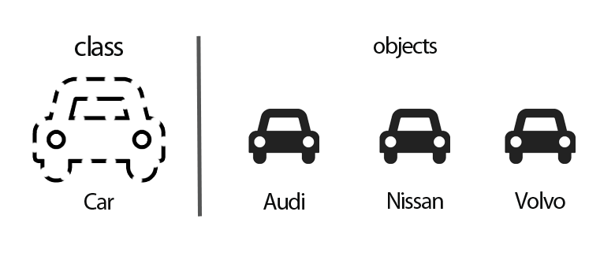
OOP Rationale
Code Reuse and Recycling: Other projects
Encapsulation: Black-box code
Modularity: More planning but better division
Software Maintenance: Much easier

Slide 9
PHP is not OO by default
PHP is a procedural language.
PHP has acquired OOP capabilities as it developed as a language.
PHP is only OOP if you are coding and working with classes and that classes are the dominant paradigm used to construct the application.
OOP splits up the application into manageable functional chunks.
Helps make larger projects more understandable.
Allows a development team work on different aspects of the same application simultaneously without interfering with each other.
Most server-side frameworks use the OOP paradigm (Laravel, CakePHP, etc).
Creating an API using a framework is much easier if you understand OOP.
Using a framework to create an API is much easier than coding everything all by yourself.
Notes:
This tutorial assumes that you have some understanding of what object oriented programming is!!

Slide 10
Namespace and foldering
Large projects can include a lot of classes:
Created specifically for the project
Framework or library classes for common tasks
Classes are usually organised as a collection of files, one class per file.
Example class on the next slide.
A meaningful folder structure is important when using classes as this will be reflected in the namespace given to any specific class.
All classes associated with a specific project should have a root folder, often with the filename of “class” or “classes”.
The folder structure of the class becomes its namespace and this then allows many classes with the same class name to be used together in the same project without fear of collision.

Slide 11
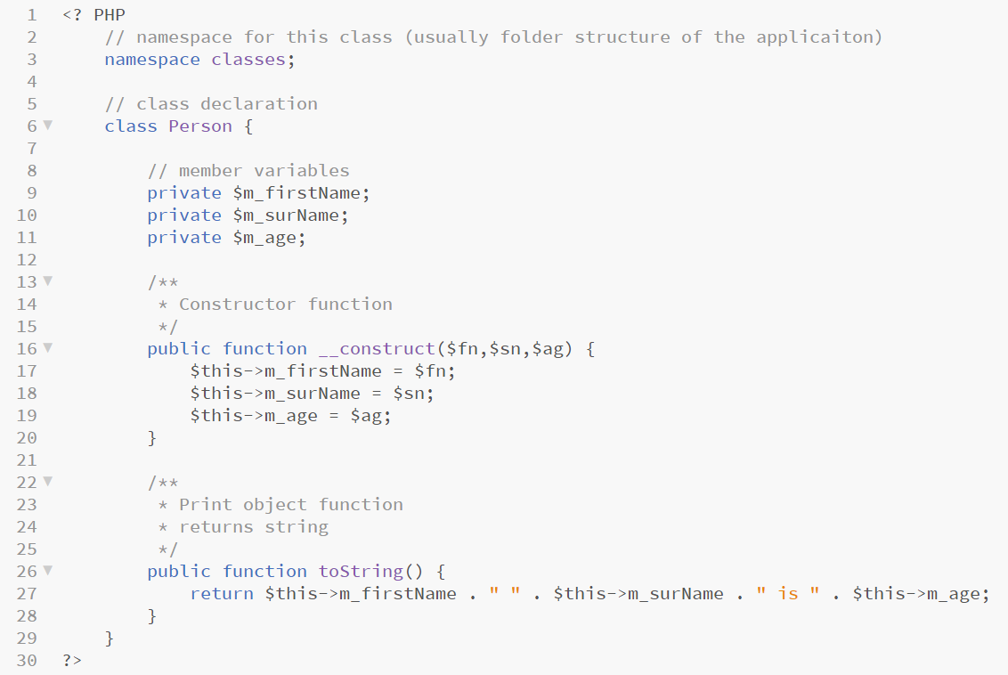
Example class
Notes:
This file will be found in <project root directory>/classes
PHP uses the arrow operator -> to refer to properties or methods of an object as opposed to languages such as JavaScript, C#, Java, etc all of which use a . for this purpose.
PHP requires the use of $this to refer to the instance of the object itself being considered

Slide 12
Using a specific class
In order to use any given class in an application, PHP requires the file to be specifically declared, traditionally with a require or include statement.
Many classes can be required by some areas of code.
To speed up the declaration and use of classes PHP programmers use an auto load call back function which loads classes in as the programmer tries to use them and the use keyword to avoid having to declare the namespace each time a specific object is called.

Slide 13
MVC and frameworks
Model – data structure representation of a database record.
View – the final page sent to the browser.
Controller – the application logic.
MVC is a design pattern often used in advanced web application design.
It is a design pattern employed by many of the popular application. development frameworks (Laravel, CakePHP, etc).
MVC splits the project into three distinct areas which can then be assigned to different programming teams.
MVC allows areas of the project to be easily overhauled (for example, if the project moves to a new database or new view framework the application logic does not need any adjustments).
Notes:
I will fit this into the project that we will code later on

Slide 14
Simple OOP user account system
BSc Applied Computing

Slide 15
Project setup
You should create a new virtual host for this project (use the instructions from week 1 if needed)
Project folder: UserAccountSystem
Project URL: account.system
This tutorial will use the Brackets editor.
All new code will be highlighted, other code will be included to indicate placement of new code only and should not be entered.
PHP can use // or # to indicate a comment.
This tutorial will use // for all comments.
Further explanation of code is included in the notes pane of specific slides.

Slide 16
This project is different!
Up to now we have dealt with smaller, self contained application projects.
This project is intended to demonstrate one aspect of a much larger system.
It involves far more coding than previous projects and it is unlikely that you will finish it during the session.
Make sure that you follow the rest of this tutorial in your own time and complete the project for next week.
This project contains many important aspects which later sessions will draw upon, continuing and completing this project in your own time is extremely important if you want to get the most out of the following sessions.
I will be reviewing your progress with this application at the start of the next session.

Slide 17
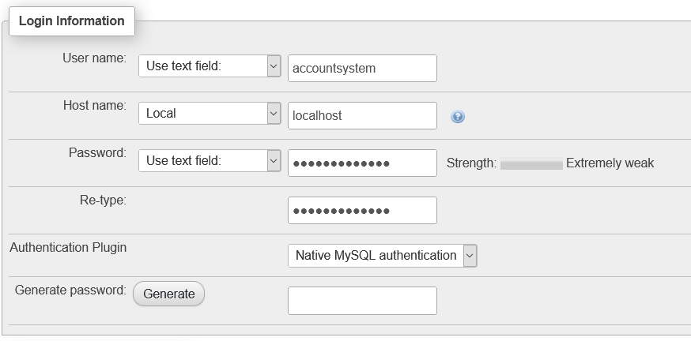
Database setup
This project will use a database setup script to configure tables required
The database itself and the user account for the webserver still need to be set up using PHPMyAdmin.*
Set up a new database with the following details:
Database: accountsystem
Username: accountsystem
Password: accountsystem
Hostname: localhost
Notes:
* See last week’s session for how to do this if you are unsure

Slide 18
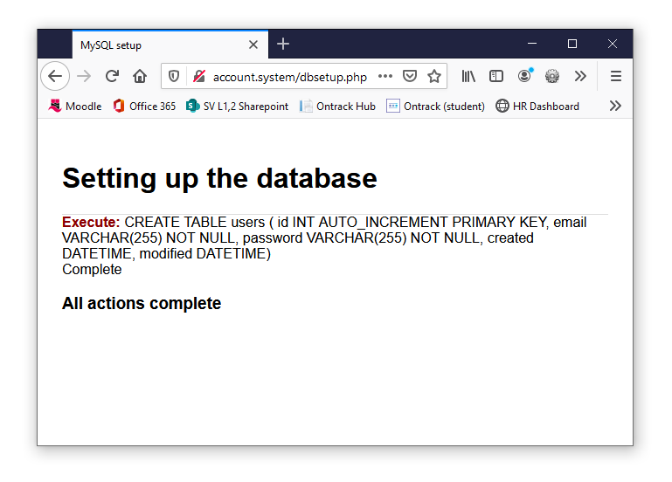
Database setup
Download the database setup script (dbsetup.php) from Moodle into the UserAccountSystem folder.
Open your browser and in the address bar type http://account.system/dbsetup.php.
Notes:
This is a simple script which can be used to store DB setup statements for re-use on other projects (this users table came from another project and saved me fiddling around in PHPMyAdmin)
Where your entity relationships are complex, this kind of setup approach allows visibility of ALL tables and relationships at once – this makes it much easier to spot mistakes
I have been using this same PHP script to setup databases for web projects for the best part of 25 years with only minor tweaks (SQL and DB access details change from project to project naturally)

Slide 19
Database setup
Double check the database setup by inspecting the new users table in PHPMyAdmin.
This is the only table that our simple user account system will need.

Slide 20
Project setup
Open Brackets and add a new index.php file to the UserAccountSystem folder as in previous sessions.
Add two folders to this same UserAccountSystem folder:
classes
views
The UserAccountSystem folder should now look like this.
Notes:
Note: Use of exclusively lowercase eliminates capitalisation errors which may crop up later

Slide 21
Coding index.php
The index page will only hold a very rough project framework which will be filled by specific views served from the views folder as dictated by a project controller class.
In Brackets, add a PHP block to the top of the index.php page.
Next add a class autoloader call-back function as shown below.
Notes:
The autoloader traps any new object that we try to use in code, it send this through the include_once statement
As this is effectively a one-page project and all request will pass through index.php, this will effectively load any class that we use into the whole project

Slide 22
Coding index.php
Next, add a use statement to include a class called UserController (we have not created this yet), which is found in the classes folder.
Thanks to the autoload function, any class (either bespoke or third party) named in a use statement will be available to the project.
The use statement must be included before any display logic or HTML which is why it is included at the top of this file.
Notes:
The autoloader traps any new object that we try to use in code, it send this through the include_once statement
As this is effectively a one-page project and all request will pass through index.php, this will effectively load any class that we use into the whole project

Slide 23
Coding index.php
Next, add a use statement to include a class called UserController (we have not created this yet), which is found in the classes folder.
Thanks to the autoload function, any class (either bespoke or third party) named in a use statement will be available to the project.
The use statement must be included before any display logic or HTML which is why it is included at the top of this file.
Add the highlighted code.
Notes:
The full path to the UserController is (for my project) C:\xampp\htdocs\UserAdminSystem\classes\UserController.php
Capitalisation is important here – as this is an object it should be capitalised so that it can be easily identified as an object

Slide 24
Coding index.php
This application is a user-login system so the PHP session is required to keep track of users who have successfully logged in.
Add a session_start() statement to indicate that the session will be used.
Finally, we instantiate the UserController object and create a reference for it in $uc.
Add the highlighted code as shown below.
Notes:
No arguments are passed to the UserController.
$_SESSION, $_POST and $_GET will be used but as these are all superglobals they are visible from within UserController

Slide 25
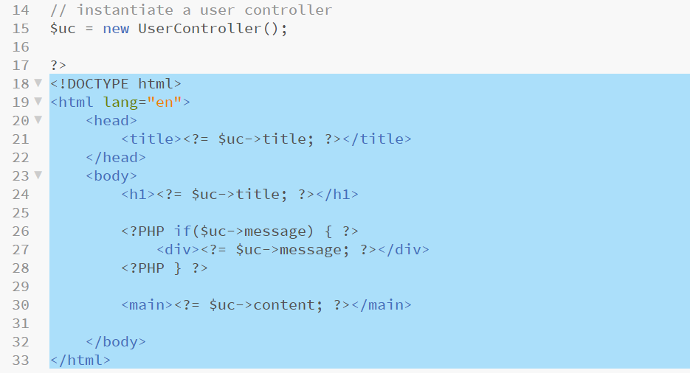
Coding index.php
Next, add the minimal framework HTML to the index.php page.
This contains a few PHP print statements which will include public properties of the $uc (UserController).
Add the highlighted code.
Notes:
PHP uses the arrow operator -> to refer to properties or methods of an object as opposed to languages such as JavaScript, C#, Java, etc all of which use a . for this purpose.
$uc->title will contain the page title
$uc->message will contain any errors (DB or user errors which we need to alert the user to)
$uc->content will contain the view HTML code

Slide 26
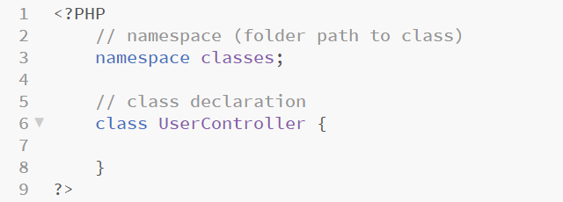
Adding the UserController class
Add a new file to the classes folder, call it UserController.php.
This file will be an object which will house all of our application logic.
This class requires a namespace of classes as it is to be found inside a folder of that name, this helps any code it contains locate itself relative to the project root.
Add the code and comments below.
Notes:
All of the logic for this class will be contained inside the brackets which are included next to the class declaration

Slide 27
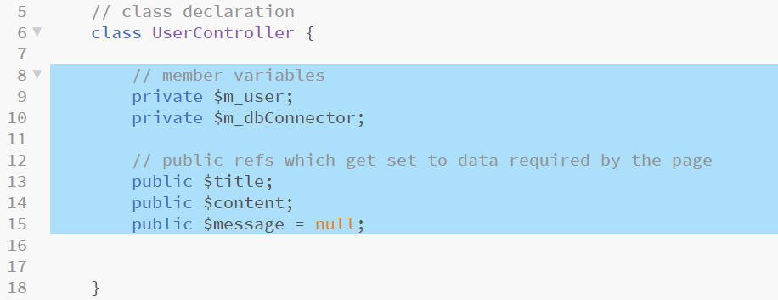
Member attributes
This class will need a few attributes which should be added first.
The public keyword denotes attributes which are in scope and to and usable by code outside of this class.
The private keyword denotes attributes which are in scope only within this class.
Add the highlighted code and comments.
Notes:
The m_ at the start of the private attribute names denotes that they are members of this class – this is not required and is a naming convention that I have picked up – it seems to help readability within OOP code
$m_user is a string which will contain the email address of any logged in user
$m_dbConnector is an object reference to a class which we have not created yet. This class will manage our database interactions for us (not quite a model as set out in MVC but as close as we will go in this project)
$title, $content and $message are all strings which are accessed and used by index.php as previously coded.
$message is initialised with a null value so that it becomes easy to check if any errors have occurred with $message != null

Slide 28
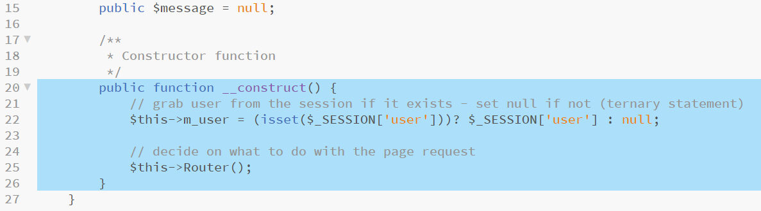
Constructor function
Constructor functions in PHP always follow the same syntax and are used to initialise data required when the class is instantiated .
In this case the constructor checks the session for a logged in user and records the logged in user if found in the session, then calls a method of itself named Router (we will code this next).
Add the highlighted code below.
Notes:
Line 22: Checks the session for user information and loads this information into $this->m_user if found or null if not using a ternary operator and the isset function as in previous projects
Line 25: Calls a method of this object (hence $this->Router();)
We will come back to this function as there is more to set up later but for now we will get the view working first

Slide 29
Router
Many frameworks use a single landing page (index.php) and then employ a concept of a Router which makes the decisions about what action has been requested and what (if any) application logic needs to be processed to complete the request.
Laravel and CakePHP use a system of URL rewriting and trapping to map routes to URLs (an example of Laravel routing is shown below).
This project is not large enough to require something of that scale but we need some sense of routing and this should be an easily identified and isolated block of code, hence it gets its own function.
This code is an example, DO NOT add it to the project currently open
Notes:
The code block shown is an example and should NOT be added to this project
The example shows how URLs map to methods of specific controllers – example http://<domain>/home maps to the index method of the HomeController

Slide 30
Adding a Router function
Our router will make decisions about the presence of certain information contained in $_POST, $_GET and $_SESSION.
The Router function will then call functions which will run application logic and will set the $message, $title and $content attributes ready for the final view to be drawn.
We should take a moment to consider which functions will be needed.
The application deals with user a user login system so it will need:
A login form for users who are not logged in but have an account
A login function to process a login request from the form
A register form for users who are not logged in and do not have an account
A register function to process a new account request from the form
A welcome page to greet the user when they successfully log in
A logout function for a user who has finished using the application
We should get the login form and the register form views working first.

Slide 31
Login view
Create a new file in the views folder with the filename login.php.
This file contains a PHP string with a simple HTML login form inside.
Note the hidden input called action with a value of login – this will be used by our router function.
Also note the use of a hyperlink with a get value of register = 1 – this will also be used by our router function.
Add the following code and save the view.

Slide 32
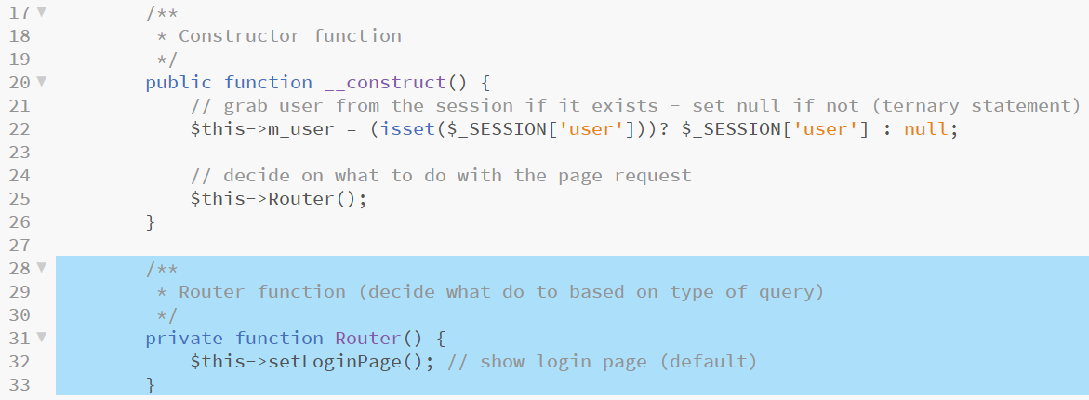
Adding a Router function
By default we should show the login form as this is the most likely thing that a user would want at the start of an interaction.
For now we add a Router function to UserController which simply makes a call to another function called setLoginPage.
Add the highlighted code and comments to UserController.php.
Notes:
Note the block comments above each function, these allow for detailed information about each function to be included readably in the code making it far easier to maintain and reuse

Slide 33
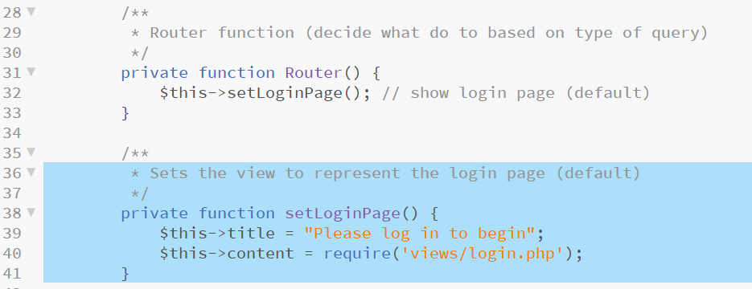
Adding setLoginPage
Now that we have called setLoginPage, we should code it.
This function simply assigns values to a few of the object attributes.
It does nothing other than assign a view so no other application logic is present.
Add the highlighted code to UserController.php and save all files.
Notes:
Line 40 sets the value of the $this-content attribute to the HTML form string contained in views/login.php

Slide 34
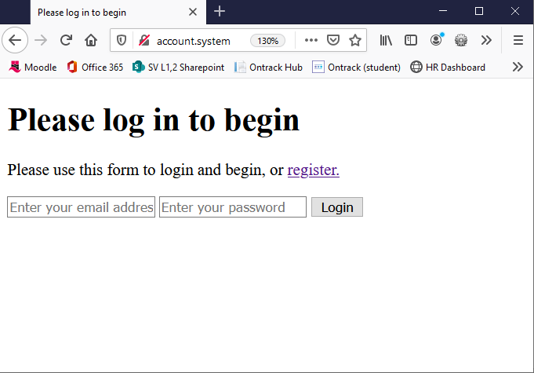
Testing the applicaiton
The application does not do a lot at present, but should now be complete enough to serve our login form.
Open a web browser and navigate to http://account.system.
You should see a page similar to the one below.

Slide 35
Adding a register view
Of course, nobody has an account yet as there is no user information in our database to login with.
To fix this we can implement a register form.
Create a new file in the views folder named register.php.
Add the code below and save this file.
Notes:
Line 3 uses another ternary operator to search for $_POST[‘email’] – this traps any previous form send and saves the email address sent into $email – this is then added back into the form on line 10
We do this in case the passwords do not match or there is some other issue that causes the registration to have to be re-run and is intended to minimise frustration on the part of the user in this event
Pay attention to line 18 – without this the code will break as it closes the string, ends the line and the PHP block

Slide 36
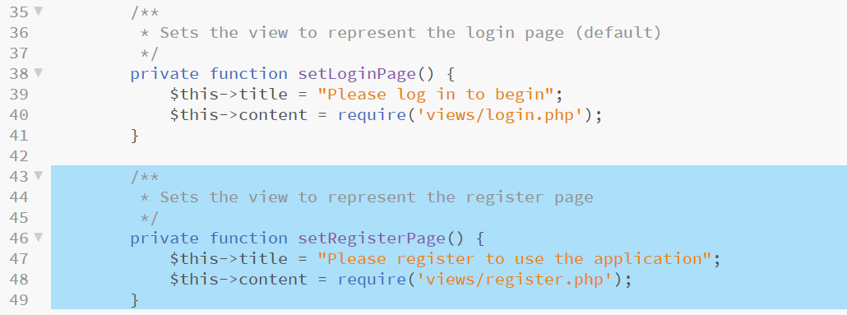
Adding setRegisterPage
Next, add a setRegisterPage function to UserController.
This function also has no application logic and simply calls a view.
Add the highlighted code to UserController.php.

Slide 37
Routing to the registration page
Amend the Router function to contain an if / else statement testing for the presence of $_GET[‘register’].
We will add additional clauses to this function in coming stages, each to represent one of the functions identified for this application on slide 30.
Change the Router function to add the highlighted code below.

Slide 38
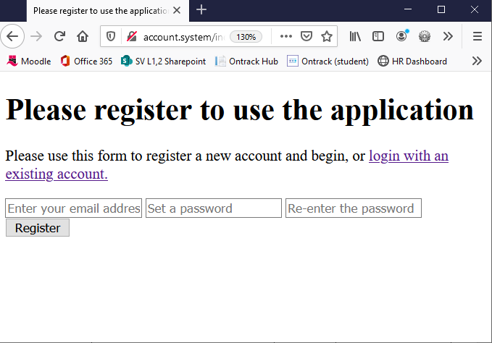
Testing the application
Refresh the page in the browser.
You should now be able to navigate between login and register views using the hyperlinks at the top of each page.
Notes:
This is a simplified version of the routing and views system found in most PHP frameworks, but essentially the same sort of process

Slide 39
DBConnector class
In order for the system to work, it needs to connect to the database we created and setup earlier on.
In order to make this easier, all of the DB connection logic, error trapping and so on will be wrapped in another class.
This creates a neat blob of logic which is easily re-used in other projects as it will contain no functionality specific to this project beyond the connection account details.
Create a new file in the classes folder with the name DBConnector.php.

Slide 40
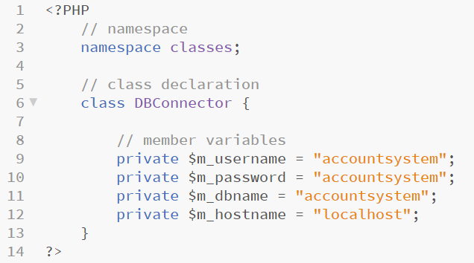
Coding DBConnector
This class will manage all of our database connection logic exposing methods to let us open, run specific queries and close a connection.
Start the class with the code below which defines a new class in the classes namespace and adds attributes with database account information for this project.
Notes:
Again, we use the m_ prefix to denote a member attribute – all of these are declared as private as we do not want them made visible to the rest of the application. This helps keep our database account details safer as private attributes are harder to expose through malicious code

Slide 41
Coding DBConnector
Two more member attributes are needed.
The first will contain any error messages generated by the database and will provide visibility of these to the application.
The second will be a reference to our mysqli connection object and will allow a number of methods to be run against the same connection without it being closed.*
Add the highlighted code to DBConnector.php.
Notes:
*This is slightly more efficient than open, query, close for every interaction, especially if it is possible that open, query, query, close is possible somewhere in the application

Slide 42
Coding DBConnector
There is no initial setup needed and nothing to run by default in this class so no constructor method is needed.
Instead we get on with coding a method which opens a database connection and stores a reference to it in the attribute we just added.
Add the highlighted code to DBConnector.php.
Notes:
Line 24 opens a mysqli connection as we did last week. This time we add \ before mysqli as this is not a built in PHP function to show that mysqli uses the application root namespace
The remaining code is very similar to that used last week, we open a connection, check for errors and load them into an error attribute if we find them – the method then returns true if the connection succeeded and false if not
We will not use this Boolean in this application but in more robust projects it is essential to have the option of checking that something has succeeded before proceeding so it is good practice to include these return statements

Slide 43
Coding DBConnector
Next add another method to allow the opposite action and close an active database connection.
Add the highlighted code to DBConnector.php.
Notes:
No need to return anything as close never fails if it can be run, if it can’t there was nothing to close and no har

Slide 44
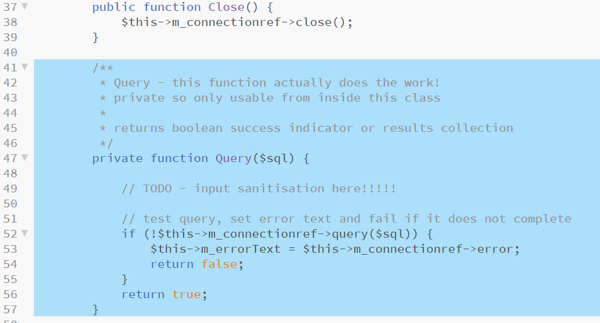
Coding DBConnector
Next add another method to run queries.
This method is set as private for reasons which should become obvious in the next few steps.
Add the highlighted code to DBConnector.php.
Notes:
Once again, nothing especially new here – please refer back to the last session if explanation of this code is required
Again, we test for errors and set error text if any are found, Boolean success is returned from the function
Note: The TODO comment – if you learnt how to implement techniques to eliminate the threats posed by SQL Injection last session, remember to come back and add them here

Slide 45
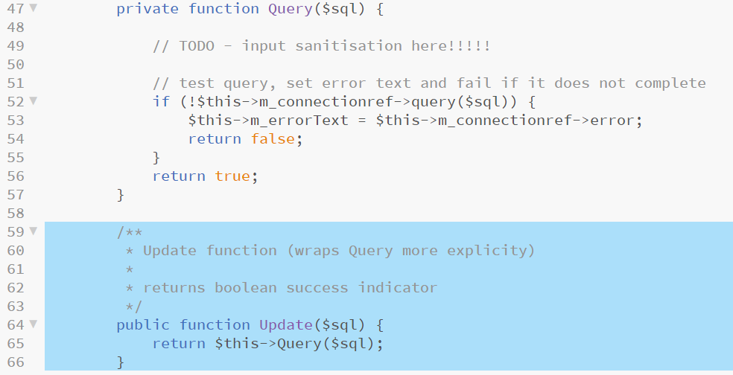
Coding DBConnector
Next add three more methods, each named for an SQL action, each calling the Query method that we just added.
Each of these will run queries which do not return result collections.
The first that we add is for the UPDATE sql action.
Add the highlighted code to DBConnector.php.
Notes:
This forces us to call methods named for each SQL action when using this class making the code that bit more readable than if we just use Query for everything

Slide 46
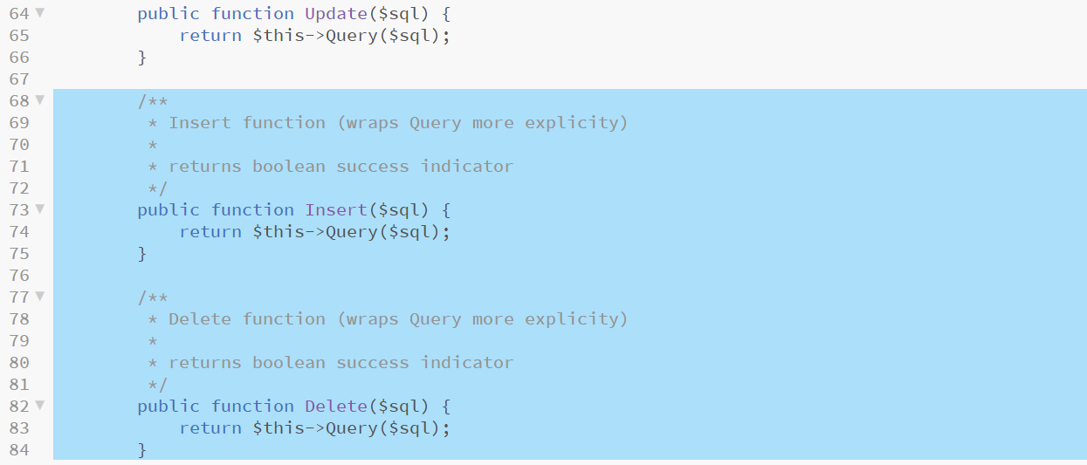
Coding DBConnector
Add similar methods for INSERT and DELETE.
Add the highlighted code to DBConnector.php.
Notes:
We can now tell this class that we want to run an Insert, a Delete or an Update making the calling code easier to understand and debug

Slide 47
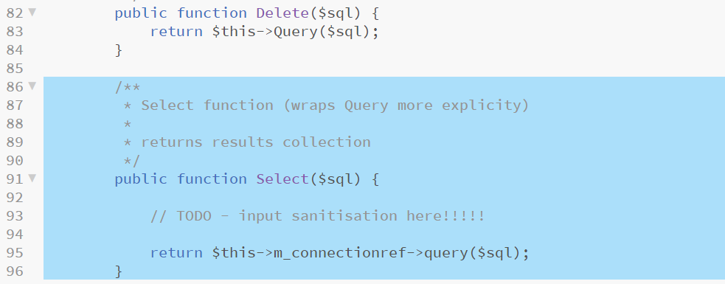
Coding DBConnector
SELECT queries work a little differently as they return a result set if successful and nothing if not, so a different method is required.
Add the highlighted code to DBConnector.php.
Notes:
Again, we add in techniques to remove the threat of SQL injection at the indicated point – in all other respects we are simply wrapping a mysqli_query statement

Slide 48
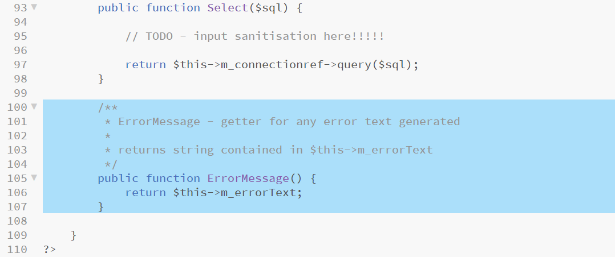
Coding DBConnector
Finally we add a final method to allow access to the contents of the $m_errorText attribute if needed.
Add the highlighted code to the end of the class and save the file.
Notes:
This kind of method, that simply returns the value of a private attribute is called a “getter” – it’s counterpart, a “setter” allows these to be changed from outside the class – this is useful for purposes of sanity checking changed, recording changes and other issues rather than just exposing the attribute directly – these techniques are common to all OOP languages and implementations

Slide 49
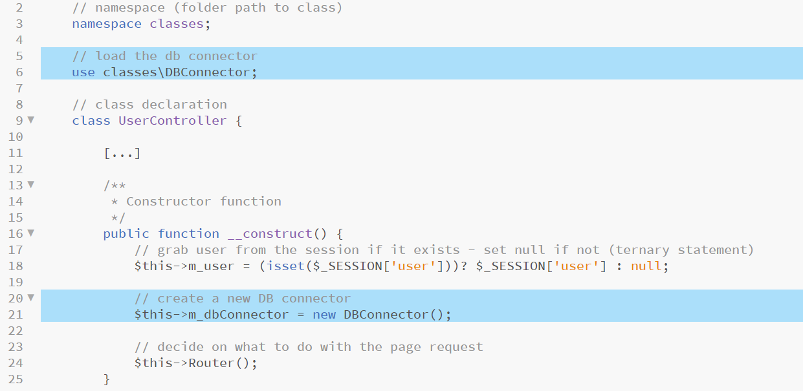
Using DBConnector
We now have a means with which to connect to our database.
We can enable UserController to use the DBConnector class by adding a use statement for it and by setting the reference for it in the constructor.
Add the highlighted code to UserController.php.
Notes:
Line 6 includes the DBConnector class meaning the UserController can make use of it
Line 21 creates an instance of DBConnector and stores it in $this->m_dbConnector for use by other methods (this could perhaps be done only if needed rather than by default as a point of optimisation, for the purposes of this exercise we will leave it like this)

Slide 50
Registering a new user
If a new user wishes to create an account and fills in the register form, we can contact the database and create an account for them.
The first thing our doRegister function should do is check that both passwords submitted match and to generate an appropriate error if not.
Add the highlighted code on the next slide to UserController.php.

Slide 51
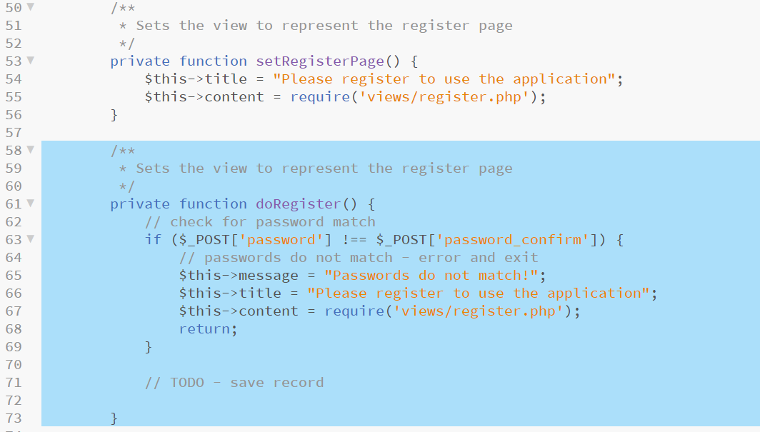
Registering a new user
Notes:
Line 63 uses a simple !== comparision between the two submitted password fields, if they don’t match we set the $message to be sent into the page to a suitable message and then reload the register form view
Line 68 returns to end this process here so none of the following code which is to follow will run in the event of the passwords not matching.

Slide 52
Registering a new user

Slide 53
Registering a new user
Next, we know that passwords match so we should create a new account for this user.
First we open a connection to the database using the Open method of the DBConnector class created earlier.
Second, we compose an SQL INSERT statement to add this new account.
Add the highlighted code to the doRegister function.

Slide 54
Registering a new user
We are ready to run our SQL statement using the Insert method of the DBConnector class and examining the response for errors.
If true, the insert succeeded and we can log the user in.
If false, the insert failed and we should display an error message and return to the register account form.
Finally, in any event, it is good practice to close off any outstanding database connections which we can do using the Close method of the DBConnector class created earlier.
The code to accomplish all of this is on the next slide.

Slide 55
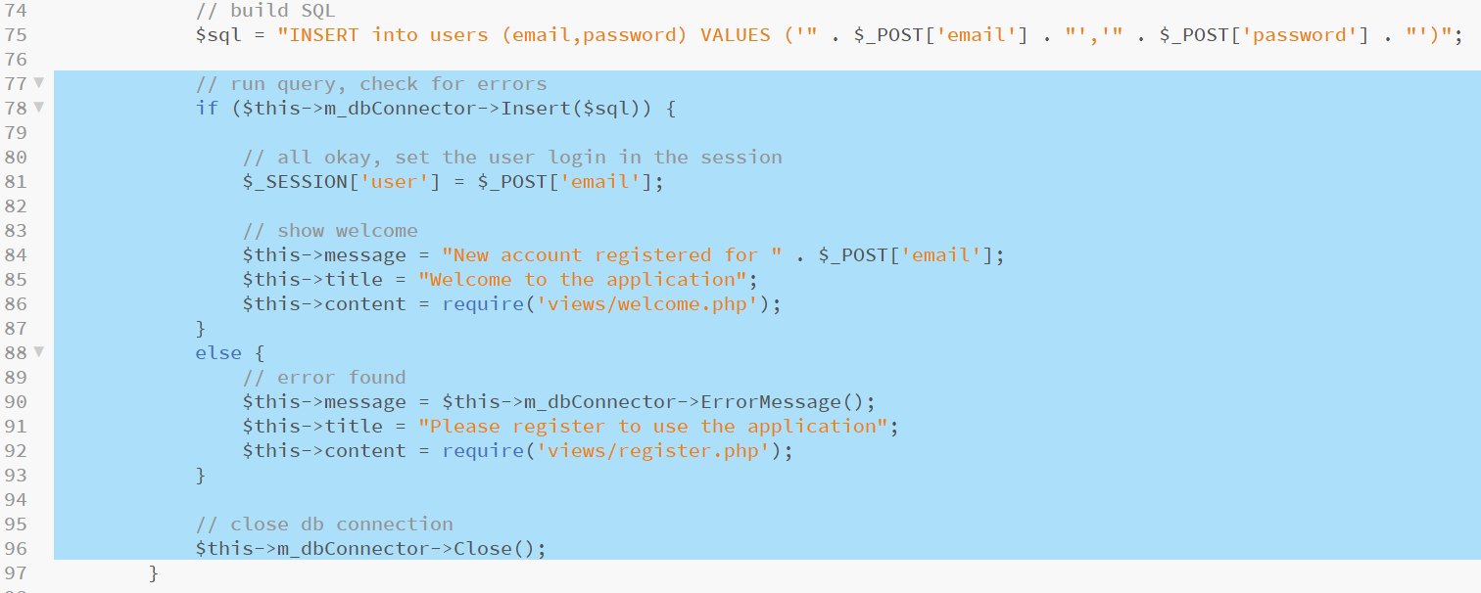
Registering a new user
Add the highlighted code to the end of the doRegister function.
Notes:
Line 79 runs the Insert query and tests the response with an if statement
If the response is true, Line 81 adds the users email to $_SESSION[‘user’] effectively logging them in, then lines 84 to 86 set the $message, $title and $content attributes to reflect a call to the welcome to the application page
If the response is false, Lines 90 to 92 trap the error by calling the ErrorMessage method of DBConnector and setting it in $message, it then sets the view to reflect the registration form content once more.
Line 96 calls the Close method of DBConnector to explicitly shut off the connection to the database

Slide 56
Adding the routing for doRegister
We need a new clause in the Router method of UserController.
In this instance a form submission has occurred which means that data will have been sent to the application using post which is the method set in the HTML registration form.
This form contains a hidden field called action with its value set to register so this is what we check for.
Add the highlighted code to the Router function.

Slide 57
Welcome page view
As we specified a view called welcome.php, we should add it.
This page will be displayed whenever a user is successfully logged in.
The only control we need to add here is a logout control.
Create a new file in the views folder with the filename welcome.php.
Add the following code and save the file.

Slide 58
More routes
We now have accounts that can be logged in so the router needs to trap any request from a user who is already logged in.
We also should add the ability to reverse this with a logout function.
The first check we should make is for a logout request as this supersedes all other requests.*
Next we check if the user is already logged in and load the welcome view if we find that they are.
Add the highlighted code to the Router function in UserController.
Notes:
* If the user requests a logout, that should only be possible from the welcome screen. If they fake it and construct a URL by hand from elsewhere, it doesn’t matter, they aren’t logged in so it won’t have any effect.

Slide 59
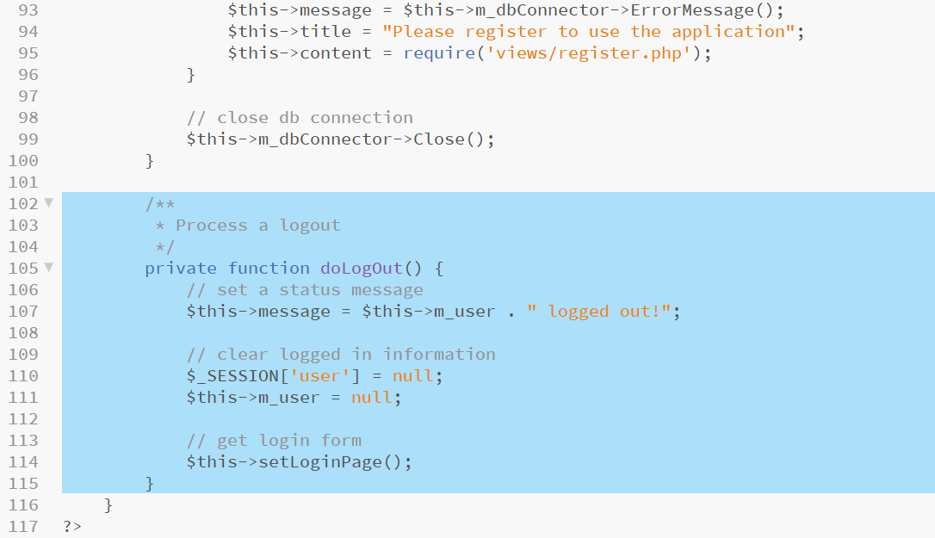
Adding doLogout
The Router now expects a function named doLogout.
This is a simple function which clears any user data from the session and then returns the user to the login form.
Add the highlighted code to the bottom of the UserController class.
Notes:
As we are not doing anything special to the login view we can simply set a status message (this builds a new string allowing us to clear the session information) then we call the existing login form method setLoginPage

Slide 60
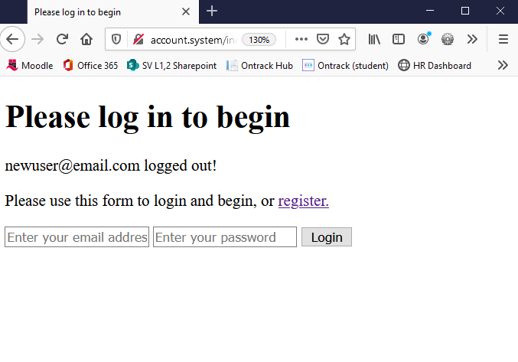
Testing registration and logout
Reload the application in your browser.
Test the registration form, create a new user who should be automatically logged in (we still cannot use the login form at this point).
Test the logout control.

Slide 61
Login function
The last element to include is the application logic behind a login request for an existing user.
First we need to add a route for a detected submission from the login form which inspects the $_POST[‘action’] field similarly to register.
Add the highlighted code to the Router function in UserController to complete the Router function.*
Notes:
*The logic here run as follows:
First we check for a logout as this supersedes all other commands
Next we check for a logged in user, if they are, we will never want to process register or login
Next we check for a request for the registration form, if found we display it
Next we check for either of the form submissions and process the results
Finally, if nothing else is true, we display the login form

Slide 62
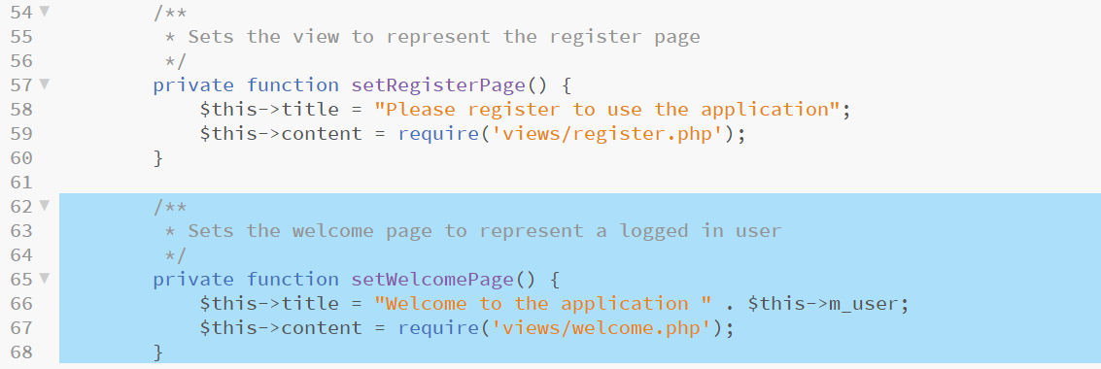
Adding setWelcomePage
The already logged in route specifies a function called setWelcomePage.
This is another small function which simply returns a view similar to setRegisterPage and setLoginPage.*
Add the highlighted code to implement this function.
Notes:
* I have added my function near setRegisterPage and setLoginPage for readability, in actual fact it doesn’t matter where in the class it is placed as long as it is contained in the UserController class

Slide 63
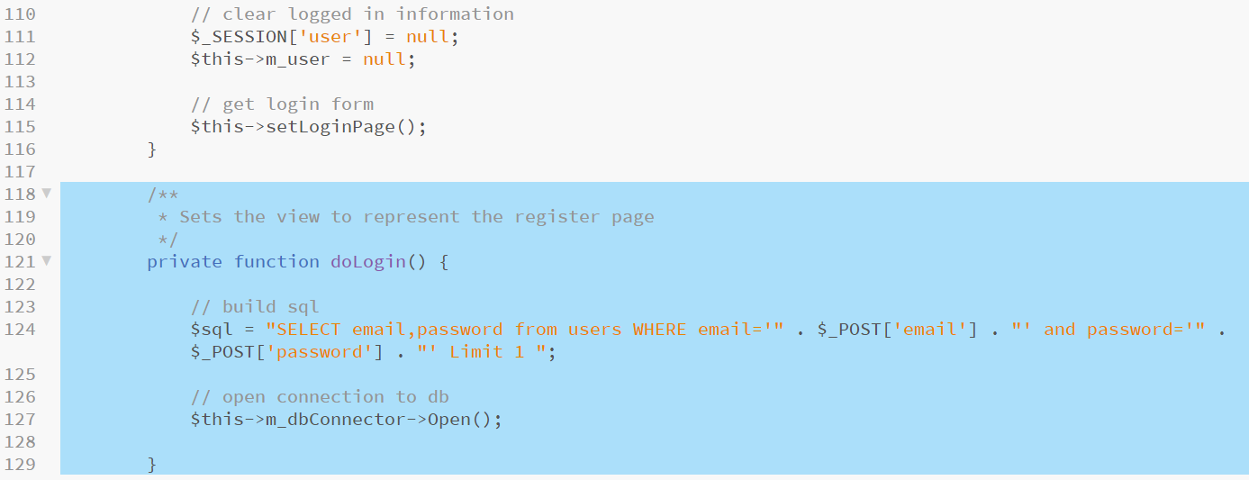
Adding the doLogin function
Start by building an SQL statement to retrieve the user record from the database using both their username and password (if a record is returned, they have the right details and should be allowed to log in).
Next open a connection to the database using the DBConnector object.
Add the highlighted code to the end of the UserController class.
Notes:
The SQL statement uses a few clauses –
SELECT indicates that we want a record set returned – this record set only needs to include the email and password fields as these are specified
WHERE indicates that we are passing an email and a password into the database to see if any records that we have their match the supplied data
LIMIT specifies that we want a maximum of 1 result (we could have made email a unique field in the database as well but as we haven’t we should entertain the possibility that we have more than one account with the same email)

Slide 64
Adding the doLogin function
Run the SQL query using the Select method of DBConnector.
Store the response in $result.
Check how many rows (records) are returned (should be either 0 or 1).
If no records are returned, the login has failed, set $message, call the login form view with doLoginForm and exit the function with return.
Whether successful or not, close the DB connection.
The code for this stage is on the following slide.

Slide 65
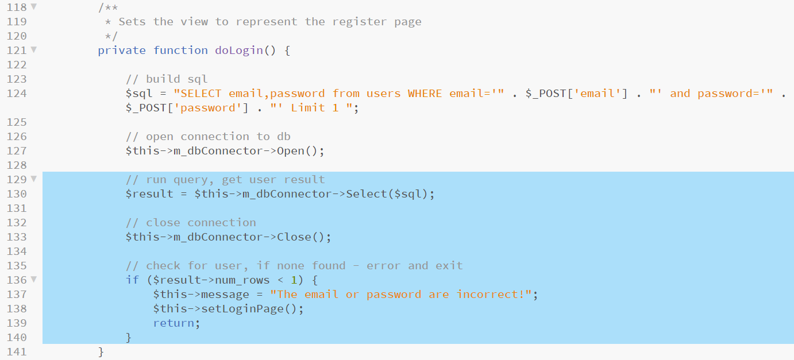
Adding the doLogin function
Add the highlighted code to the doLogin function block.

Slide 66
Completing the doLogin function
Finally, we deal with a successful login.
We convert the returned record to an associative array.
We take the email from the returned record (safer) and add it into $_SESSION[‘user’] as well as set it in $this->m_user to indicate that this user is logged in.
Finally we draw the welcome view with setWelcomePage and set the successful login message in $message.
The final block of code to add is on the following slide.

Slide 67
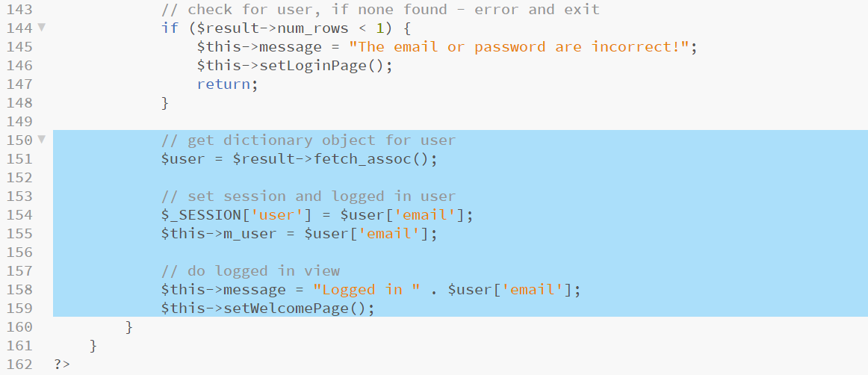
Completing the doLogin function
Add the highlighted code to the bottom of the doLogin function.

Slide 68
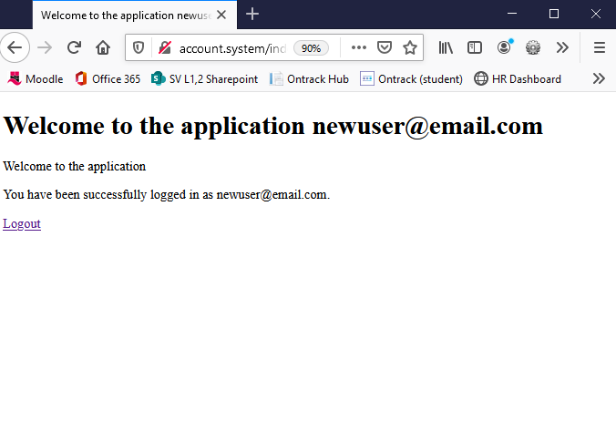
Final tests
Reload the browser and try to log in with an existing user account.
Remember to test both correct and incorrect data to make sure that incorrect account details are rejected.

Slide 69
Extensions
The issue with this project is that we save user passwords into our database in plain text – this is an obvious security flaw.
Research one-way hash encryption techniques used in PHP and convert the application to store only encrypted passwords.
Note: two-way encryption techniques are also possible in PHP but if the string can be unencrypted it is less secure and should not be used for known data such as passwords.

Slide 70
Project review
Web Services serve database information through an API.
This API is often driven by a server-side framework (Laravel, etc).
PHP frameworks commonly employ an OOP approach which is structured using an MVC design pattern or something very close to it.
This account system project uses something akin to an MVC and OOP approach whilst strengthening understanding of previous topics such as connecting to a MySQL database using PHP.
We started this unit with a gentle introduction to server-side coding
We have built experience, knowledge and understanding to the point that we now know enough to start using a server-side framework.
Next week we will install and configure Laravel.
Please make sure that you have Composer installed in readiness.

Slide 71
Session review
BSc Applied Computing

Slide 72
Recap
Recap PHP and MySQL connectivity
Last exercise progress
Reading list
Stateful vs RESTful
Use of the PHP session
PHP and Object-orientation
PHP and OOP
Namespace and foldering
Using a specific class
MVC and frameworks
Simple OOP user account system
Project setup
Project development workshop

Slide 73
Any questions?
Next…
PHP frameworks, an introduction to Laravel

