Slide 1
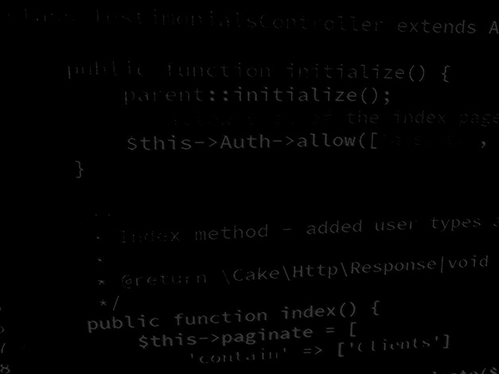
Server-side coding with PHP and Laravel Learning PHP #3 – Connecting to a MySQL database
BSc Applied Computing

Slide 2
In this session…
Recap Stateful vs Restful and the PHP Session
Last exercise progress
Reading list
Stateful vs RESTful
Use of the PHP session
Database-backed web applications
Why link to a database?
Which databases can PHP access?
Introduction to MySQL
Using PHPMyAdmin to set up a simple database
Tasks list application
Project setup
HTML (no need for CSS this week, add it if you must!)
PHP logic

Slide 3
Recap Stateful vs RESTful
BSc Applied Computing

Slide 4
Quick recap
PHP can access an area of the webserver’s memory known as the session.
A cookie is saved to the browser that the webserver recognises when subsequent requests are made and this grants access to data saved in the session for that user.
Session cookies usually last until the browser is closed but can be made to expire more quickly if desired.
An application which uses a session cookie and the session to store information is know as “stateful“.
In stateful applications the response to a request will depend on the current ‘state’ of the application and it’s relationship to the client.
State is determined by things like authentication status, location etc.
The opposite paradigm is known as RESTful.
RESTful applications always respond to the same request with the same response as they are stateless applications.
Many APIs apply the RESTful model.
APIs are what drive web services.

Slide 5
Database-backed web applications
BSc Applied Computing

Slide 6
Why connect to a database?
Does your site’s content change frequently? If the content of your site changes dramatically from day to day, a database can ease the administration of the site. […]
Does your business use ecommerce extensively? Like scores of other Web-based companies, the survival of well-known retailer Amazon depends upon a database driven Website. Details of each product they sell, including prices, descriptions, reviews and similar or complementary products, are stored in the database. […]
Does your site employ user-driven content? In the last couple of years the Internet has seen an increase in the range of sites driven by user-contributed content. Many Websites now utilise user content to varying degrees. For example, many sites provide mechanisms by which visitors can engage in discussions about topics that are related to the site’s purpose. This feedback can take many forms – user forums or discussion boards, feedback forms, and invitations for ‘comments’ or ‘reviews’.
Sitepoint

Slide 7
Which databases can PHP use?
The official list includes: CUBRID, DB++, dBase, filePro, Firebird/InterBase, FrontBase, IBM DB2, Informix, Ingres, MaxDB, MongoDB, mSQL, Mssql, MySQL, Oracle, Paradox, PostgreSQL, SQLite, SQLSRV, Sybase, tokyo_tyrant.
The actual list is much larger as community drivers exist for more niche databases such as Neo4J or Cassandra and can easily be added to projects with Composer.
I will be using MySql for the examples in this unit.
If you prefer to use something else for your application build – fine!
One way towards a high grade in this unit is to demonstrate a deep understanding of the topic by using your choice of appropriate technology elements and making them work for you.
Notes:
https://www.php.net/manual/en/refs.database.php
https://getcomposer.org/

Slide 8
MySQL (and MariaDB)
MySQL is the database server that we will use for these sessions.
To access it, a user account, password and the name of the database to be queried are all required.
MySQL accepts data queries in the SQL language.
XAMPP list the installed DB as MySQL, in fact it is likely to be MariaDB.
MySQL is owned by Oracle (since 2010), MariaDB is a fork in MySQL development started by MySQL developers after the Oracle takeover.
MySQL and MariaDB are interchangeable, they have the same syntax, processes and structure (binary replacements).
MySQL is now proprietary and supported by Oracle, MariaDB remains open source and free for all.
Any further reference to MySQL will also be referring to MariaDB.
Notes:
https://www.mysql.com/
https://blog.panoply.io/a-comparative-vmariadb-vs-mysql
https://dev.mysql.com/doc/refman/8.0/en/sql-statements.html

Slide 9
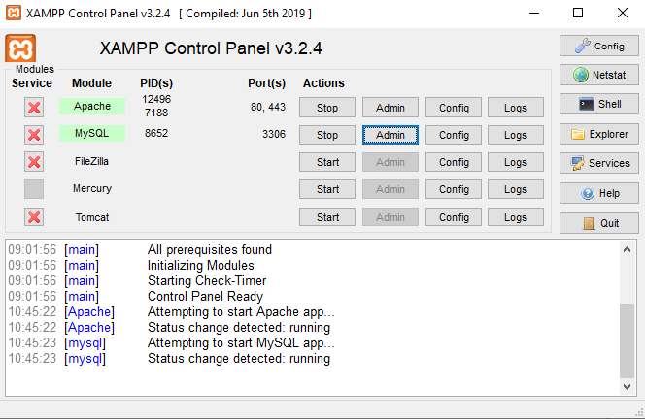
MySQL and PHPMyAdmin
As MySQL is a database server, it does not include a management interface of any sort (these take up memory).
Luckily XAMPP comes bundled with a PHP MySQL management interface known as PHPMyAdmin.
PHPMyAdmin can be launched from the XAMPP control panel.*
Notes:
* Please make sure that both Apache and MySQL are started before trying to use PHPMyAdmin
https://www.phpmyadmin.net/
https://www.mysql.com/

Slide 10
Database design
Before we set up any databases or tables, it is a good idea to design what we need for the application we are developing before we begin.
Planning database design with ERDs and data dictionaries can save many headaches and much refactoring later on.
This is a simple project and only requires one table called tasks which will be setup according to the following diagram.
Column | Data type | Key | Default value
id | Big Int | Primary | NA
description | Varchar (128) | NA | NA
completed | Boolean | NA | False
created | DateTime | NA | Current timestamp
who | Varchar (128) | NA | NA

Slide 11
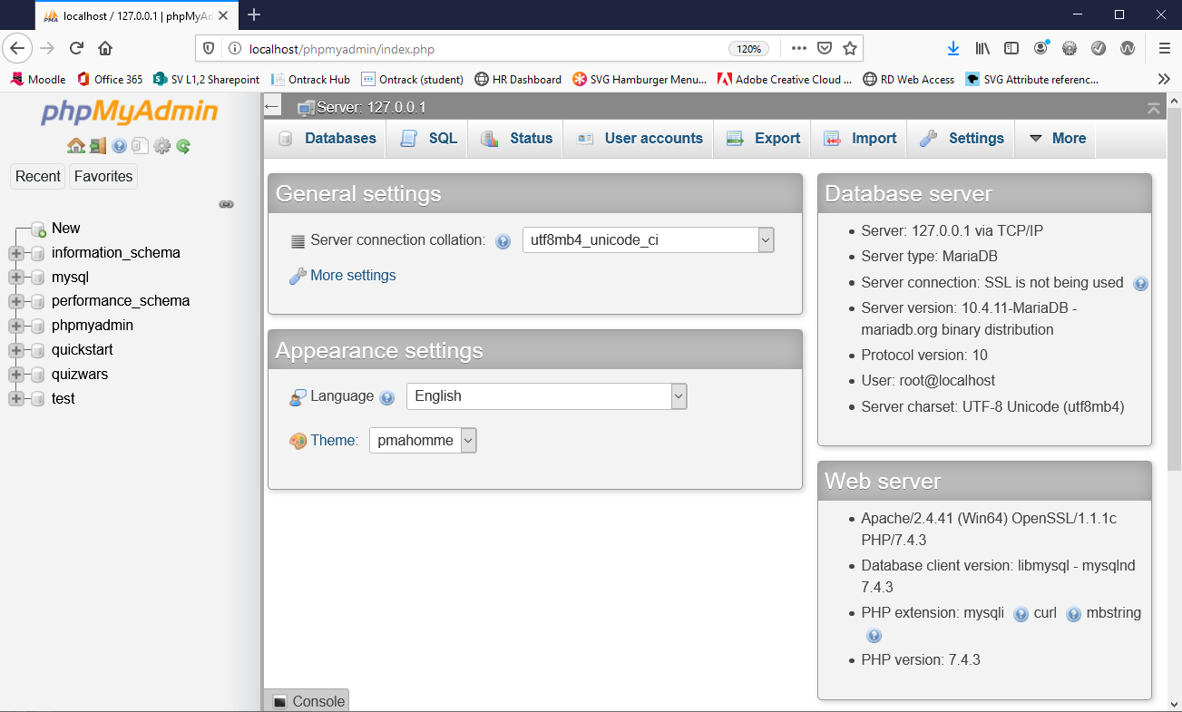
Setup the tasks table
Open PHPMyAdmin.

Slide 12
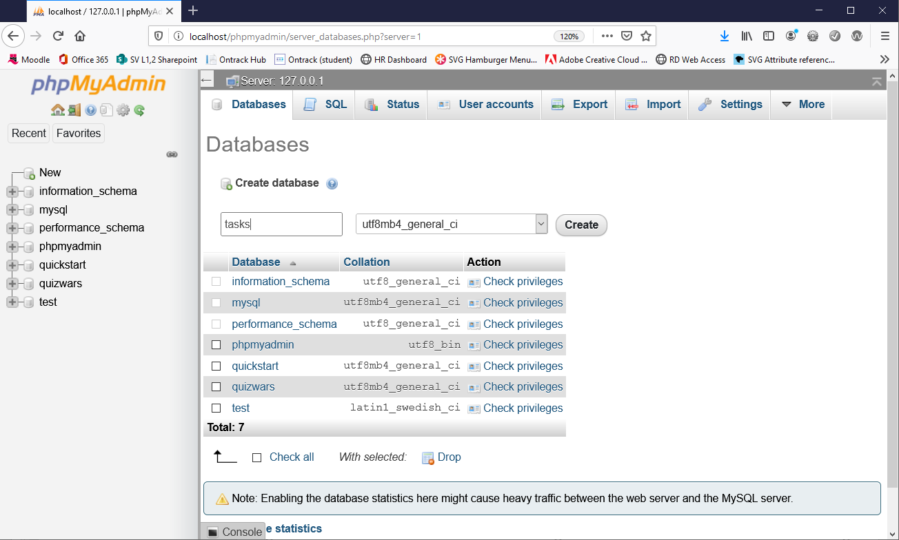
Setup the tasks table
Use the new control at the top of the left-hand list of databases.
Enter the name tasks as shown below then press the create button.

Slide 13
Setup the tasks table
We are prompted to create a new table.
Enter the name tasks and set the number of columns required to 5 (we know this as we have already planned the data design).
Press Go.

Slide 14
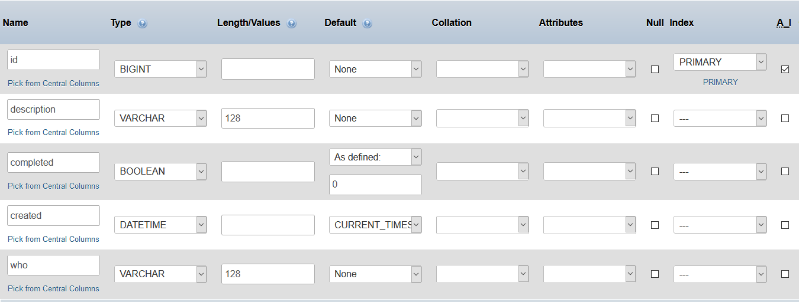
Setup the tasks table
Enter the column names, data types and defaults for this table as shown.
Note: make sure to check A_I (auto increment) on the id row, this will in turn set this column as the primary key for this table.
Use the save button to complete the table setup.
Notes:
completed is set as a Boolean but the default data is set as 0
This is because Boolean value of false often equates to numeric value of 0 in many programming languages and applications – true equates to numeric value of 1

Slide 15
Double check the tasks table
We are presented with a view of our new table structure.
Take a moment to check that everything is correct.
Use the change control as needed if mistakes have been made.

Slide 16
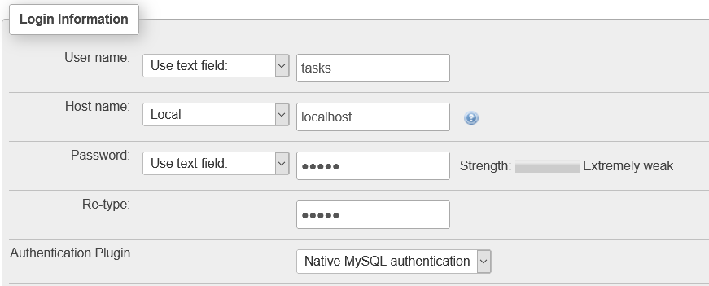
Adding a user account for Apache
Apache needs a user account for MySQL just like any other user.
Select the Privileges tab and use the Add user account control.
Setup the new user with username and password of tasks.*
Set Host name to localhost.**
Scroll right down and use the go button.
Notes:
* This is very weak but this is only our dev server and won’t hold any real data that anyone can exploit – as a result, I favour remember-ability over security
** this is IMPORTANT!!!!!

Slide 17
Tasks list application project
BSc Applied Computing

Slide 18
Setup
You should create a new virtual host for this project (use the instructions from week 1 if needed)
Project folder: TasksList
Project URL: tasks.list
This tutorial will use the Brackets editor.
All new code will be highlighted, other code will be included to indicate placement of new code only and should not be entered.
PHP can use // or # to indicate a comment.
This tutorial will use // for all comments.
Further explanation of code is included in the notes pane of specific slides.

Slide 19
Starting out
Right click the project folder and select Open as a Brackets project.
In the left hand area of Brackets, right click, select new file.
Name the file index.php.
Add in the simple HTML code shown on the next page.

Slide 20
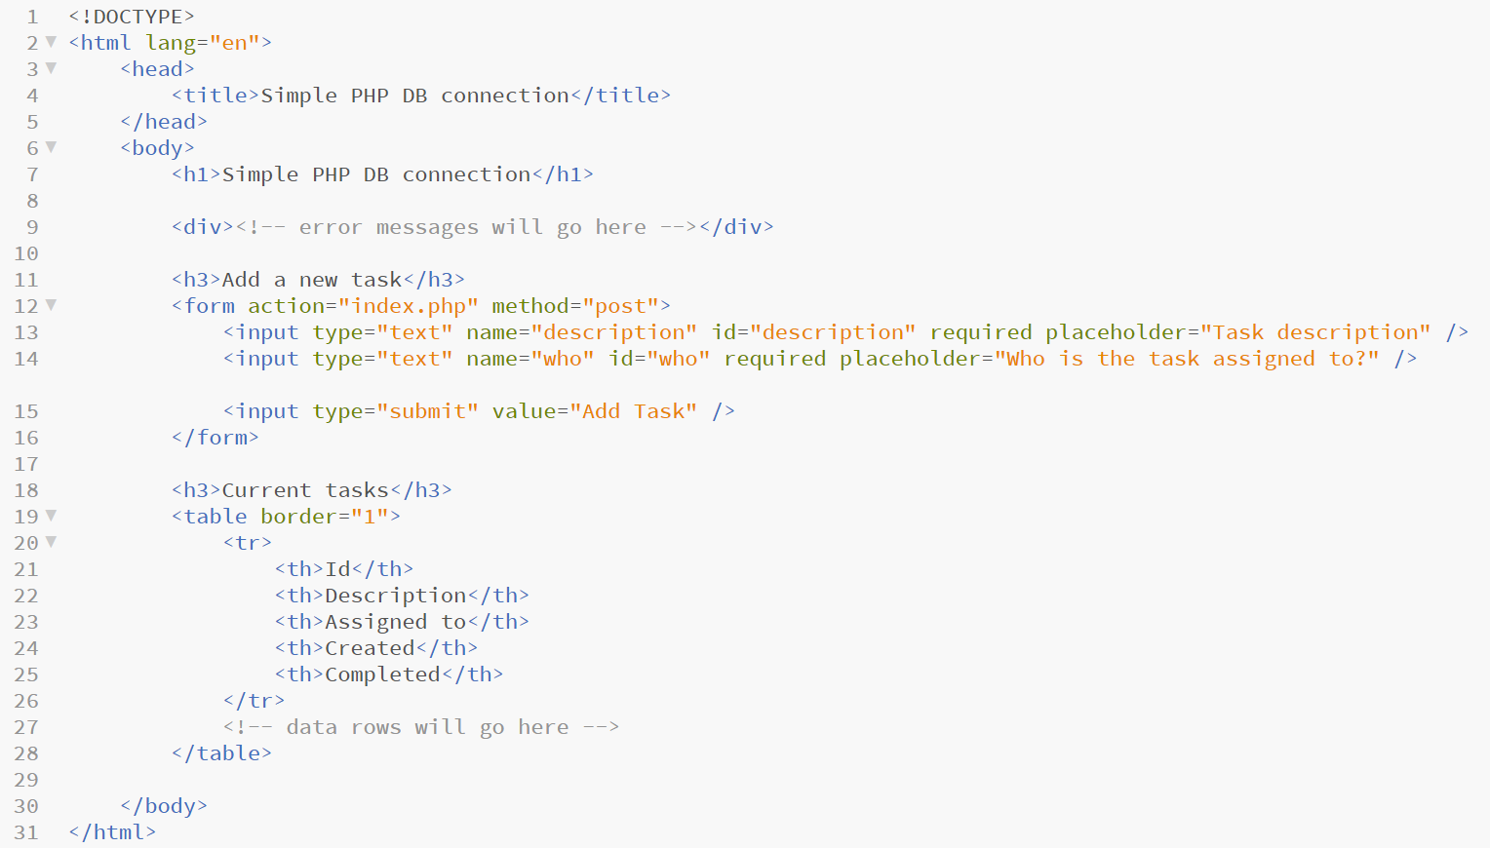
Project HTML

Slide 21
PHP block and DB authentication
Add in a PHP block and set 4 global variables.
These 4 string variables contain the MySQL account information that we set up for the webserver.
Add the highlighted code to the top of the file.

Slide 22
Tracking errors
Sometimes errors occur when communicating between servers.
The application needs somewhere to hold and display database errors so that the user is aware of anything that goes wrong.
We will use a global string variable $errorText to hold the specifics of any errors generated.
We will initially set the data in $errorText to null.
This allow us to easily check if errors have occurred in the page itself by testing if ($errorText != null).
Add the highlighted code and comment.

Slide 23
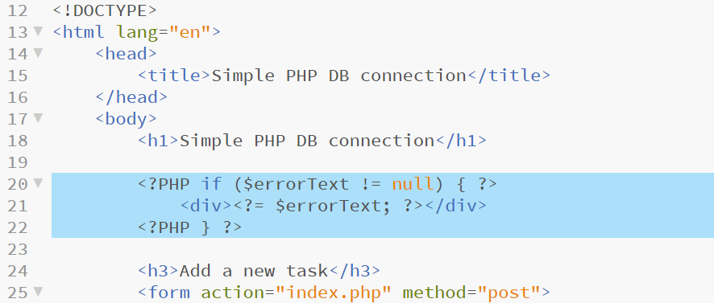
Tracking errors
Now we add the logic to the HTML to draw the error messages in the event that we get any.
Add the highlighted code, replacing the <div> </div> and comment.

Slide 24
Making a connection to MySQL
We make a connection to our MySQL using the mysqli method (XAMPP compiles MySQL drivers into PHP during install).
This instantiates a new mysqli connection object, a reference to which is stored in $connection.
Next add a test for connection errors and report any we find.
Add the highlighted code.
Notes:
$connection is passed the account data that we added to the page on slide 22
Line 15 tests our newly established connection for issues
If issues are found, line 16 copies the error into $errorText to replace the null value and so be drawn into the HTML page with the block coded on the previous slide

Slide 25
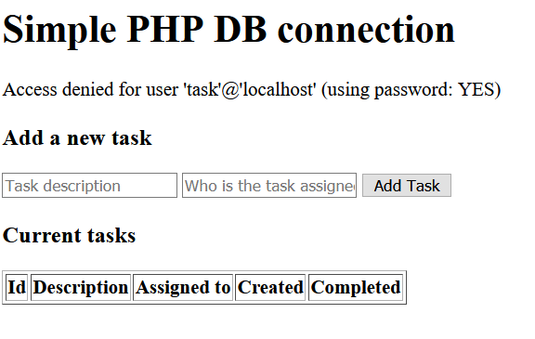
Testing the connection
Open your web browser and type the URL for the project http://tasks.list
The page should load with no errors
To test thoroughly, alter the data in one of the variables sent to connection and refresh the page in the browser, the connection should fail and an error should be drawn into the page (make sure that you change the data back afterwards)

Slide 26
Adding data to the database
We want the HTML form in the page to record the data which will be sent to the database.
The form uses the post method so any new data will be found in $_POST.
This means that we can check to see if data has been submitted to the application using the same method that we have been using in the previous projects.
Add the highlighted code to check for submitted data.

Slide 27
Adding data to the database
In order to add the data to the database, the data from $_POST has to be added into an SQL statement.
The easiest way to do this is to compile a string which contains the SQL query statement.
The SQL is run by using the query method of the $connection object.
The query method returns a Boolean indicating success (true) if the insert succeeded, or failure (false) if it didn’t.
Add the highlighted code below.
Notes:
Note: to access attributes or methods contained in a PHP object we use the arrow identified -> . This is dissimilar to many other languages (Java, C#, JavaScript) which use a .
Another Note: taking user input like this and running it directly on the database without first sanitising it is very risky in a live system!!!
See Input Sanitisation here: https://www.esecurityplanet.com/browser-security/prevent-web-attacks-using-input-sanitization.html
If the form contained values of description=“shopping” and who=“me”, the SQL statement above would read: INSERT INTO tasks (description, who) VALUES (‘shopping', ‘me')
This statement can be run directly against our database in PHPMyAdmin if issues persist
We do not need to add data for the completed, created or id columns. Id is an auto number so will simply pick the next available number, completed and created both have default values set so the database will use those as none are specified in the query

Slide 28
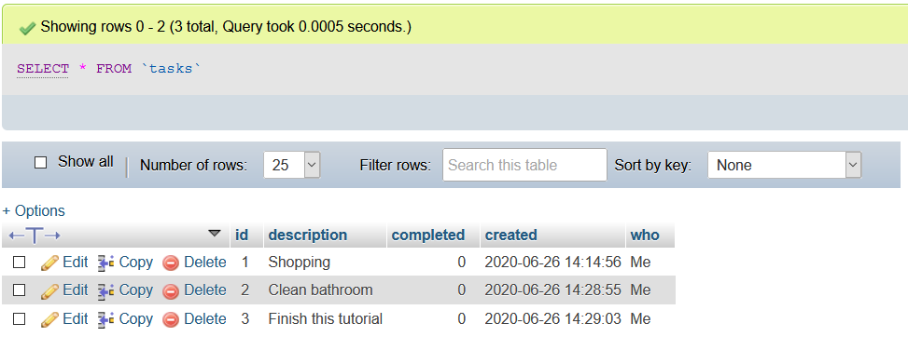
Testing the form
Reload the page in the browser.
You should now be able to use the form to add data to the database.
You cannot see this in the page yet so check in PHPMyAdmin and you can test that data has been added to your table.

Slide 29
Displaying the data in HTML
Next we should retrieve all existing data from the table, order it and display it in the HTML page.
Again we use $connection->query and pass an SQL string.
This query is a select so it returns an array of data rather than a Boolean.
Finally, we close the connection freeing up memory and resources.
Add the highlighted code.
Notes:
In actual fact, $alltasks will contain an array of associative arrays
So getting the description of the first task could be addressed as $alltasks[0][“description”]

Slide 30
Displaying the data in HTML
Now that we have a collection of data to display we loop over it with a foreach loop building a table row with each new record.
The final column contains a ternary operator (which is a condensed if / else block) which makes the Boolean data look a little nicer.
Add the highlighted code.
Notes:
In actual fact, $alltasks will contain an array of associative arrays
So getting the description of the first task could be addressed as $alltasks[0][“description”]
Ternary operator in PHP - https://www.php.net/manual/en/language.operators.comparison.php

Slide 31
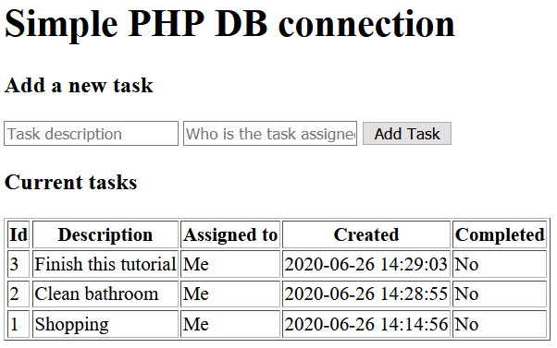
Testing the table
Reload the browser.
Any data previously entered should now appear in the page.

Slide 32
Fixing the date
The created column looks clunky so we should make the date time data look nicer with the PHP date_format method.
This method needs a PHP date object, luckily we can create one of these easily using the data_create method and passing it the date time value from the database, $r['created’].
The date_format object also needs to know what data we want to display, in this case we pass a format string of "jS M Y, g:i a“.
Amend the code in the created column as shown highlighed.
Notes:
date_format manual here - https://www.w3schools.com/php/func_date_date_format.asp
The string format "jS M Y, g:i a“ is:
j = day of the month without a leading zero (1-31)
S = The English ordinal suffix for the day of the month (2 characters st, nd, rd or th. Works well with j)
M = A short textual representation of a month (three letters)
Y = A four digit representation of a year
g = 12-hour format of an hour (1 to 12)
i = Minutes with leading zeros (00 to 59)
a = Lowercase am or pm
The comma and the colon are just a comma and a colon and get printed into the string as such

Slide 33
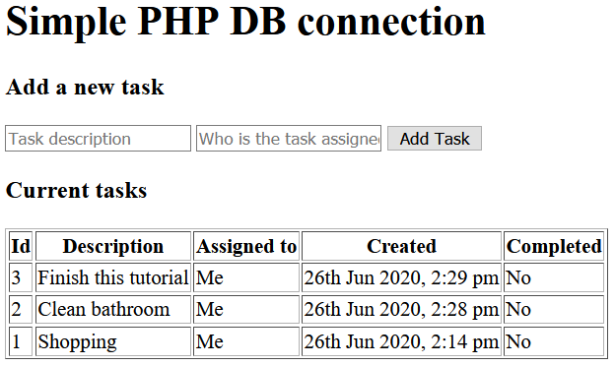
Testing the date format
Reload the browser.
The Created column should display a little more readably.

Slide 34
Setting a toggle on completed
The last thing that is needed is to indicate that the task is completed.
For this we will use a hyperlink and a get parameter, similar to the technique used for the noughts and crosses game last session.
First we add the hyperlink to the final table column, this will link back to this same page and send 2 items of data, the id of the task and its current status of completeness.
Add the highlighted code around the previous code.
Notes:
We keep the ternary that we were using as we still need the word to display, we are simply adding a hyperlink around it

Slide 35
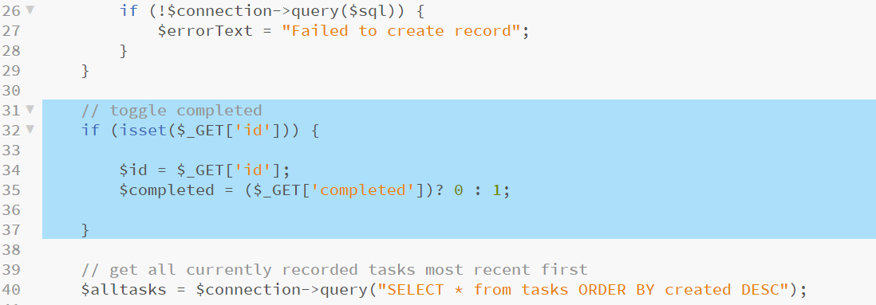
Adding the completed logic
Add another if block and this time test if the $_GET[‘id’] parameter has been sent.
If it has record the id sent and use another ternary to toggle the value in $_GET[‘completed’] and save in $current.
Add the highlighted code.
Notes:
The ternary looks complex but isn’t
If $_GET[‘completed’] = 0 then the test will fail, the second element in the ternary will run and $completed will = 1
On the other hand, if $_GET[‘completed’] = 1 then the test will pass and the first element in the ternary will run, $completed will = 0
This is a simple way of reversing a Boolean in PHP which is essentially what we are trying to do here

Slide 36
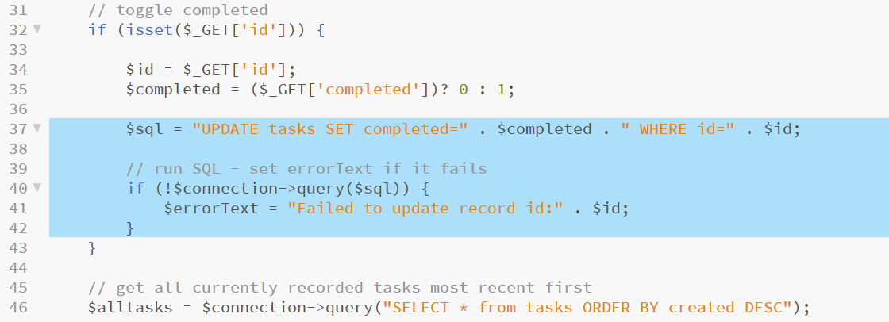
Updating the task record
Next we compile a new SQL query string (update in this instance) and run it against the database checking for errors as before.
Add the highlighted code.

Slide 37
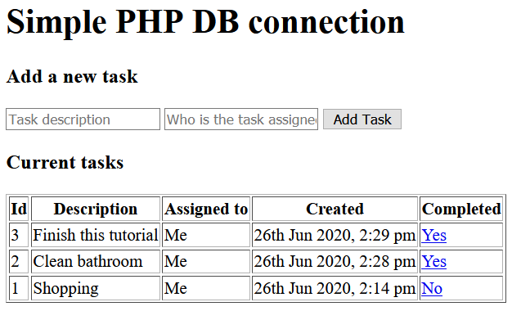
Testing the application
This last step completes this simple application!
Reload the browser and try toggling the completed status of some tasks.
Observe how this changes the records in the tasks table in PHPMyAdmin.

Slide 38
Extension
Investigate ways in which the data collected sent to this application could be sanitised before being added to SQL statements.
Implement whichever of these input sanitisation methods seems most appropriate for this application.
Test with potentially destructive data (possibly intercept this before it does any real harm!).
Key terms to search:
Input sanitisation
SQL injection

Slide 39
Project review
XAMPP bundles mysqli interface in PHP.
PHP can use many database types.
Drivers are required and can be included into PHP at install or later.
Drivers can be obtained via Composer.
XAMPP comes with the PHPMyAdmin management console.
MySQL requires a user account for the webserver to connect with.
We have reinforced use of PHP to data and added:
Manually setting up a MySQL database
Setting up a database account for the webserver to use
Use of the mysqli object to connect to this database
Simple SQL statements composed in PHP and run using mysqli->query()
Contextual return types
Trapping database errors
Iterating over data collections

Slide 40
Session review
BSc Applied Computing

Slide 41
Recap
Recap Stateful vs Restful and the PHP Session
Last exercise progress
Reading list
Stateful vs RESTful
Use of the PHP session
Database-backed web applications
Why link to a database?
Which databases can PHP access?
Introduction to MySQL
Using PHPMyAdmin to set up a simple database
Tasks list application
Project setup
HTML (no need for CSS this week, add it if you must!)
PHP logic

Slide 42
Any questions?
Next…
Object-oriented PHP (good programming practice!)

