Slide 1
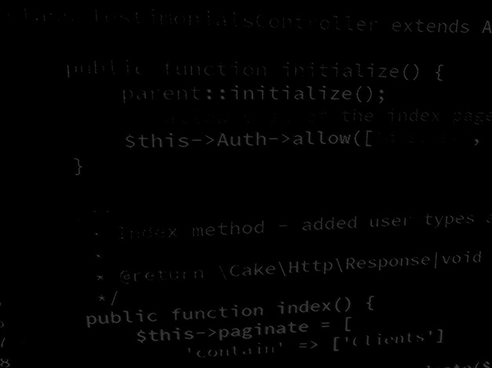
Data handling in Application development Load and save unstructured data – Notepad project
BSc Applied Computing

Slide 2
In this session…
Session Rationale
Unstructured data
Save and load data flow
File input / output streams
Notepad project
Step by step code with explanations

Slide 3
Session rationale
BSc Applied Computing

Slide 4
Unstructured Data
“Unstructured data is information that is not arranged according to a pre-set data model or schema, and therefore cannot be stored in a traditional relational database or RDBMS. Text and multimedia are two common types of unstructured content.“[1]
Unstructured data usually has meaning for the creator.
A good example of unstructured data is plain text files. *
[2]
Notes:
1: MongoDB. Unstructured Data. Available at: https://www.mongodb.com/unstructured-data. Last Accessed: 27/6/22
2: Mesevage, T. Structured vs Unstructured Data. Available at: https://monkeylearn.com/blog/structured-data-vs-unstructured-data. Last Accessed: 27/6/22

Slide 5
Save and load data flow
Options for storing and amending information are vast.
Probably the simplest is:
Load data from a file to memory.
Process data and save back to memory.
Replace the contents of the data file with the data in memory.
This process means that the live data is either stored in the file when the application is not in use, or in memory while it is.

Slide 6
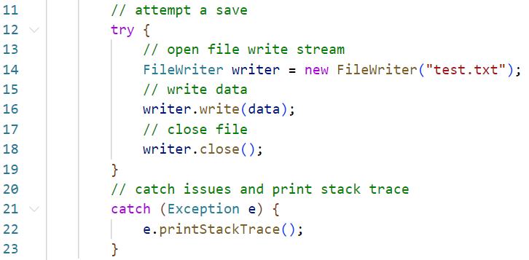
File input and output streams
Java uses system of streams based around Reader and Writer classes for all input and output.
When saving files, we will use FileWriter. [3]
Notes:
3: Programiz. Java FileWriter Class. Available at: https://www.programiz.com/java-programming/filewriter. Last Accessed: 27/6/22

Slide 7
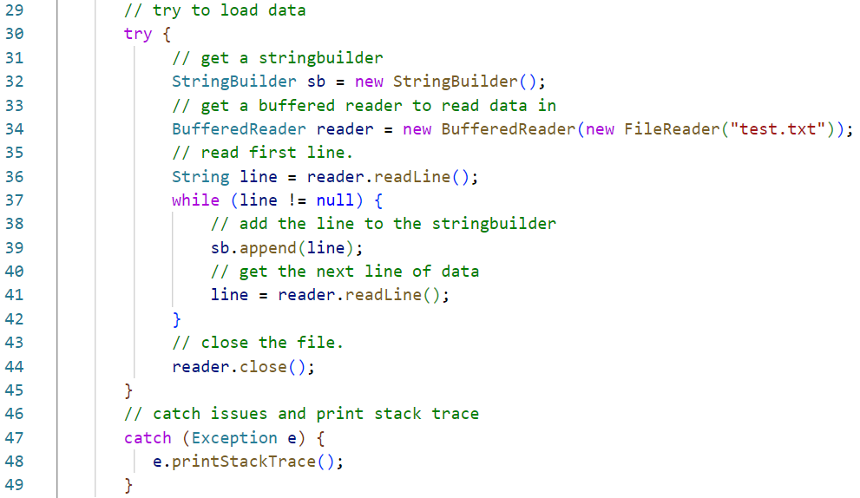
File input and output streams
When loading files, we will use FileReader and BufferedReader. [4],[5]
Notes:
4: Programiz. Java FileReader Class. Available At: https://www.programiz.com/java-programming/filereader. Last accessed: 27/6/22
5: Programiz. Java BufferedReader. Available At: https://www.programiz.com/java-programming/bufferedreader. Last accessed: 27/6/22

Slide 8
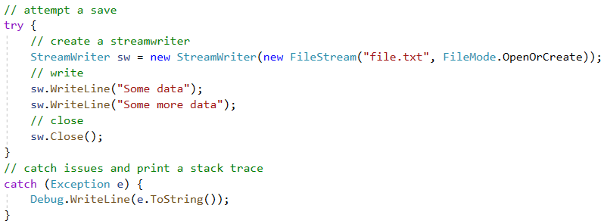
File input and output streams
These classes are very similar in approach and operation to the C# equivalent, StreamWriter and StreamReader. [6],[7]
Any experience with these classes should render the Java process reasonably familiar.
The following is a StreamWriter example blob from a C# project.
Notes:
6: Microsoft. StreamReader Class. Available at: https://docs.microsoft.com/en-us/dotnet/api/system.io.streamreader?view=net-6.0. Last Accessed: 27/6/22.
7: Microsoft. StreamWriter Class. Available at: https://docs.microsoft.com/en-us/dotnet/api/system.io.streamwriter?view=net-6.0. Last Accessed: 27/6/22.

Slide 9
Notepad project
BSc Applied Computing

Slide 10
Notepad rebuild
This project will build a simple text editor application.
This will load and save unstructured text files with a .txt file extension.
Project start up:
Open VS code
Use CTRL+SHIFT+P or View > Command Palette…
Select Java: Create Java Project… (select No Build Tools if prompted).
Select a suitable development folder
Add the project name NotePad

Slide 11
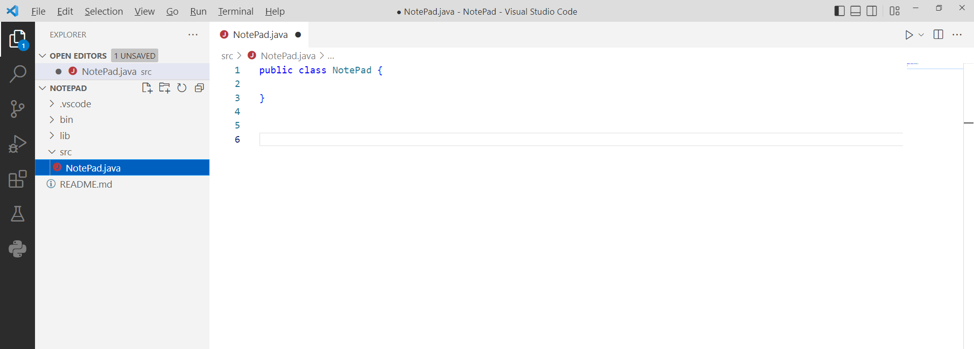
Create a new class
Add a class for the NotePad app to the src directory by opening the Command Palette* and selecting Java: New Java Class.
Give the new class the name NotePad.
In the Explorer panel, delete the default App.java file.
Notes:
* The command palette can be opened with either CTRL+SHIFT+P or View > Command Palette…

Slide 12
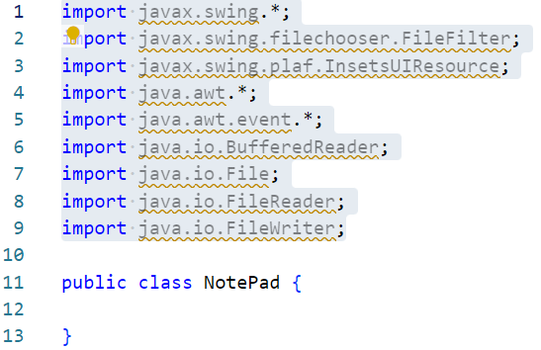
Import libraries
This project will use a number of libraries including Swing and AWT to draw the UI as well as a number of the IO classes to handle loading and saving data to files.
Add the highlighted import statements to the NotePad.java class. *
Notes:
* Ignore the green warning lines for now. These are simply telling us that these classes and libraries have not been used in the app yet… we will add instances of them as we go.

Slide 13
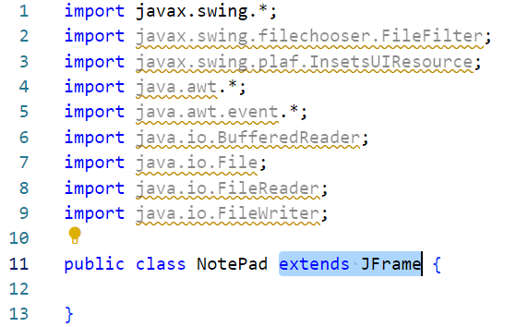
Extend JFrame
This project will use Swing to draw the user interface.
The root of a Swing interface is the JFrame class.
We will extend JFrame to make the process of building the UI simpler.
Add the highlighted extends statement to the class definition.

Slide 14
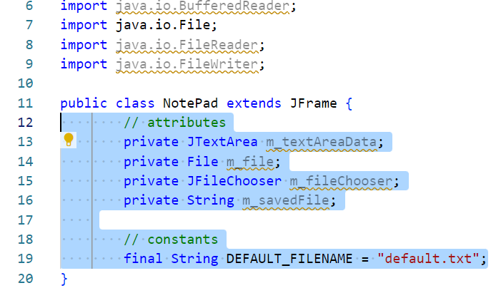
Attributes and constants
The app will need a few attributes and a single constant.
Add the highlighted code. *
Notes:
* Clarification:
Line 13 adds a global reference to the Swing JTextArea object which will be used as the main control of the application. This will allow the editing of the contents of the presently loaded text file.
Line 14 adds a global reference to the currently loaded File object. This is effectively a pointer to the location in the computer’s file system where the presently loaded file can be found.
Line 15 adds a global reference to the JFileChooser object which will be used to browse for a file to open and / or a location to save the presently loaded file to.
Line 16 adds a global reference to the content of the last file loaded when it was loaded. This will be used to compare the content of the JTextArea to before a save to see if any changes have been made and so a save is required.
Line 19 adds a static reference to the default filename that the application will set for new files created by the user (note: static values use all caps in their names in order to more easily identify them).

Slide 15
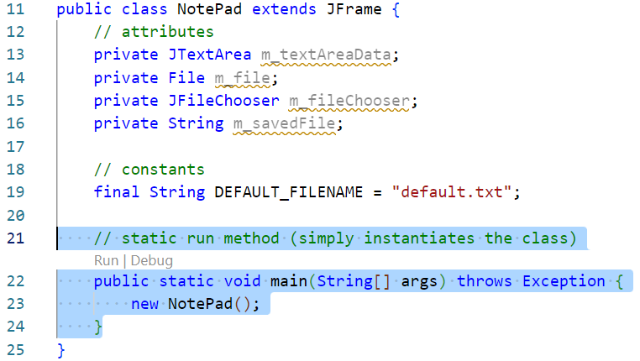
Add a main method
A main method is required for the runtime environment to understand what to do after the app loads.
Add in the following highlighted method. *
Notes:
* Clarification:
Line 22 declares the main method with the standard method signature (name return value, arguments and exceptions thrown).
Line 23 creates a new instance of the NotePad class (which will serve to draw the user interface when we have finished coding the next few methods).

Slide 16
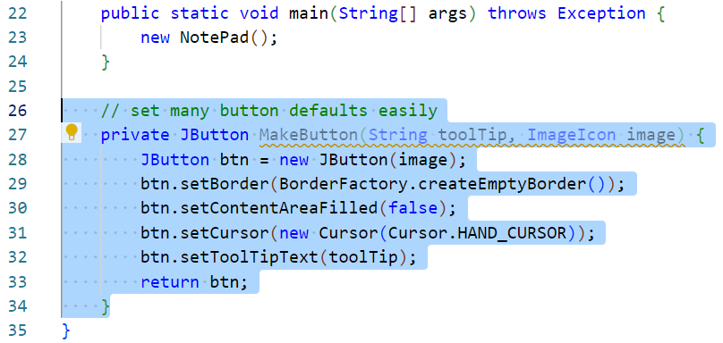
Add a button factory method
This app will need a few icon style buttons and in Swing this means setting more than a few properties.
Creating a factory method will help us create buttons with the same properties easily.
Add the following highlighted method. *
Notes:
* Clarification:
Line 27 declares the MakeButton method. This returns a new JButton and accepts two arguments, the ImageIcon to apply and the tooltip text to apply when the user hovers their mouse over this button.
Line 28 declares a new JButton setting the ImageIcon as the content.
Lines 29 and 30 turn off the default border and default background colour applied to the JButton.
Line 31 sets the user’s cursor to the click-hand icon when hovering over this button (this serves to inform the user that they can click on this button).
Line 32 applies the tooltip text passed to the method in an argument. This is especially important as this control is purely visual. Without the tooltip text, users with no or limited sight would not be able to use this control.
Line 33 returns the new JButton to whichever bit of code calls this method.

Slide 17
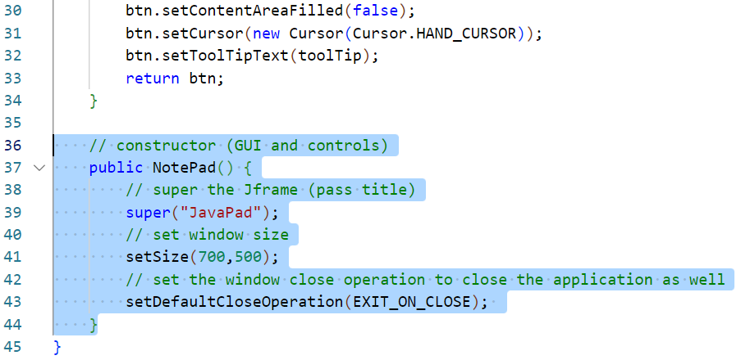
Add a constructor method
A constructor will be called when the class is instantiated, subsequently drawing the UI.
Add the following highlighted method. *
Notes:
* Clarification:
Line 37 declares the constructor method. Constructors never return anything (as they always return a new instance of this class) and this one takes no arguments.
Line 39 uses the super method to call the JFrame class constructor and set the window text for the application.
Line 41 sets the starting dimensions for the application UI.
Line 43 sets the default close operation for the application, which in this case is to close the app and release all system resources when the UI is closed.

Slide 18
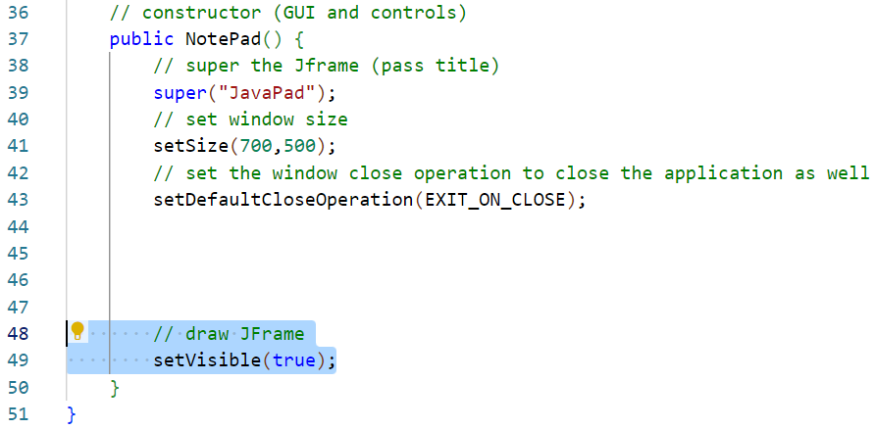
Show the UI
We will add a lot more to this method over the coming slides. For now we will add a statement so that we can check that the code works.
Add the following highlighted statement. *
Notes:
* Clarification:
Line 49 sets the JFrame to visible drawing it onscreen for the user. Leave a gap as we will shorty add a LOT of controls in before this statement. We will do this now just to test the code we have created thus far.

Slide 19
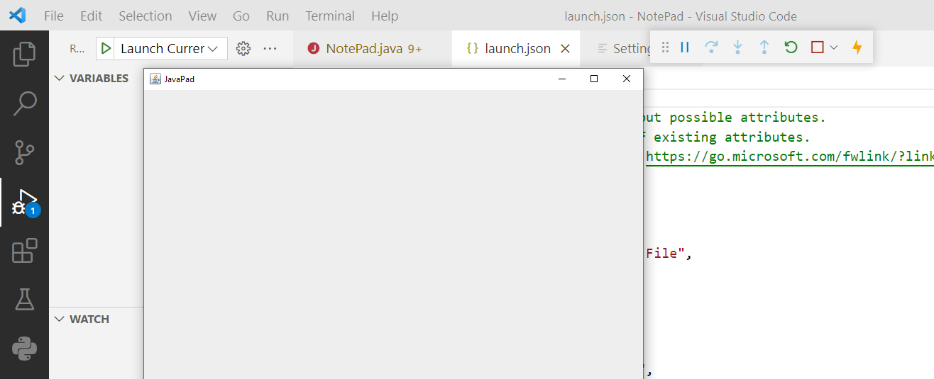
Test the UI
Open the Run and Debug panel, use the create a launch.json file control to build a launch script.
Use the green Start Debugging arrow to run the program.

Slide 20
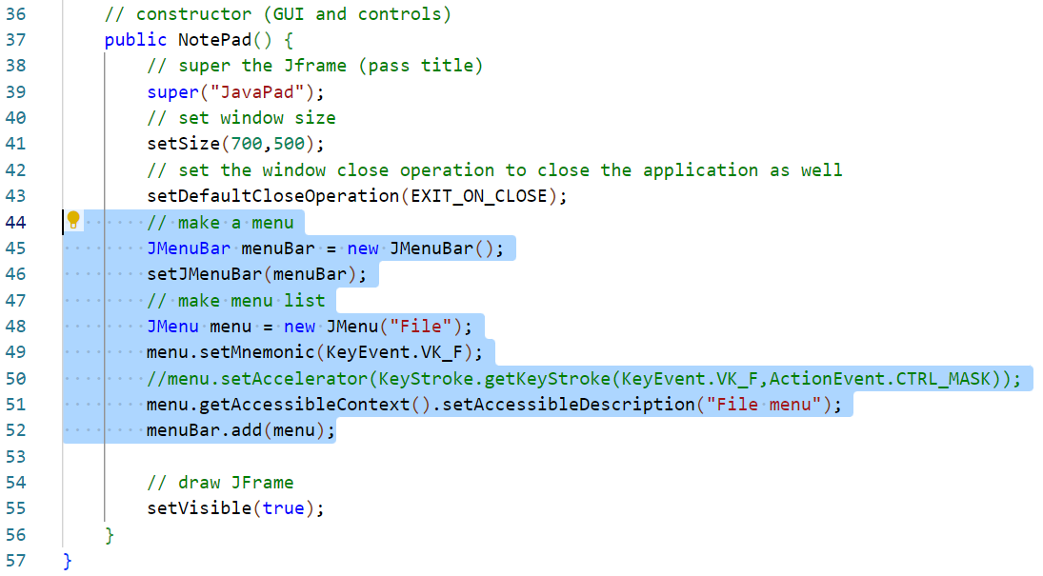
Add a menu
The UI could use a menu.
Add the following highlighted statements. *
Notes:
* Clarification:
Lines 45 and 46 create a new JMenuBar object and set it as the main menu bar for this application.
Line 48 creates a new JMenu a top level menu (like File, Home, Insert and so on are at the top of Powerpoint) and sets its text to File.
Line 49 sets the keyboard shortcut key for this menu to Alt-F.
Line 51 adds some tooltip text for this menu (again, accessibility is important).
Line 52 adds the menu to the application’s menu bar.
Note: you can ignore line 50 as this statement will break the application, which is why it is commented out in this example.

Slide 21
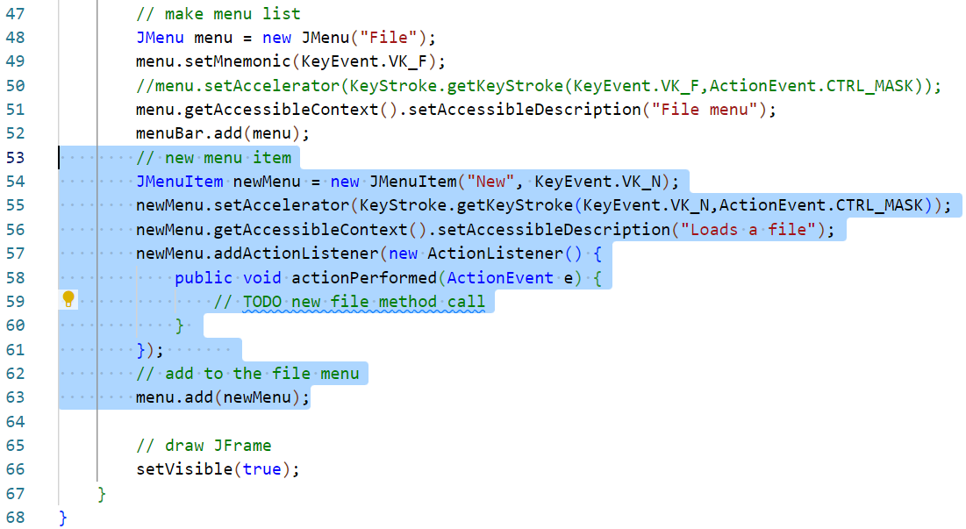
Add a menu item
The menu will need 4 controls, New File, Load File, Save File, Save As…
Add the following highlighted statements. *
Notes:
* Clarification:
Line 54 instantiates a new JMenuItem object, setting the Menu text to New and indicating that the shortcut key for this menu is CTRL-N (this draws the underline under the N to visual demonstrate the shortcut key).
Line 55 sets CTRL-N as the keyboard shortcut for this menu item.
Line 56 sets the tooltip text which is shown when a user hovers the mouse pointer over this menu item.
Line 51 adds some tooltip text for this menu (again, accessibility is important).
Lines 57 to 61 add a new ActionListener to the menu item. Swing controls can each be set to listen for specific user actions. A new ActionListener object is created and within this the actionPerformed method is overridden (this method defines what happens when a core control action, in this case a mouse click, occurs.
Line 59 this is a TODO comment which is a common coding paradigm for an aspect of the code which we intend to come back to and complete later. The TODO acts as a reminder and a marker that we can search for easily. We have not created any of the code to handle a new file call and we will need to call this code from a few places. We will build a method to handle creating a new file after we code the rest of the UI and will come back and replace this TODO then.
Line 63 adds this new menu item to the File menu.

Slide 22
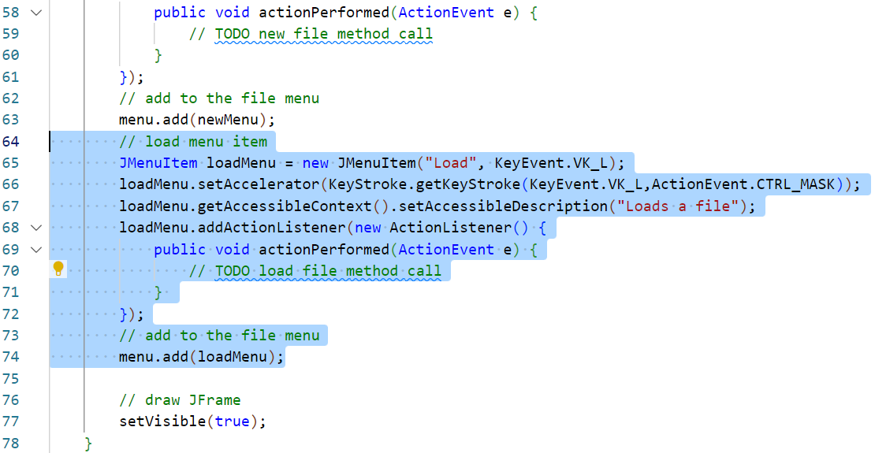
Add a menu item
Repeat the last step for a Load File menu item.
Add the following highlighted statements. *
Notes:
* Clarification:
This code is identical in purpose to the previous step with the exceptions that the text Load is set with a hotkey of CTRL-L and the tooltip text of Loads a file.
Again we include a TODO statement as we will need to return to the action listener and add a call to a load file method after we have written it.

Slide 23
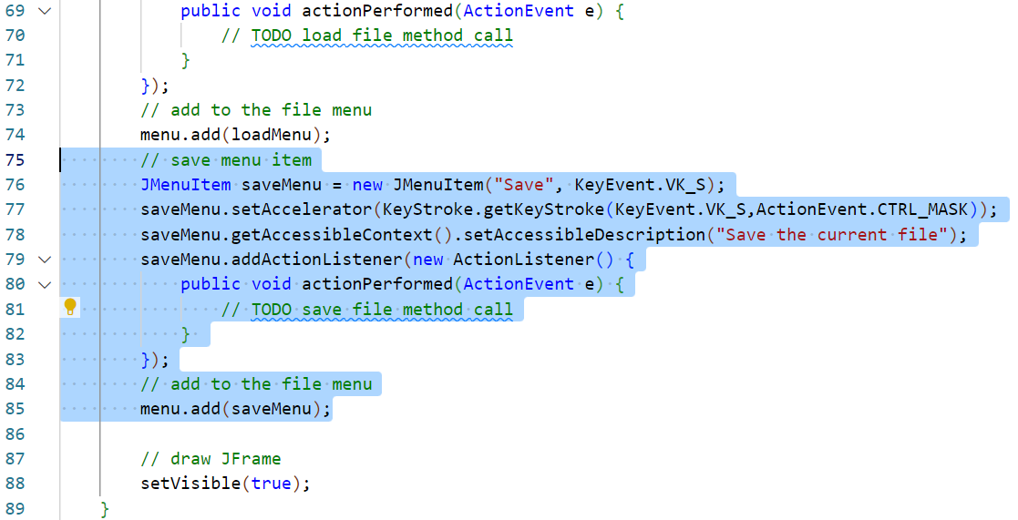
Add a menu item
Repeat the last steps to add a Save File menu item.
Add the following highlighted statements. *
Notes:
* Clarification:
This code is identical in purpose to the previous step with the exceptions that the text Save is set with a hotkey of CTRL-S and the tooltip text of Save the current file.
We include a TODO statement as we will need to return to the action listener and add a call to a save file method after we have written it.

Slide 24
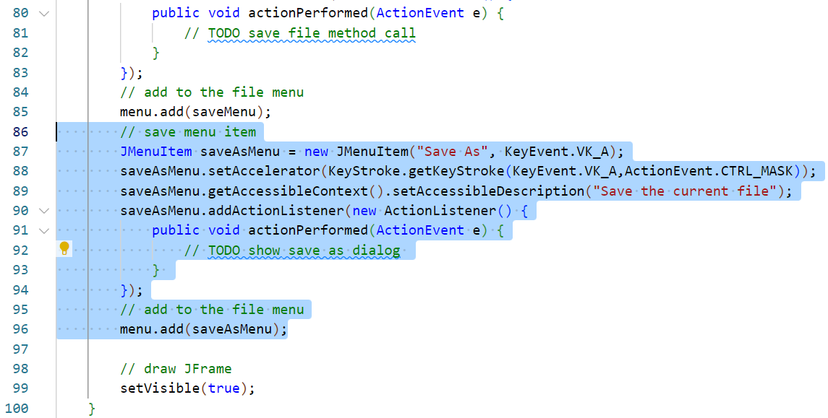
Add a menu item
Repeat the last steps to add a Save As menu item.
Add the following highlighted statements. *
Notes:
* Clarification:
This code is identical in purpose to the previous step with the exceptions that the text Save As is set with a hotkey of CTRL-A and the tooltip text of Save the current file.
We include a TODO statement as we will need to return to the action listener and add a call to a method which will draw the save as dialog box to allow the user to select where they would like the text file being edited to be saved.
This completes the application menu.

Slide 25
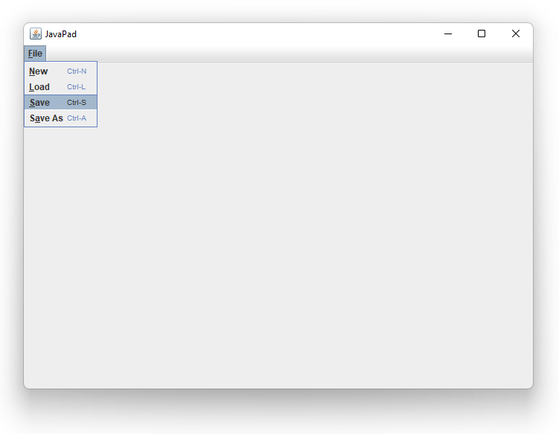
Test the menu
Use the Run and Debug panel to build and test the project.
The application should now have a menu bar with one menu.
The menu will not do anything yet as it only contains TODO comments.

Slide 26
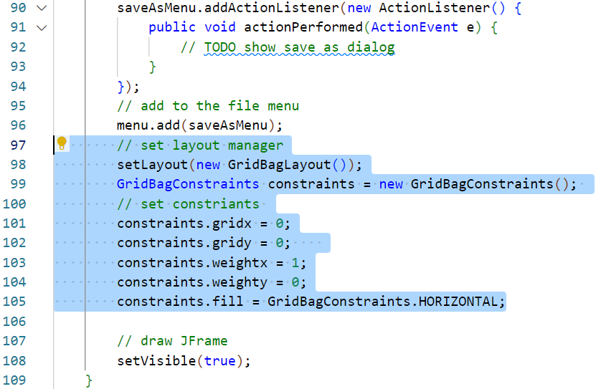
Setting up the layout manager
In Swing, the layout of components is determined by a layout manager.
Add the following highlighted statements to create and set up the LM. *
Notes:
* Clarification:
Line 98 sets the layout manager for the application to GridBagLayout. There are a few layout mangers for Swing. [8] GridBagLayout is probably the best for flexible placement of component.
Line 99 instantiates a GridBagContstraints object which we will use to control the placement of controls within the grid bag layout.
Lines 100 and 101 specify which column and row of the grid the first control will be placed in (we will have 1 column and 2 rows for this ap, the first row will contain control buttons, the second, the editor). The grid coordinates are all zero based.
Lines 103 and 104 inform each cell in the grid how they should expand. Values range from 0 to 1. In this instance, the first cell is instructed to expand horizontally but not vertically as weightx is set to 1 and weighty is set to 0.
Line 105 informs the cells how they should fill the available space. In this instance also horizontally.
8: Oracle, Java Documentation: A visual guide to layout managers. Available at: https://docs.oracle.com/javase/tutorial/uiswing/layout/visual.html. Last Accessed: 28/06/22.

Slide 27
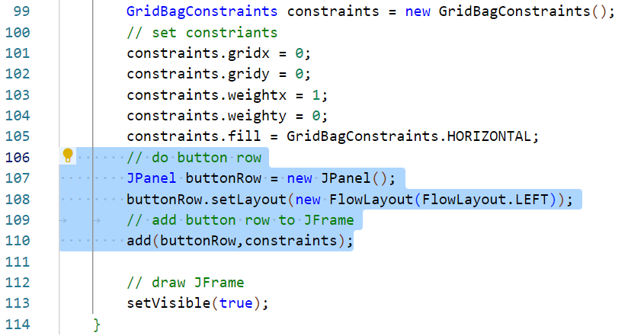
Adding a button row
A common app paradigm is to have a row of control buttons.
Add the following highlighted statements to create a button row. *
Notes:
* Clarification:
Line 107 creates a JPanel instance.
Line 108 sets the JPanel to use the FlowLayout layout manager [8]. This is then set to align left meaning that any control added to this panel will be arranged in a row from the left.
Line 110 adds the JPanel to the UI using the current state of the constraints object. This means that it will be placed in column 0 and row 0 and will expand horizontally to fill the available space.
8: Oracle, Java Documentation: A visual guide to layout managers. Available at: https://docs.oracle.com/javase/tutorial/uiswing/layout/visual.html. Last Accessed: 28/06/22.

Slide 28
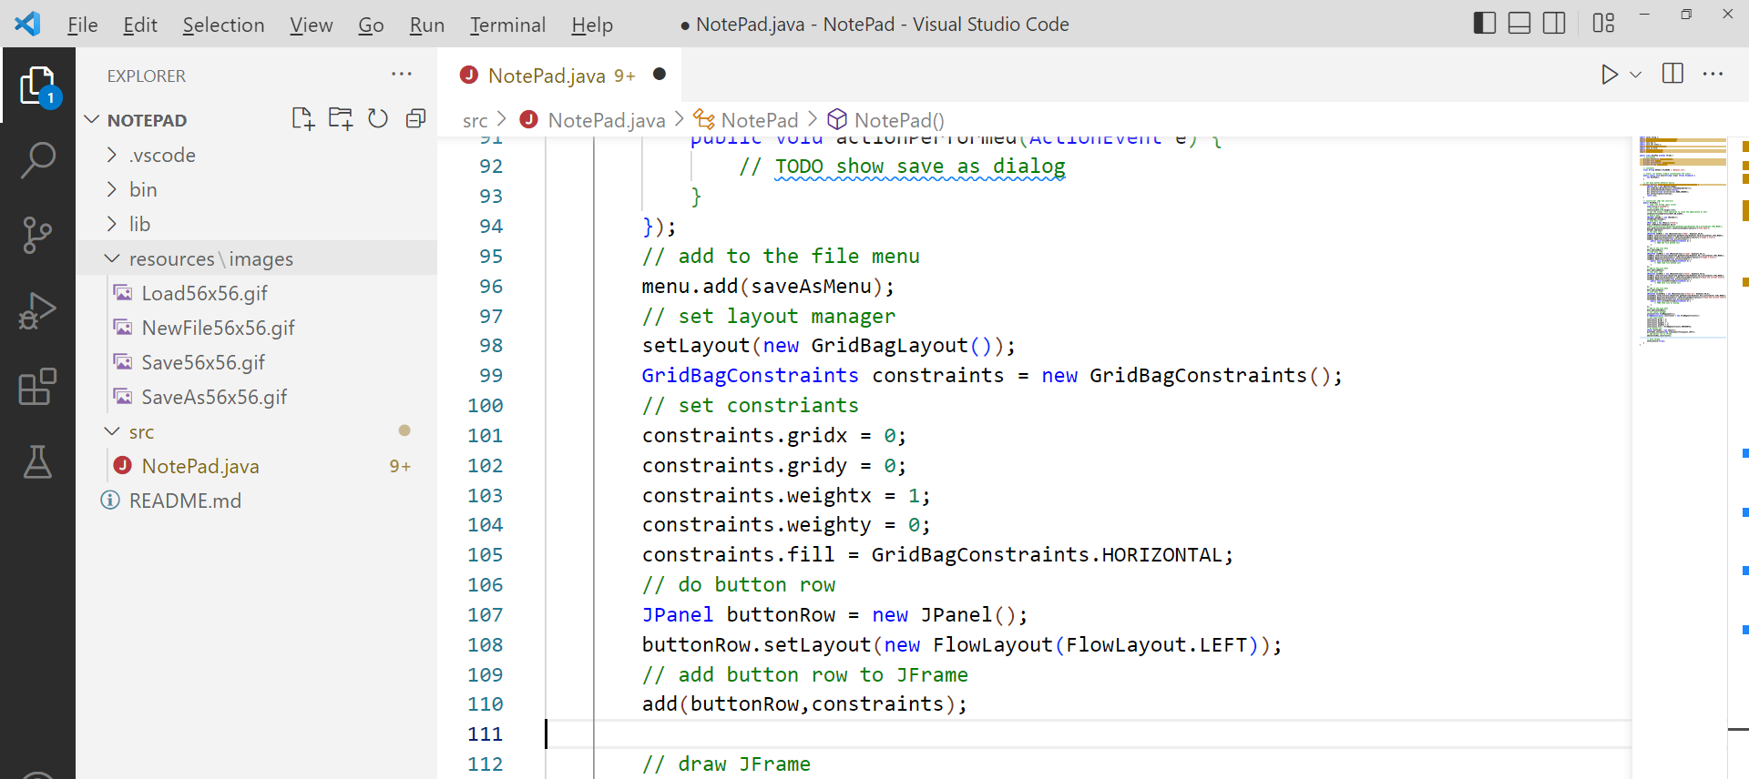
Add in button icons
Download the NotePad-Icons.zip archive from Moodle.
Expand the archive and add to the NotePad project root folder.

Slide 29
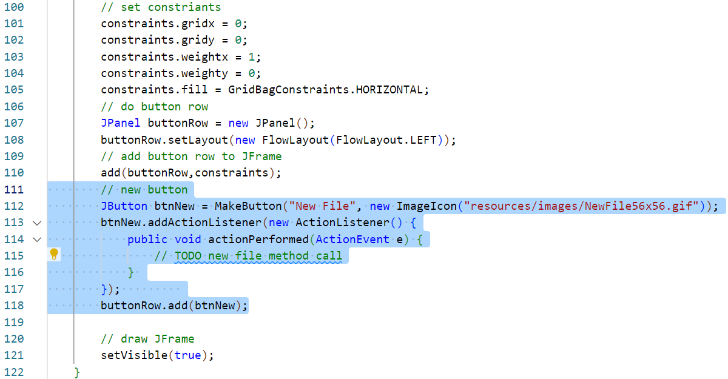
Adding a new file button
We will add the same controls as in the main menu.
Add the following highlighted statements to add a button. *
Notes:
* Clarification:
Line 112 uses the utility method created earlier to create a new JButton with many of the necessary styles pre-set. We pass in the path to the NewFile image which is encapsulated in a new ImageIcon object.
Line 113 to 117 add a new ActionListener to the button. As before, this will listen for a mouse click event. As before, presently this only contains a TODO comment as we have not built a method to handle a new file yet.
Line 118 adds the JButton to the JPanel button row.

Slide 30
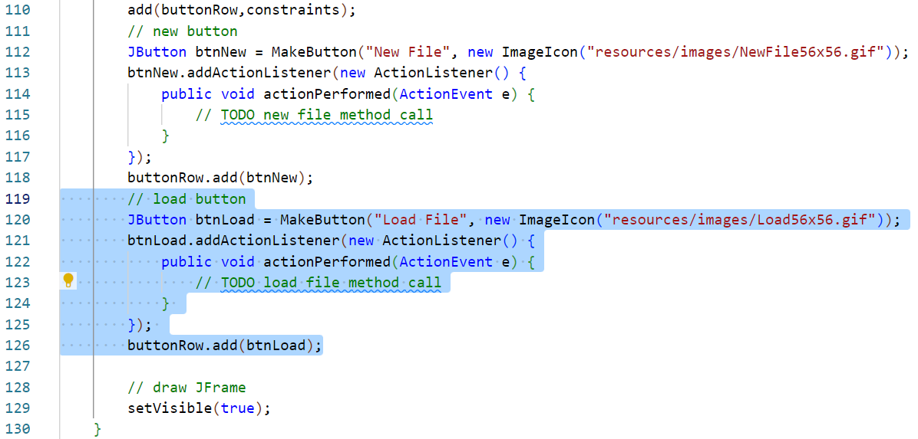
Adding a load button
We will add a load button.
Add the following highlighted statements to add the button. *
Notes:
* Clarification:
These lines repeat the previous step, this time adding a Load button. The Load image is used to create the ImageIcon and the tooltip text is set to Load File. This new button is then added to the button row as before. It will appear on the right of the Load button.

Slide 31
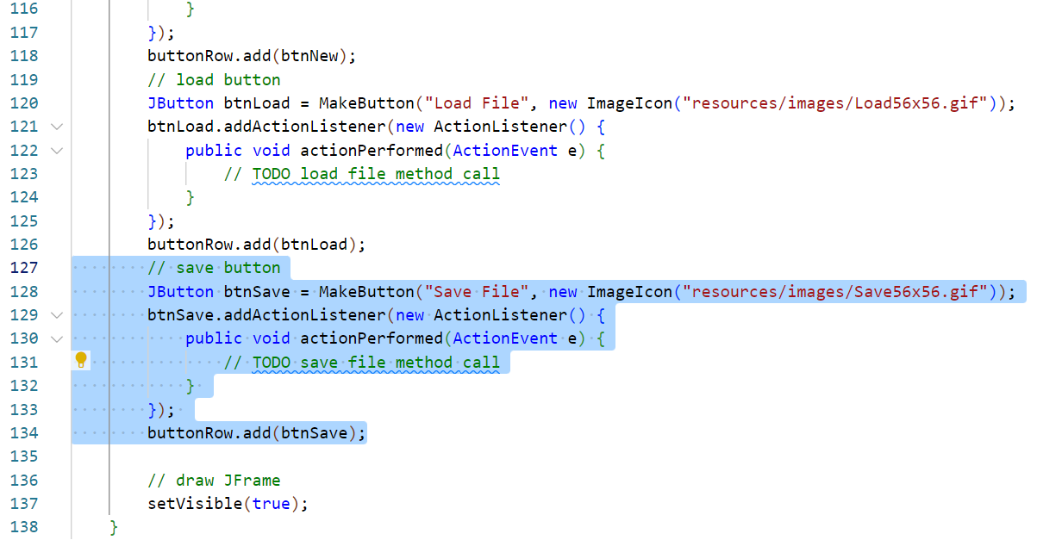
Adding a save button
Add the following highlighted statements to add a save button. *
Notes:
* Clarification:
These lines repeat the previous step, this time adding a Save button. The Save image is used to create the ImageIcon and the tooltip text is set to Save File. This new button is then added to the button row as before. It will appear on the right of the Load button.

Slide 32
Adding a save as button
Add the following highlighted statements to add a save as button. *
Notes:
* Clarification:
These lines repeat the previous step, this time adding a Save As button.

Slide 33
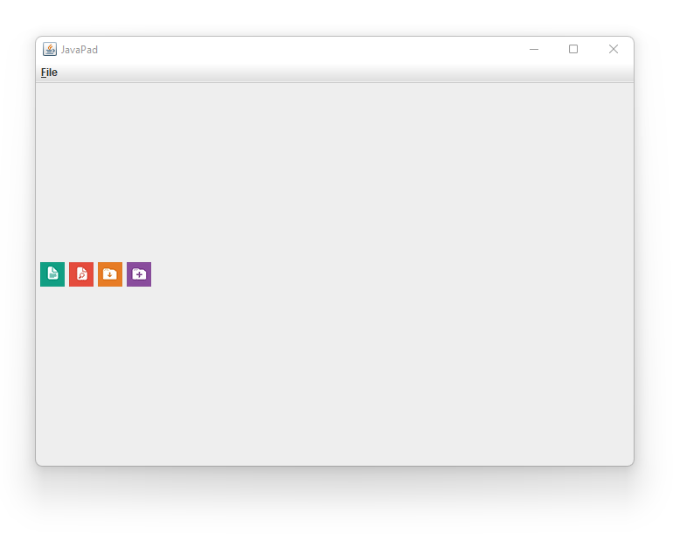
Test the button row
Use the Run and Debug panel to build and test the project.
The application should now have a button bar with 4 icon buttons. *
Notes:
* The buttons will be poorly aligned as shown. Do not worry about this now. The next step should address this.

Slide 34
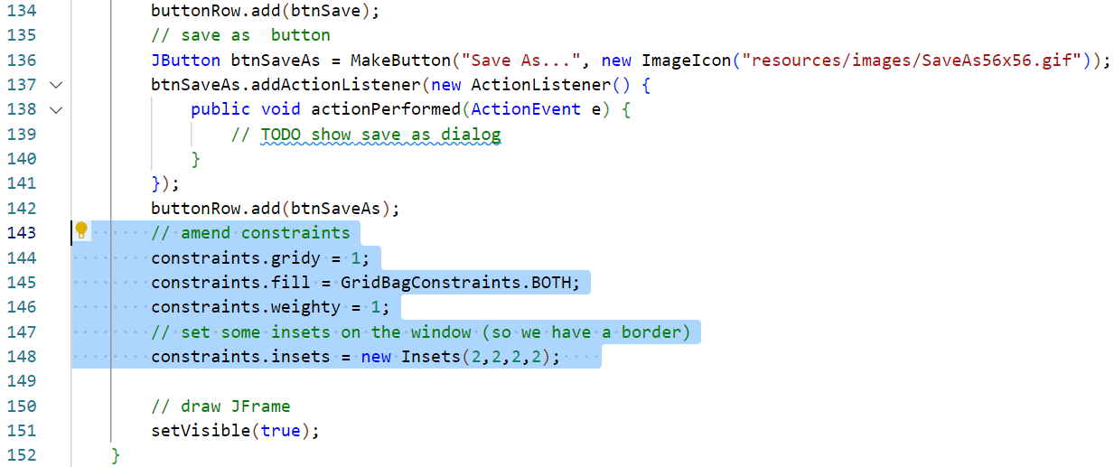
Updating constraints
We are ready to add the next row to the UI which will house the editor.
Update the constraints object for this block.
Add the following highlighted statements. *
Notes:
* Clarification:
Line 144 changes the next row that will be used from 0 to 1.
Line 145 changes the fill direction to both directions. This will expand this row to grab as much space as possible pushing the button row to the top of the UI.
Line 146 instructs this row to expand vertically. It will already expand horizontally.
Line 148 sets some insets which will provide 2px of margin inside the row so that the control does not fill right to the edge of the UI window. A small border is always nice.

Slide 35
Adding a text editor control
The main function of the application will take place in a JTextArea which we have already added a global reference to.
Add the following highlighted statements. *
Notes:
* Clarification:
Line 150 instantiates the JTextArea object.
Line 151 sets this as editable.
Line 152 sets some interior margins so that the text displayed will not collide with the edge of the control.
Line 153 sets the font and size to use with this control.

Slide 36
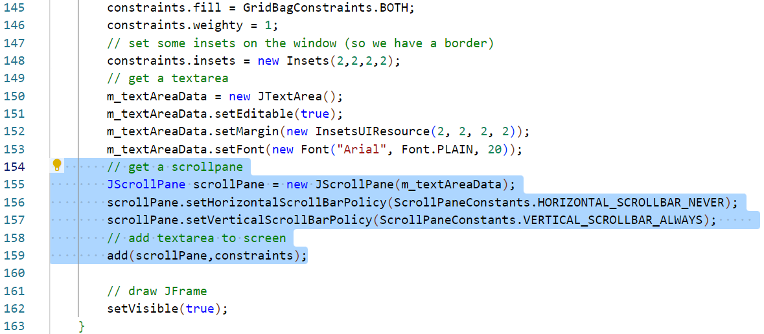
Adding a scroll pane
We want the editor window to be able to scroll around large files.
To add scrollbars to a JTextArea we need a JScrollPane.
Add the following highlighted statements. *
Notes:
* Clarification:
Line 155 instantiates a new JScrollPane object which accepts the object to scroll, in this case the JTextArea created in the last step.
Line 156 removes horizontal scrollbars.
Line 157 forces a vertical scrollbar to always draw regardless of the length of the loaded file.
Line 159 adds the JScrollPane to the UI using the current constraints settings.

Slide 37
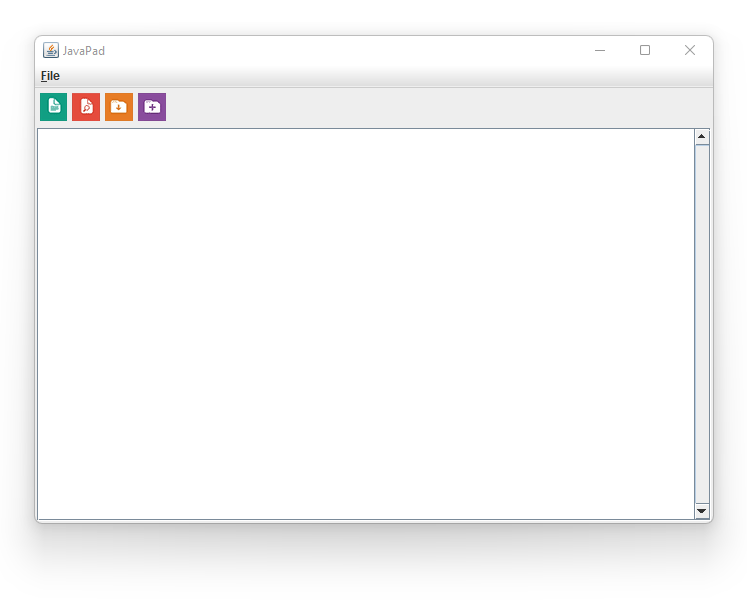
Test the complete UI
This completes the UI layout design and controls.
Use the Run and Debug panel to build and test the project.
The application UI should be complete, but will do anything yet.

Slide 38
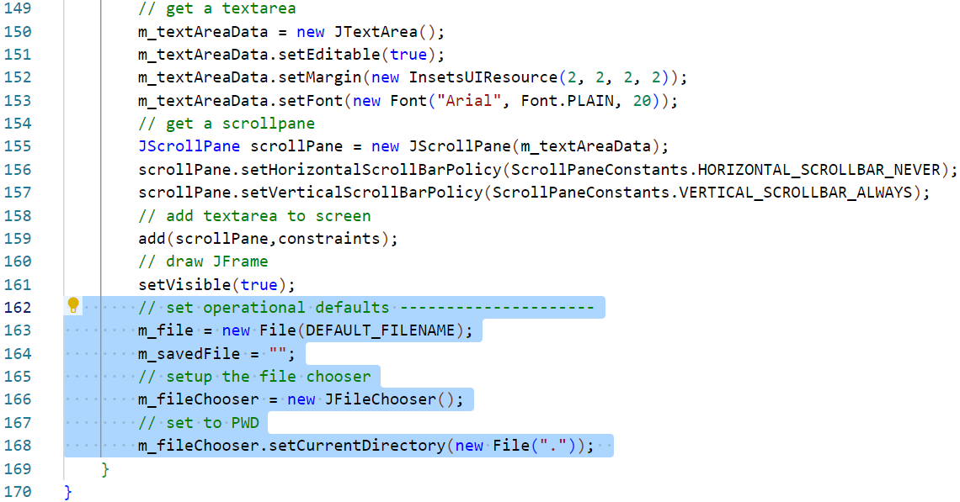
Initialise some defaults
We need to initialise a few more objects.
Add the following highlighted statements. *
Notes:
* Clarification:
Line 163 sets a File object reference to the default filename set in the constant at the top of the class.
Line 164 sets the current loaded file content to an empty string.
Line 166 instantiates the global JFileChooser reference.
Line 168 sets the starting directory of the JFileChooser to the current project directory. It does this by creating a new File reference to the shorthand for current directory “.”.

Slide 39
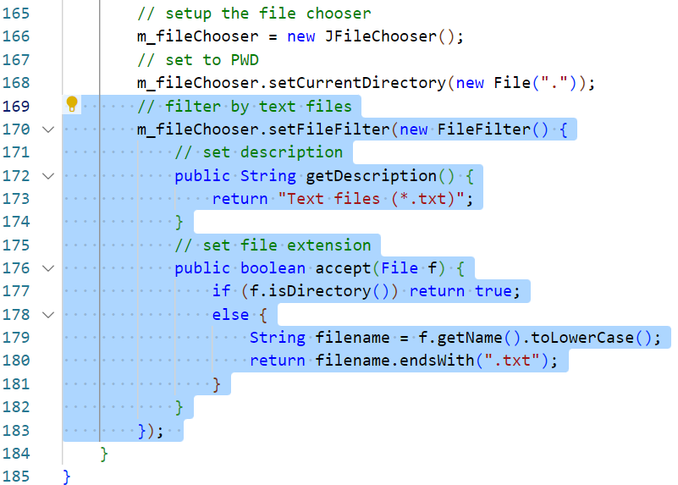
Setting a file filter
We can filter the JFileChooser by file type but doing so is a little involved.
Add the following highlighted statements. *
Notes:
* Clarification:
Line 170 sets a new FileFilter to the JFileChooser. The filter is then setup inline.
Lines 172 to 174 override the default getDescription method. This displays the description of the files that we would like to filter (in this case text files). This text will appear in the JFileChooser file type select control.
Lines 176 to 183 override the default accept method and instruct the JFileChooser whether a specific file can be displayed in the chooser or not. In this case it allows the file to be displayed if it is a directory or if its name ends with the .txt file extension.

Slide 40
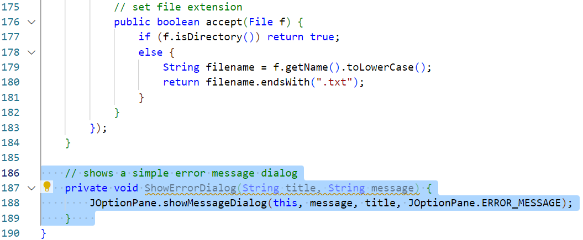
Error message dialog method
We have finished the constructor method (apart from the TODOs).
Next, add an error dialog utility method.
Add the following highlighted method. *
Notes:
* Clarification:
Line 187 declares the method as private. As this is a one file project, that does not matter. The method does not return any values and accepts 2 arguments, the title text which should appear in the dialog window bar and the actual message text to be displayed.
Line 188 use the built in Swing JOptionPane object to create a new message dialog box from the arguments passed to this method.
Note: Please pay very close attention to placement of the brackets to close the last method, to close the class and to declare this method. Try to get these correct.

Slide 41
Add a confirm dialog method
Next, add a confirm dialog utility method.
Add the following highlighted method. *
Notes:
* Clarification:
Line 192 declares the method as private. The method returns an int which corresponds to JOptionPane return value codes and accepts 2 arguments, the title text which should appear in the dialog window bar and the actual message text to be displayed. This method draws a dialog with Yes/No buttons and with a different icon from the error dialog.
Line 194 to 196 declares the dialog described above. The return statement ensures that whatever button is pressed, the code is passed to whichever process calls this method.

Slide 42
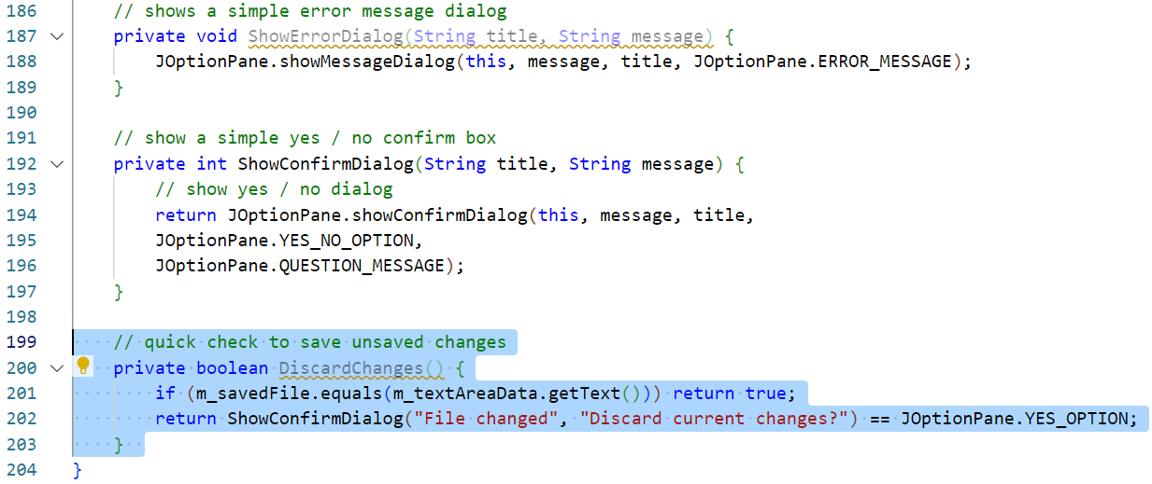
Add a discard changes method
The next method will be called whenever the user does something which would cause changes made to the current document to be lost.
Add the following highlighted method. *
Notes:
* Clarification:
Line 199 declares the method as private. The method returns a boolean which will be used to indicate whether or not the user is happy to lose the changes to the current file. This method does not require any arguments.
Line 201 tests the current content of the JTextArea against the last saved version of the current file. If they are the same, no changes have been made and so the file can be unloaded without fear of the user losing work.
Line 202 if the code reaches this line, the user must have made changes to the currently loaded file. This line uses the method created in the previous step if they would like to discard the changes that they have made returning whether or not they have agreed to this in the form of a boolean value.

Slide 43
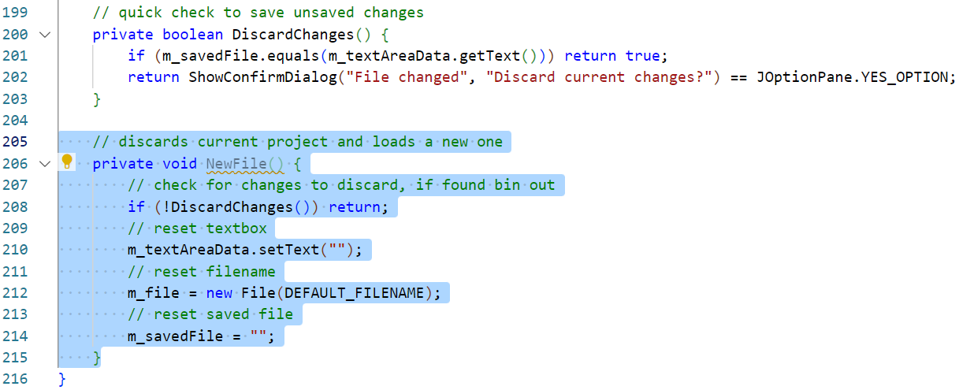
Add a new file method
It is time to start adding the application logic process methods.
We will start with the shortest, NewFile.
Add the following highlighted method. *
Notes:
* Clarification:
Line 206 declares the method as private. The method does not return a value and does not require any arguments. This method will be called from the button and menu item for new file. It effectively unloads any data presently loaded and resets the application to a new blank and unsaved document.
Line 208 tests if there are currently unsaved changes. If the user indicates that they do not want to abandon these, this process is aborted with the return statement.
Line 210 as we are setting up a new document rather than loading one, we can simply empty all of the various data stores. This line sets the JTextArea content to an empty string.
Line 212 resets the File reference to the default filename declared in the constant at the top of this class.
Line 214 sets the last opened document text to an empty string.

Slide 44
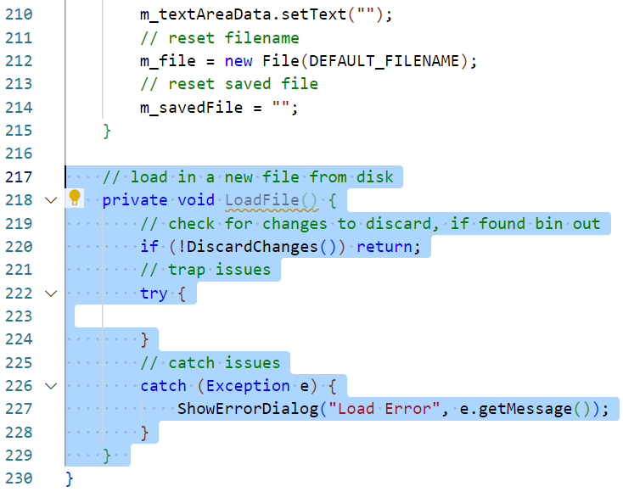
Add load data method
Next, add a method to handle loading data from files.
Add the following highlighted method. *
Notes:
* Clarification:
Line 218 declares the method as private. The method does not return a value and does not require any arguments. This method will be called from the button and menu item for load file. It will replace the currently loaded data with the data from the file selected by the user. This method is a little more involved and will take a few steps to complete.
Line 220 tests if there are currently unsaved changes. If the user indicates that they do not want to abandon these, this process is aborted with the return statement.
Line 222 starts a try block which will trap any exceptions thrown by any of the load data processes. This will contain the main application logic process for loading data and this will be coded in the next step(s).
Lines 226 to 228 add a corresponding catch block which calls the previously coded error dialog method to alert the user as to the issue experienced.

Slide 45
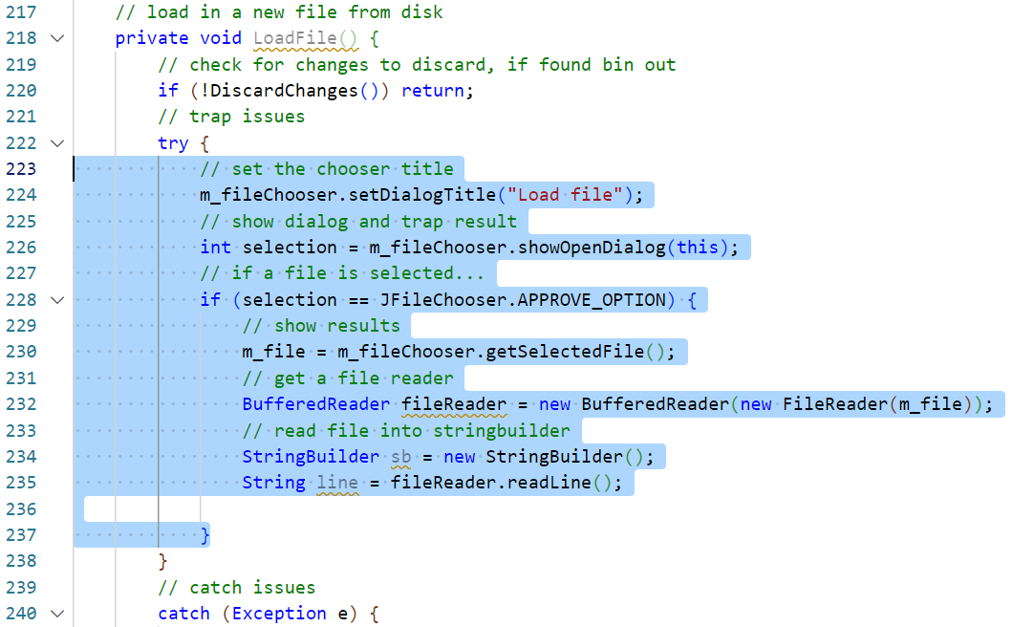
Add load data method
Start to add the load file data process.
Add the following highlighted statements. *
Notes:
* Clarification:
Line 224 sets the title text for the JFileChooser dialog. As we are using the same object for both load and save processes, changing the title accordingly is necessary.
Line 226 draws the file chooser. It also records the result of this dialog, that the file chooser has been used to select a file… or has been closed.
Line 228 tests if the file chooser has been used to select a file (if it has not, there is no need to do anything else).
Line 230 gets a reference to the selected file from the file chooser object.
Line 232 declares a BufferedReader which will be used to read the file in. As discussed earlier in this slideshow, this takes one argument which is the selected File reference which has been used to create a FileReader object.
Line 234 declares a new StringBuilder with which to collect the content of the file as it is read in.
Line 235 reads the first line of the file into a new string variable.

Slide 46
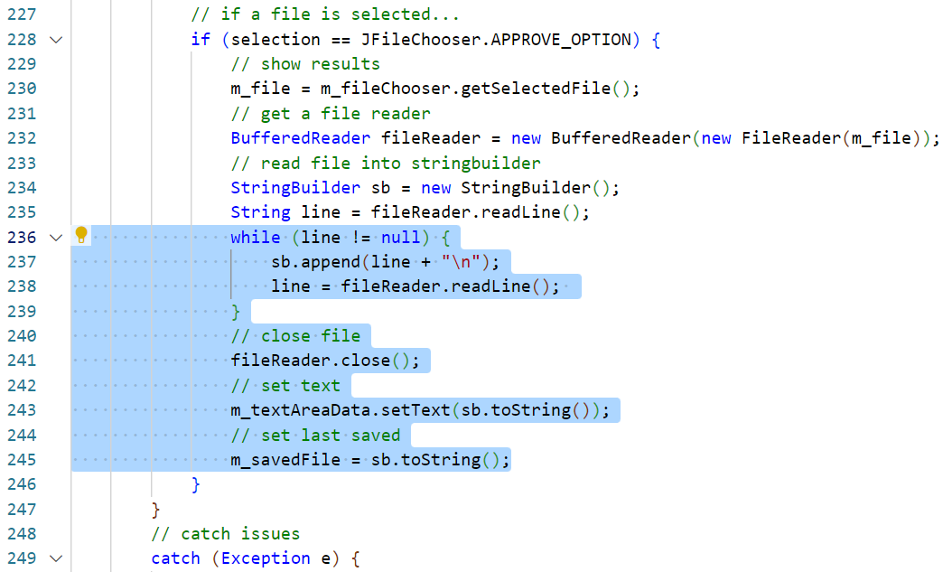
Add load data method
Complete the processes in this method.
Add the following highlighted statements. *
Notes:
* Clarification:
Lines 236 to 239 use a while loop to read the text from the file and store it in the StringBuilder one line at a time. If there is no next line of text in the file, the line variable will be set to a null value and the while loop will exit.
Line 241 closes the file as it has now been read. This will release the file lock on it and allow it to be edited or read by other applications.
Line 243 takes the text collected in the StringBuilder and sets it as the content of the JTextArea.
Line 245 records the text collected in the StringBuilder and stores it as a record of the last saved state of this data. This can then be compared against the data in the JTextArea to see if changes have been made.

Slide 47
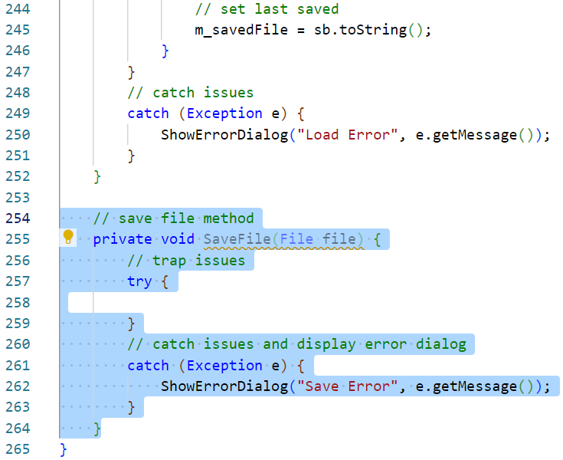
Add save data method
The corresponding method is save data.
Add the following highlighted method. *
Notes:
* Clarification:
Line 255 declares the method as private. The method does not return a value and requires a single argument of a reference to the File to save. This method will be called from the button and menu item for save file. It will replace the currently saved file with a new file containing the data in the JTextArea. This method will also take more steps to complete.
Line 261 starts a try block which will trap any exceptions thrown by any of the load data processes. This will contain the main application logic process for loading data and this will be coded in the next step.
Lines 261 to 263 add a corresponding catch block which calls the previously coded error dialog method to alert the user as to the issue experienced.

Slide 48
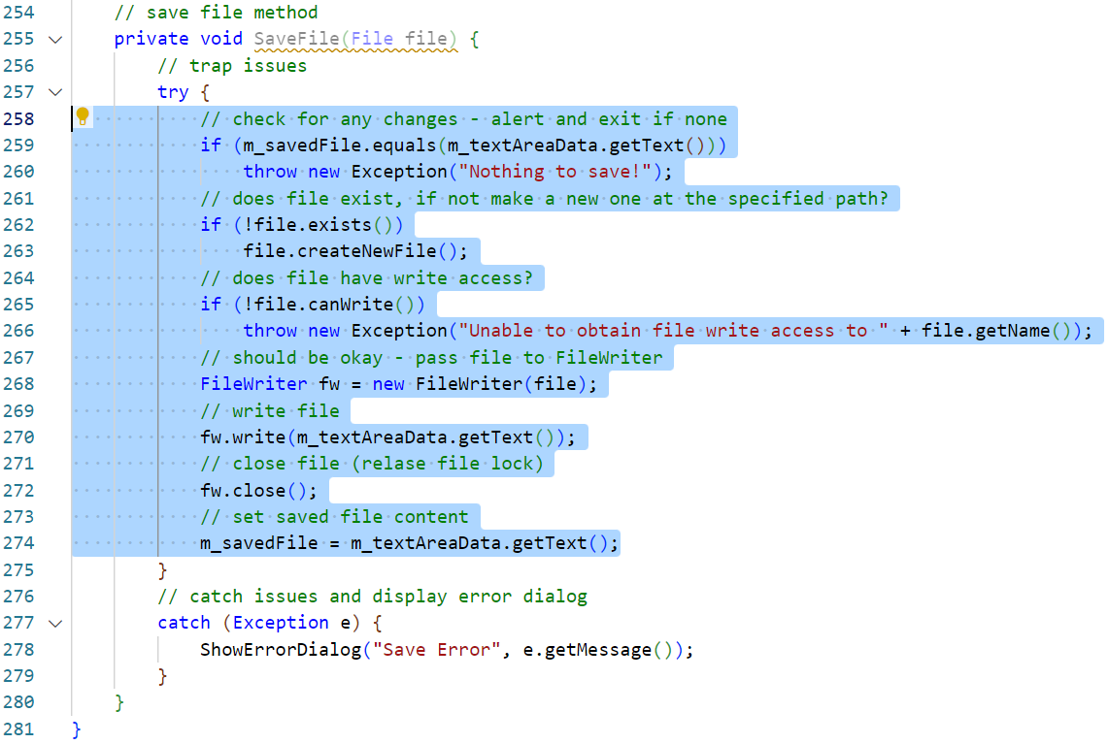
Add save data method
Add the following highlighted statements to complete this method. *
Notes:
* Clarification:
Line 259 tests if the current file needs saving. If it does not, a new exception is thrown with a message to this effect. As this statement appears in a try/catch block, the exception will trigger the catch statement on line 277 which will generate an error dialog for the user.
Lines 261 and 263 test if the File currently exists. If it does not, a new File is created using the path specified in the File object.
Lines 265 and 266 test it is possible to write to the selected File. If not, an exception is generated and thrown. This will alert the user as before.
Line 268 instantiates a new FileWriter object with a reference to the File.
Line 270 writes the contents of the JTextArea to the open File.
Line 272 closes the File releasing any file locks and leaving the File editable or viewable in other applications.
Line 274 stores a copy of the saved file to compare as before and determine if unsaved changes have been made.

Slide 49
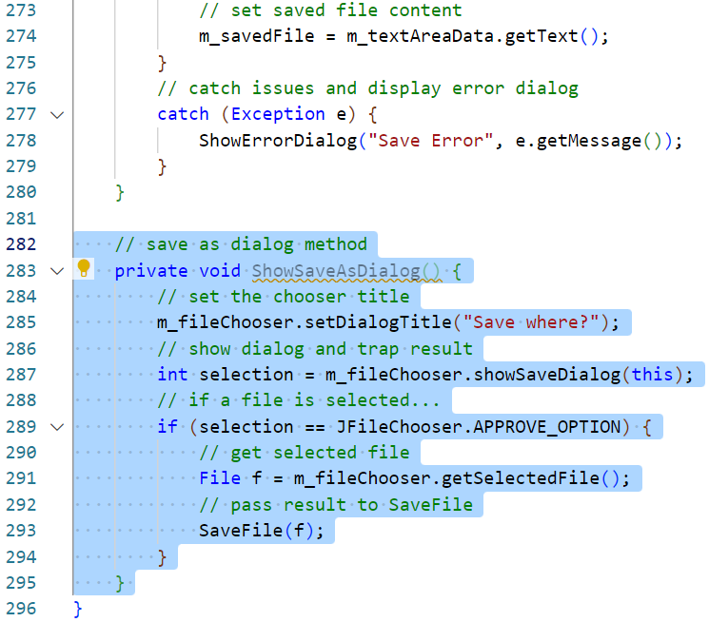
Add method to show a save as dialog
Finally, add a method to show a save as file chooser.
Add the following highlighted method. *
Notes:
* Clarification:
Line 283 declares the method as private. The method does not return a value and does not require arguments. This method will be called from the button and menu item for save as. It wrappers the SaveFile method, passing a selected File to it.
Line 285 sets the title of the JFileChooser dialog.
Line 287 as before, displays the dialog and awaits a status code response which it records in a temporary int variable.
Line 289 tests if the user has indicated positively that the selected File is where they would like to save the current data.
Line 291 creates a reference to the File selected by the user.
Line 293 passes the selected File reference to the SaveFile method coded in the last 2 slides.

Slide 50
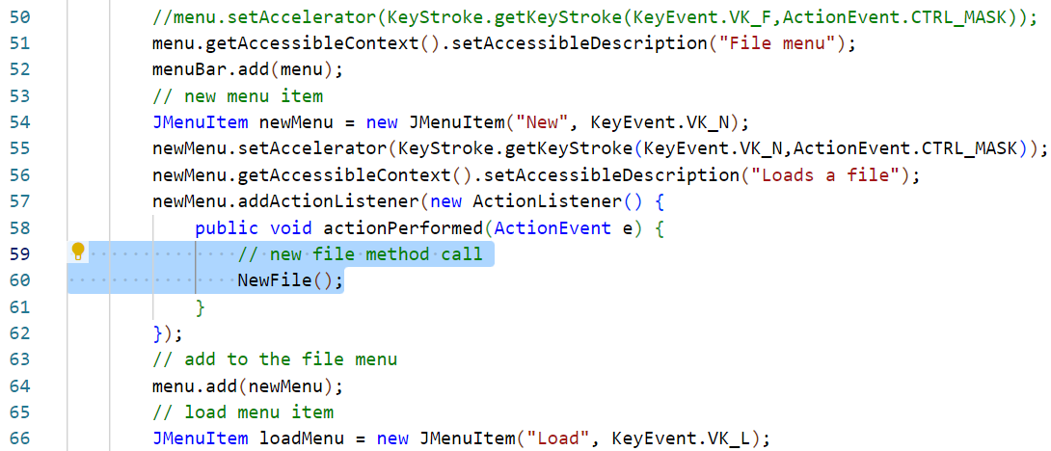
Removing TODO comments
The last step is to go back to all of the TODO comments and add references to the methods which have now been included.
Amend the code at the following location as highlighted. *
Notes:
* Clarification:
Line 59 amend the comment text to remove the TODO
Line 60 add a call to the NewFile method.

Slide 51
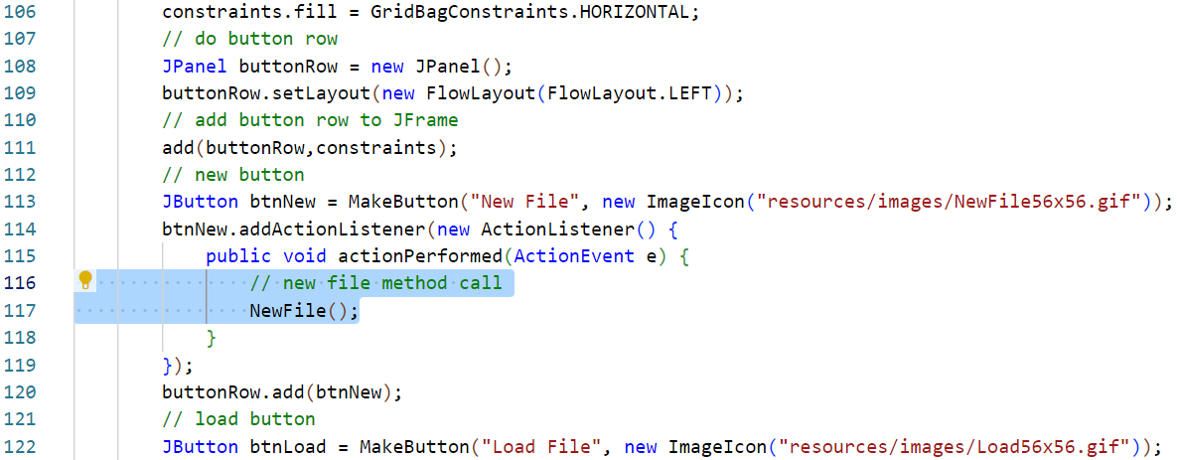
Removing TODO comments
Do the same with the corresponding button control.
Amend the code at the following location as highlighted. *
Notes:
* Clarification:
Line 116 amend the comment text to remove the TODO
Line 117 add a call to the NewFile method.

Slide 52
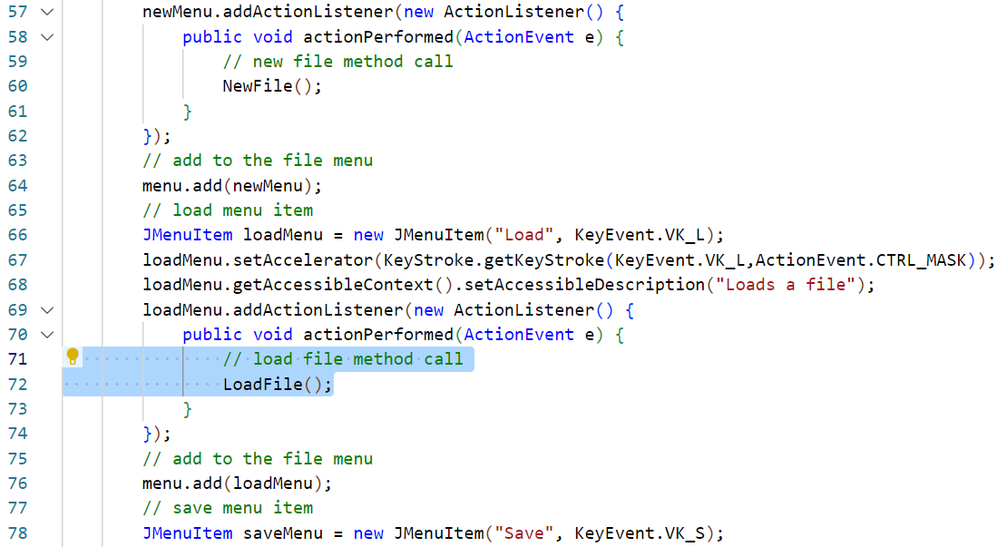
Removing TODO comments
Add in calls to the LoadFile method.
Amend the code at the following location as highlighted. *
Notes:
* Clarification:
Line 71 amend the comment text to remove the TODO
Line 72 add a call to the LoadFile method.

Slide 53
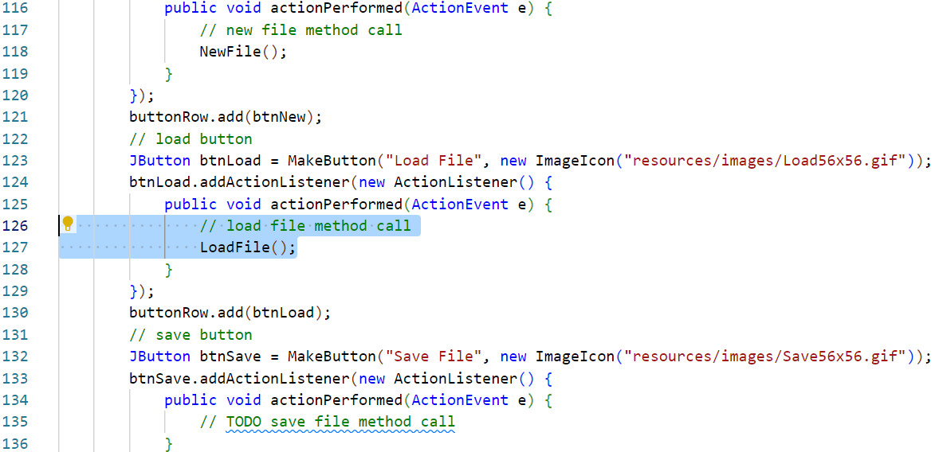
Removing TODO comments
Do the same with the corresponding button control.
Amend the code at the following location as highlighted. *
Notes:
* Clarification:
Line 126 amend the comment text to remove the TODO
Line 127 add a call to the LoadFile method.

Slide 54
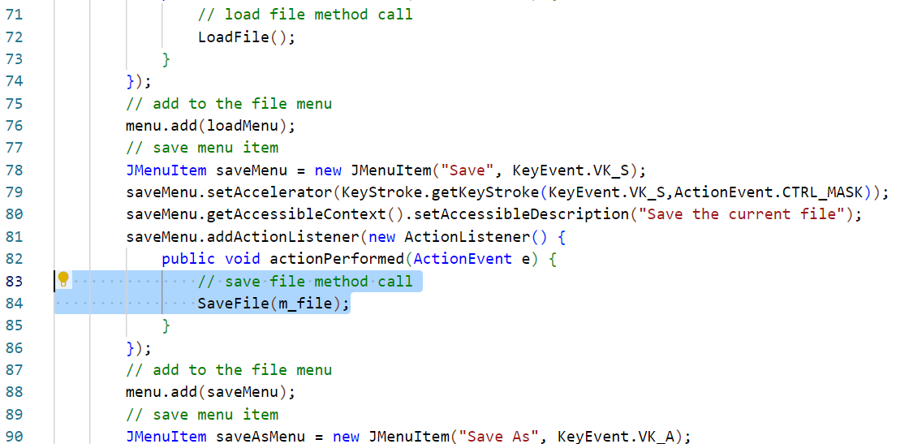
Removing TODO comments
Add in calls to the SaveFile method.
Amend the code at the following location as highlighted. *
Notes:
* Clarification:
Line 83 amend the comment text to remove the TODO
Line 84 add a call to the SaveFile method passing a reference to the currently loaded File.

Slide 55
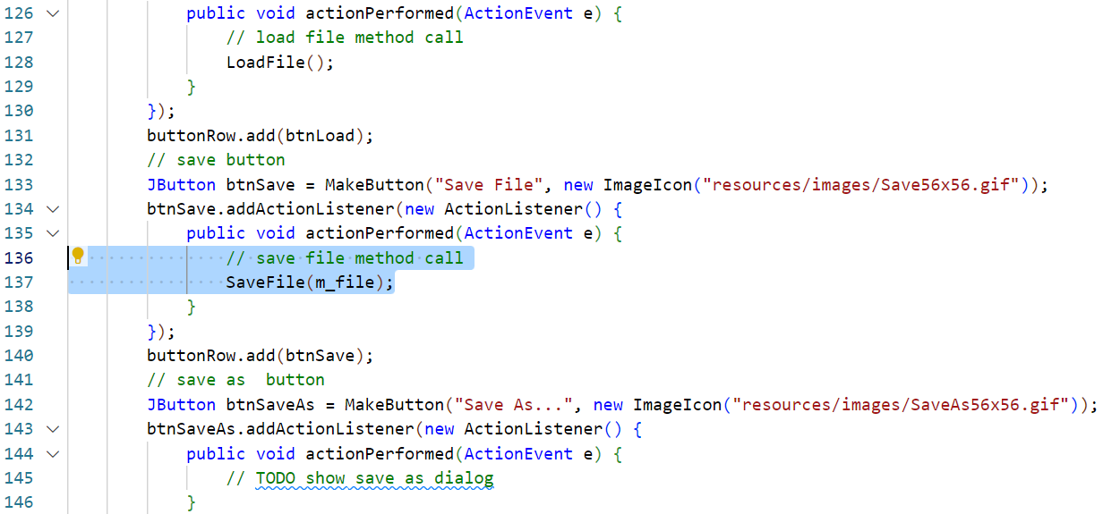
Removing TODO comments
Do the same with the corresponding button control.
Amend the code at the following location as highlighted. *
Notes:
* Clarification:
Line 136 amend the comment text to remove the TODO
Line 137 add a call to the SaveFile method passing a reference to the currently loaded File.

Slide 56
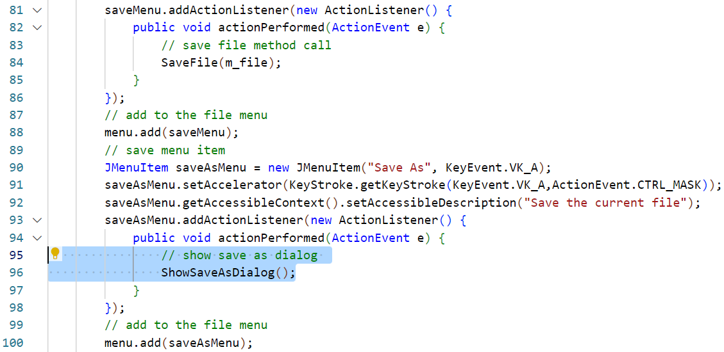
Removing TODO comments
Finally, add in calls to the SaveAs method.
Amend the code at the following location as highlighted. *
Notes:
* Clarification:
Line 95 amend the comment text to remove the TODO
Line 96 add a call to the ShowSaveAsDialog method.

Slide 57
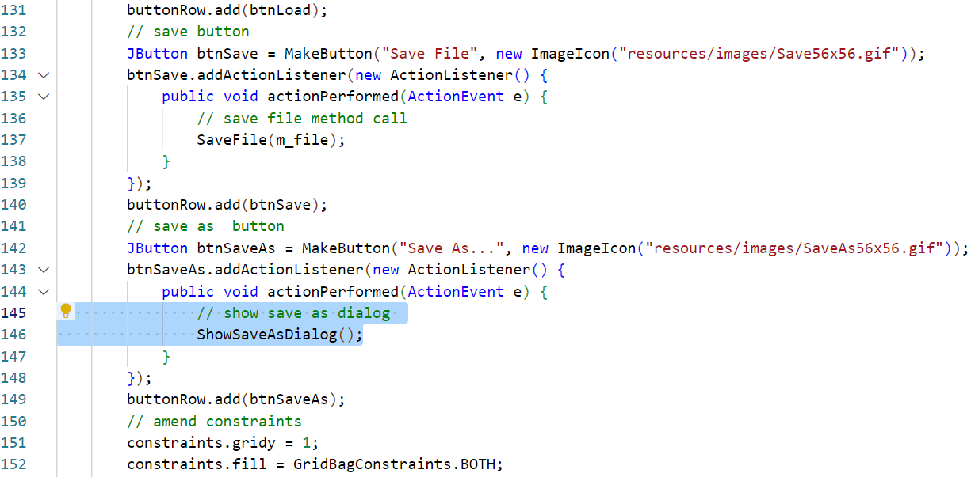
Removing TODO comments
Do the same with the corresponding button control.
Amend the code at the following location as highlighted. *
Notes:
* Clarification:
Line 145 amend the comment text to remove the TODO
Line 146 add a call to the ShowSaveAsDialog method.

Slide 58
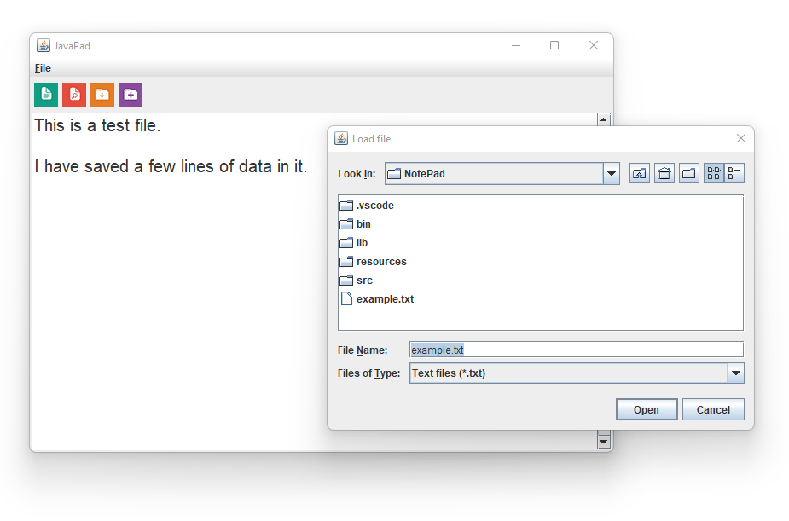
Test the complete application
Use the Run and Debug panel to build and test the project.
The application should now be complete and fully functional.

Slide 59
Project Summary
BSc Applied Computing

Slide 60
This session has covered a lot
Using Swing to create a rich, event-driven UI.
Application menu.
Buttons.
Layout managers (Grid Bag and Flow layouts).
Use of error message dialogs.
Use of methods to reduce the need for repeated code.
Factory and utility methods.
Separate processes per method (new, load, save, save as).
Loading, saving and browsing text files using Java.io classes.
Effective error handling with try/catch.

Slide 61
Unstructured data
The information contained in the files created by and edited by this application is unstructured.
The application itself is not interested in the nature or structure of the text written as it only needs to process the text as a whole.
This is easy (it may not seem it now… but it is).
Most applications require a more detailed understanding of the data that they process.
Next session we will start to explore some of the ways in which we can format and present related data so that applications can easily understand and process this for us.

Slide 62
Session recap…
Session Rationale
Unstructured data
Save and load data flow
File input / output streams
Notepad project
Step by step code with explanations

Slide 63
Any questions?
Next…
Semi-structured data – a CSV Report Calculator.

