Slide 1
Construction and the Environment
Carl James

Slide 2
Introduction
Global warming is changing our environment. To reduce its effects, environment legislation in the UK – including current Building Regulations – is changing too. Domestic and commercial construction has now to be much more thermally efficient in order to save energy in the long term.

Slide 3
For thousands of years, we have exploited the natural resources of the world – coal, oil, gas, metals, gypsum and aggregate, to name but a few. All of these are used to produce construction materials for consumption.
Today, there are many measures in place to protect the natural environment, from National Parks, to Acts of Parliament to environmentally protected green belts of land, and the efficient use of recycling techniques that save on further development of resources.

Slide 4
Global Warming
ICE Shelf Break

Slide 5
A large plot of land has come on to the market and has obtained outline planning consent for housing development. You live in a local village adjacent to this land and are a parish councillor.
The community is outraged at the decision to allow development on this piece of unspoilt, green landscape. In order to help fight an objection to full planning consent, you have been asked to identify and describe the features of the natural environment that must be considered at the planning stage, which could be used to defend development. List Six features of the natural environment with descriptions against each. P1

Slide 6
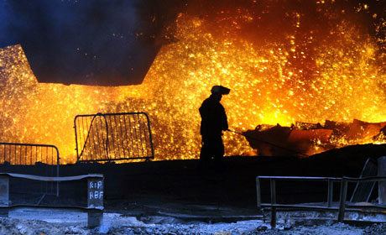
Globally
Hell on Earth

Slide 7
Green house gases and global warming
Acid rain
Ozone depletion due to CFC
Over extraction of water

Slide 8
Fossil fuels' and raw materials
Increased energy consumption
Deforestation
Loss of natural habitat
Reduction in biodiversity

Slide 9
Tip - Online BTEC Book
P2 explain four different forms of global pollution arising from construction projects

