Slide 1
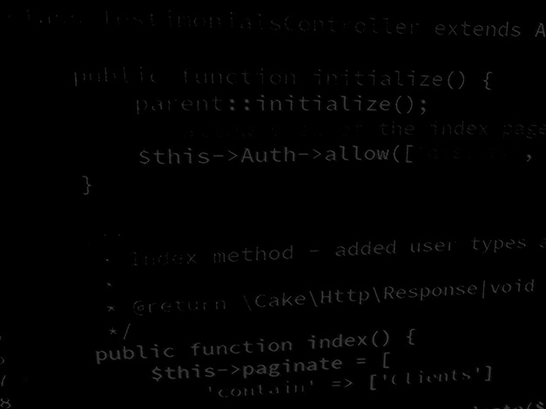
Server-side coding with PHP and Laravel Using Laravel as an API
BSc Applied Computing

Slide 2
In this session…
Recap Laravel Task List project
Last exercise progress
Server-side OOP PHP framework for both web applications and APIs
Object-relational mapping (ORMs) – Eloquent and implicit model bindings
Composer and package managers
MVC
Authentication, Validation, Policies
Laravel and APIs
What is an API?
Stateful vs RESTful (recap)
Do I need a framework?
Which Laravel aspects are required?
Converting the Task List app to an API
Project setup
Project development workshop

Slide 3
Recap Laravel Task List project
BSc Applied Computing

Slide 4
Quick recap
Laravel OOP server-side RAD framework
MVC architectural aspects
Routing
Blades
Eloquent models and implicit model bindings
Authorisation, Validation and Policies
Method spoofing (still not keen)
All of this is useful for building robust server-side web applications

Slide 5
Laravel and APIs
BSc Applied Computing

Slide 6
What is an API?
“Think of an API like a menu in a restaurant. The menu provides a list of dishes you can order, along with a description of each dish. When you specify what menu items you want, the restaurant’s kitchen does the work and provides you with some finished dishes. You don’t know exactly how the restaurant prepares that food, and you don’t really need to. Similarly, an API lists a bunch of operations that developers can use, along with a description of what they do. The developer doesn’t necessarily need to know how, for example, an operating system builds and presents a “Save As” dialog box. They just need to know that it’s available for use in their app.”
HowToGeek

Slide 7
What is an API?
A web service is a type of API
API (Application Programming Interface)
APIs make visible data and methods to other applications / clients / systems
Web services expose data usually (but not always) via HTTP or HTTPS
Web services expose data formatted using a transport language, usually JSON (but also XML)
Web services allow a variety of clients (mobile, PC, etc.) to connect to and use the same resources

Slide 8
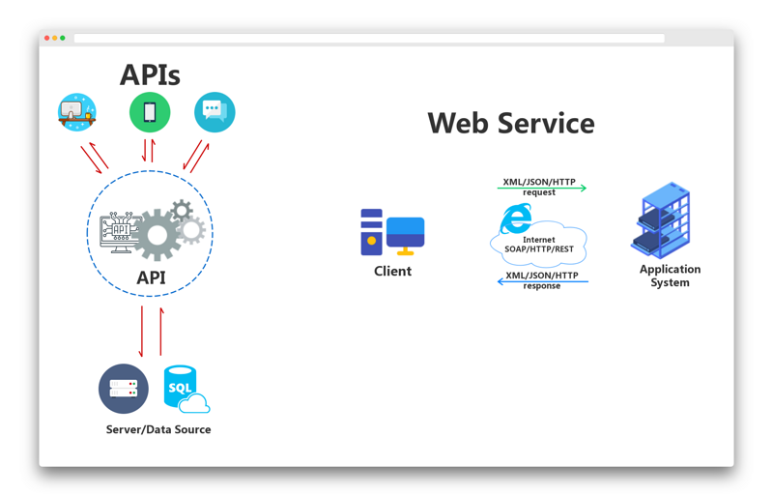
APIs and Web services

Slide 9
Stateful vs RESTful (recap)
Any application which keeps track of state (for example the state of being logged in, usually involving a session) is known as “Stateful”
Networked applications are commonly either Stateful or RESTful
RESTful applications do no use a session or keep track of state from request to request
RESTful applications usually supply a security token to the client which is then sent with each subsequent request
Stateful requests – response depends on the current state meaning that different responses are possible from the same request
RESTful requests – response is always exactly the same

Slide 10
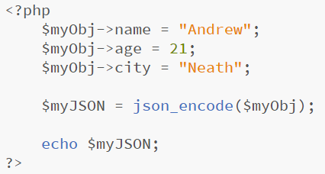
Do I need a framework?
No!
It is remarkably easy to hand code PHP which encodes objects as JSON blobs – for example:

Slide 11
Do I need a framework?
A better question is “why should I use a framework?”
You get ORM for free making all DB tasks far easier
You also get defence against SQL injection and other forms of input sanitisation to protect the DB
Password encryption for free
URL rewriting which hides the backend architecture and framework used making the application harder to attack
Robust and configurable user authentication and data validation
In this session we will see how easy it is to configure a framework to serve an API will all the listed benefits above as well as support for security tokens
All of this can be hand-coded but it quickly amounts to a huge task to attempt this without a framework*
Notes:
* This still does not mean that you have to use a framework. If you want to hand-code your project and disregard some of these aspects, fine! The goal is to get a web service running. Bear in mind that this unit is graded against the degree of knowledge and skill that you acquire, the more that you show that you can do, the better your mark.

Slide 12
Which aspects of Laravel be needed?
The major difference between a server side Laravel app and a Laravel API:
The view (JSON rather than Blades)
The web app is stateful (uses the session to maintain logged in status)
The API will be RESTful (every unique request will always result in the same response)
What will be used across both implementations:
Models
Controllers (although not the same Controllers)
Routes
ORM – all Eloquent code is identical across both implementations
Learning how to build a server-side app first has shown you how most of this works making this session far easier (hopefully)

Slide 13
Converting the Task List project to an API
BSc Applied Computing

Slide 14
Project setup
For once, not a lot of setup is needed as we are using an existing project
You WILL need to have Postman installed for this session
If needed, install it now
This tutorial is adapted from this walkthrough
This tutorial will use the Brackets editor
All new code will be highlighted, other code will be included to indicate placement of new code only and should not be entered
Further explanation of code is included in the notes pane of specific slides
Notes:
Postman: https://www.postman.com/
Walkthrough: https://medium.com/techcompose/create-rest-api-in-laravel-with-authentication-using-passport-133a1678a876
Laravel passport docs: https://laravel.com/docs/7.x/passport

Slide 15
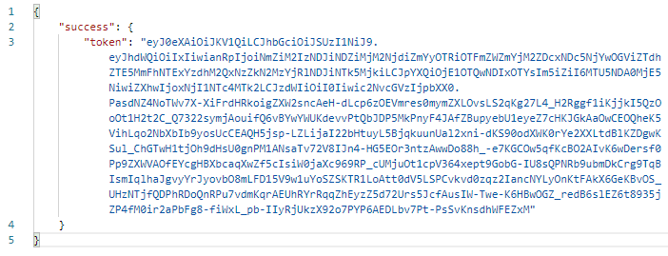
Installing Passport
As we are no longer using the session to authenticate requests we need an alternative
RESTful web services often use authentication tokens for this purpose
Authentication tokens generate an encrypted string which is passed to the authenticated user after a successful login attempt
This token is then sent with further requests from the user to identify them to the API

Slide 16
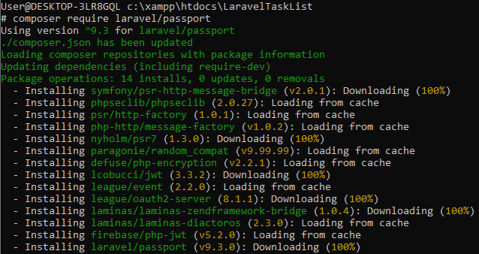
Installing Passport
Authentication tokens can be added to Laravel with the Passport library
First, we need to tell Composer to download this library
Make sure that your Shell is in the LaravelTaskList project folder
Open the XAMPP Shell and use the command:
composer require laravel/passport
Notes:
Passport docs here - https://laravel.com/docs/7.x/passport

Slide 17
Run migrate to update DB
Passport requires a few more DB tables to keep track of users assigned to specific tokens
This is only as hard as re-running migrations
Laravel migrations will only make changes to the DB if changes are specified so re-running the migration command will not affect the tables or data which already exist for this project
In the XAMPP Shell run the migration command
php artisan migrate

Slide 18
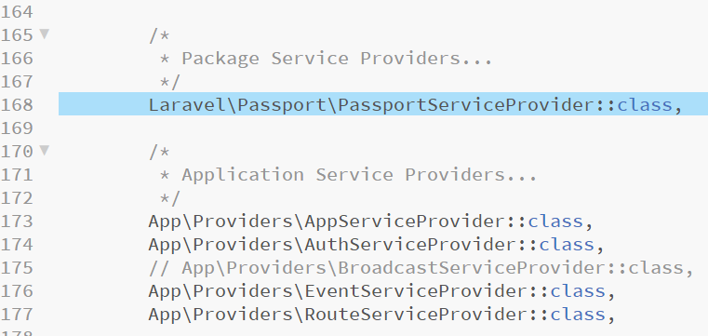
Add to list of Service Providers
Next, we need to let Laravel know that we are adding Passport as a Service Provider
Open config/app.php, find the ‘providers’ list and add the highlighted line at an appropriate point such as the one shown below, then save

Slide 19
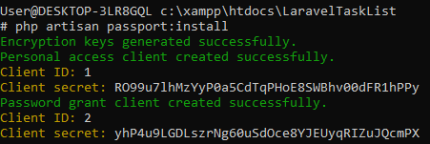
Installing Passport
Although we have downloaded Passport, it has not yet been installed into the application
Using the XAMPP Shell enter the command:
php artisan passport:install
I have 2 users in my application, the install has granted access for the existing users, new users will be added automatically

Slide 20
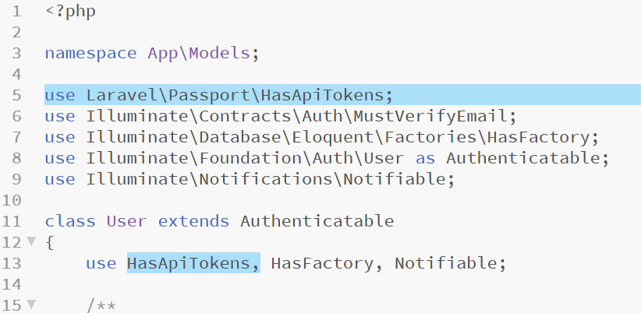
Passport configuration, User
In order to setup Passport to authenticate users in our application we need to configure the Users model, the service provider and auth config files
Open app/Models/User.php in Brackets and add the highlighted code

Slide 21
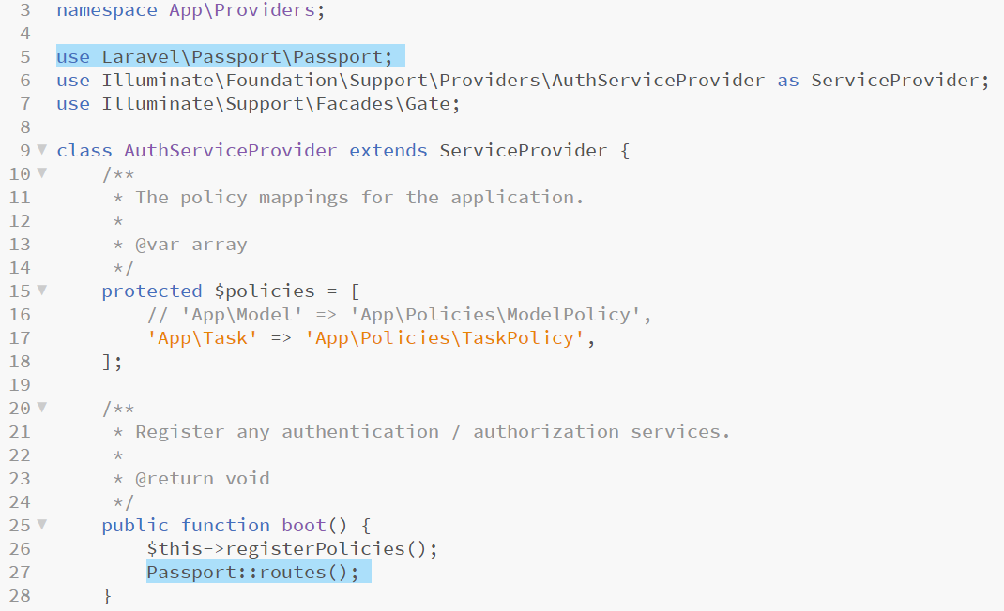
Passport configuration, AuthServiceProvider
Open app/Providers/AuthServiceProvider.php in Brackets and add the highlighted code

Slide 22
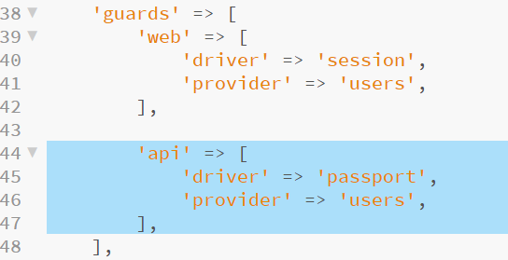
Passport configuration, Auth
Open config/Auth.php in Brackets and replace the existing API guard configuration with the following highlighted code

Slide 23
Creating open API routes
API routes live, unsurprisingly in routes/api.php and are much like the web routes already coded in routes/web.php
First we add the routes which do not require a user to be logged in, login and register
Open api.php in Brackets, remove the existing route closure and add the highlighted routes

Slide 24
Creating authenticated API routes
Laravel includes an authentication guard that will automatically validate API tokens on incoming requests
We need to specify the auth:api middleware on a group which contains any route that requires a valid access token
Add the highlighted code to api.php and save the file
Notes:
There are other ways to do this!
-The middleware can be specified in the constructor of each controller which requires authentication however this then applies to the whole controller meaning that a 3rd controller would be necessary for the open routes – each approach has benefits and drawbacks
-Another approach would be to specify the middleware in the constructor as normal and then specify methods to which it does not apply with the except method - $this->middleware('auth:api')->except('login', 'register');

Slide 25
Creating the UserController
Next we create our controller files
As these are API controller files and as we want to use the same filenames as the web controller files we will place these API controllers inside a subfolder of app/HTTP/Controllers named API
Open the XAMPP Shell making sure that it is located in the LaravelTaskList project folder use the following commands
php artisan make:controller API\UserController
php artisan make:controller API\TaskController

Slide 26
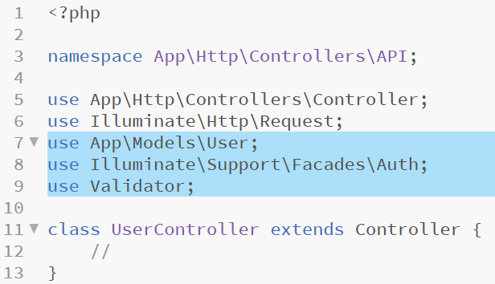
Coding UserController
We can now configure our API UserController to allow us to login and register, returning an authentication token in each case
Open app/HTTP/Controllers/API/UserController in Brackets and add the highlighted use statements to begin
Notes:
The first of these is the User model which is essentially what we are controlling
Next we include Auth and Validator as we will use a few of their functions to ease login and registration respectively

Slide 27
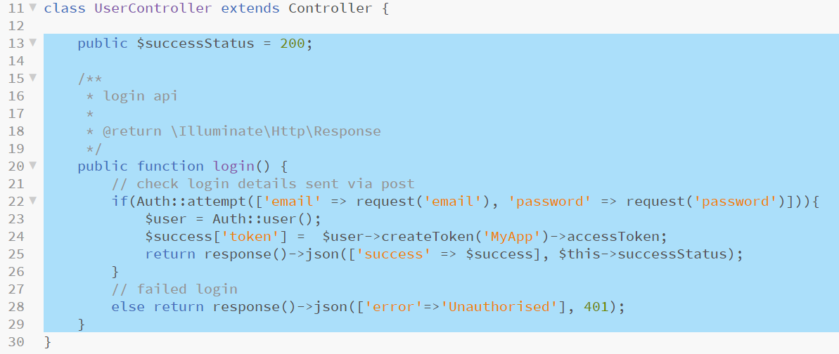
Coding UserController
We do not need to add a constructor function as we are already running authentication middleware where needed
First we add a $successStatus propery which we set to 200 (the HTTP response code for OK)
Next we add the login method – add the highlighted code
Notes:
Pay close attention to the code here! It is easy to make a mistake and generate syntax errors. Go slow and make sure that you understand what all of this is doing.
Auth::attempt tries a login with the details held in $request – if this works we return a token for the user which we have JSONified – if it doesn’t work we return a JSONified 401 error (unauthorised)

Slide 28
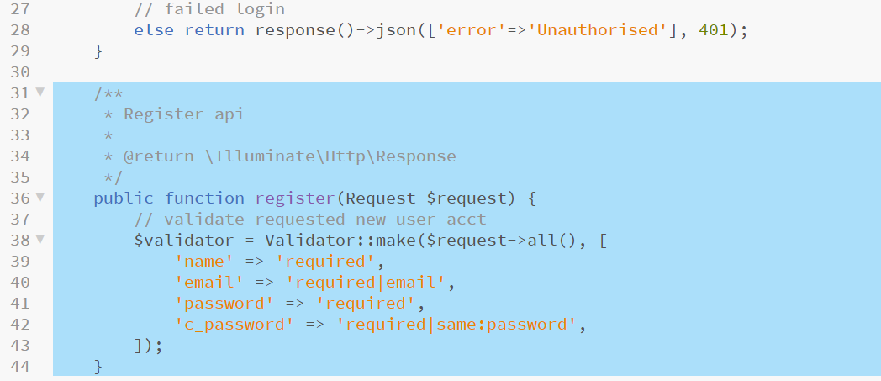
Coding UserController
The register function is slightly more involved so we will take this a little slower, firstly create the method and setup validation*
Add the highlighted code
Notes:
*This is similar to the validation setup for us by the Auth module that we included in the web project
We are specifying that name is required, that email is required and that it looks like an actual email address, that password is required and that it matches c_password – if all of this is true, we can create the account

Slide 29
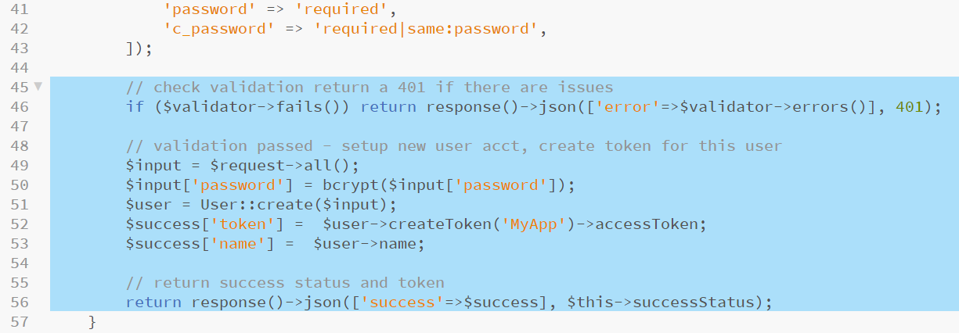
Coding UserController
Next, test the validation, if the supplied details fail generate a 401 error, JSONify it and return to the user
If the validation passes, create a new user account and security token then return the success code (200) and the token to the new user
Add the highlighted code to the register method

Slide 30
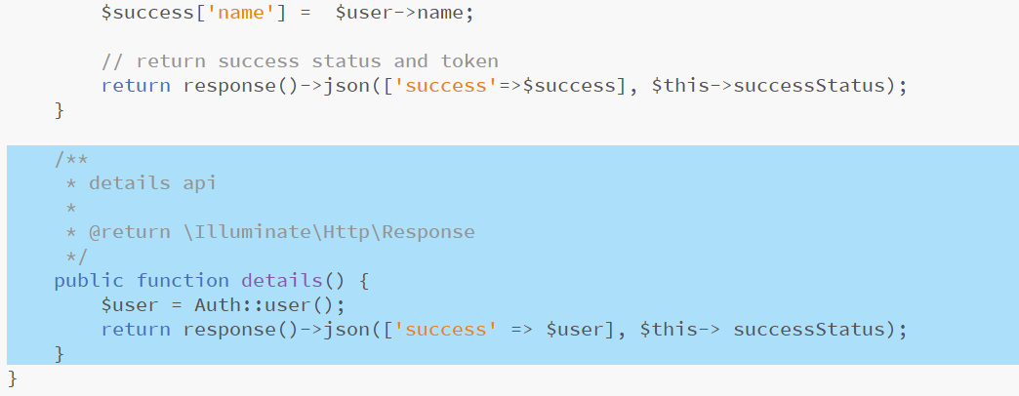
Coding UserController
Finally, we need a details method to return existing logged in user data
This is more straightforward, we retrieve the logged in user from the Auth module (they must be logged in or the auth:api middleware will error the request before it gets here), JSONify it and return it
Add the highlighted code and save the UserController
Notes:
Here we do more or less what was demonstrated at the start of the session, we take a data object and transform it into JSON to be conveyed back to the requester

Slide 31
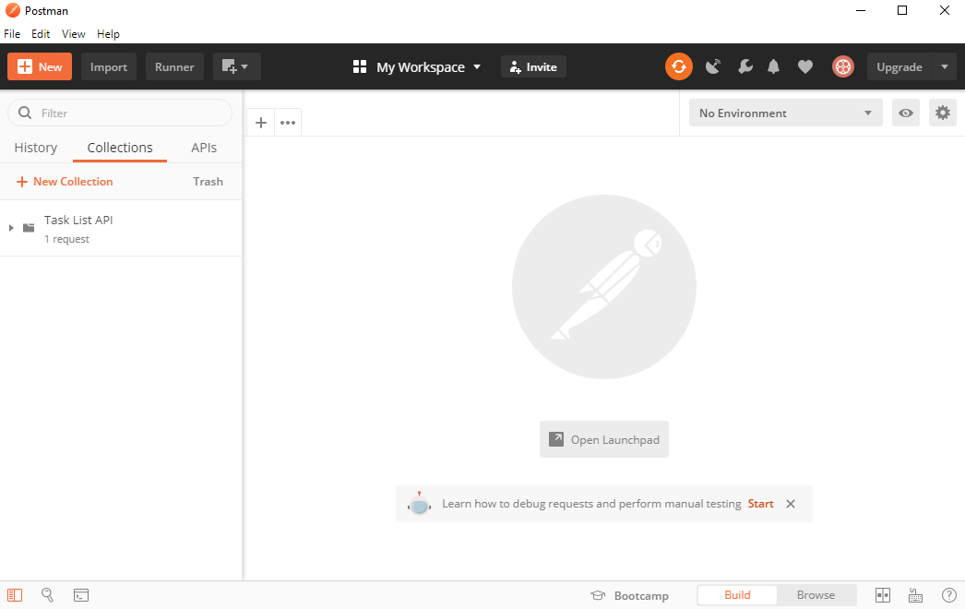
Testing the UserController routes
We can now test out the User-based functions using Postman
If this is your first time using Postman, it’s fairly straightforward
First create a New Collection to save our tests in – call it Task List API

Slide 32
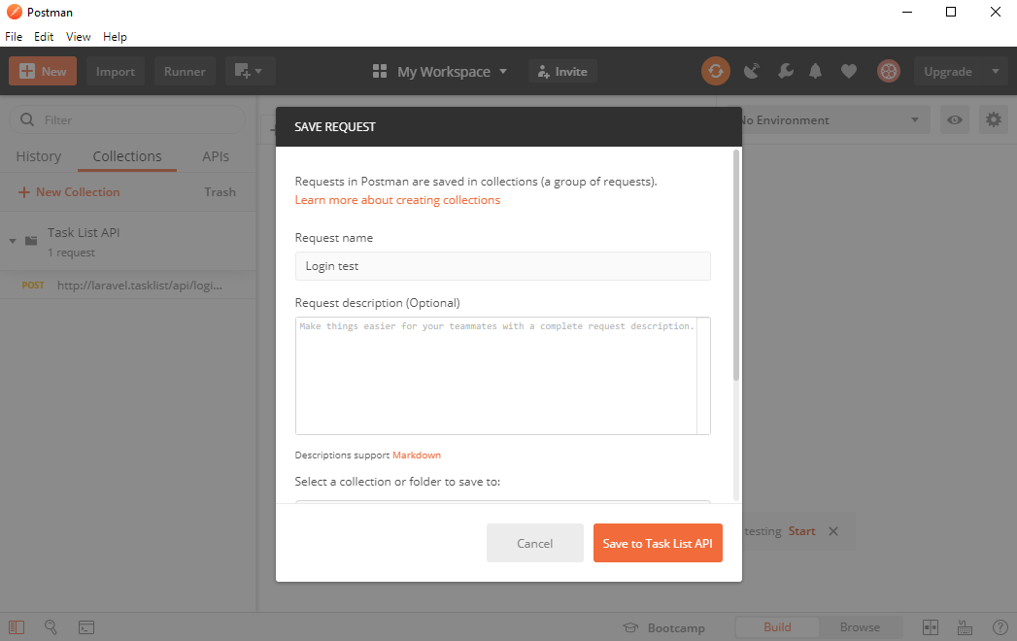
Testing the UserController routes
We will test the login route first using a existing user account
Use New > Request and name the request Login test – save it in the Task List API collection

Slide 33
Testing the UserController routes
Set the request type from the default of GET to POST as required by our login route
Add the URL to our API’s login function
Notes:
Note the /api subfolder which is assumed for routes in the api.php file, this keeps it separate and distinct from http://laravel.tasklist/login which will hit the web application rather than the API

Slide 34
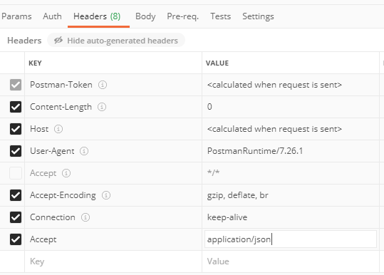
Testing the UserController routes
We need to tweak the headers to specify that we want a JSON response
Open the headers tab and uncheck the Accept *\* header
Add a new Accept header with a value of application\json

Slide 35
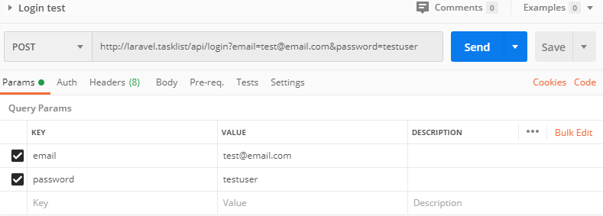
Testing the UserController routes
Open the Params tab and enter key / value pairs for email and password for one of your existing Task List application user accounts

Slide 36
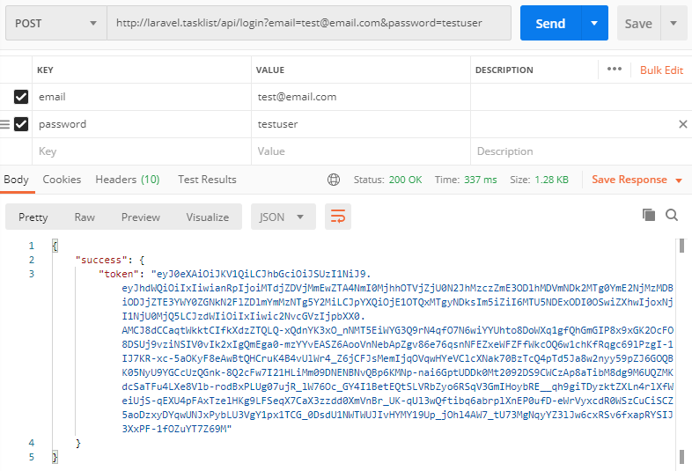
Testing the UserController routes
Press Send, if the email and password are correct, the API should return a success message and an authentication token – save the request

Slide 37
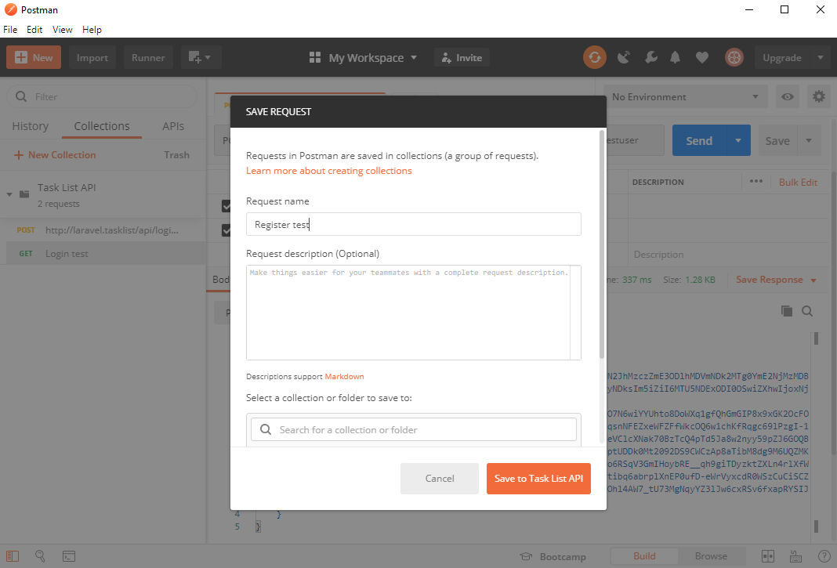
Testing the UserController routes
Create a new request named Register test then save to Task List API

Slide 38
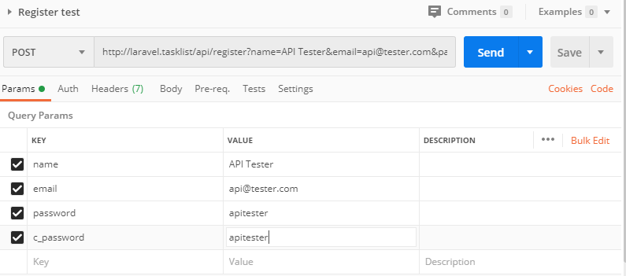
Testing the UserController routes
Set the request type to POST and add the URL to the API register function
Add key / value parameters for a new user registration (name, email, password and c_password)

Slide 39
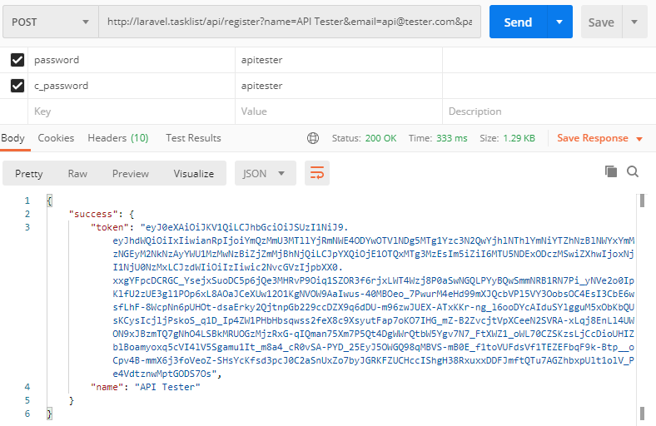
Testing the UserController routes
Set the Accept header to application/json as before and test the request
Providing the new user data passes validation, a new user account should be created and an authentication token returned
Notes:
You can also test that the new account has been created successfully by examining the contents of the users table in PHPMyAdmin

Slide 40
Testing the UserController routes
Finally, we can test a logged in route, details which should return details about the currently authenticated user as a JSON blob
Create a new request named Details test, set the request type to POST and the URL to http://laravel.tasklist/api/details
We do not need any parameters for this route, only headers
Set the Accept header to application/json as before
We also need to set an authorisation header but we need the authorisation token before we can do this
Return to the Register test request, the response should still be open, and copy the token text as shown on the next slide

Slide 41
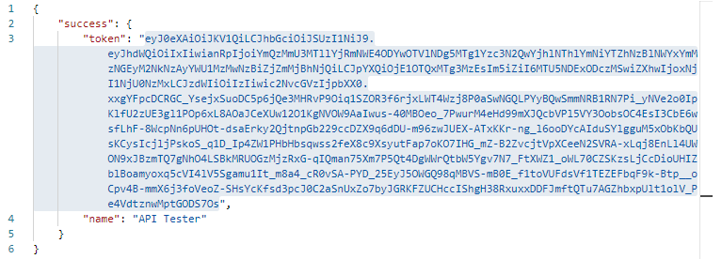
Testing the UserController routes
Copy the authorisation token from Register test

Slide 42
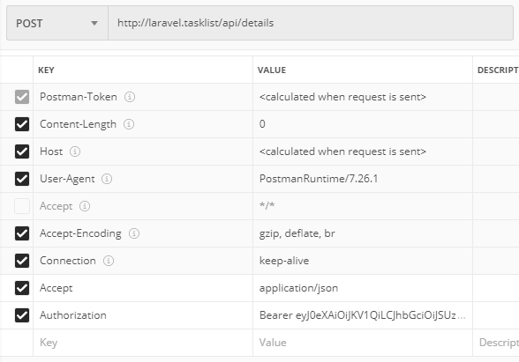
Testing the UserController routes
Add a new header to Details test named Authorization (American spelling) – add the data Bearer and a space, then paste in the token

Slide 43
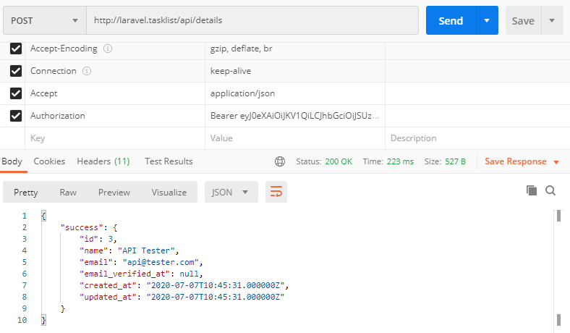
Testing the UserController routes
Press Send, and the API should return the user associated with the security token, the new account that has just been set up
Make sure that you save all of these requests in Postman for later reference, they come in very handy!
Notes:
For more robust testing, try to send invalid or un-validatable requests – see which errors are generated and returned
Make sure that you always use the Accept - application/json header

Slide 44
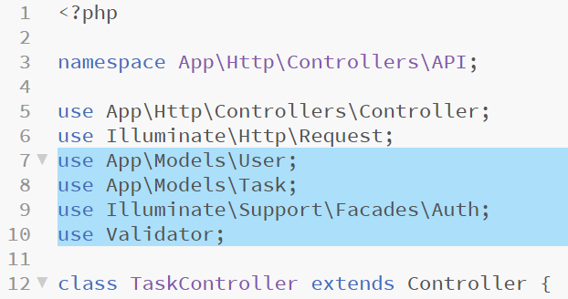
Coding TaskController methods
We will begin as we did with UserController, by adding the use statements for all included libraries and models required by this class
Add the highlighted code
Notes:
These are the same as for UserController with the exception that we require the Task model as well as the User model in this instance

Slide 45
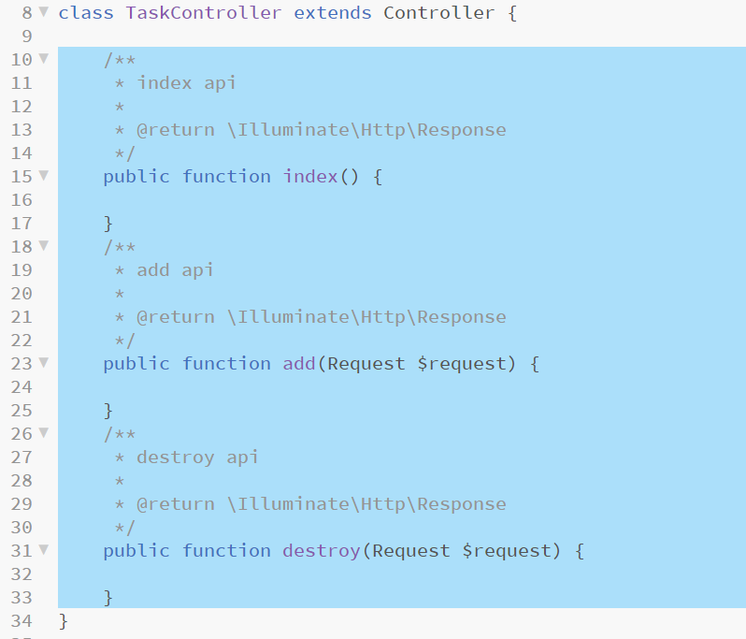
Coding TaskController methods
We have already created our API TaskController, open it in Brackets and add the method names to correspond with the routes coded in api.php
Add the highlighted code

Slide 46
Coding TaskController methods
We will begin with the index method, this will return all tasks for the current user
First we retrieve the currently authenticated user (again, this method is wrapped with authentication middleware so we WILL have a currently authenticated user if we have got to this method)
We then retrieve all tasks for that user, JSONify them and return them
Add the highlighted code
Notes:
Line 22 ask Auth to return the current user, and then uses the id property to add to the Eloquent request for all Task records which match this user id
Line 25 returns a success response (even if there are no tasks yet, the request itself has succeeded)

Slide 47
Coding TaskController methods
Next, we will code the add task method
Begin this method by validating the new task’s name, presented in the request in the same way as we did in the equivalent web TaskController
If the validation fails, return a JSONified 401 with the generated error text
Add the highlighted code
Notes:
This code is almost identical to the process in the UserController so see there for more information

Slide 48
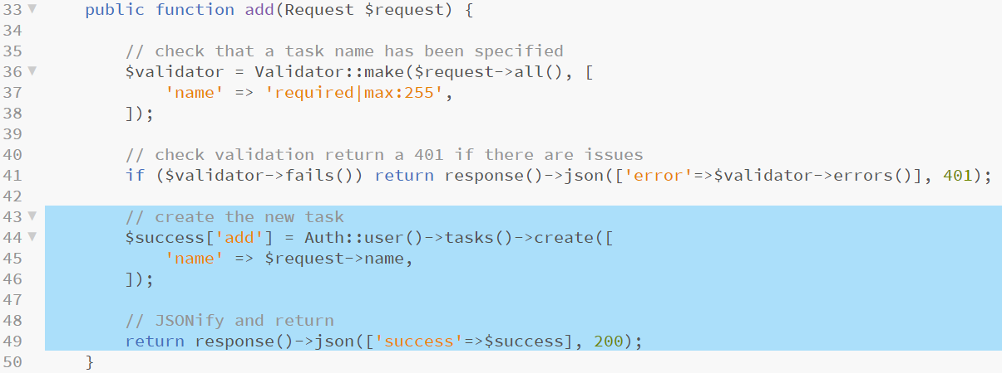
Coding TaskController methods
If the add new task request passes validation, create a new Task for this User and return it into an ‘add’ property of the $success associative array
JSONify this new task and return it with a HTTP 200 status
Add the highlighted code
Notes:
Line 44 adds a new key to the $success array named add, it assigns the new Task created by retrieving the logged in user with Auth::user() as before. As the User model knows about the Tasks model, we can use the create method as we did in the equivalent web controller to create a new Task object assigned to this User. We only need to pass the name param from the request into this as before.

Slide 49
Coding TaskController methods
Finally, we can now code the destroy method
First we make sure that a task has been selected for deletion using the Validate class this time requiring a param of task_id
We return an appropriate error should the task_id not be found
Add the highlighted code

Slide 50
Coding TaskController methods
Next, check if the Task to be deleted actually exists
Try to retrieve the Task specified in the request, if the result === null then that Task does not exist and another error is generated and returned
Add the highlighted code

Slide 51
Coding TaskController methods
We now know that we have a Task under threat of deletion but we still need to check if it belongs to the currently authenticated user
We will not be using a policy for this as with the web equivalent as the User and Task objects are retrieved independently of each other in this instance we need only compare User->id with Task->user_id to make sure that they match
If they do not, another error is generated and returned
Add the highlighted code

Slide 52
Coding TaskController methods
We now know that the Task exists and belongs to the current User, we can proceed with its removal
We can use the Eloquent delete method to remove this Task simply, we trap the response and return it in the $success associative array as before
Add the highlighted code
Notes:
This completes the TaskController methods

Slide 53
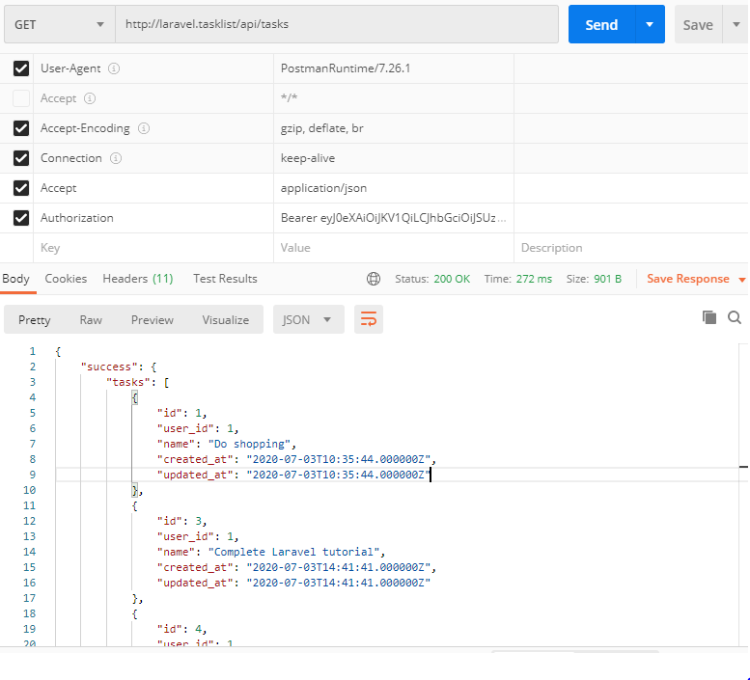
Testing the Tasks API routes
With all of the coding for this project complete, all that remains is to test our new task routes in Postman
Create a new Request named Task list test
Method: GET
URL: http://laravel.tasklist/api/tasks
Headers:
Accept: application/json
Authorization: Bearer <token text*>
Notes:
* Take the token text from a previously created user account which actually has some tasks associated with it – or do the next test first and then come back to this one

Slide 54
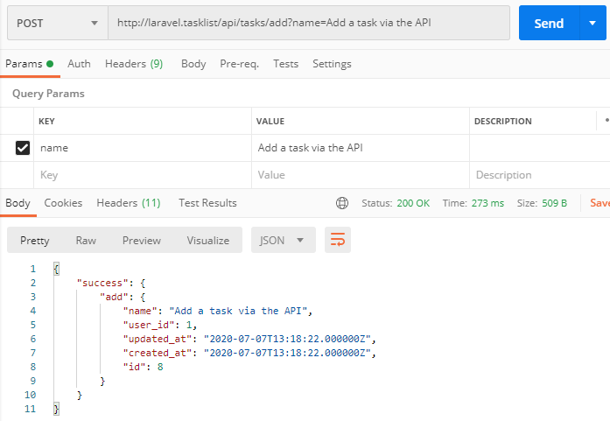
Testing the Tasks API routes
Create a new Request named Task add test
Method: POST
URL: http://laravel.tasklist/api/tasks/add
Headers:
Accept: application/json
Authorization: Bearer <token text>
Params:
name: <whatever text you like>
Notes:
You can double check that this task has completed successfully by having a look at the tasks table in PHPMyAdmin

Slide 55
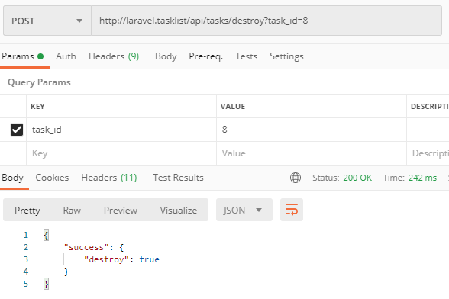
Testing the Tasks API routes
Create a new Request named Task destroy test
Method: POST
URL: http://laravel.tasklist/api/tasks/destroy
Headers:
Accept: application/json
Authorization: Bearer <token text>
Params:
task_id: <the id number of any task>
Notes:
You can double check that this destroy has completed successfully by having a look at the tasks table in PHPMyAdmin

Slide 56
You have now built a web service!
That’s all that is needed to transform an existing Laravel web application project into a web service API
The beauty of this approach is that the web application still works just as it did before meaning that you now have a choice of interactive approaches to any application that you choose to build
It is more work to build a web application first, then convert it to an API but this approach also has a few benefits
You can test that the application works as a complete and finished project which means that you can test the application flow as well as the availability of data
Most of the controller logic and routing issues will be thrashed out during the web build where it is easier to debug if there are errors

Slide 57
Project review
Web services are APIs
Laravel can support APIs very easily
Using Passport to provide authentication tokens
API routes are separate from web routes (so can have the same path)
New controllers should be built to keep logic separate (although this is not 100% necessary it avoids confusion)
APIs return JSON blobs and HTTP response codes to indicate the status of the request
These blobs can and should be picked up and used by a client application
This unit is concerned with Web Services and now you have had experience of building one
In the coming weeks we will investigate client systems which can use the data provided by web services
The more of this you can put into your own projects, the more likely you are to achieve a strong outcome to this unit

Slide 58
Session review
BSc Applied Computing

Slide 59
Recap
Recap Laravel Task List project
Last exercise progress
Server-side OOP PHP framework for both web applications and APIs
Object-relational mapping (ORMs) – Eloquent and implicit model bindings
Composer and package managers
MVC
Authentication, Validation, Policies
Laravel and APIs
What is an API?
Stateful vs RESTful (recap)
Do I need a framework?
Which Laravel aspects are required?
Converting the Task List app to an API
Project setup
Project development workshop

Slide 60
Any questions?
Next…
Introduction to JavaScript – working towards a web services client and a websockets client/server application

