Slide 1
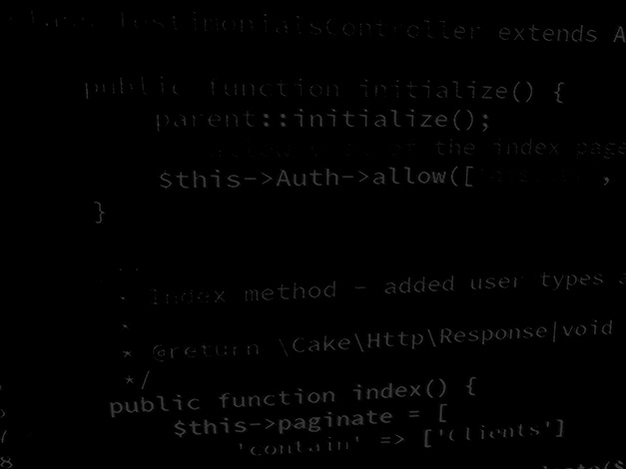
Server-side coding with PHP and Laravel Development environment setup
BSc Applied Computing

Slide 2
In this session…
Environment configuration rationale
Framework use – web root issues
Cross-Origin Resource Sharing (CORS)
Apache configuration demonstration
Windows host config (C:\Windows\System32\drivers\etc\hosts)
Enabling virtual hosts (httpd.conf)
Virtual host config (conf/extra/httpd-vhosts.conf)
Testing your configuration

Slide 3
Environment configuration rationale
BSc Applied Computing

Slide 4
Every project needs a virtual host
It is possible to serve web projects from Apache sub-folders.
Most frameworks use URL rewriting to obscure the project platform, environment and structure.
As soon as you use ANY URL rewriting, you have broken Apache’s ability to use subfolders to differentiate sites.

Slide 5
Every project needs a virtual host
The solution: For each new project, setup a virtual host.
Virtual hosts are a common configuration which allow for many websites to be hosted on the same (shared) webserver.
Each virtual host thinks that it is the entire server meaning many framework projects can exist on the same physical server without issue.

Slide 6
Cross-origin resource sharing (CORS)
Web applications and web services mostly operate from the same domain but this is not always possible.
Sometimes it is necessary to operate across domains (the server application is not in the same domain as the client application).
CORS prevents malicious, duplicate client applications to pharm data from a server.
This is a web-application-specific problem (not applicable to application sockets).
Setting up 2 virtual hosts (one server and one client) allows for us to test that our webservice API is compatible with CORS.
This will be important for assignment 2.
We will deal with the specifics of CORS in more detail when we have our own API to test against (it is really simple to deploy in Apache).

Slide 7
Apache virtual hosts configuration
BSc Applied Computing

Slide 8
Prerequisites
This session assumes that you have the following software installed:
XAMPP (Apache, PHP, MySQL, PHPMyAdmin)
Notepad++ (for editing config files)
Visual Studio Code (for coding)
Add the following VS code extensions:
PHP Extension Pack
HTML CSS Support
CSS Formatter
Format HTML in PHP
HTML Snippets

Slide 9
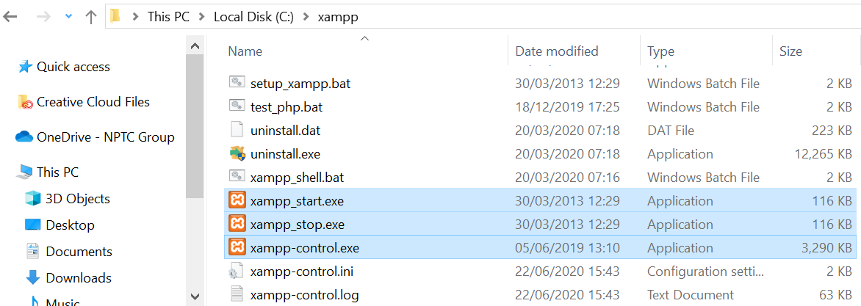
Run as administrator
Make sure that XAMPP is set to run as administrator:
The following assumes a standard XAMPP install in C:\XAMPP and a Windows OS.
Open File Explorer and find the files shown below in the XAMPP folder.

Slide 10
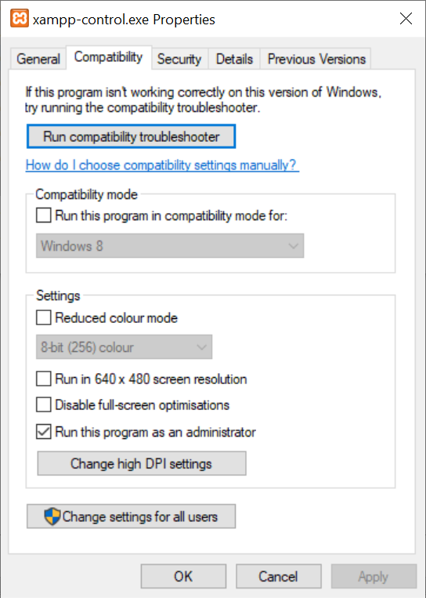
Run as administrator
For each of these three:
Right click-> select properties
Open the compatibility tab
Check “Run this program as administrator”
Press “OK”
Now open C:\xampp\mysql\bin
Do the same for:
Mysql.exe
Mysqld.exe
Now open C:\xampp\apache\bin
httpd.exe

Slide 11
Run as administrator
Windows 10 has an issue with XAMPP where MySQL can corrupt its own privileges table if not run as administrator.
I became aware of this issue once it had happened to me.
The MySQL install took me a whole morning to fix.
Running as admin should* prevent this.
*No promises!

Slide 12
Make a folder for your project
Have a name in mind for your project.
Make a new folder for it.
The folder can be anywhere but is best placed in the folder XAMPP. already uses to serve web projects.
C:\XAMPP\htdocs
We will create a test project called “VhostTest” so make a folder as shown below (do not use spaces).
C:\XAMPP\htdocs\VHostTest

Slide 13
Editing the hosts file
Virtual hosts map to specific URL requests.
We do not want to register a new domain each time we start a new project as this will quickly get expensive.
We need to fake some DNS so that our development machine thinks that it is the host for the URL that we will use.
To do this we will (mis)use the Windows hosts file.*
The hosts file is usually used to allow the configuration of a small peer to peer network.
*Hosts is a Windows file. Please do not edit other operating system files in this way or you risk damaging your operating system

Slide 14
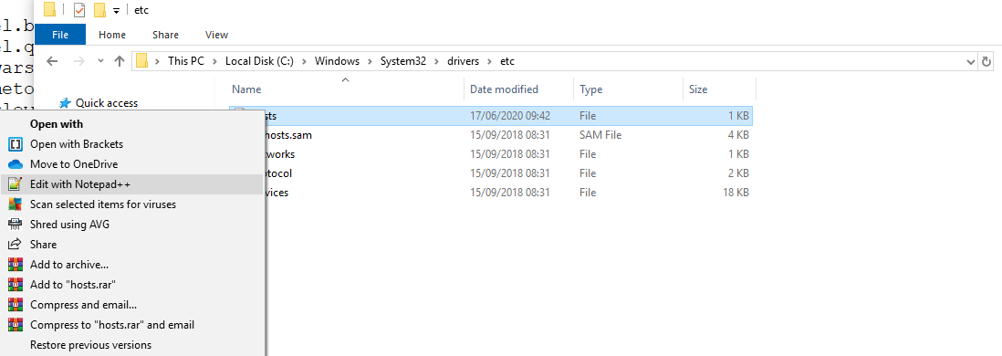
Editing the hosts file
The hosts file is located at:
C:\Windows\System32\drivers\etc\hosts
Open the hosts file by right-clicking and selecting:
Edit with Notepad++

Slide 15
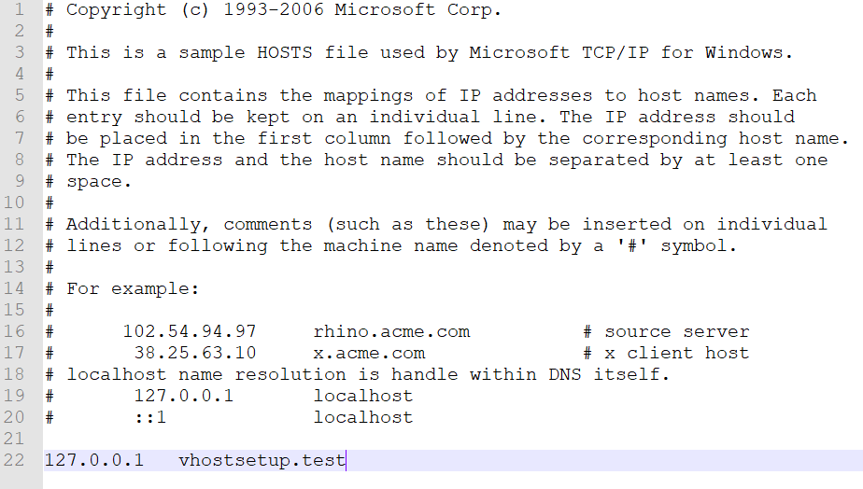
Editing the hosts file
The hosts file contains largely comments by default (lines that start with #) - Add the highlighted line below.

Slide 16
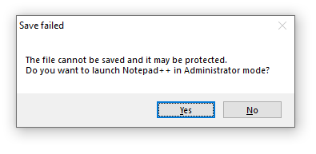
Editing the hosts file
Save the hosts file (CTRL+S)
You may get this prompt
Press “Yes” and then save as normal
Notepad++ can switch easily to administrator mode (which is why we are using it)

Slide 17
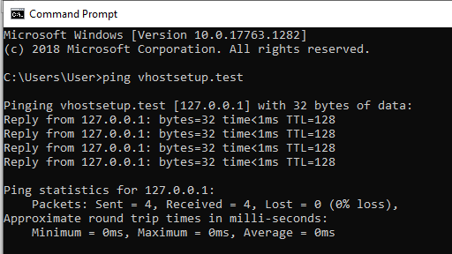
Editing the hosts file
We have now mapped our new domain (vhostsetup.test) to 127.0.0.1 which is the IP address for localhost.
We can test that this works with CMD – type ping vhostsetup.test.
If you see a reply from 127.0.0.1 the hosts file edit was successful and our development machine thinks that it is vhostsetup.test.

Slide 18
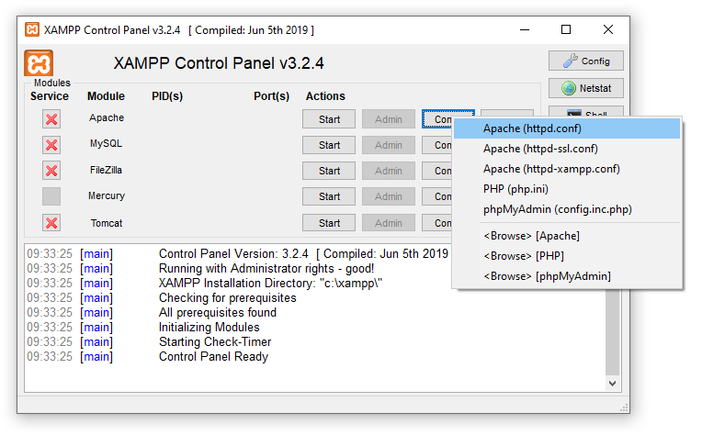
Apache virtual host setup
Open the XAMPP control panel.
The top row of controls are for Apache.
Select Config > Apache httpd.conf

Slide 19
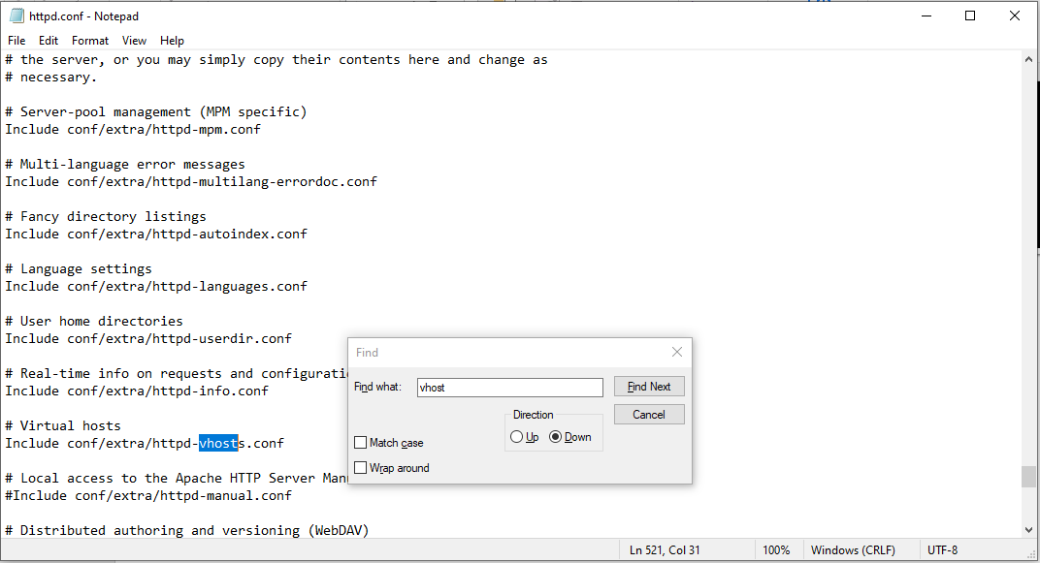
Apache virtual host setup
The main Apache config file should open in Notepad.
Use CTRL+F (or Edit > Find) and search for vhost.
Look for the line shown below (it will not be the first match).
Make sure the line does not start with # as shown below.

Slide 20
Apache virtual host setup
Now that we know that Apache is expecting virtual hosts we need to tell it about the site that we want to add as a new virtual host.
Using Windows Explorer find:
C:\xampp\apache\conf\extra\httpd-vhosts.conf
Right click and select Edit with Notepad++.
(see next slide for a visual example)

Slide 21
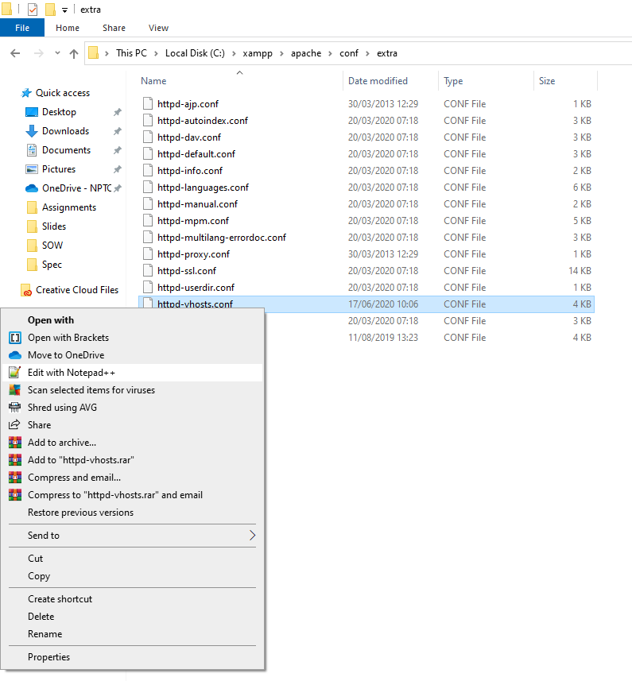
Apache virtual host setup

Slide 22
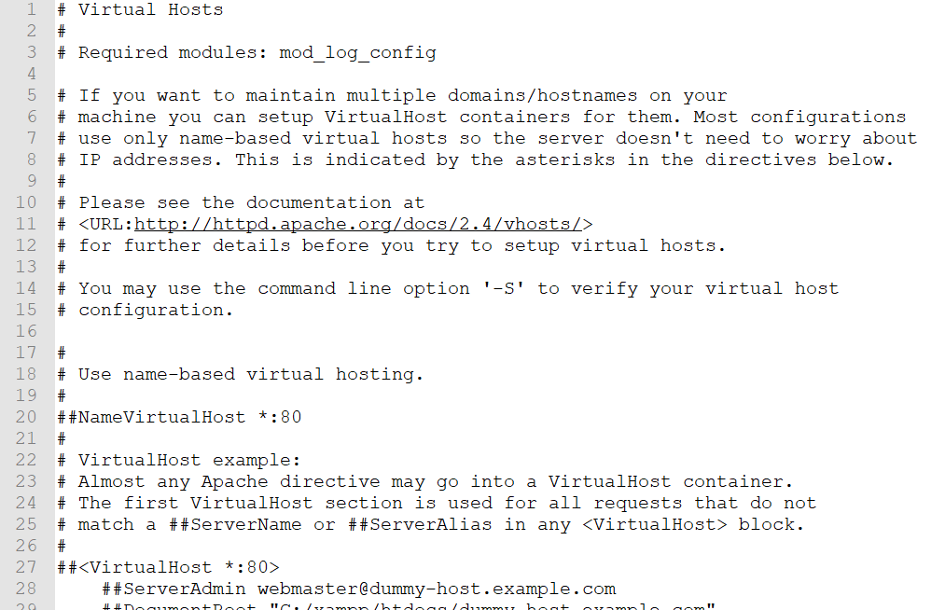
Apache virtual host setup
The virtual hosts config file should open in Notepad++.
By default, this file contains mainly commented example virtual host. configurations and notes for use of the file.

Slide 23
Apache virtual host setup
Add a few lines to the end of the file and add the following new virtual host config for the new web project.
Be very careful with spelling and capitals!
Save the file when finished.
Note: DocumentRoot and Directory are set as the path to the folder that we created, ServerName is set to the URL that we added to the hosts file.

Slide 24
Testing the new virtual host
BSc Applied Computing

Slide 25
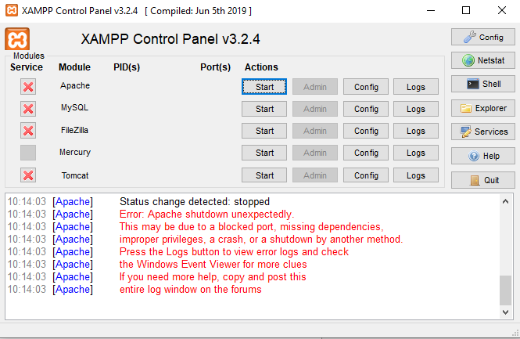
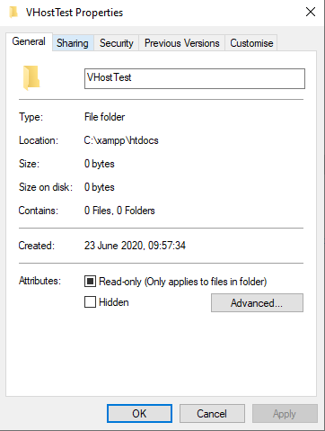
Testing the new virtual host
The first stage of testing is to start Apache.
If Apache starts successfully then the edits have been entered correctly.
If Apache fails to start:
Check the configuration in httpd-vhosts.conf VERY carefully.
Make sure that the properties of the new folder does not have a check in Read-only.

Slide 26
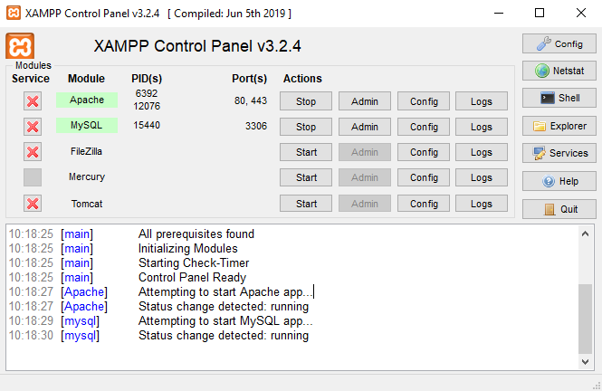
Testing the virtual host
If everything is configured correctly, both Apache and MySQL should be able to be started without issue

Slide 27
Testing the virtual host
Next, make a quick web page to test the virtual host.
Create a file named index.html in:
C:\xampp\htdocs\VHostTest
Using a text editor, add the following code and save the file:

Slide 28
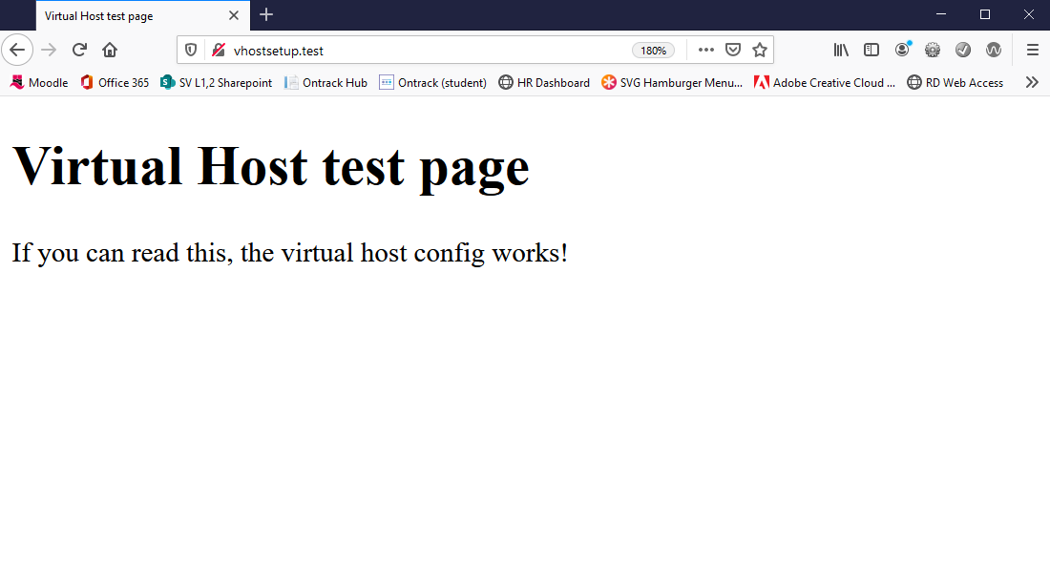
Testing the virtual host
Finally, open a web browser and enter the URL for the new virtual host. http://vhostsetup.test

Slide 29
Virtual host setup notes
BSc Applied Computing

Slide 30
Virtual host setup notes
This process may seem long and drawn out but it actually quite quick when you get the hang of it.
Every new exercise or project should have its own virtual host.
Make up a new folder name and URL for each and add them to the windows hosts file and the Apache httpd-vhost.conf file as needed.
Apache can handle many more virtual hosts than you will need it to so do not worry about adding more as you start new projects.

Slide 31
Virtual host setup – next session
Next week’s project is to build a higher or lower guessing game, test your understanding by setting up a virtual host ready for this project.
Make a folder called higherlowerPHP.
Setup a hosts record for the URL higherlower.game.
Setup the virtual host entry.
Test with a copy of the simple HTML page used earlier.

Slide 32
Virtual host and URL rewriting, additional Apache resources
BSc Applied Computing

Slide 33
Virtual host and URL rewriting resources
Apache virtual hosts setup documentation.
Introduction to URL rewriting.
Mod_rewrite config.
Mod_rewrite cheat sheet.
Rule debugger.

Slide 34
Any questions?
Next session
Learning PHP #1

