Slide 1
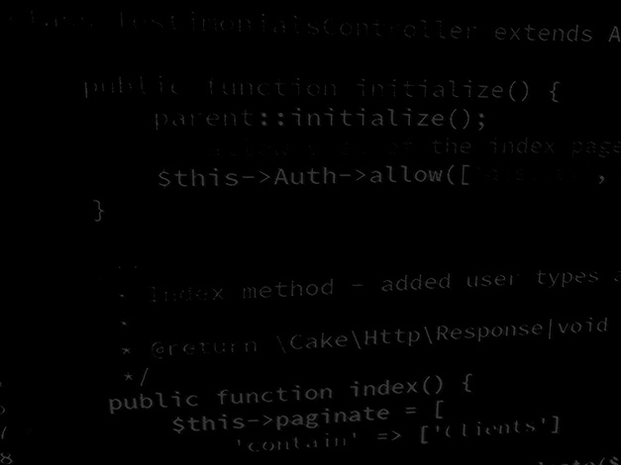
Major Project and Research Methods Writing an Abstract
BSc Applied Computing

Slide 2
In this session…
Why write an abstract?
Purposes of abstract.
Checklist.
Editing an Abstract.

Slide 3
Writing an Abstract
Major Project and Research Methods

Slide 4
Why Write an Abstract?
As a fundamental aspect of your Major Project Report, you will be required to condense the contents of the report to form an Abstract.
This Abstract will then form the initial section of the report.
Online databases of technical papers can only show the paper’s abstract.
It is up to the reader to work out from the abstract if the paper as a whole is worth reading or buying.
The abstract exists to sell your work.
An abstract is generally 100-200 words long.
Extended abstracts can be 400-500 words.

Slide 5
The Purpose of an Abstract
Abstracts typically serve five main goals:
Help readers decide if they should read the entire article.
Help readers and researchers remember key findings on a topic.
Help readers understand a text by acting as a pre-reading outline of key points.
Index articles for quick recovery and cross-referencing.
Allow supervisors to review technical work without becoming bogged down in the details.

Slide 6
Abstract checklist
Motivation:
Why do we care about the problem and the results?
How important is the work?
How difficult is it?
Problem statement:
What is the problem you’re trying to solve?
What is the problem scope?
Do not use too much jargon.
This is generally squeezed into the first sentence or two.

Slide 7
Abstract checklist
Approach:
How did you solve the problem?
How are you making progress on the problem?
Is it simulation, modelling, construction, data analysis, experiment…?
What was the extent of the research?
What variables did you measure, control or ignore?
The structure of this section should follow the organisation of the paper itself. Think of it as an outline of the paper.

Slide 8
Abstract checklist
Results:
What’s the answer?
Is it smaller/faster/cheaper?
Provide the actual final numbers
Conclusions:
What are the implications of your work?
Is it going to change the world?
Does it show that this approach is a waste of time?
Are your results general, potentially generalisable or specific to a particular test case?

Slide 9
Editing the Abstract
The first version of an abstract is often created by copying and pasting sections from the paper.
This generally includes words that are unnecessary and can easily be removed.
Once the extra words are gone, check that each sentence leads smoothly into the next.
You may need to combine sentences to make logical connections clearer.
Do not condense so far that it is unreadable!
Polish the style.
Never use ‘I’.

Slide 10
In this session…
Recap:
Project Proposal
Quality Management for IT Projects.
Academic Research Quality.
Relevance for the Project Proposal.
Task/Workshop.

Slide 11
Any questions?
No?
Work on the Project!

