Slide 1
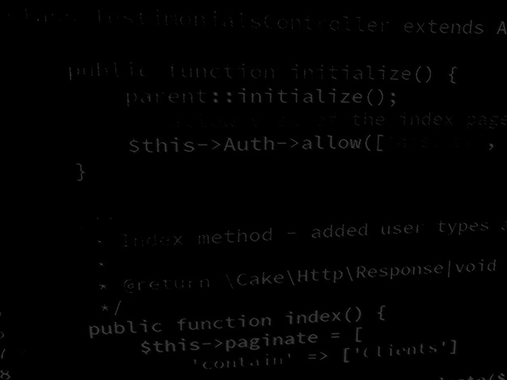
Data handling in Application development MVC project rebuild
BSc Applied Computing

Slide 2
In this session…
Last Session
MVC architecture
Interfaces
Data classes
Static vs instantiated classes
Session Rationale
MVCing the Result Calculator project
Result Calculator project
Step by step code with explanations

Slide 3
Last session
BSc Applied Computing

Slide 4
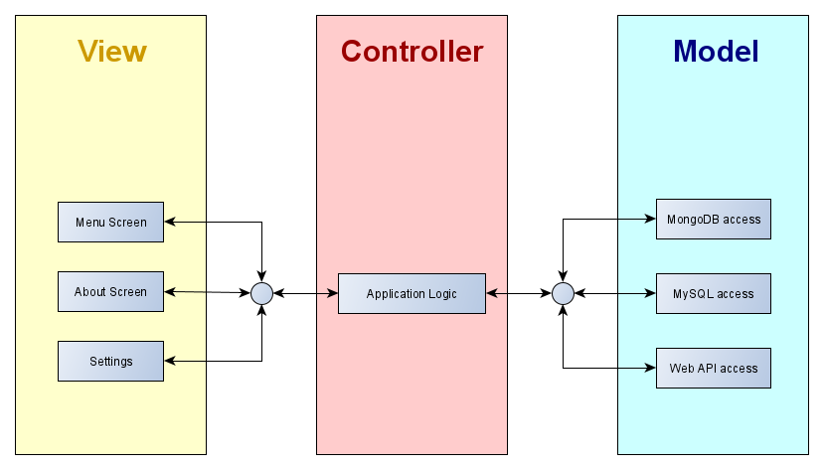
MVC architecture
MVC divides a build up into specific functional areas.
Best achieved by adopting the object-oriented programming paradigm.
Allows a clean division of labour, the database interface programmer does not need to know anything about the code created by the UI designer, or vice versa.

Slide 5
Interfaces
Interfaces are a special type of object.
Interfaces are never instantiated or extended.
The interface forces all classes to respond to an application similarly.
An interface defines the methods which any class implementing them must include.
In the example below, any class implementing this interface must include:
A method named getName which returns a String.
A method named setName which accepts a single String as an argument.

Slide 6
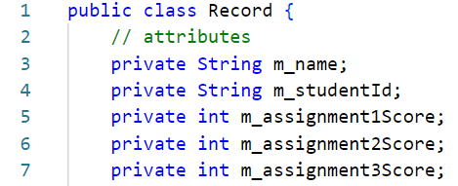
Data classes
MVC architecture applications often employ data classes. *
These are instantiated with a single record of data and stored in a collection (ArrayList, HashMap, etc).
Using data classes significantly simplifies data handling.
For our Result Calculator, we could define a class with the following fields:
Storing the data like this avoids all of the parsing that the last version of the application required.
Notes:
* In Java these are often referred to as POJOs (Plain Old Java Object) or Java Beans (kind of, our example above is not quite a Java Bean as it does not implement the Serializable interface). In Python they are data classes. Other languages may use other terminology, the idea is the same.

Slide 7
Static vs instantiated classes
“A static class […] is a type of class which is instantiated only once in a program. It must contain a static member (variable) or a static member function (method) or both. The variables and methods are accessed without the creation of an object.”[1]
“Instantiating means to create an instance of an object in […] memory. Instantiated classes are those classes which require an object to be created before it’s variables and methods are called. It is similar to a normal class used in C++, Java and other programming languages. These classes can be instantiated more than once and holds unique values for each of its object.”[1]
Instantiated classes are only in memory while active and can be destroyed.
Static classes are always in memory.
Notes:
1: GeeksForGeeks. When to use static vs instantiated classes in PHP? Available at: https://www.geeksforgeeks.org/when-to-use-static-vs-instantiated-classes-in-php/. Last Accessed: 5/8/22.

Slide 8
Session rationale
BSc Applied Computing

Slide 9
MVCing the Result Calculator project
Model:
Java bean class for storing student record data.
Access interface which dictates how the application can load and save data.
Class which controls loading and saving data to a CSV.
View:
Main UI window.
Add and edit record window.
Controller:
Main application logic (where the initial main method is).
This is not THE solution… it is A solution.
Notes:
* There are actually a two more classes required but these are quite specific and will be covered in more detail later.

Slide 10
Static vs instantiated classes
Static classes should be used where their functionality is required only once (such as application logic).
Instantiated classes should be used:
When there is more than one instance of the class required and these instances contain different data (such as a Java Bean).
Where performance heavy aspects of the application (such as the UI) can be removed from memory when no longer required.
Considering the Result Calculator:
Both view UI classes will be instantiated to improve performance. *
The Java bean class will need to be instantiated once for each student record.
The CSV load / save class uses an interface and so needs to be instantiated.
The application logic is singular and should be static.
Notes:
* In this instance, the main window is always in memory… but as the application could be modified to remove or hide it when not in use and as Swing required an instantiated object, we will use that model.

Slide 11
Project design
For our Result Calculator project:
We have separated the application into functional units using the MVC architecture model.
We know how many classes we will need.
We know which types of classes these will be.
We have already built the application logic once.
Some of this will have to change as the application will now access a list of objects rather than a list of CSV strings.
Much of the remaining logic will be very similar.
We will reuse the design materials from the first build (screen designs, algorithms, requirements).

Slide 12
Result calculator project
BSc Applied Computing

Slide 13
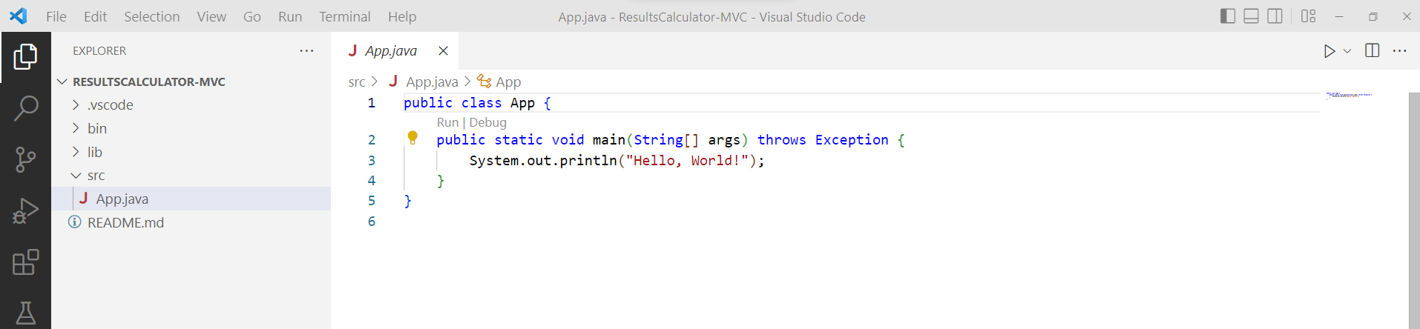
Project design
With a clear design to work from we can proceed with the build…
Project start up:
Open VS code
Use CTRL+SHIFT+P or View > Command Palette…
Select Java: Create Java Project… (select No Build Tools if prompted).
Select a suitable development folder
Add the project name ResultCalculator-MVC.

Slide 14
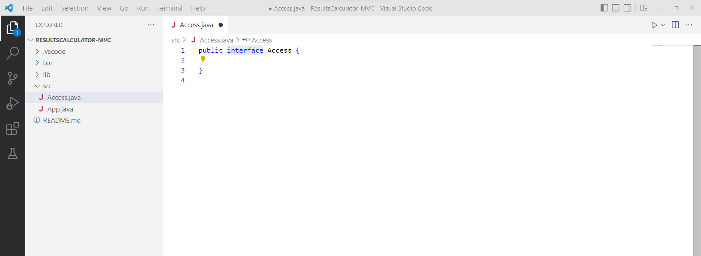
Create an interface
Add a new class to the src directory by opening the Command Palette* and selecting Java: New Java Class.
Give the new class the name Access.
Change the declaration from class to interface as highlighted.
Notes:
* The command palette can be opened with either CTRL+SHIFT+P or View > Command Palette…

Slide 15
Code the interface
The interface will need to declare a few methods which any class implementing this interface will then be bound to include.
Necessarily interfaces are quite brief and this is all the code needed.
Add the highlighted code including the import statement. *
Notes:
* Clarification
Line 4 declares a method named saveData which accepts an ArrayList of Record objects and returns a boolean to indicate success or failure of the operation (we have not coded the Result object yet). This method will be used to save any current data to file.
Line 5 declares a method named loadData which returns a boolean to indicate the success or failure of the load operation. This method will retrieve saved data from a file and make it ready for use in the application.
Line 6 declares a method named getErrorText which returns a String. It will be used to retrieve any error messages generated by load or save operations.
Line 7 declares a method named getResults which will return an ArrayList of all currently loaded Record objects (we could do this after a load operation but separating these processes can provide more flexibility).

Slide 16
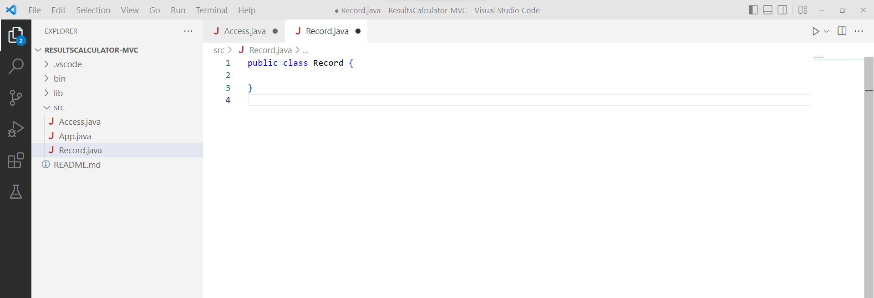
Create the data class
Next, we will add the data class which will be instantiated, each instance holding a single student record.
Add a new class to the src directory by opening the Command Palette* and selecting Java: New Java Class.
Give the new class the name Record.
Notes:
* The command palette can be opened with either CTRL+SHIFT+P or View > Command Palette…

Slide 17
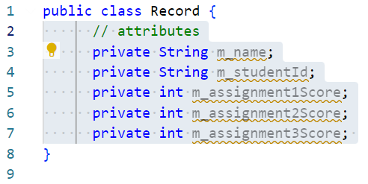
Code the data class
Begin coding the data class with the attributes needed to store each student record.
We need Strings to store the student’s name and id.
Each assignment result will be stored in it’s own int.
The application can do any further maths required for us.
Add the highlighted code. *
Notes:
* Clarification
These attributes are all named with an m_ prefix. The m stands for member. This is a coding style which helps identify when an attribute is manipulated via a getter, setter or directly (this is more obvious by default in Java when compared to other languages, but it does not hurt to keep a consistent style). As these are variables, there is no requirement to use m_ … but it is recommended that you do so at least until you get used to how helpful this kind of style can be.

Slide 18
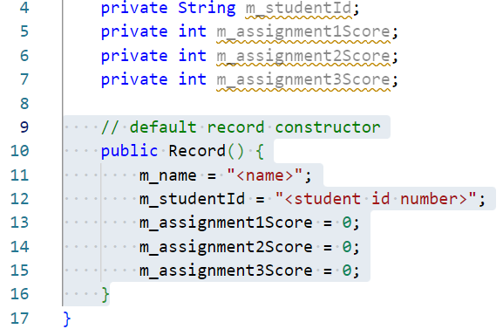
Code the data class
Next, add a constructor method which will provide some default values for the attributes.
Add the highlighted method. *
Notes:
* Clarification
Line 10 declares the constructor method (constructors do not require a return data type) which does not require arguments.
Lines 11 to 15 set some dummy data for the new record.

Slide 19
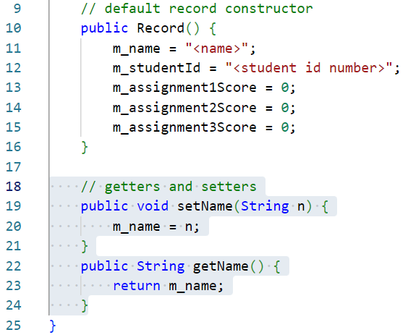
Code the data class
Add getter and setter methods for the m_name attribute.
Add the highlighted methods. *
Notes:
* Clarification
Line 19 declares a setter method for the student’s name. It accepts a single argument of the string to set.
Line 22 declares a getter method for the student’s name which returns the String value currently set.
Notes:
1: In this instance, the getter and setter methods do little more than wrapper a private value making it act like a public value. This may seem like a waste of time. It is good practice to code member values in this way as getter and setter methods can be used to validate incoming data or to make values read-only. If used properly, they greatly improve the flexibility and security of your application.
2: I generally code getter and setter methods after the attribute block and before the constructor method. I am not sure why I did not do this here. It does not matter which order these things appear in the class but it is a good idea to adopt your own standard and stick to it… doing so will make debugging far easier as you will have a set pattern to work with.

Slide 20
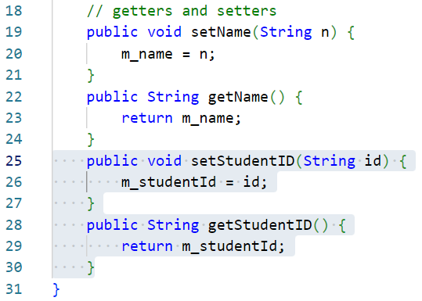
Code the data class
Add getter and setter methods for the m_studentId attribute.
Add the highlighted methods. *
Notes:
* Clarification
These work similarly to those described on the last slide.

Slide 21
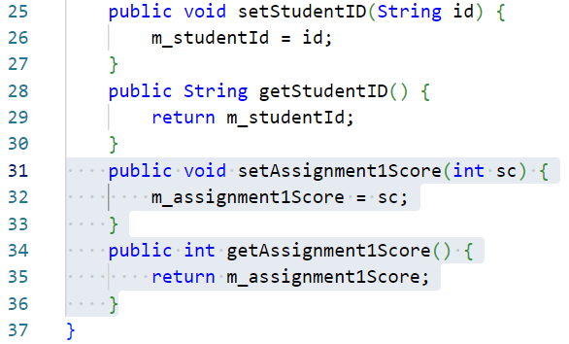
Code the data class
Add getter and setter methods for the m_assignment1Score attribute.
These methods will manipulate an int value rather than a String.
Add the highlighted methods. *
Notes:
* Clarification
These work similarly to those described on the last slides with the exception of manipulating an int attribute rather than a String.

Slide 22
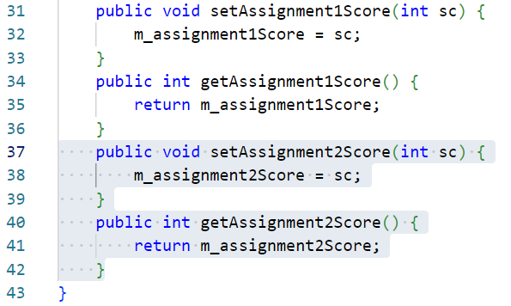
Code the data class
Add getter and setter methods for the m_assignment2Score attribute.
Add the highlighted methods. *
Notes:
* Clarification
These work similarly to those described on the last slide.

Slide 23
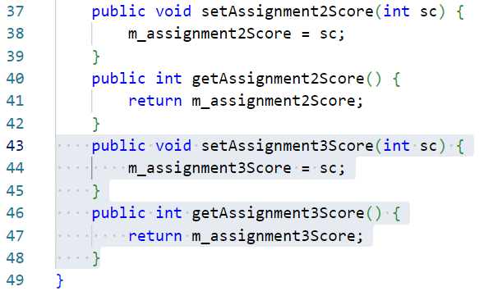
Code the data class
Add getter and setter methods for the m_assignment3Score attribute.
Add the highlighted methods. *
Notes:
* Clarification
These work similarly to those described on the last slide.

Slide 24
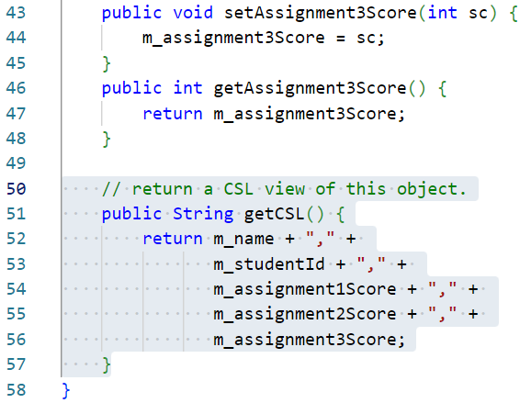
Code the data class
Add a method which returns a CSV formatted String of this object.
Add the highlighted method. *
Notes:
* Clarification
Line 51 declares a public method named getCSL (CSL = comma-separated list… another term for CSV).
Line 52 concatenates all values held in this instance of the object together with commas and then returns the resulting String.
Note: This method will provide a shortcut for us to create a CSV version of this record for saving. In later, non-CSV versions of this project, this method can be used to debug currently held data.

Slide 25
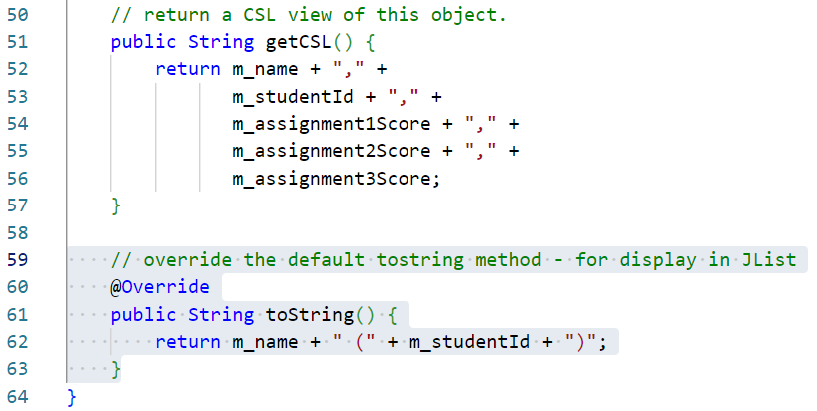
Code the data class
Override the default toString method to get a nicely formatted list entry for this object instance.
Add the highlighted method. *
Notes:
* Clarification
Line 60 declares the @Override keyword which makes sure that the following method will correctly override a supertype method (Record is a subtype of Object, and Object implements toString).
Line 61 declares the method which returns a String and which does not accept any arguments. This is the same method signature as the superclass method (Object.toString()).
Line 62 returns a nicely formatted string representing this student’s name and their ID. This will be used for displaying in the JList panel in the main UI window.

Slide 26
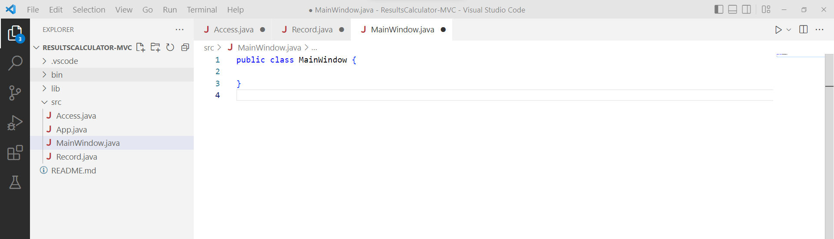
Create the MainWindow class
Next, we will add the main UI class.
Much of this code will be very similar to the previous build of this project so explanations will be brief.
Add a new class to the src directory by opening the Command Palette* and selecting Java: New Java Class.
Give the new class the name MainWindow.
Notes:
* The command palette can be opened with either CTRL+SHIFT+P or View > Command Palette…

Slide 27
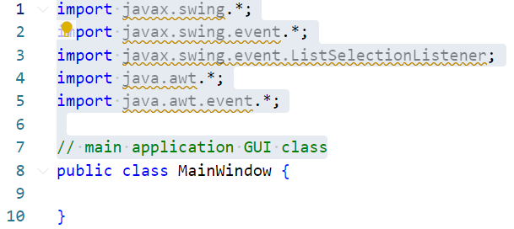
Code the MainWindow class
Add in the required AWT and Swing import statements for this class.
Make sure that the comment above the class declaration is added as the more classes get added, the harder it can be to keep track of what everything does.
Add the highlighted code. *
Notes:
* Clarification
This should be fairly straightforward at this point.

Slide 28
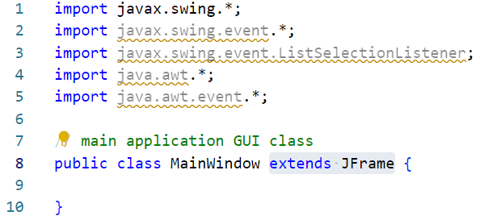
Code the MainWindow class
This class will be the main UI window.
Rather than instantiate a JFrame object and keep a reference to this in scope as controls and methods are added to it, this class will extend JFrame so the parent window will always be in scope.
Add the highlighted code to the class declaration. *
Notes:
* Clarification
This should be fairly straightforward at this point.

Slide 29
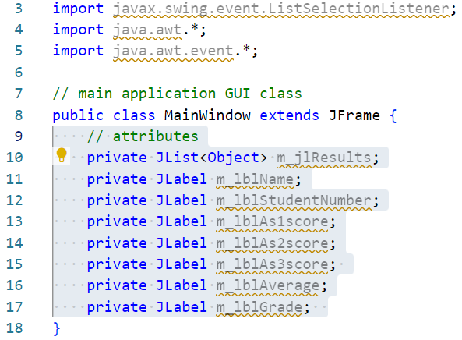
Code the MainWindow class
Add in attributes to make UI controls accessible within the class.
Add the highlighted code. *
Notes:
* Clarification
From the last build, we know that the main window has a JList to describe all records loaded and several JLabels to display whichever record is presently selected.

Slide 30
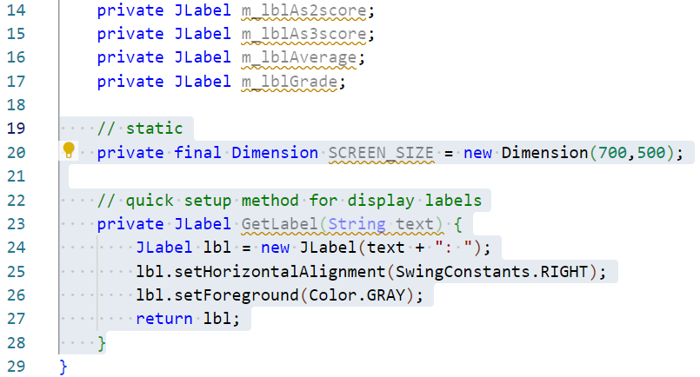
Code the MainWindow class
Add in some utilities to set screen size and label style.
Add the highlighted code. *
Notes:
* Clarification
Line 20 sets a constant value for the UI window start size as a Dimension object.
Line 23 to 28 is an identical utility method from the last build which is intended to simplify the creation of JLabel objects.

Slide 31
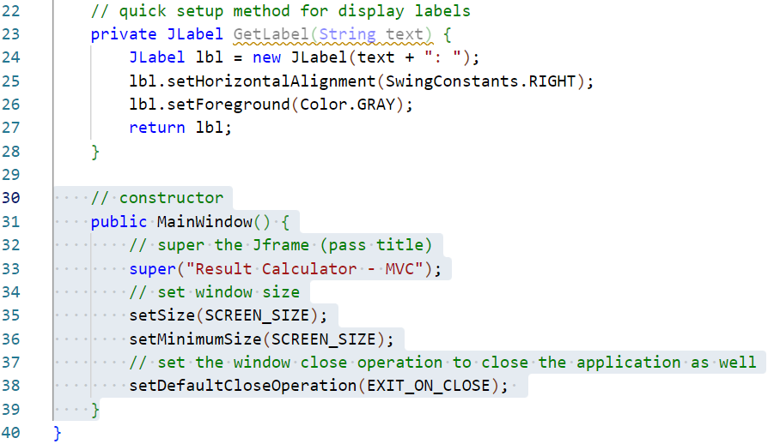
Code the MainWindow class
Add a constructor method for the MainWindow class.
Add the highlighted method. *
Notes:
* Clarification
Line 31 declares the constructor method. Constructors never return anything (as they always return a new instance of this class) and this one takes no arguments.
Line 33 uses the super method to call the JFrame class constructor and set the window text for the application.
Line 35 sets the starting dimensions for the application UI.
Line 36 sets the minimum size that the application can draw. This limits the application to be able to grow but not shrink below its initial size.
Line 38 sets the default close operation for the application, which in this case is to close the app and release all system resources when the UI is closed.

Slide 32
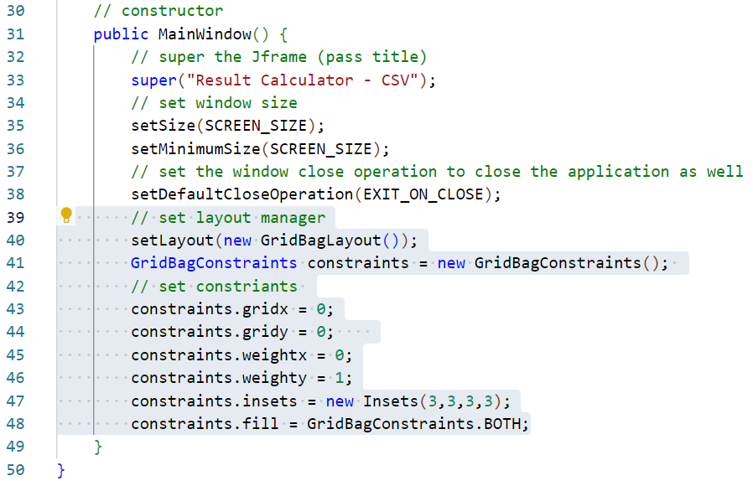
Code the MainWindow class
Add a layout manager method for the MainWindow class.
Add the highlighted code. *
Notes:
* Clarification
Line 40 declares a new GridBayLayout and sets this as the parent window layout manager.
Line 41 instantiates a new GridBagConstraints class which will be used to define how controls are placed and behave in the UI.
Lines 43 and 44 set the starting grid cell coordinates to add child controls into.
Lines 45 and 46 sets weight of the start cell. Weight controls how the cell will expand. The higher the number, the more the cell will expand in relation to its neighbours. A value of 0 indicates that the cell will not expand beyond the space needed for its contents.
Line 47 sets insets (margins) for the cell.
Line 48 tells the cell to try to expand both horizontally and vertically according to its weight.

Slide 33
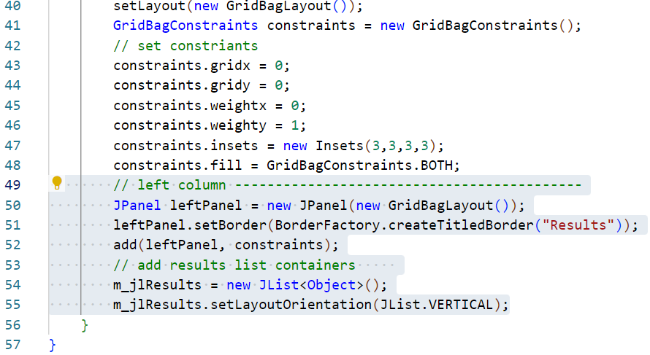
Code the MainWindow class
Add a begin coding the left column controls.
Add the highlighted code. *
Notes:
* Clarification
Line 50 declares a new JPanel instance and assigns it a GridBagLayout layout manager.
Line 51 draws a border around this panel with a title (similar to the GroupBox control in MS Forms), this takes one argument which is the text to display on the border, Results.
Line 52 adds this new panel to the window using the current constraints object (this was set up in the previous step).
Line 54 instantiates a JList control with a collection of Objects as a data source. This is stored in the global m_jlResults object (m = member and jl = JList) .
Line 55 sets the orientation of the list to vertical.

Slide 34
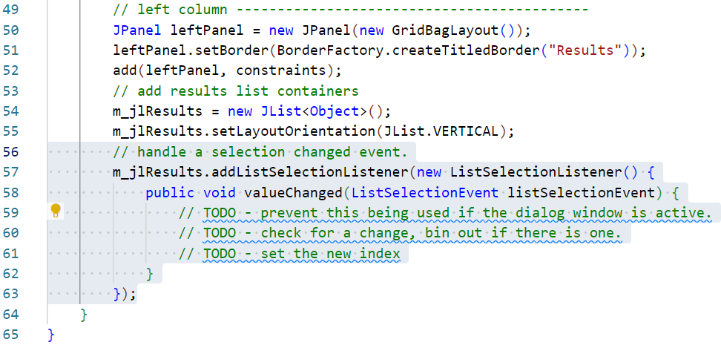
Code the MainWindow class
Add an event listener to detect when the user selects a new record.
Add the highlighted code. *
Notes:
* Clarification
Lines 57 to 63 add a ListSelectionListener to the JList. This object contains the valueChanged event which will fire when the user changes the selected item in the list.
Line 58 adds the required valueChanged method, which we cannot presently implement as we have not coded any application logic, or in fact the Controller class which will contain these.
Lines 59 to 61 are TODO statements which will call methods in the controller class which has not been coded yet. We will return to these later in the build.

Slide 35
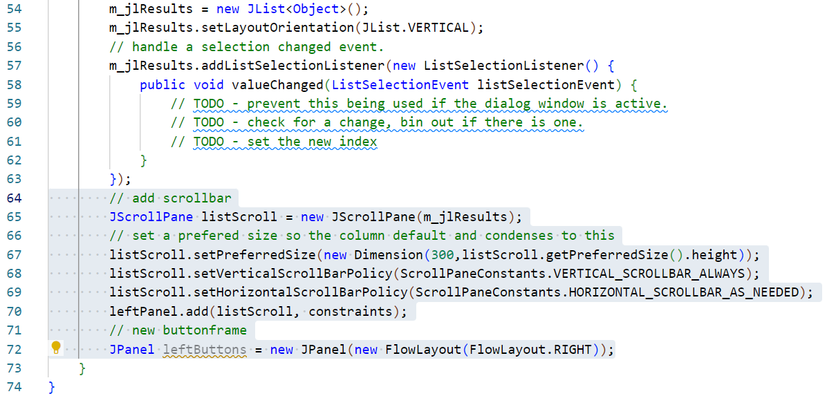
Code the MainWindow class
Add a JScrollPane and button JPanel to the left side of the UI.
Add the highlighted code. *
Notes:
* Clarification
Line 65 instantiates a new JScrollPane control passing it a reference to the JList.
Line 67 sets the preferred size of the pane. We would like 300 pixels wide and as tall as needed, hence the new Dimension object.
Lines 68 and 69 set the scroll bar visibility policy. We will always need the vertical scrollbar and should not need the horizontal one.
Line 70 adds the JScrollPane containing the JList to the application layout, again, constraints do not need to be altered at this point.
Line 72 instantiates a new JPanel control with a new FlowLayout which in turn is set to right-align the contents.

Slide 36
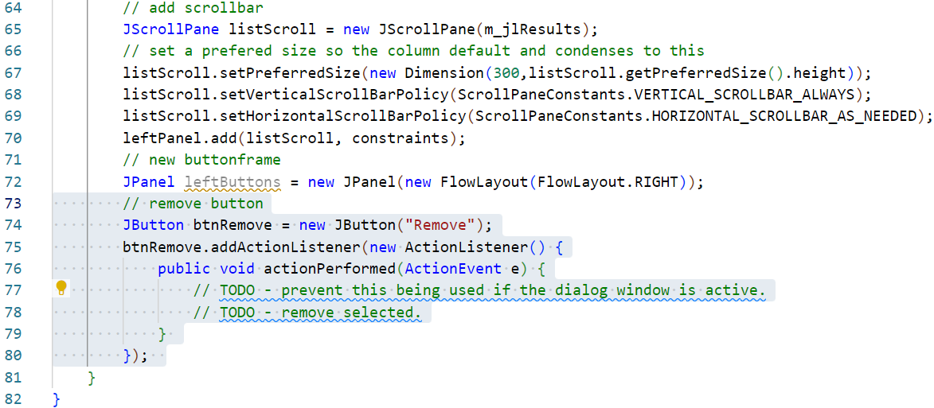
Code the MainWindow class
Add a remove record button.
Add the highlighted code. *
Notes:
* Clarification
Line 74 creates a new button with the text Remove.
Line 75 adds a new event listener to respond to button clicks.
Lines 77 and 78 are a TODO, these are also controller methods which have yet to be coded.

Slide 37
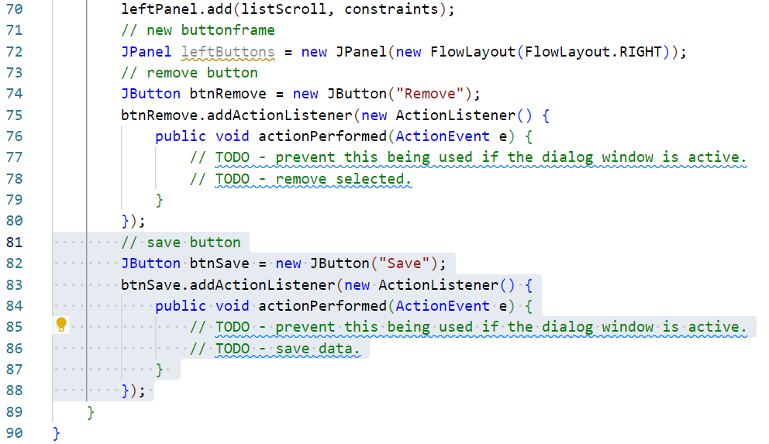
Code the MainWindow class
Add a save data button.
Add the highlighted code. *
Notes:
* Clarification
Line 82 creates a new button with the text Save.
Line 83 adds a new event listener to respond to button clicks.
Lines 85 and 86 are also TODO comments as these lines will call methods in the controller class which has not been coded yet.

Slide 38
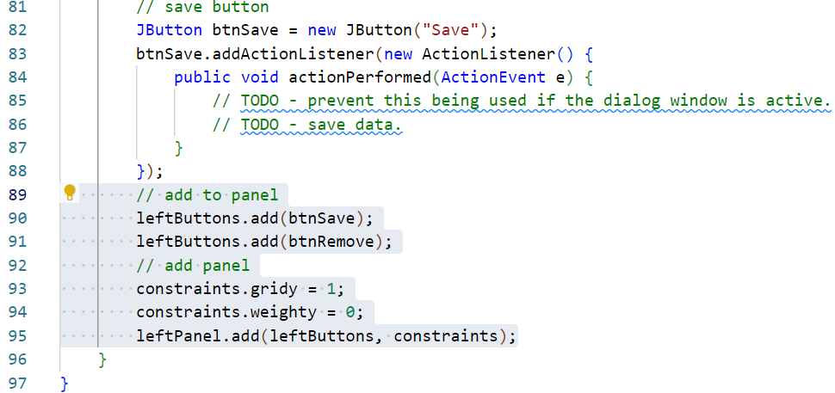
Code the MainWindow class
Add the buttons to the button panel and then add the panel into the left column of the UI.
Add the highlighted code. *
Notes:
* Clarification
Line 90 adds the remove button to the button panel.
Line 91 adds the save button to the button panel.
Lines 93 and 94 alter the constraints object to stop the button panel filling vertically and to place it on the second row of the GridBagLayout.
Line 95 adds the button panel to the UI layout according to the current settings in the constraints object.

Slide 39
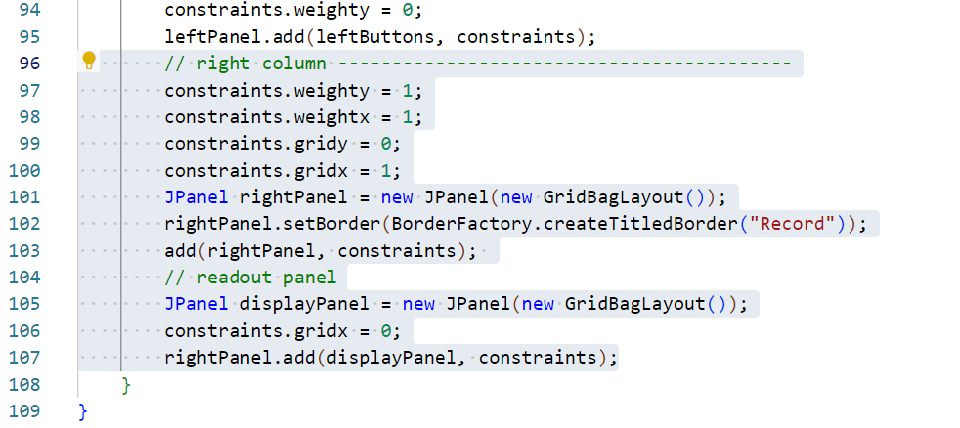
Code the MainWindow class
Create a parent JPanel for the right side of the UI and a child JPanel which will contain the controls to view a single record.
Add the highlighted code. *
Notes:
* Clarification
Lines 97 to 101 resets the constraints object setting the weight to expand in both directions filling the available space, the X property is set to 1 selecting the right hand cell of the main UI layout. The Y property is set back to 0 so that the next element added will be added to the top of the right column.
Lines 101 to 103 create a new JPanel to house the right hand column controls, this also has a titled border set with the text Record. This is then added to the main UI layout.
Line 105 instantiates a new JPanel with a GridBayLayout manager.
Line 106 sets the column number of the constraints object back to 0 as this new panel will be added to the rightPanel object rather than to the main UI.
Line 107 adds the new panel into the rightPanel object.

Slide 40
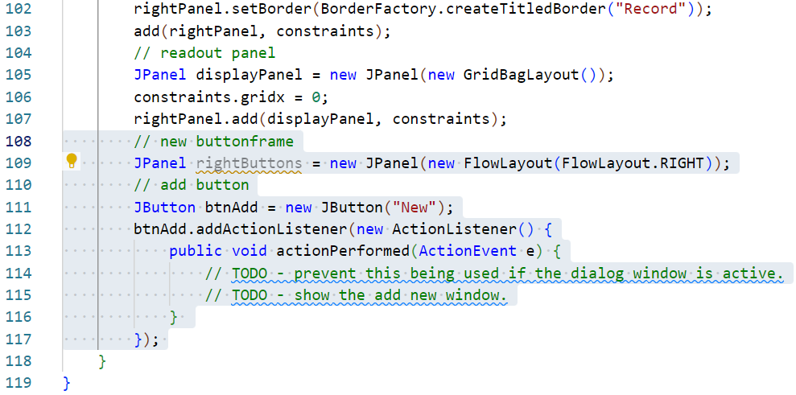
Code the MainWindow class
Add a button to trigger adding a new record.
Add the highlighted code. *
Notes:
* Clarification
Line 109 instantiates a new JPanel with a right-aligned FlowLayout.
Lines 111 to 117 creates a New button.
Lines 114 and 115 are more TODO statements which will be calling methods in the controller class which has not yet been coded.

Slide 41
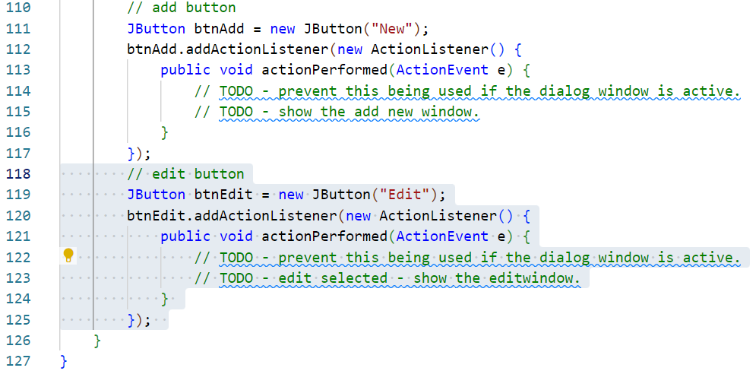
Code the MainWindow class
Add a button to trigger editing an existing record.
Add the highlighted code. *
Notes:
* Clarification
This code is largely the same as that added in the last step.

Slide 42
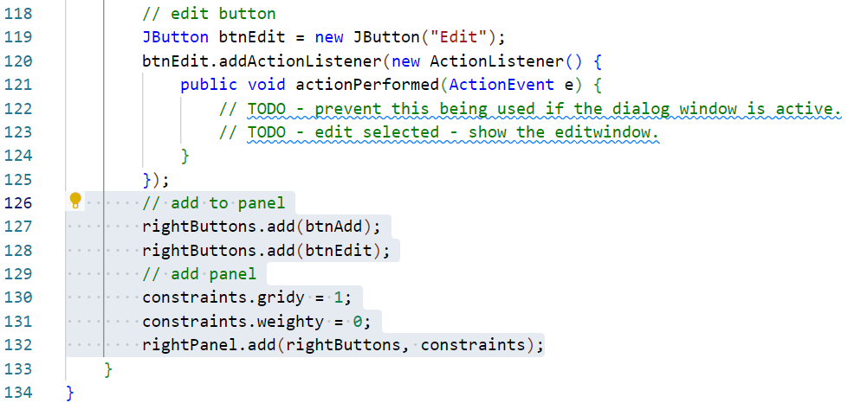
Code the MainWindow class
Add the buttons to the button panel and the button panel to the UI.
Add the highlighted code. *
Notes:
* Clarification
Line 127 adds the Add button to the rightButtons panel.
Line 128 adds the Edit button to the rightButtons panel.
Lines 130 and 131 alter the constraints object properties. In this case, the row number (Y) is set to 1 selecting the second row. The weight Y property is set to 0 meaning that this panel will not expand vertically.
Line 132 adds the rightButtons panel into the rightPanel panel (the right hand side of the UI) using the current constraints.

Slide 43
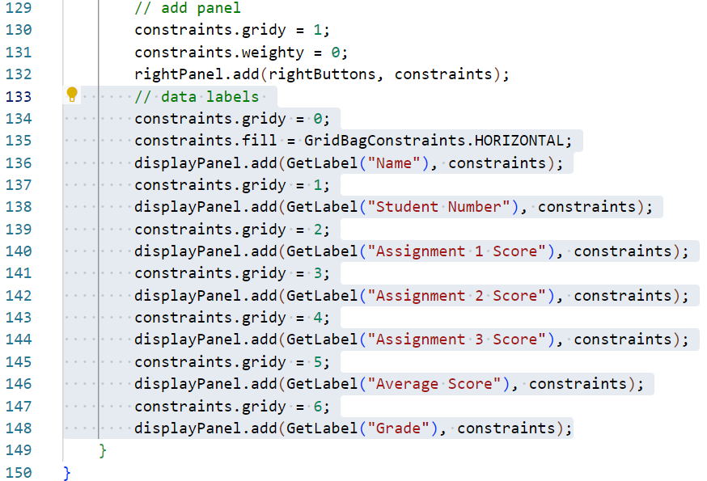
Code the MainWindow class
Add the buttons to the button panel and the button panel to the UI.
Add the highlighted code. *
Notes:
* Clarification
Line 134 resets the constraints row back to 0 as these labels will start in the top left column of the displayPanel. The displayPanel will have 2 columns and 7 rows with field labels on the left and corresponding data on the right.
Line 135 sets the fill property to horizontal.
Line 136 adds a new JLabel to the displayPanel. The JLabel is generated by the utility method that we added earlier and only requires us to pass in the text for the label to display.
Line 137 increments the row number in the constraints object by 1 so that the next label can be added to a lower row.
Lines 138 to 148 repeat these last two steps, adding all of the remaining labels to the displayPanel area.

Slide 44
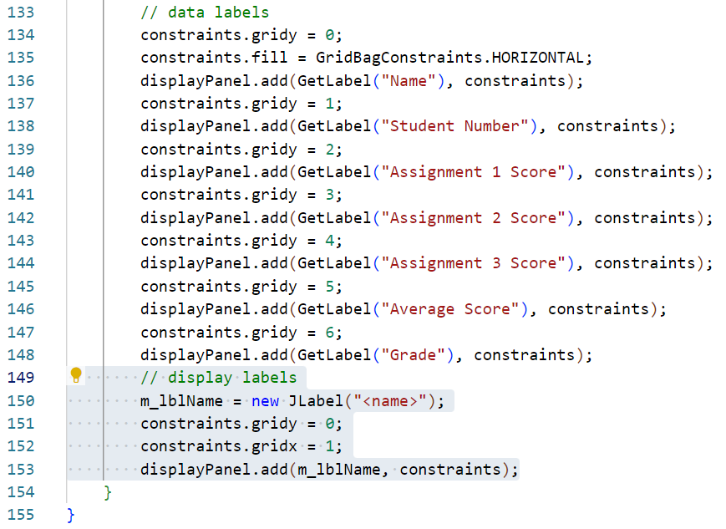
Code the MainWindow class
Add the first of the data containers.
Add the highlighted code. *
Notes:
* Clarification
Line 150 instantiates a new JLabel with some default text (this will be replaces as soon as record is loaded and is only there so that we can check placement at this stage). This label is assigned to the global reference established earlier so that other areas of the code can easily adjust its contents.
Lines 151 and 152 reset the constraints properties to reflect the top row in the right-hand column.
Line 153 adds this new label into the displayPanel in the top row of the right-hand column.

Slide 45
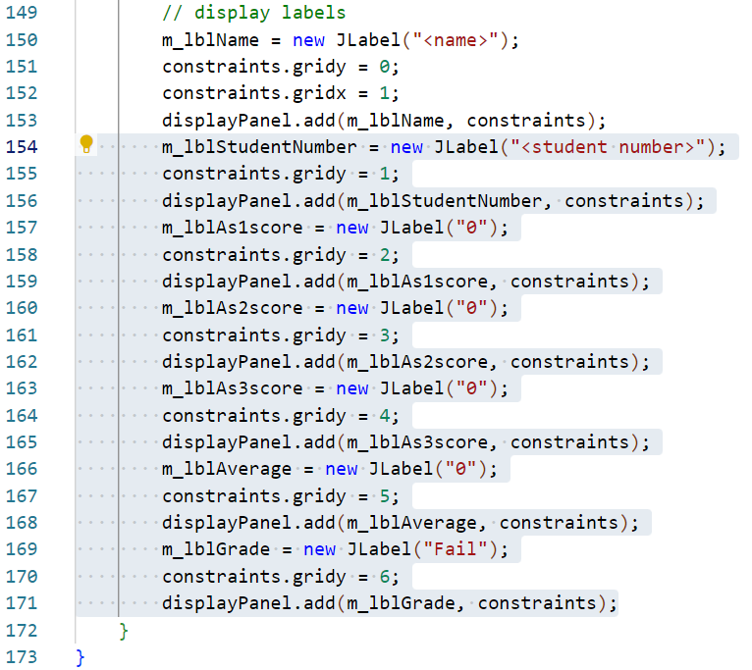
Code the MainWindow class
Finally, add the remaining data display JLabels to complete this method.
Add the highlighted code. *
Notes:
* Clarification
Line 154 instantiates a new JLabel with some more default text. As before, the label is assigned to the global reference established earlier so that other areas of the code can easily adjust its contents.
Line 155 reset the constraints properties to reflect the second row in the right-hand column (1,1).
Line 156 adds this new label into the displayPanel in the second row of the right-hand column.
Lines 157 to 171 repeat the last stages for each remaining label. A new label is created, then the constraints object is adjusted, the label is added to the displayPanel in the right-hand column.

Slide 46
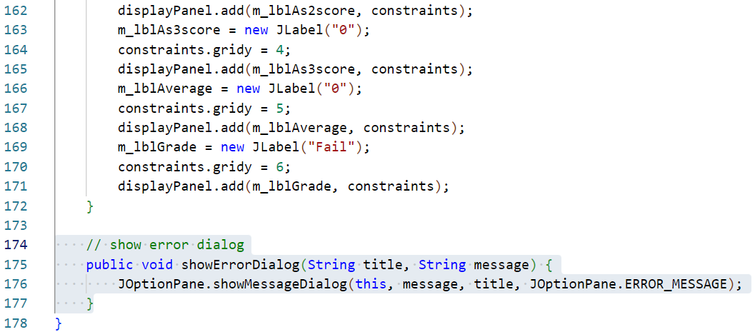
Add utility methods
Next, add some methods which will display information dialogs.
As these are UI elements, they belong here.
Add the highlighted method. *
Notes:
* Clarification
Line 175 declares the method which does not return any data but accepts two String arguments.
Line 176 displays an error dialog and populates this with the passed data.

Slide 47
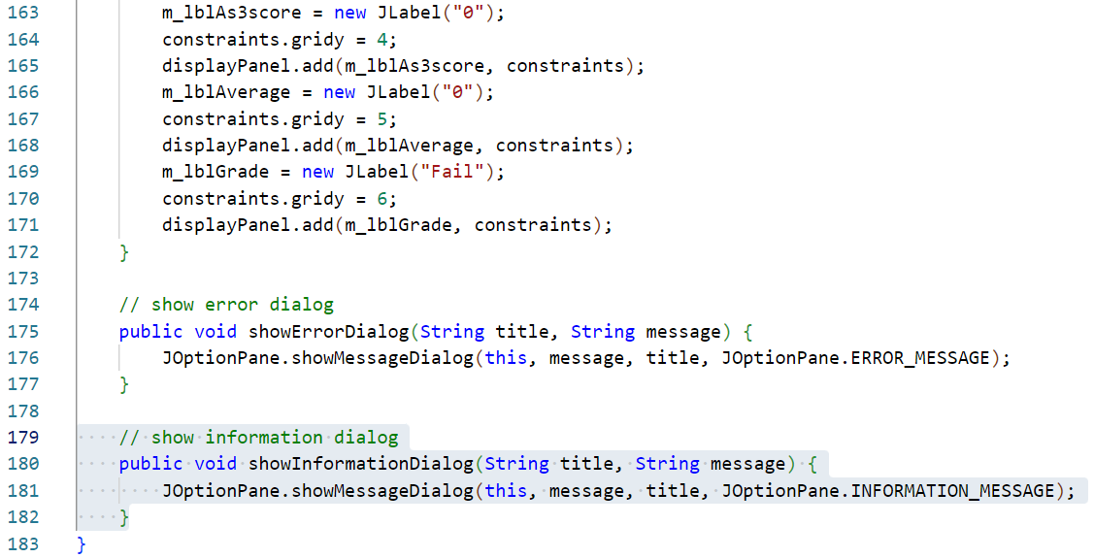
Add utility methods
Add a companion method to display information rather than errors.
Add the highlighted method. *
Notes:
* Clarification
This code is almost identical to the last step. The only difference is the type of icon displayed in the dialog.

Slide 48
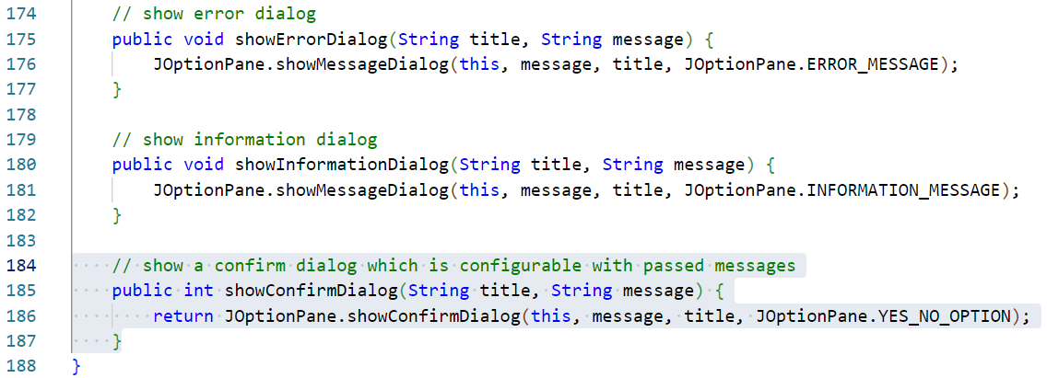
Add utility methods
Next add a method to display a confirm dialog and return the user selection when made.
Add the highlighted method. *
Notes:
* Clarification
Line 185 declares the method which returns the int generated by the confirm dialog. This method also accepts two String arguments.
Line 186 displays a confirm dialog and populates this with the passed data. When a selection is made (either yes or no), this generates a corresponding int which is returned from the method.

Slide 49
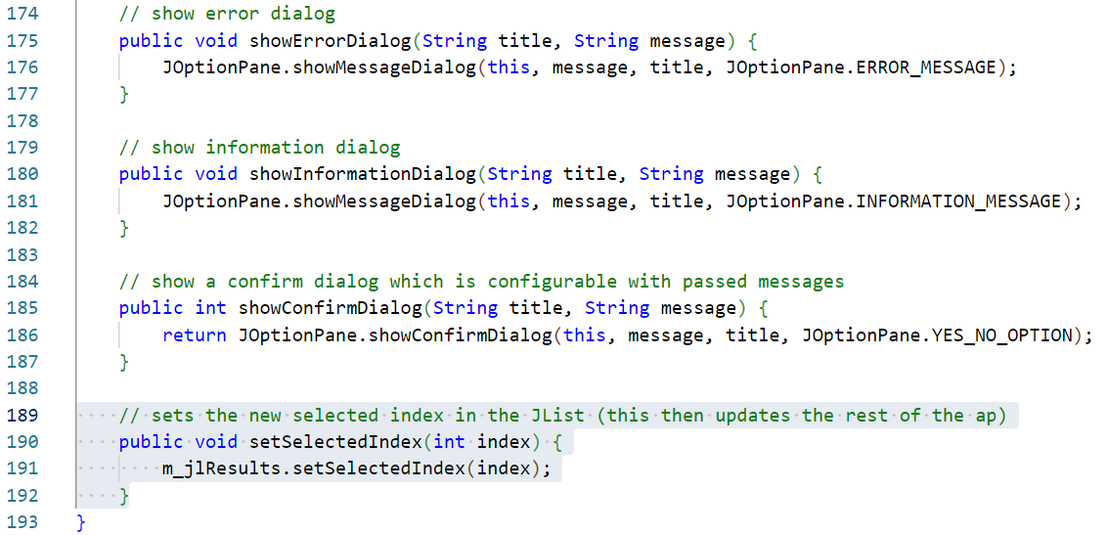
Add utility methods
Add a method to allow setting the selection in the JList.
Add the highlighted method. *
Notes:
* Clarification
Line 190 declares the method does not return any data and accepts one argument, an int indicating the index of the record to set the selection to.
Line 191 sets the selected index of the JList to the supplied data. Arguably, there could be some validation added here to make sure that the index supplied is in scope.

Slide 50
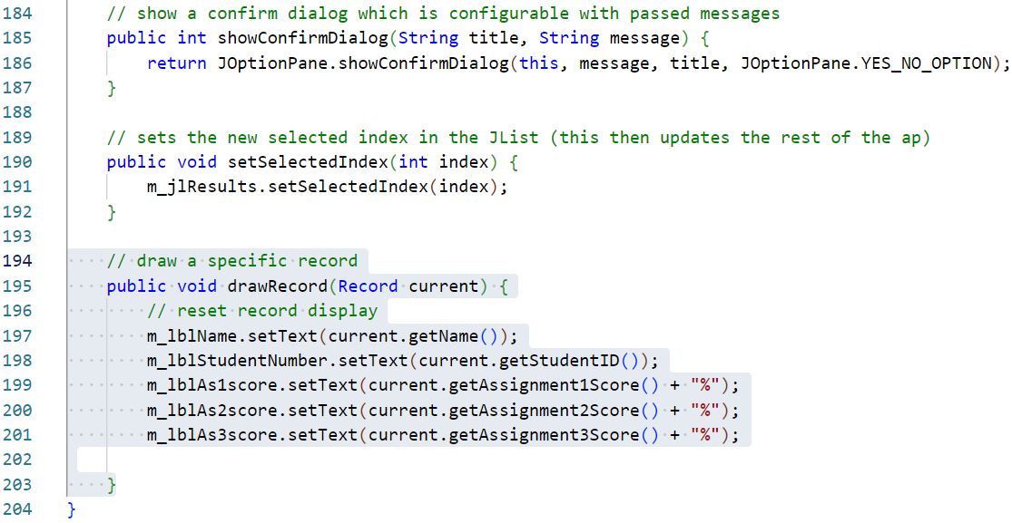
Add a drawRecord method
Add a method to draw the data in a specific record to the UI.
Add the highlighted method. *
Notes:
* Clarification
Line 195 declares the method which does not return any data but accepts an argument of a single Record object instance (this is one way in which our data class is useful, we can pass a single reference around rather than a number of disconnected values).
Lines 197 to 201 set the text of the data display labels to the respective data element from the record.

Slide 51
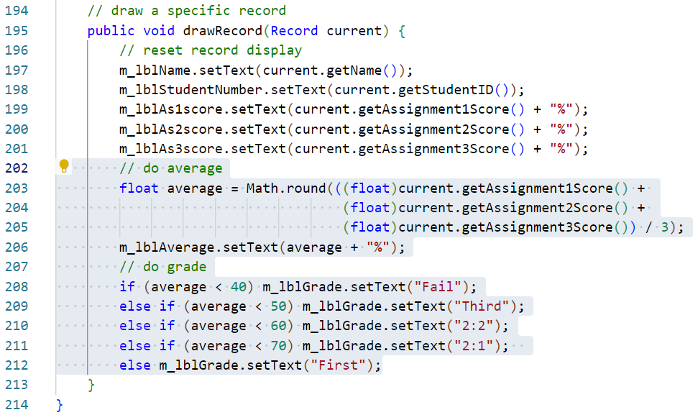
Add a drawRecord method
Add the processes to populate data to the remaining fields.
Add the highlighted method. *
Notes:
* Clarification
Lines 203 to 205 contain a single calculation to obtain a nicely rounded average score for this record.
Line 206 sets the average as the text for the relevant label.
Lines 208 to 212 tests if the average falls below each grade boundary in turn, populating the relevant label text with this grade when the test is passed.
Note: These two processes may seem like application logic and that they should be contained in the controller rather than here. They have been coded here as they are only concerned with displaying data to the user and do not alter any of the core data in any way. If you feel that this choice is wrong, please feel free to add suitable utility methods to the controller class after it has been coded and run this logic from there. One of the many joys of programming is that these kind of choices are very much a matter of taste and opinion, neither is wrong, both approaches will work.

Slide 52
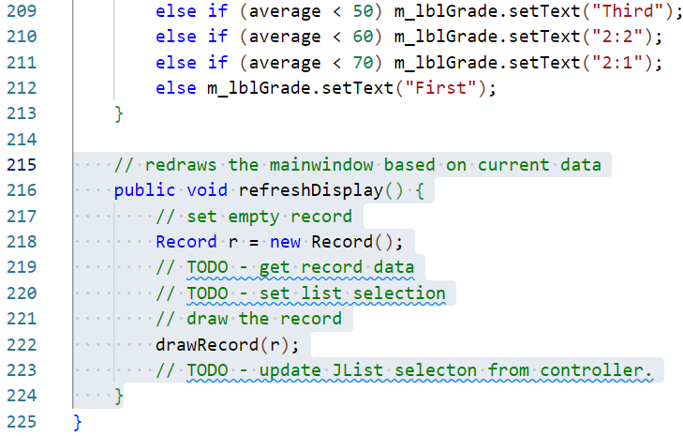
Add a refreshDisplay method
Complete the class with a final method to refresh all data in the UI.
Doing this is often easier than making refresh calls to specific elements.
Add the highlighted method. *
Notes:
* Clarification
Line 216 declares the method which does not return any data or accepts any arguments.
Line 218 creates a new, empty, Record object.
Line 219 is a TODO which will extract record title data from the controller which has not been coded yet.
Line 220 is a TODO which will obtain the currently selected Record from the controller – again, the controller has not been coded yet.
Line 222 passes the Record object to the drawRecord method completed in the previous step.
Line 223 is a TODO which will reset the selected item in the JList based on the current index stored in the controller object.
Note: the controller should be the source of all application data, including the index of the Record being viewed.

Slide 53
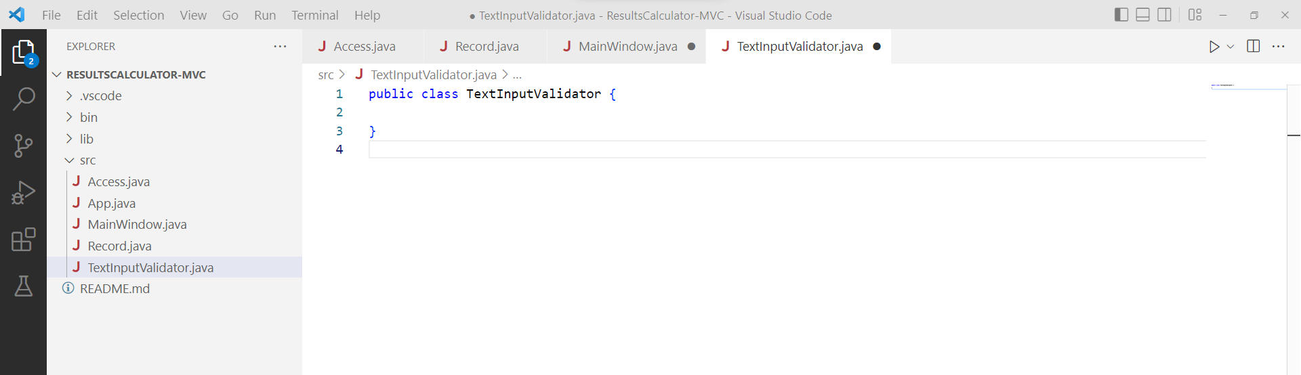
Create a TextInputValidator class
Swing allows for input validation using a number of methods, one of which is to use an input verifier.
Input verifiers are classes which contain rules for valid data.
Add a new class to the src directory by opening the Command Palette* and selecting Java: New Java Class.
Give the new class the name TextInputValidator.
Notes:
* The command palette can be opened with either CTRL+SHIFT+P or View > Command Palette…

Slide 54
Add import statements
Begin by adding a single import statement required for this class.
As this class will verify entries in Swing object, it needs a reference to Swing libraries.
Add the highlighted statement.

Slide 55
Add extends statement
In order for Swing to be able to use this class correctly, it should extend the InputVerifier base class.
Ignore the error highlighted on line 4 as this simply indicates that we have not included all of the methods required by the base class yet.
Add the highlighted statement.

Slide 56
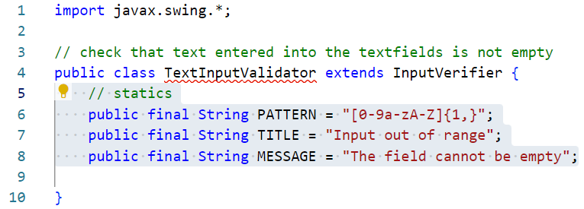
Add constants
This class requires a few constant values.
Add the highlighted statements. *
Notes:
* Clarification:
Line 6 creates a String which contains a regular expression pattern. This will be used to search String objects and see if they correspond to this pattern. In this instance, the requirement is quite loose, that the String contains at least a single alphanumeric character.
Lines 7 and 8 specify some error text to use in the instance that the String being tested does not match.
Note: As these are constant values, their reference name uses only capitals. This is a programming convention to help us understand which references are to constant values when used. There is no requirement for the capitals and lower-case may be used if preferred… This kind of convention exists for a reason and it is strongly advised that you follow it.

Slide 57
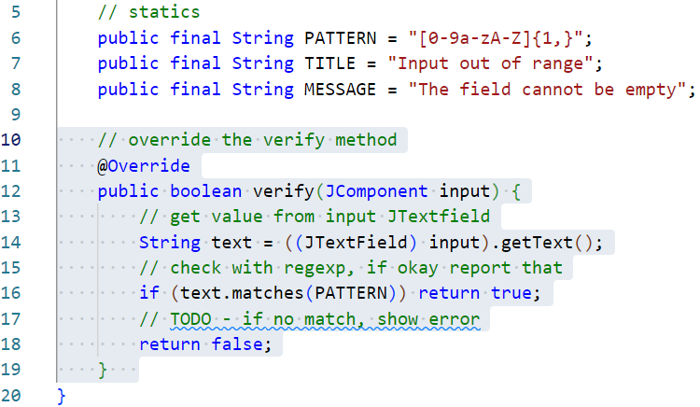
Add the verify method
We are required to override the verify method to complete this class.
Add the highlighted method. *
Notes:
* Clarification:
Line 11 indicates that the following method overrides a method in the base class. This statement will cause the compiler to make sure that the following method signature matches that in the base class and that the override can be applied successfully.
Line 12 declares the verify method which returns a boolean (true for good data, false for bad data). The method accepts a single argument of the JComonent object which has triggered the validation. This can be any relevant Swing input control as each of these are a sub-class of JComponent.
Line 14 extracts the entered text from the JTextField after casting the passed JComponent to this class. The text is stored in a String reference.
Line 16 tests if the entered text meets the requirements of the regular expression pattern. If it does, a value of true is returned and the control will release focus for this control.
Line 17 is a TODO comment which will be completed later. We will need to display an error message using the utility methods in MainWindow as this class will be instantiated. The instance being used will be held in the controller class which has not been coded yet.

Slide 58
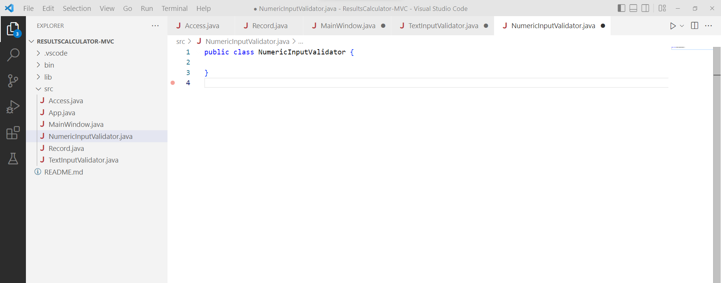
Create a NumericInputValidator class
Next, add a class to validate and correct numeric entry fields.
Add a new class to the src directory by opening the Command Palette* and selecting Java: New Java Class.
Give the new class the name NumericInputValidator.
Notes:
* The command palette can be opened with either CTRL+SHIFT+P or View > Command Palette…

Slide 59
Add import statements
Begin by adding the same single import statement required for this class as this class will also verify entries in Swing object.
Add the highlighted statement.

Slide 60
Add extends statement
As before, for Swing to be able to use this class correctly, it should extend the InputVerifier base class.
Again, ignore the error highlighted on line 5 as this simply indicates that we have not included all of the methods required by the base class yet.
Add the highlighted statement.

Slide 61
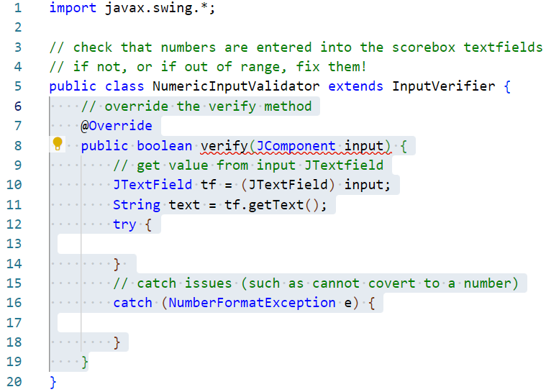
Add the verify method
We are required to override the verify method to complete this class.
Add the highlighted method. *
Notes:
* Clarification:
Line 7 indicates that the following method overrides a method in the base class. This statement will cause the compiler to make sure that the following method signature matches that in the base class and that the override can be applied successfully.
Line 8 declares the verify method which returns a boolean (true for good data, false for bad data). The method accepts a single argument of the JComonent object which has triggered the validation. This can be any relevant Swing input control as each of these are a sub-class of JComponent. This line displays an error, this is expected as this method does not yet return a value. This will be fixed in the next steps.
Line 10 creates a reference to the JTextField object which is having its contents validated. The passed JComponent is cast as JTextField as before.
Line 11 extracts the entered text from the JTextField and stores it in a String reference.
Lines 12 to 18 implement a try/catch block. As the text from this input must be evaluated as a number, this requires a parse operation which will throw an exception if it fails. In this instance, a failure can only mean an invalid value being parsed so this structure will provide a means to deal with this.

Slide 62
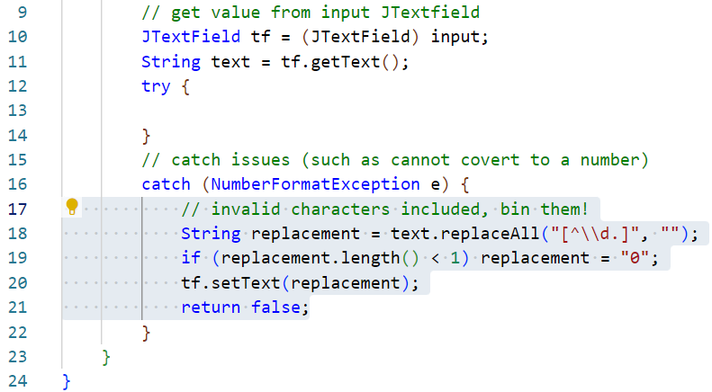
Add the verify method
Code the catch block first.
Add the highlighted statements. *
Notes:
* Clarification:
Line 18 uses another regular expression pattern. In this instance the ^ means not and the \\d means digit. So the pattern reads as “not a digit”. This is used within the replaceAll statement to effectively remove anything which is not a digit by replacing it with an empty String. The result is stored in a temporary String.
Line 19 tests if any characters remain in the String (if any numbers existed in the first place). If the String is empty, it is set to a 0 character which is a valid value.
Line 20 sets the text content of the JTextField to the adjusted String.
Line 21 returns a value of false so that focus does not shift from this control until the user has had a chance to evaluate the adjusted value.

Slide 63
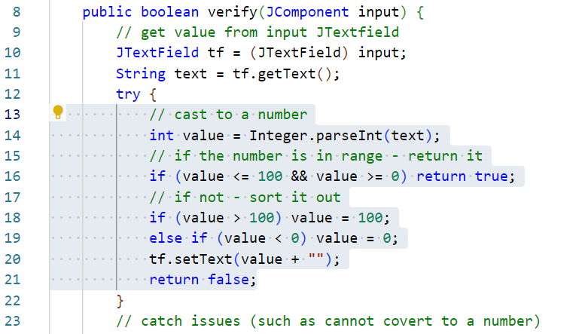
Add the verify method
Finally, code the try block.
Add the highlighted statements. *
Notes:
* Clarification:
Line 14 attempts to parse the String to an int.
Line 16 tests if the int is in range (0-100), if it is, the method returns true as the data has passed validation.
Line 18 this line will only be reached if the int is not in range. In this instance, the int is tested to see if its value is larger than 100, and if so, the value is adjusted down to 100.
Line 19 this line does the converse of the above, testing for values lower than 0 and adjusting up to 0 when found (this is unlikely but it does not hurt to have).
Line 20 sets the new value back to the JTextField.
Line 21 eturns a value of false so that focus does not shift from this control until the user has had a chance to evaluate the adjusted value.

Slide 64
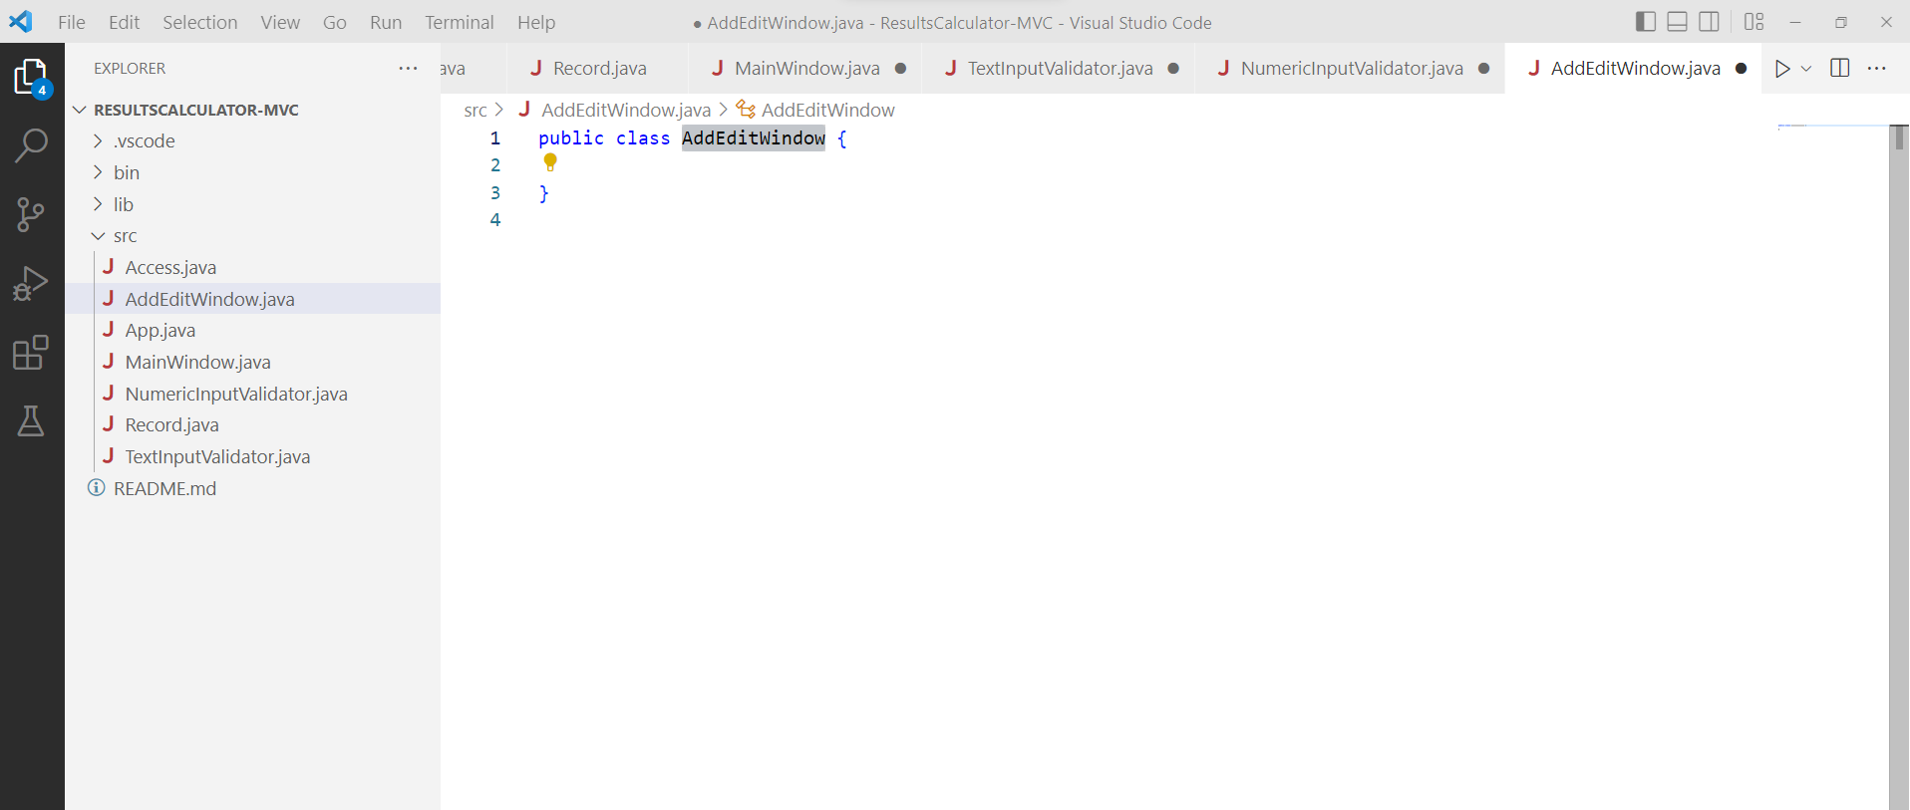
Create a AddEditWindow class
Add a new class to contain the add/edit results dialog window.
Add a new class to the src directory by opening the Command Palette* and selecting Java: New Java Class.
Give the new class the name AddEditWindow.
Notes:
* The command palette can be opened with either CTRL+SHIFT+P or View > Command Palette…

Slide 65
Add import statements
Add import statement required by this class.
As this will be a UI class, the imports are Swing and AWT libraries.
Add the highlighted statements.

Slide 66
Add an extends statement
This class will extend the JDialog super class.
JDialog is used in preference to JFrame here as JDialog will ensure that this window will remain above the MainWindow class (like a normal dialog window). In all other respects, they are both very similar.
Add the highlighted statement.

Slide 67
Add attributes and a constant
Add attribute and constant references.
Add the highlighted statements. *
Notes:
* Clarification:
Line 8 will hold a reference the Record object being edited.
Lines 9 to 13 implements global references to each of the JTextField classes that will contain the data entered by the user.
Line 16 contains a constant Dimension object which will contain the size that this dialog will be set to.

Slide 68
Add utility methods
Add a utility method to simplify creation of text label controls.
Add the highlighted statements. *
Notes:
* Clarification:
Line 19 declares the method as private (it is only needed within this class). The method will return a single JLabel object and accepts an argument of the String text to apply to the label as it is created.
Lines 20 instantiates a new JLabel with the passed text value.
Lines 21 and 22 set properties of the label to align right and use a grey text colour.
Line 23 returns the new Jlabel back to the calling process.

Slide 69
Add utility methods
Add another utility method to simplify the creation of text field controls.
Add the highlighted statements. *
Notes:
* Clarification:
Line 27 declares the method as private (it is only needed within this class). The method will return a single JPanel object and accepts three arguments. The first is a the global JTextField reference being constructed. The second is a String which will contain tooltip text which will display to the user when they hover their mouse over this control. The final argument is the width at which the JTextField should be displayed.
Lines 28 creates a new JPanel to house the text field control. Without this, the text field will expand to fill all space available in the GridBagLayout cell producing an undesirable visual outcome.
Lines 29 and 30 set properties of the text field, specifically the tooltip text and dimensions.
Line 31 adds the text field into the newly created JPanel.
Line 32 returns the JPanel back to the calling process.

Slide 70
Add a constructor method
Add a constructor method for this class.
Add the highlighted statements. *
Notes:
* Clarification:
Line 36 declares the constructor method. The method accepts two arguments. The first is a boolean which indicates if this is a new or existing record. The second is a String which contains the title text for this dialog window (this will change depending on an edit or add operation.
Line 37 is a TODO comment which will retrieve a reference to the MainWindow UI instance being used from the controller. It needs this to make sure that this dialog will always draw on top of the MainWindow. The rest of the statement will call the super method to trigger the constructor method in the JDialog class, passing the reference to the MainWindow as well as the text to display in the window bar.
Line 39 tests the passed boolean to establish if this is to be an add or edit operation.
Line 40 is another TODO. If this is an edit operation, this line will retrieve the specified record from the controller class.
Lines 42 to 46 is the converse process which creates a new Record object and resets the name and id fields to empty strings.

Slide 71
Code the constructor method
Set the global properties for this dialog window.
Add the highlighted statements. *
Notes:
* Clarification:
Line 48 sets the size of the dialog to that specified in the constant value added earlier.
Line 49 removes the ability for the user to resize this dialog window (it looks bad if this is allowed).
Line 51 sets the layout manager for this dialog window to a new GridBagLayout.
Line 52 creates a new GridBagConstraints object ready to start adding objects to the window.

Slide 72
Code the constructor method
Set up the constraints object with starting values.
Add the highlighted statements. *
Notes:
* Clarification:
Lines 54 to 59 sets the default properties of the GridBagConstraints object. Cell reference is 0,0. Cells will expand both horizontally and vertically with a margin of 3px on all sides.

Slide 73
Code the constructor method
Add in the main content panels.
Add the highlighted statements. *
Notes:
* Clarification:
Lines 61 to 68 create and add two JPanels. The first occupies the top row of the window and will contain all labels and text fields. The second will occupy the bottom row and will contain buttons.
Note: the code applied here does not doing anything new at this point so the explanation will be brief. For a fuller explanation of these lines, look to similar statements used when constructing the MainWindow class.

Slide 74
Code the constructor method
Add in control labels using the utility method created earlier.
Add the highlighted statements. *
Notes:
* Clarification:
Lines 70 to 78 create JLabel objects using the utility method coded earlier. In each case they are added to the UI before the constraints object is altered ready for the next label. One label is added for each require data entry control.

Slide 75
Code the constructor method
Add in the first text field control using the utility method created earlier.
Add the highlighted statements. *
Notes:
* Clarification:
Line 80 instantiates a new JTextField control fpr the student’s name, using the text specified in the active Record object.
Line 81 applies the TextInputValidator class, created earlier, to this control, forcing validation of the content as soon as the user moves to any other control.
Lines 82 and 83 reset the constraints object to reference the top row in the right hand column of the main panel.
Line 84 uses the utility method created earlier to wrap the new JTextField in a JPanel. This is then added into the main UI interface panel of this window. The GetTextField method accepts the JTextField object as well as the tooltip text and the size to set the JTextField as arguments.
Note: this last line is a little complex as a method call is being made inside another. If you find this hard to read, you can unpack this onto two or more lines.

Slide 76
Code the constructor method
Add in the remaining text field controls.
Add the highlighted statements. *
Notes:
* Clarification:
Each control requires a block of 4 lines.
The first builds a new JTextField with the respective data element from the Record.
The second applies an InputVerifier class, in the case of the first 2 controls, these are the TextInputValidator class and for the latter three the NumericInputValidator class is used.
The third line adjust the constraints object to reflect a new row in the GridBagLayout.
The final line passes the JTextField through the GetTextField class coded earlier so that dimensions and tool tip text can be applied to it. The resulting control is then added to the jpMainForm panel.

Slide 77
Code the constructor method
Add in the add/edit button.
Add the highlighted statements. *
Notes:
* Clarification:
Line 102 creates a new JButton with appropriate text.
Line 103 adds some tool tip text to the button.
Lines 104 to 116 adds a click action listener to detect user mouse clicks.
Lines 107 to 111 update the m_record object with the values from the data entered by the user into the UI controls.
Line 112 is a TODO comment to remind us to code the statements which will update the Controller with the amended record after we have finished.
Line 114 closes the dialog box window.
Line 118 adds the button into the jpButtonRow panel created earlier.

Slide 78
Code the constructor method
Finally, add a window listener to wait for this window to close.
Add the highlighted statements. *
Notes:
* Clarification:
Lines 120 to 125 implement a window listener which is applied to the class as a whole.
Line 121 indicates to the compiler that the following method should override a method in the base class.
Line 122 implements the windowClosing event method.
Line 123 is a TODO comment to remind us to return here and add a call to the controller to un-freeze the main UI window. Ideally, a sub window should prevent the use of the main window otherwise things will get out of step in the application. In this instance this will be achieved by disabling the buttons in the main window while this dialog is active and then re-enabling them when it closes, hence the requirement for this block.

Slide 79
Rename the App class
In the Explorer Panel, right click on the App.java file and select Rename from the menu that appears.
Rename this class Controller.

Slide 80
Coding the Controller class
We do not need the default code that VS Code has placed here for us.
Remove the Hello World statement from the Controller (line 7 in the example).
Add in the using statements required by this class.
Add the highlighted statements.

Slide 81
Coding the Controller class
Add in the attribute references required by this class.
Add the highlighted statements. *
Notes:
* Clarification
Line 7 is a definitive reference to the index of the record which has been currently selected by the user.
Line 8 will contain a global reference to the data-handling class. This is declared as an instance of the Access interface so that the actual data handling class implemented can change with minimal fuss.
Line 9 is a reference to a collection of Record objects representing the currently loaded data.
Line 10 is a refence to the MainWindow UI class.
Line 11 is a reference to the AddEditWindow UI class.
Line 12 is a boolean which will be used to indicate whether the AddEditWindow class is active or not.

Slide 82
Coding the Controller class
Add a getter and setter for the m_selectedIndex attribute.
Add the highlighted methods. *
Notes:
* Clarification
Line 15 declares the setter method. This class will not be instantiated and all methods will contain the static keyword meaning that they will be accessible with Controller.methodName from anywhere in the application. This is good design choice for singleton classes wherever possible. The method does not return a value and accepts a single argument of the int value to set as the new selected index.
Lines 17 to 21 demonstrate the power of using getter and setter methods. In this case, we do not simply set the value. The argument is tested to make sure that it is within a sensible scope (between 0 and the size of the data collection). If the argument does not fall in this range, the process ends as using it would cause an IndexOutOfBound exception if we tried to use it to retrieve a record from the collection.
Line 19 set the class member attribute with the passed value as it must be in a usable range by this point.
Line 21 calls a method which has not been coded yet, hence the error. As the method being called will be contained in this class, we will not bother with a TODO in this instance.
Lines 23 to 25 implement a standard getter method for the selected index value.

Slide 83
Coding the Controller class
Add a more getter methods for other class member attributes.
Add the highlighted methods. *
Notes:
* Clarification
Lines 26 to 28 implements a getter method which will return the number of records currently loaded by calling the size() method of the ArrayList data collection. This getter does not directly correspond to an attribute reference and so does not need a setter method. This renders it effectively read-only.
Lines 29 to 31 implement a getter method which returns whichever Record the user has indicated is the currently selected. Again, this does not directly reference a member attribute, rather it calls a method of the ArrayList class and returns the result.
Lines 32 to 34 implement a standard getter method for the m_mainWindow member attribute. No corresponding setter method is required again making this member attribute read-only.

Slide 84
Coding the Controller class
Add a more getter methods for other class member attributes.
Add the highlighted methods. *
Notes:
* Clarification
Lines 35 to 38 implements a getter method which will return the index in the ArrayList collection of a specific record. It does this by using a for loop to iterate over the collection looking for a Record object which matches that passed to this method. If no Record is found as a match, the common failure value of -1 is returned (0 is a valid index in the ArrayList).
Lines 39 to 41 implement a standard getter method which returns the value of m_dialogActive member attribute. Again, this attribute has no setter making it read-only.

Slide 85
Coding the Controller class
Begin coding the main method, the initial process which the application will run upon starting up.
Add the highlighted statements. *
Notes:
* Clarification
Line 45 is a TODO comment. We have coded an interface but no actual class to use it and to perform the load/save operation just yet. Leave this for now.
Line 47 instantiates a new MainWindow class and stores this in the m_mainWindow member attribute.
Line 49 makes the new MainWindow UI visible and active.
Line 51 instantiates a new, empty ArrayList to hold any data entered or loaded.
Line 53 sets the initial value of the m_selectedIndex member variable to 0 (the first record).
Line 55 sets the initial value of the m_dialogActive to false (as the dialog window is not presently visible).

Slide 86
Coding the Controller class
Continue coding the main method.
Add the highlighted statements. *
Notes:
* Clarification
Lines 57 to 62 run the m_dataAccess.loadData() method (this is specified in the Access interface but has not actually been coded yet as a process). If this process returns a boolean value of true, the m_records ArrayList is populated with the Record objects which have been loaded.
Line 61 calls the setSelectedIndex method coded earlier. This is needed as this will revaluate the size of the loaded collection and will handle refreshing the display with the first record.
Line 64 if a load has not been possible have been loaded this is certainly an error as the data file should be present and accessible. In this instance, an error dialog is displayed using the method coded earlier in the MainWindow class. Even a load operation on an empty data file should result in a value of true.

Slide 87
Add a Save Data method
We need a method to wrapper the interface saveData method so that UI buttons can trigger a save.
Add the highlighted method. *
Notes:
* Clarification
Line 68 declares a static method which accepts no arguments and does not return data.
Line 70 calls the saveData method of the Access interface instance loaded and passes the current data collection to this. The result is tested for success (boolean true).
Line 72 displays an information dialog informing the user that the save was successful.
Line 74 display an error dialog informing the user that the save failed.

Slide 88
Add a Get Short Names method
This method creates a formatted collection to be displayed in the JList.
Add the highlighted method. *
Notes:
* Clarification
Line 78 declares a static method which accepts no arguments and returns an Array of basic Objects.
Line 80 creates an empty Object Array and sets the size to the number of Records currently loaded to the ArrayList.
Lines 82 and 83 iterate over the data ArrayList, uses the toString method of each Record (we overrode that much earlier… go back and have another look). The resulting String is set in the corresponding element of the Object Array.
Line 85 returns the now complete Object Array.

Slide 89
Add a Remove Record method
This method deletes a Record from the loaded data.
Add the highlighted method. *
Notes:
* Clarification
Line 89 declares a static method which accepts no arguments and does not return a value.
Line 91 uses the m_selectedIndex to get a reference to the current Record.
Line 93 displays a confirm dialog for the user to make sure that they really do want to remove this Record. The result of the dialog box is tested against the JOptionPane object value of YES.
Line 96 if the user has indicated that they do want this Record removed, the ArrayList.remove method is used to complete this action.
Line 98 calls the setSelectedIndex method with a value of 0 (the first record). As the previous current record no longer exists, this changes the selection to a record which is very likely to be present and redraws the displayed data to reflect this.

Slide 90
Add a Show Add Dialog method
This method loads and displays an AddEditWindow instance.
Add the highlighted method. *
Notes:
* Clarification
Line 103 declares a static method which accepts no arguments and does not return a value.
Line 105 instantiates a new AddEditWindow passing two arguments, the first a boolean value of true to indicate that this is a new record, the second a String containing a suitable window bar title.
Line 106 makes the dialog visible.
Line 108 sets the m_dialogActive member attribute to true to indicate that the dialog is indeed active.

Slide 91
Add a Show Edit Dialog method
This method also loads and displays an AddEditWindow instance.
Add the highlighted method. *
Notes:
* Clarification
This method is very similar to the last, the only difference being on line 114 where in this case a value of false is passed along with a suitable title String.

Slide 92
Add a Add Record method
This method accepts a newly created Record and adds it to the ArrayList.
Add the highlighted method. *
Notes:
* Clarification
Line 121 declares a static method which accepts a single argument of the new Record object to add and does not return a value.
Line 123 adds the new Record to the data collection ArrayList.
Line 125 sets the currently selected Record to the this new record by getting it’s index and then displays it to the user using two methods coded earlier.
Line 127 declares that the dialog window is no longer active.

Slide 93
Add a Update Record method
This accepts an edited created Record and replaces it in the ArrayList.
Add the highlighted method. *
Notes:
* Clarification
Very similar to the last method with the exception that this time the ArrayList.set method is called and passed the edited record as well as an index reference to the old version of this same record in the ArrayList data collection.
In other respects, this method is the same as the last.

Slide 94
Add final utility methods
Complete this class with three simple utility methods.
Add the highlighted methods. *
Notes:
* Clarification
These methods all wrapper functionality previously coded making it accessible to other parts of the application. No further explanation should be required here.

Slide 95
Resolving some TODOs
Most of the TODO statements thus far have been caused by a lack of Controller class. As we have coded this now, most can be resolved.
Begin in the TextInputValidator class…
Amend the highlighted statements. *
Notes:
* Clarification
These methods all wrapper functionality previously coded making it accessible to other parts of the application. No further explanation should be required here.

Slide 96
Resolving some TODOs
Move to the AddEditWindow class.
Amend the highlighted statements. *
Notes:
* Clarification
Line 38 now calls the constructor method of the parent class JDialog.

Slide 97
Resolving some TODOs
Still within the AddEditWindow class.
Amend the highlighted statements. *
Notes:
* Clarification
Line 42 now populates the m_record ArrayList with the data returned from the Controller.getSelectedRecord method.

Slide 98
Resolving some TODOs
Still within the AddEditWindow class.
Amend the highlighted statements. *
Notes:
* Clarification
Line 115 tests the newResult boolean. If this is a new record, the Controller.addNewRecord method is used to add the current record to the ArrayList data store.
Line 116 runs the corresponding method Controller.updateExistingRecord again passing the current record.

Slide 99
Resolving some TODOs
Still within the AddEditWindow class.
Amend the highlighted statements. *
Notes:
* Clarification
Line 128 calls the Controller.reactiveMainWindow method. This unblocks the buttons in the main window UI buttons as this dialog is closing.

Slide 100
Resolving some TODOs
Move to the MainWindow class.
Amend the highlighted statements. *
Notes:
* Clarification
Line 60 tests the Controller.getDialogActive method and ends the process if it is. If the dialog is active, the event method ends here as the active record should not be changed while the dialog window is active.
Line 62 tests if the JList selected index is equal to the selected index set in the Controller. If this is the case, no further action is needed as the data is all in agreement.
Line 64 uses the Controller.setSelectedIndex method and passes it the index selected in the JList this will update the current record selected in the Controller.

Slide 101
Resolving some TODOs
Also in the MainWindow class.
Amend the highlighted statements. *
Notes:
* Clarification
Line 81 tests the Controller.getDialogActive method and ends the process if it is. If the dialog is active, the event method ends here as the active record should not be removed while the dialog window is active and editing it.
Line 83 calls the Controller.removeRecord method to remove whichever record is currently selected in the Jlist.

Slide 102
Resolving some TODOs
Also in the MainWindow class.
Amend the highlighted statements. *
Notes:
* Clarification
Line 91 tests the Controller.getDialogActive method and ends the process if it is. If the dialog is active, the event method ends here as the save process should not be activated while the dialog window is active and editing data.
Line 83 calls the Controller.saveData method to save to file all data presently held in the data store ArrayList.

Slide 103
Resolving some TODOs
Also in the MainWindow class.
Amend the highlighted statements. *
Notes:
* Clarification
Line 122 tests the Controller.getDialogActive method and ends the process if it is. If the dialog is already active, we should not spawn another.
Line 124 calls the Controller.showAddNewRecordDialog method create a new dialog window and lock the main window UI buttons.

Slide 104
Resolving some TODOs
Also in the MainWindow class.
Amend the highlighted statements. *
Notes:
* Clarification
Line 132 tests the Controller.getDialogActive method and ends the process if it is. If the dialog is already active, we should not spawn another.
Line 134 calls the Controller.showEditRecordDialog method create a new dialog window and lock the main window UI buttons.

Slide 105
Resolving some TODOs
Finally, in the MainWindow class.
Amend the highlighted statements. *
Notes:
* Clarification
Line 231 resets the contents of the Jlist to the object list obtained with the Controller.getRecordShortNames method.
Line 233 tests the Controller to see how many Records are currently in the ArrayList data store. If there are some, the Record reference r is set to whichever Record the Controller believes is currently selected.
Line 235 is unchanged in this recode.
Line 237 sets the selected index in the JList to whichever index the Controller believes is the currently selected Record.

Slide 106
Creating the file access class
We have now coded the majority of the app.
The only thing that remains is to code the CSV load / save processes.
To do this, we will create a new class which will implement the Access interface created earlier.
We will re-use this approach for each of the remaining file and data types that we will explore in this unit, for this reason, coding this class has been left until last.

Slide 107
Create a file access class
Add a new class to contain the add/edit results dialog window.
Add a new class to the src directory by opening the Command Palette* and selecting Java: New Java Class.
Give the new class the name CSVAccess.
Notes:
* The command palette can be opened with either CTRL+SHIFT+P or View > Command Palette…

Slide 108
Add import statements
Add import statement required by this class.
As this will be an IO class, the imports largely from the java.io libraries.
Add the highlighted statements.

Slide 109
Add an extends statement
This class will implement the Access interface.
Ignore the error, this is caused by the fact that we have implemented the interface, that in doing so we have promised to include a number of methods and that we have not included these yet.
Add the highlighted statement.

Slide 110
Add attributes and a constant
Add attribute and constant references.
Add the highlighted statements. *
Notes:
* Clarification:
Line 9 declares a reference to a String which will contain any error text generated by either a load or save action which cannot complete.
Line 10 declares an ArrayList of Record objects which will be used to load data from file into. The data will be stored here until it is requested by the Controller.
Line 13 contains a constant String which contains the file name of the data file that we want to load and save to. Adjusting this value will cause the application to refer to a different data file.

Slide 111
Add getter methods
Add getter methods for the two attributes just added.
Add the highlighted methods. *
Notes:
* Clarification:
Lines 16 to 18 declares a getter for the error text String.
Lines 29 to 21 declares a getter for the results ArrayList of Records.

Slide 112
Add a utility methods
Add a utility method to convert a Record object to CSV String.
Add the highlighted methods. *
Notes:
* Clarification:
Line 24 declares the method which returns a String and accepts a single argument of the Record object to convert.
Lines 25 to 29 builds a string representing a CSV version of the data contained in the Record. This is then returned back to the calling function.

Slide 113
Add a save data method
Add a the framework for a save data method.
Add the highlighted methods. *
Notes:
* Clarification:
Line 33 declares the method specified in the interface which returns a boolean to indicate success or failure and accepts a single argument of an ArrayList collection of Records to save.
Lines 35 to 42 implements a try/catch block. As a file write is an operation which can generate exceptions, this block will prevent the application crashing if the write fails.
Line 40 sets the error message attribute to the message generated by the exception thrown.
Line 41 returns false to indicate that the file write has failed.

Slide 114
Add a save data method
Add in the save process.
Add the highlighted statements. *
Notes:
* Clarification:
Lines 37 to 41 build a data String to save. Each record will be placed on its own line (separated with \n, the newline character) and will be arranged as CSV.
Line 37 creates a temporary ArrayList of Strings, each entry will be a single record as a CSV.
Line 39 uses a lambda function (look it up) to iterate over the dataset passed into the function. Each record is converted to a CSV String using the utility method coded earlier. Each CSV is added to the temporary ArrayList.
Line 41 joins the items in the temporary ArrayList into a single string with the records separated with a newline string “\n”.
Line 43 creates a new FileWriter instance with the constant attribute FILE_NAME.
Line 44 writes the data String to the file using the FileWriter instance.
Line 46 closes the FileWriter releasing the file lock on the data file.
Line 48 clears off any previously saved error text (if the process makes it this far, there won’t be any errors).
Line 49 returns a value of true to indicate a successful save.

Slide 115
Add a load data method
Finally, we add a method to load data from file.
Add the highlighted method. *
Notes:
* Clarification:
Line 59 declares the method specified in the interface which returns a boolean to indicate success or failure and does not require any arguments.
Lines 61 to 68 implements a try/catch block. As a file read is an operation which can generate exceptions, this block will prevent the application crashing if the write fails.
Line 66 sets the error message attribute to the message generated by the exception thrown.
Line 67 returns a value of false to indicate that the file read has failed.

Slide 116
Add a load data method
Begin coding the data load process statements.
Add the highlighted statements. *
Notes:
* Clarification:
Line 63 creates a new empty ArrayList of Record objects for the data to load into.
Line 65 creates a new BufferedReader instance which wraps a new FileReader instance, accepts the same FILE_NAME constant to read from the same data file (as this same file is used for both read and write operations, using a constant for the filename cuts down on silly bugs).
Line 67 reads the first line from the file and stores it in a String variable with a reference of line.
Lines 68 to 70 implement a while loop which will keep reading data from the file as long as there is more data to read. The contents of this loop will be coded in the next slide.
Line 72 closes the BufferedReader after the file read releasing the file lock on the data file.
Line 75 returns true to indicate a successful file read operation.

Slide 117
Add a load data method
Complete the load method by adding the contents of the while loop.
Add the highlighted statements. *
Notes:
* Clarification:
Line 70 splits the data loaded into the line reference on the comma character creating an array of Strings.
Line 72 creates a new Record object instance.
Lines 73 to 77 set the attributes of the Record using the data from the current line. The three assignment scores are all parsed from Strings to ints. This is also an operation which may result in an exception being thrown. Luckily, this process is already enclosed in a try/catch block so issues here should be intercepted. As the application is responsible for writing the data file, this kind of exception should never occur unless the user directly tampers with the data.
Line 79 adds the new Record to the ArrayList.
Line 81 reads the next line from the data file.

Slide 118
Set the file access class
Return to the Controller class and implement the CSVAccess file handler class, in the process removing the last TODO comment.
Amend the highlighted statements. *
Notes:
* Clarification
Line 46 populates the Access reference in the Controller class with an instance of the CSVAccess class that we have just completed.

Slide 119
Test the application
BSc Applied Computing

Slide 120
Test the application
Open the Run and Debug panel, use the create a launch.json file control to build a launch script.
Use the green Start Debugging arrow to run the program.
You should be able to fully use the application.
Notes:
You will probably get an error the first time the application runs as there is presently no data file to load. Click ok and the application should work as expected.

Slide 121
Test the application
Stop the application and check the data file which can now be found in the Explorer panel.
Start the application again to load in the data saved in the previous run.
Notes:
You will probably get an error the first time the application runs as there is no data file to load Click ok and the application should work as expected.

Slide 122
Project Summary
BSc Applied Computing

Slide 123
This project has covered…
Applying an MVC architecture to an existing project.
Using an interface to reduce dependencies between MVC layers.

Slide 124
Semi-structured data
Comma-separated values (CSV) files.
This is a nice simple schema for storing related information.
The data file can be edited manually.
Excel understands the CSV format and will format rows and columns automatically using lines and commas.
It does have some drawbacks.
The format is dependant upon one record for each line.
The format is dependant on comma characters and new line characters so commas and new lines cannot appear as aspects of the data.
Some times human readable data formats are desirable. A handful of CSV records are quite readable in data form, several hundred records are not.
All numbers need to be parsed from String to int or float before the application can perform mathematical operations with them.
Character encoding formats can alter the readability of these files (invalid characters can break a load).

Slide 125
Session recap…
Last Session
MVC architecture
Interfaces
Data classes
Static vs instantiated classes
Session Rationale
MVCing the Result Calculator project
Result Calculator project
Step by step code with explanations

Slide 126
Any questions?
Next…
Building an XML file load and save class.

