Slide 1
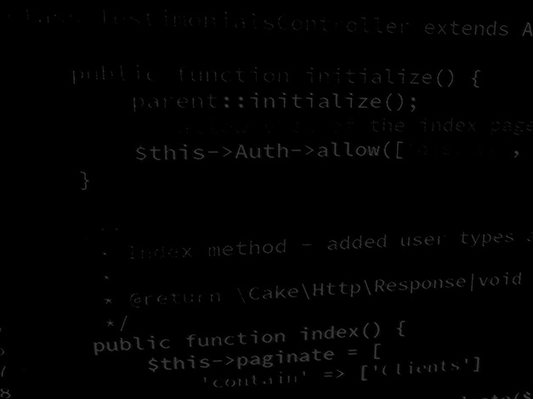
Data handling in Application development Structured data, coding a MySQL load / save data class
BSc Applied Computing

Slide 2
In this session…
Last Session
Semi-structured data
JSON
Session Rationale
Structured data
MySQL
Caveats
Result Calculator project
Configuring MySQL using PHPMyAdmin
Adding a MySQL load / save class

Slide 3
Last session
BSc Applied Computing

Slide 4
Semi-structured data
“Semi-structured data refers to data that is not captured or formatted in conventional ways. Semi-structured data does not follow the format of a tabular data model or relational databases because it does not have a fixed schema. However, the data is not completely raw or unstructured, and does contain some structural elements such as tags and organizational metadata that make it easier to analyse. The advantages of semi-structured data is that it is more flexible and simpler to scale compared to structured data.”[1]
In order for an application to be able to use data, rather than just edit it, the data needs to conform to some kind of schema so that the application can recognise one bit of data from another.
Notes:
1: Teradata. What is Semi-Structured Data? Available at: https://www.teradata.com/Glossary/What-is-Semi-Structured-Data. Last Accessed: 29/6/22

Slide 5
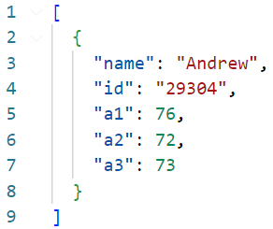
What is JSON
JavaScript Object Notation.
Saves data in a more computational format with square brackets representing lists and curly brackets representing objects.
Similar (but not identical) to the CSS data format.
Somewhat overcomes the file size issues of XML by reducing formatting information.
In the case of our Result Calculator application *:
Notes:
* The example saves each record as a list of keys and values separated by colons. JSON is able to save numerical information and String information, it can indicate its datatype by adding or omitting quotation marks.

Slide 6
When and where to use JSON
JSON creates formatted data blobs which are simple to parse from a data collection for saving to disk, and equally simple to load and parse to memory.
JSON is far more efficient than XML but is equally less human-readable.
As a result JSON is a better choice for large blobs of data or for data which have to be saved frequently but it will still hit a performance bump with reasonably large data stores... Unless these are all save to individual files… but then that will increase load time and resources.
JSON is a good is an excellent choice when data is saved and read by applications, especially when those applications do not share a platform.
For example: JSON can be served from an API running PHP on a Linux server and have that read by a Windows-based C# application.
As with XML, this is a perfectly acceptable data format for the results calculator application due to the small amount of data saved.

Slide 7
Session rationale
BSc Applied Computing

Slide 8
Structured data
“Structured data usually resides in relational databases (RDBMS). Fields store […] data like phone numbers, Social Security numbers, or ZIP codes. Records even contain text strings of variable length like names, making it a simple matter to search.”
“Data may be human- or machine-generated, as long as the data is created within an RDBMS structure.”
“This format is eminently searchable, both with human-generated queries and via algorithms using types of data and field names, such as alphabetical or numeric, currency, or date.”[3]
[4]
Notes:
3. Taylor, C. Structured vs. Unstructured Data. Available at: https://www.datamation.com/big-data/structured-vs-unstructured-data/. Last Accessed: 22/9/22.
4. Structured Data. [Original Image, c.2022].

Slide 9
MySQL (and MariaDB)
MySQL is the database server that we will use for these sessions.
To access it, a user account, password and the name of the database to be queried are all required.
MySQL accepts data queries in the SQL language. [5]
XAMPP list the installed DB as MySQL, in fact it is likely to be MariaDB. [6]
MySQL is owned by Oracle (since 2010), MariaDB is a fork in MySQL development started by MySQL developers after the Oracle takeover.
MySQL and MariaDB are interchangeable, they have the same syntax, processes and structure (binary replacements).
MySQL is now proprietary and supported by Oracle, MariaDB remains open source and free for all.
Any further reference to MySQL will also be referring to MariaDB.
Notes:
5. MySQL. Chapter 13 SQL Statements. Available at: https://dev.mysql.com/doc/refman/8.0/en/sql-statements.html. Last Accessed: 22/9/22.
6.. Chojrin, M. MariaDB Vs MySQL: Performance, Licensing & Support. Available at: https://blog.panoply.io/a-comparative-vmariadb-vs-mysql. Last Accessed: 22/9/22.

Slide 10
Before any coding…
It should be acknowledged that the best way to interact with an RDBMS is to save records one at a time.
To make our application do this cleanly would require a structural rethink of the Controller class and possibly the Record class. It would certainly require amending the Access interface.
Ordinarily, the task would be analysed and if a database server is required, this approach would be built in.
For the purposes of time, speed and sanity, the Result Calculator’s MySQL save method will loop through its list of Records. Any new records will be added to the database. Any existing records will be compared against a copy retrieved from the database, if changes are found, a new version of the record will be saved.
This is NOT ideal and not performant. It will demonstrate how to load and save data to a MySQL database, which is the overriding point.

Slide 11
Result calculator project
BSc Applied Computing

Slide 12
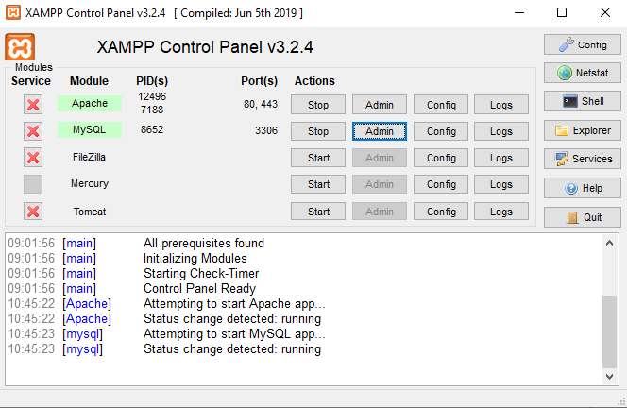
MySQL and PHPMyAdmin
As MySQL is a database server, it does not include a management interface of any sort (these take up memory).
Luckily XAMPP comes bundled with a PHP MySQL management interface known as PHPMyAdmin.
Start by launching PHPMyAdmin from the XAMPP control panel. *
Notes:
* Please make sure that both Apache and MySQL are started before trying to use PHPMyAdmin.
For more information about PHPMyAdmin, see https://www.phpmyadmin.net.
For more information about MySQL see https://www.mysql.com.

Slide 13
Database design
Before we set up any databases or tables, it is a good idea to design what data we need for the application we are developing.
Planning database design with ERDs and data dictionaries can save many headaches and much refactoring later on.
This is a simple project and only requires one table called results which will be setup according to the following diagram.
Column | Data type | Key | Default value
id | Big Int | Primary | Autonumber
name | Varchar (128) | NA | Null
student_id | Varchar (128) | NA | Null
a1 | int | NA | 0
a2 | int | NA | 0
a3 | int | NA | 0

Slide 14
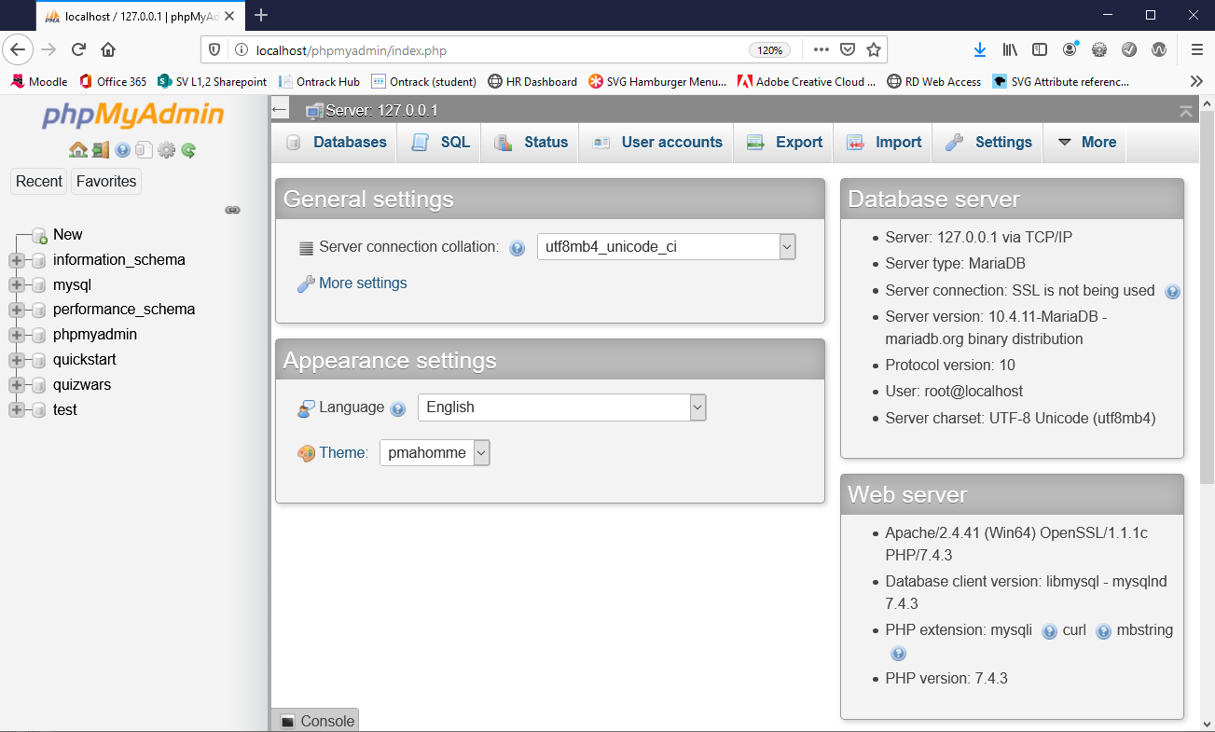
Setup the database
Open PHPMyAdmin

Slide 15
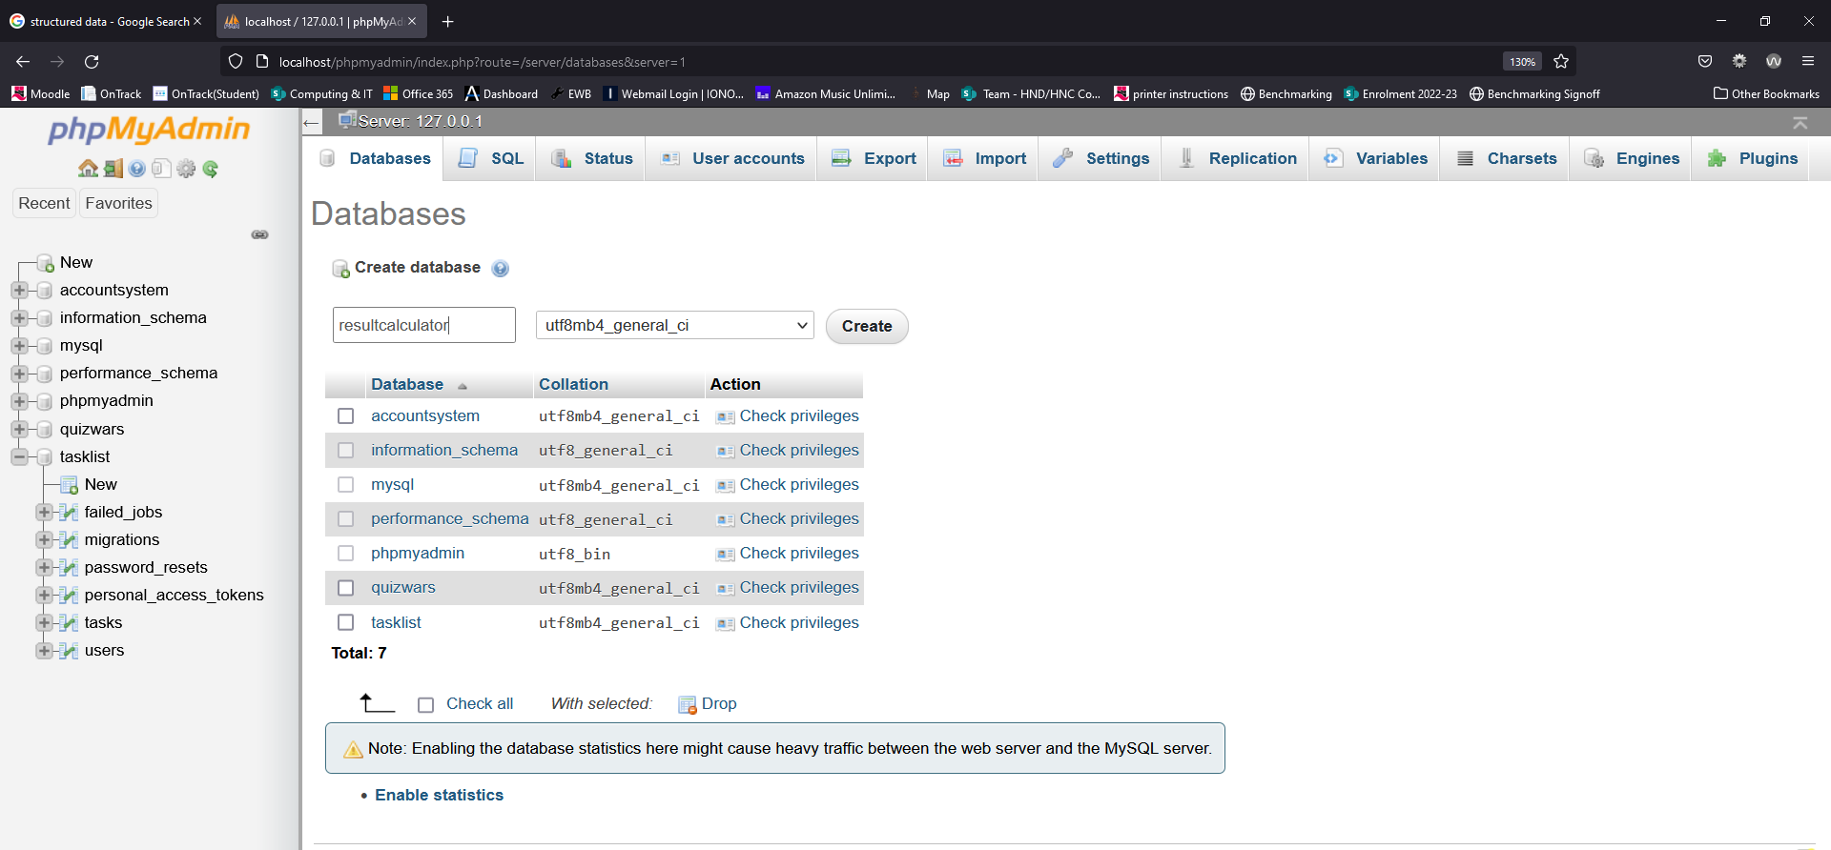
Setup the database
Use the new control at the top of the left-hand list of databases.
Enter the name resultcalculator as shown below then press create.
1
2
3

Slide 16
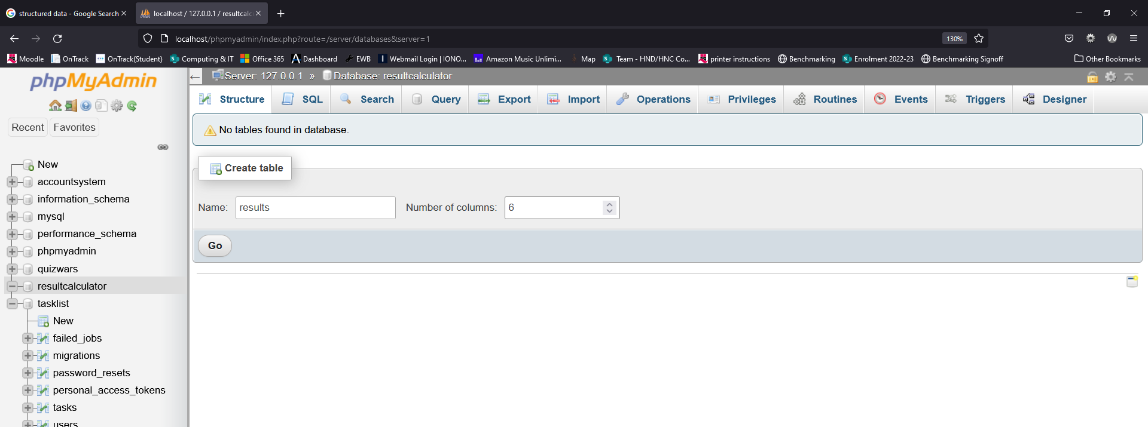
Setup the results table
We are prompted to create a new table.
Enter the name results and set the number of columns required to 6 (we know this as we have already planned the data design).
Press Go.

Slide 17
Setup the results table
Enter the column names, data types and defaults for this table as shown.
Note: make sure to check A_I (auto increment) on the id row, this will in turn set this column as the primary key for this table
Use the save button to complete the table setup

Slide 18
Double check the results table
We are presented with a view of our new table structure
Take a moment to check that everything is correct
Use the change control as needed if mistakes have been made

Slide 19
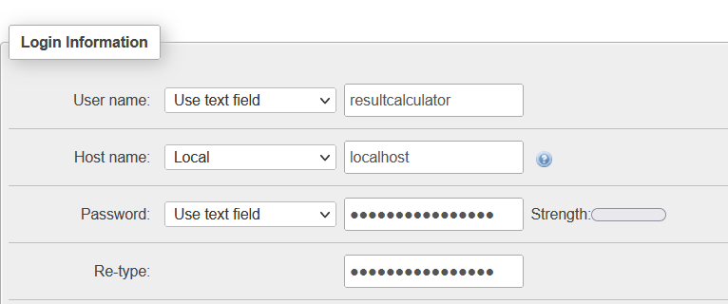
Adding a user account
MySQL requires a user account for the result calculator application to access it.
Select the Privileges tab and use the Add user account control.
Setup the new user with username and password of resultcalculator.*
Set Host name to localhost. **
Scroll right down and use the go button.
Notes:
* This is very weak but this is only our dev server and won’t hold any real data that anyone can exploit – as a result, I favour remember-ability over security
** this is IMPORTANT!!!!!

Slide 20
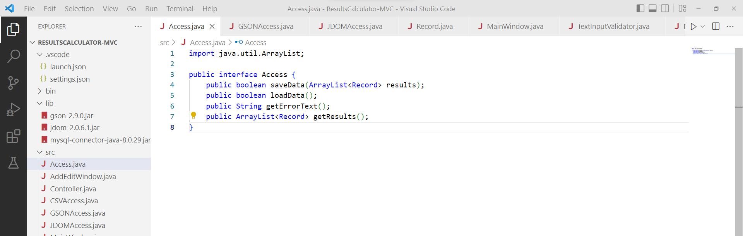
Project start
We will continue to build into the last project.
Project start up:
Open the project name ResultCalculator-MVC.
Download the mysql-connector-java-8.0.29.jar from Moodle and add it to the project lib directory. *
Notes:
* If you would like to use a the most up-to-date version of MySQL Connector, you can get it here: https://mvnrepository.com/artifact/mysql/mysql-connector-java
At the time of writing, 8.0.29 is not the most recent release although it does not have any known vulnerabilities.

Slide 21
Amending the Record class
Database records will frequently contain an ID primary key.
Ideally, each Record instance would contain a reference to the database record primary key associated with it.
Luckily, we can add another attribute to the Record class without disrupting the load/save operations of the previous Access classes as they simply will not try to use this.
Open the Record class file and make the following amendments…

Slide 22
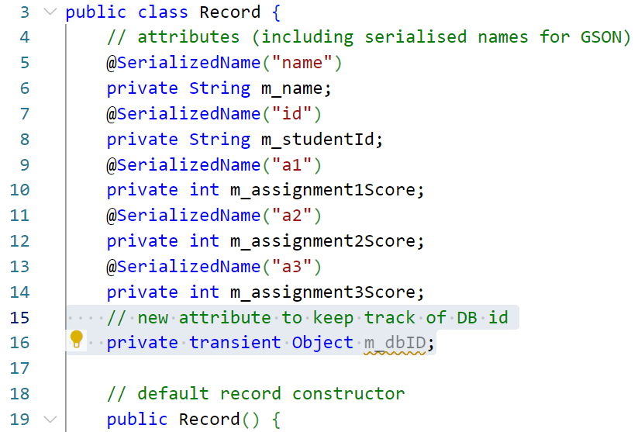
Amending the Record class
Add a new attribute for the database primary key.
Add the highlighted statement. *
Notes:
* Clarification:
Line 16 adds in a reference to a new transient attribute using the Object datatype (this means that we can put any type of data into this as different databases have different types of primary key this allows us to keep our options open). Transient means that this attribute is not serialised and included when the class is converted to JSON.

Slide 23
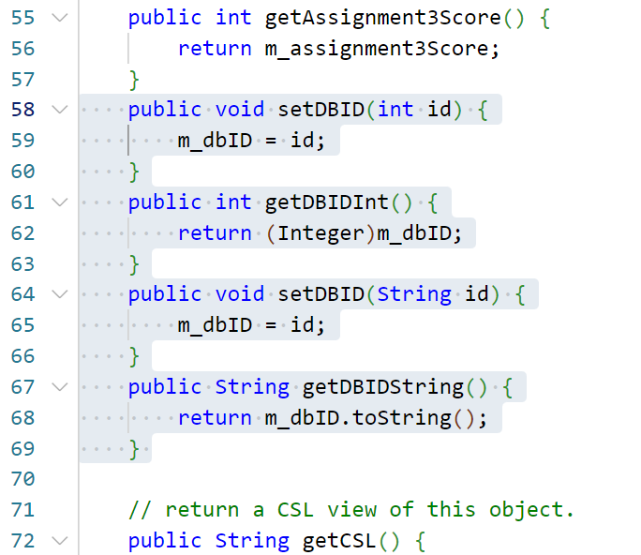
Amending the Record class
Add a getter and setter methods for the new attribute.
Add the highlighted methods. *
Notes:
* Clarification:
Lines 58 to 60 adds a setter method to set the DBID attribute if passed argument is an int.
Lines 61 to 63 add a getter method which returns the DBID as an int.
Lines 64 to 66 and 67 to 69 do the same but this time getting and setting DBID if a String is required.

Slide 24
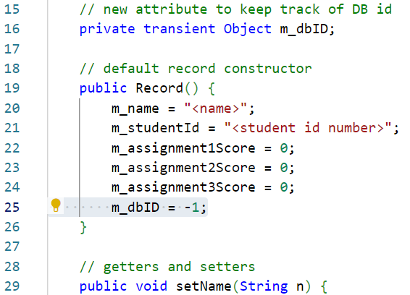
Amending the Record class
Set a default value for the new attribute in the constructor method.
Add the highlighted statement. *
Notes:
* Clarification:
Line 25 sets a default value of -1 for the DB ID – as the database might set a record ID of 0, -1 is the first value it definitely will not set. As a result, this value can be used to determine if the Record has been saved to the database.

Slide 25
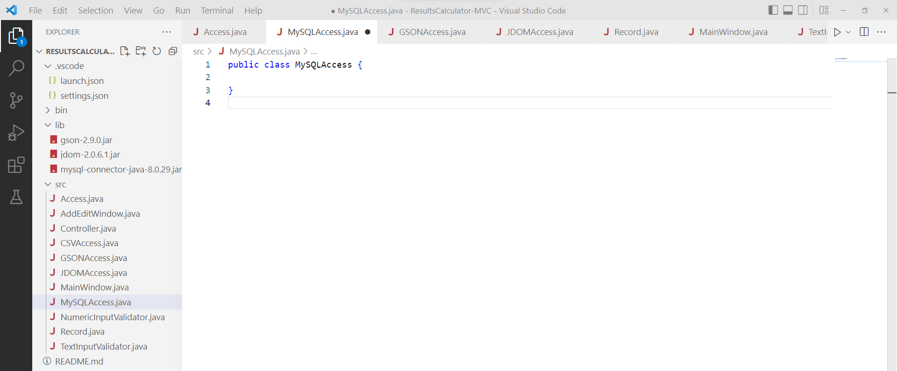
Create a data load / save class
Add a new class to the src directory by opening the Command Palette* and selecting Java: New Java Class.
Give the new class the name MySQLAccess.
Notes:
* The command palette can be opened with either CTRL+SHIFT+P or View > Command Palette…

Slide 26
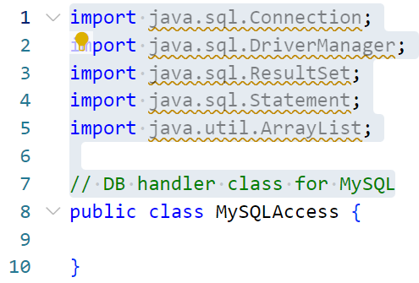
Add import statements
Add import statements required by this class.
Most of these are MySQL driver libraries.
Add the highlighted statements.

Slide 27
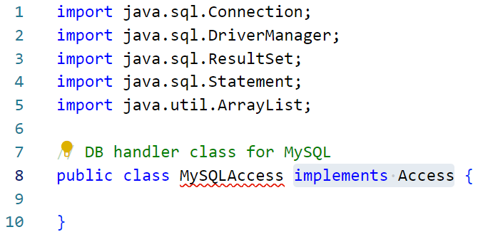
Add an implements statement
This class will implement the Access interface.
Ignore the error, this is caused by the fact that we have implemented the interface, that in doing so we have promised to include a number of methods and that we have not included these yet.
Add the highlighted statement.

Slide 28
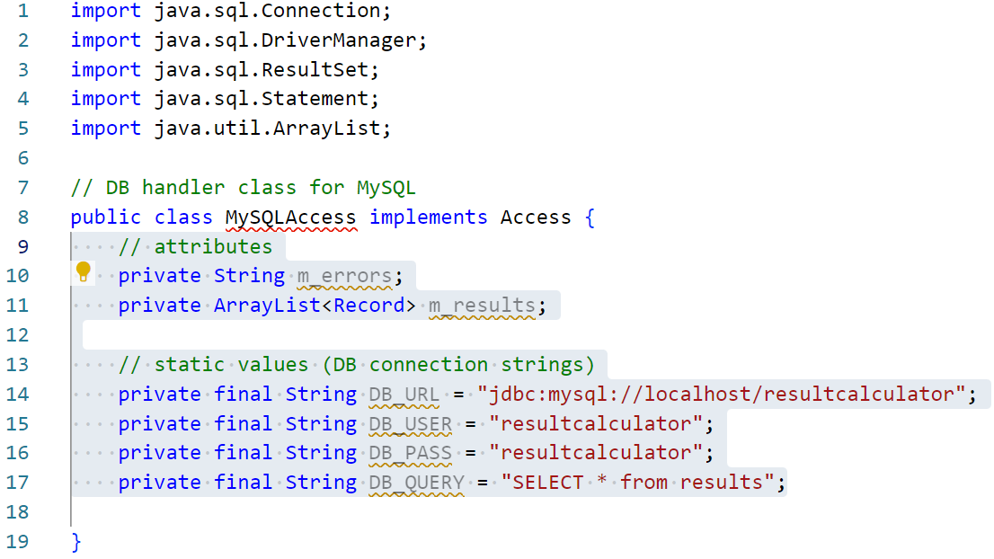
Add attributes and a constant
Add attribute and constant references.
Add the highlighted statements. *
Notes:
* Clarification:
Line 10 declares a reference to a String which will contain any error text generated by either a load or save action which cannot complete.
Line 13 declares an ArrayList of Record objects which will be used to load data from file into. The data will be stored here until it is requested by the Controller.
Lines 14 to 16 contain constant Strings which contains access credentials for the database server, namely the connection string, the username and the password set earlier.
Line 17 contains a blanket “select all data” SQL query which will be run later and is only split out here for clarity.

Slide 29
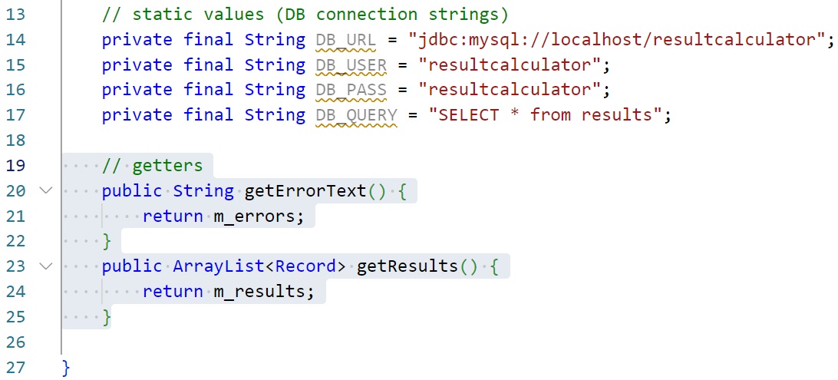
Add getter methods
Add getter methods for two attributes just added.
Add the highlighted methods. *
Notes:
* Clarification:
Lines 20 to 22 declares a getter for the error text String.
Lines 23 to 25 declares a getter for the results ArrayList of Records.

Slide 30
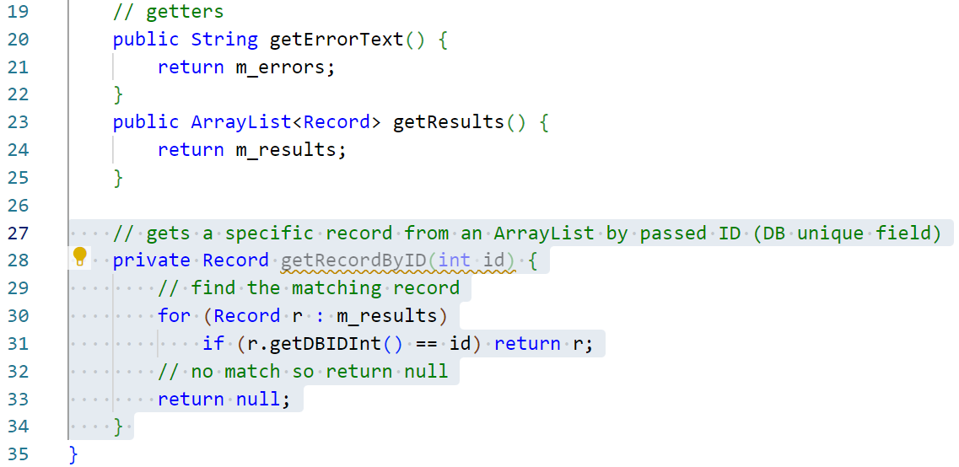
Add a utility method to get a Record
Add a method to identify a specific Record by id.
Add the following highlighted method. *
Notes:
* Clarification:
Line 28 declares the method which returns a Record and accepts a single argument of the int based ID to search for.
Line 30 declares a foreach loop to iterate over the collection of Record objects loaded.
Line 31 returns the first Record from the collection where the getDBIDInt method returns a matching value for the int passed as an argument to the method.
Line 33 if no match is made, this line is reached and a null value is returned instead. This line should NEVER be reached as the arguments should all be drawn from active Record instances.

Slide 31
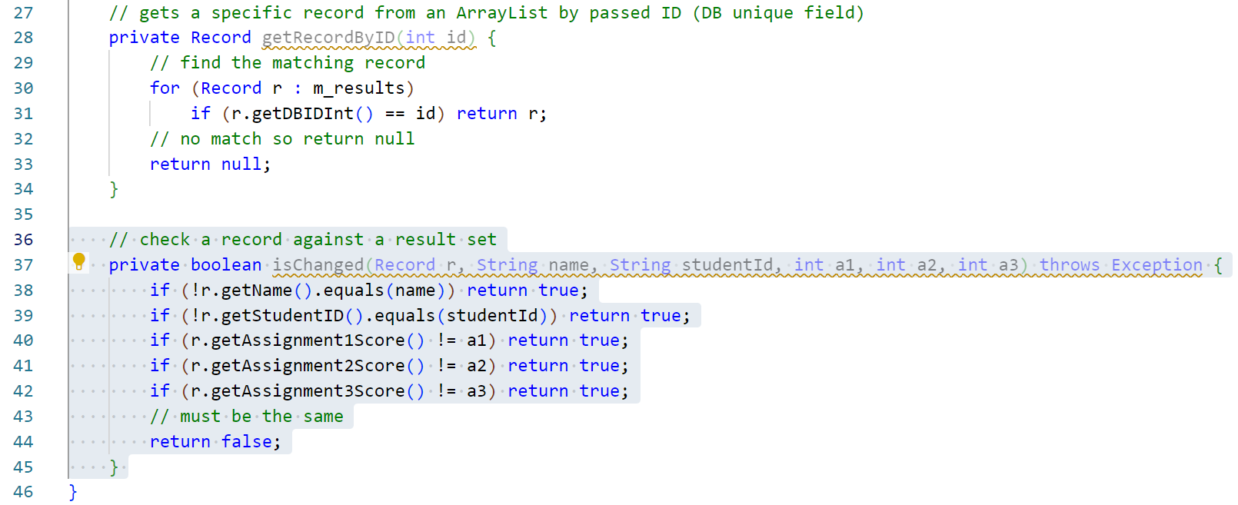
Add a method to check a Record
Add a method which checks if a Record has changed.
Add the following highlighted method. *
Notes:
* Clarification:
Line 37 declares the method which returns a boolean and accepts a list of arguments, the first is the Record instance to test, the remaining are values which might be found in the Record.
Lines 38 to 42 systematically test each attribute of Record against supplied arguments. If any are found to be different, a value of true is returned.
Line 44 if no match is made, this line is reached and a false value is returned instead as the Record matches all data supplied.

Slide 32
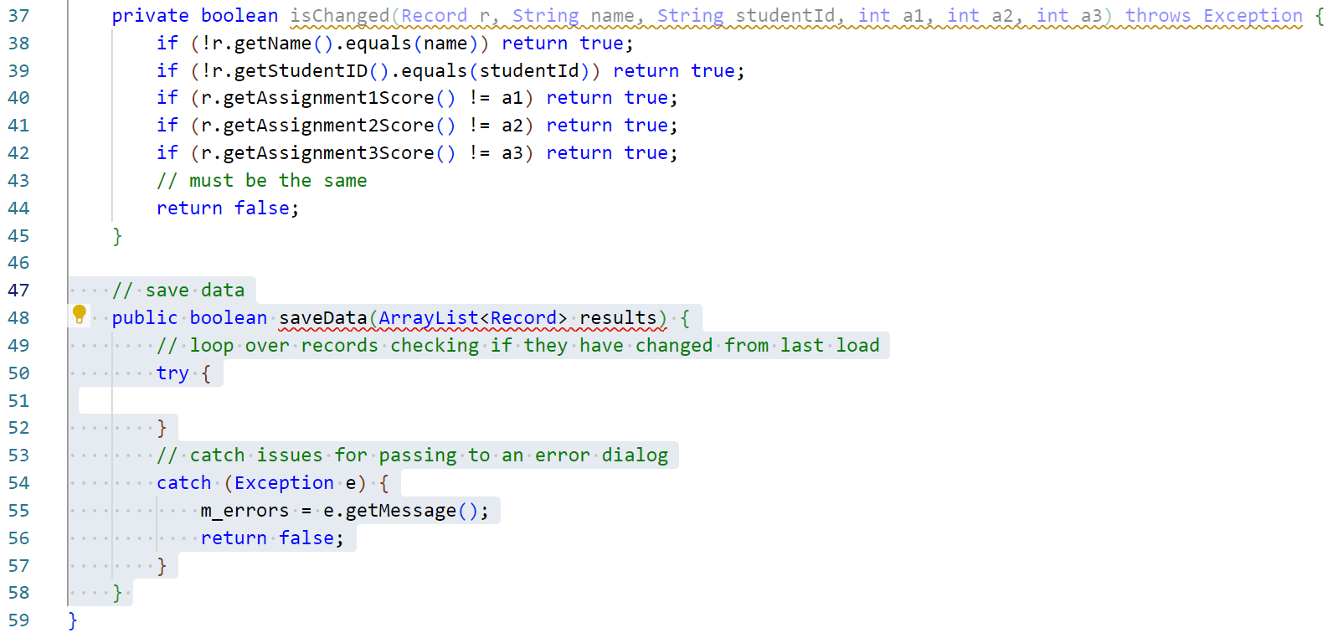
Add a save data method
Add a the framework for a save data method.
Add the highlighted methods. *
Notes:
* Clarification:
Line 48 declares the method specified in the interface which returns a boolean to indicate success or failure and accepts a single argument of an ArrayList collection of Records to save.
Lines 50 to 58 implements a try/catch block. As a file write is an operation which can generate exceptions, this block will prevent the application crashing if the write fails.
Line 55 sets the error message attribute to the message generated by the exception thrown.
Line 56 returns false to indicate that the file write has failed.

Slide 33
Add a save data method
This method will be a little more involved than in previous classes.
In this build we will iterate over the collection of Records to save then:
Check to see if the DBID field is empty, if so this is a new record:
Save the new record to the database.
Select the newly entered record from the database to find the ID it has been given.
Set the DBID property on the Record object.
If the DBID field is not empty this is an existing record:
Select the previously saved record from the database.
Check the saved data against the Record object to see if anything has changed.
If anything has changed, update the record in the database.
Get a list of all records from the database:
Iterate over these looking for Records that have been deleted from the collection in memory, build a list of records to delete.
Iterate over the list of records to delete, delete these records from the database.
This is a little unorthodox and stems from an application flow designed to deal with single save data-files. *
Notes:
* Good analysis of the brief would have identified the need for a database. This should have led to an application workflow more in sympathy with the idea of loading, deleting and saving individual records at a time rather than the whole datastore at once.
It is important to recognise this limitation in the following code and to recognise that a far more performant approach is possible.

Slide 34
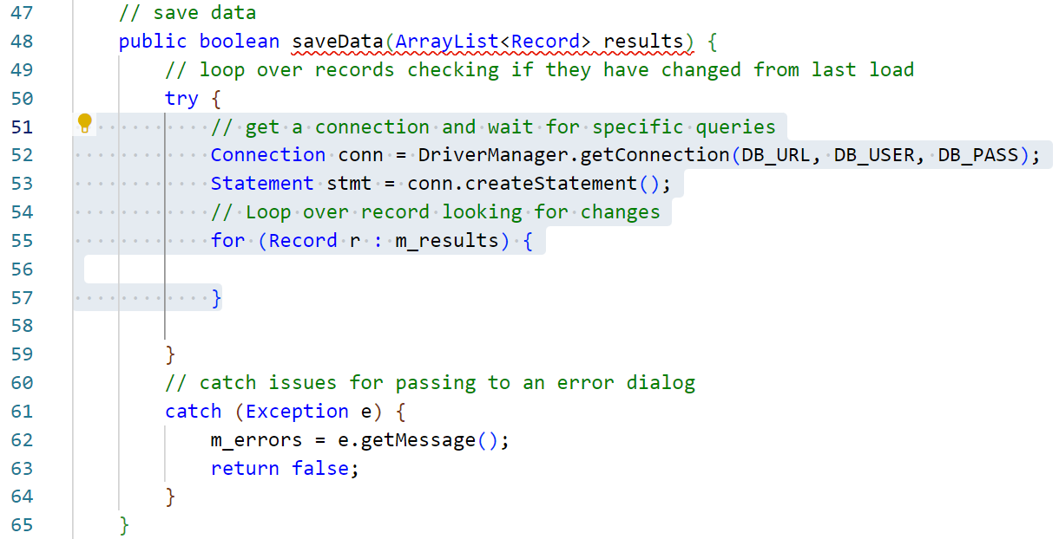
Add a save data method
Create a MySQL connection, an initial statement and a foreach loop.
Add the highlighted statements. *
Notes:
* Clarification:
Line 52 Uses the MySQL driver libraries to create a connection object with the database using the authentication constants that were created earlier.
Line 53 creates a Statement object from the Connection. This will be used to issue command to the database.
Lines 55 to 57 declare a foreach loop which will iterate over the contents of the collection of Records passed to this method as an argument.

Slide 35
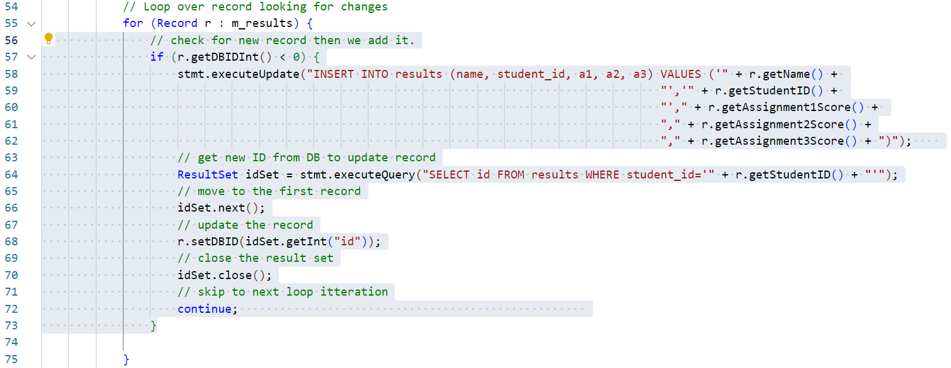
Add a save data method
Inside the foreach loop, first check for new Record objects.
Add the highlighted statements. *
Notes:
* Clarification:
Line 57 implements an if block to test if the DBID attribute of the current Record object is empty (less than 0). If this is the case, it has not been set yet as this is a new Record.
Lines 58 to 62 are in fact one large statement which composes an SQL query to add this new record to the database. This SQL statement is in the form of a String. The String is then passed to the executeUpdate method of the Statement object created earlier. This will add the record to the database.
Line 64 creates another SQL query, this time one which selected the data which was just added to the database using the student id field to identify the record.
Line 66 selects the first result from the collection of the results generated by this query (there should be only one result so simply selecting the first result is acceptable).
Line 68 sets the DBID attribute on the Record object with the id data assigned to the result by the database. This is prone to error as we are not checking anything else and it is entirely likely that 2 identical student ids could be used. There are various fixes here, from forcing unique student ids on the database to checking all data rather than just a single field. A more robust and heavyweight approach is overkill here as we are just exploring the methodology.
Line 72 skips the rest of the code in this iteration of the foreach loop moving to the next Record.

Slide 36
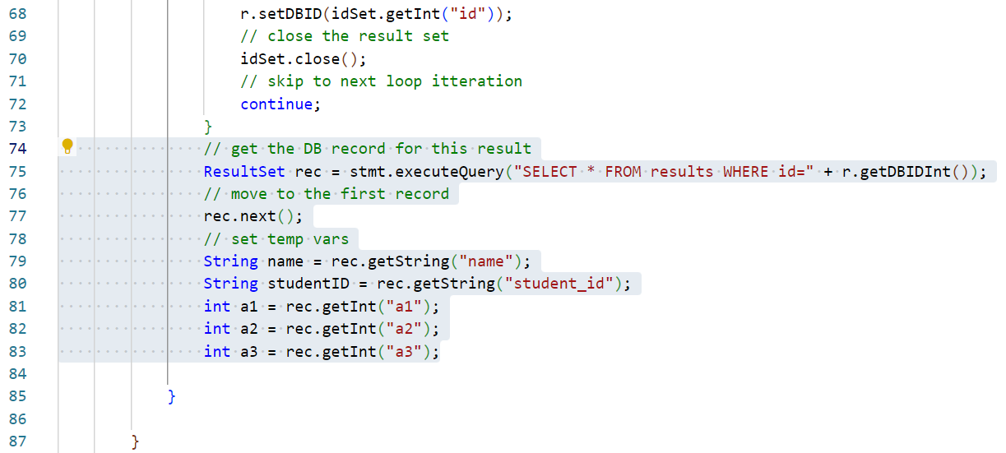
Add a save data method
Next, select any existing matching result from the database.
Add the highlighted statements. *
Notes:
* Clarification:
Line 75 creates an SQL query which selects any data saved to the database which matches the DBID of the current Record. This absolutely should result in 1 record being returned as DBID is a unique field.
Lines 79 to 83 creates temporary variables for each aspect of data from this result.

Slide 37
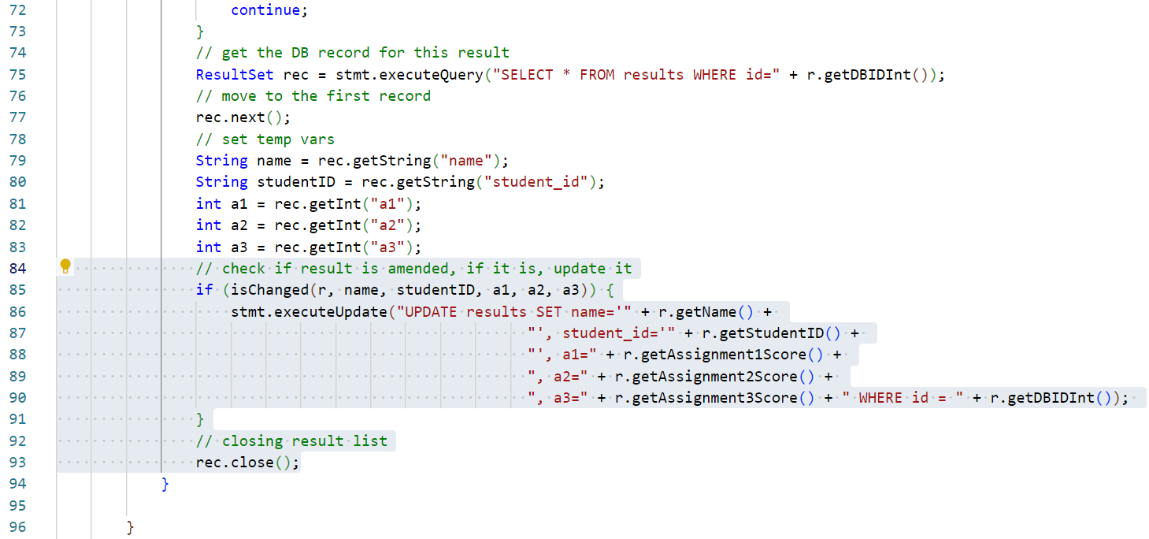
Add a save data method
Test the data from the database against the current Record.
Add the highlighted statements. *
Notes:
* Clarification:
Line 84 uses the utility method created earlier to test if the current Record holds different data to its counterpart from the database.
Lines 86 to 90 these lines are, again, a single statement. If the above test is passed then the record is different to the saved version and needs an update. These lines prepare and execute an SQL statement to update all data fields for this Record on the database.
Line 93 closes the ResultSet object created by the SELECT query above. This removes this data from memory and allows the Statement object to be reused.

Slide 38
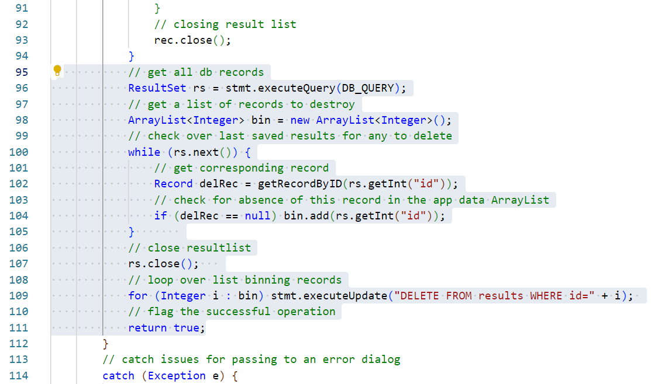
Add a save data method
Check for any records that need deleting from the database.
Add the highlighted statements. *
Notes:
* Clarification:
Line 96 uses the pre-prepared “select everything” SQL query coded earlier to create a ResultSet of all data presently in the database.
Line 98 creates an ArrayList of ints which will represent the database id of any record that requires deletion.
Lines 100 to 105 implement a while loop to iterate over the ResutSet of data from the database.
Line 102 attempts to retrieve the matching Record from the collection passed to this method as an argument.
Line 104 tests if the Record corresponding to this database record is null, if so, it has been deleted. The id of this result it added to the ArrayList for deletion from the database. We cannot delete this record now as we are currently in the middle of an interaction with the database.
Line 107 closes the ResultSet releasing all memory and objects associated with it.
Line 109 iterates over the collection of ints in the ArrayList using a foreach loop. Each record in the collection is deleted from the database one at a time.
Note: It should be noted that this kind of blanket deleting of data from a database is bad practice. If the data is deleted in error, it’s still gone. Better to add an Archive field which can denote if this is an active record, perhaps archived records which have not been touched for a certain amount of time can then be deleted. Often this kind of task is completed using another table for records to be deleted which is then purged every so often.

Slide 39
Add a load data method
Finally, we add a method to load and parse data from the XML file.
Add the highlighted method. *
Notes:
* Clarification:
Line 121 declares the method specified in the interface which returns a boolean to indicate success or failure and does not require any arguments.
Lines 123 to 130 implements a try/catch block. As a file read is an operation which can generate exceptions, this block will prevent the application crashing if the write fails.
Line 128 sets the error message attribute to the message generated by the exception thrown.
Line 129 returns a value of false to indicate that the file read has failed.

Slide 40
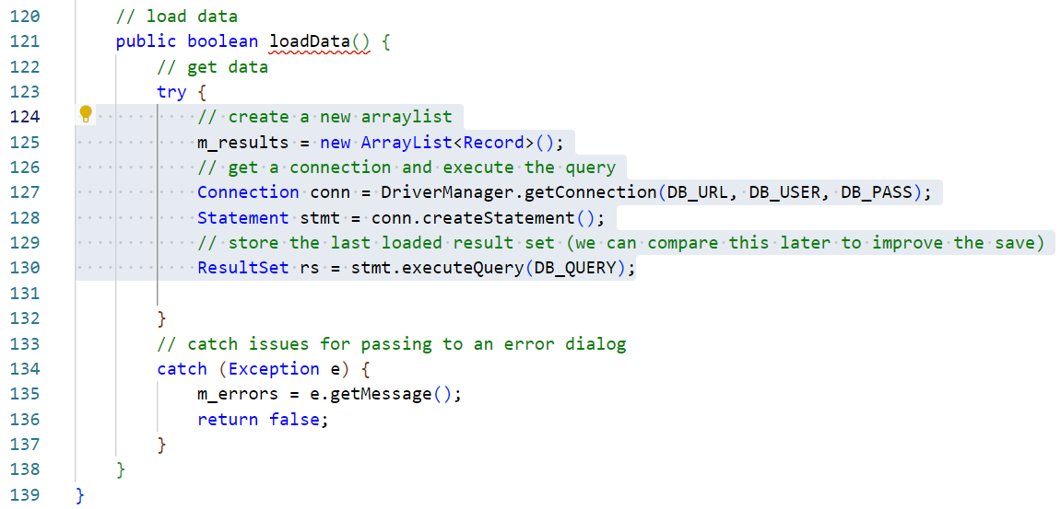
Add a load data method
Add the ability for this new method to connect to the database.
Add the highlighted statements. *
Notes:
* Clarification:
Line 125 resets the ArrayList collection of Record objects to a new, empty collection.
Line 127 Uses the MySQL driver libraries to create a connection object with the database using the authentication constants that were created earlier.
Line 128 creates a Statement object from the Connection. This will be used to issue command to the database.
Line 130 executes the default SQL SELECT all query created previously as a constant. The results from this query are loaded into a ResultSet collection.

Slide 41
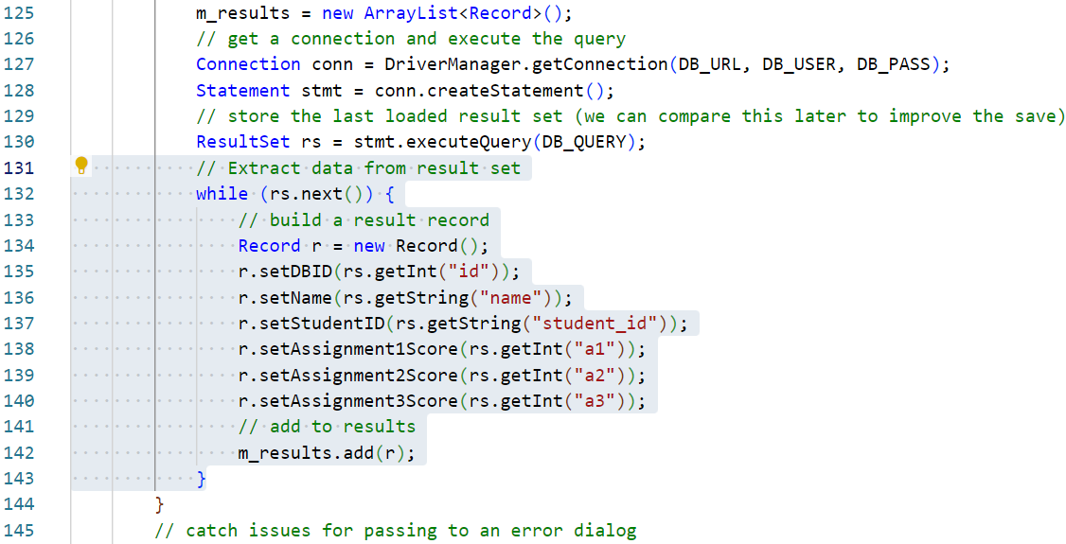
Add a load data method
ETL (Extract, Transform, Load) the data to a collection of Record objects.
Add the highlighted statements. *
Notes:
* Clarification:
Lines 132 to 143 implements a while loop which iterates over the ResultSet contents, taking each in turn and loading its data into a new Record instance. The Record is then added to the global m_results ArrayList collection. In this loop there are 2 temporary variables, r is used as a reference to the new Record object, rs is used as a reference to the ResultSet member being converted.

Slide 42
Add a load data method
Finally, close the database connection.
Add the highlighted statements. *
Notes:
* Clarification:
Line 144 closes the ResultSet closing the database connection.
Line 147 returns true indicating a successful load operation.

Slide 43
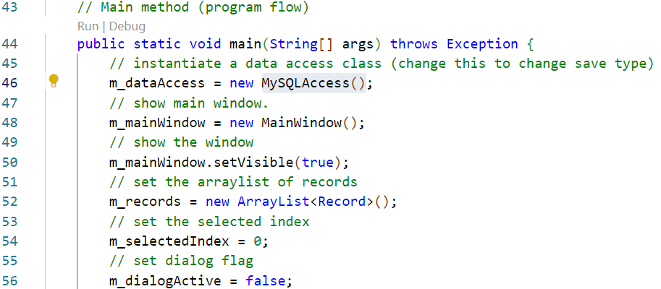
Set the Controller to use MySQL
The application needs to be set to use the new MySQL load/save class.
Amend the highlighted statement. *
Notes:
* Clarification:
Line 46 is altered from using the old GSONAccess class to using the new MySQLAccess class. As both of these classes implement the Access interface, the rest of the application can be left unaltered as it already knows how to interact with any class using the Access interface. The application should now load and save data to the MySQL database created earlier.

Slide 44
Test the application
BSc Applied Computing

Slide 45
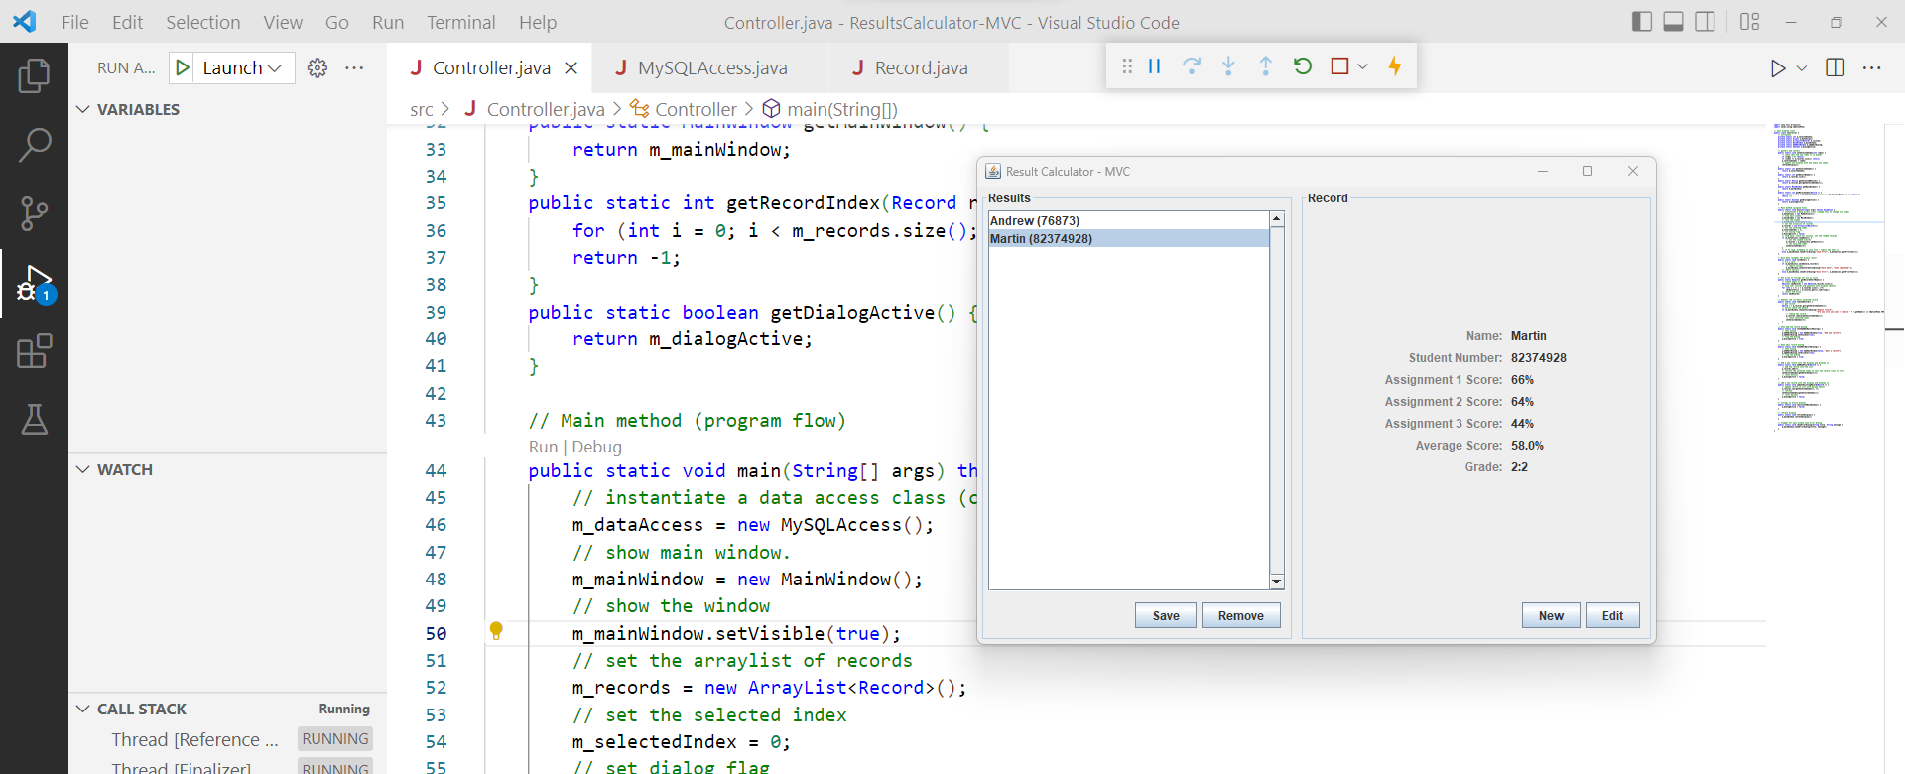
Test the application
Open the Run and Debug panel.
Use the green Start Debugging arrow to run the program.
You should be able to fully use the application. *
Notes:
* If you get an authentication error here, it is possible that either the authentication details have not been set on the database correctly, or that MySQL has corrupted its user’s table (which is does occasionally on Windows client operating systems). If the latter is the case please Google for repairing tables in MySQL and then re-apply the user account for this database as described earlier in this tutorial.

Slide 46
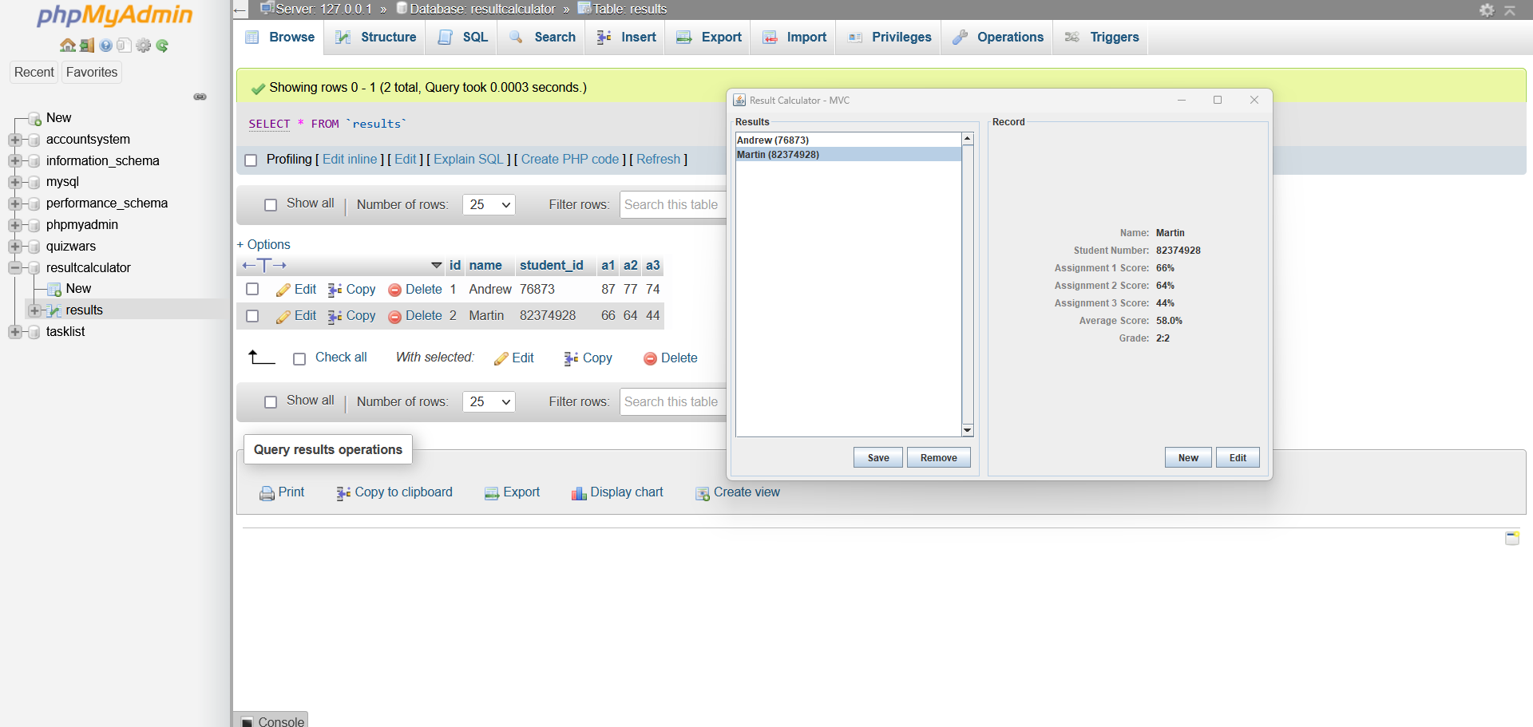
Test the application
Stop the application and check PHPMyAdmin.
Start the application again to load in the data saved in the previous run.

Slide 47
Project Summary
BSc Applied Computing

Slide 48
This project has covered…
Taking advantage of the of the functional divisions created by the MVC architecture and of OOP interfaces.
Using the MySQL database server we have implemented an inefficient but demonstrative alternative datastore to the text-based files created previously.
Applying 3rd party libraries (JAR files) manually to a Java project.

Slide 49
To reiterate…
It should be acknowledged that the best way to interact with an RDBMS is to save records one at a time.
To make our application do this cleanly would require a structural rethink of the Controller class and possibly the Record class. It would certainly require amending the Access interface.
Ordinarily, the task would be analysed and if a database server is required, this approach would be built in.
For the purposes of time, speed and sanity, the Result Calculator’s MySQL save method will loop through its list of Records. Any new records will be added to the database. Any existing records will be compared against a copy retrieved from the database, if changes are found, a new version of the record will be saved.
This is NOT ideal and not performant. It will demonstrate how to load and save data to a MySQL database, which is the overriding point.

Slide 50
Session recap…
Last Session
Semi-structured data
JSON
Session Rationale
Structured data
MySQL
Caveats
Result Calculator project
Configuring MySQL using PHPMyAdmin
Adding a MySQL load / save class

Slide 51
Any questions?
Next…
Saving the data to the NoSQL MongoDB Atlas cloud service.

