Slide 1
Type of building use
Understanding common forms of low-rise construction currently used for domestic and commercial buildings
Carl James

Slide 2
Building uses
Creating a safe enclosure was the first requirement of humankind in the development of housing.
Since then, our requirements have included many more things to improve our standard of living and our built environment.

Slide 3
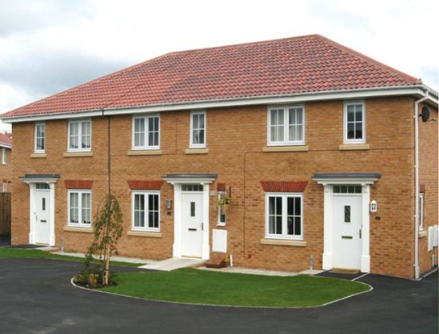
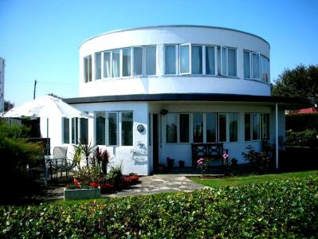
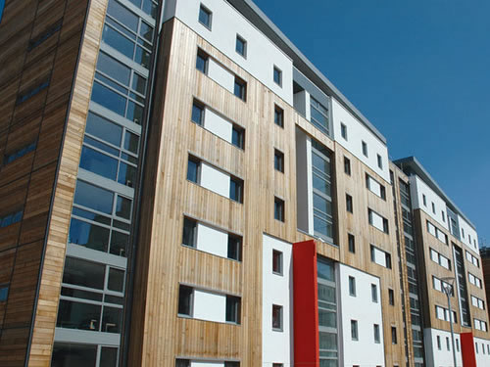
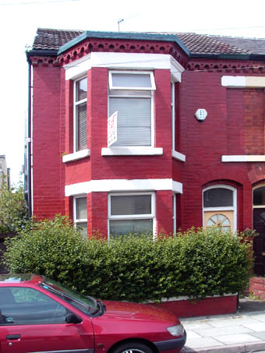
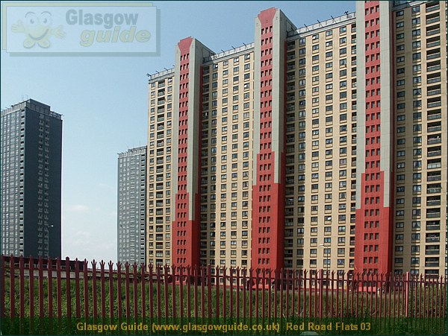
Houses and Flats

Slide 4
Houses are typically small structures of one or two storeys with simple components such as bricks, mortar, timber to make floors, roofs, windows and so on.
Plastic resins and other synthetic materials have become available in recent years and have made houses significantly more efficient in thermal performance and noise exclusion.

Slide 5
Improvements in the comfort features of houses, such as integrated kitchens, built-in bedroom furniture and building services, have meant that our houses have become increasingly sophisticated structures, which have to comply with legislation and regulations that place high standards of performance on both the quality of the finished product and also the workmanship of the assembly of these components.

Slide 6
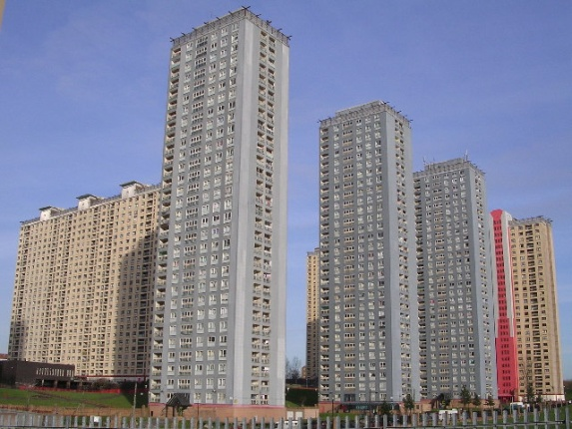
Flats and apartments group together individual dwellings in a common structure, making the construction and assembly of these units more economic than if one unit only was occupying the land.

Slide 7
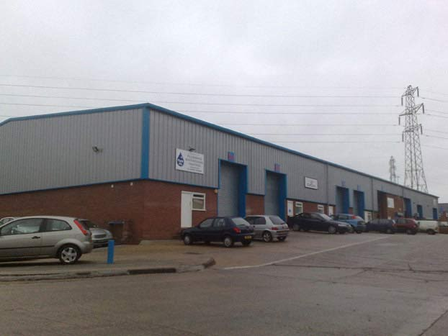
Warehouses and industrial units

Slide 8
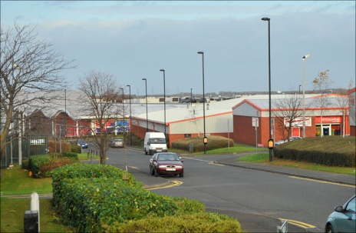
Warehouses and light industrial units are commercial buildings and do not list comfort as their main criterion.
More likely, they are open-span buildings with steel frames and clad with aluminium or functional materials that allow space to be enclosed both economically and safely.

Slide 9
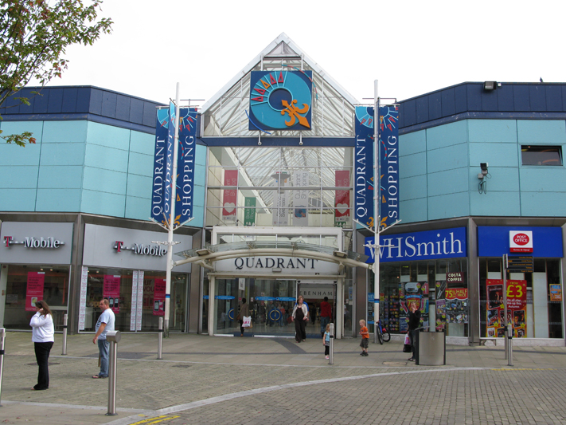
Retail

Slide 10
Retail outlets such as shops and commercial buildings can be purpose built or adapted from existing buildings. Newly built premises often take the form of large open span, portal frame buildings which provide a large floor space such as those used in supermarkets and low-rise department stores.
Smaller shops and retail outlets modified from larger-type houses need special works to adapt them from a residential property into a building that meets the requirements of employment and more frequent visitors that a retail outlet will have.

Slide 11
The requirements for fire resistance, noise reduction and ventilation are stricter for commercial buildings than they are for domestic dwellings, and any modification will need to take account of these if the adaptation is to be successful.

Slide 12
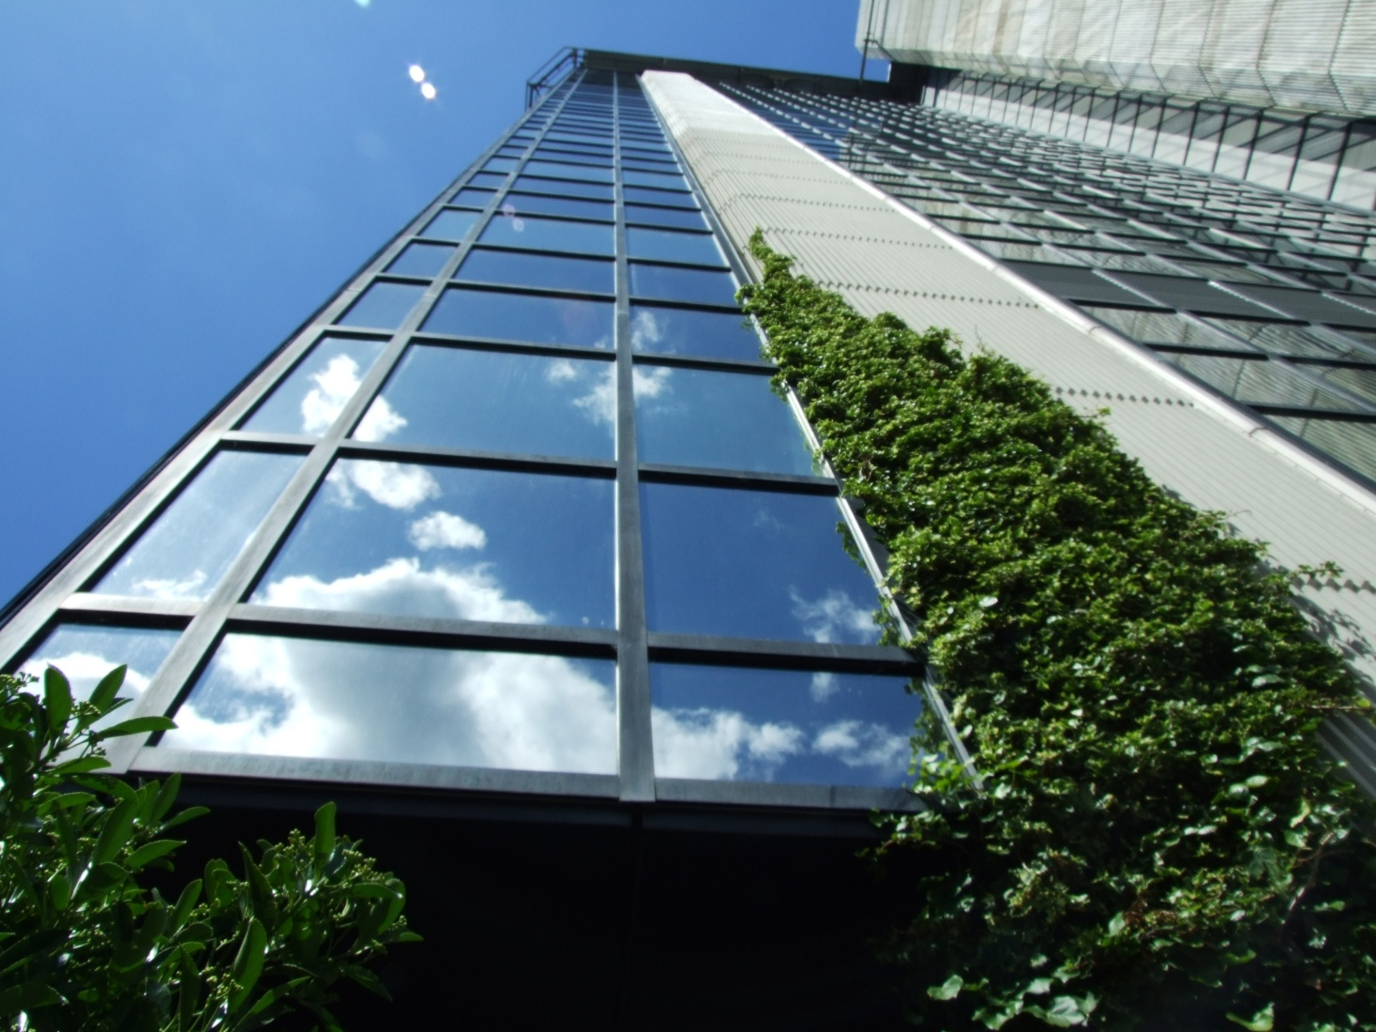
Offices

Slide 13
Offices also use large open-span buildings, with many employers choosing to create smaller working spaces based on the functional requirements of the work that will be undertaken there, for example secure areas for accounts or transactions requiring the storage or exchange of money, or the creation of small private units where individual discussion can take place and privacy is required for clients.

Slide 14
Small office buildings can be built in much the same way as housing, although should the requirement be for more than four storeys or for larger spans, then a more robust method of construction will be necessary, perhaps including the use of structural steel rather than bricks, mortar and timber.

