Slide 1
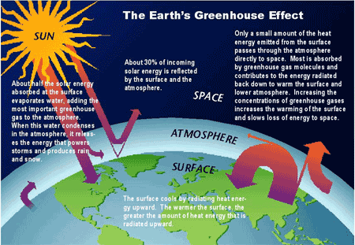
P2 :Explain four different forms of
global pollution arising from
construction projects ?

Slide 2
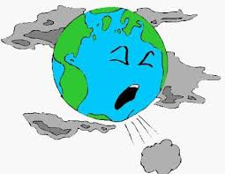
Air pollution
Air pollution is caused mainly by the burning of fossil fuels.
In construction the making of cement causes air pollution, in the form of carbon dioxide emissions.
Cement factories account for 5 percent of global emissions of carbon dioxide, the main cause of global warming.
The burning of fossil fuels create carbon dioxide ,which is released into the atmosphere and further thickens the o zone layer making the earth warmer.
Air pollution causes lung problems in parts of urban areas example concrete factories in Egypt have resulted in more frequent cases of lung cancer.

Slide 3
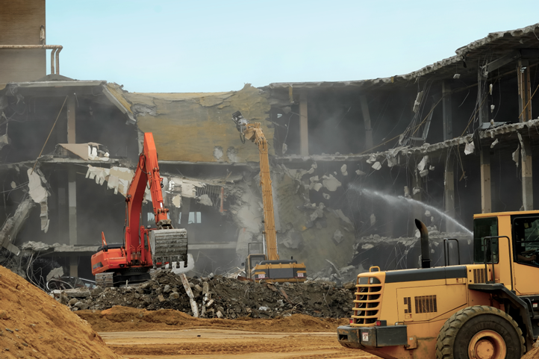

Noise pollution
Noise pollution is the disturbance or harm of balance of human or animal life due to excessive amounts of noise created via construction processes.
Within the united kingdom there must be a set amount of money given to the local community to compensate them for the excessive noise caused by the construction processes.
A lot of Noise pollution comes from constructions sites from demolition to the buildings. This creates large quantities of noise.

Slide 4
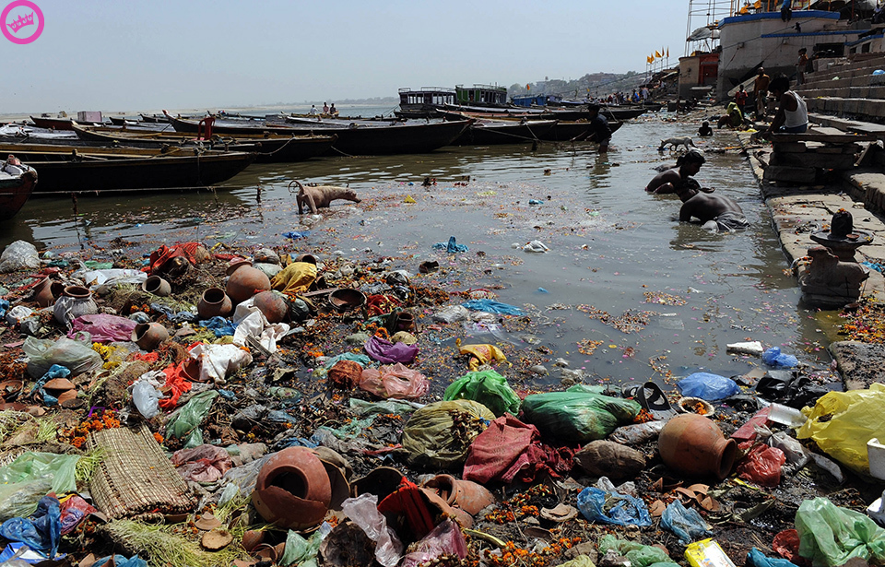
Water pollution
Water pollution is the contamination of a water course due to the dumping of materials/liquids.
In the UK it is illegal to dump toxic waste (Oil) down a drain.
Water pollution can create serious problems to a local environment
Water pollution is monitored through the construction process through the monitoring of local water sources.

Slide 5
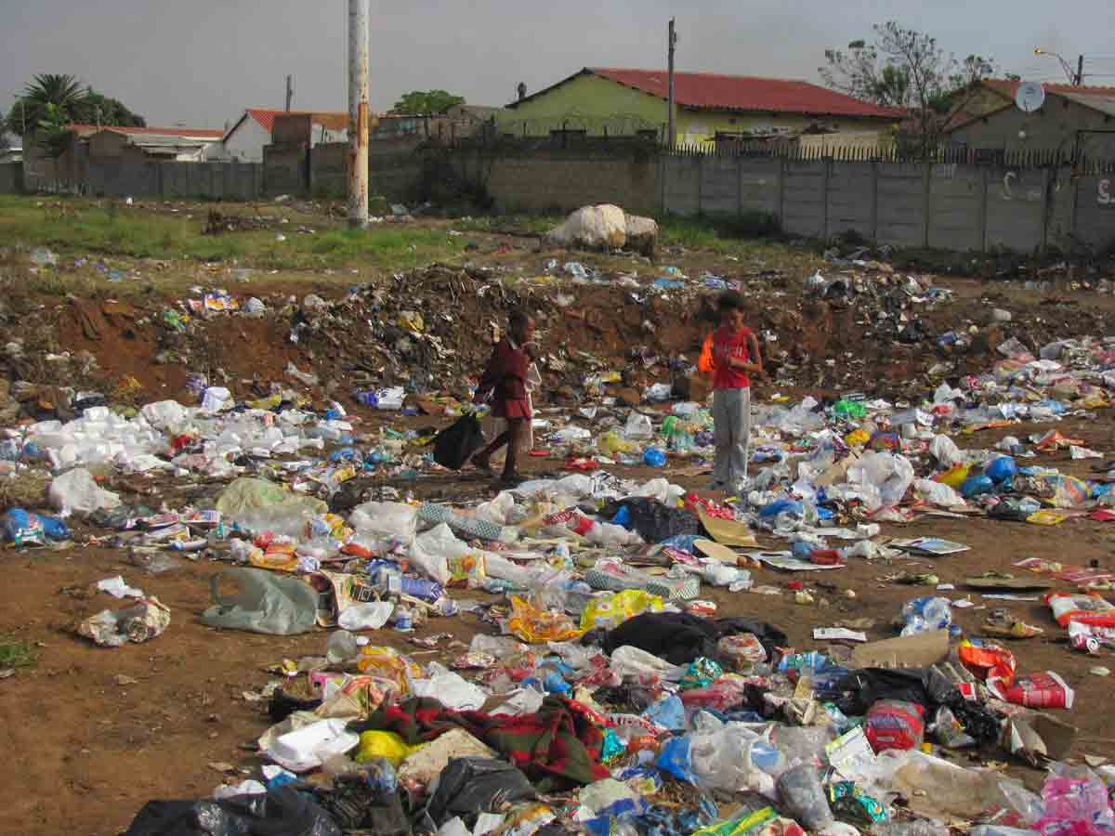
Land pollution
Land pollution is the destruction of the earth land due to the misuse of human resources example rubbish.
Land pollution is also caused in construction by the clearing of forest land to make way for new projects (buildings)
Land pollution is also caused in construction by not disposing of waste materials .In construction the waste goes to landfill or is dumped somewhere (fly-tipping)

Slide 6
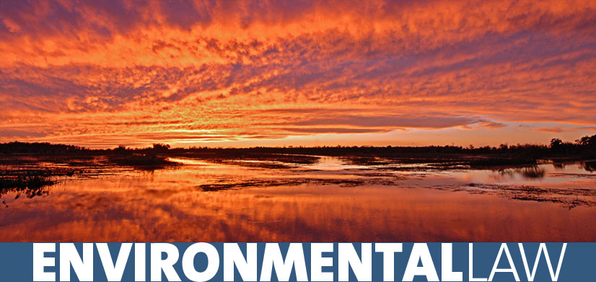
Key methods used to protect the natural environment in construction

Slide 7

Legislation
The environmental protection act 1990 is a powerful piece of legislation introduced to protect the UK’s environment.
The environment agency has passed legislation to cover the following areas:
Water
Air
Chemicals
Conservation
Energy
Land
Noise and statutory nuisance
Pollution prevention and control
Plant protection
Radioactive substances
Waste

Slide 8
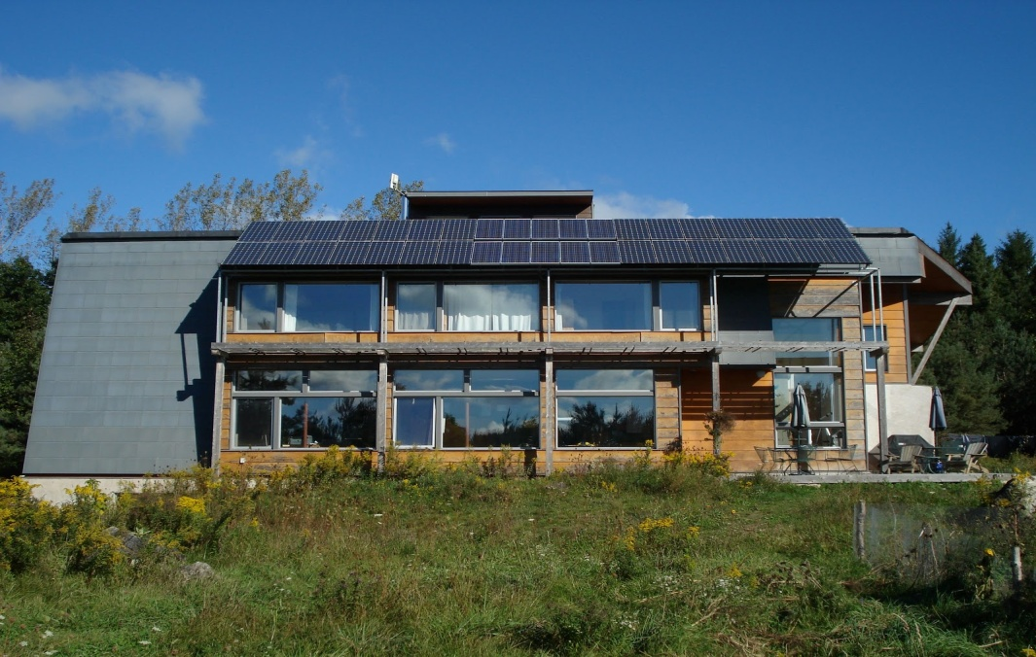
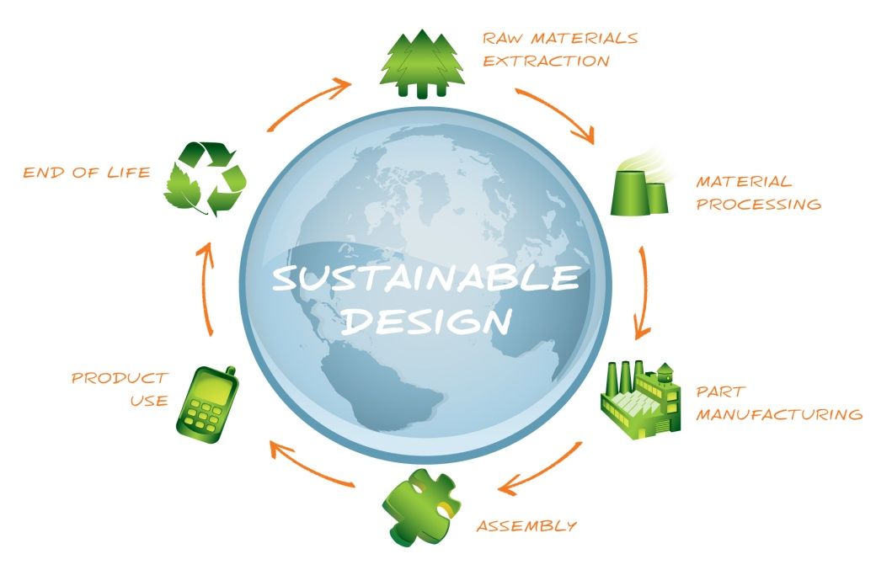
Design and specification
Good designs are essential to protect any local and global environment. The orientation of many buildings can harness the suns energy to create a natural light instead of an artificial light which saves a lot of energy. Also use of better quality materials and more time spent on thermal will in long term save a buildings maintenance which saves energy which therefore means less damage to the local environment. Another way a designer can help save the environment is to use more local materials to reduce the carbon footprint and to also use more renewable resources.

Slide 9
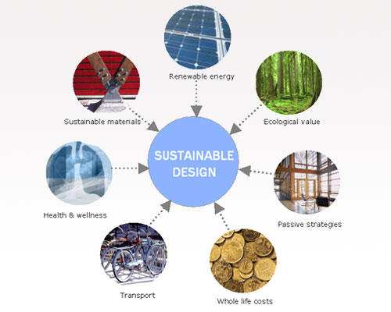
Improved management of construction sites
The site manager could also purchase local raw products that can be used such as gravel for drainage that can help reduce the cost of transport and also reduce the effects that the transport has on the environment.
The site manager could also purchase local raw products that can be used such as gravel for drainage that can help reduce the cost of transport and also reduce the effects that the transport has on the environment.

Slide 10

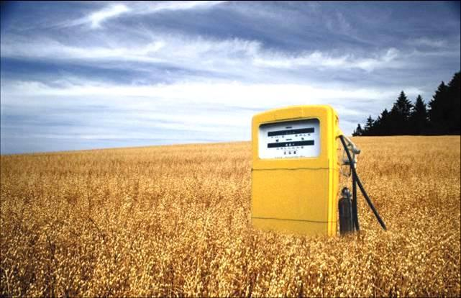

Minimization of pollution
Pollution has marked a massive effect on the environment and also peoples health and well being. There are ways to minimize pollution such as:
Fitting fume scrubbers to a high part of a chimney to remove any solids and any pollutant chemicals that can be released into the air.
Treating the water of foul drainage before it is discharged into the sea, this will stop any bad chemicals going into the water damaging the wildlife in the sea.
Minimizing any waste by recycling construction products such as timber, metals, and bricks which will reduce the pollution because they wont be getting dumped into a landfill site
Using fuels such as bio fuels and low sulphur fuels that emit cleaner emissions released during combustion in engines

Slide 11
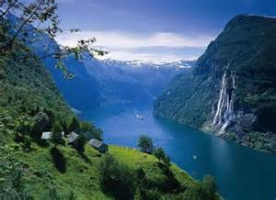
Six different features of the natural environment that must
be considered at the planning
stage of a construction project ?

Slide 12
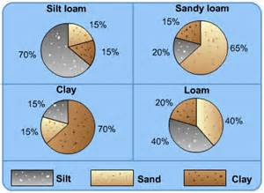
Soil quality
The soil has to be taken into account when building because it can effect the planning stage. The soil needs to be suitable for the project. The soil must be able to support trees and natural wildlife.

Slide 13
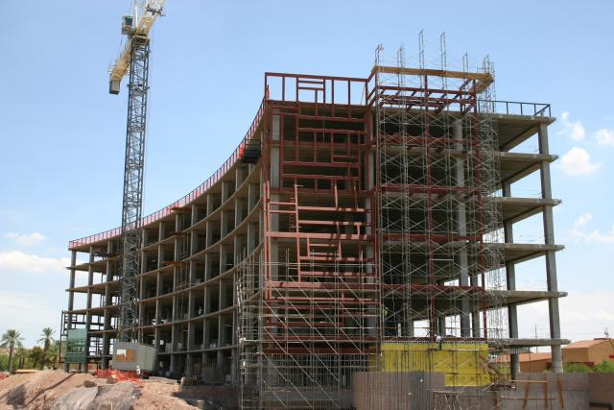
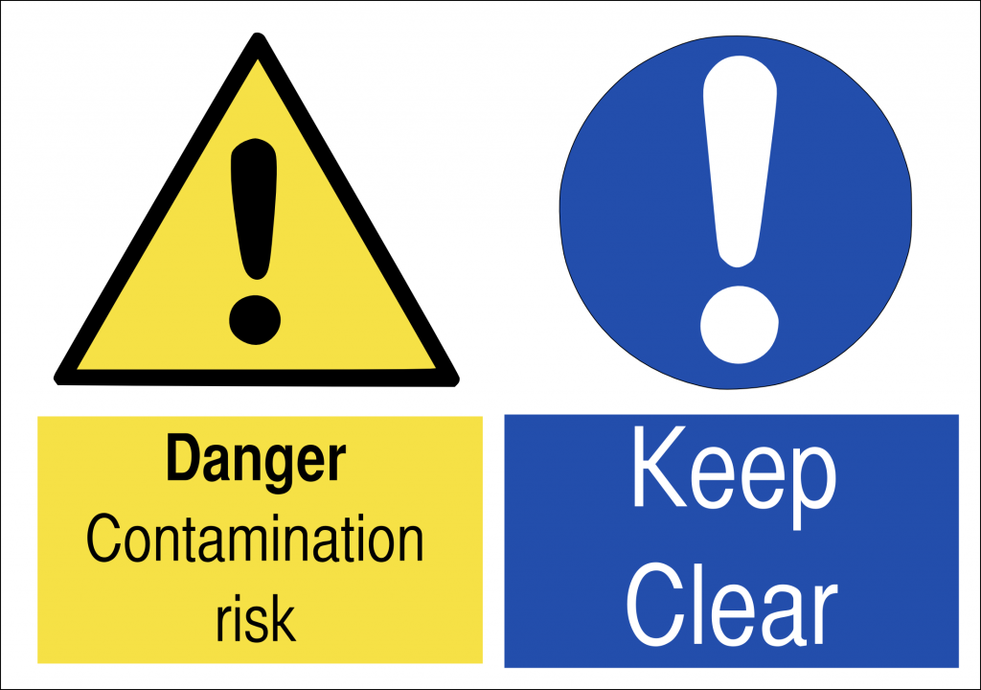
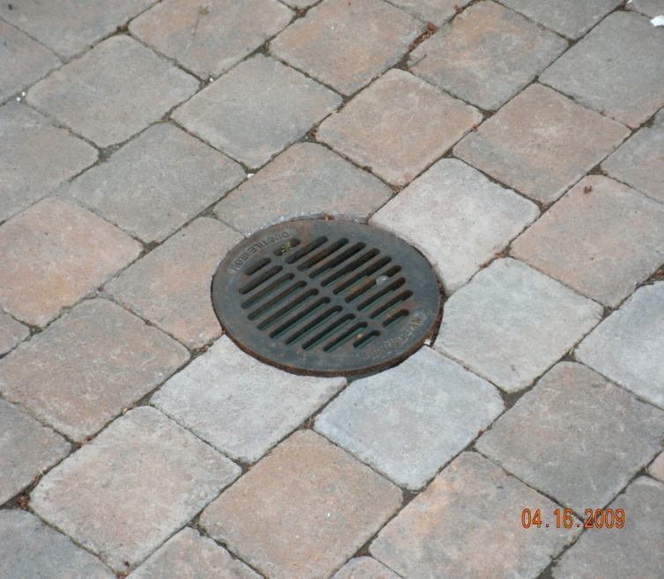
Problems that need to be identified when planning.
Drainage
Structure
Organic
Fertility
Contamination

Slide 14
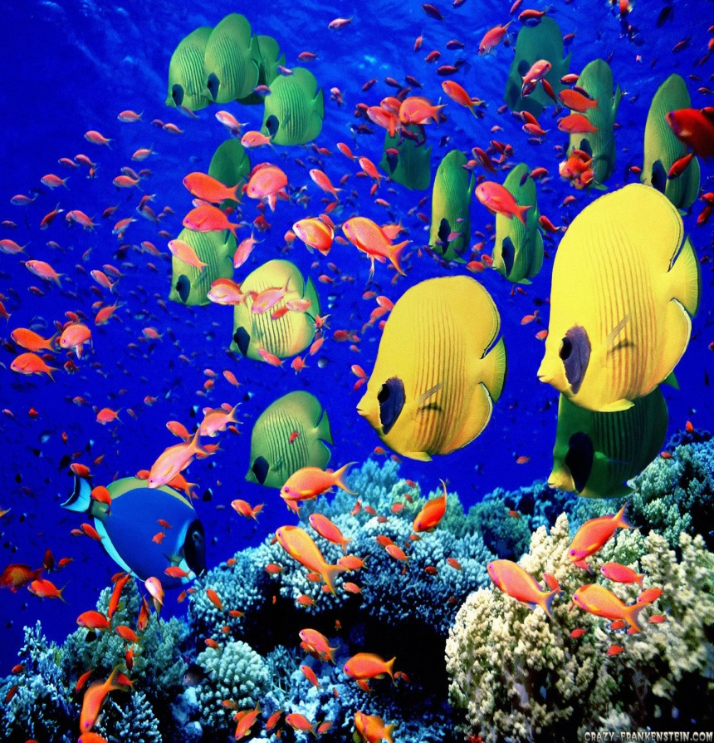
Marine
This is only applied when working near the sea. The problems occur near:
Cliffs
Sea
Harbours
beaches

Slide 15
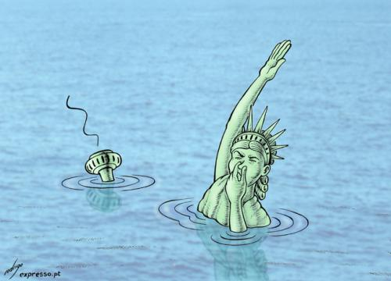
Effects
The Sea is full of creatures which haven't been discovered yet. Sea levels have also risen from global warming. If a structure was built in these areas then it would have to have the suitable materials to prevent flooding.

Slide 16
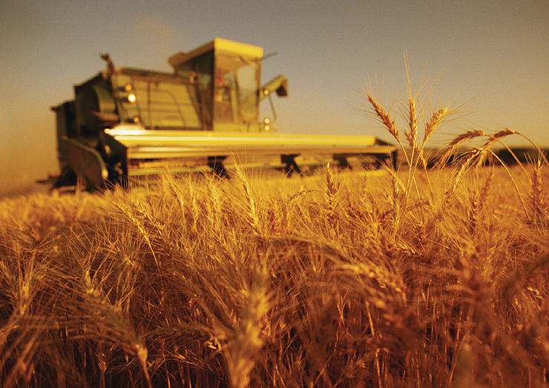
Agricultural.
Land that is used to produce food is called agricultural land (farms). This comes into account because if you built a tower near a farm, You could block sunlight reaching the crops. Also if you are producing pollution then the farmyard animals can be contaminated so the meat wont be fresh and natural.

Slide 17
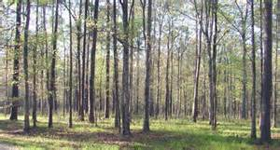
forestry
Large parts of land is covered by forestry. The habitats of animals that live in the forest could be destroyed. The trees also produce oxygen, if all the trees are chopped down then the oxygen levels would decrease and will destroy the ozone layer that protects us from the sun. the soil becomes weak when the trees are taken out by the roots.

Slide 18

Wildlife
All wildlife is taken into account ranging from small insects to elephants. There are many regulations that must be followed when working on a project. Certain animals need to be protected as they could be near extinction and also may be rare. If there are animals found on a site that are near extinction, the project will finish immediately.

Slide 19
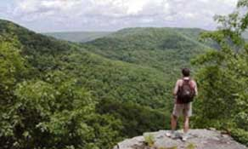

Natural amenities
The natural environment is also used for sporting events such as:
Boat racing
Angling
Canoeing
These sports are popular so if a project effects the sport then it may upset the sport participants.

Slide 20

Beaches and mountains
These areas need to be investigated as their part of natural amenities. The mountains are used for hill walkers and the beaches are a popular place to the public on a hot day. A beaches natural flow of sand could be changed by construction.

Slide 21
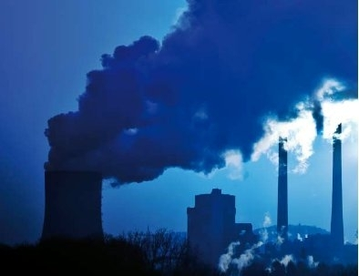
Four different forms
of local pollution arising from
construction projects may harm the
local environment

Slide 22

Noise pollution
Noise pollution is a local type of pollution construction due to the fact that although noises can be relatively loud they cannot be heard over extremely large distances.
The largest producer of noise pollution in the construction industry is demolition.
Noise pollution can damage the local environment by frightening local animals with large quantity's of noise causing them to leave that habitat. Also it can disrupt the lives of local people by damaging their sleeping patterns.

Slide 23
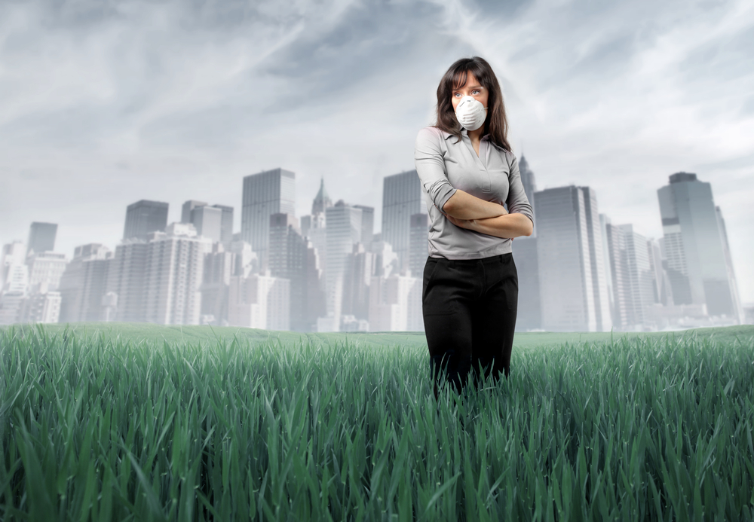
Air pollution
The burning of diesel and petrol to work machines can contaminate the air causing bad smells and also affect people with breathing problems.
Also the fine particles produced through out construction can easily travel through the air causing difficulty with breathing.

Slide 24
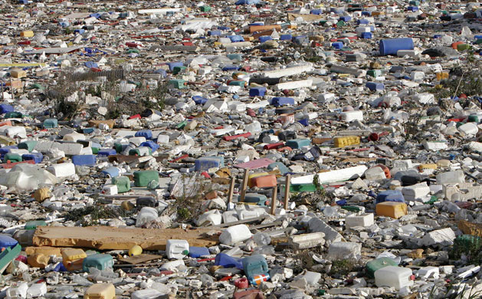
Waste disposal
Allot of waste is produced within construction processes and this waste can sometimes be mishandled and can sometime contaminate the local environment.
If this waste is not disposed of properly it can contaminate the land, for example polluting local streams.

Slide 25
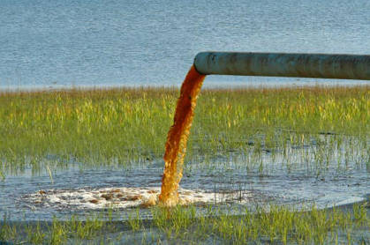
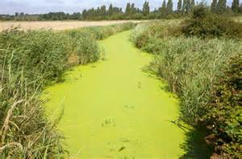
Water pollution
Sometimes in construction processes the waste material is dumped into local water supply's to save money.
This can damage the quality of rivers causing animals who depend on that water source to either become ill from contaminated water or to have to move onto another area to find a new supply of water.
Also if water that is supplied to homes becomes contaminated it could cause a wide spread amount of illnesses within the local community .

