Slide 1
ESSENTIAL DIGITAL LITERACY SKILLS
Welcome
Croeso
Tutor: Tammy Wise

Slide 2
Aims & Objectives
To understand the technology, tools and techniques associated with digital literacy.
To share information safely using a variety of methods online.

Slide 3
There are six strands to Essential Digital Literacy
Digital Responsibility- knowing how to stay safe and act appropriately online.
Digital Productivity – knowing which technologies, tools and techniques to use and how to organise, share and protect digital information.
Digital Information Literacy- being able to find, critically evaluate and use digital information safely.
Digital Collaboration- sharing knowledge and collaborating with others to complete tasks and solve problems.
Digital Creativity- Being able to use digital media to complete tasks, generate content and develop opportunities.
Digital Learning – understanding how technology can extend learning opportunities.

Slide 4
1. What is Digital Literacy?

Slide 5
What is Digital Literacy?

Slide 6
What is Digital Literacy?

Slide 7
What is Digital Literacy?

Slide 8
What is Digital Literacy?

Slide 9
What is Digital Literacy?

Slide 10
SKILLS DEVELOPMENT PORTFOLIO
htpps://www.youtube.com/watch?v=p2k3C-iB88w

Slide 11
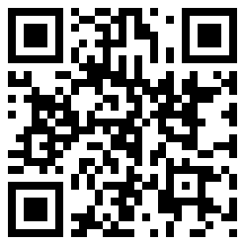
Download a QR Reader
Visit your app store on your mobile phone and download a ‘QR Reader’.
“Scan me for a discussion on digital tools”

Slide 12
MEDIA TYPES & USES
http://c4lpt.co.uk/top100tools/
Sign up for Google Drive
Sign up for Padlet
What are the strengths & weaknesses of tools that you use?

