Slide 1
The 4M’s
In Construction Management

Slide 2
Objective
TSSBAT gain and understand the four M’s required for a construction project.

Slide 3
AIMS
TSSBAT list the Four M’s in construction
TSSBAT recognise control measures for the four M’s

Slide 4
Lets all think what the four M’s are in construction.

Slide 5
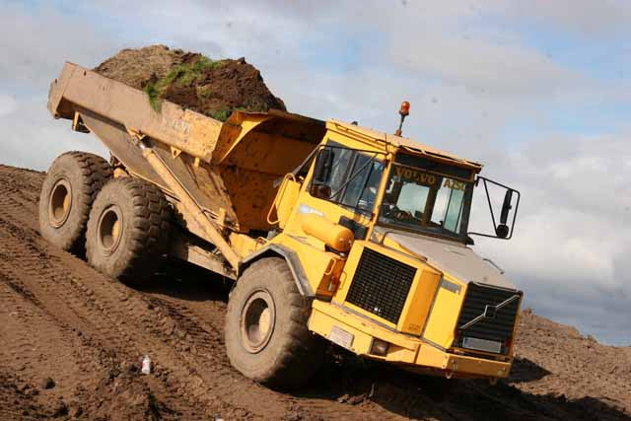
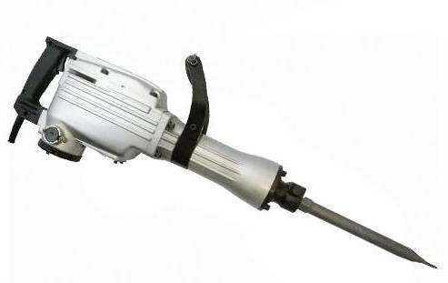
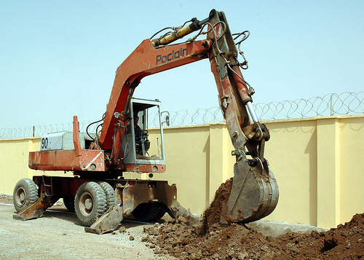
Answers

Slide 6
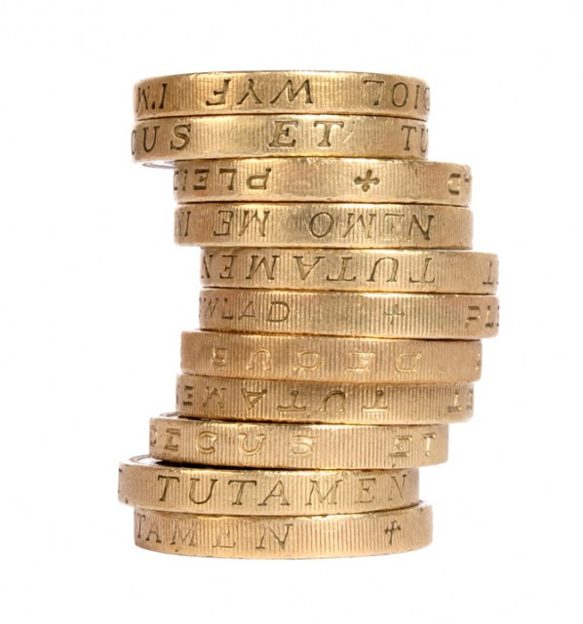

Slide 7
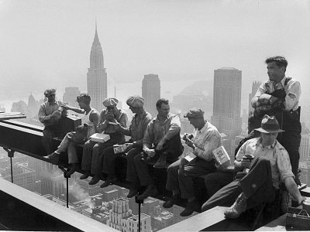
Manpower (this term is not derogatory to women it is still used today)

Slide 8
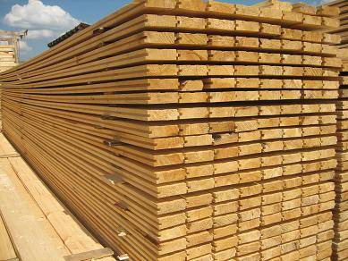
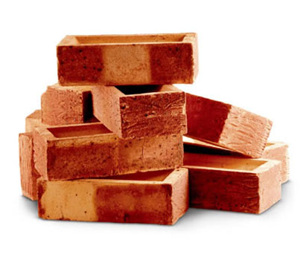

Slide 9
Money
Money is considered the most important of the 4M’s.

Slide 10
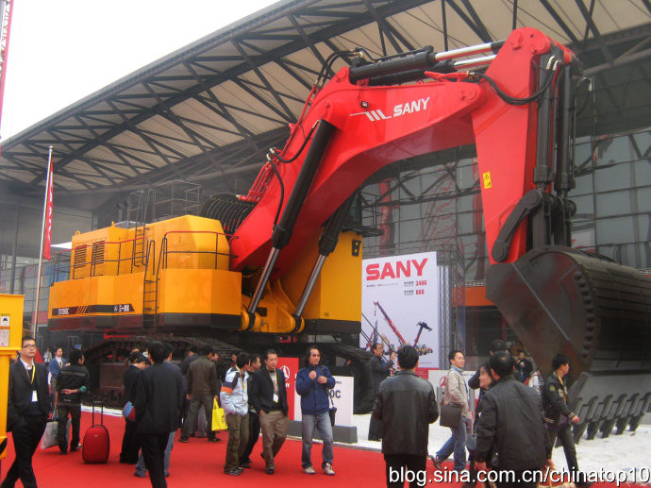
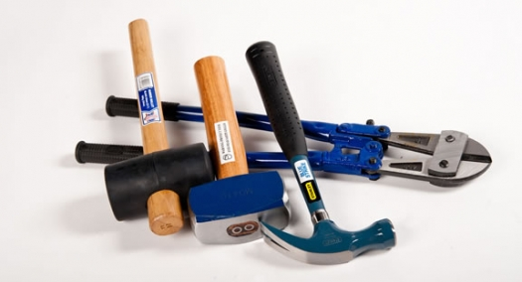
Remember Machinery (Plant)
Machinery cover a whole load of plant from mass excavators to small hand held tools like hammers or chisels.

Slide 11
In Groups produce a presentation detailing the following :
What type of stock materials do we use in construction?
Explain the importance of money?
What labour will be present on a building site to carry out construction work?

