Slide 1
The 4M’s In Construction Management

Slide 2
Lesson Objective
At the end of the lesson the students should be able to;
Establish the relationship between the 4M’s required for a construction project.
Lesson Aims
Identify the Four M’s in construction.
Research control measures for the four M’s.

Slide 3
Lets all think what the 4M’s are in construction?

Slide 4
Answers
Machinery Materials
Manpower Money

Slide 5
Task 1
In pairs students to produce list of resources, which will be required to carry out the construction of a residential building. Without the use of computers.

Slide 6
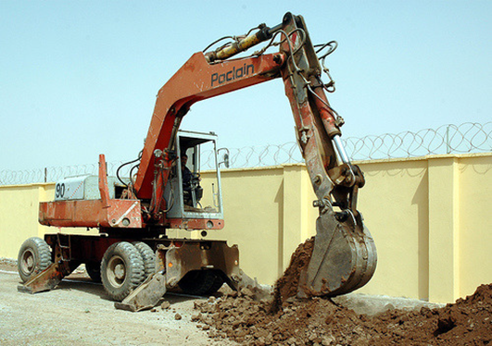
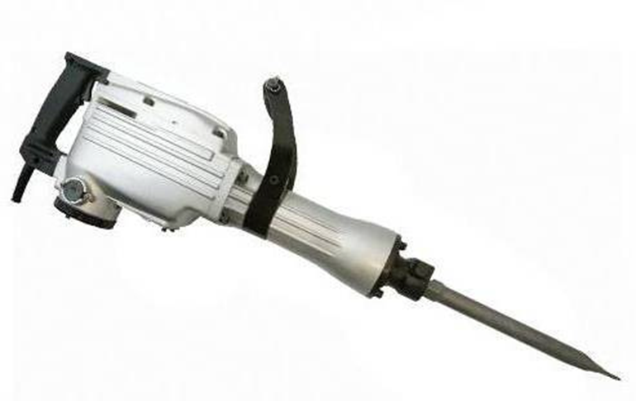
Machinery

Slide 7
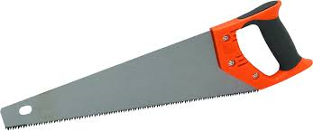
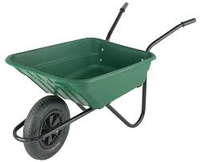
Machinery

Slide 8
Manpower

Slide 9
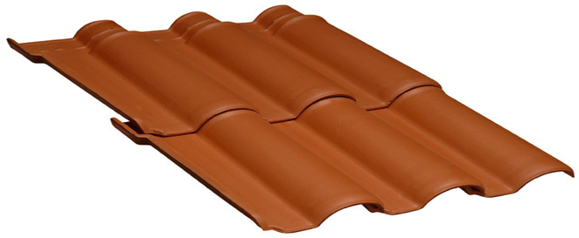
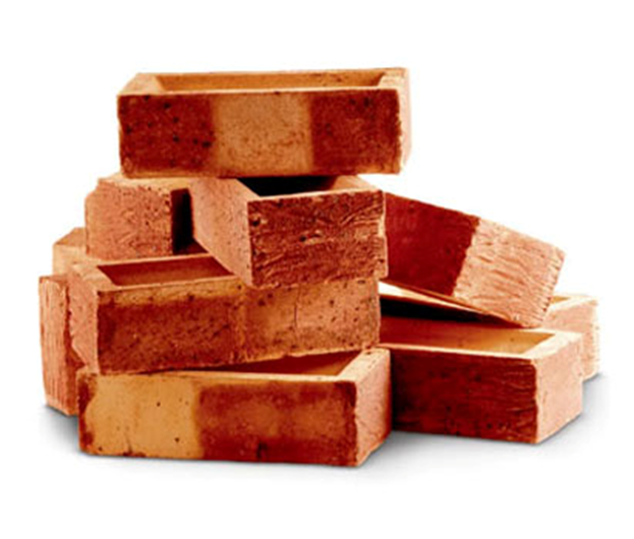
Materials

Slide 10
Money
Money is considered the most important of the 4M’s.

Slide 11
Task 2
In Groups produce a presentation detailing the following :
What type of stock materials do we use in construction?
Explain the importance of money?
What labour will be present on a building site to carry out construction work?
Types of machinery used on site.

