Slide 1
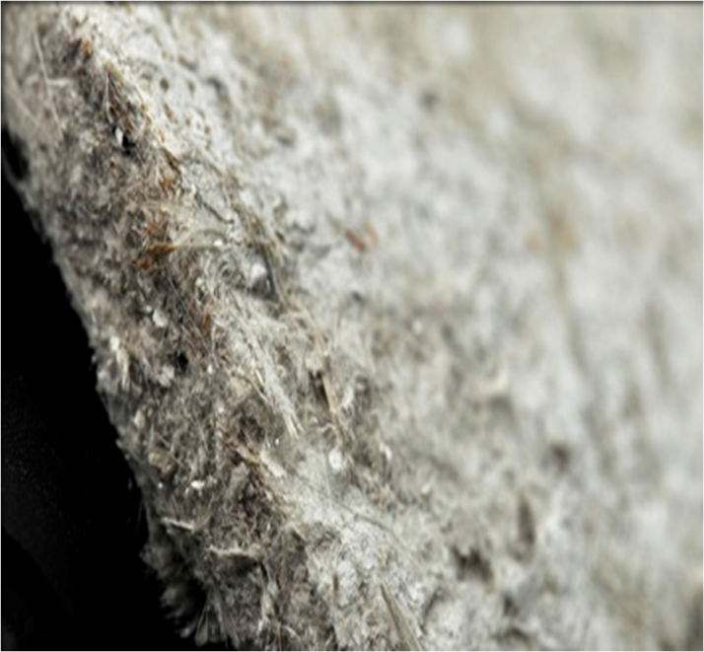
click
now
Notes:
Tutor notes: Try to ensure that every two slides or so there is a point where you can ask your students for brief thoughts, ideas or view points to ensure they are following and engaging with the content.

Slide 2
The devastating
consequences
click
now
click
now
Notes:
Tutor notes: The video clip features Chris, who talks about his experience of contracting an asbestos-related disease.
Show the film to the students. Before students watch the film, ask them to think about all the people who could be affected by asbestos in the workplace.
To start the film, click your mouse button.
Sadly, Chris died on 19th March 2010.
When the film finishes, open up a short classroom discussion. The aim is to discover the level of knowledge, misinformation/myths and if the students have any understanding of the risks involved in working with asbestos. Ask the class the following questions:
1) What do you think about this short film?
2) What does the class know about asbestos?
3) Does anybody in the class know someone who has been affected by asbestos?
2

Slide 3
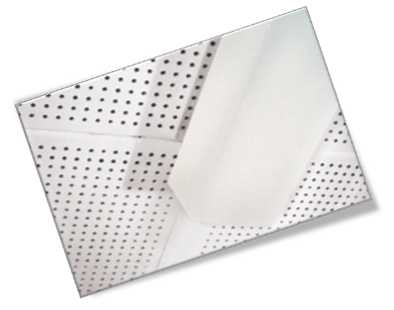
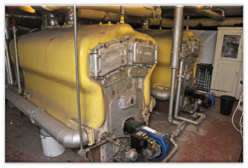
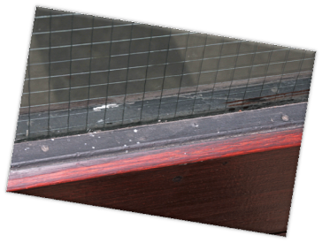
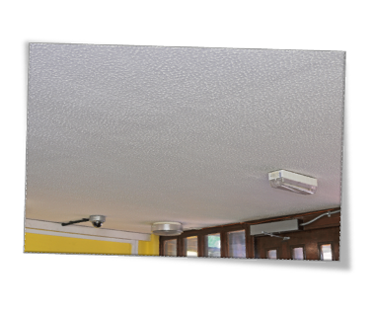
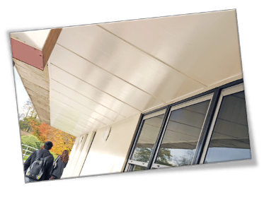
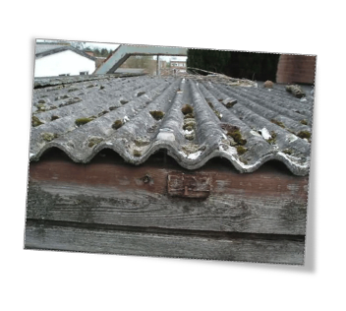
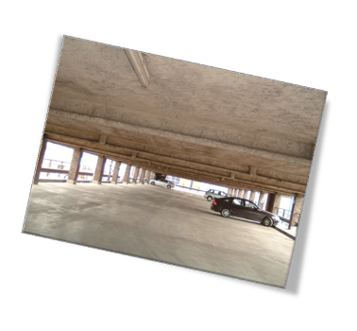
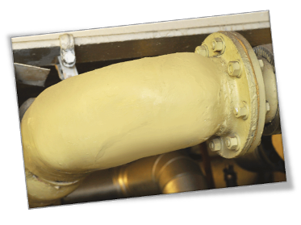
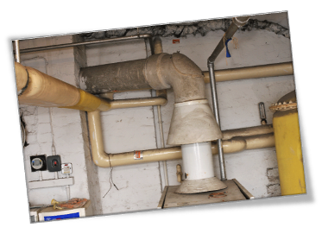
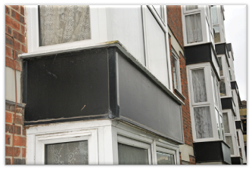
Used in buildings, for example:
What is Asbestos?
Boilers
Ceiling tiles
Fire doors
Natural mineral
Soffit boards
Textured coatings
Cement sheeting
Resistant to heat, electricity and chemical damage
Sprayed coatings
Asbestos cement
boiler flue
Boards around
windows, fireplaces,
radiators etc.
Gaskets and sealants
on pipe joints
click
now
Notes:
Tutor notes: Click your mouse button for each image to appear.
Lead a discussion with students about why asbestos was once used.
Asbestos is a naturally occurring fibrous material. It is very resistant to heat, electricity and chemical damage, plus, it absorbs sound really well and is as strong as steel when being stretched. Asbestos-containing materials are versatile and were used extensively in the UK as building materials (eg for fire-proofing and as insulation material), from the 1950s.
The three main types of asbestos that have been used commercially are:
blue (crocidolite);
brown (amosite); and
white (chrysotile).
Usage began to decline in the 1970s as evidence about the harmful effects of asbestos were gradually better understood. The use of blue and brown asbestos was banned by law in 1985 and using white asbestos was finally banned in 1999. This means that asbestos-containing materials can still be found in many buildings built or refurbished up to the year 2000.
Here are some of its uses in the building trade - See how many of them your students can recognise on this slide: boilers, ceiling tiles, fire doors, soffit boards, textured coatings, eg ‘Artex’, cement sheeting, sprayed coatings, asbestos cement boiler flue, gaskets and sealants on pipe joints, boards around windows, fireplaces and radiators, etc.

Slide 4
About 5000 people die every year in GB
That’s more people than are killed in
road accidents
You can’t see it, taste it or smell it
You won’t know you have been
exposed to it
click
now
Notes:
Tutor notes:
Asbestos is difficult to identify. Often referred to by colour, this refers to its raw mineral state and you cannot generally tell the type of asbestos by simply looking at it.
For building use, asbestos is usually mixed with another material, for example, board, insulation or coatings, which often look similar to other materials. In addition, asbestos-containing materials are often covered or placed behind other building materials, so it's hard to know if you're working with it or not. But, if you work in a building built before the year 2000, it's likely that some parts of the building will contain asbestos.

Slide 5
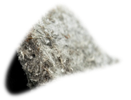
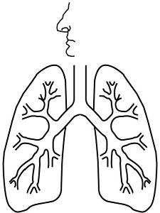
asbestos
If you are young = greater danger
click
now
click
now
Notes:
Tutor notes: Ask students. ‘does anyone know how asbestos can kill?’ (Listen to answers before continuing to show lung diagram)
Generally, asbestos is only a risk if it is disturbed or damaged so that fibres are released into the air where they can be breathed in.
Unlike other minerals, asbestos doesn't grind into small grains – it breaks down into tiny fibres. These fibres are smaller than hair, and can only be seen under a microscope. When someone breathes in asbestos fibres, some of them become lodged in delicate lung tissue. The body's immune system tries to break the fibres down, but asbestos is resilient and only breaks down extremely slowly.
Over time, if exposure to asbestos is repeated, fibres build up and can damage the lung tissue and lining. Damage can continue to develop for many years - even if there is no further exposure to asbestos. Eventually, the lungs can be very badly harmed due to asbestos-related diseases, such as mesothelioma, lung cancer, asbestosis and diffuse pleural thickening. You don't need to remember the names of these illnesses. Just remember that they are all horrible, and some of these conditions will kill.
All exposure to asbestos should be avoided. However, that does not mean you should worry about a single one-off exposure, this is very unlikely to lead to disease - It is not true that one single fibre kills. A key factor in the risk of developing an asbestos-related disease is the total number of fibres breathed in. The degree of risk depends on the total lifetime cumulative exposure; the type of asbestos involved and the time elapsed since you were first exposed. Young people, if routinely exposed to asbestos over time, because of the latency, are at greater risk of developing disease than older workers. It is therefore very important you protect yourself now to prevent the possibility of contracting an asbestos-related disease in the future. It is also important to understand that people who smoke and are also exposed to asbestos fibres are at a much greater risk of developing lung cancer.

Slide 6
The devastating
consequences
click
now
click
now
Notes:
Tutor notes: This is an optional additonal video clip telling Jean’s story (Chris’s wife).
Before students watch the film, ask them to think about who could be affected by the consequences of asbestos exposure in the workplace.
Show the film to the class. To start the film, click your mouse button,.

Slide 7
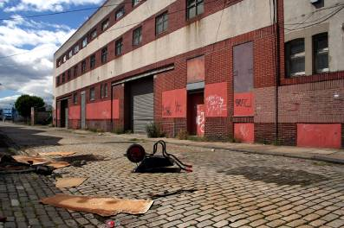
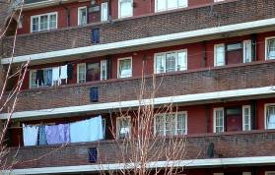
Any building constructed or refurbished
before 2000 may contain asbestos
click
now
Notes:
Tutor notes:
All asbestos was finally banned in Great Britain in 1999. It can’t be used in manufacture, construction or elsewhere. However, asbestos-containing materials still exist in many buildings that were constructed or refurbished before 2000. That could be an industrial building, office block or a house.
Without taking proper precautions, disturbing asbestos can release fibres into the air. So, if the asbestos-containing material is in good condition and is unlikely to be disturbed or damaged during the normal use of the building, it is safer to leave it in place.
Therefore, you could still find asbestos in lots of buildings today!

Slide 8
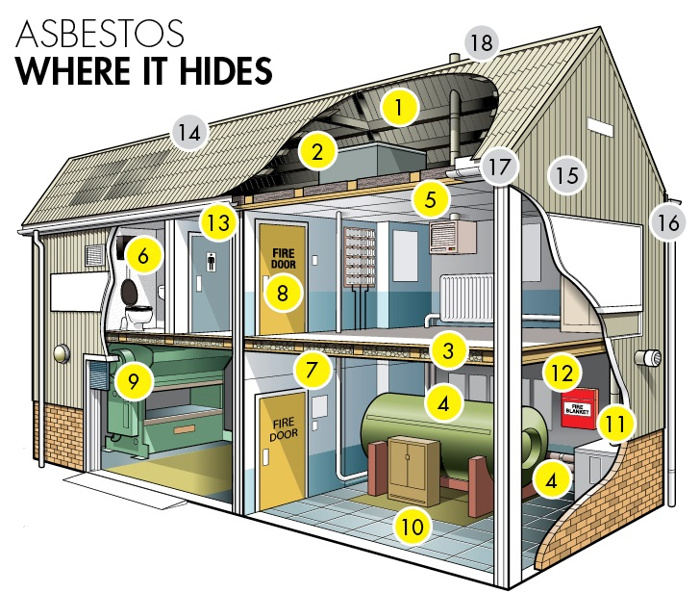
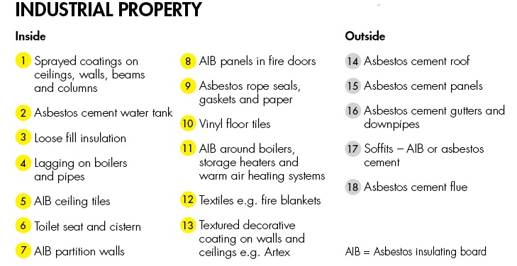
click
now
Notes:
Tutor notes:
This is a diagram of a pre-2000 industrial premises. The numbers show places where asbestos might be hidden. There are common misconceptions about There is a task sheet of this diagram that accompanies the presentation and can be used to test knowledge at the end.

Slide 9
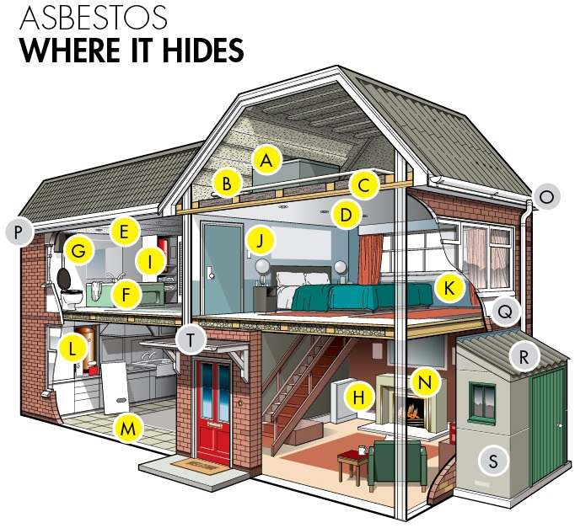
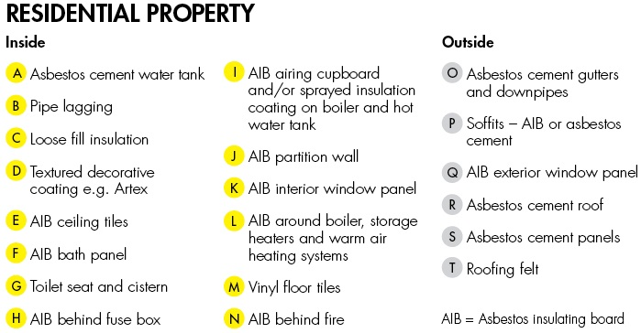
click
now
Notes:
Tutor notes:
This is a diagram of a pre-2000 home. The numbers show places where asbestos might be hidden. There is a task sheet of this diagram that accompanies the presentation and can be used to test knowledge at the end.
There are common misconceptions about where asbestos can be found and these diagrams aim to dispel the myths that:
Asbestos is only found in industrial properties or blocks of flats
Asbestos is only in old buildings
Asbestos is only found outside

Slide 10
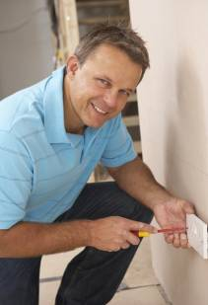
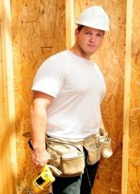
You
Around 8 joiners die every week
Around 6 electricians die every week
Around 4 plumbers die every week
ANY tradesperson is at risk
click
now
Notes:
Tutor notes: Ask the students, ‘who is likely to come into contact with hidden asbestos?’
The answer is, anyone in the building and maintenance trade working on an existing buidling. In other words, YOU. When cutting, drilling, sanding or hammering asbestos-containing materials or removing panels, tiles, etc. which contain asbestos, asbestos fibres can be released into the air. Without proper protection, you – and anyone working with you or nearby – is in real danger of breathing in the fibres.
In Great Britain, asbestos-related diseases kill over twenty tradespeople every week. This is not just joiners, electricians and plumbers, but anyone doing refurbishment or maintenance including gas engineers, caretakers, heating and ventilation installers, painters and decorators, general builders, roofers etc. etc.

Slide 11
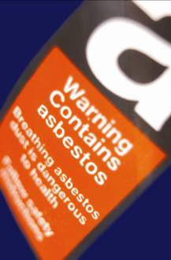
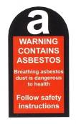
Ask the building manager or your boss for
information on asbestos in the building
or the area your working in
If no information about asbestos is available,
stop and check. You have a legal right to
know
Remember, the people you are working with may not be aware of the dangers, or worse; not care!
click
now
Notes:
Tutor notes: Explain to students that if they think asbestos may be present where they are working, they must stop work and check.
People in charge of the maintenance and repair of workplace buildings have a legal duty to provide anyone likely to disturb asbestos-containing materials with up-to-date information about the location and condition of asbestos before work starts, so that the appropriate precautions can be taken. This information is often referred to as the ’asbestos register’.
Ideally, information about asbestos should already have been obtained by the contractor/employer as part of the contract tendering process. If you are not given information about whether asbestos is present, you need to ask your boss or the building manager before you start any work. Older colleagues may tell you asbestos is not really that bad and to get on with the job. It’s up to you who you listen to…but are they still going to be around in 20 years to help you if you’ve contracted an asbestos-related disease?
The legal requirement to provide information does not apply to domestic building owners/occupiers, and therefore does not cover private/rented domestic housing. If work is being done in domestic premises, then the contractor/employer must establish whether asbestos is present before work starts. Therefore, you should ask your boss for information about asbestos before doing any work.

Slide 12
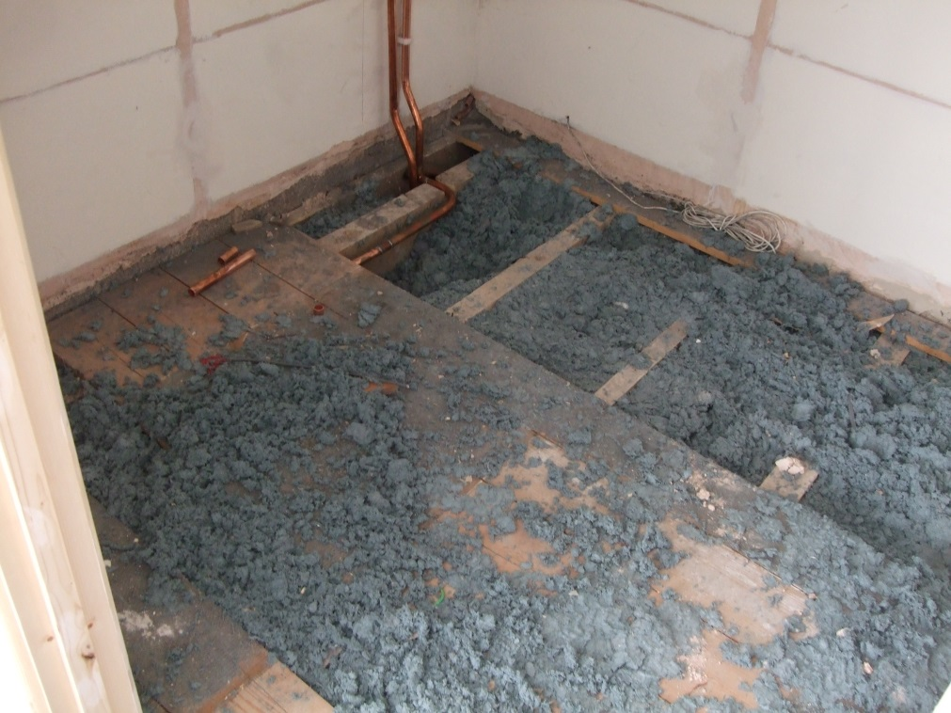
What should I do if I disturb it?
click
now
Notes:
Tutor notes: Ask the students what they should do if they think they have disturbed asbestos without any precautions.
You should:
stop work immediately;
minimise the spread of possible contamination by keeping others out, closing the area off and putting up warning signs;
tell your boss; and
if there is visible dust on clothing, put on an FFP3 type disposable mask (FFP=Filtering Face Piece) and wipe the area and yourself down with damp rags.
Dispose of contaminated clothing, damp rags and mask as contaminated waste

Slide 13
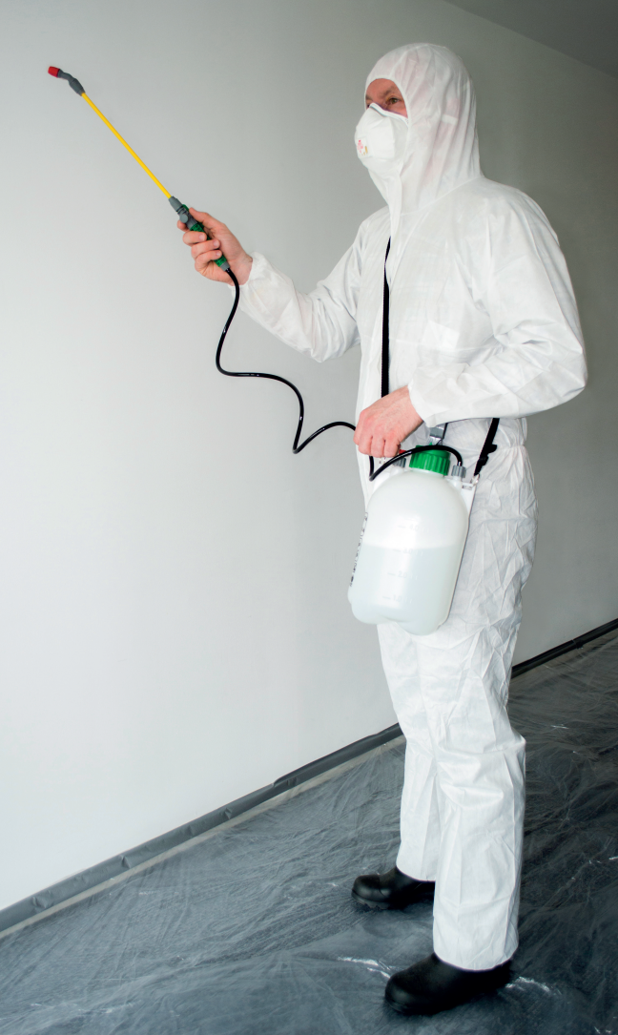
What training do I need?
Your employer must provide adequate information, instruction and training where an employee is likely to be exposed to asbestos
click
now
Notes:
People that carry out any work on asbestos materials must have the correct instruction, information and training. There are three types of asbestos training:
1. Awareness training
2. Training for work with asbestos that does not require a license
Training for asbestos work that does require a license
Asbestos Awareness
This is the most basic level of training. It will not equip you to carry out work that may disturb asbestos, but will teach you:
• Why asbestos is dangerous
• Where it is found and how to avoid working on it
• How to protect yourself if you accidentally disturb asbestos
It is important for anyone who may disturb asbestos in their normal everyday work, such as any tradesperson or maintenance worker.
Training for asbestos work that does not require a license
This will not equip you to do all work on asbestos as most work requires a licensed contractor. It is important for anyone who may actually disturb lower risk materials doing the small non-licensed tasks in the How-to Guides. This will teach you:
• To assess the risks of exposure to asbestos associated with the particular job
• Safe work practices, control measures and work methods
• Selection and appropriate use of protective equipment
• How to handle and dispose of contaminated waste
• Emergency procedures
• Relevant legal requirements
Training to carry out licensed asbestos work
Most work with asbestos containing materials must be carried out by licensed contractors under very strict conditions. This type of work requires very detailed training.
For more information got to www.hse.gov.uk/asbestos/training.htm
The UK Asbestos Training Association, UKATA, and Independent Asbestos Training Providers, IATP, represent organisations which provide suitable training. Other training providers also exist.

Slide 14
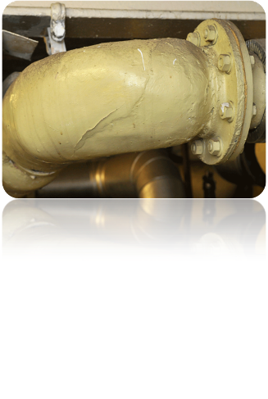
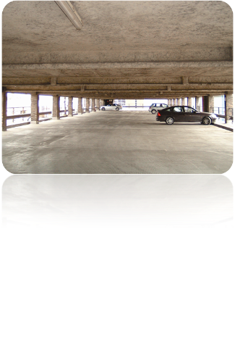
click
now
Most work with asbestos requires a licensed contractor
Notes:
Tutor notes: Ask students if they think they can do work on asbestos containing materials.
All types of asbestos are classified as class 1 human carcinogens (which means they cause cancer), but blue and brown asbestos are known to be much more dangerous than white asbestos.
The risk an asbestos-containing material presents depends on the type of asbestos it contains (often, more than one type may be present) and how easily the fibres are released from the material into the air when it is damaged, disturbed or worked on.
Most work on high risk materials, eg asbestos insulation/lagging, sprayed coatings and asbestos insulating board, can only be carried out by licensed contractors. They have special training, wear special protective clothing, and will seal rooms and take other precautions to prevent the spread of asbestos.
Short-duration maintenance tasks can be carried out on low risk asbestos-containing materials, eg asbestos cement sheet, without a licence, but if you plan to disturb asbestos you must have job-specific non-licensed training – Awareness training alone is not enough.

Slide 15
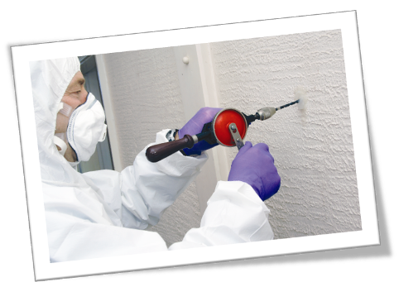
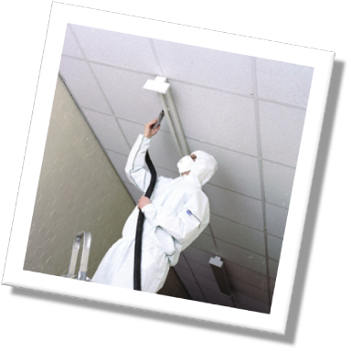
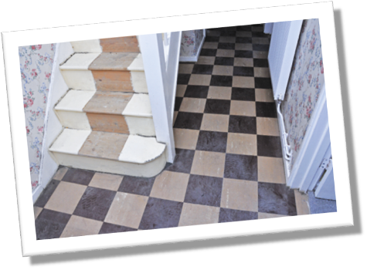
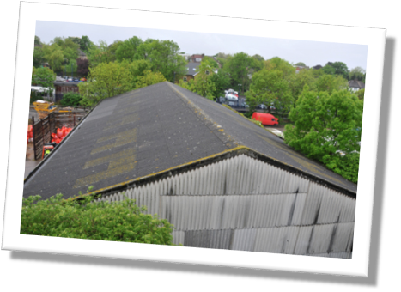
What can a trained non-licensed contractor do?
Drill holes in asbestos insulating board (AIB)
Replace light fittings attached to AIB
Replace asbestos-containing floor tiles
Clean guttering on an asbestos cement roof
Anything beyond this type of work requires
specialist help
click
now
Notes:
Tutor notes: The aim is not to stop people working, but to ensure they are working safely. So… what can you do?
Normally, non-licensed work includes work on asbestos cement sheet, asbestos-containing textured coatings and certain work of ‘short duration’ on asbestos insulating board.
‘Short duration’ means any one person doing this type of work for less than 1 hour, or more people doing the work for a total of less than 2 hours, in any 7 day period.
With the right non-licensed training and the correct equipment, you can do such maintenance jobs as:
drilling holes in or passing cables through asbestos insulation board (AIB) – short duration work only;
replacing light fittings attached to AIB ceiling tiles;
removing asbestos–containing floor tiles (tiles may have asbestos-paper backing or be fixed with asbestos-containing mastic); and
cleaning guttering on an asbestos cement roof – these types of roofs are fragile and precautions must be taken to protect against the risk of falls from height.
But, remember, you need to have job-specific non-licensed training first.
Further examples and guidance on non-licensed work can be found in HSE’s publication, Asbestos Essentials (HSG 210) which can be found at: www.hse.gov.uk/asbestos/essentials/index.htm.

Slide 16
3 Key Principles:
Wear the right kit
Keep dust down
Clean up properly
click
now

Slide 17
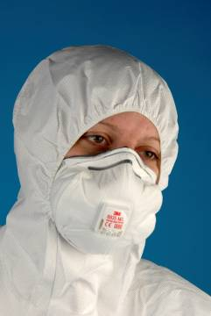
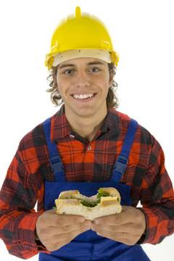
Wear a disposable, correctly fitted FFP3 face mask
Use Type 5 disposable overalls to stop the tiny asbestos fibres getting on your clothes.
Don’t reuse overalls and masks – dispose of them safely as hazardous waste, don’t take them home
Make sure you put the legs of the overalls over the top of your footwear – don’t tuck
• Don’t eat, drink or smoke in the workplace
click
now
Notes:
Tutor notes: Explain to the students how they can minimise their risk when they plan to work with asbestos.
Wear suitable disposable overalls and respiratory protective equipment. Ordinary dust masks are not effective with asbestos fibres (using an ordinary dust mask is like catching peas in a goal net). You must wear a FFP3 respirator mask. The mask must fit your face properly – warning: if you have stubble, the mask will not be effective! FFP3 masks are not suitable for people with beards or stubble, or for long periods of continuous use; you need specialist equipment and training for such situations.
If you take a break: don’t eat, smoke or drink in the workplace.

Slide 18
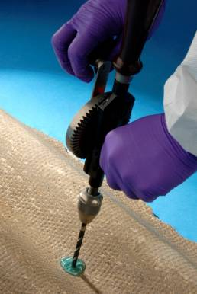
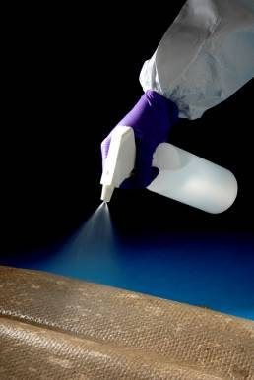
Use a garden sprayer or a hand held water spray to keep materials damp
Wet the materials with a mixture of eight parts water to one part washing-up liquid
Keep materials damp but not too wet. Do not use a hose as this can be high-pressure
Use plastic sheets to cover your work area to help stop the spread of dust
Use hand tools not power tools as they create a lot of dust
click
now
Notes:
Tutor notes: Explain to the students how they can minimise their risk when they plan to work with asbestos.
Minimise dust:
Cause as little disturbance to the material as possible and stop the fibres from being released into the air.
Hand tools should be used instead of power tools where possible, particularly drilling, as power tools are high energy and generate a lot of dust
A blob of wallpaper paste or shaving gel is used to capture the fibres and stop them escaping when drilling
Materials should be kept damp to stop dust going into the air. This is helped by using washing up liquid in the water or a proprietary wetting agent
Too much water will create a slurry with asbestos fibres in it that is difficult to contain and clean up.

Slide 19
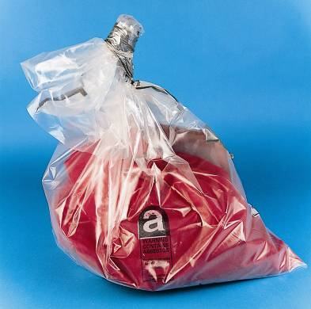
Clean up as you go to stop waste building up
Use a damp cloth to wipe down tools and surfaces to remove asbestos fibres
Don’t sweep up or use a domestic vacuum cleaner. Only a class H vacuum is suitable as this has a special type of filter
Make sure all waste including masks, overalls, cloths and plastic sheets are double bagged in plastic sacks, sealed with tape and labeled as asbestos waste.
Dispose of properly as hazardous waste at a licensed disposal site
click
now
Notes:
Tutor notes: Explain to the students how they can minimise their risk when they plan to work with asbestos.
When you finish work: decontaminate yourself, wipe down your overalls with a damp rag and remove them before removing your mask. Double-bag asbestos waste, label it, and take it to a licensed disposal site.
Job-specific non-licensed training will make sure students have the skills to:
use and fit a face-mask;
use safe work methods; and
deal with asbestos waste.

Slide 20
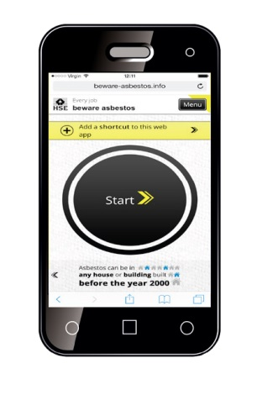
The Beware Asbestos web app
Free to use
Works on your phone, tablet and computer
Asks simple questions and advises you what to do to stay safe
Identifies where jobs require a licensed asbestos contractor
Finds a licensed contractor near you
Provides simple how-to guides for small, non-licensed jobs
Photos of asbestos materials
click now
Go to www.beware-asbestos.info
Notes:
Ask the students to look up the web app and bookmark it or add a shortcut icon so they can return to it

Slide 21
It’s very dangerous, especially to young people
It can be found in almost any pre-2000 building
If in doubt, stop work and check
Only if you are trained can you do minor maintenance work
Don’t put yourself at risk
– asbestos is a hidden killer
End
http://www.hse.gov.uk/asbestos/tradesperson
Notes:
Tutor notes: [ask students for suggestions] ‘So in summary, can you tell me what we’ve learned about asbestos?’
These are the really important points you need to remember:
Asbestos is very dangerous, especially to young people;
Asbestos can be found in almost any pre-2000 building;
If in doubt, stop work and check;
You can only do minor jobs, and only if you’ve been trained. It is a legal requirement!
You have a legal right to training if you think you need it;
Don’t put yourself at risk – asbestos is a hidden killer.
Ask the students to complete the task sheet.
For more information, encourage the students to visit the HSE website, which includes an interactive version of the task sheet and a Do you know the facts? quiz to test their understanding.

