Slide 1
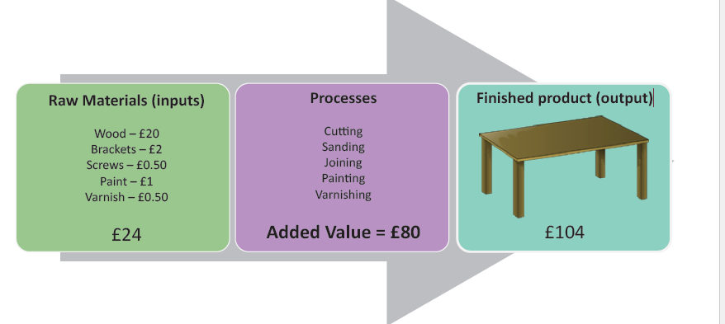
Added Value
Calculation of added value
The difference between the cost of purchasing raw materials and the price for which the finished good is sold for.

Slide 2
How might added value be increased? (page2)
Purchasing cheaper raw materials
• Improving the efficiency of the production process
• Raising the price of the product
• Achieving brand status for a product can create added value.
• Offering additional services with a product can result in added value
• Improving customer access or convenience is a well-proven method of adding value.

Slide 3
ADD VALUE To Win More Customers & Increase Sales

Slide 4
Production

Slide 5
There are three types of production – ways of producing goods.

Slide 6
Consider the following organisations and identify the production method used, advantages and disadvantages and use of technology,

Slide 7
Job Production
Advantages
Disadvantages
Single items, usually to the buyer’s specification
Produces unique products and they are made one at a time
Results in high-quality products
Employees are highly skilled
Interesting and challenging jobs
Is labour-intensive
Can take a long time to make
Prices of any goods produced are also likely to be a great deal higher
Skilled workers will command higher payments for their time and expertise

Slide 8
Batch Production
Advantages
Disadvantages
Lower unit costs and higher output than job production
Employees are likely to be semi-skilled
Use the same assets or capital equipment to produce a range of goods
Allows businesses to aim at niche markets
Some economies of scale will be gained when compared with job production
Time is lost when machines have to be reset
Business may not be equipped to deal with large scale orders
Batch may not meet quality assurance, financial cost and time

Slide 9
Flow Production
Advantages
Disadvantages
Allows identical products to be made in large volumes
Production of the products is much faster than job or batch production
can meet the demand of large quantities
Workers can be skilled or unskilled which lowers wages costs
unit costs are low and businesses will benefit from economies of scale
often large amounts of capital investment involved through high set-up costs
machines/robotics can be very expensive
breakdowns and hold-ups can be very expensive
products produced through flow production are identical and this method does not allow for a wide product range

Slide 10
The type of production used will depend on a number of factors:
the product being produced;
the cost of labour;
the cost of capital;
the availability of money for investment;
technology;
the skills of labour;
the size of the market;
customer requirements.

Slide 11
Productivity

Slide 13
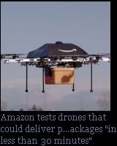
Technological Change
Mini
Amazon
Retail
Physical stores

