Slide 1
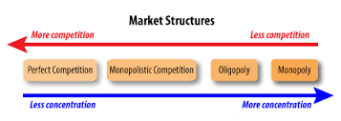
Aims and objectives
Introduce the aims and objectives for the session.
Answer business plan questions.
Explain market structures – monopoly, oligopoly and perfect competition.
Role play each market structure whilst the class decides which one you are presenting.
Analyse the market structures and give examples of each in a written task.

Slide 2
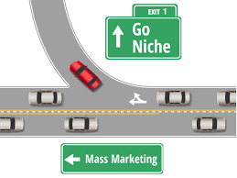
Aims and objectives
Define niche and mass markets and give examples.
Show a YouTube video on niche and mass marketing.
Arrange the niche and mass marketing example cards.
Answer the Kahoot quiz questions on Niche/ mass marketing and market structures.
Recap the aims and objectives for the session.

Slide 3
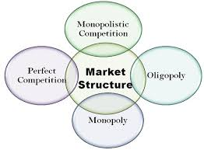
Market structures
There are a variety of differing market structures which are separated by the levels of competition that exist within each market and the market conditions in which the businesses operate.
Competition increases as the number of businesses in the market increases the common structures are :
Monopoly
Oligopoly
Monopolistic competition
Perfect competition

Slide 4
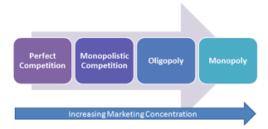
Market structures
Competition increases as the number of businesses in the market increases the common structures are :
Monopoly
Oligopoly
Monopolistic competition
Perfect competition

Slide 5
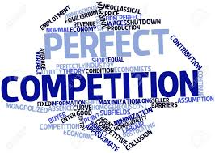
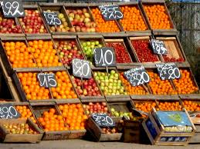
Perfect competition
• There are a large number of businesses competing and no one business is large enough to influence the activities of others.
• There are no market leaders and no price leaders, so each business must accept the going price on the marketplace – they are price takers.
• The goods sold are homogenous – there is no difference between the goods sold by one business or any other business. This means that there is no branding, no product differentiation, no way of telling goods apart.

Slide 6
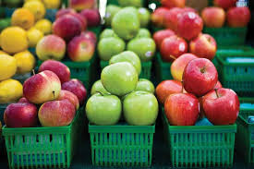
Perfect competition
• Businesses have equal access to technology, meaning that they have equal levels of productivity and each business will benefit in the same way from any economies of scale that are available.
• Consumers in a perfectly competitive market have full market information, they know what is being sold and the price the goods are sold at. They can access a wide number of suppliers to the market.
• Businesses are free to leave or enter
the market at any time: there are no
barriers to entry or exit.

Slide 7
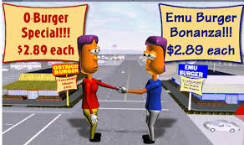
Perfect competition
These unrealistic conditions mean that perfect competition is merely a model.
In reality there is always some sort of branding or differentiation – whether it is the quality of products, price of products or the location of where products are sold.
It has some use as the starting point
to analyse the behaviour of other
market structures in the real world.

Slide 8
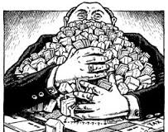
Monopoly
• A single producer within a market – one business has 100% of the marketplace. This is known as a pure monopoly.
• They are likely to erect barriers to prevent others from entering their market.
• Monopolists are called price makers
as they have a significant influence on
price. Nonetheless, they cannot simply
charge what they want as the law of
supply and demand still operates.

Slide 9
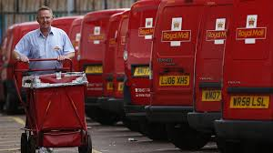
Monopoly
Pure monopolies were not uncommon in the UK 30 years ago. The average household only had the option of one gas supplier, one home telephone supplier, and one electricity supplier etc.
With the introduction of competition into these markets through deregulation and privatisation, these monopolies have in the main disappeared.
Until recently the Royal Mail had a monopoly over the delivery of letters in the UK, but even this is now opening up to competition.

Slide 10
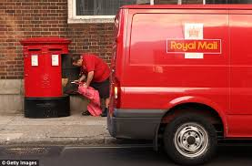
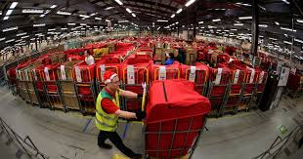
Monopoly
Pure monopolies with 100% of the market are now very rare.
The UK and EU competition authorities regard any business with over 25% of the market as having potential monopoly power, and will investigate situations where it believes this power is being abused.
Monopolies can, however, offer advantages to consumers. Being big or very big they can benefit from massive economies of scale, reducing prices and making goods affordable. Also the profits earned can be used for investment into improving products, improving production techniques and developing new products.

Slide 11
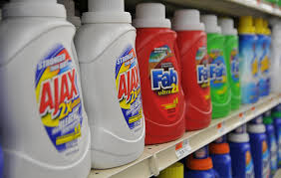
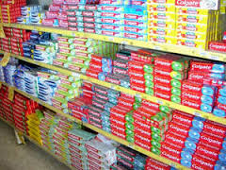
Monopolistic competition
• A large number of relatively small businesses in competition with each other.
• Products are similar, but differentiated from each other. Brand identity is relatively weak.
• Businesses are not price takers; however, they only have a limited degree of control over the prices they charge

Slide 12
Monopolistic competition
You are likely to be aware of local business in specific markets that are quite similar to each other – for example, hairdressers or take-away restaurants.
Within every monopolistic market sector each business tries to offer something different and possess an element of uniqueness, but all are essentially competing for the same customers.

Slide 13
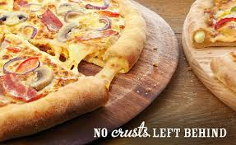
Monopoly differentiation
Differentiation may take a number of forms in this market structure. For example, businesses could use physical product differentiation.
This is where businesses use size, design, colour, shape, performance and features to make their products different from competitor businesses.
For example, pizza outlets produce their
products with stuffed crusts, thin and
thick bases and in all shapes and sizes.
They may also attempt differentiation
through methods of free delivery.

Slide 14
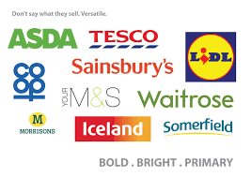
Oligopoly
• There are many businesses but only a few dominate the market.
• Each business tends to have differentiated products with a strong brand identity.
• Brand loyalty is encouraged by the use of heavy advertising and promotion.

Slide 15
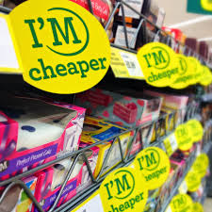
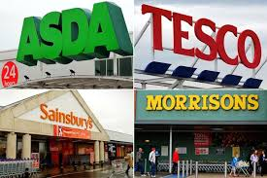
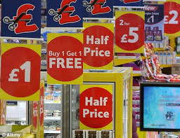
Oligopoly
• Prices can be stable for long periods, although short price wars do occur.
• Some barriers to entry do exist: for example, high start-up costs in relation to manufacturing.

Slide 16
Oligopoly Examples
Many of our largest industries, whether manufacturing, retailing or service industries, are oligopolistic in nature.
In retailing, the grocery market is dominated by Tesco, Sainsbury’s, Morrison's and Asda.
In clothing retailing, each age group have just three or four major chain stores that dominate their marketplace.

Slide 17
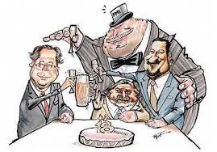
Oligopoly – Cartels
When businesses in an oligopolistic market act together (collude), a cartel is formed.
Cartels try to keep prices high, whilst the businesses involved share the market between themselves.
This type of collusion has occurred in a wide range of industries:
For example, the airline industry and
the sports clothing industry.
This formal collusion is illegal.

Slide 18
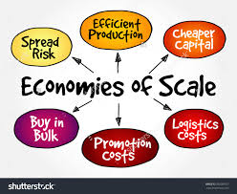
Oligopolies – Advantages
However, oligopolies are not without advantages to consumers.
Large size leads to :
Economies of scale
High profits means money for innovation and investment
Oligopolies targeting a wide range of market segments provide variety and choice.

Slide 19
Oligopolies – Advantages
A very good example of the advantages of the oligopolistic market structure can be found in communications.
By communications we mean
mobile phones, landlines, the
internet and television.
A small number of very large businesses have put huge amounts of investment into these industries over the last 30 years, meaning that service and customer choice has improved dramatically.

Slide 20
Activity 2 – Role play
Task:
You will be given business example cards and your task is
to present yourself to the class.
The class will then guess which one you are.
Time: 10 mins

Slide 21
Activity 3
Task:
Written task
Your task is to define and give
examples of a Monopoly, Oligopoly
and imperfect competition.
You will then discuss your answers with the group.
Time: 15 mins and 5 mins discussion

Slide 22
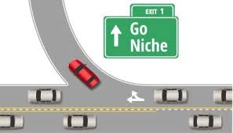
Markets – Niche / Mass
Different businesses can operate in very different markets – some are local, others global.
Some businesses are focussed on consumer markets (B2C), others sell to other businesses (B2B).
For many businesses there will be large seasonal variations in their sales; others may find much more constant sales throughout the year.

Slide 23
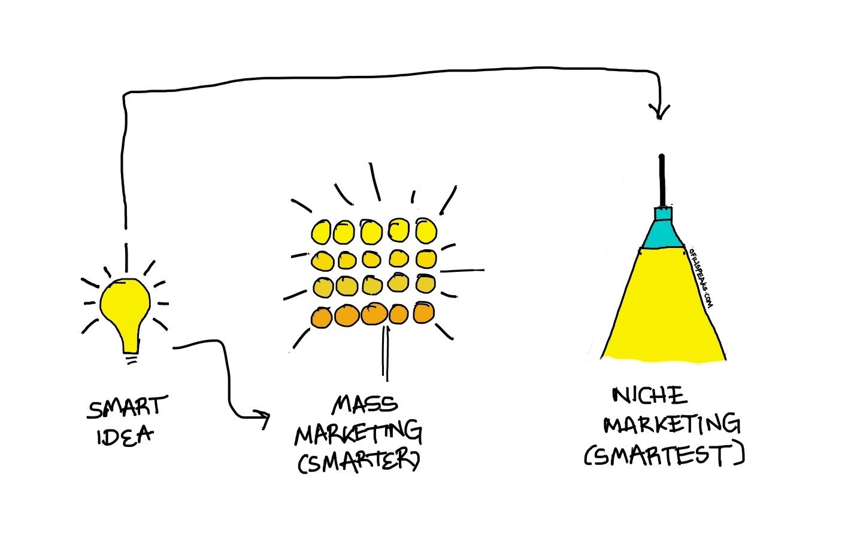

Slide 24
Markets – Niche / Mass
Although mass market businesses may seem to dominate the retail world there is still plenty of space for niche market businesses.
Each business will still use the marketing mix, but how they adapt their strategy depends largely upon the target market.
In most markets there is one
dominant (mass) segment and
several smaller (niche) segments.

Slide 25
Mass Marketing
This is when a business targets its advertising and promotional spending at the whole market, not at a particular segment. It involves the marketing of a good or service to all possible consumers in the same way .
Economies of scale can be taken
advantage of because of higher
production output and capacity.
Mass- produced vehicles such as
those produced by Toyota target
a global mass market.

Slide 26
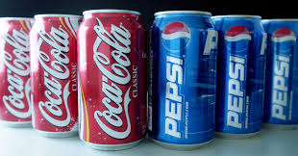
Mass marketing
Low-cost operations, heavy promotion, widespread distribution and the development of market-leading brands are key features.
The costs of setting up in order to compete in a mass market can be very high and competition can be very ﬁerce, as Coca Cola and Pepsi Cola clearly show.

Slide 28
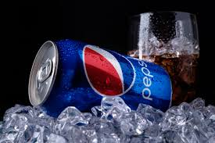
Mass marketing examples
Coca Cola – Targets the mass market they hope everyone will buy their product.
Pepsi – Also target the mass market directly competing with Coca Cola.
McDonalds – Target the mass market using many different products.
Nike – Targets the mass market and appeals to the entire market.
Colgate – Targets the mass market and appeals to the whole market.

Slide 29
Niche marketing
Niche marketing is where a business targets a smaller segment of a larger market, where customers have specific needs and wants.
• A higher price can often be charged
customers are prepared to pay for
expertise and tend to be loyal.
• There must be a full understanding of the desires and needs of the niche. This understanding can be gained through market research, but is often initially based on more of a ‘gut feeling’ and an understanding that comes through personal experience.

Slide 30
Niche marketing
• Niche marketing businesses are able to concentrate on their strengths, developing products from what the business is good at. As niche businesses can gain expert knowledge of the targeted part of the market, their products or services directly meet the needs of customers, giving the niche marketing business a real advantage over potential competitors.
• Alternatively, mass market businesses
can target the niche if it grows in value
or size and existing small businesses
may find this competition impossible
to deal with.

Slide 31
Niche marketing
Lower start-up costs help niche market businesses in their early stages. The business may have the market to themselves (at least for a while), because competition may ignore the niche, either because of lack of awareness or because it is too small for large businesses to focus on.
However, market niches can
disappear as a result of
in economic conditions,
fashion or taste.
One or more specific segments of the market are targeted with niche marketing.

Slide 33
Niche marketing examples
LuluLemon Athletica - is one example of a typical niche retail company. The retailer specializes in exercise equipment, athletic wear and exercise accessories for women.
Ties.com - is another example of an Internet-based niche retail company. The business, which shares its name with its main website, has been in operation since 1998. It focuses exclusively on men's neckties and related products.
Quidsi - is a successful niche retailer with a large Internet presence. The company operates diapers.com, which specializes in diapers and child care products.

Slide 34
YouTube video
https://www.youtube.com/watch?v=eevofo_20Uk

Slide 35
Activity 4
Task:
Your task is to match the niche and mass marketing example cards.
You will then discuss your findings with the group.
Time: 15 mins

Slide 36
Activity 5
Task:
Complete a Niche / mass marketing
Market structures.
Kahoot quiz.
Time: 15 mins

Slide 37
Aims and objectives
Introduce the aims and objectives for the session.
Answer business plan questions.
Explain market structures – monopoly, oligopoly and perfect competition.
Role play each market structure whilst the class decides which one you are presenting.
Analyse the market structures and give examples of each in a written task.

Slide 38
Aims and objectives
Define niche and mass markets and give examples.
Show a YouTube video on niche and mass marketing.
Arrange the niche and mass marketing example cards.
Answer the Kahoot quiz questions on Niche/ mass marketing and market structures.
Recap the aims and objectives for the session.

