Slide 1
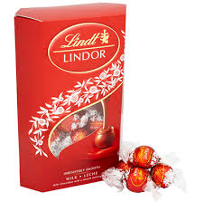
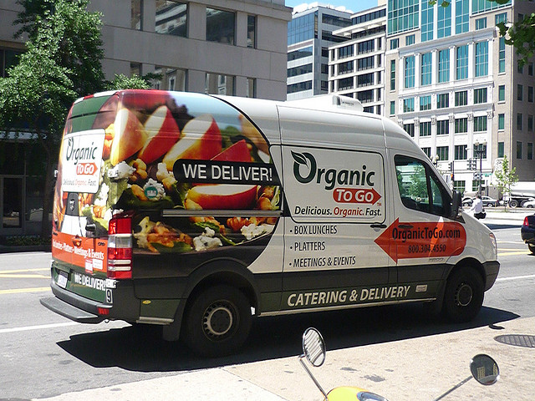
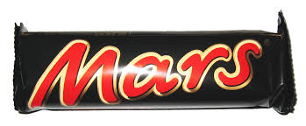
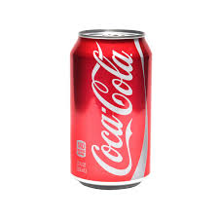
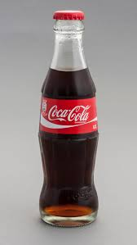
Niche Marketing
Mass Marketing
Lindt
Cadbury
Organic to go
Mars
Ties.com
Coca cola

Slide 2
Where a business targets a smaller segment of a larger market, where customers have specific needs and wants.
Appealing to the entire market with one uniform strategy or offer.
Success usually associated with low-cost operation, heavy promotion, widespread distribution or market leading brands.
Less competition the firm is a “big fish in a small pond”
Extremely expensive form of marketing and it is usually used by large companies that are well established.
Profit margins often higher and customers tend to be more loyal.
Allows you to reach out to large number of people at the same time within a period of time.
Risk of over dependence on a single product or market.

Slide 3
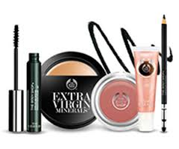
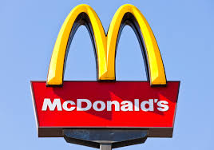
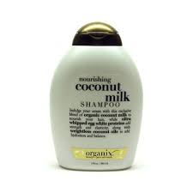
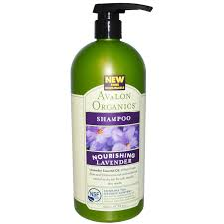
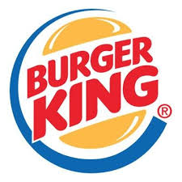
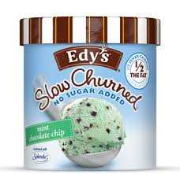
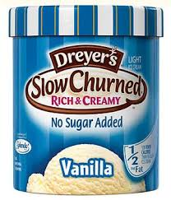
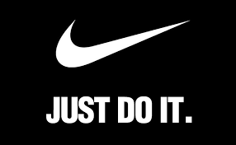
Lululemon.com
Ford
Make up not tested on animals
McDonalds
Organic shampoo
Burger king
Sugar free ice cream
Nike

