Slide 1
Aims and objectives
Introduce the aims and objectives for the session.
Explain market segmentation and discuss the importance of segmentation.
Show a YouTube video on market segmentation.
Complete a market segmentation Kahoot quiz.
Answer the segmentation quiz questions using your buzzer.
Evaluate the use of market segmentation by completing a written task.
Discuss your findings with the class.
Read a market segmentation case study example.
Recap the aims and objectives for the session.

Slide 2
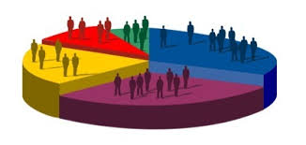
Activity 1
Task:
Using your show me boards discuss :
Market segmentation.
The main bases of segmentation.
Time : 5 mins

Slide 3
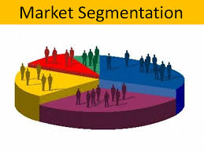
Market segmentation
A market segment is any sub-group of a larger market.
Mass market businesses divide their target markets into segments (sub-groups) that have common features, or are made up of individuals that make purchasing decisions based on common factors.
When this is done businesses produce and market products aimed at each of these segments.

Slide 5
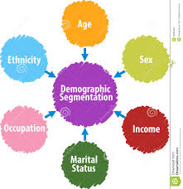
Types of segmentation
Demographic
Age, social class, gender, income.
Example:
Banks oﬀer diﬀerent accounts to diﬀerent age groups.

Slide 6
Psychographic
Allows targeting of groups on personality
and emotionally based behaviour –
attitudes, opinions and lifestyles.
Example:
Diﬀerentiating cars by emphasising
diﬀerent features – safety and
capacity for the family car

Slide 7
Types of segmentation
Geographic
Regions of the country – rural, urban, suburban.
Global marketing often requires diﬀerent
products for diﬀerent countries.
Example:
Global brands such as McDonalds
and Coca Cola require diﬀerent
ingredients in diﬀerent countries

Slide 8
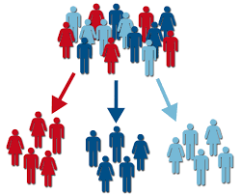
Segmentation characteristics
Firstly, segments must be recognisable.
They must be different enough from
other segments to make producing
for that segment worthwhile.
For example :
Housing is built for different groups of people: flats for single people, two bedroom houses and starter homes for young couples, three or four bedroom houses for families, bungalows for retired people.

Slide 9
Segmentation characteristics
Also segments must have critical mass.
This means that they must be big enough
or produce enough sales value to make
the production of products or services
targeted at the segment worthwhile.
The market for two-seater sports cars has grown rapidly in recent years making the segment attractive:
Not only to niche market businesses such as Lotus, but also to mass market businesses like Toyota, Honda and Nissan.

Slide 10
Segmentation characteristics
Segments have to be targetable.
Having their own identity means that
they can be promoted to, and have
marketing directed towards them.
On daytime TV, there are many adverts for retirement plans, or funeral expenses plans, often sold in a reassuring but concerned manner.
They are targeted at a segment which is aware of the potential problems of costly funeral expenses, or leaving a loved one without financial support.

Slide 11
Segmentation characteristics
Once segments have been identified, then businesses can use a target marketing approach.
Targeted marketing allows the business
to stress those product features that
are most relevant for each particular
segment (e.g. price vs. quality vs.
brand identity).
This targeting will occur even if the
product being sold to different
segments is almost identical.

Slide 12
Segmentation – Changes
Finally, customers change their preferences and patterns of behaviour over time (the customer life cycle).
Sustainable customer relationships in all
phases of the customer life cycle can
come from segmenting markets.
Businesses that serve different segments along a customer’s life cycle can lead their customers from stage to stage by always offering them a special solution for their particular needs.

Slide 13
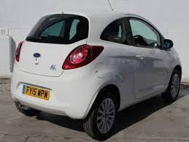
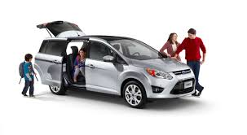
Segmentation examples
For example, most car manufacturers offer a product range that caters for the needs of all phases of a customer life cycle:
A first car for students/young workers, a fun car for young professionals, a family car for young families, SUV for growing families etc.

Slide 14
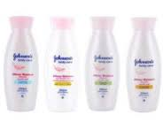
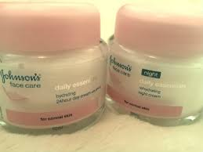
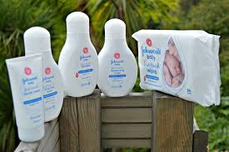
Skincare cosmetics brands often offer a branded series of products for babies, teens, young adults, mums, and more mature skin.

Slide 15
Seasonal markets
Many markets have large seasonable variations.
Classic examples are ice cream (during the pre-summer period), fireworks and diet plans (in January).
Seasonal marketing will have a huge influence on the activities of businesses involved in these industries as each will have a critical sales period, which can make or break a business.

Slide 16
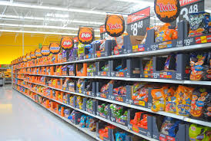
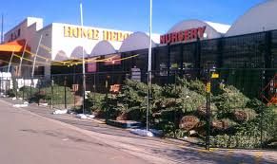
Seasonal markets
Few businesses are totally immune to seasonality of sales.
Lines of stock are adapted and changed – the big supermarkets have titled seasonal aisles.
All of these seasonal changes
have to be thought about and
planned several months in
advance to ensure that all
aspects of the marketing mix
are in place when required.

Slide 17
YouTube video – Segmentation
https://www.youtube.com/watch?v=DUuirqtSqpg

Slide 18
Handout – Market segmentation
You will receive a handout on market segmentation.

Slide 19
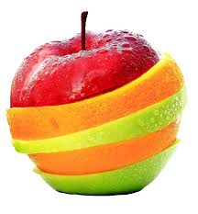
Activity 2
Task:
Kahoot quiz - Segmentation
Time: 20 mins

Slide 20
Market segmentation questions
What is market segmentation?
How are markets segmented?
What are the bases of demographic segmentation?
Can you explain psychographic segmentation?
What is geographic segmentation?
Why do companies segment markets?
Give an example of market segmentation?

Slide 21
BREAK
15 mins

Slide 22
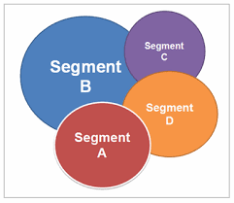
Activity 3
Task:
Your task is to explain the main bases of segmentation in a
written task.
Time: 30 mins and 10 mins discussion.

Slide 23
Activity 3
Task:
Segmentation case study example
Time: 15 mins

Slide 24
Aims and objectives
Introduce the aims and objectives for the session.
Explain market segmentation and discuss the importance of segmentation.
Show a YouTube video on market segmentation.
Complete a market segmentation Kahoot quiz.
Answer the segmentation quiz questions using your buzzer.
Evaluate the use of market segmentation by completing a written task.
Discuss your findings with the class.
Read a market segmentation case study example.
Recap the aims and objectives for the session.

