Slide 1
Consumer protection – Aims objectives
Introduce the aims and objectives for the session.
Using your show me boards discuss and define consumer protection.
Explain the need for consumer protection and give examples of legislation.
Discuss the importance of ethics in consumer protection.
Show a subliminal advert YouTube video and discuss with the group.
Answer consumer protection Kahoot quiz questions.
Complete a consumer protection example task sheet.
Examine and evaluate the use of consumer protection by completing a past paper question.
Recap the aims and objectives for the session.

Slide 2
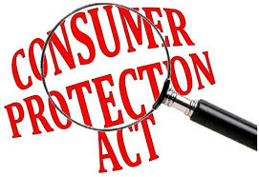
Activity 1
Task:
A3 paper and pens
Explain why consumers need protection.
What types of protection are used to protect consumers.
Time: 5 mins and 5 mins discussion

Slide 3
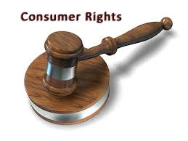
Why do consumers need protection?
The relationship between consumers and producers is not a relationship that is based on a level playing field.

Slide 4
The advantage in almost all purchasing
and consumption situations lies with
big business. Businesses understand
how to manipulate customers’
behaviour; they try to control price
and competition in the market place
and are in the position to produce goods and services that perhaps do not fully meet the expectations of the consumer.

Slide 5
Legislators (law makers) and consumer protection groups argue that without a strong legal framework, businesses will operate in a way that will maximise their profits with little consideration of the impact this will have on customers.

Slide 6
This may seem extreme; after all there are many businesses that focus on brand value, customer satisfaction, quality of service and quality of product.
But not all businesses would voluntarily keep to the highest of marketing principles. Laws are needed to protect consumers and limit the worst excesses of capitalist behaviour.

Slide 7
Two types of consumer protection
To assist in the protection of consumers there are two separate groups of regulations:
• Firstly, legislation to protect consumers who
enter into contracts with retailers or producers.
A contract is made when goods or services are
purchased.
• Secondly, legislation with regard to competition policy.
This is large-scale policy designed to control the way
that markets operate.

Slide 8
Consumer protection legislation
As stated, when consumers purchase goods or services, contracts are formed between the consumer and the retailer and the producer of those goods or services.
To clarify the nature of these
contracts and to establish the
requirements of producers and
retailers, a series of laws have
been passed.

Slide 9
The Sale of goods act 1994
The Sale and Supply of Goods Act 1994 states that goods must be of merchantable quality, fit for their intended purpose, lasting for a reasonable amount of time and be as described.
This means that the goods must be capable of doing what they were designed to do and what the purchaser would reasonably expect them to be able to do.

Slide 10
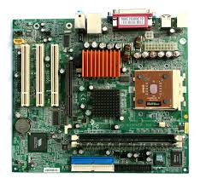
The Sale of goods act 1994
For example
If you purchase a new car it must be capable of reliably transporting its driver and passengers.
If you purchase a computer that was described as a top-end gaming computer, and you looked at the motherboard and discovered a 200 MHz chip and no graphics card, the goods are not as described.

Slide 11
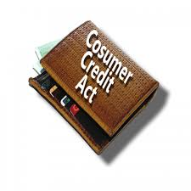
Consumer credit act 1974
The Consumer Credit Act 1974 controls the way that goods can be bought and sold on credit.
Under this act the use of APR was established. APR is the annual percentage rate of interest – this must be clearly stated when credit is being offered.

Slide 12
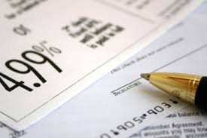
The use of APR allows consumers to easily compare competitive interest rates and to judge the true cost of borrowing.
Also this act established the use of ‘cooling-off’ periods where in many cases consumers have 14 days in which they are able to change their mind about entering into a credit arrangement.

Slide 13
YouTube video – APR
Quick quid
https://www.youtube.com/watch?v=53qLEHl_Cfg

Slide 14
Trade descriptions act 1972
The Trade Descriptions Acts 1968 and 1972 are designed to prevent and make it a criminal offence to give untrue or misleading descriptions of goods with regard to their content, size, weight and price. Because of this legislation, manufacturers and retailers have to take a great deal of care about information presented on the packaging of their goods, or within advertisements and any other form of promotional material.

Slide 15
Distance selling regulations
Distance selling regulations help protect consumers who buy over the phone or online.
If businesses break these regulations then the consumer is not bound by the purchase contract.

Slide 16
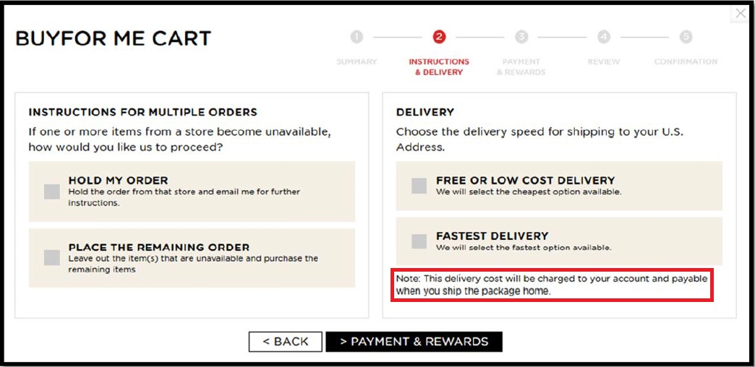
These regulations provide the consumer with a cancellation period of 14 days: the ‘cooling off’ period during which consumers are entitled to change their minds and cancel the contract and receive a full refund, regardless of whether the product is defective.
Also consumers are not bound by charges they have not expressly agreed to – such as hidden delivery or card payment costs.

Slide 17
The role of the ombudsman
However, retailers and consumers still find issues to dispute.
If a customer has a complaint that in their view has not been satisfactorily dealt with by the business concerned the next step in finding redress might be the Ombudsman Service.

Slide 18
The Ombudsman Service can be used to complain if consumers have an issue with pricing, quality of service, quality of goods or mistreatment.
In a number of industries, including financial services, communications (e.g. phones and the internet), energy (e.g. gas and electricity), and property (e.g. estate agents and surveyors) the ombudsman findings are binding and the business concerned must comply with the ruling.

Slide 19
Activity 2
Task:
Your task is to read the case study example of consumers needing protection.
You must decide in which customer needs which protection.
Time: 15 mins

Slide 20
Competition and Markets authority
On a national basis, The Competition and Markets Authority (CMA) works to encourage the establishment of voluntary codes of practice within industries.
For example, ABTA (Association of British Travel Agents) and ATOL (Air Travel Organisers’ Licensing) protect and reimburse holidaymakers if their travel company ceases trading (if the company is a member).

Slide 21
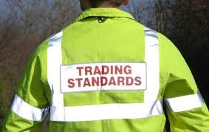
The CMA will also advise the government when it believes that new legislation is required. On a local basis, Trading Standards Departments and Environmental Health Departments work to help ensure obedience to the legislation.
For example, Trading Standards officers are often found touring markets and car boot sales checking for sales of counterfeit goods.

Slide 22
Legislation with regard to competition policy competition policy is focussed upon controlling the power of big business.
If businesses in a monopoly or near monopoly are able to hold a dominant market position, then they are likely to have control over price or the amount produced within the market. (Royal Mail)
Governments (UK and EU) will therefore put in place laws and regulators to limit the potential abuse of market power and thereby protect consumers.

Slide 23
CMA and cartels
In April 2014 the Competition and Markets Authority (CMA) replaced the Competition Commission and most of the roles of the Office of Fair Trading.
One role of the CMA is to examine situations where companies act together, forming an illegal cartel to limit the competition within an industry.

Slide 24
Businesses, if they have a choice, will not compete on price and they may take the view that by creating a dominant market position by working with other large businesses, they can limit price competition.
Q – Why?
Because of the potential of cartels and collusion between businesses, legislation allows for guilty parties to be fined up to 10% of turnover for each year of illegal activity.

Slide 25
The role of the CMA
• Investigating mergers which could restrict competition
• Conducting market studies and investigations in markets where there may be competition and consumer problems
• Investigating where there may be breaches of UK or EU prohibitions against anti-competitive agreements and abuses of dominant positions

Slide 26
The role of the CMA
• Bringing criminal proceedings against individuals who commit the cartel offence
• Enforcing consumer protection legislation to tackle practices and market conditions that make it difficult for consumers to exercise choice.
• Co-operating with sector regulators and encouraging them to use their competition power.

Slide 27
Ethical issues – Consumer protection
Ethical issues related to consumer protection, apart from legal considerations, businesses also need to consider the ethics of their relationships with customers.
Consumers can be manipulated by businesses and their marketing professionals.

Slide 28
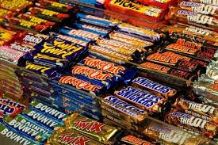
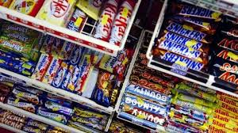
Supermarket ethics
It used to be standard for all supermarkets to have displays of sweets and chocolates next to checkouts: children would use ‘pester power’ to get their parents to buy sweets whilst they queued.
It was only as a result of customer pressure that these displays have been changed to now display less impulse purchase items instead – offering items such as batteries, laces and breath-freshening mints.

Slide 29
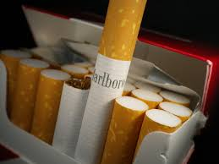
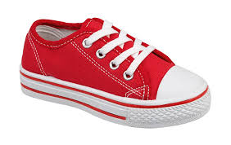
Consumer ethics
This change by supermarkets to a more ethical stance is not seen in all consumer markets – it is quite usual for businesses to target expensive brands at children and teenagers. Can it be ethical for businesses to convince children that the only pair of trainers worth having costs £70?
With cigarette smoking declining in developed countries is it right that the major tobacco businesses should discount their prices to win customers in developing countries?

Slide 30
Business and ethics
Being ethical in marketing is always a problem area for those businesses producing and marketing consumer products.
It can be a difficult balancing act for businesses to try to maximise sales whilst at the same time marketing their products in a way that does not encourage overconsumption or excessive behaviour by customers.
McDonalds ‘supersize’ was once
a marketing winner, but with
increased worries about people’s
weight problems, the campaign was dropped.

Slide 31
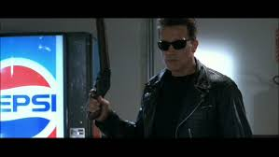
Product placement
Product placement is when a company pays a TV channel or a programme-maker to include its products or brands in a programme.
This is allowed but there are
rules from Ofcom (the broadcasting
regulator) on how this is done.
For example, no product placement can be carried out on children’s tv programmes and certain products such as cigarettes and alcohol are not allowed.

Slide 32
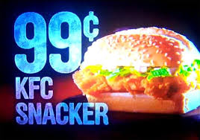
Subliminal advertising
Subliminal advertising (placing fleeting or hidden images in films or TV programmes in the hope that viewers will process them unconsciously) was banned in the 1970s, but that does not stop the unscrupulous from taking advantage of natural human reactions.

Slide 33
YouTube video
Subliminal advertising example:
https://www.youtube.com/watch?v=umi7pbkVaeg
Rogue traders:
https://www.youtube.com/watch?v=-NjE-vCe0k4

Slide 34
Activity 3
Task:
Complete a Kahoot quiz on consumer protection
Time: 20 mins

Slide 35
BREAK
15 mins

Slide 36
Activity 4
Task:
Your task is to complete a consumer protection past paper question.
Time : 30 mins and 10 mins discussion

Slide 37
Consumer protection – Aims objectives
Introduce the aims and objectives for the session.
Using your show me boards discuss and define consumer protection.
Explain the need for consumer protection and give examples of legislation.
Discuss the importance of ethics in consumer protection.
Show a subliminal advert YouTube video and discuss with the group.
Answer consumer protection Kahoot quiz questions.
Complete a consumer protection example task sheet.
Examine and evaluate the use of consumer protection by completing a past paper question.
Recap the aims and objectives for the session.

