Slide 1
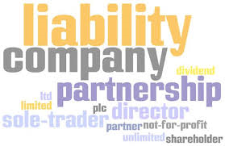
Aims and objectives
Introduce the aims and objectives for the session.
In groups discuss the difference between the private and public sector.
Explain the private and public sector and give examples.
Discuss the private sector structures, sole trader, partnerships and limited companies.
Give examples of charities, cooperatives and social enterprises.
Evaluate the business structure advantages and disadvantages.
Show YouTube videos on the public and private sectors and also sole trader examples.
Complete a group Kahoot quiz on the business structures.

Slide 2



Arrange the business structure example and definition cards in groups.
Role play a business structure whilst the class decides which structure you are.
Evaluate the business structures by writing a description of each and give examples.
Explain your evaluations to the class.
Recap the aims and objectives for the session.

Slide 3

Activity 1
Task:
What is the difference between the private and public sector?
Show me boards
Time: 5 mins

Slide 4

The public sector
The public sector is made up of organisations that are owned and run by the government.
This part of the economy is huge, and includes some of the largest employers in the UK.
The government spends over £450
billion a year running public sector
organisations and providing public
sector services.
The largest public sector organisation, the NHS, is the
biggest civilian employer in Europe, costing nearly £120 billion a year to run.

Slide 5
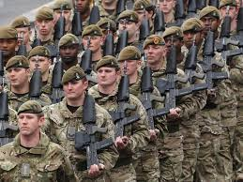
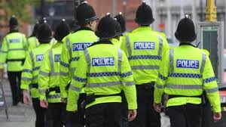
Why do we need the public
sector?
Some goods and services which we need in our everyday lives would simply not be provided by the private sector who are looking to make profits.
These necessities include street lighting, defence (army, navy, air force) and the police. The problem with these goods is that
we can all benefit from them without paying for them. So if someone paid for, and installed street lighting, anyone walking down that road would benefit.

Slide 6

Public sector goods
Public goods (and services) have two features:
• non-excludability;
• non-rivalry.

Slide 7
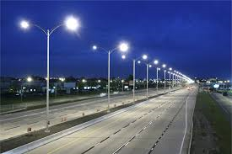
Non excludable
This means that individuals cannot be prevented from enjoying the benefits of the provision of public goods or services.
We all gain from having violent criminals kept behind bars, as the threat to our family’s well-being is reduced. No individual is excluded from this benefit.
The same non-excludability would
apply to having public goods such
as street lighting – if street lights
are provided by a local authority
all will benefit.

Slide 8
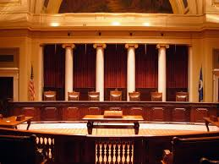
Non rivalry
This means that one person gaining from consumption of a good or service does not prevent others from also gaining from the good or service.
If an individual eats an ice cream for example, then less ice cream is available for others to consume. Rivalry exists here.
However, if an individual benefits
from gaining justice in the Law
Courts, this does not prevent any
other individual from also being
able to benefit from such a public
service. They are not rivals for this service.

Slide 9
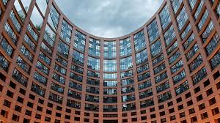
Public sector goods
Not all goods provided by the public sector are public goods.
There is another group of goods and services that is supplied by both the private and public sectors, but if left to just the private sector the quantity supplied of these goods and services is likely to be much less than the level of provision which is most efficient for the economy.

Slide 10

Public sector - Merit goods
The two best examples of these merit goods are education and health care.
There are of course private schools and private hospitals but most patients are treated by the NHS, and most children go to state schools. The government spends a great deal of money trying to ensure that we have an effective Health Service and schools and colleges that supply a well-educated and trained workforce.

Slide 11

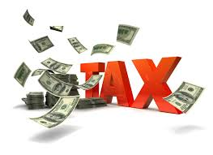
These merit goods are said to have positive externalities. This means that the consumption of these goods will have positive effects not only on the individual that consumes them, but also on society in general.
By attending school, individuals become
better educated and skilled. Some
individuals may use their knowledge
and skills to set up businesses which
employ people who themselves will
pay tax and contribute to society.

Slide 12

Private sector
This is the part of the UK economy that is operated by businesses owned by shareholders or private individuals.
Although making profits, and giving a return to owners (increasing shareholder value), will always be the number one and two priorities of businesses in the long run, in the short term there can be other important objectives to pursue.

Slide 14


https://www.youtube.com/watch?v=ENl72eTVLfo

Slide 15


Business structures
Sole traders are the most popular form of business in the UK and are run by a single individual. A quick examination of a business directory such as Yellow Pages will show that there are thousands in every town or city.
Sole traders are easy to set up; it is just a matter of informing the Inland Revenue that an individual is self-employed and registering for class 2 National Insurance contributions within three months of starting in business.

Slide 16

Sole trader – Benefits (A04)
• Costs are low due to the simplicity of setting up and no legal formalities, so there is little administrative cost.
• Also no formal audited accounts are required, though it makes good business sense to keep a full set of business records.
• The sole trader benefits from fast decision-making and may (within employment law) hire and fire as they please.

Slide 17


Sole trader problems (A04)
• Firstly there is often limited capital. Sole traders often rely on their own savings and perhaps secured business loans.
• It is likely that the sole trader will have a limited range of skills. A sole trader may be an expert plumber, but is he or she an expert at marketing, managing staff, and controlling
cash flow? With the need to be effective at all these tasks comes immense pressure.

Slide 18
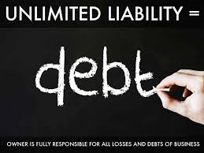
Sole trader problems (A04)
• All the decisions and the future success of a business rest with one person.
• The sole trader has unlimited liability. This means that the business owner is liable for all the debts of the business, up to and including the value of all assets held.

Slide 19
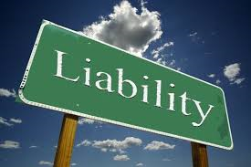

Sole traders
One of the major problems of running a small business is the likelihood of falling into debt.
With one in three businesses failing within two years of starting, it is probable that a good proportion of those unsuccessful entrepreneurs will not only lose the money that they initially invested, but additional money too.

Slide 20
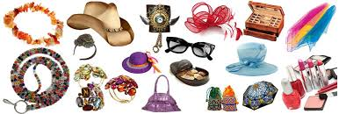
Sole traders
Imagine a situation where a sole trader opens a shop selling fashion accessories.
The shop premises are let on a two year lease; she (the entrepreneur) arranges a phone contract for the shop, leases equipment like a checkout till and shop fittings – all for the same two years.
The total amount payable per month comes to £1300. Unfortunately after 9 months she has run out of cash, sales were dismal and she can’t afford to continue.

Slide 21


Partnerships
Partnerships involve the joint ownership of a business. Normally there can be between two and 20 partners, but in certain businesses such as accountancy firms, there can be
many more partners than this.
Partnerships are often found in professions such as lawyers, accountants and doctors, but can be found in any type of business activity.

Slide 22

Partnership rules
The rules of partnership
are laid down in a
Partnership Agreement,
or the Deed of Partnership.
The Deed of Partnership lays out such rules of operations as the amounts of capital invested, the share of profits each partner is to receive, the roles and responsibilities of each partner, the voting shares of the partners, what is to happen on the death of a partner and the rules for dissolution of the partnership.

Slide 23

Partnerships
Should a dispute arise without a partnership agreement giving methods of settling the dispute, then the dispute would be settled according to the 1890 Partnership Act.
This is best avoided, particularly where unlimited liability is involved, as the act states that each partner is equally responsible for any debts – each partner is ‘jointly and severally’ liable.

Slide 24

Partnership advantages (A04)
There are a number of advantages of the partnership structure over that of a sole trader.
These include: (Shared)
Wider range of skills
Greater availability of capital
Shared decision-making
Increase expertise.

Slide 25


Partnerships disadvantages (A04)
However, becoming a partner does not overcome all the disadvantages of being a sole trader:
Capital can still be limited, with the same problems of raising external capital that a sole trader has.
The partners still have unlimited liability of partners (sleeping partners who invest, but take no part in the day-to-day running of the business can have limited liability).

Slide 26


Also partnerships are dissolved on the death of a partner and this can cause complications in re-establishing the partnership.
Although there are many advantages when partners become involved in a business for the first time (such as increased capital, greater input into decision-making, a wider spread of skills), new partners can, and do, cause strains within a business.

Slide 27

YouTube video
Sole traders and partnerships:
https://www.youtube.com/watch?v=9HbSXpnUq5A

Slide 28

Limited companies
There are two types of business structure that have limited liability:
• Private limited companies (Ltd);
• Public limited companies (PLC).

Slide 29


These businesses exist separately from their owners, who are known as shareholders.
Employees are employed by the Ltd or PLC, and assets (buildings, machinery) are owned by the Ltd or PLC. This separate legal existence is known as incorporation – the business exists in the eyes of the law. Any legal action is taken against the business and not the shareholders.
Shareholders are only liable to lose the amount of money they have invested in the business – hence, their liability is limited.

Slide 30

Public limited companies
Although they have the same type of liability there is one major difference. Public limited companies trade their shares on the stock market. In the UK there are two main stock markets. These are:
• The Alternative Investment Market (AIM) – for smaller companies;
• The London Stock
Exchange (LSE) –
for larger businesses.

Slide 31



Shares on these stock markets are freely bought and sold: so in effect the ownership of PLCs are changing all the time.
This change of ownership normally has very little impact on
the running of the business.
One small shareholder sells their shareholding, another small shareholder buys, and this happens thousands of times a day.

Slide 32

Private limited company
Advantages (A04)
Limited liability;
• Shares can only be sold if all the
shareholders agree – control is not
lost to outsiders;
• capital can be raised through increasing shareholders;
• other businesses and lenders are more likely to trade and invest;
• the business continues if one of the owners dies;

Slide 33

Private limited company disadvantages (A04)
• legal procedure in setting up, increases costs;
• profits have to be shared with shareholders;
• shares cannot be sold to the public which may restrict the investment of additional capital;
• financial information
is in the public domain.

Slide 34

Public limited companies
Advantages (A04)
• limited liability;
• the business continues if one of the owners dies;
• capital can be raised through selling shares to the public;
• it is easier to raise finance from banks and other lenders who are more willing to lend to PLCs;
• they are likely to have economies of scale;

Slide 35

Public limited companies
Disadvantages
• increased costs in setting up;
• anyone can buy shares so there is an increased threat of losing control;
• increased legal requirements;
• the company accounts are in the public domain – more information has to be published than private limited companies;
• divorce of ownership and control;

Slide 36

YouTube video
Public limited company:
https://www.youtube.com/watch?v=93Q66bOyaa0

Slide 37

Activity 1
Task:
Business structures – Kahoot quiz.
Time: 10 mins

Slide 38

Non profit organisations
There are a growing number of business organisations that are not in business for the money – they are not out to maximise profits. Instead their focus is on social or ethical objectives.
Within this group of organisations we find charities, co-operatives and social enterprises, between them providing a range of goods and services, and more often than not competing with ‘for-profit businesses’.

Slide 39


These not-for-profit organisations cannot just sell
on the basis of who they are or what they stand for – if they just did this it is unlikely they would last for long.
They have to provide a quality and value-for-money service, just like any other business.

Slide 40


Charities
Charities are established with the aim of collecting money from individuals and spending it on a cause, which is usually specified in its title.
Although they are not established to make
profits, they can earn surpluses.
Many well-known charities such as
Oxfam, Friends of the
Earth and Save the Children
have been around for a long
time and employ many people.

Slide 41

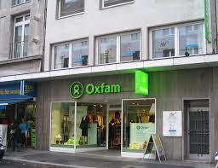

Oxfam was started in 1942; the RSPCA began over 100 years earlier, in 1824.
Charities can often have a narrow focus (single issue) in what they are trying to achieve.

Slide 42

Big Issue – charity
Big Issue’s mission statement is:
Our mission as a UK charity for people who are homeless, is to connect vendors with the vital support and personal solutions that enable them to rebuild their lives; to find their own paths as they journey away from homelessness.

Slide 43

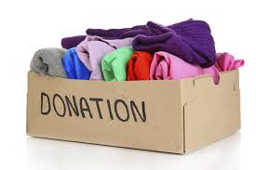
Charity donations
Charities still raise the majority of their finances through voluntary donations, but more and more charities now operate retail outlets as well.
Oxfam have been doing this for a number of years and their shops contain new items often produced as a result of their development projects, as well as donated items such as books and clothes.

Slide 44
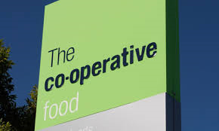

Co operatives
Business co-operatives were initially set up in the 19th century as part of a social movement by working people.
They were established around workplaces or in districts of industrial towns, and were designed to prevent profiteering and exploitation by company shops and tallymen (door-to-door lenders).

Slide 45

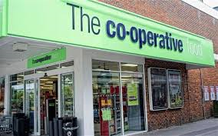
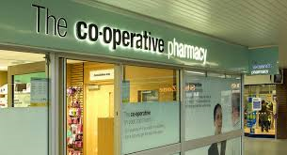
A co-operative is an organisation owned by its
members.
Employees of co-operatives automatically
become members after a short probationary period,
and shoppers at co-operative shops such as ‘the Coop’,
can apply to become members: acceptance is
automatic.

Slide 46


Members benefit through the payment of a dividend (their share of the co-operatives profits) in the form of money-off vouchers.
Just like any business, co-operatives have managers and there is a business hierarchy, but it is much flatter than that found in a typical business – there are fewer layers to the hierarchy.

Slide 47

Social enterprises
Social enterprises are a booming organisation structure.
Social enterprises trade to help solve social problems, improve the communities they operate in, and improve the environment.
They are businesses with clear social objectives and are currently thriving in a number of industries and sectors of the economy.

Slide 48

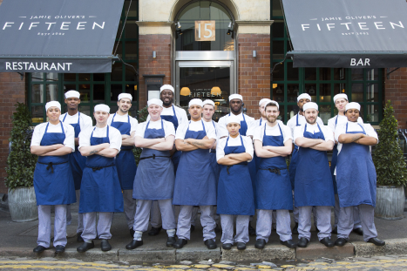
Many social enterprises aim to make profits from selling goods and services in the open market; but then, instead of paying dividends, they reinvest these profits, toward achieving their social objectives.

Slide 49

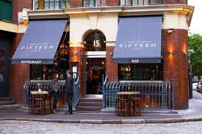
The chef Jamie Oliver has had great success with his ‘15’ chain of restaurants, providing training in a range of cooking and catering skills for homeless and unskilled young people.
Profits from the first restaurant go towards opening new restaurants and spreading the benefits to a larger number structure offers them this motivational opportunity.

Slide 50

The government is looking at the social enterprise model as a way of providing services such as child protection. Other social enterprises operate in the housing, drinks and holiday sectors, as well as many other sectors, and the number of social entrepreneurs is
rapidly growing.
Many young people, fresh out of university, are looking for a type of satisfaction from work that cannot come from employment in a large business, and the social enterprise

Slide 51
YouTube video
https://www.youtube.com/watch?v=ATXtUgWeRWQ

Slide 52

BREAK
15 mins

Slide 53
Activity 2
Task:
Match business structure examples to correct examples.
Group discussion.
Time: 10 mins and 5 mins discussion

Slide 54

Activity 3 – Role play
Task:
You will be given a business structure.
Your task is to explain yourself to the group.
Time: 10 mins

Slide 55
Activity 4
Task:
Write a description of each structure with examples.
Group discussion.
Time: 20 mins and 10 mins

Slide 56

Homework task
Task:
Past paper questions – Business structures
Hand in work to be marked next week.

Slide 57
Aims and objectives
Introduce the aims and objectives for the session.
In groups discuss the difference between the private and public sector.
Explain the private and public sector and give examples.
Discuss the private sector structures, sole trader, partnerships and limited companies.
Give examples of charities, cooperatives and social enterprises.
Evaluate the business structure advantages and disadvantages.
Show YouTube videos on the public and private sectors and also sole trader examples.
Complete a group Kahoot quiz on the business structures.

Slide 58
Arrange the business structure example and definition cards in groups.
Role play a business structure whilst the class decides which structure you are.
Evaluate the business structures by writing a description of each and give examples.
Explain your evaluations to the class.
Recap the aims and objectives for the session.

