Slide 1
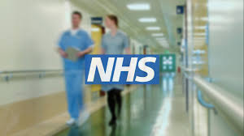
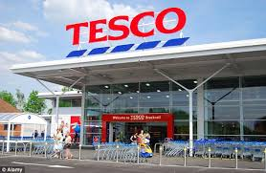
NHS - I am operated by the government and do not
Aim to make a profit but provide a service of
Healthcare to my customers.
Am I in the private or public sector.
Tesco - I am owned by shareholders and my
Main aim is to make as much profit as possible
I do support the local community by offering
Free computers for schools.
Am I in the private or public sector.

Slide 2
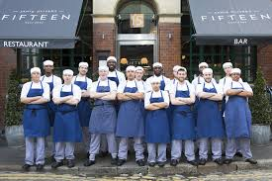
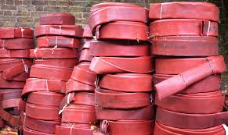
Jamie oliver currently runs Fifteen.
The main aim is to educate young
People and support them whilst gaining
Qualifications in the cooking field. All
Profits are reinvested back into the
Business.
The Elvis & Kresse Organisation (EaKo) takes industrial waste materials, turns them into stylish luggage and hand bags and donates 50% of the profits to the Fire Fighters Charity

Slide 3
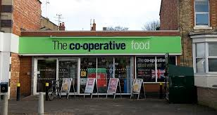
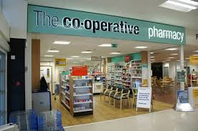
Co operative food is an organisation owned by its members. Employees automatically become members after a short probationary period, and shoppers at co-operative shops such as ‘the Coop’, can apply to become members: acceptance is automatic.
Co operative pharmacy is an organisation owned by its members. Employees and customers can be members. Members benefit through the payment of a dividend (their share of the co-operatives profits)
in the form of money-off vouchers.

Slide 4
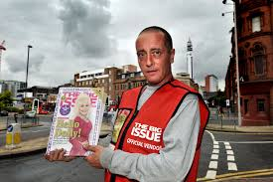
Big Issue’s mission statement is:
Our mission as a UK charity for people who are homeless, is to connect vendors with the vital support and personal solutions that enable them to rebuild their lives; to findtheir own paths as they journey away from homelessness.
Oxfam was started in 1942.
Oxfam is an international confederation of charitable organizations focused on the alleviation of global poverty.

Slide 5
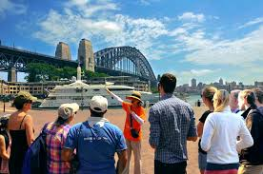
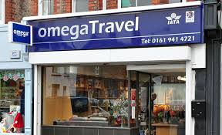
My name is Andrew, I am tour guide. I work for myself
and am based in Australia and I do not employ anyone.
I also have sole responsibility for any business debts
And my possessions can be taken to cover my debts.
Sole trader
I am Omega travel. I am owned by a single owner and have
Five employees who all work different hours. I am registered
With HRMC and am responsible for all my businesses debts.
Sole trader

Slide 6
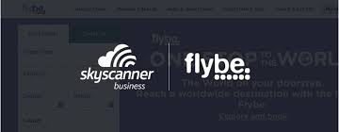
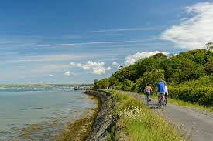
We are sky scanner and Flybe. We are owned by only three people
And have recently signed a partnership agreement. All of our
Members are responsible for all the business debts.
Partnership
We are Northern Ireland Bed and Breakfast
Partnership. We have over 50 employees and
Are owned by two people who share experience
And also share profits.
Partnership

Slide 7
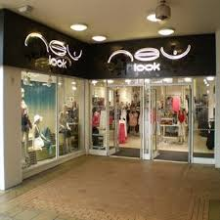
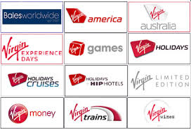
I am Richard Branson the owner of Virgin ltd, I am the most
Common form of business ownership in the U.K, I can invite
People to buy shares but I am not on the stock exchange. I
Am also only liable to pat debts up to what I have invested.
Private limited company
I am New Look. I do have shareholders and I am only liable to cover debts up to the amount I have invested in the company. I have stores all over the UK and also sell online. I am not on the stock exchange
Private limited company

Slide 8
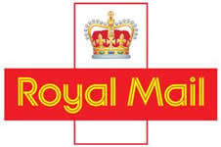
I am Royal mail. I was previously not on the
Stock exchange but I have now moved to the
Stock exchange. I have the letters PLC at the
End of my name and deliver letters and parcels
all over the world.
Public limited company
I am British petroleum, You can buy stocks and shares
Through the London stock exchange and my shareholders
Have limited liability so are only liable to cover debts up to
What was invested.
Public limited company

