Slide 1
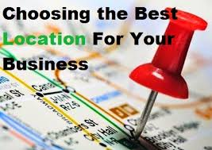
Aims and objectives
Introduce the aims and objectives for the session.
Explain the factors that affect business location and give examples.
Show a YouTube video on business location.
Discuss in groups the Ikea location riots.
Evaluate the statement ‘location is key to business success’.
Present your evaluations to the class and question your peers.
Answer the revision questions on business locations.
Recap the aims and objectives for the session.

Slide 2
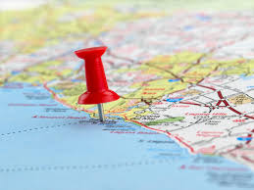
Activity 1
Task:
Using your show me boards.
Discuss business location and the key factors that
affect location.
Time: 5 mins

Slide 3
Business location
For many industries location is now far more complex than was previously the case.
Apple, for example, has its headquarters
in California, but most of its products are
produced in Asia.
A computing company may have its head office in Dublin, but have its servers located in India, the UK and Germany. Nonetheless, even with these modern complications some basic rules still apply.

Slide 4
Business location
Location for new and existing businesses is still largely determined by:
• Access to customers;
• Access to factors of production;
• Minimisation of costs.

Slide 5
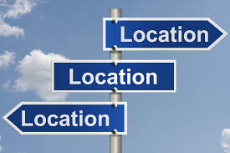
Key location factors
Increased choice in international location
Costs
The market and competition
Social reasons
Government influences
Labour
Infrastructure
Political issues

Slide 6
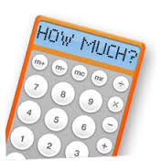
Cost
For most new businesses the most important location factor is likely to be the cost.
New businesses, especially sole traders, will have limited capital so they will need to keep their costs low.

Slide 7
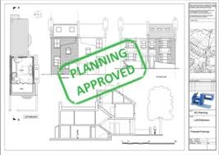
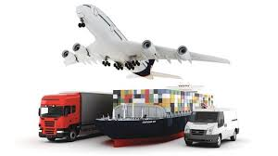
Location – Costs
The setting up of a new business will incur a number of location costs including:
• planning permission;
• purchasing or rental/leasing;
• refurbishment;
• business rates;
• labour costs;
• transport costs.

Slide 8
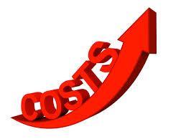
Location – Costs
A new business may be unable to choose the ideal location for their business as they may not be able to afford the location costs.
Therefore new businesses will often consider locating elsewhere, accepting that they are not selecting the optimum location. In the longer term they may have an objective to relocate when they have built up a customer base and have increased capital.

Slide 9
Location – Costs
A new business will need to consider the importance of location on its success. This will depend on its products and services and the market it will operate in.
Because a new business may be limited in its choice of a suitable location due to costs, it will need to consider the other key location factors and determine what the most important factor is for them.

Slide 10
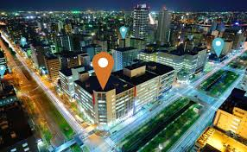
The market and competition
The market is the place where buyers and sellers meet. Most commercial B2C exchanges (buying and selling in consumer markets) still take place face-to-face, so a physical location is required.
Retail location should be driven by access to customers, but there will be a balance between customer footfall and rental/lease costs.

Slide 11
Market and competition - location
Costs of location will vary according to likely sales and customer potential, but within each price band there will be both good and bad locations.
Identical stores from the same chain with the same staffing levels and sales square footage can have significant variations in annual turnover.

Slide 12
Market location
Retail location is not just about footfall, it is about type of footfall.
If a new retail store is looking to locate in a shopping centre, it is a must to look carefully at the image of the anchor tenant.

Slide 13
Market location – Anchor tenant
An anchor tenant is usually the first and the leading tenant in a shopping centre whose prestige and name recognition attracts other tenants and, it is hoped, shoppers.
The anchor tenant sets the tone and image of the shopping centre, so the business owners need to examine the demographics of customers and whether their product would match the customer profile. Sometimes being near similar stores can help.

Slide 14
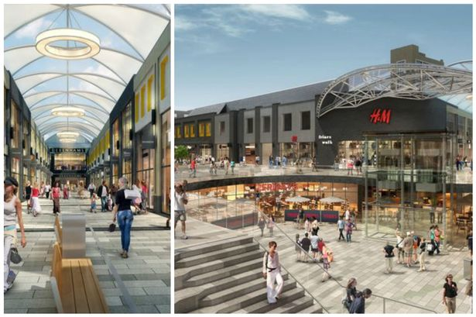
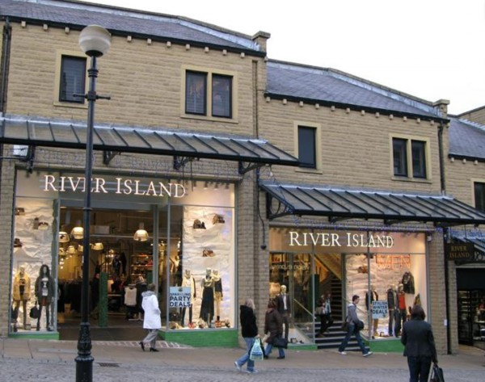
Anchor tenant example

Slide 15
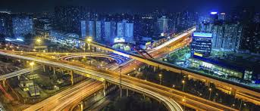
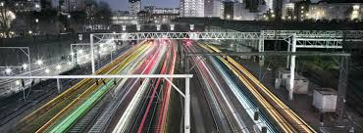
Infrastructure
The type and quality of infrastructure also affects access to markets. Infrastructure used to mean roads, rail and shipping. However, a more modern definition includes electronic communication systems, training agencies and financial services.
For many modern businesses, such as those that are e-commerce based or the rapidly growing call centre industry, quality infrastructure has a very different meaning from that understood by road hauliers and heavy goods manufacturers.

Slide 16
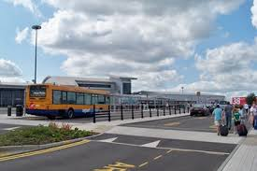
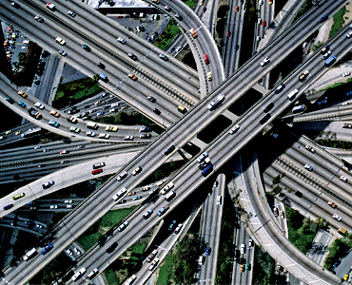
Infrastructure
In the UK there is a major imbalance in development between the South East and the rest of the country.
Improved infrastructure is being planned to resolve this problem but it is likely that this will be a very long-term solution.

Slide 17
Labour
The factor of production labour can also be a deciding factor in determining location. By labour we mean cost of labour, availability of labour, and the skills of labour.
Businesses can be attracted to certain areas by the skilled labour that may be available. For example, the aero technology workers in Coventry and Bristol, or the thriving community of software developers in Cambridge, linked to the university.

Slide 18
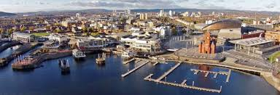
Cost of labour
Cardiff is rapidly developing a booming media industry which is attracting new international investors looking to recruit talented workers.
The cost of labour is also a determining factor. International location has a habit of following low-cost labour to wherever it is available.

Slide 19
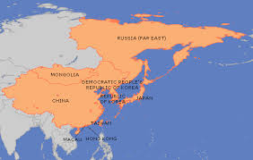
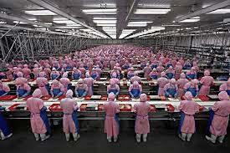
Cost of labour
Many UK manufacturing businesses have relocated to the Far East and China where labour costs are very low; although there is some evidence that this trend will be reversed as wage rates in these areas start to increase.

Slide 20
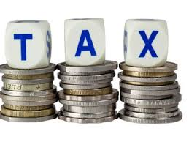
Government influences
The cost of labour can be affected by the availability of government grants, giving incentives to move to particular regions of a country, and by government taxation policies.
The availability of low cost and suitable land resources can also be an important factor when determining location.

Slide 21
Government influences
National governments, along with regional development agencies, often work hard to ensure that planning permission is available to allow large developments to proceed and they also offer incentives such as tax breaks and help with recruitment and training of workers.

Slide 22
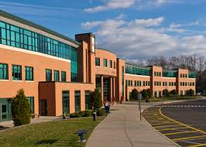
Social reasons
These too can also have an impact on location. Managers want to live in an environment that suits them and their families. They want leisure facilities, good schools, and low crime.
Alternatively managers can often retain a commitment to their existing workforce, even when it makes economic and business sense to relocate a business.

Slide 23
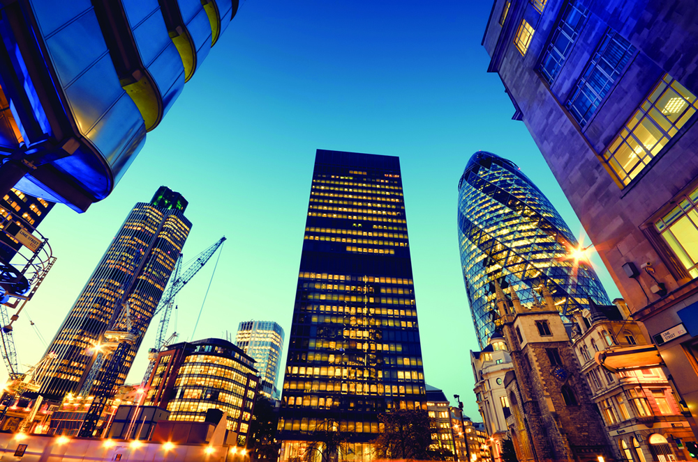
Increase choice of
international location
Footloose businesses are those that move from location to location, basing themselves wherever best suits their needs at a particular point in time:
• changing patterns of trade;
• improved communications;
• freer flows of capital.

Slide 24
International locations
All of the above mean that the largest businesses, though still influenced by the same factors that dictate national location of business, do have the alternative of locating their production facilities virtually anywhere in the world.
As long as there is a stable political background and an available workforce, most countries will offer the possibility of hosting a production (or even a remote service) base.

Slide 25
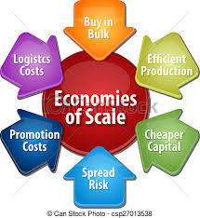
International – Economies of scale
The main influences on international location beyond politics and labour force factors are likely to be maximising economies of scale.
Economies of scale – The more you buy the cheaper
each individual part is.

Slide 26
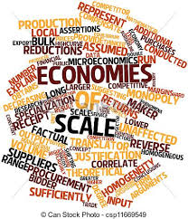
Location – Economies of scale
If businesses are able to have a single plant supplying all their requirements for a type of product or range of components, then the business’s average costs of production can fall.
Therefore there are huge factories
providing cakes to sell throughout
Europe, or producing injection-
moulded plastics for distribution
throughout the world.

Slide 27
Transport costs
The falling costs of international transport have allowed this to occur.
Back in the 1950s the final cost of selling imported goods included transport costs which made up around 25% of the selling price.
Through containerisation and
increased efficiency of systems
this proportion has fallen well below 5%.

Slide 28
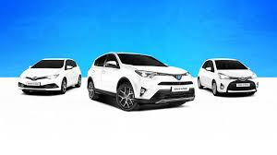
Political factors
Political factors can also have an influence on location.
Tariff and quota-free access to trading blocs such as the EU, or NAFTA (North American Free Trade Association) may depend on setting up a production facility within that trading bloc.
Far Eastern companies such as Toyota and Honda, wanting free access to European markets, have large production units in the UK today.

Slide 29
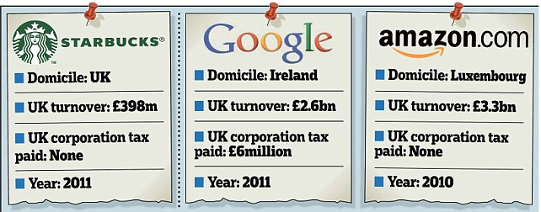
Transfer costing
Companies sometimes establish head office operations where taxation levels are lower than their home base.
This can allow transfer costing to take place.

Slide 30
Transfer costing
Transfer costing is a process by which businesses are able to inflate their profits in countries where taxation levels are relatively low, and decrease their profits where taxation levels are relatively high.
A number of companies, including Starbucks and Amazon, have hit the headlines recently for this sort of activity.

Slide 31
International wage difference
Comparative international wage levels also need to be considered when deciding on worldwide location.
High-tech industries can often choose from willing and skilled workforces from many different global locations.
One famous directory enquiry service answers enquiries in a Cardiff office during the day, and then switches between the hours of 10pm and 8am to an office in Manila.

Slide 32
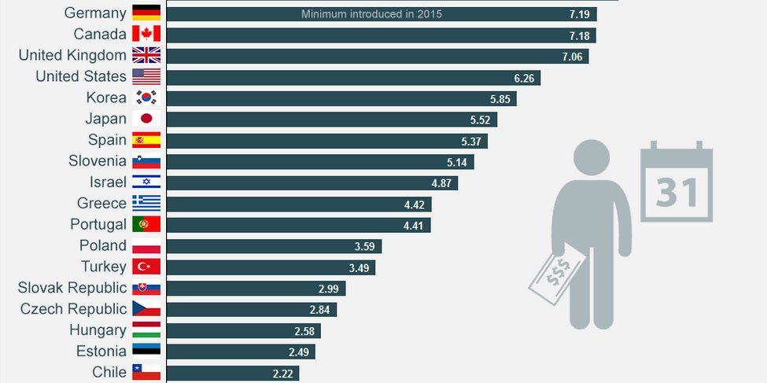

Slide 33
YouTube video
https://www.youtube.com/watch?v=vqbz49Hva_I

Slide 34
Activity 2
Task:
Your task is to read a business location article with the group.
Time : 15 mins

Slide 35
BREAK
15 mins

Slide 36
Activity 3
Task:
Complete a business location – Kahoot quiz.
Time: 15 mins

Slide 37
Activity 4
Task :
Location is key to business success – Written evaluation.
Time: 30 mins and 10 mins discussion.

Slide 38
Aims and objectives
Introduce the aims and objectives for the session.
Explain the factors that affect business location and give examples.
Show a YouTube video on business location.
Discuss in groups the Ikea location riots.
Evaluate the statement ‘location is key to business success’.
Present your evaluations to the class and question your peers.
Answer the revision questions on business locations.
Recap the aims and objectives for the session.

