Slide 1
Business finance
Introduce the aims and objectives for the session.
Define business finance and discuss the internal sources of finance.
Complete a written task on internal sources of finance.
Explain the external sources of finance.
Discuss the external sources of finance.
Show a YouTube video on external sources of finance.
Arrange the internal and external sources of finance.
cards and discuss with the class.
Describe each source of finance in a written task.
Discuss your evaluations with the class.
Recap the aims and objectives for the session.

Slide 2
Activity 1
Task:
A3 paper and pens
What sources of finance are available to businesses?
Time: 10 mins

Slide 3
Business finance
Businesses cannot survive without finance, whether in the form of initial funds to start the business, working capital to run the business day-to-day, or investment capital to help the business grow.
For a new business starting out it is unlikely that external forms of finance will be available. (9/10 fail)

Slide 4
Business finance
Apart from capital provided by the entrepreneur and friends and family, sources of finance are likely to be severely limited.
These new sole traders and microbusinesses are likely to continue to struggle to find external sources of finance until they establish an effective trading record.

Slide 5
Business finance
The most suitable finance option for a business depends on many things:
• how much funding is needed;
• the amount of time the money is required for;
• what the finance will be used for;
• the affordability of repayments;
• whether or not personal or business assets are available as security;
• whether or not the business owner is willing to give up a share of ownership, perhaps through taking on a partner or selling shares.

Slide 6
Sources of finance
There are two sources of finance available :
Internal sources of finance.
External sources of finance.

Slide 7
Internal sources of finance
Retained profit
Working capital
Sale of assets

Slide 8
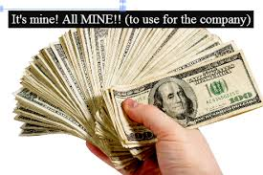
Retained profit
This is regarded as the single most important source of finance and is also the cheapest source of finance.
As a business becomes more profitable, it makes sense to build up and retain some profit (reserves).
This will provide a liquidity buffer
and potential funds for growth.

Slide 9
Reserves, reinvested profits, come with only one cost – the loss of profit distribution to owners.
Short-term pressures to pay profits to owners (normally shareholders) can, however, restrict the availability of this form of finance.

Slide 10
Working capital
By reducing their trade credit period and collecting debts more efficiently, a business may receive money from customers more quickly. However, this is likely to drive customers away (A04) and may have the opposite effect on making finance available.
Reducing stock holdings is another
way to release finance but a sudden
surge in demand could result in lost
Sales (A04) if the business is unable to
meet delivery dates.

Slide 11
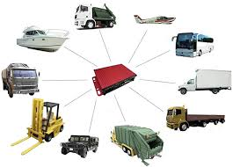
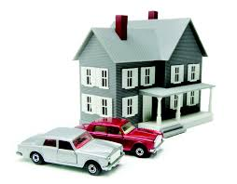
Sale of assets
Established businesses are able to sell off assets that are no longer required, such as buildings and machinery.
Smaller businesses are unlikely to have such unwanted assets and, if growth is an objective, they are much more likely to want to acquire assets as opposed to losing them.

Slide 12
Activity 2
Task:
Your task is to complete a written evaluation of internal sources
of finance.
Time: 20 mins

Slide 13
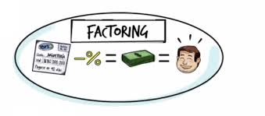
External sources of finance
Bank loans
Overdrafts
Trade credit
Factoring
Leasing and hire purchase

Slide 14
External sources of finance
Commercial mortgages
Sale and lease back
Share capital
Venture capitalists
Government assistance

Slide 15
Bank loans
Any new business will need a bank account, but it is unlikely that any bank will provide loan finance to a new start-up unless security is offered.
A loan is borrowing a fixed amount, for a fixed period of time, perhaps 3–5 years.

Slide 16
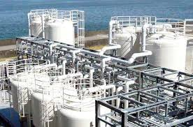
Bank loans
Payments made up of interest and capital are made monthly. Security, if available, will very often come in the form of property.
Offering security against a loan can make it much easier to get funding and reduces interest rates charged – but increases risk to personal assets (A04). If the business owner is not able to maintain payments, homes can be lost or business assets removed.

Slide 17
Overdrafts
As a business develops an effective trading record then an overdraft facility may be provided by the bank. An overdraft is the facility to withdraw more from an account than is in the bank account, resulting in a negative balance. Businesses often depend upon authorised overdrafts to provide working capital.
The nature of business often
means that money is paid out
on costs before revenue is received.
This leaves a funding deficit.

Slide 18
Overdrafts canceled
An overdraft is designed to cover this funding deficit and provide working capital. Unfortunately overdrafts can be withdrawn by a bank with just 30 days’ notice (A04).
This means a long-term dependency on an overdraft has dangers. The business relying upon an overdraft for day-to-day funds may find that with a withdrawal of the overdraft facility, they do not have money for paying bills, wages, suppliers etc.

Slide 19
Trade credit
This is an interest-free way to raise finance. Businesses buy items such as fuel and raw material and pay for them at a later date – possibly 30–90 days later.
Many suppliers today, however, offer discounts for early payment so delaying payment may result in higher costs (A04) in the long run. Businesses that take a long time to pay their bills also tend to gain a bad reputation in the marketplace.

Slide 20
BREAK
1 hour

Slide 21
YouTube video
Sources of finance
https://www.youtube.com/watch?v=c8hIwQ5xFY8

Slide 22
Factoring
An alternative to an overdraft is for a business to use a factoring service. Factoring is a method of turning invoices into cash. Banks and other financial organisations offer factoring services which pay a proportion of the value of an invoice (80–85%) when the invoice is issued.
The balance, minus a fee, is paid to the business when the invoice is paid. This flexible form of finance (A04) keeps pace with business growth as the funding is directly linked to the turnover of the company. The factor will also undertake all credit management and collections work.

Slide 23
Factoring
The use of this service results in savings in administration costs, which can be substantial, and faster customer payments means lower interest costs on any overdraft facility.
Bad debt protection can also
be built into the service. Factoring
services are only offered to
businesses with a good trading
record and reliable customers.
It is, however, an effective
alternative to an overdraft,
as the cost is generally lower.

Slide 24
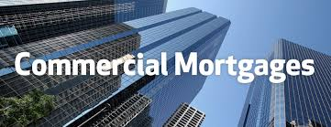
Commercial mortgage
If a business owns property a commercial mortgage may be available. With a commercial mortgage the property is used as security against the loan and the loan can be as much as 60 or 70% of the value of the property.
Because security is being offered to the lender, the interest rates will be lower than an unsecured loan (A04).

Slide 25
Commercial mortgage
Payments are made monthly for the term of the mortgage. Failure to make repayments may lead to the property being repossessed by the lender.
Commercial mortgages might run for 10 or 15 years so generally have predictable costs – this can be helpful with budgeting and predicting cash flow.

Slide 26
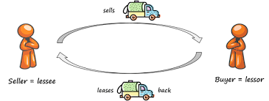
Sale and leaseback
Another asset-based method of raising funds for SMEs (small and medium-sized enterprises) is sale and leaseback.
Sale and leaseback involves the business selling assets (buildings, machinery) to a finance company and then leasing the asset back.

Slide 27
Sale and leaseback
This method of raising finance means that the capital that is produced can be reinvested into growing the business. This means that an asset owned by the business can be turned into capital for reinvestment in the business.
Sale and leaseback also carries potential tax benefits (A04) as the leasing costs are offset as an operating expense.

Slide 28
Government assistance
Although hard to come by, both local and central government may offer finance to business start-up schemes (Princes Trust Grants) qualifying criteria do tend to be quite narrow and businesses setting up in regions of high unemployment tend to be favoured.
The amounts available tend to be relatively small and are for a limited period of time.

Slide 29
Share capital
A long-term method of providing funds for growth is to sell shares. This means that the business may move from being a partnership or sole trader to becoming a limited company.
There are a number of advantages to being a limited company which include limited liability and reduction in risk for the owners. However, the main reason is to bring in new shareholders who invest capital for growth.

Slide 30
Share capital
Share capital is a form of permanent capital; this means it does not have to be repaid. Owners of shares have a say in how the business is run, but the amount of influence they have depends upon the percentage shareholding they own.
The major disadvantage of bringing in shareholders is of course loss of control (A04).

Slide 31
Share capital
The business owner or owners will have decisions influenced by new investors. Also the new shareholder investors may be looking for an exit strategy within a few years. This means that they are expecting the business to grow rapidly and then they expect to be able to sell their shares, taking their capital gain.

Slide 32
Share capital
This is the scenario often seen on Dragons’ Den, the BBC television programme. The question business owners have to answer is how much of a business is the owner willing to give up to gain the finance they need.
YouTube video – Dragons Den
https://www.youtube.com/watch?v=_QvguJJNilA

Slide 33
Venture capitalist
Venture capitalists are professional investors who can invest large amounts of capital into small and medium-sized businesses.
Venture capitalists and venture capital companies (who exist to invest into growing businesses), will not only take a shareholding but also expect to be fully involved in running the business.

Slide 34
Venture capitalist
They will take seats on the board and appoint managers and advisors to help generate success and growth. From the business owners’ point of view, all this input of skills and capital allows the business to grow at a speed that was previously impossible.
Some of the best-known internet businesses (Facebook, Google, Twitter) depended upon venture capital to fund growth. Venture capitalists are often quite happy to focus on growth for the short and medium term, with the expectation that profits will come later.

Slide 35
Activity 3
Task:
Match the internal and external sources of finance cards.
Time: 10 mins and 5 mins discussion

Slide 36
Activity 4
Task:
Sources of finance – Exam question.
Explain the external sources of finance.
Time: 30 mins

Slide 37
Sources of finance questions
What are the internal sources of finance ?
What is liquidity?
What is working capital ?
Explain each internal source of finance as a group.

Slide 38
Sources of finance questions
What are the external sources of finance ?
Explain each source of finance.
What is the most likely form of security for a bank loan?
What is the main disadvantage of an overdraft ?

Slide 39
Sources of finance
What is factoring ?
What is an advantage of factoring ?
What is a lease or higher purchase?
What is a disadvantage of factoring?
What is sale and leaseback?

Slide 40
Business finance questions
What is share capital ?
What is the most common form of share capital?
What is a venture capitalist?

Slide 41
Activity 2
Task:
Your task is to complete a Kahoot quiz on business finance.
Time: 15 mins

Slide 42
Dragons Den pitches – H/W
https://www.youtube.com/watch?v=OzH3MuxGVls – ProWaste
https://www.youtube.com/watch?v=kzcQtXA5Gc8 – Hungry House
https://www.youtube.com/watch?v=s8d5wxGEGc8 – Zapper

Slide 43
Business finance
Introduce the aims and objectives for the session.
Define business finance and discuss the internal sources of finance.
Complete a written task on internal sources of finance.
Explain the external sources of finance.
Discuss the external sources of finance.
Show a YouTube video on external sources of finance.
Arrange the internal and external sources of finance
cards and discuss with the class.
Describe each source of finance in a written task.
Discuss your evaluations with the class.
Recap the aims and objectives for the session.

