Slide 1
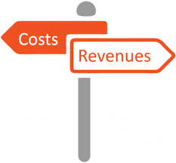
Aims and objectives
Introduce the aims and objectives for the session.
Discuss in groups, what is fixed and variable costs.
Define revenue and profit and discuss importance.
Calculate the revenue and profit using two examples.
Explain fixed and variable costs and give examples of each.
Show a YouTube video on fixed and variable costs.
Calculate the revenue and profit for Pizza Hut and McDonalds.
Explain the difference between direct costs and overheads.
Calculate, fixed and variable costs, revenue and profit.
Arrange the fixed, variable, direct and overhead cost cards.
Recap the aims and objectives for the session.

Slide 2
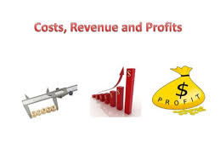
Activity 1
Task:
What is revenue ?
What is fixed costs?
What is variable costs?

Slide 3
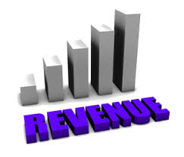
Revenue
Revenue is the money a business makes from sales.
In other words, it is the value of the sales and is also referred to as turnover. The total amount of money a business receives from its sales is called total revenue.
Total revenue = quantity sold x selling price

Slide 4
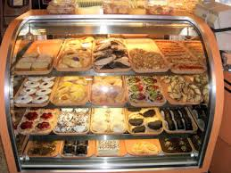
Activity 2
Total revenue = quantity sold x selling price
Jersey Bakery has sold a total of 100 cakes this week,
50 last week and 75 the week before.
These cakes were sold for a selling price of £10
Total revenue = (100+75+50) x 10
Total revenue = 225 x 10
Total revenue = £2,250

Slide 5
Profit
By calculating the total revenue a business can then work out if they have made a profit or a loss.
Profit = total revenue – total costs
Of course, all businesses want to make a profit. However, if total costs are greater than total revenue then the business will make a loss.

Slide 6
Activity 3
Profit = total revenue – total costs
Jersey bakery has a total revenue of £2,250 and has total
costs of £900.
Profit = 2,250 – 900
Profit = £1350

Slide 7
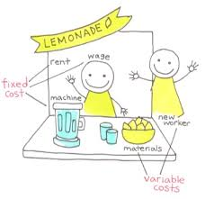

Slide 8
Fixed costs
In every business some costs will remain the same whatever the level of output produced or products sold.
For Example:
For a shop, even if no customers visit, the rent or mortgage will have to be paid. There will still be business rates to pay, and the electricity for lighting, fridges etc. will still have to be paid.

Slide 9
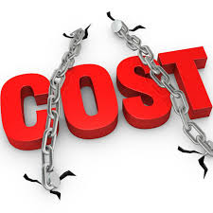
Fixed costs
An ice cream salesman in his van will have to pay insurance and road tax even if no ice creams are sold.
These are all fixed costs.
Fixed costs are costs that do not vary with output. No matter how much is made or how little is sold, fixed costs still have to be paid.

Slide 10
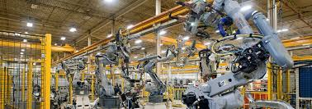
Fixed costs examples
Depreciation – Car, Van, machinery.
Insurance – Car, building.
Marketing - Expenses.
Machinery - Purchases / hire.
Utilities – Gas, electric, water
Rent – On factories.
Salaries – Fixed monthly / yearly wage.

Slide 11
Variable costs
Variable costs behave quite differently from fixed costs. Variable costs vary in direct proportion to output – as output increases variable costs increase, as output falls variable costs fall.
Using the example of a tailor’s shop,
variable costs would include cloth,
cotton, buttons etc. None of these
raw materials of the suits or dresses
made would be used if no goods
were produced. So when output or
sales are nil, then variable costs are nil.

Slide 12
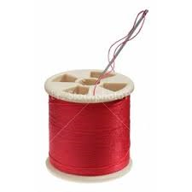
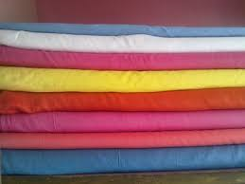
Variable costs
However, as soon as output starts, then these raw materials start being used. As more and more suits and dresses are made, so more and more cloth, buttons and cotton are used. We can therefore say that at output zero, variable costs are zero; but as output increases variable costs also rise.

Slide 13
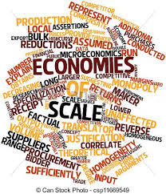
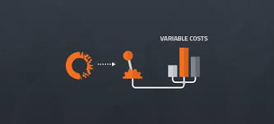
Variable costs
We assume that there is a constant relationship between output and variable costs, but in most cases this constant relationship does not hold true.
Businesses who produce more often benefit from purchasing economies of scale, so as output increases variable costs per unit produced start to fall.

Slide 14
Variable cost examples
Direct materials. The most purely variable cost of all, these are the raw materials that go into a product.
Piece rate labour
Raw materials
Staff wages.
Credit card fees

Slide 15
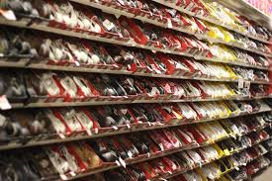
Example 1 :
Shoes Galore makes designer shoes. And is struggling calculating
Fixed and variable costs you have been called into help.
Marketing : £750
Raw materials : £50 per item
Rent for unit: £1,500
Machinery hire: £1,000
Complete this on your own.

Slide 16
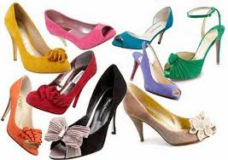
Example 1 :
Variable costs :
Raw materials : £50 per item
Total: £50 per item
Fixed costs
Marketing : £750
Rent for unit: £1,500
Machinery hire: £1,000
Total : £3,250

Slide 17
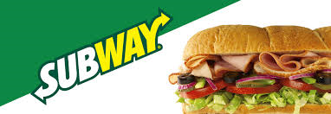
Example 2:
Subway Neath is struggling calculating fixed and variable costs you have been called into help.
Staffs wages: £7,500
Rent for unit: £3,500
Machinery hire: £2,000
Marketing: £550
Complete this on your own.

Slide 18
Example 2 :
Variable costs :
Staffs wages: £7,500
Total: £7,500
Fixed costs
Rent for unit: £3,500
Machinery hire: £2,000
Marketing: £550
Total fixed costs = £6,050

Slide 19
Total costs
Total costs are found by adding together fixed costs and variable costs. At every level of output (apart from nil), a business’s costs will be a combination of fixed and variable costs – the two added together make total costs.
Total cost = Fixed costs x variable costs

Slide 20
Fixed costs = Total cost
At zero output the business only has fixed costs, there are no variable costs.
So at zero output, fixed costs = total costs. However, once the business starts production or starts making sales then total costs will be made up of fixed and variable costs.

Slide 21
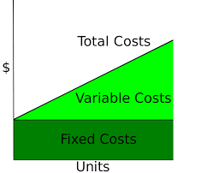
Fixed and variable costs
https://www.youtube.com/watch?v=WPCu-s-heio

Slide 22
Total cost example
Fixed costs
Salaries - £1,000
Depreciation - £500
Car insurance - £500
Total fixed costs - £2,000
Variable cost
Production supplies - £500
Staff wages - £400
Total variable costs - £900
Total cost = Fixed costs + variable costs
Total cost = 2,000 + 900
Total cost = 2,900

Slide 23
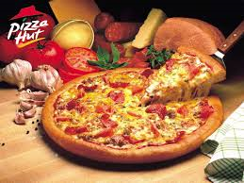
Activity 4 – Total revenue
Pizza Hut Neath
Total revenue = quantity sold x selling price
Pizza Hut Neath has sold 1000 pizzas this week
At an average selling price of £10.50.
What is the total revenue ?

Slide 24
Activity 5 – Profit
Pizza Hut Neath
Profit = total revenue – total costs
Pizza Hut Neath has a total revenue of £10,500 and has total
costs of £2,250.
What is the profit ?

Slide 25
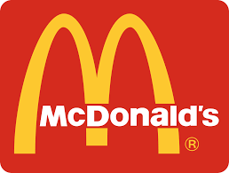
Activity 6 – Total revenue
McDonalds Britton Ferry
Total revenue = quantity sold x selling price
McDonalds Britton Ferry has sold 25,150 meals this week
And average selling price of £5
What is the total revenue ?

Slide 26
Activity 7 – Profit
McDonalds Britton Ferry
Profit = total revenue – total costs
McDonalds Britton Ferry has a total revenue of £125,750 and has total costs of £36,750
What is the profit ?

Slide 27
Costs – Direct or overheads
It is important for managers to be able to judge profitability. Without information on profitability, or lack of profitability, effective decisions cannot be made.
To enable these decisions to be made businesses must have a method of allocating costs to each product, department, branch or factory.
One method of implementing this cost allocation is to divide a business’s costs into direct costs and overheads.

Slide 28
Direct costs
Direct costs are costs that arise specifically from the production of a product or the provision of a service.
Examples of direct costs include:
• rent on a shop;
• materials or components;
• direct labour;
• expenses such as copyright payments on a published book, or licence fees for use of patents.

Slide 29
Direct costs
These direct costs can be totalled to give the direct costs of producing the product.
However, revenue minus direct costs does not indicate profitability. The business must also apportion overheads or indirect costs to the product.

Slide 30
Indirect costs (Overheads)
The production of any product results in a business paying costs not directly related to production or service provision.
For example, a factory producing 10 different goods, will have 10 to managers in charge of each product, and will employ a secretary or receptionist for each manager.
The overhead cost of employing the secretary or receptionist needs to be apportioned or allocated to the products to gain a picture of true profitability.

Slide 31
Overheads
Overhead expenses include:
Accounting fees, advertising, insurance, interest, rent, repairs, supplies, taxes, telephone bills, travel expenditures, and utilities.
There are essentially two types of business overhead - Administrative overheads and manufacturing overheads.

Slide 32
Overheads
For retailers, advertising is an overhead;
The cost of advertising should be shared out amongst retail outlets to better judge profitability. So the true profitability of a product, factory, outlet etc. can only be judged if we take from revenue both direct costs and overheads.
Overheads are therefore costs not directly related to production.

Slide 33
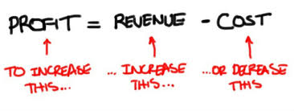
Activity 8
Task:
Your task Is complete the written task scenario
Time : 20 mins

Slide 34
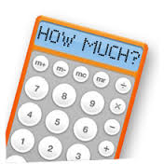
Activity 9
Task:
Arrange the fixed and variable cost cards.
Direct costs and overheads
Time: 10 mins

Slide 35
Aims and objectives
Introduce the aims and objectives for the session.
Discuss in groups, what is fixed and variable costs.
Define revenue and profit and discuss importance.
Calculate the revenue and profit using two examples.
Explain fixed and variable costs and give examples of each.
Show a YouTube video on fixed and variable costs.
Calculate the revenue and profit for Pizza Hut and McDonalds.
Explain the difference between direct costs and overheads.
Calculate, fixed and variable costs, revenue and profit.
Arrange the fixed, variable, direct and overhead cost cards.
Recap the aims and objectives for the session.

