Slide 1
Aims and objectives
Introduce the aims and objectives for the session.
In groups define fixed, variable costs and revenue using
show me boards.
Explain break even analysis and give examples of its importance.
Discuss how to calculate break even and explain methods.
Calculate the breakeven point and explain the methods.
Discuss your calculations with the class.
Complete a Kahoot quiz on Break even formulas.
Calculate profit and loss and the breakeven point using two examples.
Discuss your break even, profit and loss findings with the class.
Answer the breakeven revision questions.
Recap the aims and objectives for the session.

Slide 2
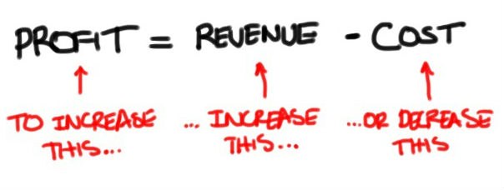
Activity 1
Task:
What are fixed/ variable costs?
What is revenue and what is profit formulas?
Show me boards.
Time: 10 mins

Slide 3
Break even
Reach a point in a business venture when the profits are equal to the costs.

Slide 4
Break even analysis
To gain an understanding of calculating break-even we will use the example of a young entrepreneur wishing to start up a business delivering packages of fruit and veg.
He knows that the last local shop in his area closed last year. Sensibly, he has carried out market research which indicates that there will be a good level of demand, but before he begins he needs to know how profitable the business might be. He has also fully researched the costs of starting up as a deliveryman and the costs of purchasing supplies.

Slide 5
Fruit and veg shop example
The costs he has researched are as follows:
• cost of delivery van purchase £6000;
• insurance and road tax £100 per month;
• petrol £10.00 per day;
• average cost of fruit and veg box £5.00;
• Salaries - £1150 per month;
• loan repayment £500 per month for twelve months.

Slide 6
Break even – Fruit and veg
His market research indicates that the fruit and veg boxes will have an average sales price of £9.00.
The question then is how many boxes will he need to sell to cover all his costs, i.e. to break even?
He decides to calculate break-even on a monthly basis.

Slide 7
Break even point
Fixed costs
Loan - £500 per month
Petrol costs - £250 per month
Insurance/road tax - £100 per month
Salaries - £1150 per month
Total fixed costs - £2000 per month
Variable costs
£5.00 per box
Sales revenue
£9.00 per box

Slide 8
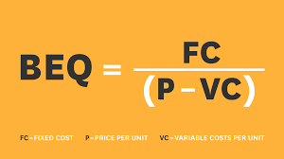
BE – Contribution method
Calculating break-even point using the contribution method.
Once we have calculated costs, the next step in calculating break-even output or sales is finding out how much contribution each item sold produces for the business.

Slide 9
Contribution per unit
Every product made has a variable cost and a selling price (which must obviously be higher).
The difference between the selling price per unit and the variable cost per unit is known as the CONTRIBUTION towards covering the business’s fixed costs.

Slide 10
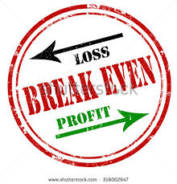
Break even output example
There is a simple formula for calculating break-even output.
Break-even output = Fixed costs
Contribution per unit.
Contribution per unit = Selling price – Variable costs (per unit)

Slide 11
Break even point - fruit and veg
Break-even output = Fixed costs
Contribution per unit.
Contribution per unit = Selling price – Variable costs (per unit)
Break even in units = £2,000
£9 - £5
Break even in units = £2,000 / 4
Break even in units = 500 boxes

Slide 12
Profit and loss
We can now see that to break even our deliveryman must sell 500 fruit and veg boxes per month.
• If he sells more than 500 boxes he will make a profit.
• If he sells less than 500 boxes he will make a loss.
At break-even point the
total contribution equals
the total fixed costs.

Slide 13
Calculating profit and loss
Break-even analysis also allows us to calculate the profit or loss a business will make at different levels of output.
This will always be important – after all our grocery seller may wish to go into business only if his profits are likely to be at a certain level.
First of all calculate the
break-even output, in the
above case we know it is
500 boxes per month.

Slide 14
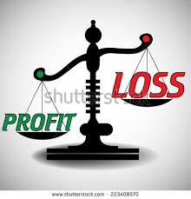
Profit and loss calculation
As a result of his market research he believes that he can sell 650 boxes a month.
He now wants to know what his profit will be at that level of sales. To find out how much profit will be made, we again use the idea of contribution.

Slide 15
Profit per sales
In this case predicted sales are 650. Break-even sales are 500.
Profit per sales = Predicted sales – Break even sales x Contribution per unit
Profit per sales = 650 – 500 x £4
Profit per sales = 150 x £4
Profit per sales = £600
His profits per month on sales of 650 boxes will be £600.

Slide 16
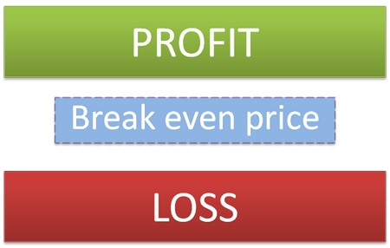
YouTube video – Break even point
https://www.youtube.com/watch?v=ZihWEVWCJYk

Slide 17
Activity 2
Task:
Calculate the break even point of an example.
Time: 15 mins an 5 mins discussion

Slide 18
BREAK
15 mins

Slide 19
Activity 3
Task:
Break even Kahoot quiz.
Time: 10 mins

Slide 20
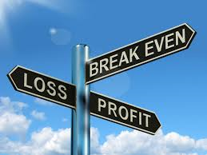
Activity 4
Task:
Calculate Breakeven point of two scenarios.
Time: 30 mins and 5 mins discussion

Slide 21
Break even point questions?
What is the break even point?
What is the break even point formula – Draw on board.
Calculate the break even point when fixed costs are £1,000, variable
Costs are £3.00 per unit and the selling price is £13.00 per unit.
4) How can you calculate profit by using break even?
5) Calculate the profit made if 150 units were sold?

Slide 22
Aims and objectives
Introduce the aims and objectives for the session.
In groups define fixed, variable costs and revenue using
show me boards.
Explain break even analysis and give examples of its importance.
Discuss how to calculate break even and explain methods.
Calculate the breakeven point and explain the methods.
Discuss your calculations with the class.
Complete a Kahoot quiz on Break even formulas.
Calculate profit and loss and the breakeven point using two examples.
Discuss your break even, profit and loss findings with the class.
Answer the breakeven revision questions.
Recap the aims and objectives for the session.

