Slide 1
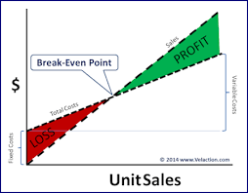
Aims and objectives
Introduce the aims and objectives for the session.
Explain how to draw a break even graph by using a new example.
Calculate the break even point and draw a new graph.
Show a YouTube video on break even.
Answer the break even quiz questions.
Calculate the break even point and express this on a graph using a new example.
Recap the aims and objectives for the session.

Slide 2
Break even scenario example
Claire’s Hairdressers
1) You are required to calculate the breakeven point for the example below and express this on a graph (10)

Slide 3
Claire's hairdressers financials
The costs he has researched are as follows:
Insurance and road tax - £450 per month;
Van rental - £500 per month,
Utility bills - £1,000 per month
Average cost of each item £5.00;
Salaries - £1,800 per month;
loan repayment £1,000 per month for twelve months.
Rent for the shop - £750 per month
His market research indicates that each item will have an average sales price of £15.00.

Slide 4
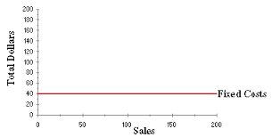
Fixed costs calculation
Fixed costs
Insurance and road tax £450 per month;
Van rental - £500 per month,
Utility bills - £1,000 per month
Salaries - £1,800 per month;
loan repayment £1,000 per month for twelve months.
Rent for the shop - £750 per month
Total fixed costs - £5,500

Slide 5
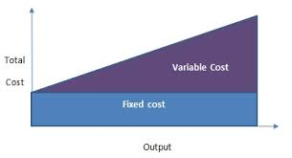
Variable costs and sales revenue
Variable costs
Average cost of each item £10.00;
Total Variable costs - £5.00 per item
Sales revenue
£15 per item

Slide 6
Break even formula
Break-even output = Fixed costs
Contribution per unit.
Contribution per unit = Selling price – Variable costs (per unit)

Slide 7
Break even calculation
Break even in units = £5,500
£15 - £5
Break even in units = £5,500 / 10
Break even in units = 550 items

Slide 8
BE graph calculations
Fixed costs
Plot horizontal on graph
£5,500

Slide 9
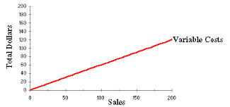
Variable costs
Plot vertical on graph
Number of units x variable costs
= Variable cost per number of units
Point 1 – Zero
Point 2 - 800 = 800 x 5 = 8,000
Point 3 – 1,200 = 1,200 x 5 = 12,000

Slide 10
Total costs
Plot vertical on graph
Total costs = Fixed costs + variable costs at selected number of units
Point 1 – Fixed costs
Point 2 – Units – 800 = 5,500 + (800 x 5) = £9,500
Point 3 – Units – 1,200 = 5,500 + (1,200 x 5) = £11,500

Slide 11
Revenue
Plot vertical on graph – Why?
Revenue = quantity sold x selling price
Point 1 – Zero
Point 2 - 800 x 15 = £12,000
Point 3 – 1,200 x 15 = £18,000

Slide 12
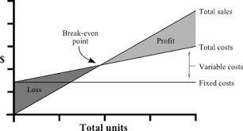
Break even point
Breakeven point - Where profit line and total costs line intersect.
Plot and join up revenue and output.
NOTE : Make sure each are in correct place.
TIP : PLOT DOTS ON GRAPH FIRST TO MAKE SURE LINES UP

Slide 13
Draw break even graph
Draw Break even graph on board and in books.

Slide 14
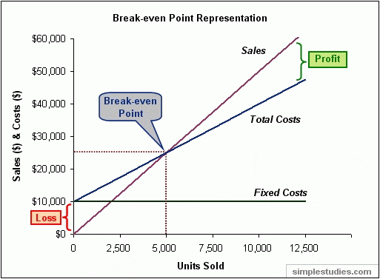
Activity 5
Task:
Calculate the breakeven point.
Draw a break even graph.
Calculate the profit and loss.
Time: 30 mins and 5 mins discussion.

Slide 15
YouTube video
https://www.youtube.com/watch?v=TLOo2mY6FIw

Slide 16
Activity 6
Task:
Break even quiz questions
Time: 15 mins

Slide 17
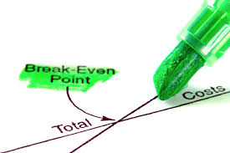
Activity 7
Task:
Calculate the breakeven point.
Draw a break even graph.
Calculate the profit and loss.
30 mins and 5 mins discussion.

Slide 18
Break even graph questions
What is the break even formula?
The break even is point is when lines ………………………… cross ?
The horizontal axis are marked?
The vertical axis are marked?
The Fixed costs line is ? Why?

Slide 19
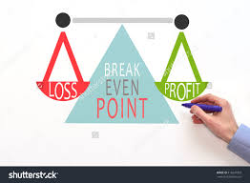
6) The Variable cost line is ? Why?
7) The total cost line starts from ? Why ?
8) The revenue line starts from ?
9) The break even point is marked where on the graph?
10) Why is it important to always give your graph a heading?

Slide 20
Aims and objectives
Introduce the aims and objectives for the session.
Explain how to draw a break even graph by using a new example.
Calculate the break even point and draw a new graph.
Show a YouTube video on break even.
Answer the break even quiz questions.
Calculate the break even point and express this on a graph using a new example.
Recap the aims and objectives for the session.

