Slide 1
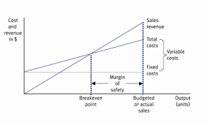
Break even – Margin of safety
Lesson Objectives:
Introduce the aims and objectives for the session.
Explain the margin of safety and calculate margin of safety.
Express the margin of safety on chosen graphs.
Calculate changes in revenue and total costs.
Calculate changes in revenue and total costs using
your break even graphs.
Discuss your answers as a group.
Recap the aims and objectives for the session.

Slide 2
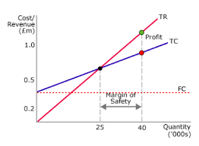
The margin of safety
A business’s margin of safety is the difference between output level and break-even output, when output is above break-even.
So if output is 900 units and break-even is 500 units, then the margin of safety is 400 units.
The margin of safety indicates
the amount by which demand
can fall before a business
incurs losses.

Slide 3
Margin of safety
The margin of safety can be identified on the break-even chart by measuring the difference between the break-even point and the actual level of output.
Businesses will want to ensure that they have a healthy margin of safety just in case an unexpected drop in sales affects their business.
A small margin of safety
could put the business at
risk if they experience a drop in sales.

Slide 4
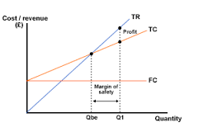
Margin of safety example
Draw Break even graph (Fruit and veg example)
Fixed costs - £2,000
Sales - £1,000 - £10,000
Output – 100 - 1000
Variable costs, revenue and total costs lines.
Expected sales – 1,000 and Break even 500 and selling price £9

Slide 5
Margin of safety example
Time: 5 mins

Slide 6
Activity 1
Task:
Draw the margin of safety on your Break even graphs :
Claire's Hairdressers - Expected sales – 1,000 units per month
Pizza Paradise – Expected sales – 800 units per month
Time: 10 mins

Slide 7
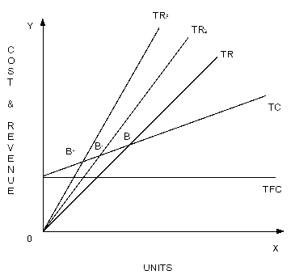
Changes in costs and revenues
Costs and revenues are not fixed, and a break-even chart can be used to show the effect of an increase or drop in revenue and/or costs on the profitability of a business.

Slide 8
An increase in the price of the boxes of fruit and veg from £9 to £11 will change the total revenue line (Revenue 2), it becomes steeper and will cut the total cost line sooner, resulting in break-even at a lower level of output.
If the price was reduced then the opposite would happen and the break-even point would be at a higher level of output.

Slide 9
Changes in revenue example
Show how this affects graph on board.
Time: 5 mins

Slide 10
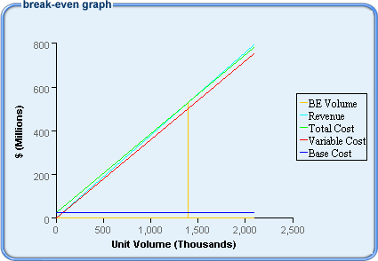
Changes in total costs
An increase in the variable cost will change the total cost line (Total costs 2).
It becomes slightly steeper and will cut the revenue line at a higher output level, resulting in break-even at a higher level of output.
If the costs were reduced
then the opposite would happen.

Slide 11
Changes in total costs example
Show how this affects graph on board.
Time: 5 mins

Slide 12
Activity 2
Task:
Calculate and draw what happens when revenue rises and total costs rise.
Using Claire’s hairdressers example.
Time: 15 mins

Slide 13
Break even – Margin of safety
Lesson Objectives:
Introduce the aims and objectives for the session.
Explain the margin of safety and calculate margin of safety.
Express the margin of safety on chosen graphs.
Calculate changes in revenue and total costs.
Calculate changes in revenue and total costs using
your break even graphs.
Discuss your answers as a group.
Recap the aims and objectives for the session.

