Slide 1
Business functions
Introduce the aims and objectives for the session.
Read unit 2 handbook.
Explain to the group, what functional departments exist.
Discuss the various functional departments in an organisation.
Express the objectives of various functional departments.
Show a YouTube video on Functional departments.
Answer functional departments quiz and Kahoot quiz questions.
Complete a written past paper question on functional departments.
Discuss your answers with the group.
Read a functional department case study example.
Recap the aims and objectives for the session.

Slide 2
Activity 1
Task:
Read unit 2 handbook
Time: 10 mins

Slide 3
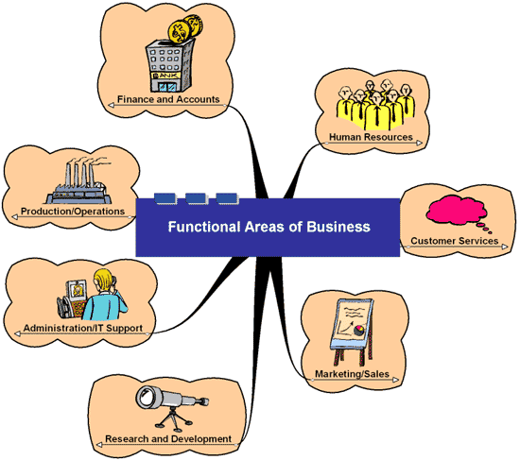
Activity 2
Task:
What functional departments exist?
Time: 5 mins

Slide 4
Functional departments
When a business has a traditional hierarchical structure, it will be typically structured by functional departments i.e. departments with clearly defined roles and responsibilities.
This division into functional departments helps with communication as people know who to speak to if a problem arises. It also helps workers understand their roles and how the business works, setting out the responsibilities of each part of the business.

Slide 5
Functional departments
Although departments are separate from each other, their roles are connected.
For example:
The human resources department is responsible for making sure that the other departments have enough workers with the right skills; the finance department ensures that there is money available to carry out activities across all departments.

Slide 6
Functional departments
Marketing works with production by providing information about the products that customers want, whilst purchasing has the job of making sure that there are enough materials for production to manufacture.

Slide 7
Functional areas
In most large companies the functional areas are as follows:
•Marketing (Sales and Marketing);
•Human Resources (Personnel);
•Finance (Accounts);
•Operations (Production).

Slide 8
Functional departments
They may vary in name but essentially they carry out the same functions.
Depending on the type of business, there may be a range of other functional departments which specialise in performing a particular type of task.

Slide 9
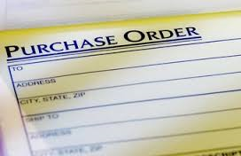
Specialist departments
Typical examples are:
•Legal Department;
•Transport Department;
•Purchasing Department;
•Design Department;
•Technical Department.

Slide 10
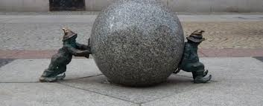
Functional objectives
These are the goals of each of the functional departments and if a business is to be successful then these objectives must be closely tied to the corporate objectives.
For example, if the marketing department sets itself a goal of achieving 10% more sales over the next year, whilst the human resources department is seeking to reduce staffing by 5% across the company in the same period, then they are likely to be working against each other.

Slide 11
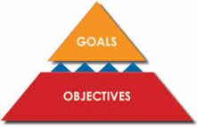
Functional objectives
Goals must be carefully coordinated to ensure that they are consistent with the corporate objectives – in other words, all departments are working together to achieve the same overall objectives of the organisation.

Slide 12
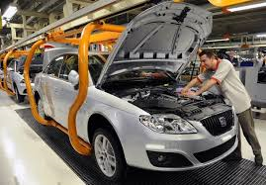
Functional objectives
Depending on the nature of the organisation in question, some departments are likely to be much larger than others.
For example:
In a car manufacturing business, operations management is likely to employ the majority of the workforce. Nonetheless, the other functional departments are essential to the success of the business.

Slide 13
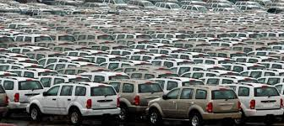
Functional objectives
No matter how efficiently the production line is run, there is no point in producing thousands of cars per week if the sales and marketing department have not persuaded enough potential customers to purchase them.
All functional departments
must work in conjunction
with one another in order
to achieve a common set
of objectives set out in
the corporate plan.

Slide 14
YouTube video
Functional departments
https://www.youtube.com/watch?v=9tcC3oOTUMI

Slide 15
Activity 3
Task:
Functional departments quiz questions
Time: 10 mins

Slide 16
Activity 4
Task:
Functional departments Kahoot quiz
Time: 10 mins

Slide 17
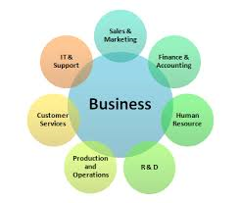
Activity 5
Functional departments written task
‘Why would functions differ per business’
‘Business functions have to work together to achieve objectives’
Time: 30 mins

Slide 18
Activity 6
Task:
Group discussion of findings
Time: 10 mins

Slide 19
Activity 7
Task:
Functional departments case study
Time: 15 mins

Slide 20
Business functions
Introduce the aims and objectives for the session.
Read unit 2 handbook.
Explain to the group, what functional departments exist.
Discuss the various functional departments in an organisation.
Express the objectives of various functional departments.
Show a YouTube video on Functional departments.
Answer functional departments quiz and Kahoot quiz questions.
Complete a written past paper question on functional departments.
Discuss your answers with the group.
Read a functional department case study example.
Recap the aims and objectives for the session.

