Slide 1
Marketing mix – 4ps
Introduce the aims and objectives for the session.
Discuss, what is marketing in groups.
Explain marketing and give examples.
Complete a written description of marketing.
Discuss market orientation, product and asset lead marketing.
Show a YouTube video on market orientation, product and asset lead marketing.
Complete a marketing Kahoot quiz.
Undertake a written analysis of market orientation, product and asset lead marketing.
Recap the aims and objectives for the session.

Slide 2
Activity 1
Task:
What is marketing?
What are the 4Ps of marketing?
Time: 10 mins

Slide 3
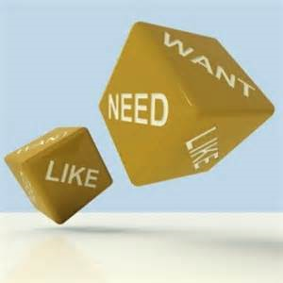
Marketing defined
‘Marketing is the management process involved in identifying, anticipating and satisfying customer requirements profitably.’
Source: The Institute of Marketing.

Slide 4
Marketing definitions
There are many different definitions of marketing but it must be remembered that marketing is not simply about advertising and selling. Any definitions that imply this are incorrect.
Marketing affects all aspects of a business and can be regarded as a philosophy – a way of thinking about how to satisfy customers’ needs and wants. It is an ongoing process and businesses must be prepared to respond to any changes that take place which impact upon the market in which they operate.

Slide 5
Marketing activities
•Researching the market – this involves gathering and analysing information on consumers, the marketplace and competition.
•Analysing the market – this is an examination
of market conditions to identify new opportunities.
•Setting of marketing goals – these must be linked to the business’s overall objectives.
•Developing a marketing strategy – this
involves constructing a plan which details
how the marketing objectives can be
achieved.

Slide 6
Marketing mix – 4Ps
This strategy should be based around the use of the marketing mix, the4Ps of marketing:
•product;
•price;
•promotion;
•place.

Slide 7
Marketing activities
Marketing involves a whole range of activities, starting with researching the market and setting objectives.
It also includes developing new products, designing packaging, establishing the right marketing mix, etc.

Slide 8
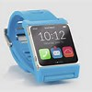
Marketing activities
All these activities are aimed at providing goods and services which will satisfy the customer and at making a profit for the business.
The better the marketing, the more desirable (or desired) the product or service which is provided for the customer and the more profits the business should be able to make.

Slide 9
YouTube video’s
Marketing examples:
Red Bull space jump:
https://www.youtube.com/watch?v=FHtvDA0W34I
Buster the Boxer:
https://www.youtube.com/watch?v=4qo27xcVS5I
Mogs Christmas Calamity:
https://www.youtube.com/watch?v=kuRn2S7iPNU

Slide 10
Activity 2
Task:
Marketing description – written task
Time: 20 mins

Slide 11
Types of markets
Businesses need to be aware of the type of market they operate in. The strict definition of a market is ‘a place where buyers and sellers meet’.
This meeting does not have to be physical; it can, for example, be on the phone or over the internet. The actual marketplace of a business can be small, local markets with a specific location.

Slide 12
Types of markets
Other markets are national or international with no single location.
For example:
The world market for oil is a global market in which buyers and sellers are linked by telephones, faxes and the internet, and trading takes place in many locations.

Slide 13
Types of marketing
Market orientation
When a business bases its marketing mix on its perception of what the market wants.
Product orientation
When a business bases its marketing mix
on what the business sees as its internal strengths.
Asset lead orientation
When marketing decisions are based on the needs of the consumer and the strengths of the business.
Q – Which is the best?

Slide 14
Market orientated
When a business is market-orientated, the business’s marketing activities will be dictated by the market.
It will at all times attempt to meet the needs of the market with little if any reference to internal strengths of the business. Any business that is market-orientated thinks that its most important ‘asset’ is its customers.
The business believes that, as long as it is able to identify potential customers, find out what they want, and then produce that for them, it will remain successful.

Slide 15
Advantages (A04)
New products designed to meet customer needs
Decisions based on effective market research
Flexible to changes in taste and fashion

Slide 16
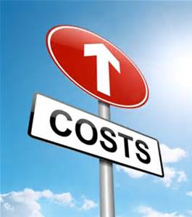
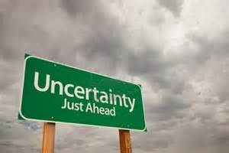
Disadvantages (A04)
• high cost of market research to understand the market;
• constant internal change as the needs of the market are met;
• unpredictability of the future, especially from the point of view of staff;
• abandonment of earlier product investment.

Slide 17
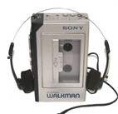
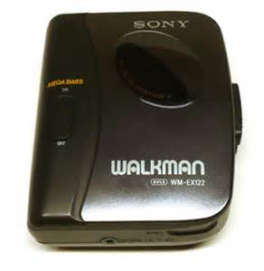
Product orientated
When a business is product-orientated, it will base its products or services on what it perceives as its internal strengths.
Businesses with a product-orientated approach to selling try to sell whatever they can make, without trying to find out if it is what the customers want. Sony grew hugely successful using this policy. The clearest example was the Walkman cassette player, launched in the late 1970s.

Slide 18
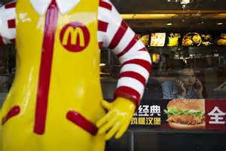
Product orientated
Marketing professionals said it would not sell because it had no recording facility – a generation of teenagers proved them wrong.
McDonald’s approach with its products is heavily product-orientated, with core products produced the same way in a range of very different international markets. The initial focus is on developing and making the product then trying to sell it to consumers.

Slide 19
Advantages (A04)
Focus on product development
Increased economies of sale
Easier to apply production management methods
Focus on quality

Slide 20
Disadvantages (A04)
• Changes in market structure will not be responded to;
• fashion and taste are not accounted for in the product mix.

Slide 21
Asset lead marketing
The perfect situation is of course for a business to relate customer taste to the business’s own strengths.
Therefore, a business should find out what the market wants, and then ask the question:
‘How using our skills, knowledge, assets and brands, can we meet these customer needs?’

Slide 22
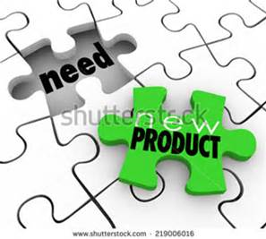
Asset lead marketing
Asset-led marketing tries to achieve this – the key word here is ‘led’.
Assets such as labour force skills, management skills, patents, recognised brands or capital, should be used to help satisfy consumer demand.
Identify what you are good at and relate this to customer needs.

Slide 23
Asset lead marketing
This relating of internal strengths to market needs should be one of the basic rules of any business’s marketing strategy as this approach focuses on the most appropriate opportunities, given the business’s assets.
How to effectively combine these two factors (internal strength and market needs) can be demonstrated by examining the use of database marketing.

Slide 24
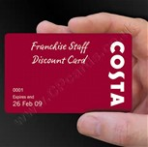
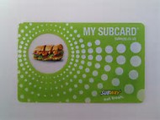
Asset lead – Loyalty cards
The growth of store loyalty cards has allowed the development of database marketing.
Using this form of marketing, businesses develop a database of their customers’ activities, shopping habits and tastes. They then use this database to target sectors of their market with different offers, promotions etc. This targeted marketing improves the effectiveness of marketing spend.

Slide 25
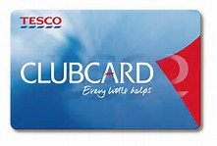
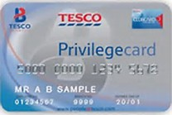
Database marking example
A simple example of this would be Tesco sending details of their back-to-school children’s clothes promotions to customers on their database who spend money on fish fingers and burgers (these customers are likely to have young children).
The business has targeted a market segment that is most likely to buy the promoted product. In this example we see that the internal strength of the business is the effective application of IT; this is then related to seasonal market demand, increasing product sales.

Slide 26
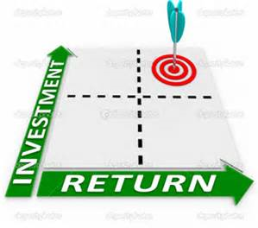
Advantages (A04)
Progressive change
Quality of output
Strengths linked to market needs
Maximising return from assets

Slide 27
YouTube videos
Q - Discuss whether the products shown are product or customer-orientated ?
Wiltshire Farm Foods (2014)
https://www.youtube.com/watch?v=kSmrdxNPvIg
Sony Walkman commercial (1983)
https://www.youtube.com/watch?v=7lipckhgG5g

Slide 28
Activity 3
Task:
Kahoot quiz – Marketing
Time: 15 mins

Slide 29
Activity 4
Task:
Written task – Types of markets
Time: 30 mins and 10 mins discussion

Slide 30
Marketing mix – 4ps
Introduce the aims and objectives for the session.
Discuss, what is marketing in groups.
Explain marketing and give examples.
Complete a written description of marketing.
Discuss market orientation, product and asset lead marketing.
Show a YouTube video on market orientation, product and asset lead marketing.
Complete a marketing Kahoot quiz.
Undertake a written analysis of market orientation, product and asset lead marketing.
Recap the aims and objectives for the session.

