Slide 1
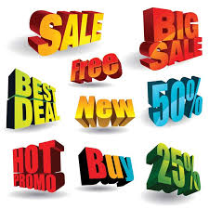
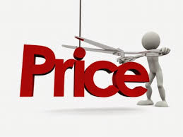
Marketing mix – Price
Introduce the aims and objectives for the session.
Discuss in groups what a price maker or price taker is.
Explain the difference between a price maker and price taker.
Complete a price maker or taker quiz.
Explain the various pricing strategies and give examples.
Show a YouTube video on pricing strategies.
Arrange the pricing strategies definition cards in groups.
Complete a pricing strategies Kahoot quiz.
Examine and evaluate the various pricing strategies in a written task.
Answer the group questions using your buzzers.
Recap the aims and objectives for the session.

Slide 2
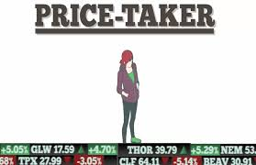
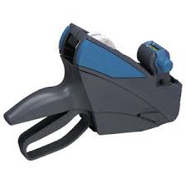
Activity 1
Task:
What is a price maker / taker?
Time: 5 mins

Slide 3
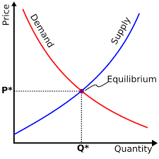
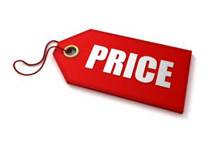
Price – S&D
There are a wide variety of pricing strategies available to businesses.
Before they can consider which to adopt, businesses must take into consideration the effects of supply and demand in the marketplace. This interaction of supply and demand is known as the market mechanism.

Slide 4
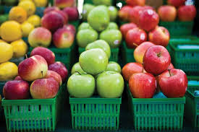
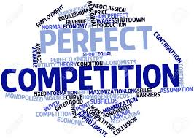
Price takers
The market mechanism, through the interaction of supply and demand, will set the price of products and also determine the quantity supplied.
However, in certain circumstances, businesses will have to accept the price set by the market. This type of business is known as a price taker. Accepting the market price (being a price taker) is the only option under perfect competition.

Slide 5
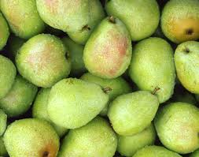
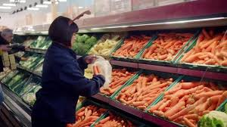
Price takers
Perfect competition occurs when goods are undifferentiated (cannot be told apart), there are a large number of producers, and buyers have complete information about what is available on the marketplace.
When a good produced is indistinguishable from the competition and there are a large number of suppliers, then a situation nearing perfect competition can arise.

Slide 6
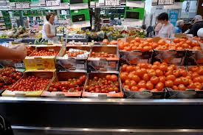
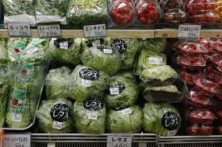
Price takers
We can see near perfect competition in the markets for some fresh produce (lettuces, cucumbers, tomatoes etc.). In these circumstances the producer has little or no control over price, and so must accept the going market price. The producer is a price taker.

Slide 7
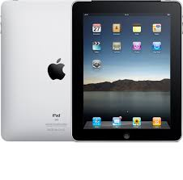
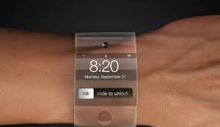
Price makers
When a business is not a price taker, which is the case in the majority of markets, then it has the opportunity of using pricing strategies.
Not all pricing strategies are available to all businesses, but there are still choices to be made.

Slide 8
Price makers
Pricing strategies fall into two broad groups:
1. Market-orientated strategies – businesses are market-orientated when they produce what the market wants. With regard to price, this means that a market-orientated business will set a price at the level the market is willing to accept.
2. Cost-based strategies – businesses are product-orientated when they produce goods without in-depth reference to the needs of consumers. With regard to price, this means that a product-orientated business will set a price related to the cost of producing or supplying the product.

Slide 9
Activity 2
Task:
Price takers / Price makers – Quiz
Time: 10 mins

Slide 10
Market orientation – pricing strategies
Market orientation pricing strategies:
Market skimming
Destroyer pricing
Loss leader pricing
Going rate pricing
Market penetration
Psychological pricing

Slide 11
Market orientation – Pricing strategies
The type of strategy used will depend upon several factors.
These may include:
The type of product
The product range
Economic circumstances
The financial strength of the business
The levels of competition in the market.

Slide 12
Market skimming
Market skimming means charging a high price to maximise profits on each item sold for a limited period. The aim is to gain as much profit as possible for a new product while it remains unique in the market.
The ability to skim depends on having either a technological advantage or an advantage based on brand image. If technological advantages exist, then some consumers, known as early adopters, are willing to purchase products so that they can be the first to own these products..

Slide 13
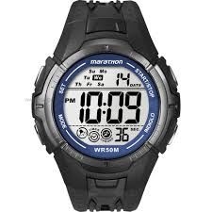
Market skimming
Digital watches are a good example of this. When they were first launched, digital watches may have sold for around £500: similar watches today might sell for £25. Each generation iPhone initially ‘skims’ the market when first released.
Brand image can also allow market skimming to occur. Products from brands such as Armani or Chanel will be at the top of the market price band. Businesses will work hard to protect, develop and increase the value of their brand image to allow skimming strategies to continue.

Slide 14
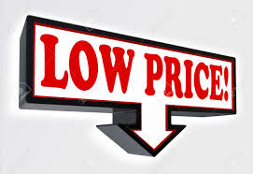
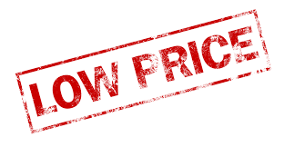
Penetration pricing
In this case the objective is to gain market share. It involves pricing a product at a low level so that retailers and consumers are encouraged to purchase the product in large quantities.
This pricing strategy can help establish brand loyalty – when the price of the product does rise from the initially low level, customers will continue to purchase it. However, if the price is set too low, customers may take the view that the product is low quality and therefore they will not purchase it in the first place.

Slide 15
Penetration pricing
Businesses using this policy to break into a new market may initially lose revenue. If the life cycle of the product is relatively short this policy should be avoided, as the business will not have enough time to recover the cost of this strategy.
There must be enough time for market share to grow and then the price can be gradually raised and the initial cost of the penetration strategy can be recovered.

Slide 16
Going rate pricing
For many small businesses accepting the current market pricing structure is all they are able to do. When this is the only option there is a strong element of being a price taker.
They must sell their goods or services at a price broadly in line with the price charged by their competitors. Normally as new entrants enter the market, the price charged will have to be similar to that of the market leader.

Slide 17
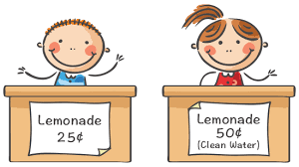
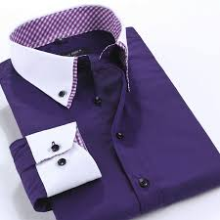
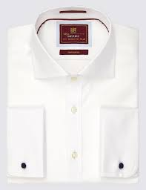
Psychological pricing
Using this strategy, prices are set at the level that matches what consumers may expect to pay. Consumers perceive that they are receiving value from the price paid.
For example: A producer of shirts which has established a reputation for quality and style would set a price well above what a high street store such as Marks and Spencer might charge, even though the difference in quality may be marginal. This will help to reinforce the image of the company.

Slide 18
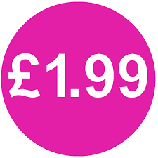
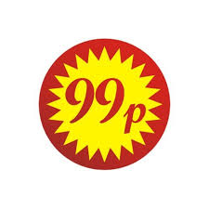
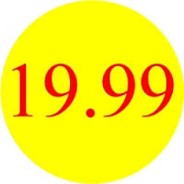
Psychological pricing
The policy of pricing goods just a little below a round figure, such as £19.99, is also an example of psychological pricing.
Businesses using this tactic hope to convince potential purchasers to buy their goods in the belief that they are getting value for money.

Slide 19
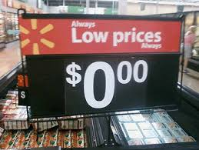
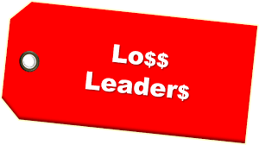
Loss leader pricing
This strategy involves the selling of products at a loss, with the expectation that this will generate further sales of some form, elsewhere in the business.
The additional sales that occur will hopefully recoup the initial loss and subsequently make a profit for the business. The classic example of this has been supermarkets selling goods like bread at a loss in order to attract customers into their stores.

Slide 20
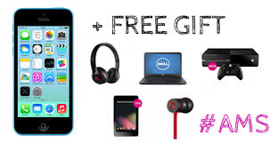
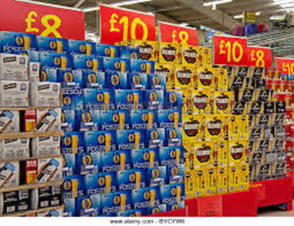
Loss leader pricing
An increasingly common example, which is much more controversial, is supermarkets selling heavily discounted beer and wines.
Other examples of loss leader pricing include free mobile phones, where profits will be made on line rentals. Most mobile phones are now sold on a loss leader basis.

Slide 21
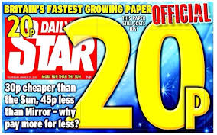
Destroyer pricing
This is also known as predatory pricing. This involves setting a price low enough to drive competitors out of the market. This type of pricing is not only used by the largest businesses on a national scale, but it can also appear in battles between local businesses. Destroyer pricing is often seen as anti-competitive and therefore illegal.

Slide 22
Destroyer pricing
Microsoft has been investigated by competition authorities in the US and Europe for allegedly using destroyer pricing strategies through the bundling of free programmes (such as Windows Media Player) within its operating systems.

Slide 23
YouTube video
Pricing strategies
https://www.youtube.com/watch?v=KMElsJcnbMo

Slide 24
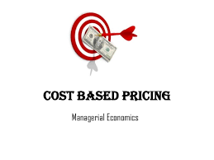
Cost based pricing methods
Contribution pricing
Full cost pricing
Cost plus pricing

Slide 25
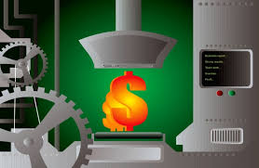
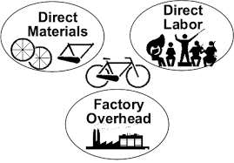
Cost-based pricing strategies
Businesses which concentrate on internal costs when pricing products are known as product-orientated businesses. Pricing strategies used are based around the costs of production.
There are three main types of product-based pricing, and each uses the costs of production/supply as the basis of deriving price.

Slide 26
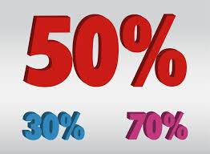
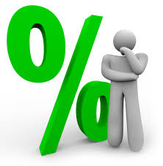
Cost plus pricing
Using this method, a profit percentage is added to the average cost of producing the good. This is known as adding a mark-up.
Therefore, if the production costs of the good are £1, and the business adds a profit percentage of 40%, then the business will sell the good at £1.40.

Slide 27
Cost plus advantages and disadvantages (A04)
Advantages: firstly changes in costs can be passed directly on to the buyer and secondly, every good sold is sold at a profit.
Disadvantages : Actions of competitors are often totally ignored. This can lead to loss of sales or loss of profits if a higher price could be charged because of little or no competition. Also, for exporters, this method makes no allowance for currency changes that will affect the price of goods and order levels.

Slide 28
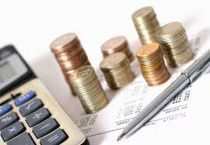
Full cost pricing
This is similar to cost plus pricing but it takes the concept further. Now all the costs of the business are taken into consideration.
This means that each good will bear its proportion of overhead costs such as marketing and administration. The advantages and disadvantages are similar to cost plus pricing but there is the added disadvantage of the complexity of apportioning overhead costs.

Slide 29
Contribution pricing
This is another variation on the same theme, but in this case price will be based on the variable costs plus a contribution towards overheads and profits.
This method can give flexibility because orders can be accepted on a different contribution basis for different products. This flexibility allows pricing strategies, such as price discrimination between different buyers, to be used.

Slide 30
Criticisms of cost-based pricing (A04)
As a result of its product-orientated approach, cost-based pricing takes no account of customers’ needs or wishes. If prices are set too high then sales will inevitably suffer.
Using these methods means that a further increase in prices must occur as overheads are redistributed. Also, when a business produces a large range of products, allocating overheads is a complex and time-consuming procedure.

Slide 31
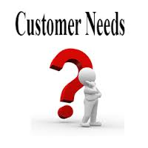
Criticisms of cost based pricing
Cost-based pricing takes no account of the situation in the marketplace and is too rigid when the pattern of demand changes.
It can still be argued, however, that businesses using cost-based pricing methods concentrate more on their strengths and do not waste time, energy and money on futile price wars or price-based competition

Slide 32
Activity 3
Task:
Pricing strategies – Arrange definitions
Time: 10 mins

Slide 33
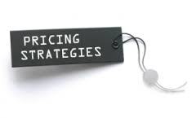
Activity 4
Task:
Pricing strategies – Exam question.
Time: 30 mins

Slide 34
Activity 5
Task:
Kahoot quiz – Pricing strategies
Time: 15 mins

Slide 35
Marketing mix – Price
Introduce the aims and objectives for the session.
Discuss in groups what a price maker or price taker is.
Explain the difference between a price maker and price taker.
Complete a price maker or taker quiz.
Explain the various pricing strategies and give examples.
Show a YouTube video on pricing strategies.
Arrange the pricing strategies definition cards in groups.
Complete a pricing strategies Kahoot quiz.
Examine and evaluate the various pricing strategies in a written task.
Answer the group questions using your buzzers.
Recap the aims and objectives for the session.

