Slide 1
Marketing mix – Promotion
Introduce the aims and objectives for the session.
Discuss promotion in groups.
Explain the promotional objectives and give examples.
Complete a promotional objectives quiz.
Give examples of above and below the line promotion.
Show a YouTube video on above and below the line promotion.
Arrange the above and below the line promotion cards.
Analyse above and below the line promotion in a written task.
Complete a Kahoot quiz on promotion.
Recap the aims and objectives
for the session.

Slide 2
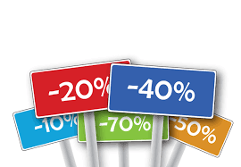
Activity 1
Task:
What is promotion?
Time: 5 mins

Slide 3
Promotion
Promotion is the attempt, through various forms of media, to draw attention to a product and thereby gain and retain customers.
All types of promotion try to communicate with the public in an attempt to encourage them to purchase a business’s products or services. As consumers we are surrounded by promotion.

Slide 4
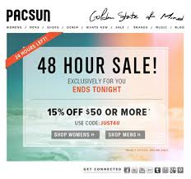
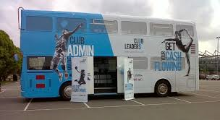
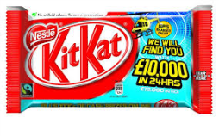
Promotion
We cannot get away from it – whether it is on TV, on buses, on the packaging of food we eat, or in the mail we receive almost every day.
Promotion allows us to find out about products and provides us with up-to-date information about those products. It also allows us to make educated choices about the goods we consume, provides free-to-view TV and internet and keeps thousands of people employed. However, it can encourage a waste of resources, pushing up prices and encouraging greed and envy when wants cannot be satisfied.

Slide 5
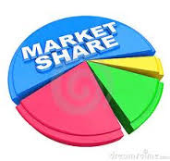
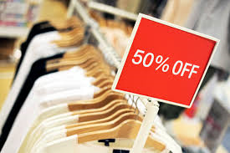
Objectives of promotion
The general description of the overall objective of promotion to gain and retain customers can be extended to include the following specific objectives:
• To provide potential customers with readily available information about the product so that the consumer knows the benefits of using the product and where to access the product. This is often the objective for new product launches.
•To increase sales or market
share by targeting both
existing customers and
new customers.

Slide 6
Objectives of promotion
•To give the products an image, or to establish a brand identity. A great deal of promotional activity which takes place is done to keep the product in consumers’ minds. This reminds consumers why they bought the product and why they should continue using it over rival brands.
•To establish a corporate image. Some advertising does not sell a specific product or range of products; instead the objective is to establish the right image of the producer or retailer within the mind of the consumer.

Slide 7
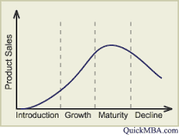
Objectives of promotion
•To enable long-term business planning to take place. Promotion is part of the whole process of bringing a product or service to market. Effective promotion allows life cycles to be developed and prolonged. This then enables production and investment to occur with greater confidence.

Slide 8
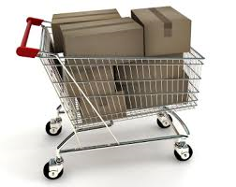
Purchasing phases
It must be remembered that most products are not purchased on impulse, before purchases are made the consumer moves through a series of phases or levels of commitment to the product.
These phases can be outlined as:
1) Being unaware of the product’s existence
2) Awareness of the product’s existence
3) Understanding of the benefits of the product
4) Establishing a liking for, or commitment to, the product
5) Finally - the purchase of the product

Slide 9
Activity 2
Task:
Promotional objectives – Quiz questions
Time: 10 mins

Slide 10
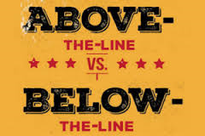
Types of promotion
Promotion can be :
Above-the-line
Below-the-line.

Slide 11
Promotion – YouTube video
https://www.youtube.com/watch?v=zzYFC-l-ZcE

Slide 12
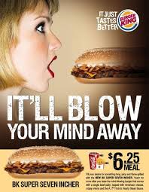
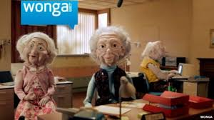
Above-the-line promotion
Above-the-line promotion is what is generally called advertising. It is used to reach a mass audience. It is worth noting that advertising and promotion are not the same.
Above-the-line promotion (advertising) is carried out through various independent media:
The most important being TV, magazines, newspapers, radio, posters and, of increasing importance, the internet.

Slide 13
Above the line promotion
The choice of media used depends on a number of factors:
•Target market – who is the business trying to sell to?
•Whether the objective is to convey information or another type of message – will the product sell only when consumers fully understand its function, or do people buy on impulse?
•Cost – for many small businesses this is the first question they ask about any form of promotion.

Slide 14
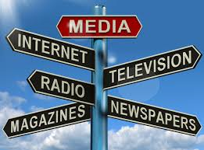
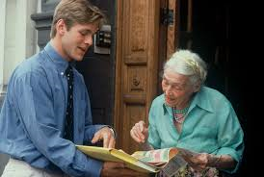
The choice of media used depends on a number of factors:
•The reach of the media – who reads the magazine or watches the adverts? Are they likely to buy the product?
•The product itself – is the product suited to a certain type of promotion? For example, is the best way to promote plastic food containers through personal selling door to door or by an advert in the local paper?

Slide 15
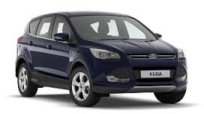
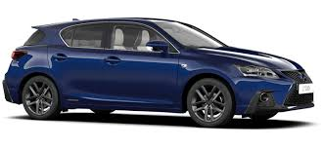
Above the line – Example
For most mass market products a combination of the above media will be used, each of which will be used to deliver a different message about the product.
For example, when promoting a car, the manufacturer may use national television adverts to project the image of the car to a wide market and appeal to the aspirations of the potential buyers.

Slide 16
Magazines may be used to reinforce this image, whilst local radio might be used to tell customers about local price and finance deals and which garages in the area stock the car.

Slide 17
Above the line – Example
In this example of promoting the car, we can see a division of the type of advertising message.
One type of message sells the product through image, style and the aspirations of the potential buyer – this is known as persuasive advertising. The local radio promotion is much more informative.

Slide 18
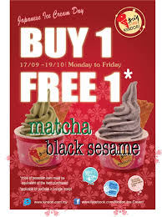
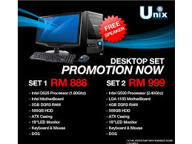
Above the line – mix
Most products will use a combination of the two types of advertising. The type of media used in advertising will, to a large extent, determine whether the emphasis is on persuasion or information.
Also certain products lend themselves to one or the other type. For example, the promotion of ice cream brands will tend to be more persuasive, while the promotion of computers will tend to be more informative.

Slide 19
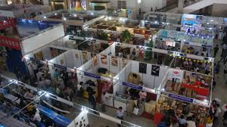
Below-the-line promotion
Below-the-line promotion offers a wide range of alternative promotional strategies and these are often used to support above-the-line promotion.
Below-the-line promotion targets consumers directly.

Slide 20
Below the line promotion
Examples of below-the-line promotion are:
•Personal selling;
•Packaging;
•Sales promotions;
•Direct mailing;
•Exhibitions and trade fairs;
•Public relations.

Slide 21
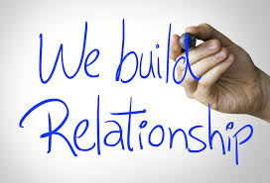
Below the line promotion
For many consumer products, below-the-line promotion is used only for short-term periods. Offers and promotions come and go quite quickly.
However, for other products, such as industrial goods, producer goods and financial services, personal selling plays a long-term strategic role in establishing a relationship with the customer.

Slide 22
Promotion is complex
Promotion is a complex issue. The type of promotion used will differ between products, the markets targeted and throughout the various stages of a product’s life cycle.

Slide 23
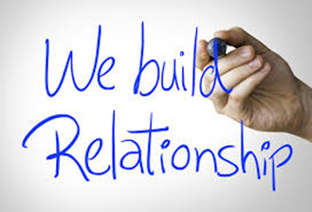
YouTube video
Methods of promotion
https://www.youtube.com/watch?v=54OxSWV3RPI

Slide 24
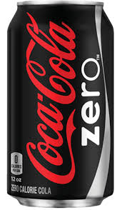
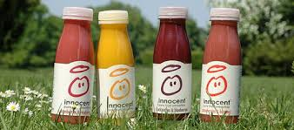
Factors impacting strategy
Product differentiation – many markets are highly competitive. It is important that promotion provides a method of product differentiation. The role of promotion is to differentiate its product in the market and make it stand out from the crowd.
The focus here remains on those features, functions or benefits that may not be offered by a competitor or may not be offered so well.

Slide 25
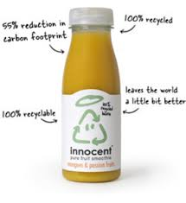
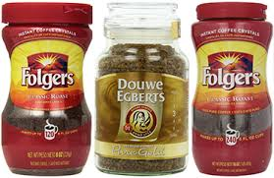
Factors impacting strategy
Products, like Innocent smoothies, differentiate through an ethical approach to their products.
Coffee brands can be differentiated through types of user – value for money or luxuriously expensive.

Slide 26
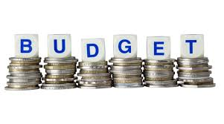
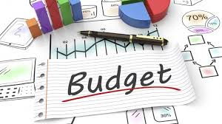
The marketing budget available – it is normal to set a total budget for promotional activities based on the objectives of the business, the availability of cash and actions of competitors.

Slide 27
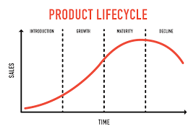
The stage in the product life cycle – during the introduction and growth stages of the product life cycle there may be a more informative approach, in order to raise customer awareness. During the maturity and saturation stages a more persuasive approach may be adopted to reinforce customers’ allegiance.

Slide 28
Cultural sensitivity – if a product is to be launched in a new international market or translated across markets, it becomes imperative to take into consideration local affiliations and sensitivities. These include both cultural and religious considerations. Often, these issues may even present themselves within one country.

Slide 29
The target market – the people who make up the target market need to be considered before committing to a promotional strategy.
If a market is not tech-savvy (technically aware), then more traditional means may need to be employed. Conversely, the younger generation, used to accessing information on a daily basis via their iPhones, may be targeted via the internet.

Slide 30
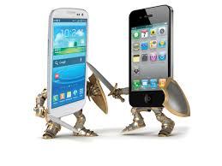
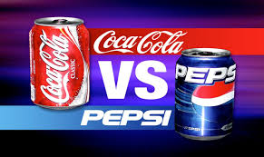
Competitor actions – the promotional strategies a competitor uses need to be taken into account as well.
If a competitor is about to launch a campaign which targets a segment of the population not previously targeted, then perhaps a business needs to react in order to protect market share.

Slide 31
Activity 3
Task:
Arrange above and below line cards
Time: 10 mins

Slide 32
Activity 4
Task:
Exam question – Promotional strategies.
Time: 30 mins

Slide 33
Activity 5
Task:
Read an above and below the line promotion
case study with the group.
Time: 10 mins

Slide 34
Activity 6
Task:
Kahoot quiz – Promotion
Time: 10 mins

Slide 35
Marketing mix – Promotion
Introduce the aims and objectives for the session.
Discuss promotion in groups.
Explain the promotional objectives and give examples.
Complete a promotional objectives quiz.
Give examples of above and below the line promotion.
Show a YouTube video on above and below the line promotion.
Arrange the above and below the line promotion cards.
Analyse above and below the line promotion in a written task.
Complete a Kahoot quiz on promotion.
Recap the aims and objectives
for the session.

