Slide 1
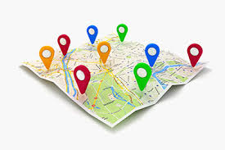
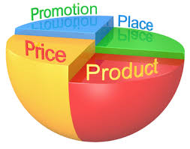
Marketing mix – Place
Introduce the aims and objectives for the session.
Discuss in groups what distribution is.
Explain the various distribution channels available to businesses.
Show a YouTube video on distribution channels.
Discuss the usefulness of internet in marketing.
Arrange the distribution channel definition cards.
Complete a distribution channel written task.

Slide 2
Explain the importance of the marketing mix in decision making.
Answer the marketing mix decision questions using your buzzers.
Complete a marketing mix decisions quiz.
Answer the Kahoot quiz questions on marketing mix decisions.
Complete a written task on marketing mix decisions.
Recap the aims and objectives for the session.

Slide 3
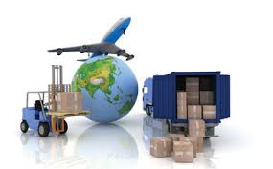
Activity 1
Task:
What is distribution?
Time: 5 mins

Slide 4
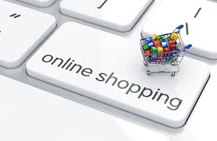
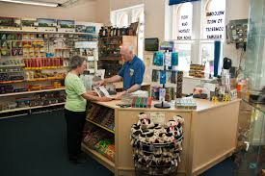
Place
Place is all about where businesses sell their products and what methods are used to distribute the goods to the customer. Place is ‘the marketplace’, where buyers and sellers meet and exchange payment in return for goods and services.
The marketplace does not have to be ‘physical’, such as a shop – it could be online, over the phone or through mail order.

Slide 5
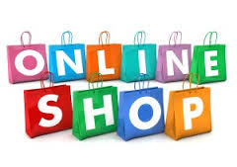
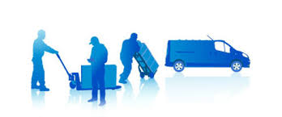
Place
The two key questions businesses ask in relation to place are:
1.Where shall we sell our products?
2.What methods shall we use to distribute the goods to the final consumer?

Slide 6
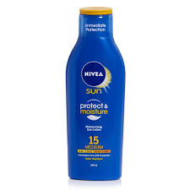
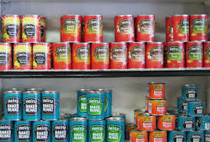
Place – Choices
For some goods choosing the right ‘place’ is obvious:
Baked beans are traditionally sold on supermarket shelves, chocolate bars in newsagents, sun cream in chemists and so on.
However, choosing a place to sell a product can be more complex and may be part of an overall strategy in an attempt to achieve an image or develop a brand.

Slide 7
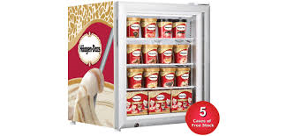
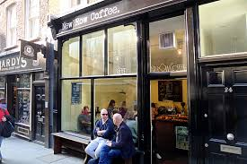
Why ‘place’ is important
The place where a product is sold can be used as part of a strategy to establish a certain brand identity. When Häagen-Dazs ice cream was launched in the UK, it was only available through upmarket outlets such as Harrods and Covent Garden coffee bars.
The objective was to establish a super-premium ice cream brand.

Slide 8
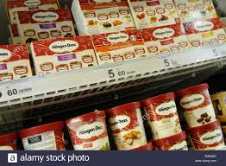
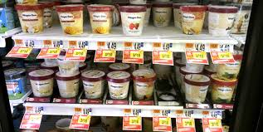
Only when this perception was established in consumers’ minds was the product offered for sale through a wider range of outlets.
Today it can be found in supermarkets all across the UK.

Slide 9
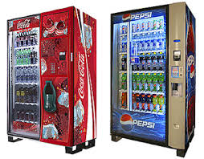
Place – soft drinks
Some goods are now sold through a wider range of outlets than ever before, which encourages higher levels of consumption. A good example of this widening of the number of places where a product is sold can be seen with some soft drinks.
Go into any train station, airport or leisure centre and you will see soft drinks vending machines.

Slide 10
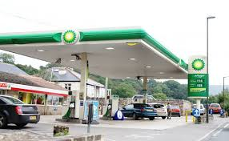
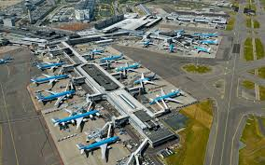
Premium prices are often charged because demand
Is high – participants are thirsty and hot after a game
of squash and 90p for a can of Coke is acceptable.

Slide 11
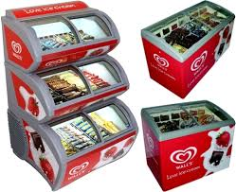
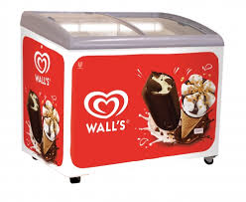
Place – Walls ice cream
Prime selling space can be jealously protected. Manufacturers offer retailers discounts if their brand is given pride of place on supermarket shelves.
Wall’s ice cream has fought through the courts to prevent other brands being sold in fridges they have supplied to local supermarkets and independent shops.

Slide 12
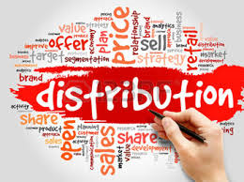
Distribution
Distribution is all about
how to get the goods to the customer.
Traditional methods have relied upon the ‘Manufacturer – Wholesaler – Retailer – Consumer’ chain.
However, for many goods and services this relationship has broken down. Direct selling, whether through the internet, or through magazines, catalogues or junk mail, can allow businesses to supply their customers more readily – and often at much lower prices.

Slide 13
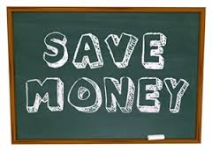
Cutting out the middle man
With the growth in size of retailers and improvements in stock ordering methods, there has been a reduction in the need for the ‘middleman’ – wholesalers are often cut out of the equation.
This use of a direct supply relationship between manufacturer and retailers cuts costs for large businesses. This puts increasing pressure on smaller retailers, who still rely on wholesalers to supply them with their goods for sale.

Slide 14
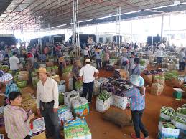
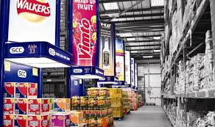
Using a wholesaler
Traditional methods of distribution have relied upon the ‘Manufacturer – Wholesaler – Retailer – Consumer’ chain.
The wholesaler has a role in breaking bulk – this means buying large quantities from the manufacturer and selling smaller quantities to the retailer. This relationship is useful to all parties concerned.

Slide 15
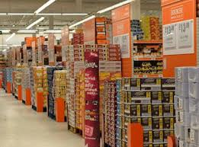
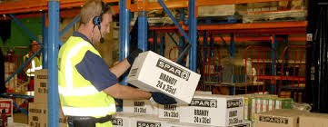
The manufacturer has the convenience of selling in bulk to the wholesaler. Single drops of very large quantities lower distribution expenses.
The small retailer, who buys in quite small quantities, benefits because they do not have to store large quantities of stock and can buy at their own convenience.

Slide 16
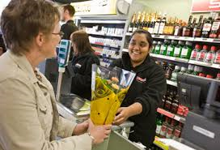
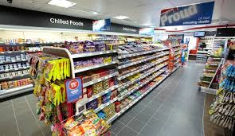
Manufacturer to retailer
For many goods and services the use of wholesalers has declined significantly. With the retail market now dominated by big businesses the role of the wholesaler has become much less important.
Manufacturers supply most of their produce direct to the big retailers, each of which buys massive quantities.

Slide 17
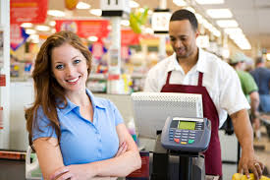
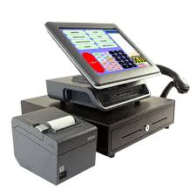
This growth in the size of retailers, and improvements in stock ordering and handling methods (EPOS systems), has led to a reduction in the need for the middleman – wholesalers are cut out of the chain.
This reduction in the length of the distribution chain cuts costs for large businesses and represents a good example of a purchasing economy of scale.

Slide 18
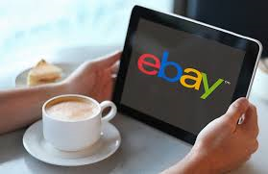
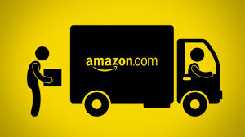
Direct selling
Direct selling - Manufacturer to Consumer
Direct selling, whether through junk mail, magazines and increasingly through the internet, has allowed manufacturers to charge much lower prices.
Books bought over the internet can be 40% cheaper than high street prices. (Amazon)

Slide 19
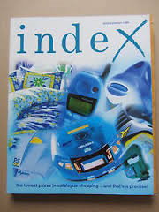
More singles are now sold as downloads from online music retailers such as iTunes than as CDs through record shops.
Traditional catalogue shops, such as Index, have been replaced by B2C – Business to Consumer internet shopping. Selling direct allows manufacturers to keep more of the profits and attract customers through competitive prices and convenience.

Slide 20
YouTube video
Place
https://www.youtube.com/watch?v=HF5DxyOqzo8

Slide 21
Internet marketing
Internet sales are increasing massively.
During November 2015 online sales were over £7 billion in the UK, up 9% on the previous year.
Tesco, the UK’s largest grocery retailer, have a full range of products for sale on the internet and their major competitors, such as Sainsbury’s, Asda and Morrisons have all followed their example.

Slide 22
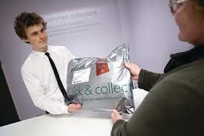
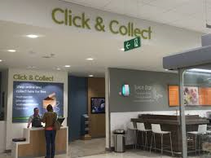
The internet retailer Amazon.com, which started as an online bookseller, has opened up distribution centres all over the UK, employing thousands of previously unemployed people.

Slide 23
‘Click and collect’ is becoming more and more popular.
John Lewis reported that 40% of its online sales over Christmas 2014 were through ‘click and collect’. Business to business trade on the internet, where shopping around for best value is so important, looks like becoming the new method of cost reduction.

Slide 24
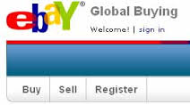
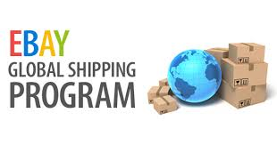
E-commerce
E-commerce can offer a low-cost way for small businesses to compete against much larger rivals:
Products can be marketed and sold worldwide with an internet e-commerce enabled shop. To actually set up an internet based shop can cost just a few hundred pounds and the cost can be further reduced through the use of auction sites such as Ebay.

Slide 25
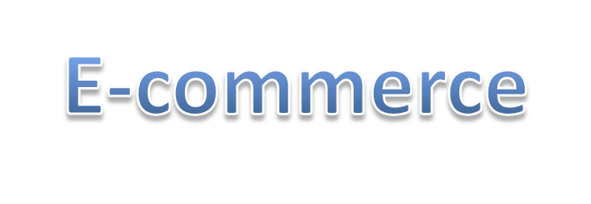
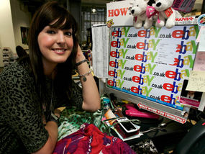
There are several entrepreneurs who have become millionaires by selling through Ebay.
Although some potential customers are still wary of using the internet to buy goods because of issues related to fraud or non-delivery, the majority of UK households have purchased goods online and the proportion using e-commerce continues to grow significantly.

Slide 26
Multi-channel distribution
It makes sense to try to use a combination of distribution channels.
For example:
Apple sets up its own shops (with carefully designed brand values) in major cities. It also sells through a huge range of retailers and, of course, has an online presence. In adopting such a strategy Apple is maximising as many of the advantages as it can from each distribution channel chosen.

Slide 27
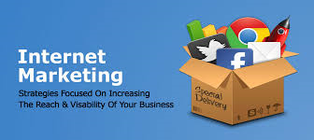
Activity 2
Task:
Usefulness of internet marketing – discussion
Time: 10 mins

Slide 28
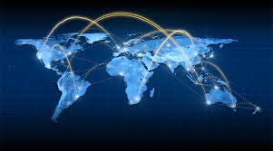
Activity 3
Task:
Arrange distribution channel definition cards
Time: 10 mins

Slide 29
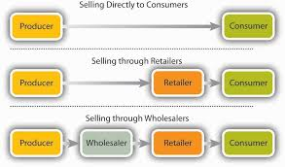
Activity 4
Task:
Distribution channels written task
Time: 30 mins

Slide 30
Decisions related to the
marketing mix
All businesses have choices to make when it comes to marketing their products:
•What shall the price be?
•What is the best design for the product?
•Where should it be sold?
•How should the product be promoted?

Slide 31
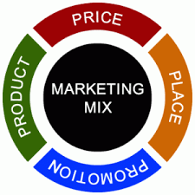
Marketing mix – 4Ps
These decisions and how they relate to each other are known as the marketing mix, often referred to as the 4Ps of marketing:
Price
Product
Place
Promotion.

Slide 32
Marketing mix – 4Ps
Every product sold will have different combinations of these four factors and these combinations will change over time.
None of the 4Ps can be ignored, but priority will be given to different combinations of the four factors.

Slide 33
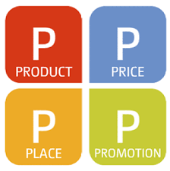
The priorities a business will decide upon will depend as much on the needs of consumers and the actions of competitors as upon the nature of the product or service itself.
The elements of the marketing mix which have priority will vary over time, depending on the nature of the market in which the product or service is being sold.

Slide 34
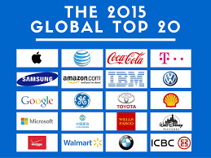
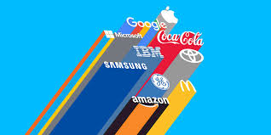
Global brands and marketing
The development of global brands has been one of the most important changes in how products are marketed across the world. Brands that cross international borders are like gold dust to companies.
Businesses that are able to make their products appealing to consumers in many different countries can benefit from significant marketing and production economies of scale.

Slide 35
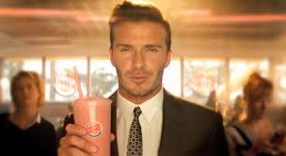
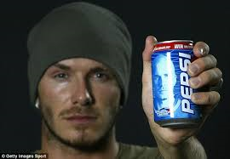
Reaching millions of potential consumers around the world with a marketing strategy that differs very little from one country to another can drive down costs and increase profit.
Global superstars can be used to promote a product throughout the world because they have universal appeal. Getting the likes of David Beckham to promote your product can boost global sales massively, fully justifying the enormous fee such a superstar may command.

Slide 36
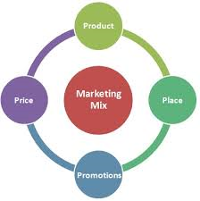
Marketing mix
different contexts
How the marketing mix is applied will differ in a variety of contexts:
•local markets;
•national markets;
•global markets;
•goods or services markets;
•niche markets;
•mass markets.

Slide 37
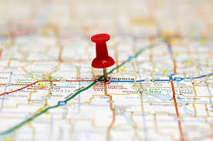
Local and national markets
Local markets allow specific marketing tactics to be used, adapting the 4Ps to local taste and incomes.
National markets need more consistency. A national marketing strategy needs to be developed, allowing the brand to become known and understood.

Slide 38
Global markets
With global markets we have seen the need to establish an identifiable global brand – making promotion as homogenous as possible.
Utilising the same advert with a local voiceover is typical of many global marketing campaigns. Where global marketing often differs is in relation to pricing.

Slide 39
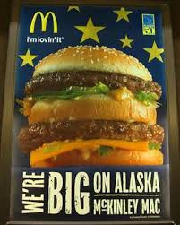
The level of income of the target market may vary from country to country and pricing needs to reflect this.
In some circumstances penetration pricing needs to be used in order to establish a product or service, especially when strong domestic brands dominate the market.

Slide 40
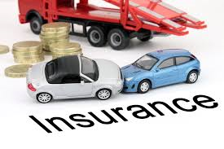
Goods/ Services
Goods are perhaps easier to market than services.
With goods there is a tangible product, but with services it is perhaps more difficult to identify what the customer needs. The focus on marketing for many services, for example insurance, holidays, car hire, professional services (healthcare) is often based on simplicity and clarity.

Slide 41
‘This is what we do, we do it effectively and quickly, and we will make clear the benefits’.
We see this with a range of TV adverts, for example BUPA healthcare, Hertz car hire, the marketing of financial comparison websites etc.

Slide 42
Mass marketing
Often for businesses mass marketing is not an option – after all appealing to and developing products for a mass market is an expensive business.
There are huge product development costs, massive expenditures on promotion and constant competition.

Slide 43
Niche marketing
With niche marketing a business will target a single niche within the market, ignoring the rest of the marketplace.
Niche marketing is based on designing goods or services specifically tailored for the needs of a relatively small target market. Therefore, there must be a full understanding of the desires and needs of the niche. This understanding can be gained through market research, but is often based on an understanding of a particular market that comes through personal experience.

Slide 44
Niche marketing
The internet has allowed businesses selling niche products to access markets far more readily.
In the past, one of the major problems facing niche product businesses has been being unable to economically target customers who are likely to be geographically dispersed.

Slide 45
Now the internet removes this problem and raising awareness is much simpler. There is no need to list in local Yellow Pages throughout the country or use magazine ads that may be irrelevant to most readers.
Instead, potential customers can access the niche product/service providers by quickly searching websites.

Slide 46
Internet Marketing decisions
The development and widespread use of the internet over the last twenty years has had a huge impact on marketing.
Each of the 4Ps has had to change and evolve to meet the demands of this new method of reaching customers.

Slide 47
Clicks and bricks
Clicks and bricks is a marketing term which means that businesses need to have a web presence (clicks), plus a physical presence on the high street or in shopping centres (bricks).
Examples of businesses using this form of widening of distribution channels include PC World, Argos and Tesco. Each of these businesses has been very successful in using a web presence to increase sales and customer loyalty.

Slide 48
Social media
Zoella, the hugely popular fashion and lifestyle blogger, has just bought a £1 million house.
She has seven million YouTube followers and each video she posts is topped and tailed with adverts aimed at the demographic of her followers. This is a typical example of how social media is used to market products.

Slide 49
Social media – Viral adverts
Viral advertising is another form of social media advertising, with funny or stylish ads being sent from person to person.
This form of marketing is of growing importance as fewer young people consume traditional media (TV and newspapers) and instead consume entertainment and information online.

Slide 50
M-commerce
M-commerce (mobile commerce) is the buying and selling of goods and services through wireless handheld devices such as mobile phones. This means ‘having your retail outlet in your consumers’ pocket’. Through mobile technology it is now possible to reach your customer 24 hours a day.

Slide 51
M Commerce
M-commerce does not just mean buying:
It is about providing your customers with product information, promotions and all other aspects of the marketing mix.
Consumers use M-commerce to compare prices online, take photos for future reference and research their potential purchases online.

Slide 52
Pricing and the internet
A comparison of prices has become a great deal easier for customers.
Using the web, individuals can carry out
their own research or use comparison sites,
such as Money Supermarket, to find the
best deal across a huge range of products.
This access to pricing information has had
an impact on prices charged by businesses.
It has been argued by economists that the increase in internet shopping has had a direct impact on lowering inflation rates.

Slide 53
E-tailing
Online shopping (sometimes known as E-tailing, from ‘electronic retail’ or E-shopping) is a form of electronic commerce which allows consumers to directly buy goods or services from a seller over the internet.
The internet has changed buying habits and E-tailing is now a very important part of the retail industry, and is continuing to grow.

Slide 54
The internet, and the use of search engines, has made accessing customers a great deal easier than in the past. All a business needs to sell its products is a decent website, some form of payment processing and ‘shop’ software. All of this can be created for less than £500.
In fact, there are 1000s of entrepreneurs running their businesses through auction sites such as Ebay, with hardly any fixed costs at all. All of these businesses mean extra competition for existing traditional businesses – as well as lowering prices for customers.

Slide 55
Activity 5
Task:
Kahoot quiz – Marketing mix decisions
Time: 15 mins

Slide 56
Activity 6
Task:
Past paper question – Marketing mix decisions
Time: 30 mins

Slide 57
Marketing mix – Place
Introduce the aims and objectives for the session.
Discuss in groups what distribution is.
Explain the various distribution channels available to businesses.
Show a YouTube video on distribution channels.
Discuss the usefulness of internet in marketing.
Arrange the distribution channel definition cards.
Complete a distribution channel written task.

Slide 58
Explain the importance of the marketing mix in decision making.
Answer the marketing mix decision questions using your buzzers.
Complete a marketing mix decisions quiz.
Answer the Kahoot quiz questions on marketing mix decisions.
Complete a written task on marketing mix decisions.
Recap the aims and objectives for the session.

