Slide 1
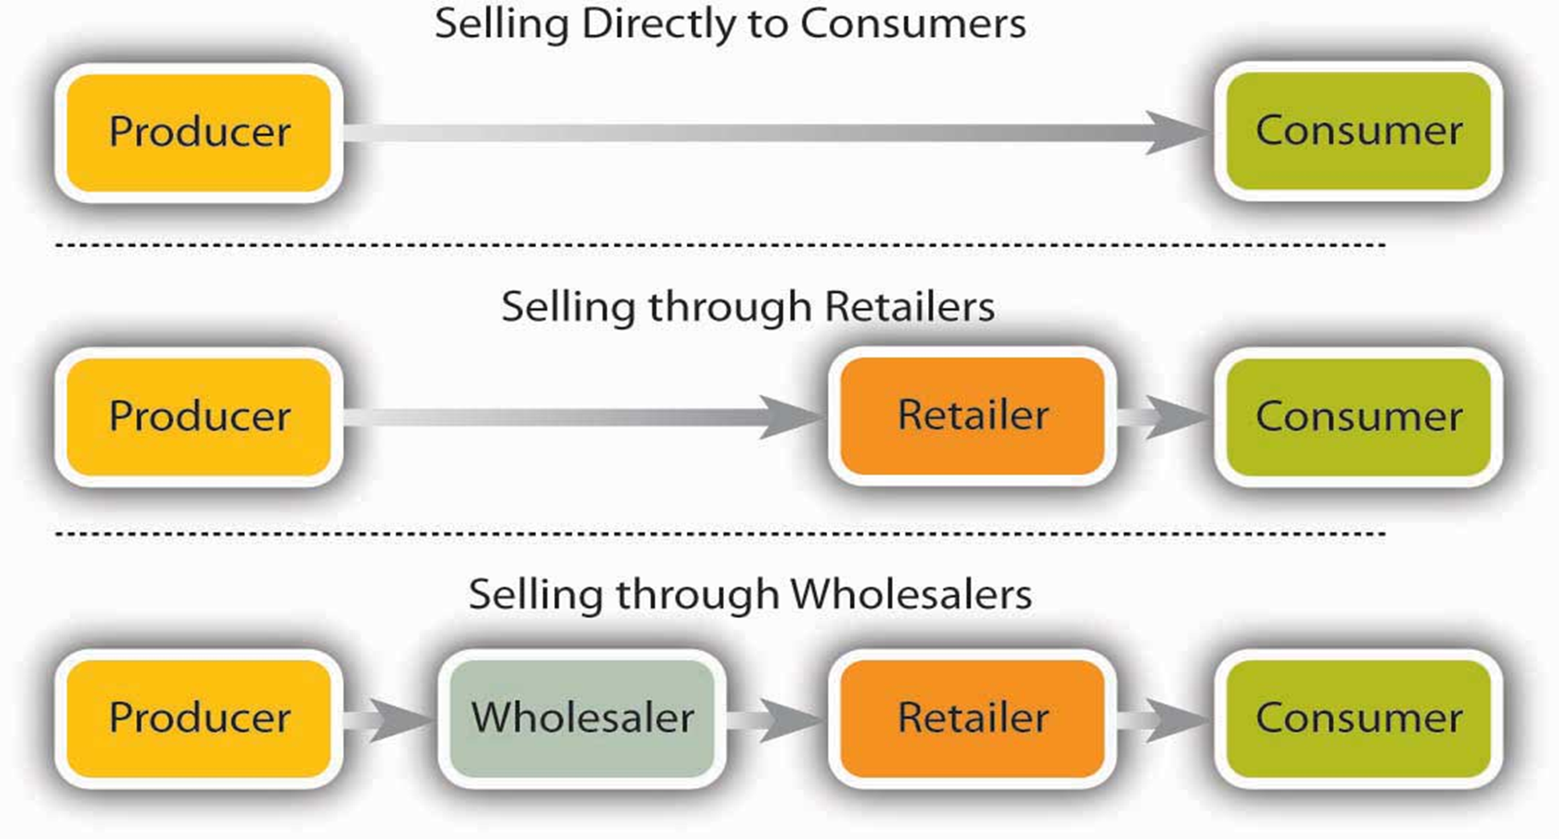

Slide 2
The wholesaler has a role in breaking bulk – this means buying large quantities from the manufacturer.
Shops not have to store large quantities of stock and can buy at their own convenience.
The manufacturer has the convenience of selling in bulk to the wholesaler.
For many goods and services the use of wholesalers has declined significantly.
Manufacturers supply most of their produce direct to the big retailers, each of which buys massive quantities.
Single drops of very large quantities lower distribution expenses.
This growth in the size of retailers, and improvements in stock ordering and handling methods (EPOS systems)
Small retailer, who buys in quite small quantities, benefits.

Slide 3
This has led to a reduction in the need for the middleman – wholesalers are cut out of the chain.
B2C – Business to Consumer
internet shopping
This reduction of the distribution chain cuts costs and represents a good example of a purchasing economy of scale.
Selling direct allows manufacturers to keep more of the profits and attract customers through competitive prices.
Has allowed manufacturers to charge much lower prices.
Books bought over the internet can be 40% cheaper than high street prices.

