Slide 1
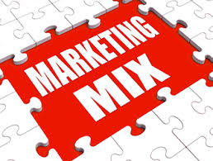
Marketing mix decisions
Complete a distribution channel written task.
Explain the importance of the marketing mix in decision making.
Answer the marketing mix decision questions using your buzzers.
Complete a marketing mix decisions quiz.
Answer the Kahoot quiz questions on marketing mix decisions.
Watch Theo adventure capitalist in India.
Complete a written task on marketing mix decisions.
Recap the aims and objectives for the session.

Slide 2
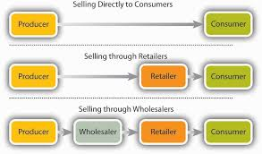
Activity 4
Task:
Distribution channels written task
Time: 30 mins

Slide 3
Decisions related to the
marketing mix
All businesses have choices to make when it comes to marketing their products:
•What shall the price be?
•What is the best design for the product?
•Where should it be sold?
•How should the product be promoted?

Slide 4
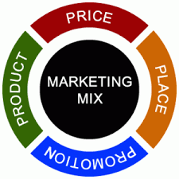
Marketing mix – 4Ps
These decisions and how they relate to each other are known as the marketing mix, often referred to as the 4Ps of marketing:
Price
Product
Place
Promotion.

Slide 5
Marketing mix – 4Ps
Every product sold will have different combinations of these four factors and these combinations will change over time.
None of the 4Ps can be ignored, but priority will be given to different combinations of the four factors.

Slide 6
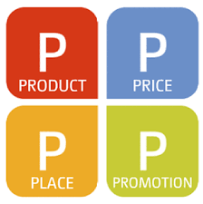
The priorities a business will decide upon will depend as much on the needs of consumers and the actions of competitors as upon the nature of the product or service itself.
The elements of the marketing mix which have priority will vary over time, depending on the nature of the market in which the product or service is being sold.

Slide 7
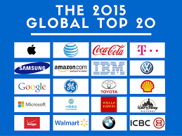
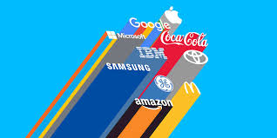
Global brands and marketing
The development of global brands has been one of the most important changes in how products are marketed across the world. Brands that cross international borders are like gold dust to companies.
Businesses that are able to make their products appealing to consumers in many different countries can benefit from significant marketing and production economies of scale.

Slide 8
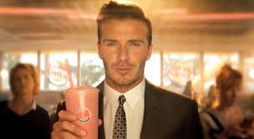
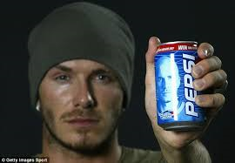
Reaching millions of potential consumers around the world with a marketing strategy that differs very little from one country to another can drive down costs and increase profit.
Global superstars can be used to promote a product throughout the world because they have universal appeal. Getting the likes of David Beckham to promote your product can boost global sales massively, fully justifying the enormous fee such a superstar may command.

Slide 9
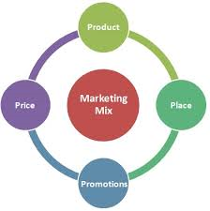
Marketing mix
different contexts
How the marketing mix is applied will differ in a variety of contexts:
•local markets;
•national markets;
•global markets;
•goods or services markets;
•niche markets;
•mass markets.

Slide 10
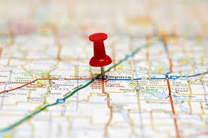
Local and national markets
Local markets allow specific marketing tactics to be used, adapting the 4Ps to local taste and incomes.
National markets need more consistency. A national marketing strategy needs to be developed, allowing the brand to become known and understood.

Slide 11
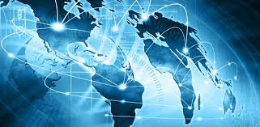
Global markets
With global markets we have seen the need to establish an identifiable global brand – making promotion as homogenous as possible. Utilising the same advert with a local voiceover is typical of many global marketing campaigns. Where global marketing often differs is in relation to pricing. The level of income of the target market may vary from country to country and pricing needs to reflect this. In some circumstances penetration pricing needs to be used in order to establish a product or service, especially when strong domestic brands dominate the market.

Slide 12
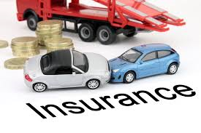
Goods/ Services
Goods are perhaps easier to market than services.
With goods there is a tangible product, but with services it is perhaps more difficult to identify what the customer needs. The focus on marketing for many services, for example insurance, holidays, car hire, professional services (healthcare) is often based on simplicity and clarity.

Slide 13
‘This is what we do, we do it effectively and quickly, and we will make clear the benefits’.
We see this with a range of TV adverts, for example BUPA healthcare, Hertz car hire, the marketing of financial comparison websites etc.

Slide 14
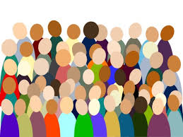
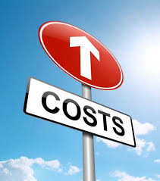
Mass marketing
Often for businesses mass marketing is not an option – after all appealing to and developing products for a mass market is an expensive business.
There are huge product development costs, massive expenditures on promotion and constant competition.

Slide 15
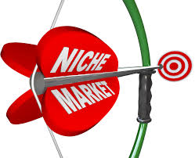
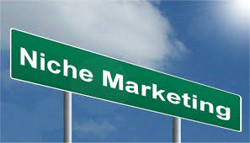
Niche marketing
With niche marketing a business will target a single niche within the market, ignoring the rest of the marketplace.
Niche marketing is based on designing goods or services specifically tailored for the needs of a relatively small target market. Therefore, there must be a full understanding of the desires and needs of the niche. This understanding can be gained through market research, but is often based on an understanding of a particular market that comes through personal experience.

Slide 16
Niche marketing
The internet has allowed businesses selling niche products to access markets far more readily. In the past, one of the major problems facing niche product businesses has been being unable to economically target customers who are likely to be geographically dispersed.
Now the internet removes this problem and raising awareness is much simpler. There is no need to list in local Yellow Pages throughout the country or use magazine ads that may be irrelevant to most readers. Instead, potential customers can access the niche product/service providers by quickly searching websites.

Slide 17
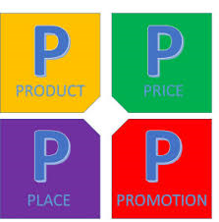
Internet Marketing decisions
The development and widespread use of the internet over the last twenty years has had a huge impact on marketing.
Each of the 4Ps has had to change and evolve to meet the demands of this new method of reaching customers.

Slide 18
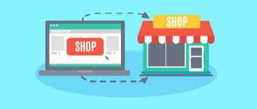
Clicks and bricks
Clicks and bricks is a marketing term which means that businesses need to have a web presence (clicks), plus a physical presence on the high street or in shopping centres (bricks).
Examples of businesses using this form of widening of distribution channels include PC World, Argos and Tesco. Each of these businesses has been very successful in using a web presence to increase sales and customer loyalty.

Slide 19
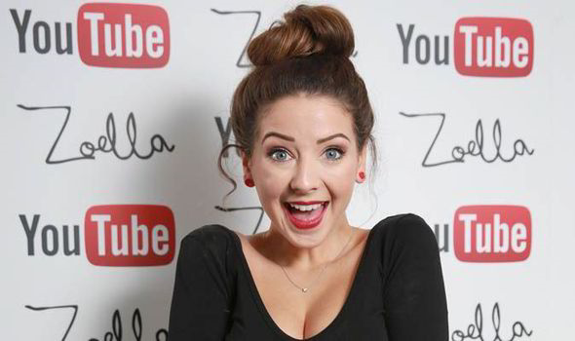
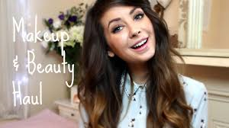
Social media
Zoella, the hugely popular fashion and lifestyle blogger, has just bought a £1 million house.
She has seven million YouTube followers and each video she posts is topped and tailed with adverts aimed at the demographic of her followers. This is a typical example of how social media is used to market products.

Slide 20
Social media – Viral adverts
Viral advertising is another form of social media advertising, with funny or stylish ads being sent from person to person.
This form of marketing is of growing importance as fewer young people consume traditional media (TV and newspapers) and instead consume entertainment and information online.

Slide 21
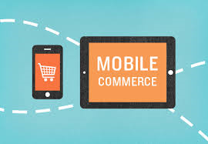
M-commerce
M-commerce (mobile commerce) is the buying and selling of goods and services through wireless handheld devices such as mobile phones. This means ‘having your retail outlet in your consumers’ pocket’. Through mobile technology it is now possible to reach your customer 24 hours a day.

Slide 22
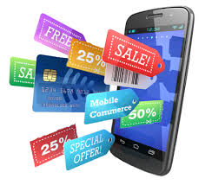
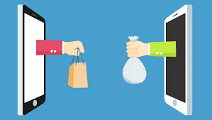
M Commerce
M-commerce does not just mean buying:
It is about providing your customers with product information, promotions and all other aspects of the marketing mix.
Consumers use M-commerce to compare prices online, take photos for future reference and research their potential purchases online.

Slide 23
Pricing and the internet
A comparison of prices has become a great deal easier for customers.
Using the web, individuals can carry out
their own research or use comparison sites,
such as Money Supermarket, to find the
best deal across a huge range of products.
This access to pricing information has had
an impact on prices charged by businesses.
It has been argued by economists that the increase in internet shopping has had a direct impact on lowering inflation rates.

Slide 24
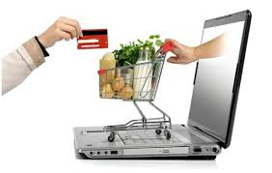
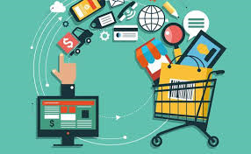
E-tailing
Online shopping (sometimes known as E-tailing, from ‘electronic retail’ or E-shopping) is a form of electronic commerce which allows consumers to directly buy goods or services from a seller over the internet.
The internet has changed buying habits and E-tailing is now a very important part of the retail industry, and is continuing to grow.

Slide 25
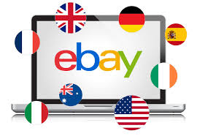
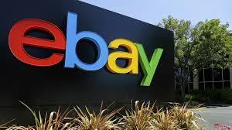
The internet, and the use of search engines, has made accessing customers a great deal easier than in the past. All a business needs to sell its products is a decent website, some form of payment processing and ‘shop’ software. All of this can be created for less than £500.
In fact, there are 1000s of entrepreneurs running their businesses through auction sites such as Ebay, with hardly any fixed costs at all. All of these businesses mean extra competition for existing traditional businesses – as well as lowering prices for customers.

Slide 26
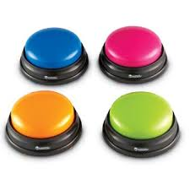
Activity 5
Task:
Marketing mix decisions – Questions – Buzzers
Time: 10 mins

Slide 27
Activity 6
Task:
Marketing mix decisions quiz
Time: 15 mins

Slide 28
Activity 7
Task:
Kahoot quiz – Marketing mix decisions
Time: 15 mins

Slide 29
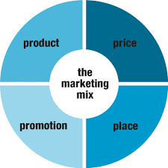
Activity 8
Task:
Written task – Marketing mix decisions
Time: 30 mins

Slide 30
Marketing mix decisions
Complete a distribution channel written task.
Explain the importance of the marketing mix in decision making.
Answer the marketing mix decision questions using your buzzers.
Complete a marketing mix decisions quiz.
Answer the Kahoot quiz questions on marketing mix decisions.
Watch Theo adventure capitalist in India.
Complete a written task on marketing mix decisions.
Recap the aims and objectives for the session.

