Slide 1
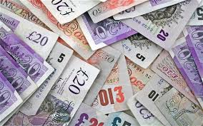
Cash flow forecast and statements
Introduce the aims and objectives for the session.
Answer the cash flow questions in groups.
Calculate a cash flow statement and discuss your answers with the group.
Explain the advantages and disadvantages of cash flow forecasts.
Show a YouTube video on Cash flow statements.
Complete a written analysis of the advantages and disadvantages of cash flow statements.
Calculate a cash flow statement and present to the class.
Recap the aims and objectives for the session.

Slide 2
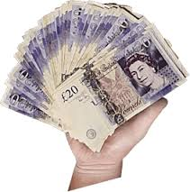
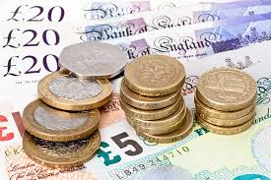
Cash is king !
It is often said that in business ‘cash is king’. This is because cash, at least in the short term, is the most important asset a business can have.
Without cash, neither employees nor suppliers can be paid and, therefore, the business will grind to a halt. Cash is the oil in the machine of business and a cash flow forecast tells us how much cash is predicted to be available to the business.

Slide 3
Cash flow forecast and statements
A forecast cash flow statement shows the expected flows of cash into and out of a business over a trading period in the immediate future – e.g. the next six months or year.
A cash flow forecast predicts how much cash is, or will be, available in a business, or how much cash will be needed to keep the business running.

Slide 4
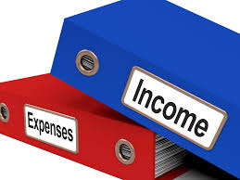
Cash flow forecast
The cash flow forecast is made up of three parts:
• revenue/income;
• expenses/outgoings;
• balances.

Slide 5
Cash flow forecast – Good Wood
To obtain a picture of what is included in a cash flow forecast we will examine the cash flow forecast of Good Wood Trading.
Good Wood is a sole trader who is just setting up in business manufacturing wooden garden furniture. The items made will be sold through gardening exhibitions, and to local garden centres on a credit basis. The predicted cash flow forecast for the first six months of trading is shown on the next few slides.

Slide 6
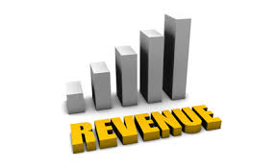
Cash flow forecast – Revenue
Revenue is the income received by a business for goods sold or services provided. It is the cash flow into a business.
For Good Wood it is sub-divided into cash sales and debtor payments.

Slide 7
Revenue – Sections
Cash sales are created when sales are made and payment is immediate. This payment can be by cash or with debit and credit cards. In all of these cases the money is immediately available for use by the business.
Debtor payments occur because many businesses sell goods on credit – payment for the goods may not be due for 30 days or more. When goods are sold on credit, a debtor is created. We only enter the revenue from these sales when payment is made.
All the payments received by a business within the time period are known as total revenue.

Slide 8
Cash flow forecast – Revenue
 | January | February | March | April | May | June
Revenue | £ | £ | £ | £ | £ | £
Cash sales | 600 | 1200 | 1750 | 2300 | 2600 | 3000
Debtor payments | 0 | 600 | 850 | 1300 | 1490 | 1430
Total revenue | 600 | 1800 | 2600 | 3600 | 4090 | 4430

Slide 9
Expenses
Under expenses or expenditure all of the money spent by a business within a time period is shown. This is the money flowing out of the business.
There are many different types of expenditure – some of the more common types are shown on the cash flow forecast.

Slide 10
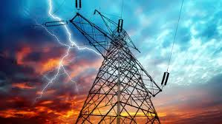
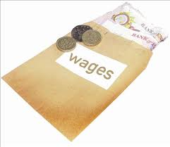
Expenses examples
In a cash flow the expenses of a business are broken down so we can see exactly where the money is going. In January, Good Wood will spend £800 on wages, £60 on electricity and so on. All of these are examples of money flowing out of a business.
Total expenses is the total of all categories expenditure for the time period. For Good Wood the total expenditure for January is predicted to be £2450. This means that the total of cash flowing out of the business is expected to be £2450.

Slide 11
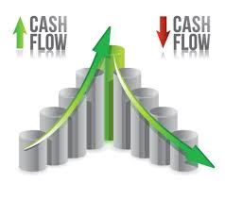
Calculating net cash flow
As explained above total revenue is the total of cash flow into the business and total expenses is the total spending by the business.
Net cash flow is calculated by taking total expenses away from total revenue.
If revenue is greater than expenses
then this figure is positive (+):
if expenses are greater than revenue,
then the net cash flow is a negative (–).

Slide 12
Expenses | January | February | March | April | May | June
Raw materials | 970 | 1200 | 1350 | 1380 | 1670 | 1500
Wages | 800 | 800 | 800 | 900 | 900 | 900
Loan repayments | 220 | 220 | 220 | 220 | 220 | 220
Rates | 40 | 40 | 40 | 40 | 40 | 40
Electricity | 60 | 60 | 60 | 100 | 100 | 100
Travelling | 80 | 80 | 150 | 150 | 150 | 150
Sundries | 130 | 80 | 80 | 80 | 80 | 80
Exhibition charges | 150 | 150 | 250 | 250 | 300 | 300
Total expenses | 2450 | 2630 | 2950 | 3120 | 3460 | 3290
Net cash flow | -1850 | -830 | -350 | 480 | 630 | 1140

Slide 13
Closing balances
Once calculated, net cash flow can then be used to obtain the closing balance for the period.
To find the closing balance, if the net cash flow is a negative we deduct this from the opening balance, or if it is a positive figure we add net cash flow to the opening balance. The opening balance is the amount of cash available at the beginning of the period.

Slide 14
Closing Balance calculations
January there is a closing balance of –£1100, i.e. a predicted cash shortage of £1100. This was calculated by taking the net cash flow –£1850 from the opening balance £750. The closing balance for one month or period becomes the opening balance for the next month or period.
In this case the closing balance for January of –£1100, becomes the opening balance for February.

Slide 15
Closing balance
 | January | February | March | April | May | June
Opening balance | 750 | -1100 | -1930 | -2280 | -1800 | -1170
+/- Net cash flow | -1850 | -830 | -350 | 480 | 630 | 1140
Closing balance | -1100 | -1930 | -2280 | -1800 | -1170 | -30

Slide 16
Activity 1
Task:
Calculate a cash flow forecast example.
Time: 20 mins

Slide 17
YouTube video – Cash flow statement
https://www.youtube.com/watch?v=GkGdlgX3xYI

Slide 18
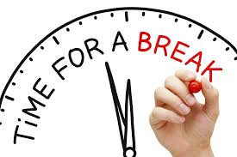
BREAK

Slide 19
Cash flow forecast problems
Forecast cash flow statements are a prediction of the likely flows of cash into and out of a business.
They will be based on past experience (when the business has a previous trading history), current and likely future economic and financial trends, along with the knowledge and understanding of the managers/owners and the future plans of the business.

Slide 20
Cash flow forecast problems
As with all forecasts the further we look into the future the less certainty we have.
Because of this, and because businesses operate in a world with changing fashions, changing economic climate, and changing competition, a business’ actual cash flow statement can be very different from its cash flow forecast.

Slide 21
Sales are not at the expected level
Increased/decreased competition
Economic growth/decline
Changing spending patterns of consumers/changing fashions
Government influences, e.g. increased or decreased taxation

Slide 22
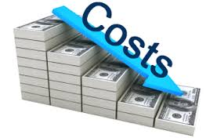
Costs increase
Raw materials cost increases Higher than expected level of inflation
Interest rate increases
Increased labour costs

Slide 23
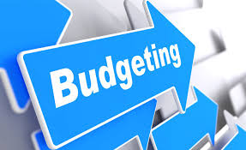
Internal factors
Poor initial predictions of income and expenditure
Late payment of debtor
Poor budgeting and lack of control of spending

Slide 24
Making use of a cash flow forecast
All businesses should monitor cash flow and examine any differences between actual and forecast figures. This will allow action to be taken before a real business crisis arises.
As experience is gained in managing and monitoring cash flow, business owners and managers will be able to improve the accuracy of their forecasts.

Slide 25
The forecast cash flow is also used to tell us if the business is likely to have enough money coming in to pay all of its expenses. If the forecast cash flow tells us that the business is unlikely to have enough money coming in to cover costs, then the business must arrange to obtain the required amount of money.
Perhaps the most popular method of funding a shortage of cash is to borrow from a bank (external) and this borrowing can take the form of loan or an overdraft. However, there are other methods of funding, each of which has an important part to play.

Slide 26
So what happens when a business needs cash, or liquidity? Up to now we have just referred to cash, but the fact is we are talking about the liquidity of a business.
Liquidity is a measure of the availability of working capital. If managers of a business say they have a liquidity or working capital problem, this means that they will have a problem meeting all their immediate or near future expenditure demands. In other words, they do not have enough cash in hand, or do not expect enough cash to be flowing into the business and cannot convert enough assets into cash in the short term to be able to pay all their bills

Slide 27
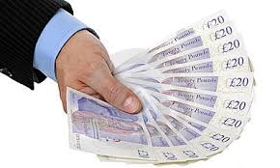
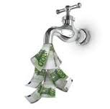
This is important as businesses do not always (in fact rarely) need to keep enough immediate cash on hand to meet likely future expenditure.
What they must do, however, is keep enough ‘liquid assets’ available, in order that cash flow can be effectively managed. So if there is a predicted cash shortage, what can managers/owners do?

Slide 28
Solutions to a predicted cash shortage
• Increase revenue – this is much easier said than done. A business may try to increase prices but this is likely to reduce demand. Alternatively, new methods of distribution (places to sell) may be found; but in the short run this will increase costs and worsen the cash flow situation.
• Reduce costs – wages are often a major cost. Reducing staff will cut costs, but will impact on output or service provided. Looking for cheaper suppliers makes sense, but there could be an impact on quality.

Slide 29
• Delay payment – if the business has creditors then delaying payment will improve immediate cash flow. However, the impact could be delayed deliveries, interest charges on debts, as well as demand for cash on delivery for future supplies.
• Extra funding – this could be a new injection of capital from the owner, or perhaps a business loan. However, if cash flow is predicted to be poor, then loans become unlikely. Outside investors could possibly be interested, but are unlikely to act quickly and will want a share of the business. An overdraft is possible if the business has a good account management history with the bank.

Slide 30
Benefits of preparing a cash flow forecast
• An accurate cash flow forecast will allow a business to get a clear idea of how it is performing (although it does not provide an accurate statement of profitability), and how it is likely to perform in the future.
• The forecast allows managers to be able to specify times when the business may need additional funding, such as when cash outflow exceeds inflow.

Slide 31
• In addition, inconsistencies in future performance can be identified and remedied.
• Also, when there is predicted to be a large positive cash flow, businesses can plan ahead on how to use this money – perhaps by investing or paying off debts.

Slide 32
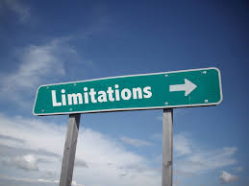
Limitations of using a cash flow forecast
• Drawing up cash flow forecasts takes management time that might be more productively used completing other tasks in the business.
• Cash flow forecasts need to be accurate to have value: this may be especially difficult to achieve if the business has little or no trading history to base the predicted cash flow on.

Slide 33
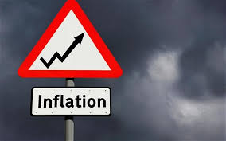
• The longer the timescale the less accurate the forecast is likely to be.
• Inflation can impact on the accuracy of figures.
• Cash flow forecasts needs to be monitored to have ongoing usefulness.

Slide 34
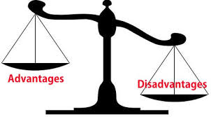
Activity 2
Task:
Written - advantages and disadvantages of the method.
Time: 20 mins

Slide 35
Activity 3
Time:
Calculate cash flow statement
Time: 20 mins

Slide 36
Cash flow forecast and statements
Introduce the aims and objectives for the session.
Answer the cash flow questions in groups.
Calculate a cash flow statement and discuss your answers with the group.
Explain the advantages and disadvantages of cash flow forecasts.
Show a YouTube video on Cash flow statements.
Complete a written analysis of the advantages and disadvantages of cash flow statements.
Calculate a cash flow statement and present to the class.
Recap the aims and objectives for the session.

