Slide 1
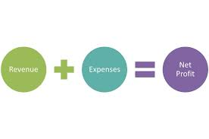
Profit and loss – Net profit
Explain the net profit calculation on the profit and loss account.
Calculate net profit using the given example.
Use your knowledge to complete a profit and loss account using the example.
Complete a Profit and loss formula Kahoot quiz.

Slide 2
Net profit – Profit and loss account
Net profit is often referred to as ‘the bottom line’ in business. This is for two reasons. Firstly on a simple presentation of a profit and loss account, it is the actual bottom line.
Secondly, the net profit figure tells us the actual profits of the business after all costs have been paid.

Slide 3
Net profit – Profit and loss
Less expenses | £ | £
Wages | 27, 880
Rent | 4,600
Rates | 2,350
Travel | 2,600
Sundry expenses | 860
Electricity | 300
Total expenses | 38,590
Net profit |  | 30,110

Slide 4
Net profit – Profit and loss account
The gross profit for Frying Tonite has already been calculated in the trading account.
Now we have to allow for expenses. Expenses are the indirect costs that the business incurs. These expenses are not direct costs of production.

Slide 5
Examples of expenses include rent, interest payments and electricity. The total expenses figure is placed in the second column, beneath the figure for gross profit.
To find Frying Tonite’s net profit we will have to total these expenses and take them away from the gross profit.

Slide 6
Net profit calculation
To calculate net profit, we simply take the figure for total expenses away from the gross profit figure.
Net profit = Gross profit – total expenses
For Frying Tonite, gross profit is £68 700, expenses are £38 590. So:
£68 700 – £38 510 = £30 110 net profit

Slide 7
Net profit explained
Net profit is an indicator of how efficient the business is overall, this is because all the business’s revenues and expenses are included in the calculation.
Like the figure for gross profit, net profit on its own does not help us judge the level of efficiency. A large business is likely to have a much higher net profit figure than a small business because it manages its expenses better.

Slide 8
Activity 3
Task:
Calculate net profit using the two examples
Time: 15 mins

Slide 9
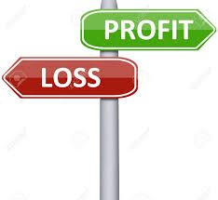
Activity 4
Task:
Calculate profit and loss account using two new examples.
Time: 30 mins

Slide 10
Activity 5
Task:
Kahoot quiz – P&L accounts
Time: 10 mins

Slide 11
Profit and loss – Net profit
Explain the net profit calculation on the profit and loss account.
Calculate net profit using the given example.
Use your knowledge to complete a profit and loss account using the example.
Complete a Profit and loss formula Kahoot quiz.

