Slide 1
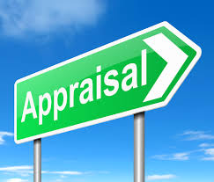
Workforce appraisal
Introduce the aims and objectives for the session.
Explain the appraisal system and self/ peer assessment.
Answer the advantages and disadvantages of appraisal quiz.
Discuss how workforce appraisal can help performance on the job.
Recap the aims and objectives for the session.

Slide 2
Appraisal
Built into the principle of effective Human Resource Management is the idea that staff should be regularly appraised by their direct line manager.
This means there will be regular meetings (once every six months or on an annual basis) in which the staff member’s performance is analysed, normally against performance targets.

Slide 3
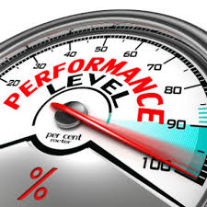
An employee may be judged on a range of tasks completed: for example, number of complaints, performance of subordinates and management of budget. As well as these measures of performance, training needs are discussed and career prospects examined.
Within the staff appraisal interview bonus earnings may also be set. Staff appraisal is sometimes referred to as performance appraisal or performance management.

Slide 4
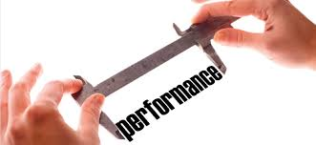
Staff appraisal benefits
• motivates;
• improves performance;
• allows the setting of achievable targets;
• identifies training needs;

Slide 5
• identifies potential;
• allows those who understand the job (i.e. the line managers) to give a value to the work done;
• enables achievable bonuses to be earned.

Slide 6
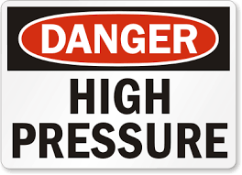
Staff appraisal disadvantages
• can cause tension in the workplace (especially in relation to the allocation of bonuses);
• puts workers under tremendous pressure to keep improving performance;
• places too much power in the hands of line managers who may be ill-equipped to use the system effectively or, alternatively, abuse the power the system gives them.

Slide 7
Appraisal – Conclusion
Also managers can have conflicting roles. At one time a supporter and developer of staff, at other times responsible for reprimanding and disciplining staff.
The success of staff appraisal in the workplace also depends on acting upon staff problems which are highlighted – if problems are not followed up, and feedback provided, demotivation can quickly occur.

Slide 8
To be successful, appraisal systems must be based on clear criteria for appraisal (set, agreed and understood targets) and managers must be trained to solve problems that can arise as a result of any poor performance indicated in appraisals.
Employees must be encouraged to fully participate in the system by talking about their problems, their own failings and adopting methods of resolving problems and improving performance.

Slide 9
Self assessment
Self-assessment is the process of having the employee:
• critically reflecting upon their own performance;
• recording their progress;
• suggesting targets for the future.
Perhaps the most important benefit of self-assessment is that the process encourages self-reflection: ‘Am I doing the best job I can and how could I improve?’

Slide 10
Peer assessment
Peer assessment refers to the process of having employees of a similar level of responsibility critically comment upon the performance of a co-worker and perhaps suggest methods of improvement.
This method helps employees learn from each other and it may be less critical (softer) than appraisal by managers. This is useful when large groups require appraisal and may be helpful as workers naturally compare their performance with that of their co-workers.

Slide 11
360 degree appraisal
360 degree appraisals involve the appraised staff member receiving feedback from people (named or anonymous) whose views are considered helpful and relevant.
This could come from staff or other stakeholders who are in a position to make judgements on performance – fellow workers, line managers, junior staff, team members, customers and suppliers.

Slide 12
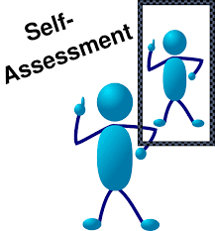
It could also include self-assessment to give a complete appraisal of the individual.
The method should provide a full (360 degree) picture of performance and may help a business when making decisions related to the promotion of individuals.

Slide 13
Activity 2
Task:
Advantages and disadvantages of appraisal quiz.
Time: 15 mins

Slide 14
Activity 3
Task:
How can performance appraisal help you on the job?
Time: 20 mins

Slide 15
Workforce appraisal
Introduce the aims and objectives for the session.
Explain the appraisal system and self/ peer assessment.
Answer the advantages and disadvantages of appraisal quiz.
Discuss how workforce appraisal can help performance on the job.
Recap the aims and objectives for the session.

